Slide 1



Noida Institute of Engineering and Technology, Greater Noida
Function and Module
Unit: 3
Problem Solving using Python
Faculty Name
Ritesh Kr. Singh
Computer Science and Engineering
B.Tech 1st semester
Ritesh Kr. Singh Unit- 3

Slide 2
Content
Introduction to Functions
Arguments and calling functions
Recursion
Decorators
Lambda functions
Modules
Packages
Ritesh Kr. Singh Unit- 3

Slide 3
Course Objective
To impart adequate knowledge on the need of programming languages
To develop programming skills using the fundamentals and basics of python language.
To enable effective usage of functions, module, lambda function and the packages.
To develop modules and import the packages .
Ritesh Kr. Singh Unit- 3

Slide 4
Course Outcome
At the end of course student will be able:
To read and write simple Python programs.
To develop Python programs with conditionals and loops.
To define Python functions and modules
To implement Python data structures - lists, tuples, dictionaries , input/output with files in Python.
To understand the concept of OOPS and exception handling in Python.
Ritesh Kr. Singh Unit- 3

Slide 5
Unit Objective
To develop and use of functions in the python.
To implement lambda functions and its advantage in the python
To import the functions from module.
To understand and installation of packages.
Ritesh Kr. Singh Unit- 3

Slide 6

Prerequisite and Recap
Conditional statement
Nested if else
loops
Ritesh Kr. Singh Unit- 3

Slide 7
Prerequisite and Recap
Conditional statement:
Syntax:
  if condition :
  statement
  else:
  statement
Loops
Syntax:
  for n in range():
Ritesh Kr. Singh Unit- 3

Slide 8
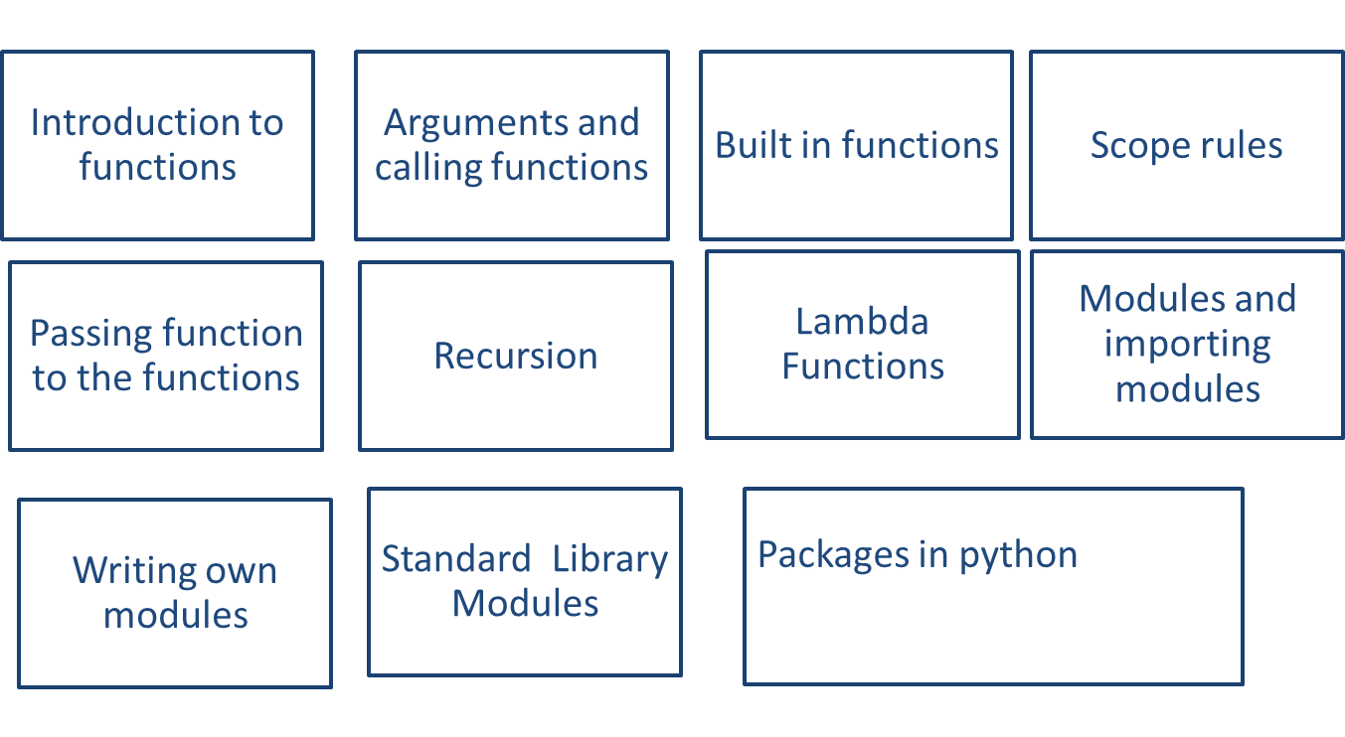
Function and Modules(CO3)
Ritesh Kr. Singh Unit- 3

Slide 9
Topic objective (CO3)
Objective:
  To develop and use of functions in the python.
  To implement lambda functions and its advantage in the python.
Ritesh Kr. Singh Unit- 3

Slide 10
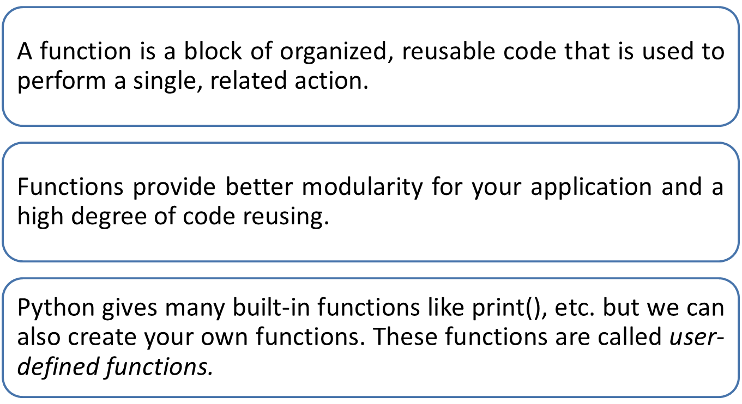
Introduction to Functions(CO3)
Ritesh Kr. Singh Unit- 3

Slide 11
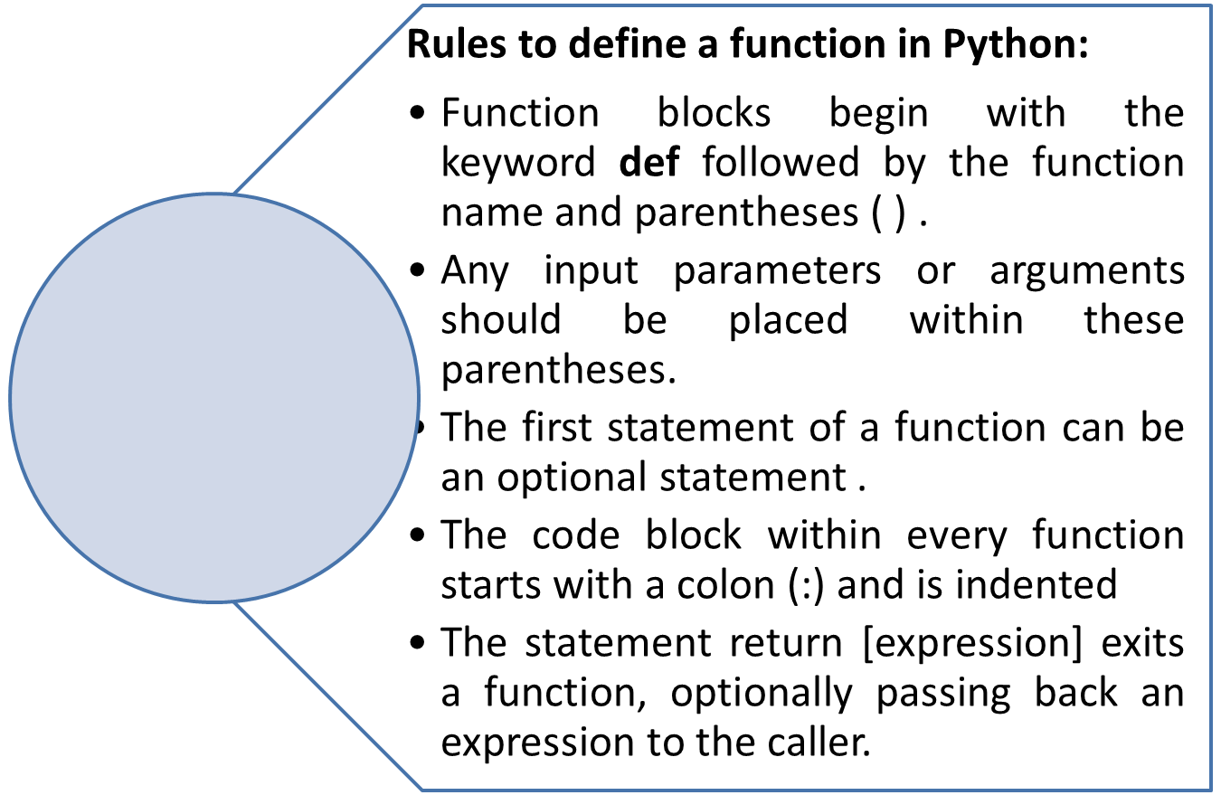
Defining a Function(CO3)
Ritesh Kr. Singh Unit- 3

Slide 12
Syntax to Define function:(CO3)
Syntax:
  def functionname( parameters ):
  "function_docstring“
  function_suite
  return [expression]
Example:
    def printme( str ):
    "This prints a passed string into this function“
    print str
    return
Ritesh Kr. Singh Unit- 3

Slide 13
Calling to the function:(CO3)
Once the basic structure of function is finalized function can be executed by calling it from the function or directly form python command prompt:
Example:
# function definition
def printme( str):
“This print in the function”
printf str
return;
#Now call of function
printme(“ welcome to the world of python”)
Ritesh Kr. Singh Unit- 3

Slide 14
Palindrome example(CO3)
def isPalindrome(string):
left_pos = 0
right_pos = len(string) - 1
while right_pos >= left_pos:
if not string[left_pos]==string[right_pos]:
return False
left_pos += 1
right_pos -= 1
return True
print(isPalindrome('aza'))
Ritesh Kr. Singh Unit- 3

Slide 15
Pass by reference vs value(CO3)
All parameters (arguments) in the Python language are passed by reference. It means ,the change also reflects back in the calling function .
# Function definition is here
def changeme( mylist ):
mylist.append([1,2,3,4]);
print "Values inside the function: ", mylist
return
# Now you can call changeme function
mylist = [10,20,30];
changeme( mylist );
print "Values outside the function: ", mylist
Ritesh Kr. Singh Unit- 3

Slide 16
Function Arguments(CO3)
We can call a function by using the following types of formal arguments −
Required arguments
Keyword arguments
Default arguments
Variable-length arguments
Ritesh Kr. Singh Unit- 3

Slide 17
Required Arguments(CO3)
Required arguments are the arguments passed to a function in correct positional order
The number of arguments in the function call should match exactly with the function definition.
Example:
# Function definition is here
def printme( str ):
"This prints a passed string into this function"
print str
return;
# Now you can call printme function
printme()
Note: at call of printme() will give syntax error
Ritesh Kr. Singh Unit- 3

Slide 18
Keyword Arguments(CO3)
Keyword arguments are related to the function calls
The caller identifies the arguments by the parameter name.
This allows to skip arguments or place them out of order because the Python interpreter is able to use the keywords provided to match the values with parameters.
Ritesh Kr. Singh Unit- 3

Slide 19
Example Keyword Arguments(CO3)
# Function definition is here
def printinfo( name, age ):
"This prints a passed info into this function"
print "Name: ", name
print "Age ", age
return;
# Now you can call printinfo function
printinfo( age=50, name="miki" )
Output:
Name: miki
Age 50
Ritesh Kr. Singh Unit- 3

Slide 20
Default Arguments(CO3)
A default argument is an argument that assumes a default value if a value is not provided in the function call for that argument.
Example:
# Function definition is here
def printinfo( name, age=35 ):
"This prints a passed info into this function"
print "Name: ", name
print "Age ", age
return;
# Now you can call printinfo function
printinfo( age=50, name="miki" )
printfinfo( name =“miki”)
Output:
Name: miki
Age 50
Name: miki
Age 35
Ritesh Kr. Singh Unit- 3

Slide 21
Variable-length Arguments(CO3)
To process a function for more arguments than specified while defining the function. These arguments are called variable-length arguments and are not named in the function definition, unlike required and default arguments..
Syntax:
def functionname([formal_args,] *var_args_tuple ): "function_docstring"
function_suite
return [expression]
Note: An asterisk (*) is placed before the variable name that holds the values of all non keyword variable arguments.
Ritesh Kr. Singh Unit- 3

Slide 22
Example Variable-length Arguments(CO3)
# Function definition is here
def printinfo( arg1, *vartuple ):
"This prints a variable passed arguments"
print "Output is: "
print arg1
for var in vartuple:
print var return;
# Now you can call printinfo function
printinfo( 10 )
printinfo( 70, 60, 50 )
Output is:
10
Output is:
70
60
50
Ritesh Kr. Singh Unit- 3

Slide 23
The Anonymous Functions(CO3)
These functions are called anonymous because they are not declared in the standard manner by using the def keyword
Lambda keyword is used.
Lambda forms can take any number of arguments but return just one value in the form of an expression.
An anonymous function cannot be a direct call to print because lambda requires an expression.
Lambda functions have their own local namespace.
cannot access variables other than those in their parameter list and those in the global namespace.
Ritesh Kr. Singh Unit- 3

Slide 24
The Anonymous Functions(CO3)
Syntax:
lambda [arg1 [,arg2,.....argn]]:expression
Example:
# Function definition is here
sum = lambda arg1, arg2: arg1 + arg2;
# Now you can call sum as a function
print "Value of total : ", sum( 10, 20 )
print "Value of total : ", sum( 20, 20 )
Output:
Value of total : 30 Value of total : 40
Ritesh Kr. Singh Unit- 3

Slide 25
Scope of Variables(CO3)
The scope of a variable determines the portion of the program where you can access a particular identifier.
There are two basic scopes of variables in Python:
  Global variables
  Local variables
Variables that are defined inside a function body have a local scope, and those defined outside have a global scope.
local variables can be accessed only inside the function in which they are declared, whereas global variables can be accessed throughout the program body by all functions.
Ritesh Kr. Singh Unit- 3

Slide 26
Global vs local(CO3)
EXAMPLE:
total = 0; # This is global variable.
# Function definition is here
def sum( arg1, arg2 ):
# Add both the parameters and return them."
total = arg1 + arg2; # Here total is local variable.
print "Inside the function local total : ", total
return total;
# Now you can call sum function
sum( 10, 20 );
print "Outside the function global total : ", total
Output:
Inside the function local total : 30
Outside the function global total : 0
Ritesh Kr. Singh Unit- 3

Slide 27
Defining Functions Inside other Functions(CO3)
  # definig function inside function
  def plus_one(number):
  def add_one(number):
  return number + 1
  result = add_one(number)
  return result
  # call of function
  plus_one(4)
Output:
5
Ritesh Kr. Singh Unit- 3

Slide 28
Passing Functions as Arguments to other Functions
  Functions can also be passed as parameters to other functions
  # Passing Functions as Arguments to other Functions
  def plus_one(number):
  return number + 1
  def function_call(function):
  number_to_add=5
  return function(number_to_add)
  function_call(plus_one)
Output:
6
Ritesh Kr. Singh Unit- 3

Slide 29
Functions Returning other Functions(CO3)
  # Defining Functions Returning other Functions
  def hello_function():
  def say_hi():
  return "Hi"
  return say_hi
  hello = hello_function()
  hello()
Output:
‘Hi’
Ritesh Kr. Singh Unit- 3

Slide 30
Decorators(CO3)
  A decorator is a design pattern in Python that allows a user to add new functionality to an existing object without modifying its structure.
  Decorators are usually called before the definition of a function.
  def uppercase_decorator(function):
  def wrapper():
  func = function()
  make_uppercase=func.upper()
  return make_uppercase
  return wrapper
  Note: Our decorator function takes a function as an argument, therefore, define a function and pass it to our decorator.
Ritesh Kr. Singh Unit- 3

Slide 31
Call of Decorators(CO3)
  def say_hi():
  return 'hello there'
  decorate = uppercase_decorator(say_hi)
  decorate()
Output:
‘HELLO THERE’
Ritesh Kr. Singh Unit- 3

Slide 32
Call of Decorators(CO3)
  # call of decoratots
  @uppercase_decorator
  def say_hi():
  return 'hello there‘
  say_hi()
Output:
‘HELLO THERE’
Ritesh Kr. Singh Unit- 3

Slide 33
Applying Multiple Decorators to a Single Function(CO3)
  def split_string(function):
  def wrapper():
  func = function()
  splitted_string = func.split()
  return splitted_string
  return wrapper
  @split_string
  @uppercase_decorator
  def say_hi():
  return 'hello there'
  say_hi()
Output:
[‘HELLO ‘,’THERE’]
Ritesh Kr. Singh Unit- 3

Slide 34
Accepting Arguments in Decorator Functions(CO3)
  def decorator_with_arguments(function):
  def wrapper_accepting_arguments (arg1, arg2):
  print("My arguments are: {0}, {1}".format(arg1,arg2))
  function(arg1, arg2)
  return wrapper_accepting_arguments
  @decorator_with_arguments
  def cities(city_one, city_two):
  print("Cities I love are {0} and {1}".format(city_one, city_two))
  # call of Decorators
  cities("Nairobi", "Accra")
Output:
My arguments are: Nairobi, Accra Cities I love are Nairobi and Accra
Ritesh Kr. Singh Unit- 3

Slide 35
Recursion(CO3)
A recursive function is a function defined in terms of itself via self-referential expressions.
It means that the function will continue to call itself and repeat its behaviour until some condition is met to return a result.
All recursive functions share a common structure made up of two parts: base case and recursive case
Ritesh Kr. Singh Unit- 3

Slide 36
Demonstration of Recursion(CO3)
Recursive function for calculating n!
Decompose the original problem into simpler instances of the same problem:
n ! = n x (n−1) x (n−2) x (n−3) ⋅⋅⋅⋅ x 3 x 2 x 1
n! = n x (n−1)! ( Recursive case)
Recusrvie case repeated till than it reaches base case:
n! = n x (n−1)!
n! = n x (n−1) x (n−2)!
n! = n x (n−1) x (n−2) x (n−3)! ⋅ ⋅
n! = n x (n−1) x (n−2) x (n−3) ⋅⋅⋅⋅ x 3 x 2!
n! = n x (n−1) x (n−2) x (n−3) ⋅⋅⋅⋅ x 3 x 2 x 1! (1! Is base case)
Ritesh Kr. Singh Unit- 3

Slide 37
Demonstration of Recursion(CO3)
def factorial_recursive(n):
# Base case: 1! = 1
if n == 1: return 1
# Recursive case: n! = n * (n-1)!
else:
return n * factorial_recursive(n-1)
#Now call of function
factorial_recursive(5)
Output:
120
Ritesh Kr. Singh Unit- 3

Slide 38
Quiz-Function(CO3)
1. What is the output of the following function call?
def fun1(name, age=20):
print(name, age)
fun1(‘NIET', 25)
  NIET 25
  NIET 20
2. Select which is true for Python function
  A Python function can return only a single value
  A function can take an unlimited number of arguments.
  A Python function can return multiple values
  Python function doesn’t return anything unless and until you add a return statement
3. Select which true for Python function
  A function is a code block that only executes when it is called.
  Python function always returns a value.
  A function only executes when it is called and we can reuse it in a program
  Python doesn’t support nested function
Ans
Option a
Ans:
b and c
Ans:
Option a ,b and c
Ritesh Kr. Singh Unit- 3

Slide 39
Quiz-Function(CO3)
4. What is the output of the following displayPerson() function call
def displayPerson(*args):
for i in args:
print(i)
displayPerson(name="Emma", age="25")
  TypeError
  Emma
  25
  name
  age
  None
5. What is the output of the following display() function call?
def display(**kwargs):
for i in kwargs:
print(i)
display(emp="Kelly", salary=9000)
  TypeError
  Kelly
  9000
  (’emp’, ‘Kelly’)
  (‘salary’, 9000)
  emp
  salary
Ans
Option a
Ans:
Option d
Ritesh Kr. Singh Unit- 3

Slide 40
Weekly Assignment(CO3)
Explain functions in python with example.
Write a python function to check number passed as argument is perfect number or not.
Explain keyword and default argument in function with example.
Write a function in python to develop lambda function to swap two numbers.
Ritesh Kr. Singh Unit- 3

Slide 41
Prerequisite and Recap(CO3)
Functions
Lambda functions
Passing function to the functions
Ritesh Kr. Singh Unit- 3

Slide 42
Prerequisite and Recap(CO3)
Functions
  Arguments and its use
  Scope rules
Lambda functions
Syntax:
lambda [arg1 [,arg2,.....argn]]:expression
Ritesh Kr. Singh Unit- 3

Slide 43
Topic objective(CO3)
Objective:
To import the functions from module.
To understand and installation of packages.
Ritesh Kr. Singh Unit- 3

Slide 44
Module Definition(CO3)
A module allows to logically organize Python code.
A module makes the code easier to understand and use.
A module is a Python object with arbitrarily named attributes that can bind and reference.
A module is a file consisting of Python code.
A module can define functions, classes and variables.
A module can also include runnable code.
Ritesh Kr. Singh Unit- 3

Slide 45
import Module(CO3)
Python source file as a module by executing an import statement in some other Python source file.
The import has the following syntax −
  import module1[, module2[,... moduleN]
  Hello.py
  def SayHello(name):
  print("Hello {}! How are you?".format(name))
  return
# Import module hello
import Hello
Hello.SayHello(“NIET”)
Output:
NIET
Ritesh Kr. Singh Unit- 3

Slide 46
The from...import Statement(CO3)
Python's from statement lets you import specific attributes from a module into the current namespace.
The from...import has the following syntax −
  from modname import name1[, name2[, ... nameN]
For example,
To import the function Fibonacci from the module fib, use the following statement
from fib import fibonacci
Ritesh Kr. Singh Unit- 3

Slide 47
Locating Modules(CO3)
When you import a module, the Python interpreter searches for the module in the following sequences −
  The current directory.
  If the module isn't found, Python then searches each directory in the shell variable PYTHONPATH.
  If all else fails, Python checks the default path. On UNIX, this default path is normally /usr/local/lib/python/.
Note: The module search path is stored in the system module sys as the sys.path variable.
The sys.path variable contains the current directory, PYTHONPATH, and the installation-dependent default.
Ritesh Kr. Singh Unit- 3

Slide 48
Renaming the Imported Module(CO3)
use the as keyword to rename the imported module as shown below:
Example:
Import math as cal
cal.log(4)
Output:
1.3862943611198906
Ritesh Kr. Singh Unit- 3

Slide 49
Dir() function(CO3)
The dir() function returns all properties and methods of the specified object, without the values.
This function will return all the properties and methods, even built-in properties which are default for all object.
Syntax:
dir(object)
Note: Object that want to see the attributes
Example:
dir(“math”)
dir(“io”)
Ritesh Kr. Singh Unit- 3

Slide 50
Standard library modules function(CO3)
The Python interpreter has a number of built-in functions.
They are loaded automatically as the interpreter starts and are always available.
Built-in modules are written in C and integrated with the Python interpreter
Each built-in module contains resources for certain system-specific functionalities such as OS management, disk IO, etc
Some of listing is as follows:
  OS module
  Math module
  Statistics module
  Collection modules
  Random modules
Ritesh Kr. Singh Unit- 3

Slide 51
OS Module(CO3)
The OS module in Python provides functions for creating and removing a directory (folder), fetching its contents, changing and identifying the current directory etc.
Creating Directory
mkdir() function create directory
Removing a Directory
rmdir() function removes directory
List Files and Sub-directories
listdir() function returns the list of all files and directory.
Changing the Current Working Directory
chdir() function to change current directory.
Ritesh Kr. Singh Unit- 3

Slide 52
Sys Module(CO3)
The sys module provides functions and variables used to manipulate different parts of the Python runtime environment.
sys.argv
  returns a list of command line arguments passed to a Python script
sys.exit
  This causes the script to exit back to either the Python console or the command prompt
sys.path
  This is an environment variable that is a search path for all Python modules.
Ritesh Kr. Singh Unit- 3

Slide 53
Math Module(CO3)
Some of the most popular mathematical functions are defined in the math module.
These include trigonometric functions, representation functions, logarithmic functions, angle conversion functions, etc.
Example are:
math.pow()
math.log()
math.log10()
math.exp()
Etc.
Ritesh Kr. Singh Unit- 3

Slide 54
Statistics Module(CO3)
The statistics module provides functions to mathematical statistics of numeric data.
The following popular statistical functions are defined in this module.
  mean()
  median()
  mode()
  stdev()
  Etc.
Ritesh Kr. Singh Unit- 3

Slide 55
collections Module(CO3)
The collections module provides alternatives to built-in container data types such as list, tuple and dict etc.
The following popular collections functions are defined in this module.
  namedtuple()
  OrderedDict()
  deque()
  Etc.
Ritesh Kr. Singh Unit- 3

Slide 56
Random Module(CO3)
Functions in the random module depend on a pseudo-random number generator function random(), which generates a random float number between 0.0 and 1.0.
The following popular random functions are defined in this module.
  random. random()
  random. randint ()
  random. randrange()
  random. choice()
  random. shuffle()
  Etc.
Ritesh Kr. Singh Unit- 3

Slide 57
Creating and Installing Packages in Python(CO3)
A package in Python takes the concept of the modular approach to next logical level..
A package can contain one or more relevant modules. Physically, a package is actually a folder containing one or more module files.
Steps to create packages:
  Create a new folder named D:\MyApp.
  Inside MyApp, create a subfolder with the name 'mypackage'.
  Create an empty __init__.py file in the mypackage folder.
  Using a Python-aware editor like IDLE, create modules greet.py and functions.py with following code:
Ritesh Kr. Singh Unit- 3

Slide 58
More in Creating and Installing Packages in Python(CO3)
greet.py
def SayHello(name):
print("Hello " + name)
return
functions.py
def sum(x,y):
return x+y
def average(x,y):
return (x+y)/2
def power(x,y):
return x**y
Ritesh Kr. Singh Unit- 3

Slide 59
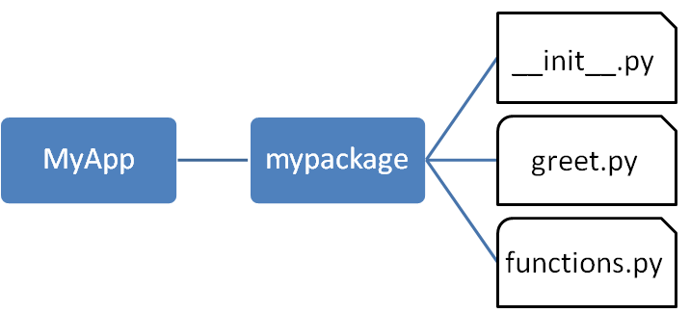
More in Creating and Installing Packages in Python (CO3)
We have created our package called mypackage. The following is a folder structure:
Ritesh Kr. Singh Unit- 3

Slide 60
Importing a Module from a Package(CO3)
Invoke the Python prompt from the MyApp folder.
D:\MyApp>python
Import the functions module from the mypackage package and call its power() function
from mypackage import functions
>>> functions.power(3,2)
9
It is also possible to import specific functions from a module in the package
from mypackage.functions import sum
>>> sum(10,20)
30
Ritesh Kr. Singh Unit- 3

Slide 61
__init__.py(CO3)
The package folder contains a special file called __init__.py, which stores the package's content.
It serves two purposes:
  The Python interpreter recognizes a folder as the package if it contains __init__.py file.
  __init__.py exposes specified resources from its modules to be imported.
Note that __init__.py is essential for the folder to be recognized by Python as a package. You can optionally define functions from individual modules to be made available.
Ritesh Kr. Singh Unit- 3

Slide 62
__init__.py(CO3)
The __init__.py file is normally kept empty.
However, it can also be used to choose specific functions from modules in the package folder and make them available for import.
Modify __init__.py as below:
  from .functions import average, power
  from .greet import SayHello
The specified functions can now be imported in the interpreter session or another executable script.
Ritesh Kr. Singh Unit- 3

Slide 63
__init__.py(CO3)
Create test.py in the MyApp folder to test mypackage.
test.py
from mypackage import power, average,
SayHello SayHello()
x=power(3,2)
print("power(3,2) : ", x)
Output of above script:
D:\MyApp>python test.py
Hello world
power(3,2) : 9
Ritesh Kr. Singh Unit- 3

Slide 64
Installing packages(CO3)
Once a package is created, it can be installed for system wide use by running the setup script. The script calls setup() function from setup tools module.
Steps are as follows:
Save the following code as setup.py in the parent folder 'MyApp'.
The script calls the setup() function from the setup tools module.
The setup() function takes various arguments such as name, version, author, list of dependencies etc.
The zip_safe argument defines whether the package is installed in compressed mode or regular mode.
Ritesh Kr. Singh Unit- 3

Slide 65
Installing packages(CO3)
Example: setup.py:
from setuptools import setup
setup(name='mypackage',
version='0.1',
description='Testing installation of Package',
url='#', author='malhar', author_email='mlathkar@gmail.com',
license='MIT', packages=['mypackage'],
zip_safe=False)
Ritesh Kr. Singh Unit- 3

Slide 66
Installing packages(CO3)
Now execute the following command to install mypack using the pip utility. Ensure that the command prompt is in the parent folder, in this case D:\MyApp
D:\MyApp>pip install .
Processing d:\MyApp
Installing collected packages: mypack
Running setup.py install for mypack ... done
Successfully installed mypackage-0.1
Now mypackage is available for system-wide use and can be imported in any script or interpreter.
D:\>python
>>> import mypackage
>>>mypackage.average(10,20)
>>>mypackage.power(10,2)
Output:
15.0
10
Ritesh Kr. Singh Unit- 3

Slide 67
Quiz-Module(CO3)
1.Which of these definitions correctly describes a module?
a) Denoted by triple quotes for providing the specification of certain program elements
b) Design and implementation of specific functionality to be incorporated into a program
c) Defines the specification of how it is to be used
d) Any program that reuses code
2. Which of the following is not an advantage of using modules?
a) Provides a means of reuse of program code
b) Provides a means of dividing up tasks
c) Provides a means of reducing the size of the program
d) Provides a means of testing individual parts of the program
3. Program code making use of a given module is called a ______ of the module.
a) Client
b) Docstring
c) Interface
d) Modularit
4. Which of the following is not a valid namespace?
a) Global namespace b) Public namespace
c) Built-in namespace d) Local namespac
Ans: b
Ans: c
Ans: a
Ans: b
Ritesh Kr. Singh Unit- 3

Slide 68
Weekly Assignment(CO3)
Explain Modules in python with example.
Create a packages and install in the system with example.
Explain the standard library modules with example.
What is dir() function? Explain in detail.
Ritesh Kr. Singh Unit- 3

Slide 69
Faculty Video Links, You tube & NPTEL Video Links and Online Courses Details(CO3)
Self Made Video Link:
Youtube/other Video Links
Functions:
https://www.youtube.com/watch?v=9Os0o3wzS_I
Lambda function:
https://www.youtube.com/watch?v=F0twSjTMx1I
Module:
https://www.youtube.com/watch?v=7GXaobCrBb4
Packages:
https://www.youtube.com/watch?v=UK97NoQK23k
Ritesh Kr. Singh Unit- 3

Slide 70
MCQ(CO3)
1. What is the output of the following function call
def outerFun(a, b):
def innerFun(c, d):
return c + d
return innerFun(a, b)
return a
result = outer
Fun(5, 10)
print(result)
  5
  15
  (15,5)
  syntax error
Ritesh Kr. Singh Unit- 3

Slide 71
MCQ(CO3)
2. What is the output of the following function call?
def fun1(num):
return num + 25
fun1(5)
print(num)
  25
  5
  name error
  none
Ritesh Kr. Singh Unit- 3

Slide 72
MCQ(CO3)
3. Choose the correct function declaration of fun1() so that we can execute the following function call successfully
fun1(25, 75, 55)
fun1(10, 20)
  def fun1(**kwargs)
  No, it is not possible in Python
  def fun1(args*)
  def fun1(*data)
Ritesh Kr. Singh Unit- 3

Slide 73
MCQ(CO3)
4 . What is the output of the add() function call?
def add(a, b):
return a+5, b+5
result = add(3, 2)
print(result
  (8,7)
  15
  8
  none
Ritesh Kr. Singh Unit- 3

Slide 74
Expected Questions for University Exam(CO3)
Explain keyword and default argument in function with example
Write a program to implement simple calculator with add , subtract , multiplication and division
Explain higher order functions with respect to lambda expressions. Write a python code to count occurrences of an element in the list.
Explain packages in the python with installation steps.
Differentiate iterators and recursion. Write a program for recursive factorial of a number.
Ritesh Kr. Singh Unit- 3

Slide 75
Old Question Papers(CO3)
Discuss functions in python with its part and scope. Explain with example(Take simple calculator with add , subtract , multiplication and division.)
Explain higher order functions with respect to lambda expressions. Write a python code to count occurrences of an element in the list.
Write a program to sort list of dictionaries by value in python-using lambda functions.
Differentiate iterators and recursion. Write a program for recursive Fibonacci series.
Ritesh Kr. Singh Unit- 3

Slide 76
Summary(CO3)
A function is a block of organized, reusable code that is used to perform a single, related action.
A module is a Python object with arbitrarily named attributes that can bind and reference.
Package can be installed for system wide use by running the setup script.
Ritesh Kr. Singh Unit- 3

Slide 77
References(CO3)
Python Programming using problem solving Approach by Reema Thareja
Think Python: An Introduction to Software Design by Allen B. Downey
www.python.org
www.w3schools.com
Ritesh Kr. Singh Unit- 3

Slide 78

References(CO3)
Ritesh Kr. Singh Unit- 3

