Slide 1



Noida Institute of Engineering and Technology, Greater Noida
INTRODUCTION OF ARTIFICIAL INTELLIGENCE
Unit: 01
ARTIFICIAL INTELLIGENCE
Alka Singh
(CSE)AIML
B Tech 3rd Sem

Slide 2
Well –Posed Learning Problems:
Tom Mitchell’s definition of Machine Learning
A Computer program is said to learn from experience E for some class of tasks T and performance measure P if its performance on tasks T as measured by P improves with experience E.
A well – posed learning problem must have following three features:
The class of Tasks
Measure of performance
Source of Experience

Slide 3
Certain examples that efficiently defines the well-posed learning problem are –
To better filter emails as spam or not
Task T – Classifying emails as spam or not
Performance Measure P – The fraction of emails accurately classified as spam or not spam
Experience E– Observing you label emails as spam or not spam

Slide 4
Certain examples that efficiently defines the well-posed learning problem are –
2. A checkers learning problem
Task T – Playing checkers game
Performance Measure P – percent of games won against opponent
Experience E – playing implementation games against itself

Slide 5
Certain examples that efficiently defines the well-posed learning problem are –
3. Handwriting Recognition Problem
Task T – recognizing and classifying handwritten words within images
Performance Measure P – percent of words accurately classified
Experience E – a database of handwritten words with given classifications

Slide 6
Certain examples that efficiently defines the well-posed learning problem are –
4. A Robot Driving Problem
Task T – driving on public four-lane highways using vision sensors
Performance Measure P – average distance travelled before an error (as judged by human overseer)
Experience E– a sequence of images and steering commands recorded while observing a human driver

Slide 7
Certain examples that efficiently defines the well-posed learning problem are –
5. Face Recognition Problem
Task T – predicting different types of faces
Performance Measure P – able to predict maximum types of faces
Experience E – training machine with maximum amount of datasets of different face images

Slide 8
Certain examples that efficiently defines the well-posed learning problem are –
6. Automatic Translation of documents
Task T – translating one type of language used in a document to other language
Performance Measure P – able to convert one language to other efficiently
Experience E – training machine with a large dataset of different types of languages

Slide 9
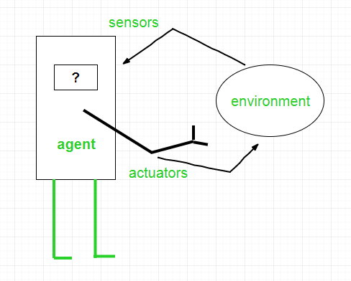
Agents in Artificial Intelligence
9/7/2021

Slide 10
Continue…
To understand the structure of Intelligent Agents, we should be familiar with Architecture and Agent Program.
Agent = Architecture + Agent Program
Examples of Agent:-
A software agent
A Human agent
A Robotic agent

Slide 11
Structure of an AI Agent
The structure of an intelligent agent is a combination of architecture and agent program. It can be viewed as:
Agent = Architecture + Agent program
Following are the main three terms involved in the structure of an AI agent:
Architecture: Architecture is machinery that an AI agent executes on.
Agent Function: Agent function is used to map a percept to an action.

Slide 12
Continue…
Agent program: Agent program is an implementation of agent function. An agent program executes on the physical architecture to produce function f.
PEAS Representation
PEAS is a type of model on which an AI agent works upon. When we define an AI agent or rational agent, then we can group its properties under PEAS representation model. It is made up of four words:
P: Performance measure
E: Environment
A: Actuators
S: Sensors

Slide 13
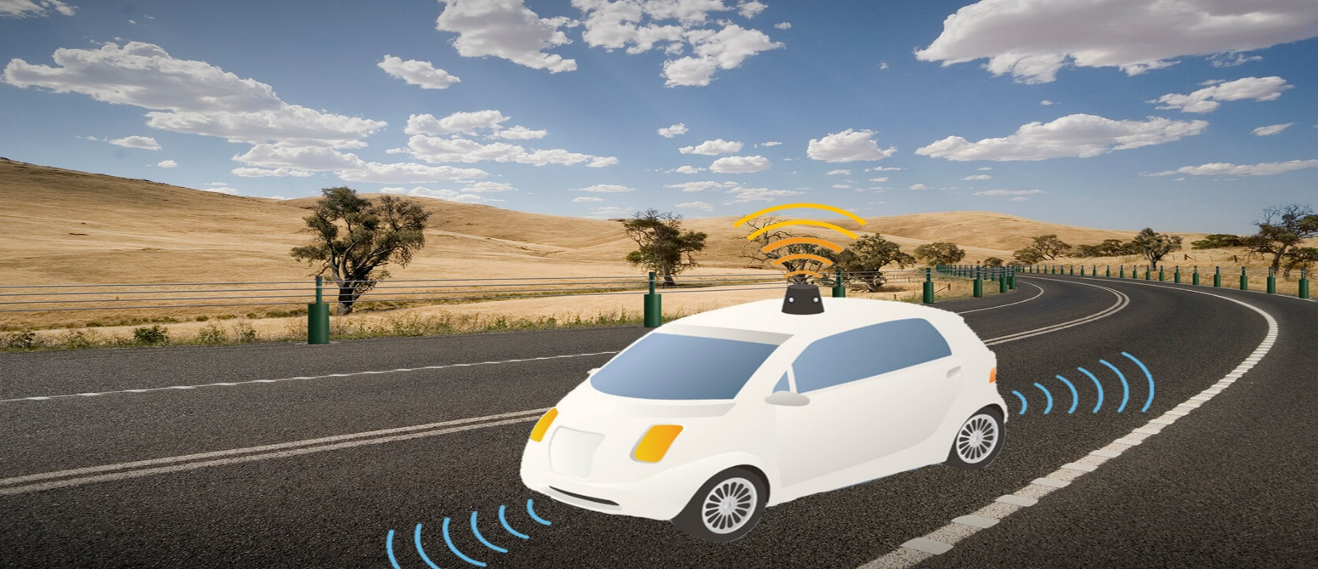
Continue…
Here performance measure is the objective for the success of an agent's behavior
PEAS for self-driving cars:

Slide 14
Continue…
Let's suppose a self-driving car then PEAS representation will be:
Performance: Safety, time, legal drive, comfort
Environment: Roads, other vehicles, road signs, pedestrian
Actuators: Steering, accelerator, brake, signal, horn
Sensors: Camera, GPS, speedometer, odometer, accelerometer, sonar.

Slide 15
What is a Reflex Agent?
There are five primary agents used in Artificial Intelligence based on their capability of perceiving intelligence. These agents are the following:
Simple Reflex Agents
Model-Based Reflex Agents
Goal-Based Agents
Utility-Based Agents
Learning Agents

Slide 16
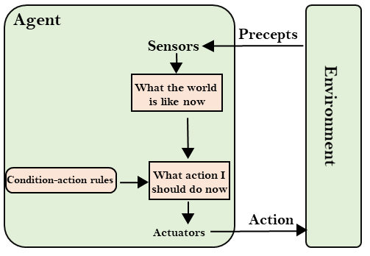
Simple Reflex agent

Slide 17
Simple Reflex Agents
The Simple reflex agents are the simplest agents. These agents take decisions on the basis of the current percepts and ignore the rest of the percept history.
These agents only succeed in the fully observable environment.
The Simple reflex agent does not consider any part of percepts history during their decision and action process.
The Simple reflex agent works on Condition-action rule, which means it maps the current state to action. Such as a Room Cleaner agent, it works only if there is dirt in the room.

Slide 18
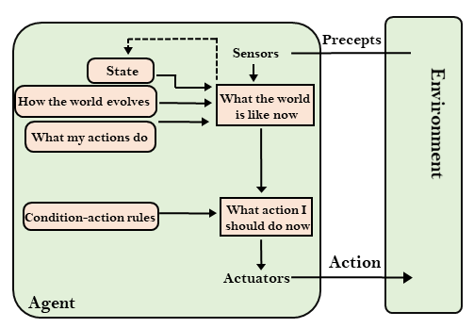
Model-Based Reflex Agent

Slide 19
Model Based Reflex Agents
The Model-based agent can work in a partially observable environment, and track the situation.
A model-based agent has two important factors:
Model: It is knowledge about "how things happen in the world," so it is called a Model-based agent.
Internal State: It is a representation of the current state based on percept history.
These agents have the model, "which is knowledge of the world" and based on the model they perform actions.

Slide 20
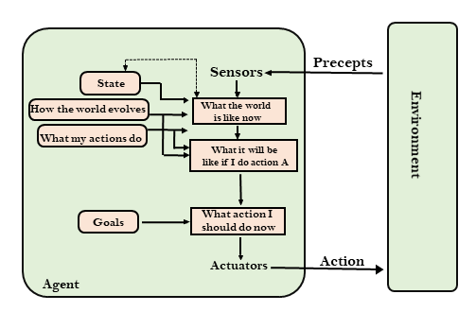
Goal-Based Agents

Slide 21
Goal Based Reflex Agents
The knowledge of the current state environment is not always sufficient to decide for an agent to what to do.
The agent needs to know its goal which describes desirable situations.
Goal-based agents expand the capabilities of the model-based agent by having the "goal" information.
They choose an action, so that they can achieve the goal.

Slide 22
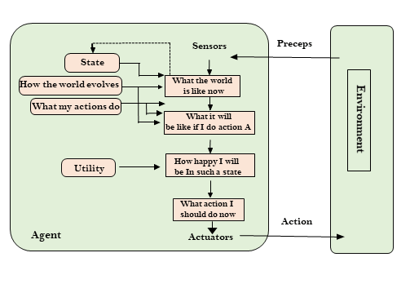
Utility Based Agents

Slide 23
Utility Based Agents
These agents are similar to the goal-based agent but provide an extra component of utility measurement which makes them different by providing a measure of success at a given state.
Utility-based agent act based not only goals but also the best way to achieve the goal.
The Utility-based agent is useful when there are multiple possible alternatives, and an agent has to choose in order to perform the best action.

Slide 24
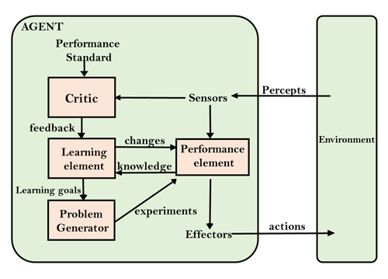
Learning Agents

Slide 25
Learning Agents
A learning agent in AI is the type of agent which can learn from its past experiences, or it has learning capabilities.
It starts to act with basic knowledge and then able to act and adapt automatically through learning.
A learning agent has mainly four conceptual components, which are:

Slide 26
Learning Agents
Learning element: It is responsible for making improvements by learning from environment
Critic: Learning element takes feedback from critic which describes that how well the agent is doing with respect to a fixed performance standard.
Performance element: It is responsible for selecting external action

Slide 27
Learning Agents
Problem generator: This component is responsible for suggesting actions that will lead to new and informative experiences.
Problem generator will give the suggestion to improve the output for learning agent.
Hence, learning agents are able to learn, analyze performance, and look for new ways to improve the performance.

Slide 28
MCQ
Q1. Which instruments are used for perceiving and acting upon the environment? a) Sensors and Actuators b) Sensors c) Perceiver d) None of the mentioned

Slide 29
MCQ
Q 2. What is meant by agent’s percept sequence? a) Used to perceive the environment b) Complete history of actuator c) Complete history of perceived things d) None of the mentioned

Slide 30
MCQ
Q3. How many types of agents are there in artificial intelligence? a) 1 b) 2 c) 3 d) 4

Slide 31
MCQ
Q4. What is the rule of simple reflex agent? a) Simple-action rule b) Condition-action rule c) Simple & Condition-action rule d) None of the mentioned

Slide 32
MCQ
Q5. What are the composition for agents in artificial intelligence? a) Program b) Architecture c) Both Program & Architecture d) None of the mentioned

Slide 33
MCQ
Q6. In which agent does the problem generator is present? a) Learning agent b) Observing agent c) Reflex agent d) None of the mentioned

Slide 34
MCQ
Q7. Which is used to improve the agents performance? a) Perceiving b) Learning c) Observing d) None of the mentioned

Slide 35
MCQ
Q8. Which agent deals with happy and unhappy states? a) Simple reflex agent b) Model based agent c) Learning agent d) Utility based agent

Slide 36
MCQ
Q9. The action of the Simple reflex agent completely depends upon __________ a) Perception history b) Current perception c) Learning theory d) Utility functions

Slide 37
MCQ
Q10. Which of the following could be the approaches to Artificial Intelligence? a) Strong Artificial Intelligence b) Weak Artificial Intelligence c) Applied Artificial Intelligence d) All of the mentioned

Slide 38
MCQ
Q11. The Face Recognition system is based on? a) Strong Artificial Intelligence approach b) Weak Artificial Intelligence approach c) Cognitive Artificial Intelligence approach d) Applied Artificial Intelligence approach

Slide 39
MCQ
Q12. What among the following is/are the example of the intelligent agent/agents? a) Human b) Robot c) Autonomous Spacecraft d) All of the mentioned

Slide 40
MCQ
Q13. A completely automated chess engine (Learn from previous games) is based on? a) Strong Artificial Intelligence approach b) Weak Artificial Intelligence approach c) Cognitive Artificial Intelligence approach d) Applied Artificial Intelligence approach

Slide 41
MCQ
Q14. Agents behavior can be best described by ______ a) Perception sequence b) Agent function c) Sensors and Actuators d) Environment in which agent is performing

Slide 42
MCQ
Q15. What is an ‘agent’? a) Perceives its environment through sensors and acting upon that environment through actuators b) Takes input from the surroundings and uses its intelligence and performs the desired operations c) a & b d)none

Slide 43
Thank You

