Slide 1



Noida Institute of Engineering and Technology, Greater Noida
Propositional & Predicate Logic
Unit: 4
Discrete Structures
(20CS-304)
Mr. Pushkal K Shukla
Asst. Prof.
AIML Deptt.
B Tech 3rd Sem
Mr. Pushkal K Shukla 20CS-304 (DS) Unit 4

Slide 2
Course Objective
A course discrete structures used to represent discrete objects and relationships between these objects. These discrete structures include sets, relation, permutations, relations, graphs and trees etc.
The subject enhances one’s ability to develop logical thinking and ability to problem solving.
Mr. Pushkal K Shukla 20CS-304 (DS) Unit 4

Slide 3
Unit 4 Objectives
Objective of proposition logic to write English sentences for logical expressions and vice-versa. Use standard notations of propositional logic.
Determine if a logical argument is valid or invalid. Apply standard rules of inference including (but not limited to) Modus Ponens, Modus Tollens.
Translate between English sentences and symbols for universally and existentially quantified statements, including statements with multiple quantifiers.
Mr. Pushkal K Shukla 20CS-304 (DS) Unit 4

Slide 4
Course Outcome
Course Outcome ( CO) | At the end of course , the student will be able to understand | Bloom’s Knowledge Level (KL)
CO1 | Apply the basic principles of sets, relations & functions in computer science & engineering related problems and to solve counting problem using recursive function theory. | K1,K3,K2
CO2 | Define the algebraic structure of a system and use these concepts such as coding theory, cryptographic algorithms etc. | K1,K2
CO3 | Apply basics of lattices in mathematical modeling | K2,K3
CO4 | Infer the validity of statements and construct proofs using predicate logic formulas. | K3,K4
CO5 | Design and use the non-linear data structure like tree and graph for circuit and network designing | K2,K6
Mr. Pushkal K Shukla 20CS-304 (DS) Unit 4

Slide 5
CO-PO’s and PSO’s Mapping
 | PO1 | PO2 | PO3 | PO4 | PO5 | PO6 | PO7 | PO8 | PO9 | PO10 | PO11 | PO12
20CS304.1 | 3 | 2 | 2 | - | - | 1 | - | - | - | 1 | 1 | 3
20CS304.2 | 3 | 3 | 2 | 2 | 1 | - | - | - | - | - | 2 | 1
20CS304.3 | 3 | 3 | 2 | 1 | - | - | 3 | - | 2 | 2 | 2 | 2
20CS304.4 | 3 | 3 | 2 | 1 | - | - | 1 | - | - | 3 | 2 | 2
20CS304.5 | 3 | 3 | 2 | 1 | - | - | 3 | - | - | 1 | 3 | 3
 | PSO1 | PSO2 | PSO3 | PSO4
20CS304.1 | 1 | 2 | 3 | -
20CS304.2 | 1 | 2 | 3 | 1
20CS304.3 | 3 | 2 | 3 | 1
20CS304.4 | 2 | 3 | 3 | -
20CS304.5 | 2 | 3 | 2
Mr. Pushkal K Shukla 20CS-304 (DS) Unit 4

Slide 6
Content (CO4)
Propositional Logic: Introduction, Propositions and Compound Statements, Basic Logical Operations, well formed formula, Truth tables, Tautology, Satisfiability, Contradiction, Algebra of proposition, Theory of Inference.
Predicate Logic: First order predicate, well formed formula of predicate, quantifiers, Inference theory of predicate logic.
Mr. Pushkal K Shukla 20CS-304 (DS) Unit 4

Slide 7
Topic Objectives: Propositions(CO4)
The student will demonstrate the ability to use mathematical logic to solve problems
The student will be able to:
  represent English-language statements using symbolic logic notation.
  use and interpret relational conjunctions (and, or, xor, not), terms of causation (if… then) and equivalence (if and only if).
  use truth tables to analyze the truth values of compound statements based on the truth values of their components.
  use truth tables to determine if two statements are logically equivalent.
  use truth tables to identify tautologies and contradictions.
Mr. Pushkal K Shukla 20CS-304 (DS) Unit 4
DSGT <number>

Slide 8
Topic Prerequisite & Recap (CO4)
Prerequisite
Basic Understanding of class 10 mathematics NCERT.
Basic Knowledge of sets and algebraic rules
Basic Understanding of Set Theory, Relations and Functions & Algebraic Structures.
Basic Understanding of Lattices & Boolean Algebra
Recap
Now students are able to develop there logical thinking by using Sets, Relations, Functions and Mathematical Induction, Algebraic Structures, Lattices & Boolean Algebra concepts and use in upcoming topic. i.e. Propositions.
Mr. Pushkal K Shukla 20CS-304 (DS) Unit 4

Slide 9
Propositional logic (PL) [CO4]
Propositional logic (PL) is the simplest form of logic where all the statements are made by propositions. A proposition is a declarative statement which is either true or false. It is a technique of knowledge representation in logical and mathematical form.
Example:
a) It is Sunday.
b) The Sun rises from West (False proposition)
c) 3+3= 7(False proposition)
d) 5 is a prime number.
Mr. Pushkal K Shukla 20CS-304 (DS) Unit 4

Slide 10
Continue…
Following are some basic facts about propositional logic:
Propositional logic is also called Boolean logic as it works on 0 and 1.
In propositional logic, we use symbolic variables to represent the logic, and we can use any symbol for a representing a proposition, such A, B, C, P, Q, R, etc.
Propositions can be either true or false, but it cannot be both.
Propositional logic consists of an object, relations or function, and logical connectives.
These connectives are also called logical operators.
The propositions and connectives are the basic elements of the propositional logic.
Mr. Pushkal K Shukla 20CS-304 (DS) Unit 4

Slide 11
Propositional logic [CO4]
Connectives can be said as a logical operator which connects two sentences.
A proposition formula which is always true is called tautology, and it is also called a valid sentence.
A proposition formula which is always false is called Contradiction.
A proposition formula which has both true and false values is called Contingency.
Statements which are questions, commands, or opinions are not propositions such as "Where is Rohini", "How are you", "What is your name", are not propositions.
Mr. Pushkal K Shukla 20CS-304 (DS) Unit 4

Slide 12
Types of Propositions
There are two types of Propositions:
Atomic Propositions
Compound propositions
Atomic Proposition: Atomic propositions are the simple propositions. It consists of a single proposition symbol. These are the sentences which must be either true or false.
Example:
a) 2+2 is 4, it is an atomic proposition as it is a true fact.
b) "The Sun is cold" is also a proposition as it is a false fact.
Mr. Pushkal K Shukla 20CS-304 (DS) Unit 4

Slide 13
Compound proposition [CO4]
Compound propositions are constructed by combining simpler or atomic propositions, using parenthesis and logical connectives.
Example:
a) "It is raining today, and street is wet."
b) "Ankit is a doctor, and his clinic is in Mumbai."
Mr. Pushkal K Shukla 20CS-304 (DS) Unit 4

Slide 14
Basic Logical Operations [CO4]
Basic Logical Operator:
Basic Logical operators/Logical connectives are used to connect two simpler propositions or representing a sentence logically. We can create compound propositions with the help of logical connectives. There are mainly five connectives, which are given as follows:
Negation: A sentence such as ¬ P is called negation of P. A literal can be either Positive literal or negative literal.
Conjunction: A sentence which has ∧ connective such as, P ∧ Q is called a conjunction.
Example: Rohan is intelligent and hardworking. It can be written as, P= Rohan is intelligent,
Q= Rohan is hardworking. → P∧ Q.
Mr. Pushkal K Shukla 20CS-304 (DS) Unit 4

Slide 15
Continue …[CO4]
Disjunction: A sentence which has ∨ connective, such as P ∨ Q. is called disjunction, where P and Q are the propositions.
Example: "Ritika is a doctor or Engineer",
Here P= Ritika is Doctor. Q= Ritika is Doctor, so we can write it as P ∨ Q.
Implication: A sentence such as P → Q, is called an implication. Implications are also known as if-then rules. It can be represented as
If it is raining, then the street is wet.
Let P= It is raining, and Q= Street is wet, so it is represented as P → Q
Biconditional: A sentence such as P⇔ Q is a Biconditional sentence, example If I am breathing, then I am alive
P= I am breathing, Q= I am alive, it can be represented as P ⇔ Q.
Mr. Pushkal K Shukla 20CS-304 (DS) Unit 4

Slide 16
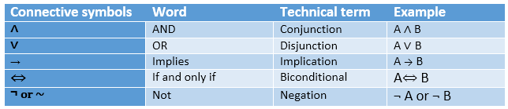
Continue… …[CO4]
summarized table for Propositional Logic Connectives:
Mr. Pushkal K Shukla 20CS-304 (DS) Unit 4

Slide 17
Truth Table (CO4)
We will examine the truth table of following logical operators
Negation (NOT)
Conjunction (AND)
Disjunction (OR)
Exclusive or (XOR)
Implication (if – then)
Biconditional (if and only if)
Truth tables can be used to show how these operators can combine propositions to compound propositions.
Mr. Pushkal K Shukla 20CS-304 (DS) Unit 4

Slide 18
Negation (NOT) (CO4)
It is Unary Operator and denoted by Symbol: ¬
P | ¬P
true (T) | false (F)
false (F) | true (T)
Mr. Pushkal K Shukla 20CS-304 (DS) Unit 4

Slide 19
Conjunction (AND) (CO4)
It is binary Operator and Symbol is ∧
P | Q | P∧Q
T | T | T
T | F | F
F | T | F
F | F | F
Mr. Pushkal K Shukla 20CS-304 (DS) Unit 4

Slide 20
Disjunction (OR) (CO4)
It is binary Operator and Symbol is ∨
P | Q | P∨Q
T | T | T
T | F | T
F | T | T
F | F | F
Mr. Pushkal K Shukla 20CS-304 (DS) Unit 4

Slide 21
Exclusive Or (XOR) (CO4)
It is binary Operator and Symbol is ⊕
P | Q | P⊕Q
T | T | F
T | F | T
F | T | T
F | F | F
Mr. Pushkal K Shukla 20CS-304 (DS) Unit 4

Slide 22
Implication (if - then) (CO4)
It is binary Operator and Symbol is →
P | Q | P→Q
T | T | T
T | F | F
F | T | T
F | F | T
Mr. Pushkal K Shukla 20CS-304 (DS) Unit 4

Slide 23
Biconditional (if and only if) (CO4)
It is binary Operator and Symbol is ↔
P | Q | P↔Q
T | T | T
T | F | F
F | T | F
F | F | T
Mr. Pushkal K Shukla 20CS-304 (DS) Unit 4

Slide 24
Statements and Operators(CO4)
Example 1 Statements and operators can be combined in any way to form new statements.
P | Q | ¬P | ¬Q | (¬P)∨(¬Q)
T | T | F | F | F
T | F | F | T | T
F | T | T | F | T
F | F | T | T | T
Mr. Pushkal K Shukla 20CS-304 (DS) Unit 4

Slide 25
Statements and Operators(CO4)
Example 2 Statements and operators can be combined in any way to form new statements.
P | Q | P∧Q | ¬ (P∧Q) | (¬P)∨(¬Q)
T | T | T | F | F
T | F | F | T | T
F | T | F | T | T
F | F | F | T | T
Mr. Pushkal K Shukla 20CS-304 (DS) Unit 4

Slide 26
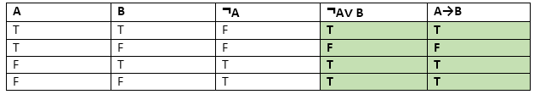
Continue… …[CO4]
Logical equivalence:
Logical equivalence is one of the features of propositional logic. Two propositions are said to be logically equivalent if and only if the columns in the truth table are identical to each other.
Let's take two propositions A and B, so for logical equivalence, we can write it as A⇔B. In below truth table we can see that column for ¬A∨ B and A→B, are identical hence A is Equivalent to B
Mr. Pushkal K Shukla 20CS-304 (DS) Unit 4

Slide 27
Example (CO4)
The statements ¬(P∧Q) and (¬P) ∨ (¬Q) are logically equivalent, since ¬(P∧Q) ↔ (¬P) ∨ (¬Q) is always true.
P | Q | ¬(P∧Q) | (¬P)∨(¬Q) | ¬(P∧Q)↔(¬P)∨(¬Q)
T | T | F | F | T
T | F | T | T | T
F | T | T | T | T
F | F | T | T | T
Mr. Pushkal K Shukla 20CS-304 (DS) Unit 4

Slide 28
Algebra of Proposition [CO4]
Properties of Operators:
Commutativity:
  P∧ Q= Q ∧ P, or
  P ∨ Q = Q ∨ P.
Associativity:
  (P ∧ Q) ∧ R= P ∧ (Q ∧ R),
  (P ∨ Q) ∨ R= P ∨ (Q ∨ R)
Identity element:
  P ∧ True = P,
  P ∨ True= True.
Mr. Pushkal K Shukla 20CS-304 (DS) Unit 4

Slide 29
Continue…[CO4]
Distributive:
  P∧ (Q ∨ R) = (P ∧ Q) ∨ (P ∧ R).
  P ∨ (Q ∧ R) = (P ∨ Q) ∧ (P ∨ R).
DE Morgan's Law:
  ¬ (P ∧ Q) = (¬P) ∨ (¬Q)
  ¬ (P ∨ Q) = (¬ P) ∧ (¬Q).
Double-negation elimination:
  ¬ (¬P) = P.
Mr. Pushkal K Shukla 20CS-304 (DS) Unit 4

Slide 30
Tautology (CO4)
A tautology is a statement that is always true.
Examples: ¬(P∧Q)↔(¬P)∨(¬Q)
If S→T is a tautology, we write S⇒T.
If S↔T is a tautology, we write S⇔T.
P | Q | ¬(P∧Q) | (¬P)∨(¬Q) | ¬(P∧Q)↔(¬P)∨(¬Q)
T | T | F | F | T
T | F | T | T | T
F | T | T | T | T
F | F | T | T | T
Mr. Pushkal K Shukla 20CS-304 (DS) Unit 4

Slide 31
Contradiction (CO4)
A contradiction is a statement that is always False
Examples: R∧(¬R) ¬(¬(P∧Q)↔(¬P)∨(¬Q))
The negation of any tautology is a contradiction, and the negation of any contradiction is a tautology.
Mr. Pushkal K Shukla 20CS-304 (DS) Unit 4

Slide 32
Satisfiability (CO4)
A proposition is satisfiable, if its truth table contains true at least once. Example: p ∧ q.
A tautology, if it is always true. Example: p ∨ ¬p.
A contradiction, if it always false. Example: p ∧ ¬p.
A contingency, if it is neither a tautology nor a contradiction. Example: p.
Mr. Pushkal K Shukla 20CS-304 (DS) Unit 4

Slide 33
Theory of Inference [CO4]
Rules of Inference
Inference:
In we need intelligent computers which can create new logic from old logic or by evidence, so generating the conclusions from evidence and facts is termed as Inference.
Inference rules:
Inference rules are the templates for generating valid arguments. Inference rules are applied to derive proofs in artificial intelligence, and the proof is a sequence of the conclusion that leads to the desired goal.
In inference rules, the implication among all the connectives plays an important role. Following are some terminologies related to inference rules:
Mr. Pushkal K Shukla 20CS-304 (DS) Unit 4

Slide 34
Continue… [CO4]
Implication: It is one of the logical connectives which can be represented as P → Q. It is a Boolean expression.
Converse: The converse of implication, which means the right-hand side proposition goes to the left-hand side and vice-versa. It can be written as Q → P.
Contrapositive: The negation of converse is termed as contrapositive, and it can be represented as ¬ Q → ¬ P.
Inverse: The negation of implication is called inverse. It can be represented as ¬ P → ¬ Q.
From the above term some of the compound statements are equivalent to each other, which we can prove using truth table:
Mr. Pushkal K Shukla 20CS-304 (DS) Unit 4

Slide 35
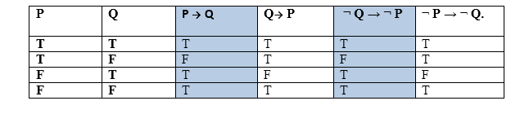
Continue… [CO4]
Hence from the above truth table, we can prove that P → Q is equivalent to ¬ Q → ¬ P, and Q→ P is equivalent to ¬ P → ¬ Q.
Mr. Pushkal K Shukla 20CS-304 (DS) Unit 4

Slide 36
Continue… [CO4]
Types of Inference rules:
1. Modus Ponens:
The Modus Ponens rule is one of the most important rules of inference, and it states that if P and P → Q is true, then we can infer that Q will be true. It can be represented as:
Example:
Statement-1: "If I am sleepy then I go to bed" ==> P→ Q
Statement-2: "I am sleepy" ==> P
Conclusion: "I go to bed." ==> Q.
Hence, we can say that, if P→ Q is true and P is true then Q will be true.
Mr. Pushkal K Shukla 20CS-304 (DS) Unit 4

Slide 37
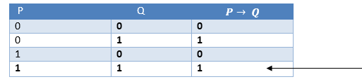
Continue… [CO4]
Proof by Truth table:
2. Modus Tollens:
The Modus Tollens rule state that if P→ Q is true and ¬ Q is true, then ¬ P will also true. It can be represented as:
Mr. Pushkal K Shukla 20CS-304 (DS) Unit 4

Slide 38
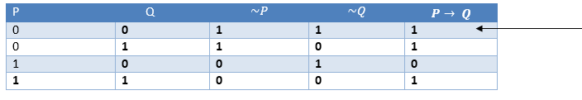
Continue… [CO4]
Statement-1: "If I am sleepy then I go to bed" ==> P→ Q
Statement-2: "I do not go to the bed."==> ~Q
Statement-3: Which infers that "I am not sleepy" => ~P
Proof by Truth table:
Mr. Pushkal K Shukla 20CS-304 (DS) Unit 4

Slide 39
Continue… [CO4]
3. Hypothetical Syllogism:
The Hypothetical Syllogism rule state that if P→R is true whenever P→Q is true, and Q→R is true. It can be represented as the following notation:
Example:
Statement-1: If you have my home key then you can unlock my home. P→Q
Statement-2: If you can unlock my home then you can take my money. Q→R
Conclusion: If you have my home key then you can take my money. P→R
Proof by truth table:
Mr. Pushkal K Shukla 20CS-304 (DS) Unit 4

Slide 40
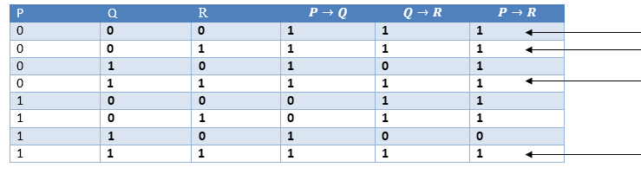
Continue… [CO4]
Mr. Pushkal K Shukla 20CS-304 (DS) Unit 4

Slide 41
Continue… [CO4]
4. Disjunctive Syllogism:
The Disjunctive syllogism rule state that if P∨Q is true, and ¬P is true, then Q will be true. It can be represented as:
Example:
Statement-1: Today is Sunday or Monday. ==>P∨Q
Statement-2: Today is not Sunday. ==> ¬P
Conclusion: Today is Monday. ==> Q
Proof by truth-table:
Mr. Pushkal K Shukla 20CS-304 (DS) Unit 4

Slide 42
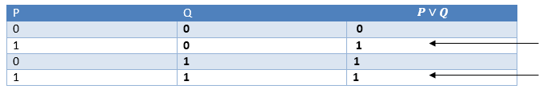
Continue… [CO4]
5. Addition:
The Addition rule is one the common inference rule, and it states that If P is true, then P∨Q will be true.
Example:
Statement: I have a vanilla ice-cream. ==> P
Statement-2: I have Chocolate ice-cream.
Conclusion: I have vanilla or chocolate ice-cream. ==> (P∨Q)
Proof by Truth-Table:
Mr. Pushkal K Shukla 20CS-304 (DS) Unit 4

Slide 43
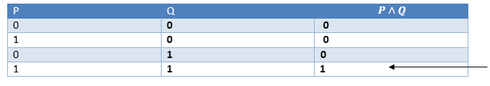
Continue… [CO4]
6. Simplification:
The simplification rule state that if P∧ Q is true, then Q or P will also be true. It can be represented as:
Proof by Truth-Table:
Mr. Pushkal K Shukla 20CS-304 (DS) Unit 4

Slide 44
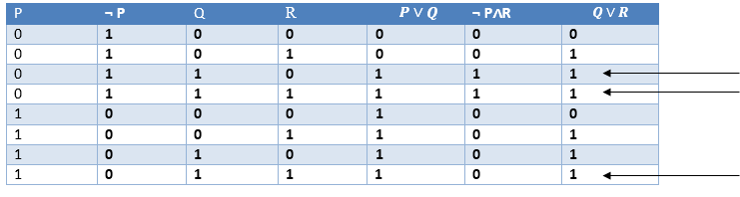
Continue… [CO4]
7. Resolution:
The Resolution rule state that if P∨Q and ¬ P∧R is true, then Q∨R will also be true. It can be represented as
Proof by Truth-Table:
Mr. Pushkal K Shukla 20CS-304 (DS) Unit 4

Slide 45
First-Order Predicate (CO4)
In the topic of Propositional logic, we have seen that how to represent statements using propositional logic. But unfortunately, in propositional logic, we can only represent the facts, which are either true or false. PL is not sufficient to represent the complex sentences or natural language statements. The propositional logic has very limited expressive power. Consider the following sentence, which we cannot represent using PL logic.
"Some humans are intelligent", or
"Sachin likes cricket."
To represent the above statements, PL logic is not sufficient, so we required some more powerful logic, such as first-order logic.
Mr. Pushkal K Shukla 20CS-304 (DS) Unit 4

Slide 46
Continue…
First-Order logic:
A predicate is an expression of one or more variables defined on some specific domain. A predicate with variables can be made a proposition by either assigning a value to the variable or by quantifying the variable.
The following are some examples of predicates −
Let E(x, y) denote "x = y"
Let X(a, b, c) denote "a + b + c = 0"
Let M(x, y) denote "x is married to y"
First-order logic is also known as Predicate logic or First-order predicate logic. First-order logic is a powerful language that develops information about the objects in a more easy way and can also express the relationship between those objects.
Mr. Pushkal K Shukla 20CS-304 (DS) Unit 4

Slide 47
Continue…
  -- Objects: A, B, people, numbers, colors, wars, theories, squares etc.
  Relations: It can be unary relation such as: red, round, is adjacent, or n-any relation such as: the sister of, brother of, has color, comes between
  Function: Father of, best friend, third inning of, end of, ......
As a natural language, first-order logic also has two main parts:
  Syntax
  Semantics
Mr. Pushkal K Shukla 20CS-304 (DS) Unit 4

Slide 48
Continue…
Syntax of First-Order logic:
The syntax of FOL determines which collection of symbols is a logical expression in first-order logic. The basic syntactic elements of first-order logic are symbols. We write statements in short-hand notation in FOL.
Basic Elements of First-order logic:
Following are the basic elements of FOL syntax:
Mr. Pushkal K Shukla 20CS-304 (DS) Unit 4

Slide 49
Continue…
Constant
1, 2, A, John, Mumbai, cat,....
Variables
x, y, z, a, b,....
Predicates
Brother, Father, >,....
Function
sqrt, LeftLegOf, ....
Connectives
∧, ∨, ¬, ⇒, ⇔
Equality ==
Quantifier ∀, ∃
Mr. Pushkal K Shukla 20CS-304 (DS) Unit 4

Slide 50
Continue…
Atomic sentences:
Atomic sentences are the most basic sentences of first-order logic. These sentences are formed from a predicate symbol followed by a parenthesis with a sequence of terms.
We can represent atomic sentences as Predicate (term1, term2, ......, term n).
Example: Ravi and Ajay are brothers: => Brothers(Ravi, Ajay).
Chinky is a cat: => cat (Chinky).
Mr. Pushkal K Shukla 20CS-304 (DS) Unit 4

Slide 51
Well Formed Formula
Well Formed Formula (wff) is a predicate holding any of the following −
All propositional constants and propositional variables are wffs
If x is a variable and Y is a wff, ∀xY∀xY and ∃xY∃xY are also wff
Truth value and false values are wffs
Each atomic formula is a wff
All connectives connecting wffs are wffs
Mr. Pushkal K Shukla 20CS-304 (DS) Unit 4

Slide 52
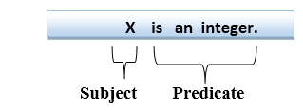
Continue…
Complex Sentences:
Complex sentences are made by combining atomic sentences using connectives.
First-order logic statements can be divided into two parts:
Subject: Subject is the main part of the statement.
Predicate: A predicate can be defined as a relation, which binds two atoms together in a statement.
Consider the statement: "x is an integer.", it consists of two parts, the first part x is the subject of the statement and second part "is an integer," is known as a predicate.
Mr. Pushkal K Shukla 20CS-304 (DS) Unit 4

Slide 53
Quantifiers in First-order logic
A quantifier is a language element which generates quantification, and quantification specifies the quantity of specimen in the universe of discourse.
These are the symbols that permit to determine or identify the range and scope of the variable in the logical expression. There are two types of quantifier:
  Universal Quantifier, (for all, everyone, everything)
  Existential quantifier, (for some, at least one).
Mr. Pushkal K Shukla 20CS-304 (DS) Unit 4

Slide 54
Continue…
Universal Quantifier:
Universal quantifier is a symbol of logical representation, which specifies that the statement within its range is true for everything or every instance of a particular thing.
The Universal quantifier is represented by a symbol ∀, which resembles an inverted A.
Note: In universal quantifier we use implication "→".
If x is a variable, then ∀x is read as:
For all x
For each x
For every x
Mr. Pushkal K Shukla 20CS-304 (DS) Unit 4

Slide 55
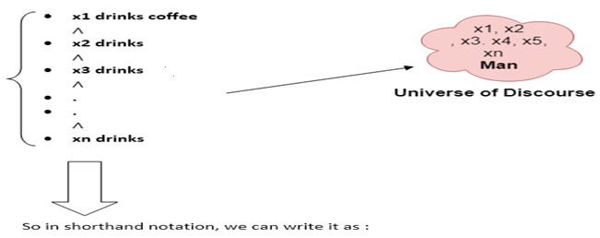
Continue…
Example: All man drink coffee.
Let a variable x which refers to a cat so all x can be represented in UOD as below:
∀x man(x) → drink (x, coffee).
It will be read as: There are all x where x is a man who drink coffee
Mr. Pushkal K Shukla 20CS-304 (DS) Unit 4

Slide 56
Continue…
Existential Quantifier:
Existential quantifiers are the type of quantifiers, which express that the statement within its scope is true for at least one instance of something.
It is denoted by the logical operator ∃, which resembles as inverted E. When it is used with a predicate variable then it is called as an existential quantifier.
Note: In Existential quantifier we always use AND or Conjunction symbol (∧).
If x is a variable, then existential quantifier will be ∃x or ∃(x). And it will be read as:
There exists a 'x.'
For some 'x.‘
For at least one 'x.'
Mr. Pushkal K Shukla 20CS-304 (DS) Unit 4

Slide 57
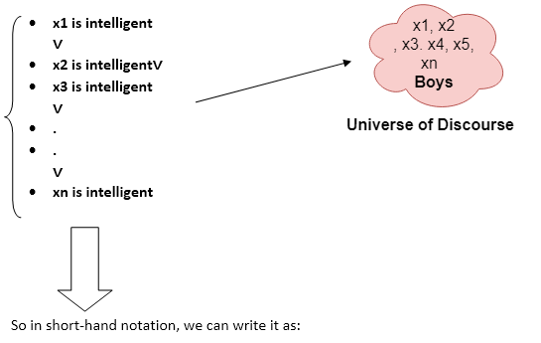
Continue…
Example: Some boys are intelligent.
∃x: boys(x) ∧ intelligent(x)
It will be read as: There are some x where x is a boy who is intelligent
Mr. Pushkal K Shukla 20CS-304 (DS) Unit 4

Slide 58
Continue…
Points to remember:
The main connective for universal quantifier ∀ is implication →.
The main connective for existential quantifier ∃ is and ∧.
Properties of Quantifiers:
In universal quantifier, ∀x∀y is similar to ∀y∀x.
In Existential quantifier, ∃x∃y is similar to ∃y∃x.
∃x∀y is not similar to ∀y∃x.
Mr. Pushkal K Shukla 20CS-304 (DS) Unit 4

Slide 59
Continue…
Some Examples of FOL using quantifier
1. All birds fly.
In this question the predicate is "fly(bird)."
And since there are all birds who fly so it will be represented as follows.
∀x bird(x) →fly(x).
2. Every man respects his parent.
In this question, the predicate is "respect(x, y)," where x=man, and y= parent.
Since there is every man so will use ∀, and it will be represented as follows:
∀x man(x) → respects (x, parent).
Mr. Pushkal K Shukla 20CS-304 (DS) Unit 4

Slide 60
Continue…
3. Some boys play cricket.
In this question, the predicate is "play(x, y)," where x= boys, and y= game. Since there are some boys so we will use ∃, and it will be represented as:
∃x boys(x) → play(x, cricket).
4. Not all students like both Mathematics and Science.
In this question, the predicate is "like(x, y)," where x= student, and y= subject.
Since there are not all students, so we will use ∀ with negation, so following representation for this:
¬∀ (x) [ student(x) → like(x, Mathematics) ∧ like(x, Science)].
Mr. Pushkal K Shukla 20CS-304 (DS) Unit 4

Slide 61
Continue…
5. Only one student failed in Mathematics.
In this question, the predicate is "failed(x, y)," where x= student, and y= subject.
Since there is only one student who failed in Mathematics, so we will use following representation for this:
∃(x) [ student(x) → failed (x, Mathematics) ∧∀ (y) [¬(x==y) ∧ student(y) → ¬failed (x, Mathematics)].
Mr. Pushkal K Shukla 20CS-304 (DS) Unit 4

Slide 62
Continue…
Free and Bound Variables:
There are two types of variables in First-order logic which are given below:
Free Variable: A variable is said to be a free variable in a formula if it occurs outside the scope of the quantifier.
Example: ∀x ∃(y)[P (x, y, z)], where z is a free variable.
Bound Variable: A variable is said to be a bound variable in a formula if it occurs within the scope of the quantifier.
Example: ∀x [A (x) B( y)], here x and y are the bound variables.
Mr. Pushkal K Shukla 20CS-304 (DS) Unit 4

Slide 63
Inference in First-Order Logic
Inference in First-Order Logic is used to deduce new facts or sentences from existing sentences. Before understanding the FOL inference rule, let's understand some basic terminologies used in FOL.
Substitution:
Substitution is a fundamental operation performed on terms and formulas. It occurs in all inference systems in first-order logic. The substitution is complex in the presence of quantifiers in FOL. If we write F[a/x], so it refers to substitute a constant "a" in place of variable "x".
Note: First-order logic is capable of expressing facts about some or all objects in the universe.
Mr. Pushkal K Shukla 20CS-304 (DS) Unit 4

Slide 64
Continue…
Equality:
First-Order logic does not only use predicate and terms for making atomic sentences but also uses another way, which is equality in FOL. For this, we can use equality symbols which specify that the two terms refer to the same object.
Example: Brother (John) = Smith.
As in the above example, the object referred by the Brother (John) is similar to the object referred by Smith. The equality symbol can also be used with negation to represent that two terms are not the same objects.
Example: ￢(x=y) which is equivalent to x ≠y.
Mr. Pushkal K Shukla 20CS-304 (DS) Unit 4

Slide 65
Continue…
FOL inference rules for quantifier:
As propositional logic we also have inference rules in first-order logic, so following are some basic inference rules in FOL:
Universal Generalization
Universal Instantiation
Existential Instantiation
Existential introduction
Mr. Pushkal K Shukla 20CS-304 (DS) Unit 4

Slide 66

Continue…
1. Universal Generalization:
Universal generalization is a valid inference rule which states that if premise P(c) is true for any arbitrary element c in the universe of discourse, then we can have a conclusion as ∀ x P(x).
It can be represented as:
This rule can be used if we want to show that every element has a similar property.
In this rule, x must not appear as a free variable.
Example: Let's represent, P(c): "A byte contains 8 bits", so for ∀ x P(x) "All bytes contain 8 bits.", it will also be true.
Mr. Pushkal K Shukla 20CS-304 (DS) Unit 4

Slide 67

Continue…
2. Universal Instantiation:
Universal instantiation is also called as universal elimination or UI is a valid inference rule. It can be applied multiple times to add new sentences.
The new KB is logically equivalent to the previous KB.
As per UI, we can infer any sentence obtained by substituting a ground term for the variable.
The UI rule state that we can infer any sentence P(c) by substituting a ground term c (a constant within domain x) from ∀ x P(x) for any object in the universe of discourse.
It can be represented as:
Example:1.
IF "Every person like ice-cream"=> ∀x P(x) so we can infer that
"John likes ice-cream" => P(c)
Mr. Pushkal K Shukla 20CS-304 (DS) Unit 4

Slide 68
Continue…
Example: 2.
Let's take a famous example,
"All kings who are greedy are Evil." So let our knowledge base contains this detail as in the form of FOL:
∀x king(x) ∧ greedy (x) → Evil (x),
So from this information, we can infer any of the following statements using Universal Instantiation:
King(John) ∧ Greedy (John) → Evil (John),
King(Richard) ∧ Greedy (Richard) → Evil (Richard),
King(Father(John)) ∧ Greedy (Father(John)) → Evil (Father(John)),
Mr. Pushkal K Shukla 20CS-304 (DS) Unit 4

Slide 69
Continue…
3. Existential Instantiation:
Existential instantiation is also called as Existential Elimination, which is a valid inference rule in first-order logic.
It can be applied only once to replace the existential sentence.
The new KB is not logically equivalent to old KB, but it will be satisfiable if old KB was satisfiable.
This rule states that one can infer P(c) from the formula given in the form of ∃x P(x) for a new constant symbol c.
The restriction with this rule is that c used in the rule must be a new term for which P(c ) is true.
It can be represented as:
Example:
From the given sentence: ∃x Crown(x) ∧ OnHead(x, John)
Mr. Pushkal K Shukla 20CS-304 (DS) Unit 4

Slide 70
Continue…
So we can infer: Crown(K) ∧ OnHead( K, John), as long as K does not appear in the knowledge base.
The above used K is a constant symbol, which is called Skolem constant.
The Existential instantiation is a special case of Skolemization process.
Mr. Pushkal K Shukla 20CS-304 (DS) Unit 4

Slide 71

Continue…
4. Existential introduction
An existential introduction is also known as an existential generalization, which is a valid inference rule in first-order logic.
This rule states that if there is some element c in the universe of discourse which has a property P, then we can infer that there exists something in the universe which has the property P.
It can be represented as:
Example: Let's say that,
"Priyanka got good marks in English."
"Therefore, someone got good marks in English.
Mr. Pushkal K Shukla 20CS-304 (DS) Unit 4

Slide 72
Faculty Video Links, Youtube & NPTEL Video Links and Online Courses Details(CO4)
Youtube/other Video Links
https://www.youtube.com/watch?v=Ib5njCwNMdk&list=PLBlnK6fEyqRhqJPDXcvYlLfXPh37L89g3&index=3
https://www.youtube.com/watch?v=6kYngPvoGxU&list=PLBlnK6fEyqRhqJPDXcvYlLfXPh37L89g3&index=4
https://www.youtube.com/watch?v=m2mf6I3g2-c&list=PLBlnK6fEyqRhqJPDXcvYlLfXPh37L89g3&index=5
https://www.youtube.com/watch?v=tACXuzfXzSI&list=PLBlnK6fEyqRhqJPDXcvYlLfXPh37L89g3&index=6
https://www.youtube.com/watch?v=ccz-w2JMsTM&list=PLBlnK6fEyqRhqJPDXcvYlLfXPh37L89g3&index=7
Mr. Pushkal K Shukla 20CS-304 (DS) Unit 4

Slide 73
Daily Quiz(CO4)
Q1 ¬ (p ↔ q) is logically equivalent to:
(a) p ↔ ¬q (b) ¬p ↔ q
(c)
Q2 Which of the following option is true?
(a) If the Sun is a planet, elephants will fly
(b) 3 +2 = 8 if 5-2 = 7
(c) 1 > 3 and 3 is a positive integer
(d) -2 > 3 or 3 is a negative integer
Q3 The truth value of given statement is
‘If 9 is prime then 3 is even’.
(a) False (b) True
Mr. Pushkal K Shukla 20CS-304 (DS) Unit 4

Slide 74
Daily Quiz(CO4)
Q4 Let P: I am in Bangalore. , Q: I love cricket. ; then q -> p(q implies p) is:
(a) If I love cricket then I am in Bangalore
(b) If I am in Bangalore then I love cricket
(c) I am not in Bangalore
(d) I love cricket
Q5 Let P: We should be honest., Q: We should be dedicated .,R: We should be over confident.Then ‘We should be honest or dedicated but not overconfident.’ is best represented by:
(a) ~P V ~Q V R
(b) P ∧ ~Q ∧ R
(c) P V Q ∧ R
(d) P V Q ∧ ~R
Mr. Pushkal K Shukla 20CS-304 (DS) Unit 4

Slide 75
Weekly Assignment(CO4)
Q1 What do you mean by logical equivalence? Explain with an example.
Q2 Construct the truth table of the following
~ (𝑃∨ (𝑄∧𝑅)) ⟺ ((𝑃∨𝑄) ∧ (𝑃∨𝑅 ))
Q3 Show that which of the following statements tautology are.
(i) (( 𝑃∨∽𝑄) ∧(∽𝑃∨∽𝑄))∨𝑄
(ii) (~𝑃∧𝑄 ⟹(𝑄⟹𝑃))
Q4 Using truth table prove that: P ↔ Q ≡ (P → Q) ∧ (Q → P).
Q5 Using logical equivalent formulas, show that
~ (P ∨ (~ P ∧ Q)) ≡ ~ P ∧ ~ Q.
Q6 Express (~𝑝→𝑟) ∧(𝑞⟷𝑞) in its principle conjunctive normal form
Q7 Define Minterms and Maxterms and find the principal disjunctive normal form of the following:- (𝑝∧𝑞) ∨ (~𝑝∧𝑟) ∨(𝑞∧𝑟)
Mr. Pushkal K Shukla 20CS-304 (DS) Unit 4

Slide 76
MCQs(CO4)
Q1 Which of the following statement is a proposition?
(a) Get me a glass of milkshake
(b) God bless you!
(c) What is the time now?
(d) The only odd prime number is 2
Q2 Let P: I am in Delhi. , Q: Delhi is clean. ; then q ^ p(q and p) is:
(a) Delhi is clean and I am in Delhi
(b) Delhi is not clean or I am in Delhi
(c) I am in Delhi and Delhi is not clean
(d) Delhi is clean but I am in Mumbai
Q3 The compound propositions p and q are called logically equivalent if ________ is a tautology.
(a) p ↔ q (b) p → q (c) ¬ (p ∨ q) (d) ¬p ∨ ¬q
Mr. Pushkal K Shukla 20CS-304 (DS) Unit 4

Slide 77
MCQs (CO4)
Q4 p → q is logically equivalent to:
(a) ¬p ∨ ¬q (b) p ∨ ¬q (c) ¬p ∨ q (d) ¬p ∧ q
Q5 p ∨ q is logically equivalent to:
(a) ¬q → ¬p (b) q → p (c) ¬p → ¬q (d) ¬p → q
Q6 Which of the following statement is correct?
(a) p ∨ q ≡ q ∨ p
(b) ¬(p ∧ q) ≡ ¬p ∨ ¬q
(c) (p ∨ q) ∨ r ≡ p ∨ (q ∨ r)
(d) All of mentioned
Q7 (p → q) ∧ (p → r) is logically equivalent to:
(a) p → (q ∧ r ) (b) p → (q ∨ r)
(c) p ∧ (q ∨ r) (d) p ∨ (q ∧ r)
Mr. Pushkal K Shukla 20CS-304 (DS) Unit 4

Slide 78
MCQs (CO4)
Q4 p → q is logically equivalent to:
(a) ¬p ∨ ¬q (b) p ∨ ¬q (c) ¬p ∨ q (d) ¬p ∧ q
Q5 p ∨ q is logically equivalent to:
(a) ¬q → ¬p (b) q → p (c) ¬p → ¬q (d) ¬p → q
Q6 Which of the following statement is correct?
(a) p ∨ q ≡ q ∨ p
(b) ¬(p ∧ q) ≡ ¬p ∨ ¬q
(c) (p ∨ q) ∨ r ≡ p ∨ (q ∨ r)
(d) All of mentioned
Q7 (p → q) ∧ (p → r) is logically equivalent to:
(a) p → (q ∧ r ) (b) p → (q ∨ r)
(c) p ∧ (q ∨ r) (d) p ∨ (q ∧ r)
Mr. Pushkal K Shukla 20CS-304 (DS) Unit 4

Slide 79
MCQs (CO4)
Q8 Which of the following statement is a proposition?
a) Get me a glass of milkshake
b) God bless you!
c) What is the time now?
d) The only odd prime number is 2
Q9 The truth value of given statement is
‘4+3=7 or 5 is not prime’.
a) False
b) True
Q10. Which of the following option is true?
a) If the Sun is a planet, elephants will fly
b) 3 +2 = 8 if 5-2 = 7
c) 1 > 3 and 3 is a positive integer
d) -2 > 3 or 3 is a negative intege
Mr. Pushkal K Shukla 20CS-304 (DS) Unit 4

Slide 80
MCQs (CO4)
Q11 What is the value of x after this statement, assuming initial value of x is 5?‘If x equals to one then x=x+2 else x=0’.
a) 1 b) 3
c) 0 d) 2
Q12 Let P: I am in Bangalore. , Q: I love cricket. ; then q -> p(q implies p) is:
a) If I love cricket then I am in Bangalore
b) If I am in Bangalore then I love cricket
c) I am not in Bangalore
d) I love cricket
Q13. Let P:If Sahil bowls, Saurabh hits a century. ,Q: If Raju bowls , Sahil gets out on first ball. Now if P is true and Q is false then which of the following can be true?
a) Raju bowled and Sahil got out on first ball
b) Raju did not bowled
c) Sahil bowled and Saurabh hits a century
d) Sahil bowled and Saurabh got out
Mr. Pushkal K Shukla 20CS-304 (DS) Unit 4

Slide 81
MCQs (CO4)
Q14 The truth value of given statement is
‘If 9 is prime then 3 is even’.
a) False
b) True
Q15 Let P: I am in Delhi. , Q: Delhi is clean. ; then q ^ p(q and p) is:
a) Delhi is clean and I am in Delhi
b) Delhi is not clean or I am in Delhi
c) I am in Delhi and Delhi is not clean
d) Delhi is clean but I am in Mumbai
Q16 Let P: This is a great website, Q: You should not come back here.
Then ‘This is a great website and you should come back here.’ is best represented by:
a) ~P V ~Q b) P ∧ ~Q
c) P V Q d) P ∧ Q
Mr. Pushkal K Shukla 20CS-304 (DS) Unit 4

Slide 82
MCQs (CO4)
Q17. Let P: We should be honest., Q: We should be dedicated .,R: We should be overconfident.
Then ‘We should be honest or dedicated but not overconfident.’ is best represented by:
a) ~P V ~Q V R b) P ∧ ~Q ∧ R
c) P V Q ∧ R d) P V Q ∧ ~R
Q18. A compound proposition that is always ___________ is called a tautology.
a) True b) False
Q19 Let P (x) denote the statement “x >7.” Which of these have truth value true?
a) P (0) b) P (4)
c) P (6) d) P (9)
Mr. Pushkal K Shukla 20CS-304 (DS) Unit 4

Slide 83
MCQs (CO4)
Q20. The statement,” Every comedian is funny” where C(x) is “x is a comedian” and F (x) is “x is funny” and the domain consists of all people.
a) ∃x(C(x) ∧ F (x))
b) ∀x(C(x) ∧ F (x))
c) ∃x(C(x) → F (x))
d) ∀x(C(x) → F (x))
Mr. Pushkal K Shukla 20CS-304 (DS) Unit 4

Slide 84
Old Question Papers(CO4)
1. Rewrite the following statements without using conditional:
(a) If it is cold, he wears a hat.
(b) If productivity increase, then wages rise.
2. Whenever Ram and Shyam are present in the party then there is some
trouble in the party. Today there is no trouble in the party. Hence Ram and
Shyam are not present in the party. Write it in symbolic notation
3. Let p be “Kailash reads Newsweek” , let “Kailash reads the New Yorker”
and let r be “Kailash reads Times”. Write each of following in symbolic
form:
(a) Kailash reads Newsweeks or The New Yorker, but not Times.
(b) Kailash reads Newsweeks and The New Yorker or he does not
read Newsweeks and Times.
(c) It is not true that Kailash reads Newsweek but not Times.
Mr. Pushkal K Shukla 20CS-304 (DS) Unit 4

Slide 85
Old Question Papers(CO4)
4. Write the contra positive of the implication: “if it is Sunday then it is a holiday
5. Show that the propositions 𝑝→𝑞𝑎𝑛𝑑 ¬𝑝∨𝑞 are logically equivalent.
7. Explain various Rules of Inference for Propositional Logic.
8. Prove the validity of the following argument “if the races are fixed so the casinos are crooked, then the tourist trade will decline. If the tourist trade decreases, then the police will be happy. The police force is never happy. Therefore, the races are not fixed.
9. What is a tautology, contradiction and contingency? Show that (p ∨ q) ∧ (¬ p ∨ r) → (q ∨ r) is a tautology, contradiction or contingency.
Mr. Pushkal K Shukla 20CS-304 (DS) Unit 4

Slide 86
Old Question Papers(CO4)
10.Show that the premises “It is not sunny this afternoon and it is colder than yesterday,” “We will go swimming only if it is sunny,” “If we do not go swimming, then we will take a canoe trip,” and “If we take a canoe trip, then we will be home by sunset” lead to the conclusion “We will be home by sunset.”
Mr. Pushkal K Shukla 20CS-304 (DS) Unit 4

Slide 87
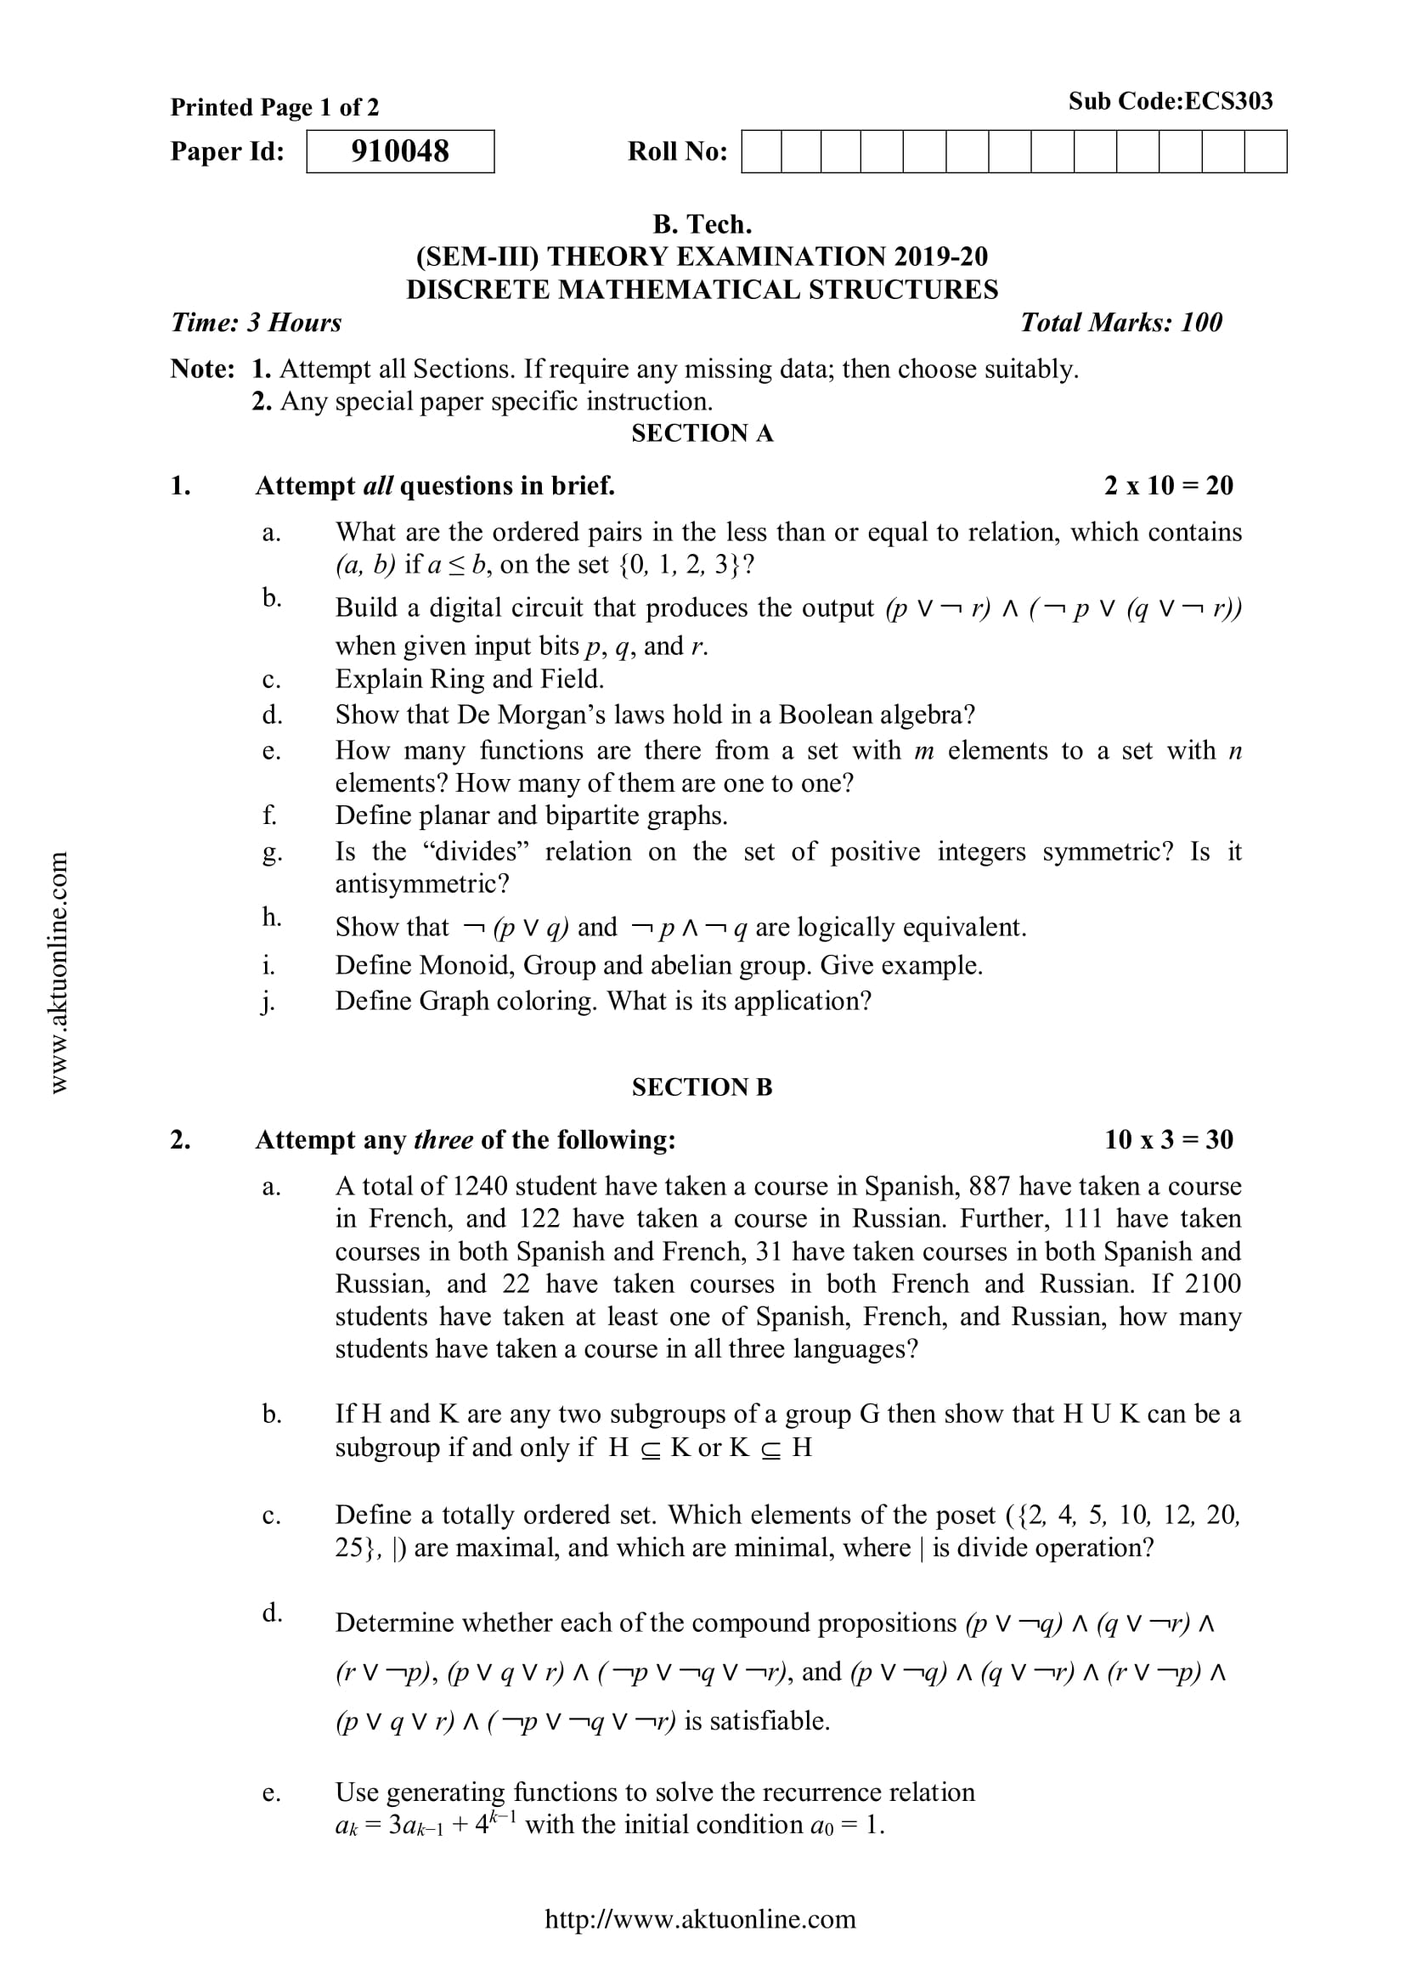
Old Question Papers (CO4)
Mr. Pushkal K Shukla 20CS-304 (DS) Unit 4

Slide 88
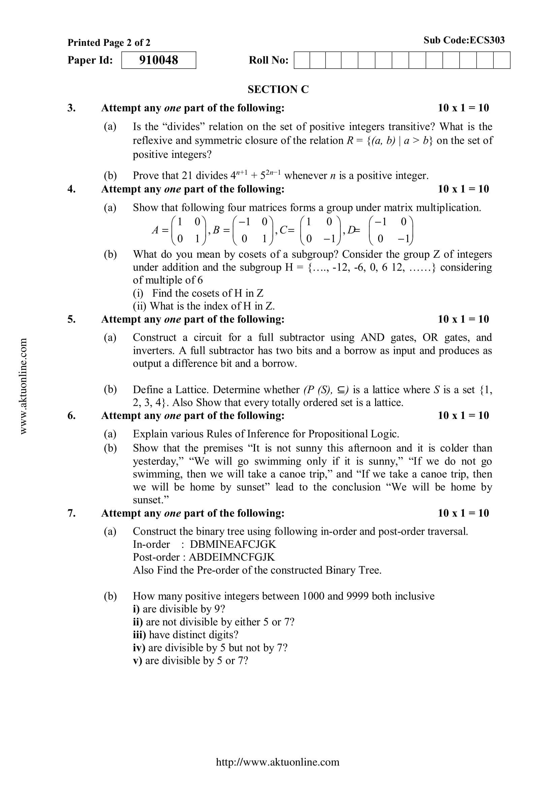
Old Question Papers (CO4)
Mr. Pushkal K Shukla 20CS-304 (DS) Unit 4

Slide 89
Old Question Papers (CO4)
For some more Old Question Papers go to the link below.
https://drive.google.com/drive/folders/1LBqJvyWPNRCdAcr9Sag4TzECfnLgRIQn?usp=sharing
Mr. Pushkal K Shukla 20CS-304 (DS) Unit 4

Slide 90
Expected Questions for University Exam(CO4)
Q1 Construct the truth table for the compound proposition
(𝑝 → 𝑞) ↔ (¬𝑝 → ¬𝑞).
Q2 Write the symbolic representation and give its contra positive statement of “If it rains today, then I buy an umbrella”
Q3 Show that ( 𝑝 → 𝑟) ∧ (𝑞 → 𝑟)𝑎𝑛𝑑 (𝑝 ∨ 𝑞) → 𝑟 are logically equivalent.
Q4 Without using truth table show that 𝑝 → (𝑞 → 𝑝) ⟺ ¬𝑝 → (𝑝 → 𝑞).
Q5 Is ¬𝑝 ∧ (𝑝 ∨ 𝑞)) → 𝑞 a tautology?
Q6 What are the contra positive, the converse and the inverse of the conditional statement “If you work hard then you will be rewarded”.
Mr. Pushkal K Shukla 20CS-304 (DS) Unit 4

Slide 91
Summary (CO4)
Now you were able to understand the concepts discrete structures include sets, relation , functions, Algebraic Structure, poset, lattice, Boolean algebra, predicate logic and prepositional laogic etc.
After understanding propositional logic students will be able to design of computing machines, artificial intelligence, definition of data structures for programming languages etc.
Propositional Logic is concerned with statements to which the truth values, “true” and “false”, can be assigned.
The subject enhances one’s ability to develop logical thinking and ability to problem solving.
Mr. Pushkal K Shukla 20CS-304 (DS) Unit 4

Slide 92
References
B. Kolman, R.C. Busby, and S.C. Ross, Discrete Mathematical Structures, 5/e, Prentice Hall, 2004.
Liptschutz, Seymour, “ Discrete Mathematics”, McGraw Hill.
Trembley, J.P & R. Manohar, “Discrete Mathematical Structure with Application to Computer Science”, McGraw Hill
Koshy, Discrete Structures, Elsevier Pub. 2008 Kenneth H. Rosen, Discrete Mathematics and Its Applications, 6/e, McGraw-Hill, 2006.
Mr. Pushkal K Shukla 20CS-304 (DS) Unit 4

Slide 93

Mr. Pushkal K Shukla 20CS-304 (DS) Unit 4

