Slide 1



Noida Institute of Engineering and Technology,
Greater Noida
Lattices
Unit: 3
Discrete Structures
(20CS-304)
Mr. Pushkal K Shukla
Asst. Prof.
AIML Deptt.
.
B Tech 3rd Sem
Mr. Pushkal K Shukla 20CS-304 (DS) Unit 3

Slide 2
Course Objectives
A course discrete structures used to represent discrete objects and relationships between these objects. These discrete structures include sets, relation , permutations, relations, graphs and trees etc.
The subject enhances one’s ability to develop logical thinking and ability to problem solving.
Mr. Pushkal K Shukla 20CS-304 (DS) Unit 3

Slide 3
Unit 3 Objectives
State the algebraic definition of a Boolean algebra
The objective of unit 3 to solve problems using the algebraic properties of the elements of a Boolean algebra
Define a poset and find the maximum and minimum elements of subsets of posets when they exist
Find the supremum and infimum of subsets of posets when they exist
Define a lattice and identify lattices among posets
Mr. Pushkal K Shukla 20CS-304 (DS) Unit 3

Slide 4
Course Outcome
Course Outcome ( CO) | At the end of course , the student will be able to understand | Bloom’s Knowledge Level (KL)
CO1 | Write an argument using logical notation and determine if the argument is or is not valid. | K3, K4
CO2 | Understand the basic principles of sets and operations in sets. | K1, K2
CO3 | Demonstrate an understanding of relations and functions and be able to determine their properties | K3
CO4 | Demonstrate different traversal methods for trees and graphs. | K1, K4
CO5 | Model problems in Computer Science using graphs and trees. | K2, K6
Mr. Pushkal K Shukla 20CS-304 (DS) Unit 3

Slide 5
CO-PO’s and PSO’s Mapping
 | PO1 | PO2 | PO3 | PO4 | PO5 | PO6 | PO7 | PO8 | PO9 | PO10 | PO11 | PO12
KCS303.1 | 3 | 2 | 2 | - | - | 1 | - | - | - | 1 | 1 | 3
KCS303.2 | 3 | 3 | 2 | 2 | 1 | - | - | - | - | - | 2 | 1
KCS303.3 | 3 | 3 | 2 | 1 | - | - | 3 | - | 2 | 2 | 2 | 2
KCS303.4 | 3 | 3 | 2 | 1 | - | - | 1 | - | - | 3 | 2 | 2
KCS303.5 | 3 | 3 | 2 | 1 | - | - | 3 | - | - | 1 | 3 | 3
 | PSO1 | PSO2 | PSO3 | PSO4
KCS303.1 | 1 | 2 | 3 | -
KCS303.2 | 1 | 2 | 3 | 1
KCS303.3 | 3 | 2 | 3 | 1
KCS303.4 | 2 | 3 | 3 | -
KCS303.5 | 2 | 3 | 2
11/05/2020
Mr. Pushkal K Shukla 20CS-304 (DS) Unit 3

Slide 6
Prerequisite & Recap (CO3)
Prerequisite
Basic Understanding of class 10 mathematics NCERT.
Basic Knowledge of sets and algebraic rules
Basic Understanding of Set Theory, Relations and Functions .
Basic Understanding of Algebraic Structures.
Recap
Now students are able to develop there logical thinking by using Sets, Relations, Functions and Mathematical Induction, & Algebraic Structures concepts and use in upcoming topic. i.e. Lattices & Boolean Algebra.
Mr. Pushkal K Shukla 20CS-304 (DS) Unit 3

Slide 7
Content(CO3)
Lattices:
Definition
Properties of lattices – Bounded, Complemented
Modular and Complete lattice.
Boolean Algebra:
Introduction
Axioms and Theorems of Boolean algebra
Algebraic manipulation of Boolean expressions
Simplification of Boolean Functions, Karnaugh maps
Logic gates
Digital circuits and Boolean algebra.
11/05/2020
Mr. Pushkal K Shukla 20CS-304 (DS) Unit 3

Slide 8
Topic Objectives: Lattices(CO3)
Objective is to learn lattices are
To solve problems using the algebraic properties of the elements of a Boolean algebra
define a poset and find the maximum and minimum elements of subsets of posets when they exist
define a lattice and identify lattices among posets
define and verify distributive property for lattices
define a sublattice
state the definitions of a bounded lattice and a complete lattice
identify bounded and complete lattices
11/05/2020
Mr. Pushkal K Shukla 20CS-304 (DS) Unit 3

Slide 9
Topic Prerequisite & Recap (CO3)
Prerequisite
Basic Understanding of class 10 mathematics NCERT.
Basic Knowledge of sets and algebraic rules
Basic Understanding of Set Theory, Relations and Functions .
Basic Understanding of Algebraic Structures.
Recap
Now students are able to develop there logical thinking by using Sets, Relations, Functions and Mathematical Induction, & Algebraic Structures concepts and use in upcoming topic. i.e. Lattices.
Mr. Pushkal K Shukla 20CS-304 (DS) Unit 3

Slide 10
Partially Ordered Sets(CO3)
Partial ordering: reflexive, anti-symmetric and transitive binary relation
Example: For S = {a,b,c}, partial ordering satisfies
    Reflexive: a ≤ a
    Anti-Symmetric: a ≤ b and b ≤ a imply a=b
    Transitive: if a ≤ b and b ≤ c, then a ≤ c
11/05/2020
Mr. Pushkal K Shukla 20CS-304 (DS) Unit 3

Slide 11
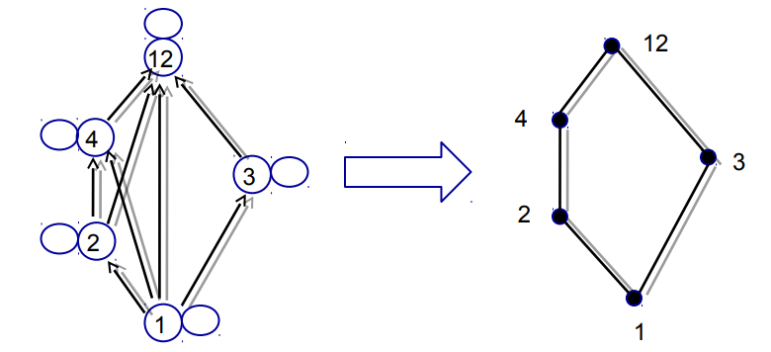
Partially Ordered Set(CO3)
Example: Let A={1,2,3,12} consider the partial order of divisibility on A. Draw the corresponding Hasse Daigram
11/05/2020
Mr. Pushkal K Shukla 20CS-304 (DS) Unit 3

Slide 12
Comparable(CO3)
If (A, ≤) is a poset, elements a and b of A are comparable if
a ≤ b or b ≤ a
In some poset, e.g. the relation of divisibility (a R b iff a | b), some pairs of elements are not comparable
2 | 7 and 7 | 2
Note: if every pair of elements in a poset A is comparable, we say that A is linear ordered set, and the partial order is called a linear order. We also say that A is a chain or totally ordered set.
11/05/2020
Mr. Pushkal K Shukla 20CS-304 (DS) Unit 3

Slide 13
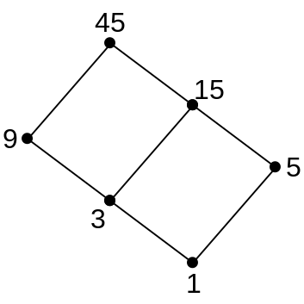
Totally Ordered Sets(CO3)
Total ordering: if for every pair a,b in S, either a≤ b or b ≤ a , then S is totally ordered by binary relation
Example: Set of all prime numbers is totally ordered by ≤
Displaying the ordering relation with a Hasse diagram
Example: Partial ordering displaying divisibility relation among all positive divisors of 45, such that the quotient is an integer
Hasse diagram
11/05/2020
Mr. Pushkal K Shukla 20CS-304 (DS) Unit 3

Slide 14
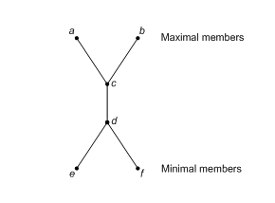
Extremal Elements of Partially Ordered Sets(CO3)
Consider a poset (A, ≤ )
Maximal Element An element a in A is called a maximal element of A if there is no element c in A such that a ≤ c.
Minimal Element An element b in A is called a minimal element of A if there is no element c in A such that c ≤ b.
An element a in A is a maximal (minimal) element of (A, ≥ ) if and only if a is a minimal (maximal) element of (A, ≤ )
11/05/2020
Mr. Pushkal K Shukla 20CS-304 (DS) Unit 3

Slide 15
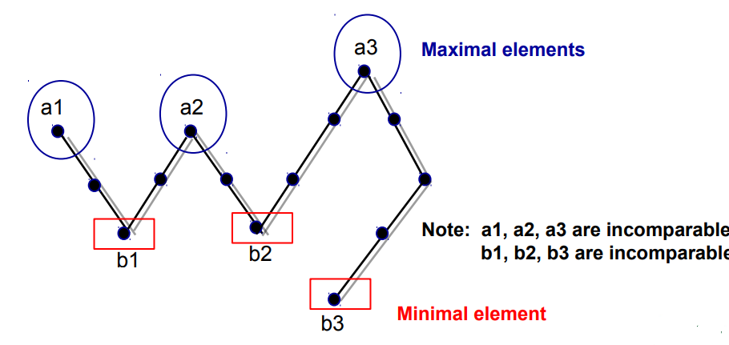
Extremal Elements of Partially Ordered Sets(CO3)
Example: Find the maximal and minimal elements in the following Hasse diagram
11/05/2020
Mr. Pushkal K Shukla 20CS-304 (DS) Unit 3

Slide 16
Extremal Elements of Partially Ordered Sets(CO3)
Example Let A be the poset of nonnegative real number with the usual partial order ≤ . Then 0 is a minimal element of A. There are no maximal elements of A
Example The poset Z with the usual partial order ≤ has no maximal elements and has no minimal elements
11/05/2020
Mr. Pushkal K Shukla 20CS-304 (DS) Unit 3

Slide 17
Greatest element and Least element(CO3)
Greatest element:
An element a in A is called a greatest element of A if x ≤ a for all x in A.
Least element
An element a in A is called a least element of A if a ≤ x for all x in A.
Note: an element a of (A, ≤ ) is a greatest (or least) element if and only if it is a least (or greatest) element of (A, ≥ )
11/05/2020
Mr. Pushkal K Shukla 20CS-304 (DS) Unit 3

Slide 18
Extremal Elements of Partially Ordered Sets(CO3)
Unit element
The greatest element of a poset, if it exists, is denoted by 1 and is often called the unit element.
Zero element
The least element of a poset, if it exists, is denoted by 0 and is often called the zero element.
11/05/2020
Mr. Pushkal K Shukla 20CS-304 (DS) Unit 3

Slide 19
Theorem 1(CO3)
If (A, ≤ ) be a poset, then
If greatest element exists, then it is unique.
If least element exists, then it is unique.
Proof: Assume that there are two greatest elements of poset (A, ≤ ), say a and b.
Therefore, x ≤ a and x ≤ b, ∀ x ∈ A.
∴a ≤ b (b is greatest element)
and b ≤ a (a is greatest element)
∴by antisymmetric property, a = b.
Similarly, for least element.
11/05/2020
Mr. Pushkal K Shukla 20CS-304 (DS) Unit 3

Slide 20
Theorem 2(CO3)
Let (L,∨, ∧) be a lattice.
commutative law for join and meet: For a, b ∈ L,
a ∨ b = b ∨ a; a ∧ b = b ∧ a
2. Associative law for join and meet: For a, b, c ∈ L,
(a ∨ b) ∨ c = a ∨ (b ∨ c ); (a ∧ b) ∧ c = a ∧ (b ∧ c )
3. Absorption law for join and meet: For a, b ∈ L,
a ∨ (a ∧ b) = a ; a ∧ (a ∨ b) = a
11/05/2020
Mr. Pushkal K Shukla 20CS-304 (DS) Unit 3

Slide 21
Proof of Theorem 2(CO3)
Proof of 1:
Let a, b ∈ L,
a ∨ b = l.u.b.{a,b} = l.u.b.{b,a} = b ∨ a
a ∧ b = g.l.b.{a,b} = g.l.b.{b,a} = b ∧ a
Proof of 2:
Let a, b ∈ L,
b ≤ (a ∨ b) ≤ (a ∨ b) ∨ c and
c ≤ (a ∨ b) ∨ c
By def. of l.u.b., b ∨ c ≤ (a ∨ b) ∨ c
Also, a ≤ (a ∨ b) ≤ (a ∨ b) ∨ c
∴ a ∨ (b ∨ c ) ≤ (a ∨ b) ∨ c …(1)
11/05/2020
Mr. Pushkal K Shukla 20CS-304 (DS) Unit 3

Slide 22
Proof of Theorem 2(CO3)
Similarly, we have a ≤ a ∨ (b ∨ c ) and b ≤ b ∨ c ≤ a ∨ (b ∨ c )
By def. of l.u.b., we get a ∨ b ≤ a ∨ (b ∨ c )
Also, c ≤ b ∨ c ≤ a ∨ (b ∨ c )
Hence, (a ∨ b) ∨ c ≤ a ∨ (b ∨ c ) …(2)
Since, ‘≤’ is anti-symmetric, ∴from (1) and (2),
(a ∨ b) ∨ c = a ∨ (b ∨ c )
Similarly, we prove for meet: (a ∧ b) ∧ c = a ∧ (b ∧ c )
11/05/2020
Mr. Pushkal K Shukla 20CS-304 (DS) Unit 3

Slide 23
Proof of (3): Absorption law:(CO3)
Let a, b ∈ L,
Since, a ≤ a ∨ b
∴ a ∨ (a ∧ b) = a
Similarly, a ∧ b ≤ and
∴ a ∧ (a ∨ b) = a
E.g. In D₂₀, 2 ∨ (2 ∧ 4) = 2 ∨ (2) = 2
and 2 ∧ (2 ∨ 4) = 2 ∧ (4) = 2
11/05/2020
Mr. Pushkal K Shukla 20CS-304 (DS) Unit 3

Slide 24
Theorem 3: Let (L,∨, ∧) be a lattice(CO3).
Idempotent laws for join and meet: For a∈ L,
a ∨ a = a; a ∧ a = a; ∀ a∈ L
Proof: Let a∈ L,
a ∨ a = l.u.b.{a, a} = l.u.b.{a} = a
a ∧ a = g.l.b.{a, a} = g.l.b.{a} = a
11/05/2020
Mr. Pushkal K Shukla 20CS-304 (DS) Unit 3

Slide 25
Theorem 4:(CO3)
Let (L,∨, ∧) be a lattice.
Suppose the greatest element 1 and the least element 0 exist, then for x ∈ L, x ∨ 1 = 1; x ∧ 1 = x; x ∨ 0 = x; x ∧ 0 = 0
Proof: Let x∈ L, since 1 is the greatest element and 0 is the least element,
x ∧ 1 ≤ x and x ≤ x ; x ≤ 1
∴x = x ∧ x ≤ x ∧ 1
∴ x ∧ 1 = x
Similarly, we prove other properties.
11/05/2020
Mr. Pushkal K Shukla 20CS-304 (DS) Unit 3

Slide 26
Lower/Upper Bound of a Subset of Set S(CO3)
Consider a poset (A, ≤)
Upper bound of a and b:
An element c in A is called an upper bound of a and b if a ≤ c and b ≤ c for all a, b in A.
Least upper bound (lub): smallest of all upper bounds
Lower bound of a and b:
An element d in A is called a lower bound of a and b if d ≤ a and d ≤ b for all a, b in A
Greatest lower bound (glb): largest of all lower bounds
Example: S = {1,3,5,9,15,45} and P = {3,5}
    Upper bounds: 15, 45 lub: 15 glb = 1
11/05/2020
Mr. Pushkal K Shukla 20CS-304 (DS) Unit 3

Slide 27
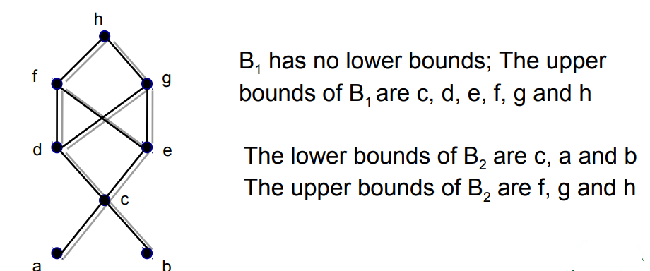
Lower/Upper Bound(CO3)
Example
Find all upper and lower bounds of the following subset of A: (a) B₁={a, b}; B₂={c, d, e}
11/05/2020
Mr. Pushkal K Shukla 20CS-304 (DS) Unit 3

Slide 28
Greatest Lower/Least Upper Bound(CO3)
Consider a poset (A, ≤), and a, b in A,
Least upper bound
An element c in A is called a least upper bound of a and b, if (i) c is an upper bound of a and b; i.e. a ≤ c & b ≤ c (ii) if c’ is another upper bound then c ≤ c’.
Greatest lower bound
An element g in A is called a greatest lower bound of a and b, if (i) g is a lower bound of a and b; i.e. g ≤ a & g ≤ b (ii) if g’ is another lower bound then g’ ≤ g.
11/05/2020
Mr. Pushkal K Shukla 20CS-304 (DS) Unit 3

Slide 29
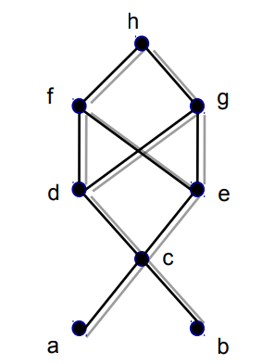
Greatest Lower/Least Upper Bound(CO3)
Example : Find all least upper bounds and all greatest lower bounds of (a) B1={a, b} (b) B2={c, d, e}
Since B1 has no lower bounds, it has no greatest lower bounds;
However, LUB(B1)=c
(b) Since the lower bounds of B2 are c, a and b,
we find that GLB(B2)=c The upper bounds
of B2 are f, g and h. Since f and g are not
comparable, we conclude that B2 has no
least upper bound.
11/05/2020
Mr. Pushkal K Shukla 20CS-304 (DS) Unit 3

Slide 30
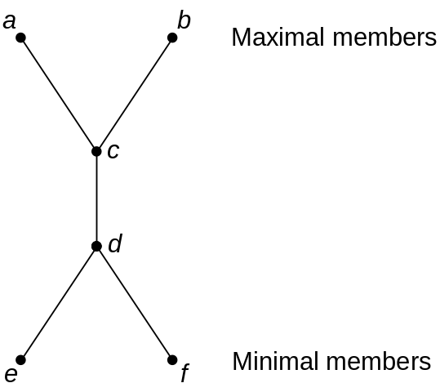
Lattice(CO3)
Lattice: partially ordered set in which every pair of elements has a unique glb and a unique lub
LUB({a, b}) by a ∨ b (the join of a and b)
GLB({a, b}) by a ∧ b (the meet of a and b)
  Least element: denoted as 0
  Greatest element: denoted as 1
  For each element a of lattice: a≤ 1 and 0≤a and
Example:
Lattice
Not a lattice
11/05/2020
Mr. Pushkal K Shukla 20CS-304 (DS) Unit 3

Slide 31
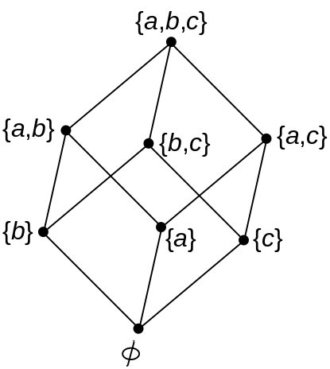
Lattice(CO3)
Example: Lattice of all subsets of set S = {a,b,c}, under the ordering relation of set inclusion, where {a,b,c} = 1 and ɸ = 0.
11/05/2020
Mr. Pushkal K Shukla 20CS-304 (DS) Unit 3

Slide 32
Lattice(CO3)
Example: consider the poset (Z⁺ , ≤), where for a and b in Z⁺ , a ≤ b if and only if a | b , then
a ∨ b = LCM(a, b)
a∧ b = GCD(a, b)
LCM: least common multiple
GCD: greatest common divisor
11/05/2020
Mr. Pushkal K Shukla 20CS-304 (DS) Unit 3

Slide 33
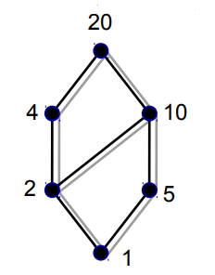
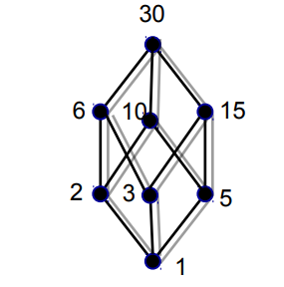
Lattice(CO3)
Example: Let n be a positive integer and D_{n} be the set of all positive divisors of n. Then D_{n} is a lattice under the relation of divisibility. For instance,
D₂₀= {1,2,4,5,10,20} D₃₀= {1,2,3,5,6,10,15,20}
11/05/2020
Mr. Pushkal K Shukla 20CS-304 (DS) Unit 3

Slide 34
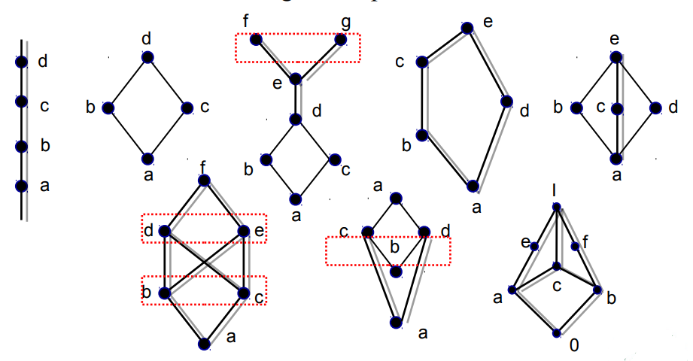
Lattice(CO3)
Example: Example 4 Which of the Hasse diagrams represent lattices?
11/05/2020
Mr. Pushkal K Shukla 20CS-304 (DS) Unit 3

Slide 35
Lattices(CO3)
Important Result:
Let L be a lattice. Then, for every a, b and c in L
If a ≤ b, then
(a) a ∨ c ≤ b ∨ c
(b) a ∧ c ≤ b ∧ c
2. a ≤ c and b ≤ c if and only if a ∨ b ≤ c
3. c ≤ a and c ≤ b if and only if c ≤ a b∧
4. If a ≤b and c ≤d, then
(a) a ∨ c ≤ b ∨ d (b) a ∧ c ≤ b ∧ d
11/05/2020
Mr. Pushkal K Shukla 20CS-304 (DS) Unit 3

Slide 36
Lattices(CO3)
Proof
(a) If a ≤ b, then a ∨ c ≤ b ∨ c
c ≤ b ∨ c ; b≤ b ∨ c (definition of LUB)
a ≤ b ; b≤ b ∨ c a≤ b ∨ c (transitivity)
therefore, b ∨ c is a lower bound of a and c , which means a ∨ c ≤ b ∨ c (why? )
The proofs for others left as exercises.
11/05/2020
Mr. Pushkal K Shukla 20CS-304 (DS) Unit 3

Slide 37
Dual of a Lattice(CO3)
Proof
(a) If a ≤ b, then a ∨ c ≤ b ∨ c
c ≤ b ∨ c ; b≤ b ∨ c (definition of LUB)
a ≤ b ; b≤ b ∨ c a≤ b ∨ c (transitivity)
therefore, b ∨ c is a lower bound of a and c , which means a ∨ c ≤ b ∨ c (why? )
The proofs for others left as exercises.
11/05/2020
Mr. Pushkal K Shukla 20CS-304 (DS) Unit 3

Slide 38
Bounded Lattices(CO3)
Bounded
A lattice L is said to be bounded if it has a greatest element 1 and a least element 0
For instance:
Example: The lattice P(S) of all subsets of a set S, with the relation containment is bounded. The greatest element is S and the least element is empty set.
Example : The lattice Z⁺ under the partial order of divisibility is not bounded, since it has a least element 1, but no greatest element.
11/05/2020
Mr. Pushkal K Shukla 20CS-304 (DS) Unit 3

Slide 39
Distributive Lattices(CO3)
Distributive
A lattice (L, ≤) is called distributive if for any elements a, b and c in L we have the following distributive properties:
1. a ∧ (b ∨ c) = (a ∧ b) ∨ (a ∧ c)
2. a ∨ (b ∧ c) = (a ∨ b) ∧ (a ∨ c)
If L is not distributive, we say that L is non distributive.
Note: the distributive property holds when
a. any two of the elements a, b and c are equal or
b. when any one of the elements is 0 or I.
11/05/2020
Mr. Pushkal K Shukla 20CS-304 (DS) Unit 3

Slide 40
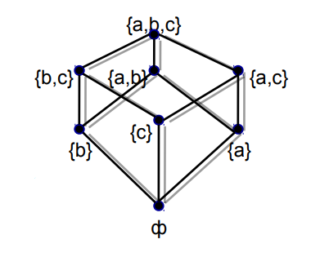
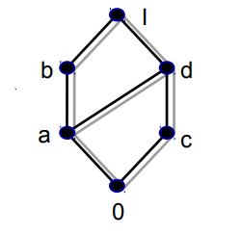
Distributive Lattices(CO3)
Example For a set S, the lattice P(S) is
distributive, since join and meet each
satisfy the distributive property.
Example The lattice whose Hasse
diagram shown in adjacent diagram
is distributive
11/05/2020
Mr. Pushkal K Shukla 20CS-304 (DS) Unit 3

Slide 41
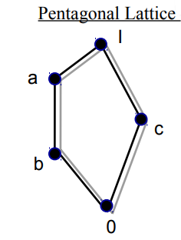
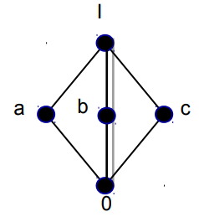
Distributive Lattices(CO3)
Example :Show that the lattices as follows are non-distributive.
a ∧ ( b ∨ c) = a ∧ I = a
(a∧ b) ∨(a ∧ c) = b ∨ 0 = b
a ∧ ( b ∨ c) = a ∧ I = a
(a∧ b) ∨ (a ∧ c) = 0 ∨ 0 = 0
11/05/2020
Mr. Pushkal K Shukla 20CS-304 (DS) Unit 3

Slide 42
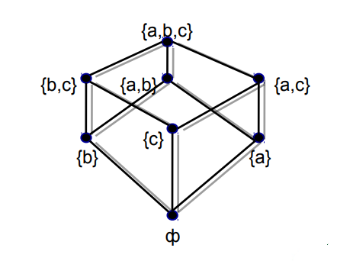
Modular Lattices(CO3)
A lattice (L, ≤) is called Modular if for any elements a, b and c in L if b ≤ a then b∨ (a∧ c) = a∧ (b ∨ c)
Example For a set S, the lattice P(S) is modular,
(if B ⊆ A) B ∪ (A ∩ C) = A ∩ (B ∪ C)
11/05/2020
Mr. Pushkal K Shukla 20CS-304 (DS) Unit 3

Slide 43
Example(CO3)
Every chain is a modular lattice
Example: Given Hasse diagram of a lattice which is modular
0 ≤ a i.e. taking b=0;
b ∨ (a ∧ c) = 0 ∨ 0 = 0
a ∧ (b ∨ c) = a ∧ c = 0
11/05/2020
Mr. Pushkal K Shukla 20CS-304 (DS) Unit 3

Slide 44
Complemented Lattice(CO3)
Complement of an element:
Let L be bounded lattice with greatest element 1 and least element 0, and let a in L.
An element b in L is called a complement of a if
a ∨ b = 1 and a ∧ b =0
Note: 0’ = 1 and 1’ = 0
Complemented Lattice:
A lattice L is said to be complemented if it is bounded and every element in it has a complement.
11/05/2020
Mr. Pushkal K Shukla 20CS-304 (DS) Unit 3

Slide 45
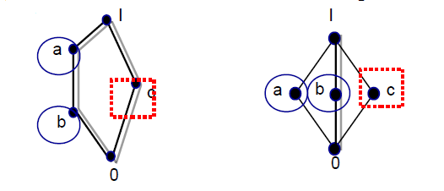
Complemented Lattice(CO3)
Example : The lattice L=P(S) is such that every element has a complement, since if A in L, then its set complement A has the properties A ∨ A = S and A ∧ A=ф. That is, the set complement is also the complement in L.
Example : complemented lattices where complement of element is not unique
11/05/2020
Mr. Pushkal K Shukla 20CS-304 (DS) Unit 3

Slide 46
Theorem(CO3)
Let L be a bounded distributive lattice. If a complement exists,it is unique.
Proof: Let a’ and a’’ be complements of the element a in L, then
a a’ ∨ = 1, a ∨ a’’= 1 ; a ∧ a’ = 0, a ∧ a’’ =0
using the distributive laws, we obtain
a’= a’ ∨ 0 = a’ ∨ (a ∧ a’’ ) = (a’ ∨ a) ∧ (a’ ∨ a’’)
= 1 ∧ (a’ ∨ a’’) = a’ ∨ a’’
Also
a’’= a’’ ∨ 0 = a’’ ∨(a ∧ a’ ) = (a’’ ∨ a) ∧ (a’’ ∨ a’)
= 1 ∧ (a’ ∨ a’’) = a’ ∨ a’’
Hence a’=a’’
11/05/2020
Mr. Pushkal K Shukla 20CS-304 (DS) Unit 3

Slide 47
Topic Objectives: Boolean Algebra(CO3)
After learning the Boolean algebra students will be able to
Perform the three basic logic operations.
Describe the operation of and construct the truth tables for the AND, NAND, OR, and NOR gates, and the NOT (INVERTER) circuit.
Draw timing diagrams for the various logic-circuit gates.
Write the Boolean expression for the logic gates and combinations of logic gates.
Implement logic circuits using basic AND, OR, and NOT gates.
Appreciate the potential of Boolean algebra to simplify complex logic expressions.
Use DeMorgan’s theorems to simplify logic expressions.
11/05/2020
Mr. Pushkal K Shukla 20CS-304 (DS) Unit 3

Slide 48
Topic Prerequisite & Recap (CO3)
Prerequisite
Basic Understanding of class 10 mathematics NCERT.
Basic Knowledge of sets and algebraic rules
Basic Understanding of Set Theory, Relations and Functions & Algebraic Structures.
Recap
Now students are able to develop there logical thinking by using Sets, Relations, Functions and Mathematical Induction, & Algebraic Structures concepts and use in upcoming topic. i.e. Boolean Algebra.
Mr. Pushkal K Shukla 20CS-304 (DS) Unit 3

Slide 49
Boolean Algebra(CO3)
An algebra which is use for simplifying the presentation & manipulation of propositional logic.
It is also know as Switching Algebra.
Invented by George Boole in 1854.
Boolean algebra is mainly use for simplify and Manipulate electronic logic circuits in computers .
11/05/2020
Mr. Pushkal K Shukla 20CS-304 (DS) Unit 3

Slide 50
Basic concepts of Boolean algebra(CO3)
It deals with the binary number system (0,1).
The three basic logical operations are:
I. AND
II.OR
III.NOT
11/05/2020
Mr. Pushkal K Shukla 20CS-304 (DS) Unit 3

Slide 51
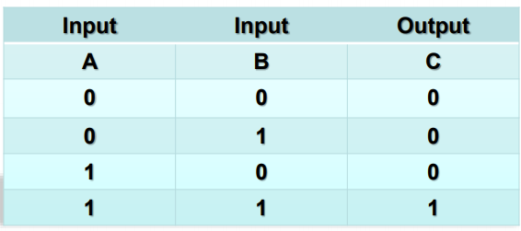
AND Operation(CO3)
AND operation is use for logical multiplication. The dot symbol (“.”)
used for representing AND operation. AND operator has an output 1 if
all the inputs are 1 otherwise the output is 0.
11/05/2020
Mr. Pushkal K Shukla 20CS-304 (DS) Unit 3

Slide 52
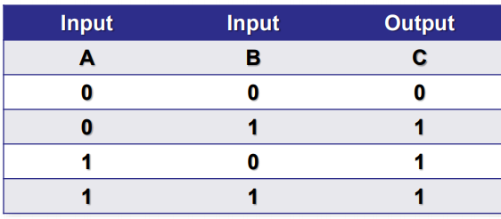
OR Operation(CO3)
OR operation is use for logical addition. The symbol (“+”) used
for represent OR operation. OR operator has an output 1 if any
of the inputs are 1 otherwise the output is 0.
11/05/2020
Mr. Pushkal K Shukla 20CS-304 (DS) Unit 3

Slide 53
NOT Operation(CO3)
NOT operation is use for complementation. The over bar symbol
(“¯”) used for represent NOT operation. NOT operator has an output 1
if input is 0 or output 0 if the the input is 1.
Input | Output
A | A’
0 | 1
1 | 0
11/05/2020
Mr. Pushkal K Shukla 20CS-304 (DS) Unit 3

Slide 54
Boolean Theorems(CO3)
Basic Theorems:-
Other Theorems:-
A+B=B+A
A.B=B.A
A+(B+C)=(A+B)+C
A.(B+C)=A.B+A.C
OR | AND | NOT
A+0=A | A.0=0 | A+A’=1
A+1=A | A.1=A | A.A’=0
A+A=A | A.A=A
A+A’=1 | A.A’=0
11/05/2020
Mr. Pushkal K Shukla 20CS-304 (DS) Unit 3

Slide 55
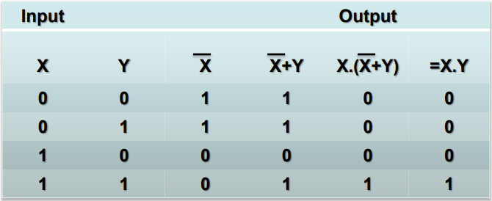
Boolean Function(CO3)
Boolean function is an expression formed with binary variable. It
is the combination of Boolean operators such as AND, OR & NOT
operators.
X.( X’+Y)=X.Y
Truth table for Boolean function.
11/05/2020
Mr. Pushkal K Shukla 20CS-304 (DS) Unit 3

Slide 56
Logic Gate (CO3)
Computer carries out all operations by the combination of signals that pass through standard blocks of built-in circuits.
Logic gate is an elementary building block of digital electronic circuits that operates one or more input signals to produce standard output.
The common use of logic gate elements is to act as switch.
In computer logic gates are use to implement Boolean functions.
11/05/2020
Mr. Pushkal K Shukla 20CS-304 (DS) Unit 3

Slide 57



Type of Logic Gates(CO3)
AND Gate
OR Gate
NOT Gate
11/05/2020
Mr. Pushkal K Shukla 20CS-304 (DS) Unit 3

Slide 58
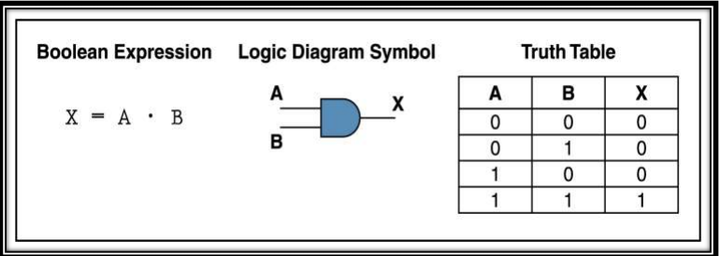
AND Gate(CO3)
AND gate is use for logical multiplication input signals.
If the input values for an AND gate are 1 then the output is 1
otherwise the output is 0.
11/05/2020
Mr. Pushkal K Shukla 20CS-304 (DS) Unit 3

Slide 59
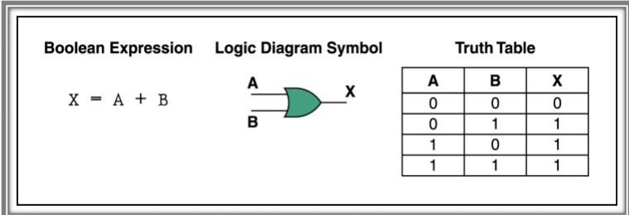
OR Gate(CO3)
OR gate performs the logical addition operation.
It is an electronic circuit that generates an output signal 1 if any of the input signal is 1.
11/05/2020
Mr. Pushkal K Shukla 20CS-304 (DS) Unit 3

Slide 60
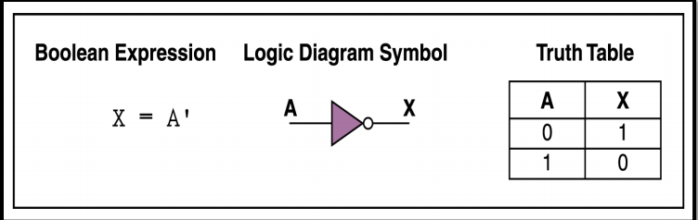
NOT Gate(CO3)
NOT gate performs the logical complementation operation.
It is an electronic circuit that generates the reverse of the input signal as output signal.
11/05/2020
Mr. Pushkal K Shukla 20CS-304 (DS) Unit 3

Slide 61
Simplification of Boolean Functions(CO3)
An implementation of a Boolean Function requires the use of logic gates.
A smaller number of gates, with each gate (other then Inverter) having less number of inputs, may reduce the cost of the implementation.
There are 2 methods for simplification of Boolean functions.
11/05/2020
Mr. Pushkal K Shukla 20CS-304 (DS) Unit 3

Slide 62
Simplification of Boolean Functions(CO3)
Two Methods
  The algebraic method by using Identities
  The graphical method by using Karnaugh Map method
The K-map method is easy and straightforward.
A K-map for a function of n variables
  consists of 2^{n} cells, and,
  in every row and column, two adjacent cells should differ in the value of only one of the logic variables.
11/05/2020
Mr. Pushkal K Shukla 20CS-304 (DS) Unit 3

Slide 63
Examples of K-Maps(CO3)
Examples:Cell numbers are written in the cells.
2-variable K-map
B
0
1
A
0
0 | 1
2 | 3
1
11/05/2020
Mr. Pushkal K Shukla 20CS-304 (DS) Unit 3

Slide 64
3-Variable K-Map:(CO3)
BC
00 01 11 10
A
0
1
0 | 1 | 3 | 2
4 | 5 | 7 | 6
11/05/2020
Mr. Pushkal K Shukla 20CS-304 (DS) Unit 3

Slide 65
4-variable K-map(CO3)
CD
00 01 11 10
AB
00
0 | 1 | 3 | 2
4 | 5 | 7 | 6
12 | 13 | 15 | 14
8 | 9 | 11 | 10
01
11
10
11/05/2020
Mr. Pushkal K Shukla 20CS-304 (DS) Unit 3

Slide 66
Literal, minterm of n variable(CO3)
Literal:
A variable or its complement is called a literal.
Minterm of n variable:
A product of n literals
  in which each variable appears exactly once, in either its true or its complemented form, but not in both, and,
  which is equal to 1 for exactly one combination of values of the n variables.
11/05/2020
Mr. Pushkal K Shukla 20CS-304 (DS) Unit 3

Slide 67
Maxterms (continued):(CO3)
For every K-map, each cell has one Maxterm
associated with it.
Thus for cell no.13 in the 4-variable K-map,
M₁₃ = A’ + B’ + C + D’
By De Morgan’s theorem,
m_{i} = M_{i}’
ADJACENT minterms (Maxterms):
Minterm which are identical, except for one variable, are considered to be adjacent to one another.
In a K-map, the corresponding cells are said to be adjacent cells.
11/05/2020
Mr. Pushkal K Shukla 20CS-304 (DS) Unit 3

Slide 68
Adjacent minterms:(CO3)
Thus in K-4,
Cell O is adjacent to cells 1, 4, 2 and 8.
In a K-map, the corresponding cells in the top and the bottom rows are adjacent to each other.
Similarly the corresponding cells in the leftmost column and the rightmost column are adjacent to each other.
An Example:
A function F, of 4 variables, is defined by the truth table given in the next slide. ( and again given in the next 3 slides):
11/05/2020
Mr. Pushkal K Shukla 20CS-304 (DS) Unit 3

Slide 69
Faculty Video Links, Youtube & NPTEL Video Links and Online Courses Details (CO3)
Youtube/other Video Links
https://www.youtube.com/watch?v=qPtGlrb_sXg&list=PL0862D1A947252D20&index=40 CO3
https://www.youtube.com/watch?v=WW7YO0b4QHs&list=PLEAYkSg4uSQ2Wfc_l4QEZUSRdx2ZcFziO CO3
Mr. Pushkal K Shukla 20CS-304 (DS) Unit 3

Slide 70
Daily Quiz(CO3)
A Poset in which every pair of elements has both a least upper bound and a greatest lower bound is termed as _______
a) sublattice b) lattice c) trail d) walk
In the poset (Z⁺, |) (where Z⁺ is the set of all positive integers and | is the divides relation) are the integers 9 and 351 comparable?
a) comparable b) not comparable
c) comparable but not determined d) determined but not comparable
If every two elements of a poset are comparable then the poset is called ________
a) sub ordered poset b) totally ordered poset
c) sub lattice d) semigroup
Mr. Pushkal K Shukla 20CS-304 (DS) Unit 3

Slide 71
Daily Quiz(CO3)
______ and _______ are the two binary operations defined for lattices.
a) Join, meet
b) Addition, subtraction
c) Union, intersection
d) Multiplication, modulo division
5. A ________ has a greatest element and a least element which satisfy 0<=a<=1 for every a in the lattice(say, L).
a) semilattice
b) join semilattice
c) meet semilattice
d) bounded lattice
Mr. Pushkal K Shukla 20CS-304 (DS) Unit 3

Slide 72
Weekly Assignment(CO3)
Define Isomorphism. Let A = {1, 2, 3, 6} and let ‘≤’ be the divisibility relation on A. Let B = {ϕ, {a}, {b}, {a,b}} and let ‘≤’ be the relation ⊆. Then (A, ≤ ) and (B, ≤) are isomorphic.
Consider the subset {2,3} {4,6} and {3,6}, and ({1,2,3,4,5,6}, / ) is the poset.
i) Draw the Hasse Diagram.
ii) Find the Lower bound and Upper bound of each subset if it exists.
iii) Find GLB and LUB of each subset if it exists.
3. Consider the Boolean function F(x1,x2,x3,x4)= x1+(x2.(x1’+x4)+x3.(x2’+x4’))
i) Simplify f algebraically
ii) Draw the logic circuit of f and reduction of f.
Mr. Pushkal K Shukla 20CS-304 (DS) Unit 3

Slide 73
Weekly Assignment(CO3)
4. In a lattice if a ≤b≤c then prove that
a) a v b = b ∧ c
b) (a v b) v (b ∧ c) =(a v b) ∧ (a v c) = b
5. Draw the hasse diagram for (D₂₄, /).
6. Draw the Hasse diagram of Poset ({{1},{2},{4},{1,2}{1,4},{2,4},{3,4},{1,3,4},{2,3,4}}, ⊆) where composition is usual subset.
Draw the K-Map and simplify the following Boolean expressions:
i) ABC+ A’BC’+ABC’+A’BC
ii) A’B’C+A’B’C’+ABC’+ABC’+A’BC’
iii) AB’C’+ABC’+ABC+AB’C+AB’C’
iv) ABC’D’+AB’C’D’+AB’C’D+AB’C’D
Mr. Pushkal K Shukla 20CS-304 (DS) Unit 3

Slide 74
MCQs(CO3)
A sublattice(say, S) of a lattice(say, L) is a convex sublattice of L if _________
a) x>=z, where x in S implies z in S, for every element x, y in L
b) x=y and y<=z, where x, y in S implies z in S, for every element x, y, z in L
c) x<=y<=z, where x, y in S implies z in S, for every element x, y, z in L
d) x=y and y>=z, where x, y in S implies z in S, for every element x, y, z in L
The graph is the smallest non-modular lattice N₅. A lattice is _______ if and only if it does not have a _______ isomorphic to N₅.
a) non-modular, complete lattice b) moduler, semilattice
c) non-modular, sublattice d) modular, sublattice
Every poset that is a complete semilattice must always be a _______
a) sublattice b) complete lattice
c) free lattice d) partial lattice
Mr. Pushkal K Shukla 20CS-304 (DS) Unit 3

Slide 75
MCQs(CO3)
A free semilattice has the _______ property.
a) intersection b) commutative and associative
c) identity d) universal
Algebra of logic is termed as ______________
a) Numerical logic b) Boolean algebra
c) Arithmetic logic d) Boolean number
Boolean algebra can be used ____________
a) For designing of the digital computers
b) In building logic symbols
c) Circuit theory
d) Building algebraic functions
Mr. Pushkal K Shukla 20CS-304 (DS) Unit 3

Slide 76
MCQs(CO3)
What is the definition of Boolean functions?
a) An arithmetic function with k degrees such that f:Y–>Y^{k}
b) A special mathematical function with n degrees such that f:Y^{n}–>Y
c) An algebraic function with n degrees such that f:X^{n}–>X
d) A polynomial function with k degrees such that f:X²–>X^{n}
F(X,Y,Z,M) = X`Y`Z`M`. The degree of the function is ________
a) 2 b) 5
c) 4 d) 1
K-map is used for _______
a) logic minimization
b) expression maximization
c) summing of parity bits
d) logic gate creation
Mr. Pushkal K Shukla 20CS-304 (DS) Unit 3

Slide 77
MCQs(CO3)
10. Let D₃₀ = {1, 2, 3, 4, 5, 6, 10, 15, 30} and relation I be partial ordering on D₃₀. The all lower bounds of 10 and 15 respectively are
A. 1,3 B. 1,5
C. 1,3,5 D. None of these
11. Hasse diagrams are drawn for
A. partially ordered sets B. lattices
C. boolean Algebra D. none of these
12. A self-complemented, distributive lattice is called
A. Boolean algebra B. Modular lattice
C. Complete lattice D. Self dual lattice
Mr. Pushkal K Shukla 20CS-304 (DS) Unit 3

Slide 78
Old Question Papers(CO3)
Draw the hasse diagram for (D₂₄, /).
Draw the Hasse diagram of Poset ({{1},{2},{4},{1,2}{1,4},{2,4},{3,4},{1,3,4},{2,3,4}}, ⊆)
3. In a lattice if a ≤b≤c then prove that
  a) a v b = b ∧ c
b) (a v b) v (b ∧ c) =(a v b) ∧ (a v c) = b
4. What is Hasse diagram. Give example.
Let (A, ≤) and (B, ≤) be two posets. Prove that (A × B, ≤) is a poset,
where (a, b) ≤ (c, d) if and only if a ≤ c, b ≤ d.
6. Draw Karnaugh map and simplify the Boolean expression: -
A’B’C’D’+ A’B C’ D + A’ B’ C D + A’B’C D’ + A’B C D
Mr. Pushkal K Shukla 20CS-304 (DS) Unit 3

Slide 79
Old Question Papers (CO3)
7. Prove that a lattice with 5 elements is not a boolean algebra.
8. Show that the following are equivalent in a Boolean algebra
a ≤ b⇔ a*b' = 0⇔b' ≤ a ⇔ a’⊕ b' = 1
9. Let (L,∨,∧,≤) be a distributive lattice and a,b∈ L . if a ∧ b = a ∧ c and
a ∨ b = a ∨ c then show that b = c
10. For any positive integer D₃₆, then find whether (D₃₆,’|’) is lattice or not?
11. Simplify the following Boolean function using K-map:
F(x,y,z)=Σ(0,2,3,7)
12. Explain Modular lattice, distribute lattice and bounded lattice with eg and diagram
Mr. Pushkal K Shukla 20CS-304 (DS) Unit 3

Slide 80
Old Question Papers (CO3)
13. Draw the Hasse diagram of (A, ≤), where A= {3,4,12,24,48,72} and relation ≤ be such that a ≤ b if a divides b
14. Find the values of the Boolean function represented by F (x, y, z) = xy + z’.
15. Answer these questions for the poset({3, 5, 9, 15,24, 45}, |).
i. Find the maximal elements.
ii. Find the minimal elements.
iii. Is there a greatest element?
iv. Is there a least element?
v. Find all upper bounds of {3, 5}.
vi. Find the least upper bound of {3, 5}.
vii. Find all lower bounds of {15, 45}.
viii.Find the greatest lower bound of {15, 45},if it exists.
Mr. Pushkal K Shukla 20CS-304 (DS) Unit 3

Slide 81
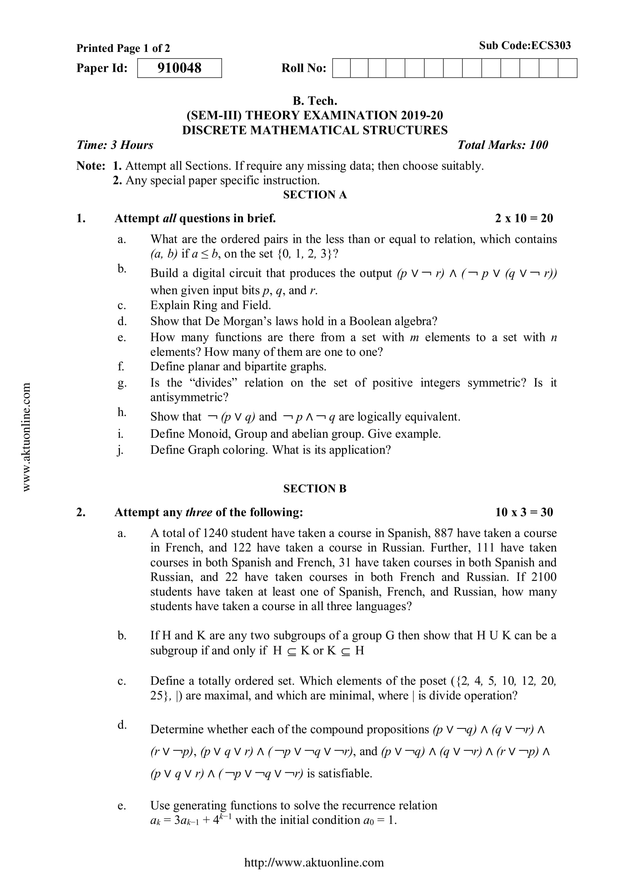
Old Question Papers (CO3)
Mr. Pushkal K Shukla 20CS-304 (DS) Unit 3

Slide 82
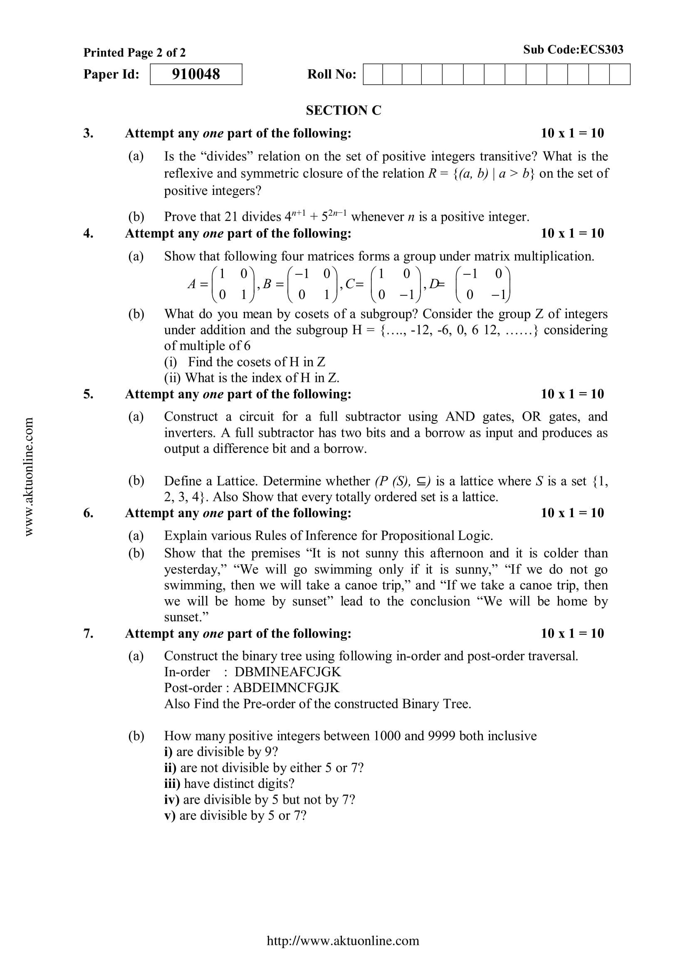
Old Question Papers (CO3)
Mr. Pushkal K Shukla 20CS-304 (DS) Unit 3

Slide 83
Old Question Papers (CO3)
For some more Old Question Papers go to the link below.
https://drive.google.com/drive/folders/1LBqJvyWPNRCdAcr9Sag4TzECfnLgRIQn?usp=sharing
Mr. Pushkal K Shukla 20CS-304 (DS) Unit 3

Slide 84
Expected Questions for University Exam (CO3)
1. In a lattice if a ≤b≤c then prove that
  a) a v b = b ∧ c
b) (a v b) v (b ∧ c) =(a v b) ∧ (a v c) = b
2. Draw Karnaugh map and simplify the Boolean expression: -
A’B’C’D’+ A’B C’ D + A’ B’ C D + A’B’C D’ + A’B C D
3. Let (A, ≤) and (B, ≤) be two posets. Prove that (A × B, ≤) is a poset,
where (a, b) ≤ (c, d) if and only if a ≤ c, b ≤ d.
4. Simplify the following Boolean function using K-map:
F(x,y,z)=Σ(0,2,3,7)
5. . Let (L,∨,∧,≤) be a distributive lattice and a,b∈ L . if a ∧ b = a ∧ c and
a ∨ b = a ∨ c then show that b = c
Mr. Pushkal K Shukla 20CS-304 (DS) Unit 3

Slide 85
Summary (CO3)
Now you were able to understand the concepts discrete structures include sets, relation , functions, Algebraic Structure, poset, lattice, Boolean algebra etc.
A lattice is an abstract structure studied in the mathematical sub-disciplines of order theory and abstract algebra. It consists of a partially ordered set in which every two elements have a unique supremum (also called a least upper bound or join) and a unique infimum (also called a greatest lower bound or meet).
Boolean algebra simplifies logic circuits to increase work efficiency of digital device.
Mr. Pushkal K Shukla 20CS-304 (DS) Unit 3

Slide 86
Summary (CO3)
Logic circuits can be built for any binary electric or electronic devices including switches, relays, electron tubes and transistors.
After learning the lattices students will able to use lattice in Page Rank of Google and measure the similarity of two orderings (ranking) on a set, i.e. Pearson correlation.
The subject enhances one’s ability to develop logical thinking and ability to problem solving.
Mr. Pushkal K Shukla 20CS-304 (DS) Unit 3

Slide 87
References
B. Kolman, R.C. Busby, and S.C. Ross, Discrete Mathematical Structures, 5/e, Prentice Hall, 2004.
Liptschutz, Seymour, “ Discrete Mathematics”, McGraw Hill.
Trembley, J.P & R. Manohar, “Discrete Mathematical Structure with Application to Computer Science”, McGraw Hill
Koshy, Discrete Structures, Elsevier Pub. 2008 Kenneth H. Rosen, Discrete Mathematics and Its Applications, 6/e, McGraw-Hill, 2006.
Mr. Pushkal K Shukla 20CS-304 (DS) Unit 3

Slide 88

Mr. Pushkal K Shukla 20CS-304 (DS) Unit 3

