Slide 1

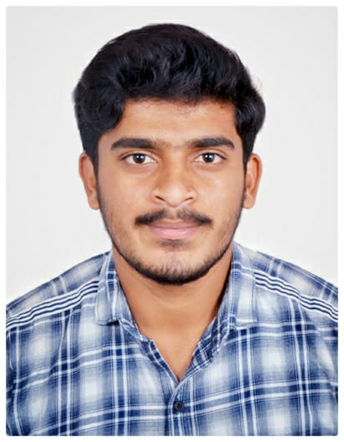



Sachin G J
Education and certificates Bachelor of Technlogy, Mechanical Engineering : 2016 - 2020
Skills
Analyst/Software Engineer
Base Location: Bangalore
Email ID: SACHIN.G-J@CAPGEMINI.COM
Mobile No: +919739656179
Grade: A4
java | java,OOPS,Generics, Collections, Array,Loops,
Backend | Spring Boot,Spring Rest Services, Spring RestFul Service
Database | Postgre SQL
UI Tech | HTML 5 & CSS, JavaScript,Es6,Bootsrap 4,
Tools | Git & GitHub, Eclipse, STS PostMan,Swagger,Visual Stu dio, Visual Studio Code, Pg Admin 4, SQL shell.
Add On skills | Immersive Learning and Java
Strengths
Full Stack Developer
Hands on experience on Core java, Postgre SQL, Entity framework, SqlServer, Spring Restful Services.
Proficient in creating Single page Web Application in React with Authentication with routing
Hands on experience in developing web pages using HTML5, CSS, Object TypeScript, Good understanding of Document Object Model (DOM) and DOM Functions
Ready to learn new technologies and implement them for the Future Knowledge improvement.
Achievement
E-VEHICLE RENTAL SYSTEM
Case study of E-Vehicle rental System along with API Gateway, Swagger, responsive UI with HTML5, CSS, Bootstrap and React used as User Interface.
Certified in AWS Certified Cloud Practitioner (level 1)
As a part of Charter Mobile Support project Phase 1 team, efficient in MBO systems, network back-office systems, charter related APIs through Swagger, Postman and database issues through Oracle SQL developer.
Got Rewards & Recognition as customer appreciation for exceptional performance in charter project.
Check out my work on GitHub
Presentation Title | Author | Date © Capgemini 2017. All rights reserved | 1

