Slide 1
Feature Detection using Harris Corner Detection & SIFT
Group 3
S/18/427 - Janith Kulatunga
S/18/030 - Supul Edirisinghe
S/18/562 - Sanjana Wijenayake
S/18/335 - Sachini Dasa
S/18/557 - Nilmi Wickramasinghe

Slide 2
SIFT Overview
Scale-Invariant Feature Transform (SIFT) is a method for detecting and describing interest points developed by David Lowe.
Interest point detectors are critical in computer vision for tasks like image matching, object recognition, and 3D reconstruction.

Slide 3
Interest Point Detectors
Interest points are locations within an image where the signal (intensity, color, etc.) changes sharply in two dimensions
Categories:
Contour-based Methods: Detect points along edges or contours.
Intensity-based Methods: Focus on regions with significant intensity variation, like corners.
Parametric Model-based Methods: Use mathematical models to identify features such as blobs or regions of interest.

Slide 4
SIFT Procedure
Starting off with image matching and recognition, SIFT features are extracted from a set of reference images and stored in a database. Following steps are followed in the SIFT,
● Scale - Space Extrema Detection
● Keypoint Localization
● Orientation Assignment
● Keypoint Descriptor
● Keypoint Matching

Slide 5
Results

Slide 6
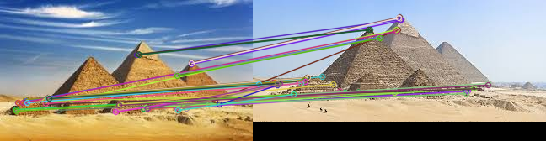
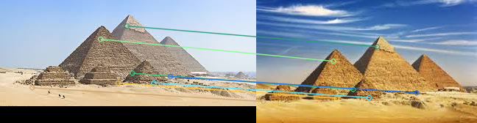
Extracting and matching interest points from a pair of images Using SIFT method (Ratio = 0.75)

Slide 7
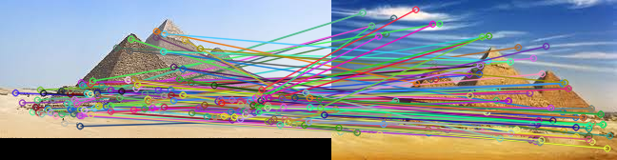
Using Harris method on the same images.

Slide 8
SIFT method with Ratio 0.9

Slide 9

SIFT method with Ratio 0.6

Slide 10
Harris Method with window size 2

Slide 11
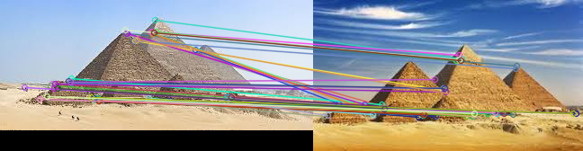
Harris Method with window size 5

Slide 12
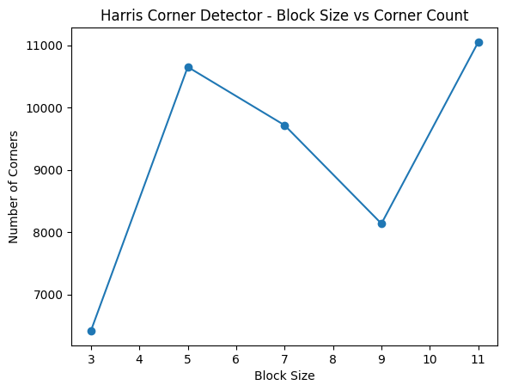
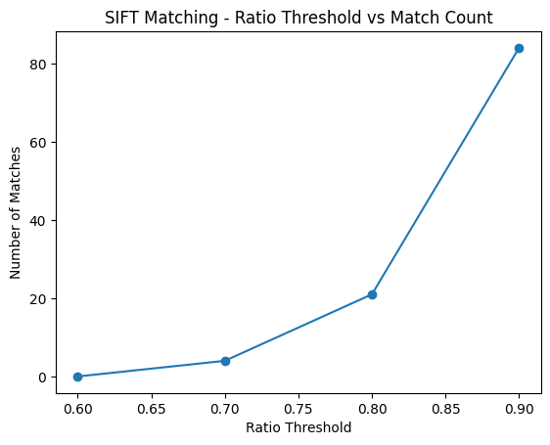
Comparison of the results of SIFT and Harris for different parameters

Slide 13
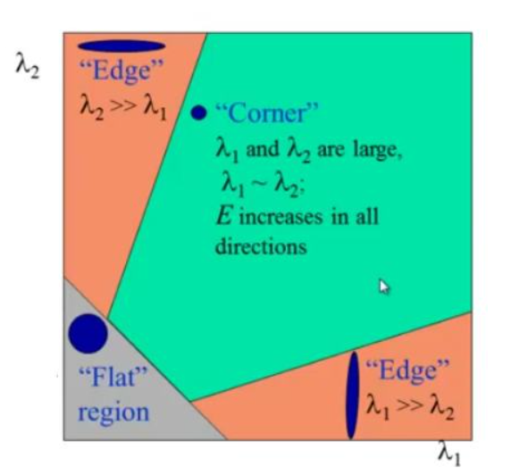
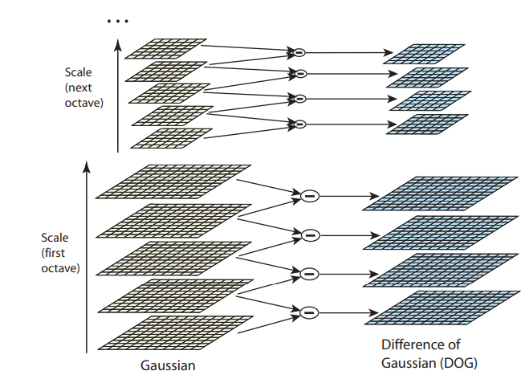
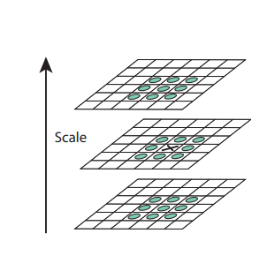
Conclusion
Harris Corner Detector is fast and simple, suitable for detecting specific types of corners, but is sensitive to the choice of parameters like window size and k as well as different scales of the images.
SIFT is a bit more computationally expensive, but it provides better and more reliable feature detection.

Slide 14
References
Schmid, C., Mohr, R., & Bauckhage, C. (2000). Evaluation of Interest Point Detectors. International Journal of Computer Vision.
https://docs.opencv.org/4.x/dc/d0d/tutorial_py_features_harris.html
https://docs.opencv.org/4.x/da/df5/tutorial_py_sift_intro.html
https://medium.com/@kdwa2404/sift-distinctive-image-features-from-scale-invariant-keypoints-a-brief-summary-763f0d15a31b

