Slide 1


Problem Statement 24 :-
Digital Library Usage Visualization
By Sachin Kumar
Roll No. 2312RES551
Indian Institute Of Technology Patna
GUVI Data Analytics Internship

Slide 2
Project Overview And Goal
Overview:
The Digital Library Usage Visualization project focuses on analyzing how students access different types of digital resources (eBooks, Journals, Videos, Theses, Articles) in an online library system.
The project uses Power BI dashboards to transform raw library access logs into interactive visual insights. By applying filters and visualizations, the system helps identify:
Which resource types are most popular
* Which departments use resources most frequently.
* Trends in resource usage across different months.
* Top accessed resources and active users.
This project enables students, faculty, and administrators to understand content demand, optimize resource allocation, and improve digital library services.

Slide 3
Objectives
The Digital Library Usage Visualization aims to:
* Visualize the usage of digital library resources (eBooks, Journals, Videos, Theses, Articles) across departments.
* Analyze patterns of student resource access over time (daily, monthly, yearly).
* Identify the most accessed resource types and departments with the highest usage.
* Provide interactive dashboards in Power BI with filters for department, resource type, and time period.
* Support decision-making for library management by highlighting content demand and usage trends.

Slide 4
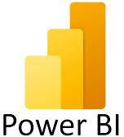


Technology Stack
The Digital Library Usage Visualization is built using a modern, lightweight, and data-friendly technology stack:
Power BI – For creating interactive dashboards and visual reports.
Power Query – For cleaning and transforming raw student marks data.
Excel/ CSV – Source files containing student marks and details.

Slide 5
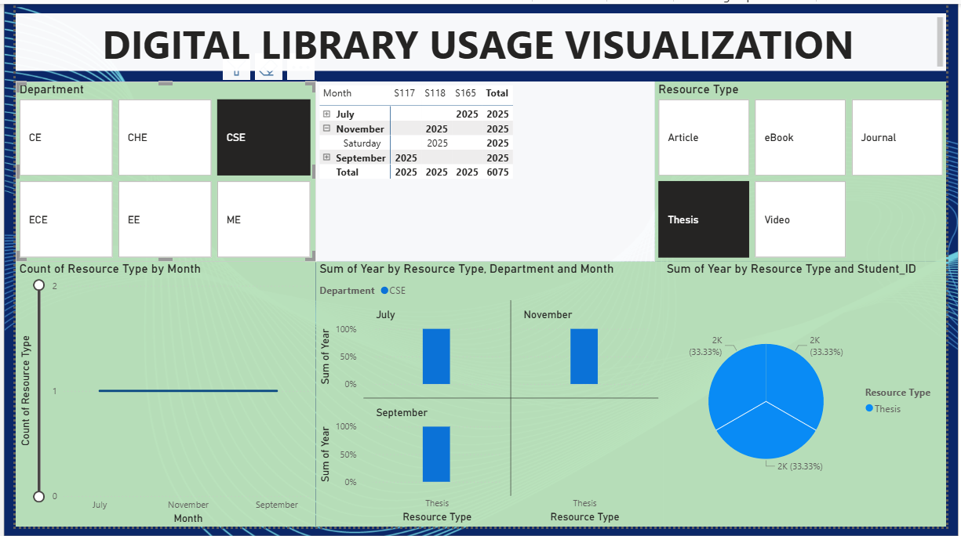
Key Features
* Department-wise Resource Usage
Interactive tiles show how different departments (CSE, ECE, EE, ME, CHE, CE) access resources.
Helps identify which department consumes the most digital content.
* Resource Type Analysis
Categories include eBook, Journal, Article, Thesis, Video.
Allows quick comparison of which formats are most popular among students.
* Time-based Usage Trends
Data can be filtered by Month and Year.
Shows changes in resource usage patterns across July, September, November, etc.
Helps track peak and low activity periods.
* Top Resource Type Insights
Pie/Donut chart highlights share of each resource type.
Provides quick view of which resource contributes the most usage.
Fig. DASHBOARD

Slide 6
CONCLUSION
Power BI dashboards reveal student resource preferences by type, department, and time.
Helps libraries make data-driven decisions for better resource allocation.
Enhances student learning experience through insights into digital usage trends.

