Slide 1
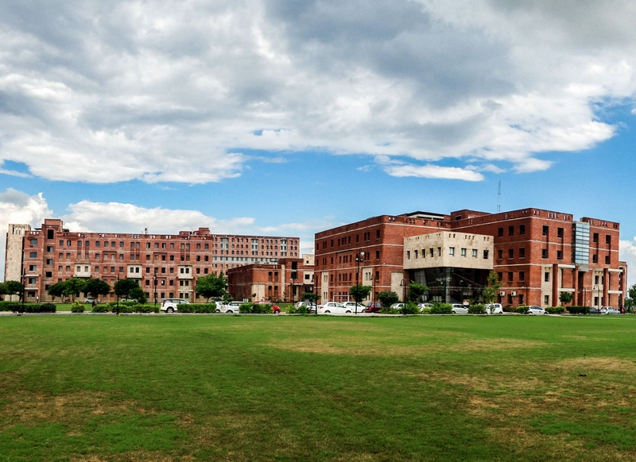

Introduction
Tour and travels
Name.: Vijay Jangid
Registration No.: 21BCAN226
Course.: BCA Data Science and Data Analytics

Slide 2
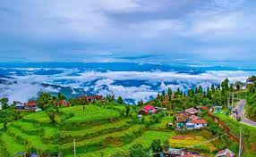
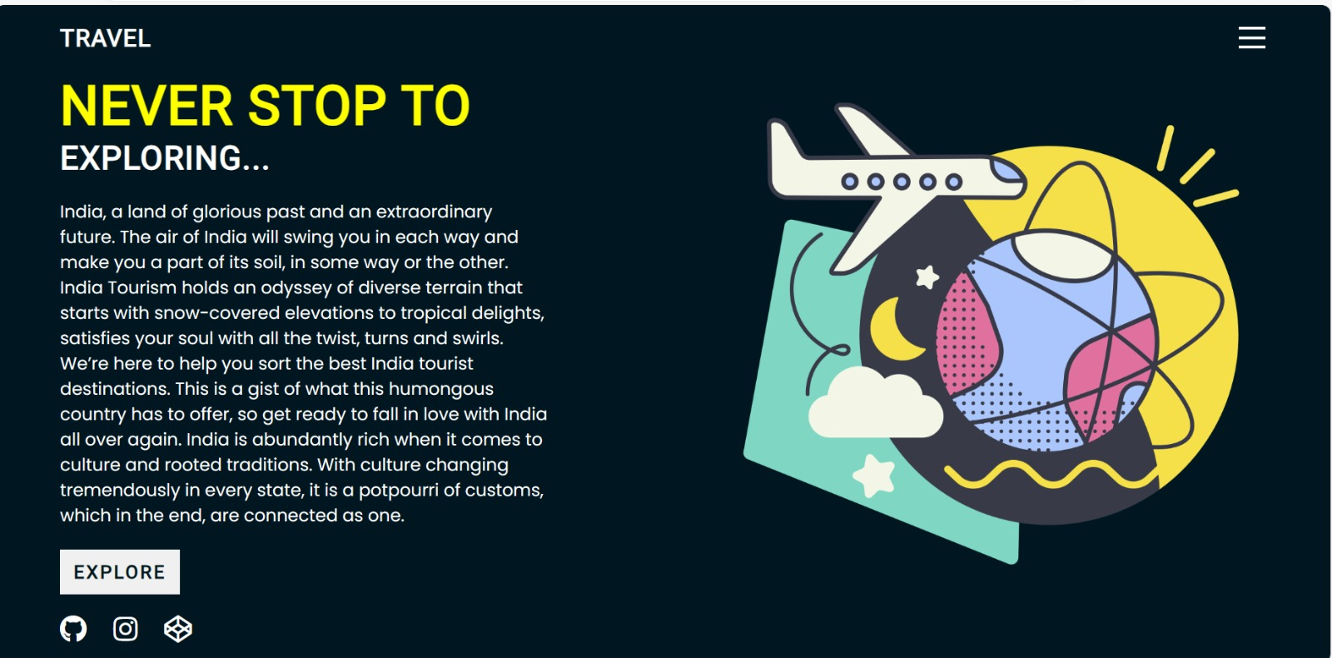
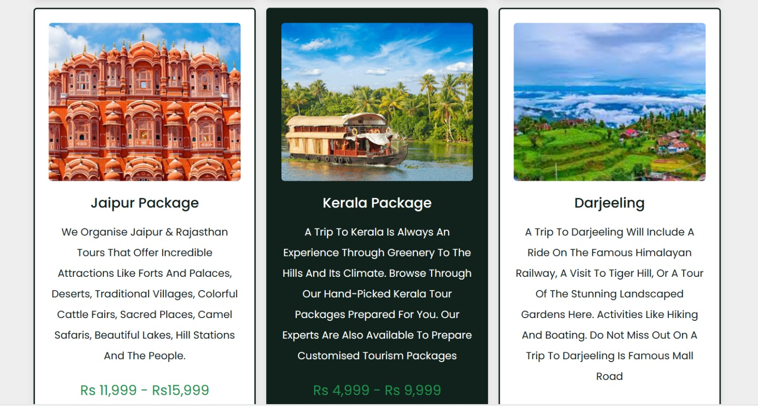
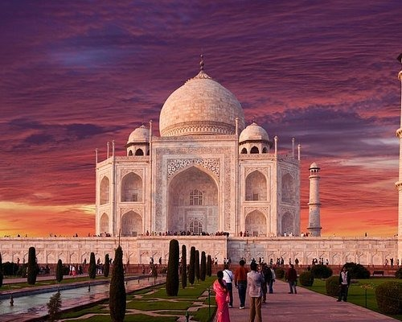
Project Title-
Tour and Travel website Project

Slide 3
Abstract
India, with its rich cultural heritage, diverse landscapes, and vibrant traditions, offers a multitude of experiences for travelers. To tap into this vast potential and facilitate seamless exploration, our project aims to develop a comprehensive tour and travel website. This presentation delves into the intricacies of the project, from conceptualization to implementation, highlighting key features, technologies employed, market analysis, and future prospects.

Slide 4
Table of Contents
Introduction Overview of the Indian tourism industry Rationale for developing a tour and travel website Project objectives and scope

Slide 5
Introduction
India is a country with a rich history and a bright future. The moment you step into India, you’ll feel a strong connection to its land and people. India has a diverse range of landscapes, from snow-capped mountains to tropical beaches, which will leave you in awe. We’re here to help you discover and sort the best tourist destinations in India. This country has so much to offer, and we’re sure you’ll fall in love with it all over again. India is a treasure trove of different cultures and traditions. Each state has its own unique customs, but they all come together to form a beautiful whole.

Slide 6
Overview of the Indian tourism industry
The Indian tourism industry is one of the largest and fastest-growing sectors of the economy, contributing significantly to GDP growth, employment generation, and foreign exchange earnings. Renowned for its rich cultural heritage, diverse landscapes, and vibrant traditions, India attracts millions of domestic and international tourists every year
While the Indian tourism industry holds immense potential, it also faces several challenges such as:
.Infrastructure development: Improvement of transportation networks, accommodation facilities, and sanitation infrastructure is crucial to accommodate the growing influx of tourists.

Slide 7
Rationale for developing a tour and travel website
In today’s digital age, the internet has revolutionized the way people plan, book, and experience their travels. A tour and travel website serves as a powerful platform to connect travelers with destinations, experiences, and services, offering numerous benefits for both users and stakeholders in the tourism industry. The rationale for developing such a website can be summarized as follows:
1. Accessibility and Convenience : A tour and travel website provides travelers with 24/7 access to information, allowing them to research destinations, compare prices, and make bookings at their convenience, from anywhere in the world. It eliminates the need for physical travel agencies or guidebooks, streamlining the planning process and saving time and effort for travelers.

Slide 8
2. Comprehensive Information: A well-designed website can offer a wealth of information about destinations, attractions, accommodations, transportation options, and activities, empowering travelers to make informed decisions based on their preferences and interests.
It can feature detailed descriptions, photos, reviews, and ratings, providing a virtual preview of the travel experience and enhancing transparency and trust.
3. Personalization and Customization
4. Booking and Reservation System
5. Cost Savings and Discounts

Slide 9
Project objectives and scope
The objectives of developing the Indian tour and travel website project are carefully defined to ensure clarity of purpose and alignment with stakeholder expectations. The scope outlines the boundaries and deliverables of the project, ensuring that it remains manageable and achievable within the specified constraints.
Create a Comprehensive Travel Platform : Develop a user-friendly website that serves as a one-stop destination for travelers seeking information, booking services, and personalized recommendations for exploring India.
Promote Tourism in India : Showcase the rich cultural heritage, diverse landscapes, and vibrant traditions of India to inspire and attract domestic and international tourists, thereby contributing to the growth of the tourism industry.

Slide 10
Enhance User Experience : Prioritize the design and functionality of the website to ensure a seamless and intuitive user experience, catering to the diverse needs and preferences of travelers.
Facilitate Booking and Reservations : Implement a secure and efficient booking system that enables users to book flights, accommodations, tours, activities, and other travel services directly through the website.
Drive Engagement and Community Building : Foster a sense of community among travelers by incorporating social media integration, user-generated content, and interactive features that encourage sharing, collaboration, and engagement.

Slide 11
Market Analysis
Understanding the current landscape of the Indian tourism market is crucial for the success of our tour and travel website project. Here is an in-depth analysis of the market.
Current trends in the Indian tourism sector
Analysis of existing tour and travel websites
Identifying gaps and opportunities

Slide 12
Current trends in the Indian tourism sector
Here are some current trends in the Indian tourism sector:
Digital Transformation: The tourism industry in India is undergoing a digital transformation. From booking flights and accommodations to discovering destinations and planning itineraries, travelers are increasingly relying on online platforms and mobile apps. This has led to the rise of online travel agencies, travel comparison websites, and mobile apps offering seamless booking experiences.

Slide 13
Cultural and Heritage Tourism: India’s rich cultural heritage and diverse history continue to attract tourists from around the world. From UNESCO World Heritage Sites to ancient temples, forts, and palaces, there’s a growing interest in exploring India’s cultural and heritage treasures. Heritage walks, guided tours, and cultural festivals are becoming increasingly popular among tourists.
Health and Wellness Tourism: There’s a growing interest in health and wellness tourism in India. Travelers are seeking destinations that offer wellness retreats, yoga and meditation centers, Ayurvedic resorts, and spa experiences. This trend is fueled by the increasing focus on holistic well-being and stress management in today’s fast-paced world.

Slide 14
Analysis of Existing Tour and Travel Websites
To gain insights into the current tour and travel website scene in India, we meticulously examined several prominent platforms. Here’s what we discovered:
MakeMyTrip: MakeMyTrip is one of the leading online travel agencies in India, offering a wide range of services, including flight bookings, hotel reservations, holiday packages, and bus and train tickets. The website features a user-friendly interface with intuitive navigation and search functionality. It also provides comprehensive information about destinations, hotels, and attractions, along with customer reviews and ratings.
Cleartrip: Cleartrip is another popular online travel agency known for its simple and clutter-free interface. The website offers a seamless booking experience for flights, hotels, trains, and activities. It provides various filters and sorting options to help users find the best deals and offers personalized recommendations based on their preferences. Cleartrip also offers a mobile app for convenient booking on the go.

Slide 15
Identifying gaps and opportunities
Identifying Gaps and Opportunities in the Indian Tour and Travel Website Landscape.
Regional Focus: Many existing websites primarily focus on popular tourist destinations, overlooking the rich cultural diversity and lesser-known attractions in India’s regions. By highlighting offbeat destinations and promoting regional tourism, we can tap into the growing demand for authentic and immersive travel experiences.
Localized Content: Most tour and travel websites offer content in English, limiting accessibility for non-English-speaking users, especially in rural areas. Providing localized content in regional languages can enhance inclusivity and reach a wider audience, particularly in Tier 2 and Tier 3 cities.
User-Generated Content.
Integration of Emerging Technologies.
Sustainable Tourism Initiatives.

Slide 16
Conclusion
The development of an innovative tour and travel website for India is not just a technological endeavor but a gateway to unlocking the country’s vast tourism potential. By combining cutting-edge technology with a deep understanding of user needs and market dynamics, our project aspires to redefine the way travelers explore and experience India. With a focus on seamless user experience, comprehensive features, and ethical considerations, we believe our website will not only contribute to the growth of the tourism industry but also foster cultural exchange and appreciation on a global scale.

Slide 17
Thank you

