Slide 1
Terraform
Creating terraform files to launch instance by segregating resources , providers,variable
Creating terraform files to provision instance with ssh connectivty

Slide 2
Creating a VPC
VPC(virtual private network) created by AWS to launch instances.
We use default vpc in general.
VPC isolates the instances on a network level.
Its like a private network in cloud.
An instance launched in one VPC can never communicate with instance in another VPC using private IP address.
They can communicate by public IP.

Slide 3
VPC
CIDR blocks: Classless Inter-Domain Routing (CIDR) block
for example, 10.0. 0.0/16 . This is the primary CIDR block for your VPC.
When you create a VPC, you must specify a range of IPv4 addresses for the VPC.
IPv4 addresses for the VPC in the form CIDR.

Slide 4
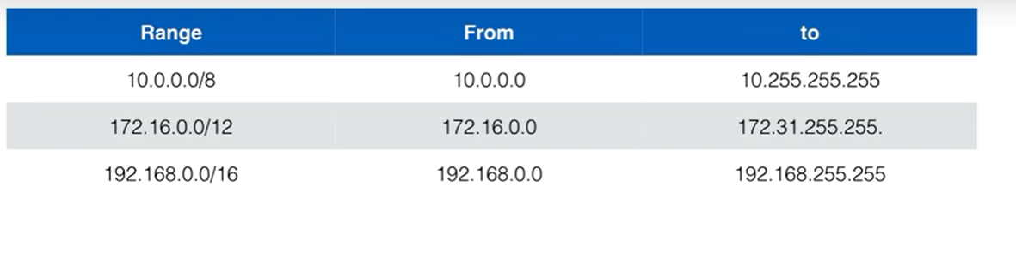
Private Subnets

Slide 5
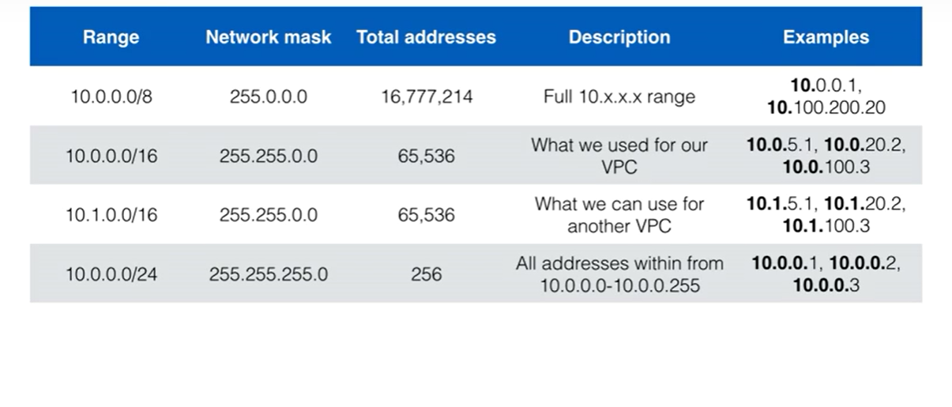
Subnet masks

Slide 6
EC2 instance
We need a new security group for EC2 instance
Ingress(incoming) and egress(outgoing) traffic
Configure ingress and egress on various protocols.

Slide 7
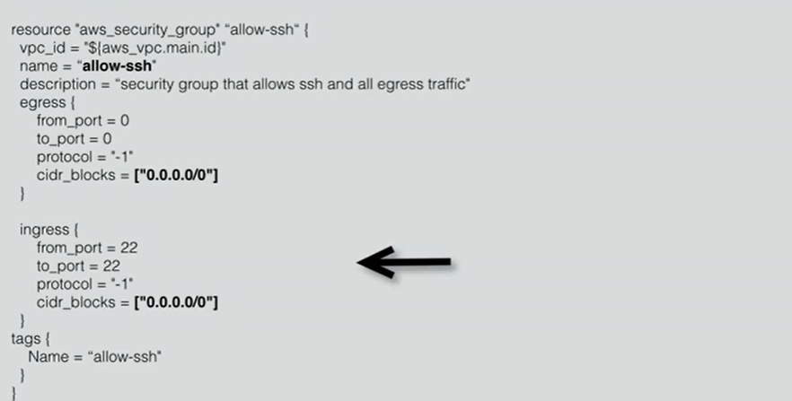
Securitygroup.tf

