Slide 1
Terraform
AWS-Instance creation
Open AWS account
Create IAM admin user
Create terraform file to spin up instance
Terraform commands

Slide 2
Terraform commands
Install modules in a directory:
Terraform init
Apply without plan
Terraform apply
Execute plan
Terraform plan
Plan o/p
Terraform plan –out=path

Slide 3
Terraform commands
Create destroy plan
Terraform plan –out destroy-path
Execute destroy plan
Terraform apply detrpy-plan
Destroy without plan
Terraform destroy
Refresh
Terraform refresh
Validate
Terraform validate

Slide 4
Terraform commands
Show state
Terraform show
Validate
Terraform validate
Execute plan
Terraform apply plan

Slide 5
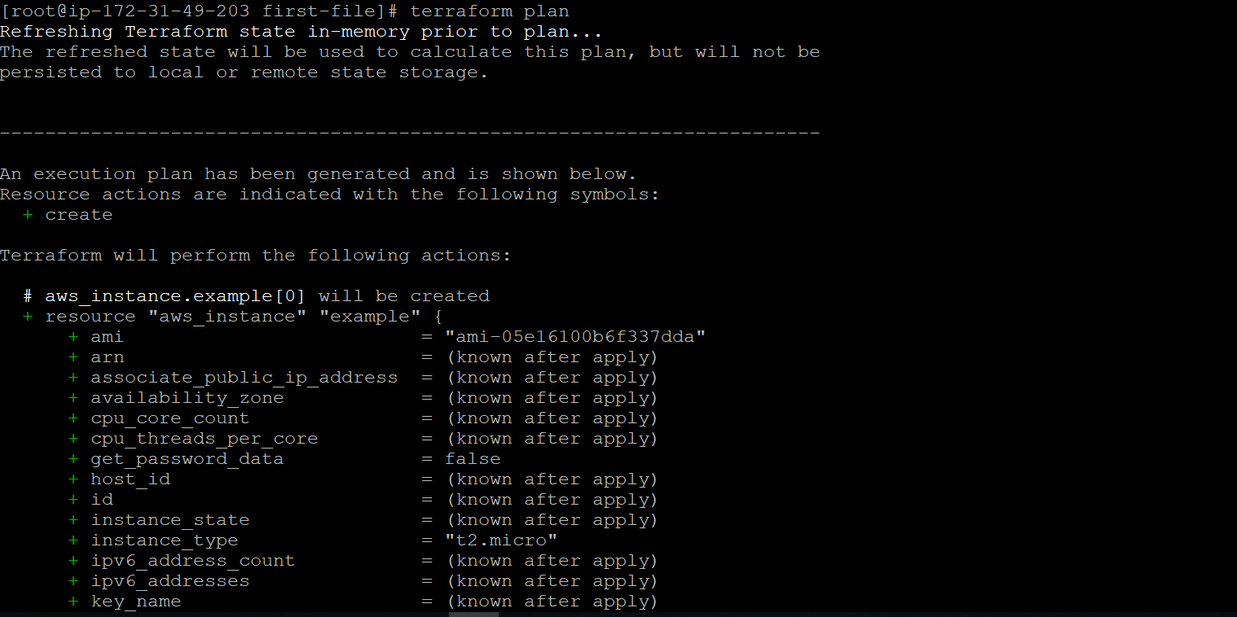
Terraform
Testing Infra based on terraform files:
Terraform plan

Slide 6
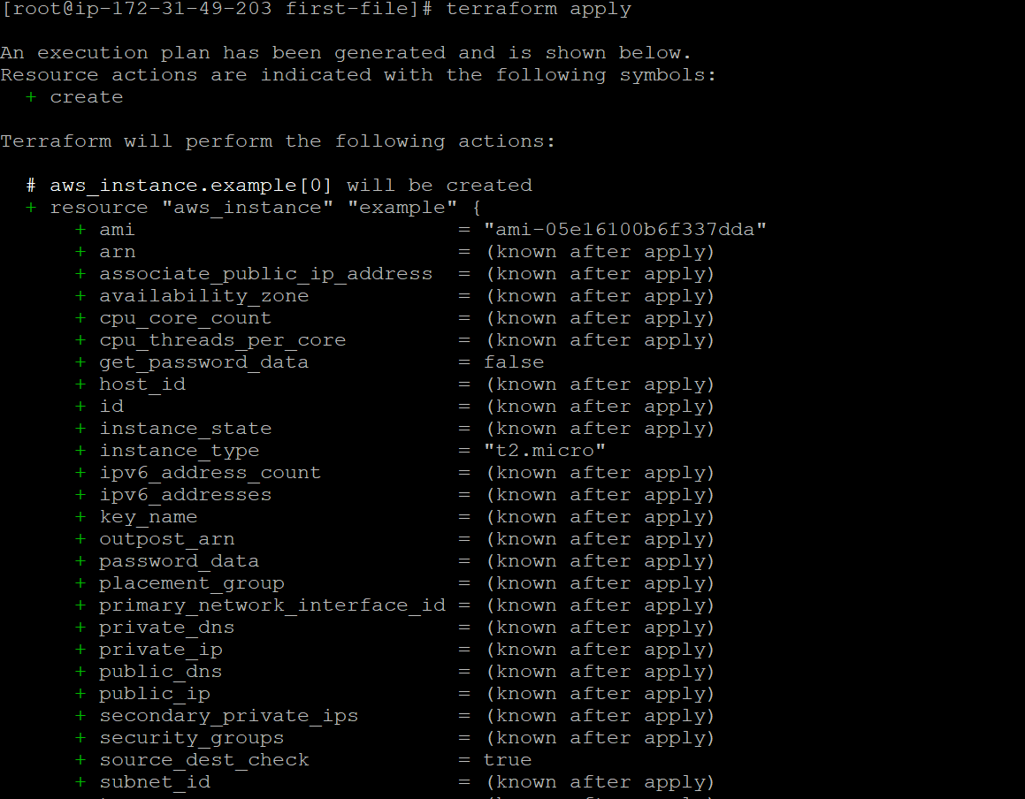
Terraform
Executing changes
Terraform apply

Slide 7
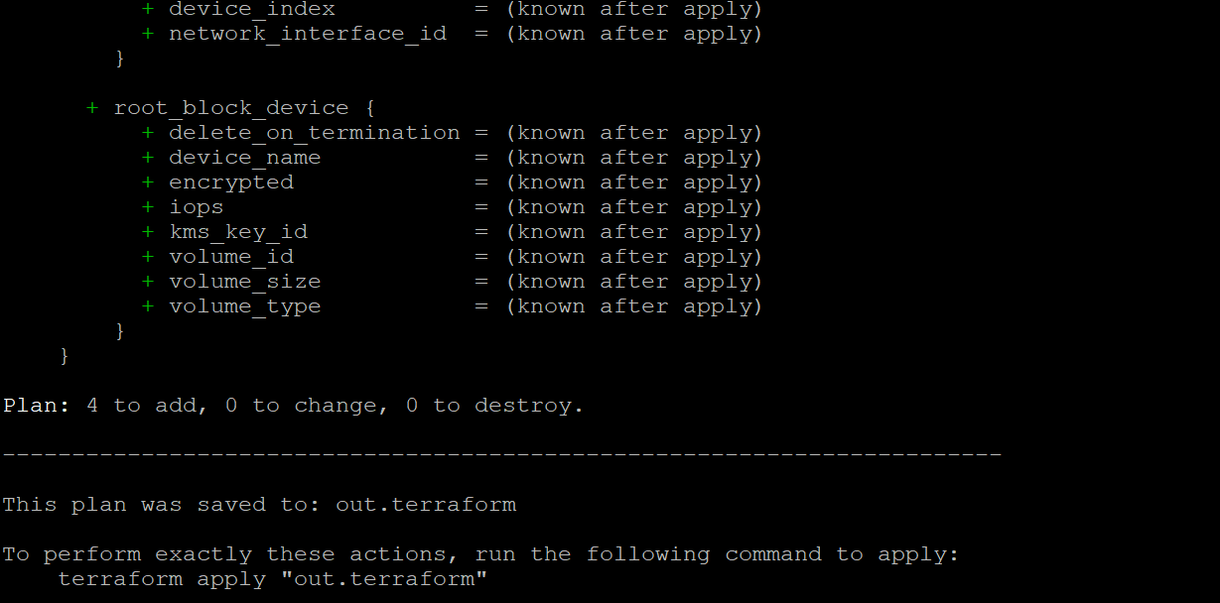
Terraform
Save changes in out file
Terraform plan –out out.terraform

Slide 8
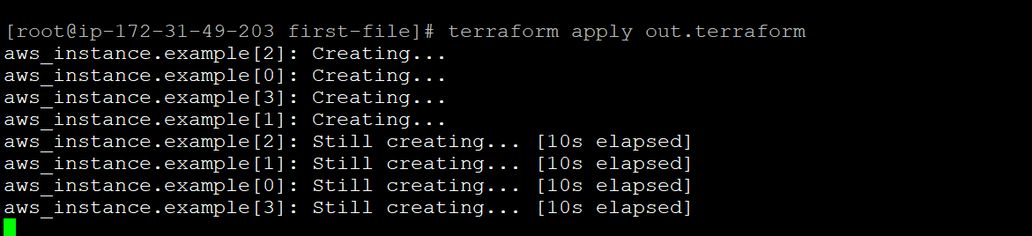
Terraform
Apply changes from out file
Terraform apply out.terraform

Slide 9
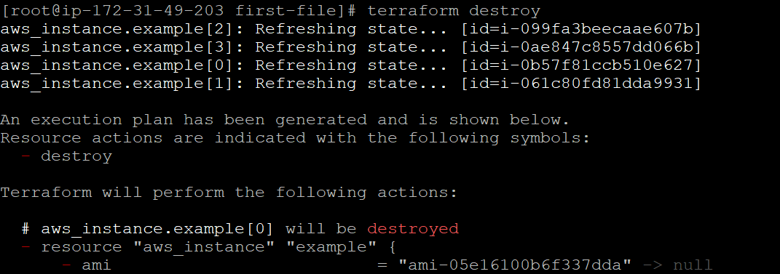
Terraform
Destroy Infra
Terraform destroy
Note: DO NOT EXECUTE IN PRODUCTION!

Slide 10
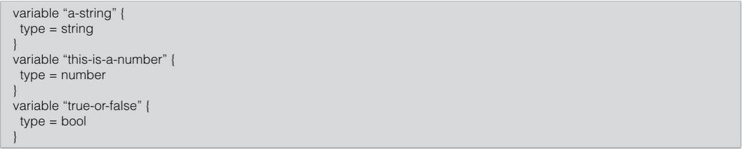
Terraform Variable type
Terraform’s simple variable type
String
Number
Boolean

Slide 11
Terraform Variable type
Terraform’s complex types
List(type)
Set(type)
Map(type)
Object({<ATTR NAME> = <TYPE>, … })
Tuple([<TYPE>, …])

Slide 12
Terraform Variable type
Object→ Same as map, but each element can have different type:
Example:
{
Firstname = “Raj”
Streetnumber = 12
}

Slide 13
Terraform Variable type
Tuple→ same as list, but each element can have different type:
[1, “string”, true]

Slide 14
Resources
Terraform resources-facts
Main meta-parameters
Timeouts
Deployment demo

