Slide 2
IAM
Identity and access management.
Control access to AWS resources
Groups
Users
Roles

Slide 3
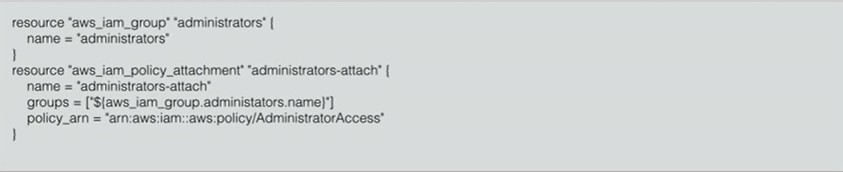
IAM Roles
Roles can give access to users/service that they normally do not have.

Slide 4
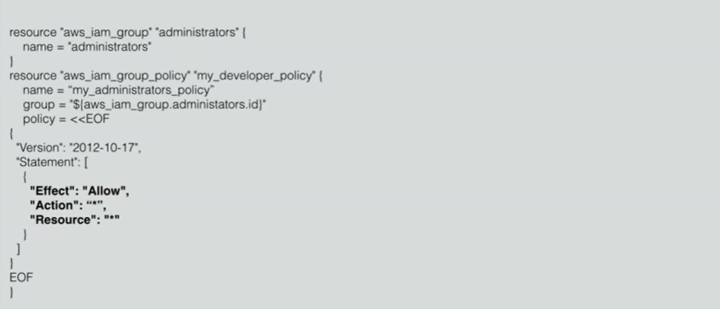
Custom policy

Slide 5
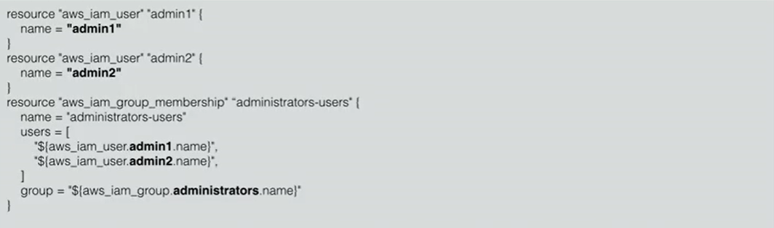
Create User and attach to group

Slide 6
Interpolation
Can interpolate other values, using ${…}
Can use math function
Can use conditionals (if-else)

Slide 7

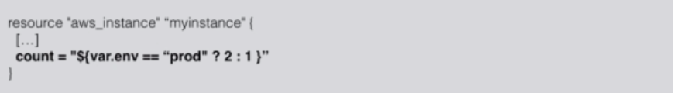
Conditionals
Interpolation may contain coditionals (if-else)
The syntax is :
For example:

Slide 8
Functions
Built-in-functions for terraform resources.
Functions are called with syntax name(arg1,arg2,..) , can be wrapped with ${..}
Its best to use reference documentation for functions:
https://www.terraform.io/docs/configuration/functions.html

Slide 9
Terraform loops
Us of for and for and for_each loops

