Slide 1
LINE FOLLOWER
PRESENTED BY – TEAM ROBOMAZE

Slide 2
TEAM MEMBERS:
SR NO. | NAME | DEPARTMENT
1. | SACHIN PANDEY | B.TECH(CSE)
2. | BHAJANPREET SINGH | B.TECH(CSE)
3. | YOUGAL ATTRI | B.TECH(CSE)
4. | JAGVEER SINGH | BCA
5. | SURBHIT RAJ SINGH | BCA

Slide 3
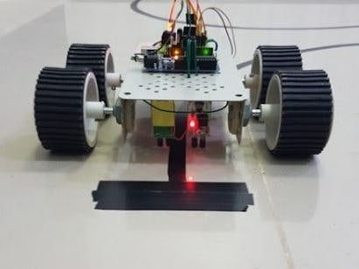
INTRODUCTION:
It’s basically a robot which follows a particular path or trajectory and decides its own course of action which interacts with obstacle. The path can be a black line on the white floor.

Slide 4
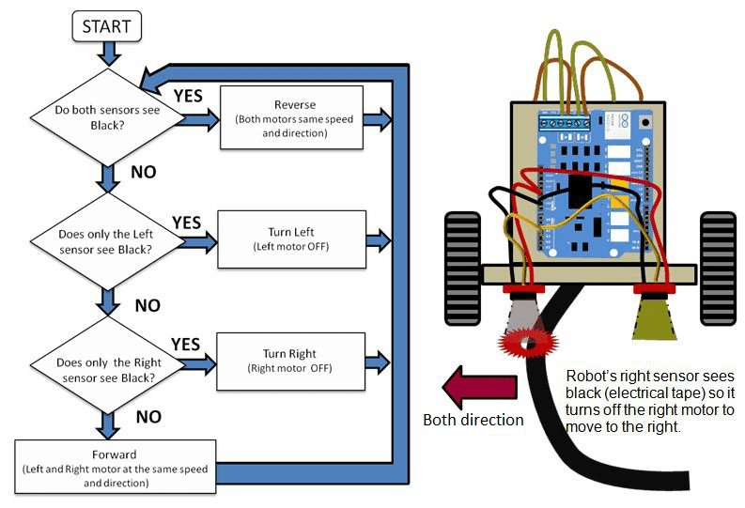
Flow chart:
The flow chart is showing the working of the line follower and the conditions it’s facing in every phase.

Slide 5
Hardware:
Arduino Uno
IR sensors
Motor Driver
Breadboard
Gear motor
Jumbled wires

Slide 6
arduino UNO:
This is a microcontroller which controls our whole project.
Type | Single-board microcontroller
Operating system | None
CPU | Microchip AVR (8-bit)
Memory | SRAM
Storage | Flash, EEPROM

Slide 7
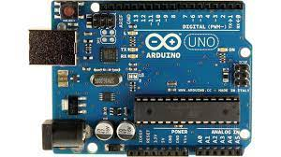
Diagram: Arduino Uno

Slide 8
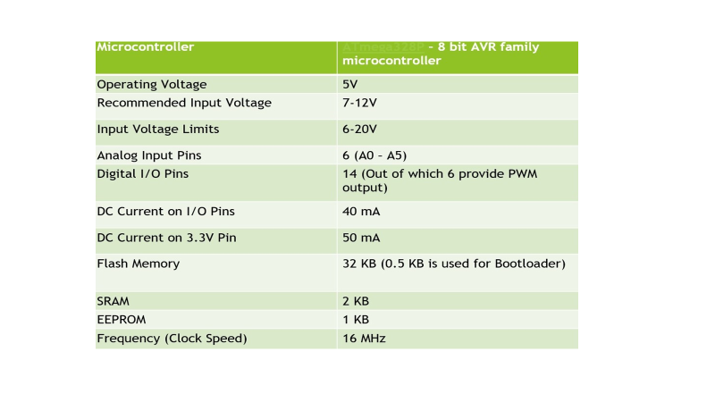

Slide 9
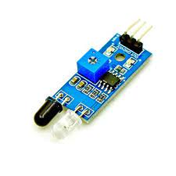
IR sensor:
IR- INFRA RED Sensor.
It emits the light in order to sense some object of the surroundings.
Diagram: IR sensor

Slide 10
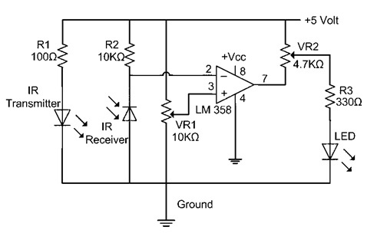
Circuit diagram:
LM358 IC 2 IR transmitter and receiver pair
Resistors of the range of kilo-ohms.
Variable resistors.
LED (Light Emitting Diode)

Slide 11
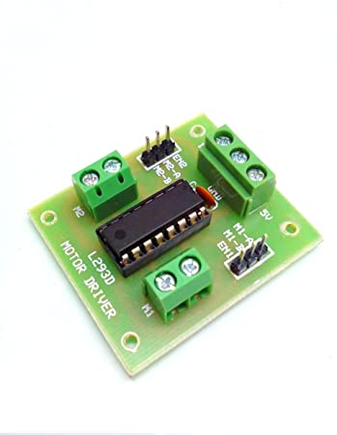
Motor Driver
The L293D is a popular 16-Pin Motor Driver IC.
It is mainly used to drive motors.
A single L293D IC is capable of running two DC motors at the same time.

Slide 12
Pin Number | Pin Name | Description
1 | Enable 1,2 | This pin enables the input pin Input 1(2) and Input 2(7)
2 | Input 1 | Directly controls the Output 1 pin. Controlled by digital circuits
3 | Output 1 | Connected to one end of Motor 1
4 | Ground | Ground pins are connected to ground of circuit (0V)
5 | Ground | Ground pins are connected to ground of circuit (0V)
6 | Output 2 | Connected to another end of Motor 1
7 | Input 2 | Directly controls the Output 2 pin. Controlled by digital circuits
8 | Vcc2 (Vs) | Connected to Voltage pin for running motors (4.5V to 36V)
9 | Enable 3,4 | This pin enables the input pin Input 3(10) and Input 4(15)
10 | Input 3 | Directly controls the Output 3 pin. Controlled by digital circuits
11 | Output 3 | Connected to one end of Motor 2
12 | Ground | Ground pins are connected to ground of circuit (0V)
13 | Ground | Ground pins are connected to ground of circuit (0V)
14 | Output 4 | Connected to another end of Motor 2
15 | Input 4 | Directly controls the Output 4 pin. Controlled by digital circuits
16 | Vcc2 (Vss) | Connected to +5V to enable IC function

Slide 13
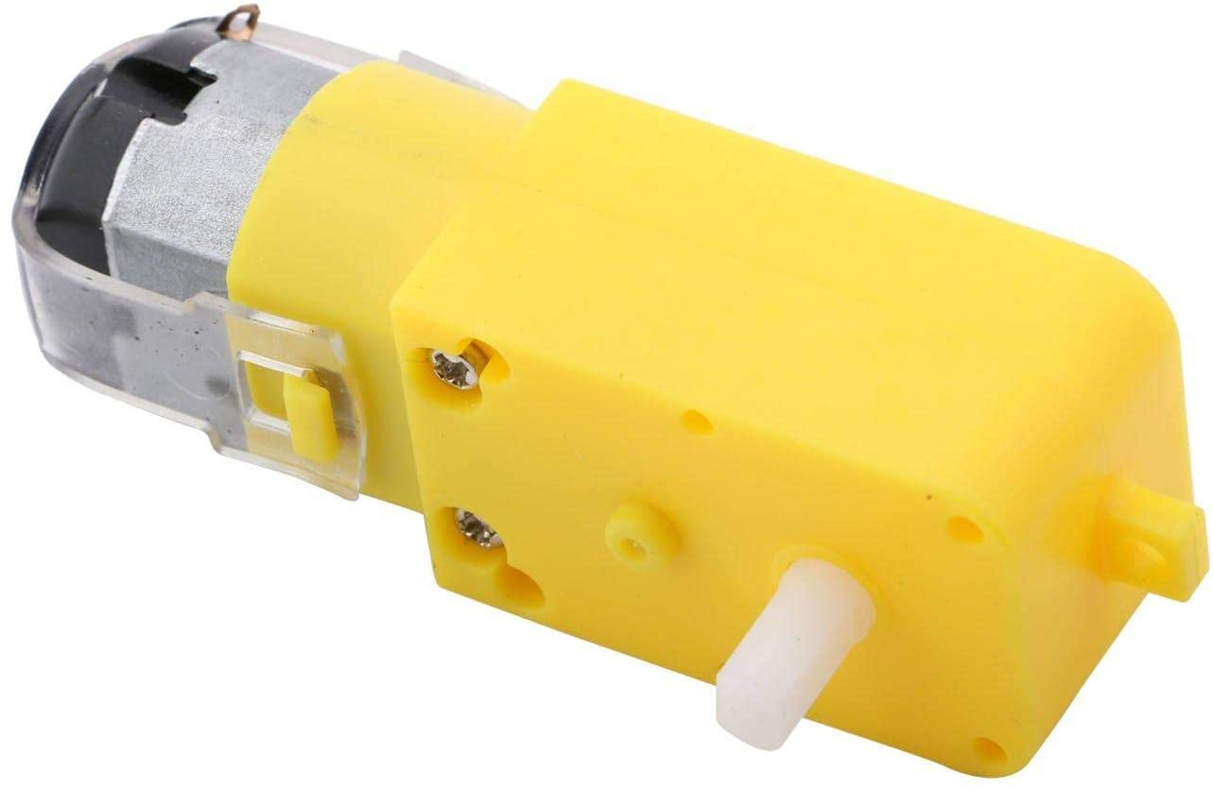
Gear motors
A geared motor is a component whose mechanism adjusts the speed of the motor, leading them to operate at a certain speed.

Slide 14
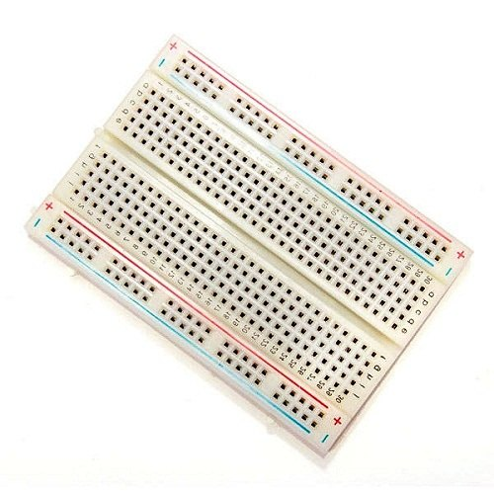
Bread Board
A breadboard is a construction base for prototyping of electronics.

Slide 15
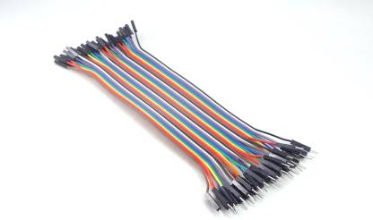
Jumbled Wires
A jump wire is an electrical wire, or group of them in a cable, with a connector or pin at each end, which is normally used to interconnect the components of a breadboard or other prototype or test circuit.

Slide 16
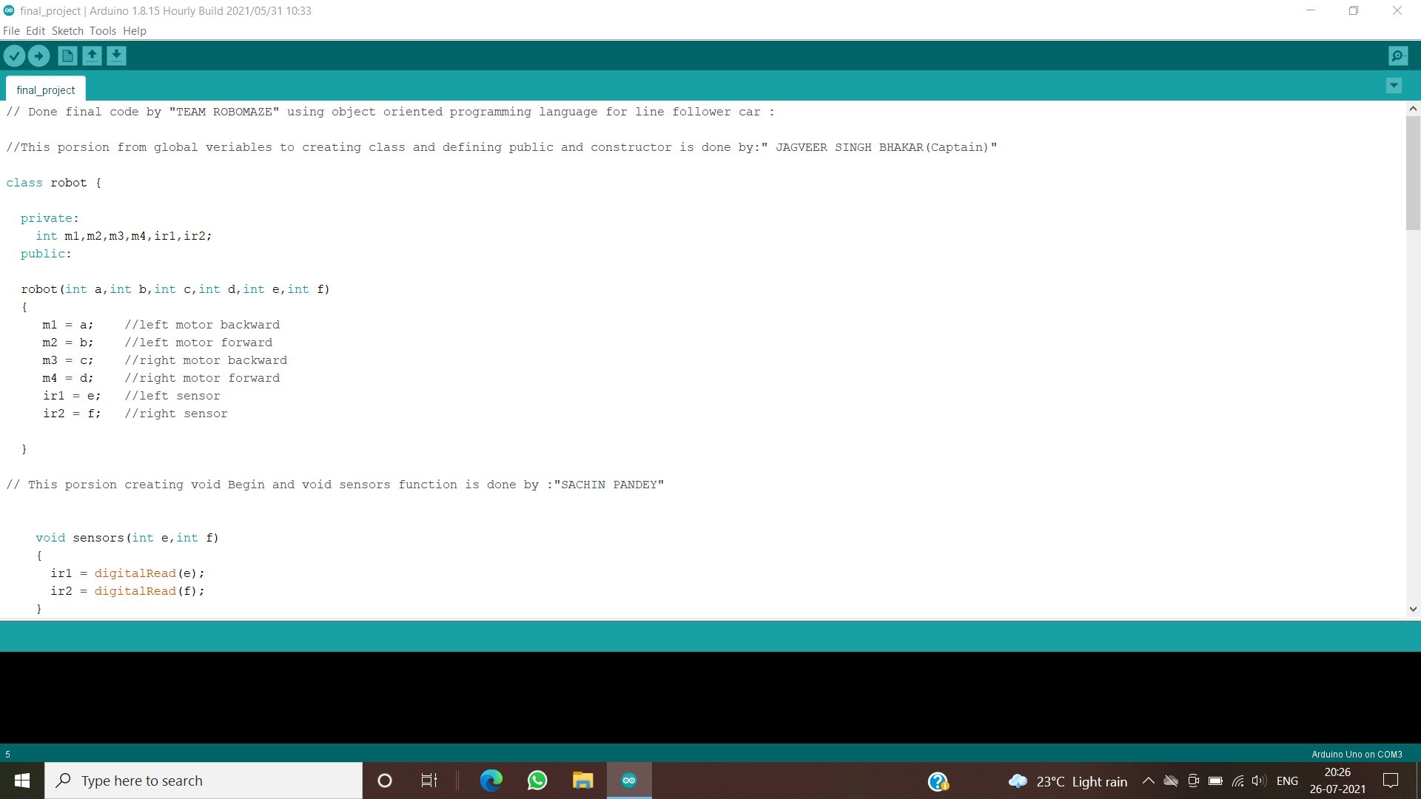
Programming
In this project class and object orientation programming is used .
Constructor is also used in our program .

Slide 17
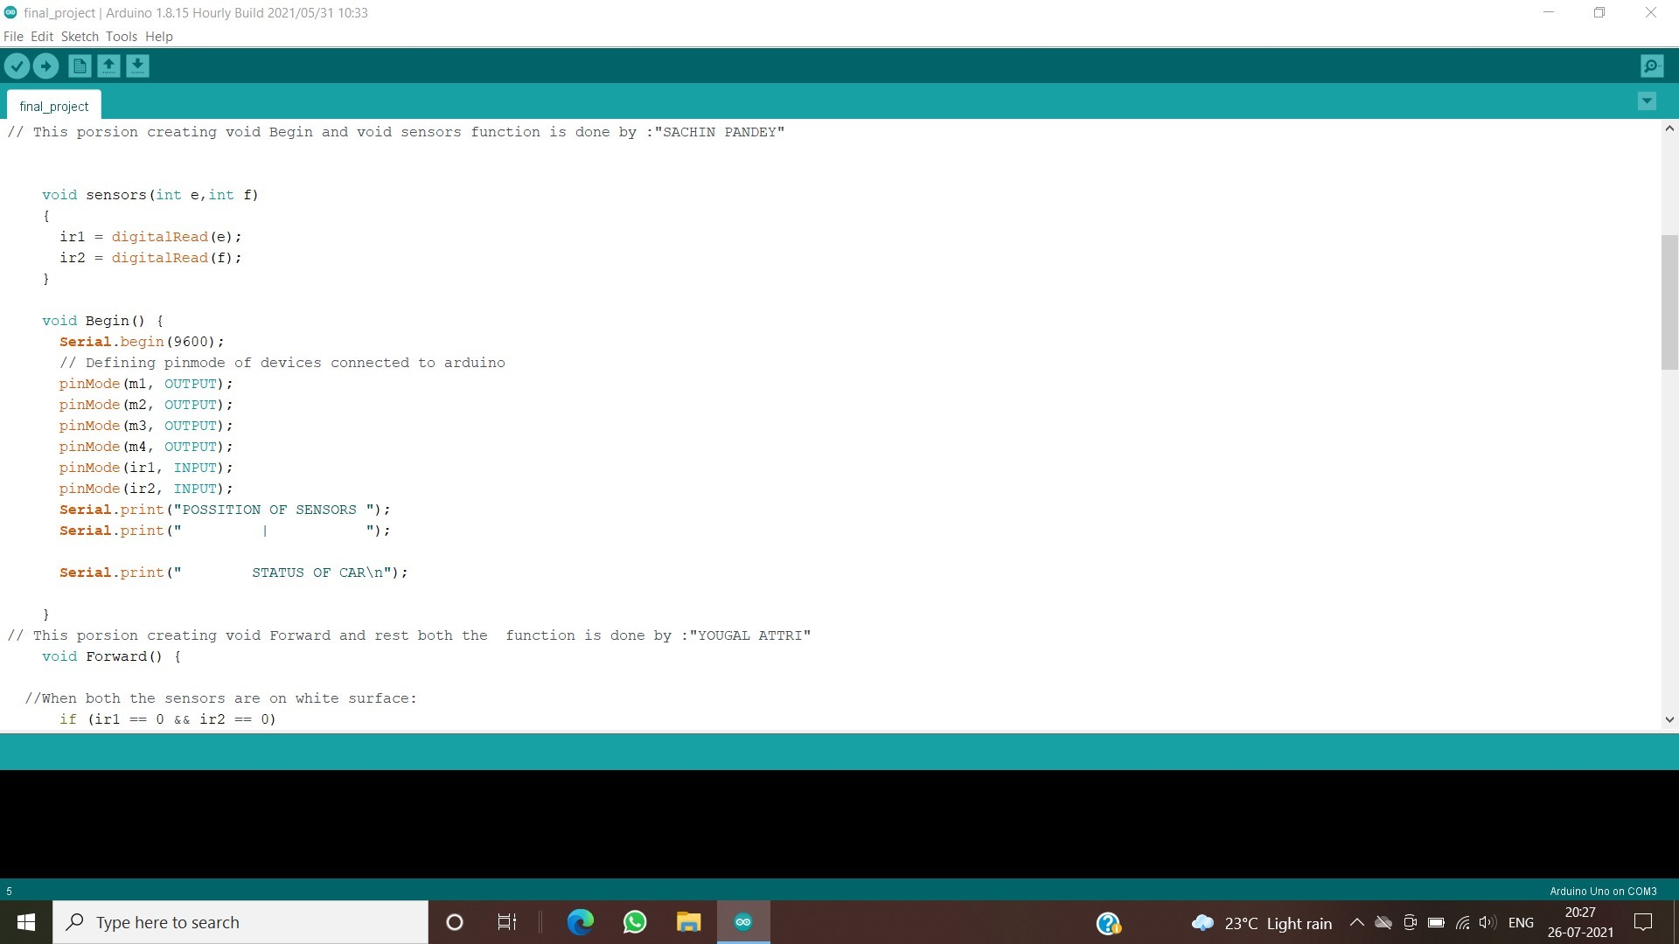

Slide 18


Slide 19
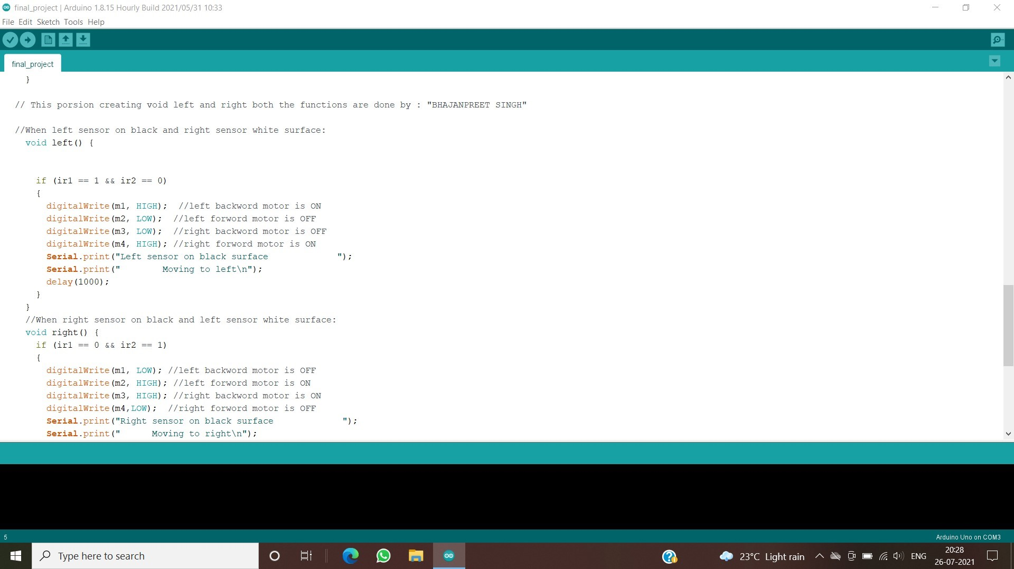

Slide 20
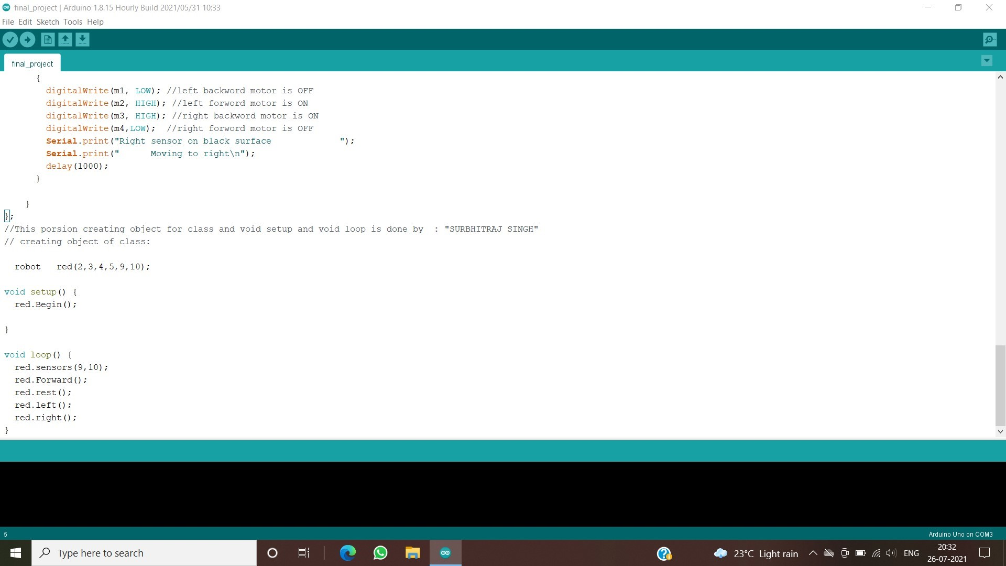

Slide 21
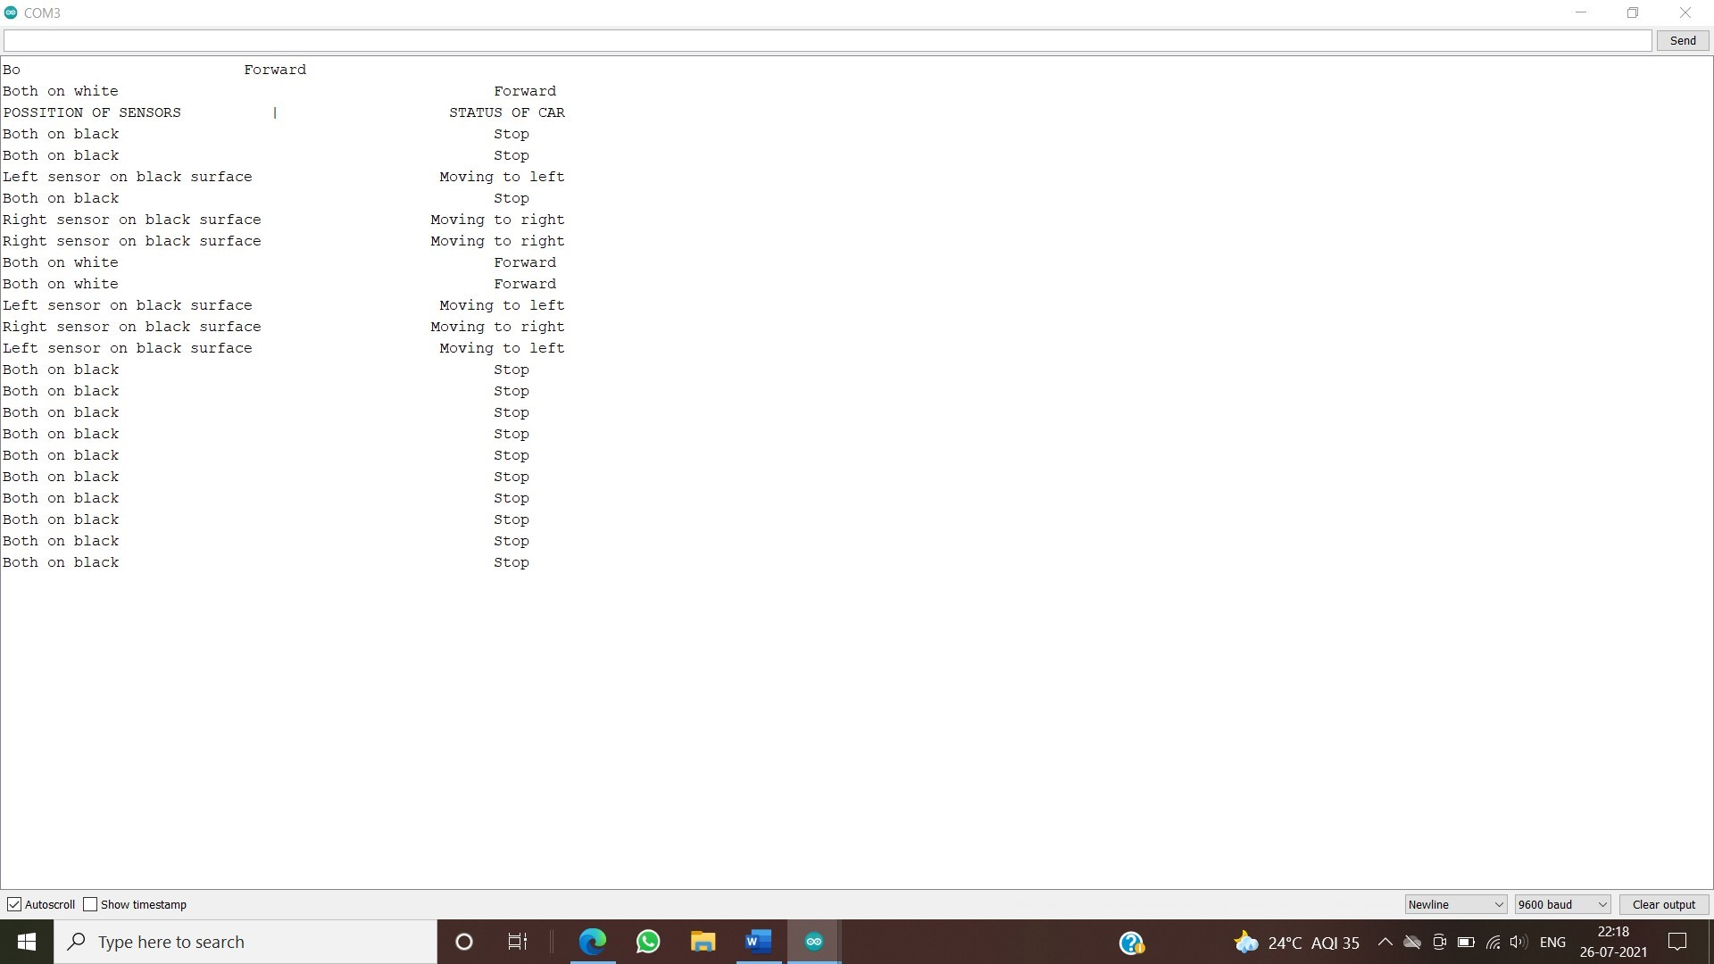
Database:
We have saved data of our line follower robot car motions.
Saving data from serial monitoring function from Arduino ide application and sending to excel sheet.

Slide 22
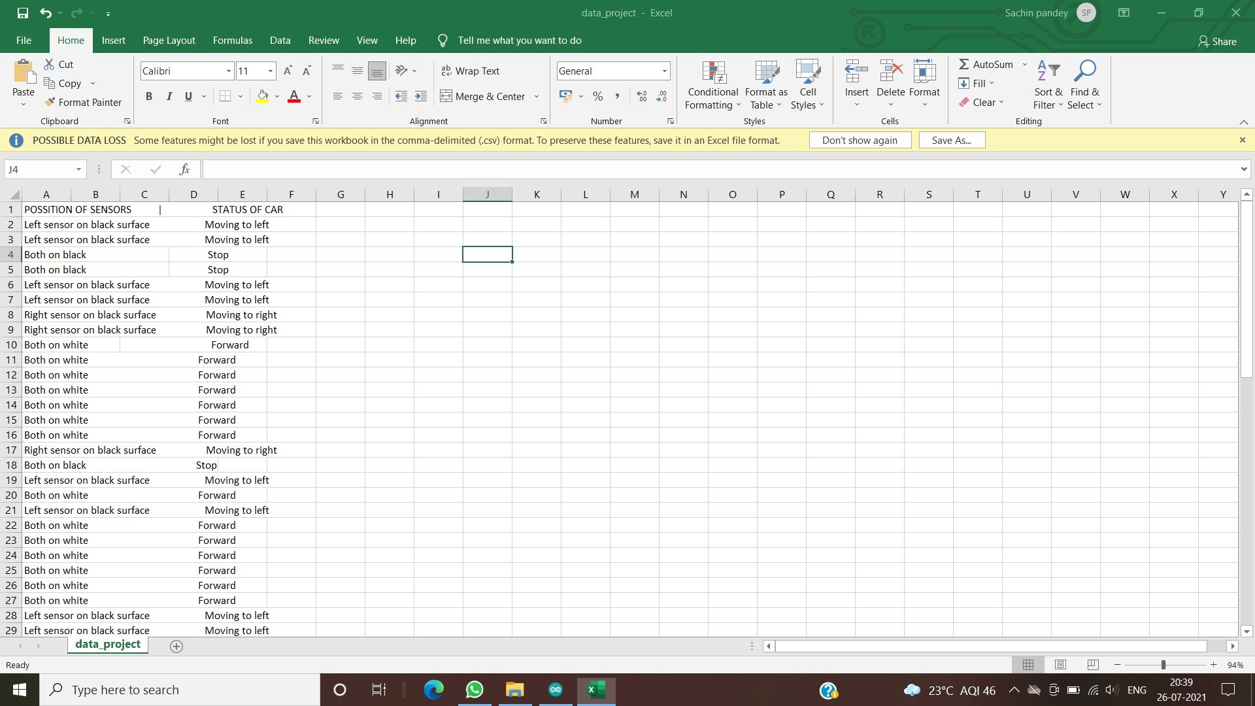
Storing data in excel sheet:

Slide 23
THANK YOU

