Slide 1
Information of project’s apparatus
By:-Team Robomaze

Slide 2
List of main apparatus used in line follower project:-
Arduino Uno
IR Sensor
L293D Motor driver
ESP8266 Wifi module
Gear motors
Bread board
Jumbled wires

Slide 3
(A).ARDUINO UNO
Introduction
Pin mapping

Slide 4
1.Introduction of Arduino UNO
Microcontroller board developed by Arduino.cc and based on Atmega328
User-friendly and open source single chip microcontroller device.
Easy to use and understand among other types of Arduino

Slide 5
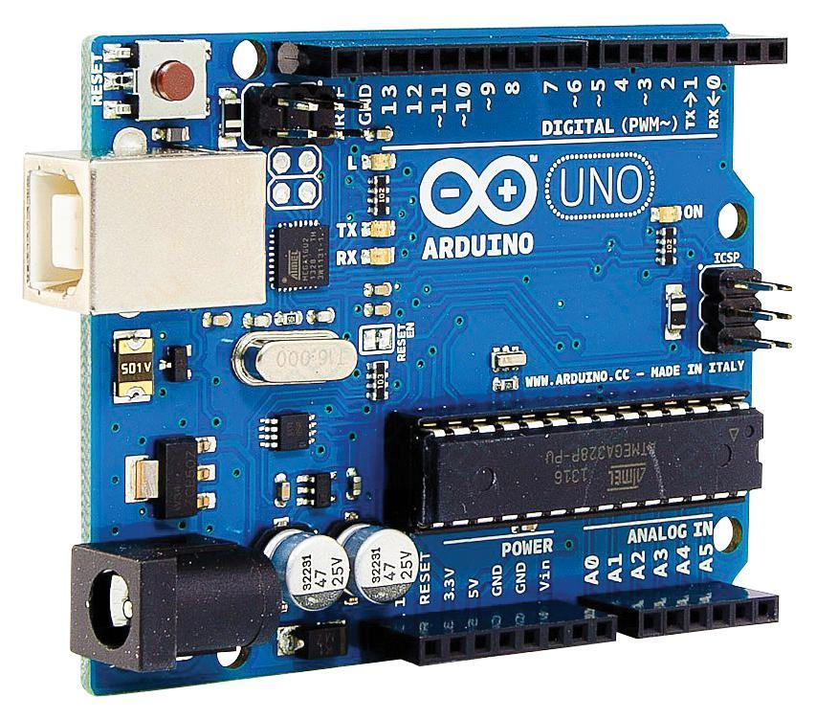

Slide 6
Microcontroller | ATmega328P – 8 bit AVR family microcontroller
Operating Voltage | 5V
Recommended Input Voltage | 7-12V
Input Voltage Limits | 6-20V
Analog Input Pins | 6 (A0 – A5)
Digital I/O Pins | 14 (Out of which 6 provide PWM output)
DC Current on I/O Pins | 40 mA
DC Current on 3.3V Pin | 50 mA
Flash Memory | 32 KB (0.5 KB is used for Bootloader)
SRAM | 2 KB
EEPROM | 1 KB
Frequency (Clock Speed) | 16 MHz

Slide 7
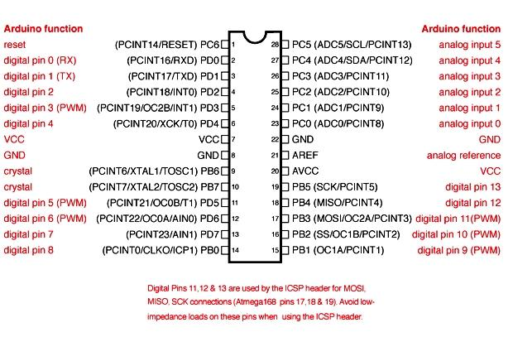
2.Pin mapping

Slide 8
Pin category | Pin name | Details
Power | Vin, 3.3V, 5V, GND | Vin: Input voltage to Arduino when using an external power source. 5V: Regulated power supply used to power microcontroller and other components on the board. 3.3V: 3.3V supply generated by on-board voltage regulator. Maximum current draw is 50mA. GND: ground pins.
Reset | Reset | Reset the microcontroller.

Slide 9
Analog Pins | A0 – A5 | Used to provide analog input in the range of 0-5V
Input/Output Pins | Digital Pins 0 - 13 | Can be used as input or output pins.
Serial | 0(Rx), 1(Tx) | Used to receive and transmit TTL serial data.
Analog pins |  | For input and output

Slide 10
External Interrupts | 2, 3 | To trigger an interrupt.
PWM | 3, 5, 6, 9, 11 | Provides 8-bit PWM output.
SPI | 10 (SS), 11 (MOSI), 12 (MISO) and 13 (SCK) | Used for SPI communication.

Slide 11
Inbuilt LED | 13 | To turn on the inbuilt LED.
TWI | A4 (SDA), A5 (SCA) | Used for TWI communication.
AREF | AREF | To provide reference voltage for input voltage.

Slide 12
(B).IR sensor
Introduction
Types
Working
Circuit explaination

Slide 13
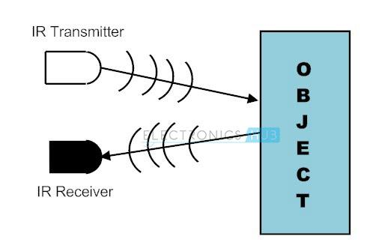
1.Introduction
IR- INFRA RED Sensor.
It emits the light in order to sense some object of the surroundings.

Slide 14
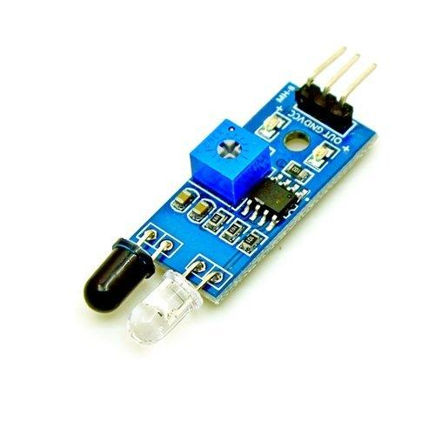
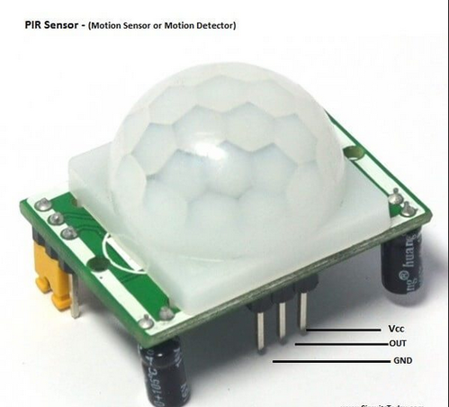
2.Types
Two types :
a.Active
b.Passive
(a).Active IR sensor (b).Passive IR sensor

Slide 15
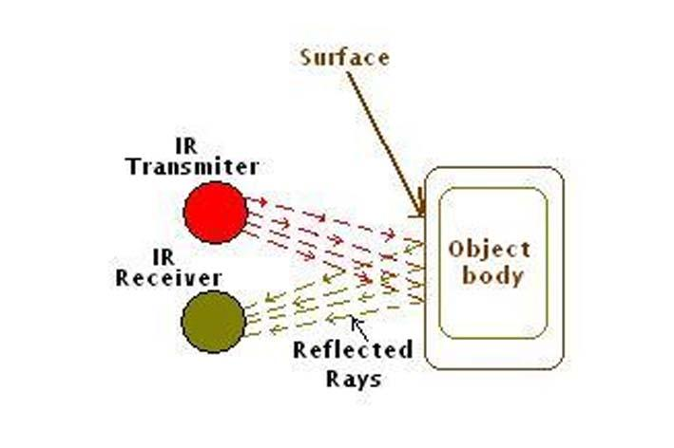
3.Working
Based on Transmitter and Receiver.

Slide 16
4.Circuit explaination
Main components:
1.LM358 IC 2 transmitter and receiver.
2.Registers of the range of kilo ohms.
3.Variable registere.
4.LED

Slide 17
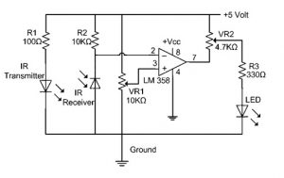
Diagram of circuit

Slide 18
(C).L293D Motor driver
Introduction
Motor functioning and motion
Pin configuration

Slide 19
1.Introduction
The L293D is a popular 16-Pin Motor Driver IC.
It is mainly used to drive motors.
A single L293D IC is capable of running two DC motors at the same time.

Slide 20
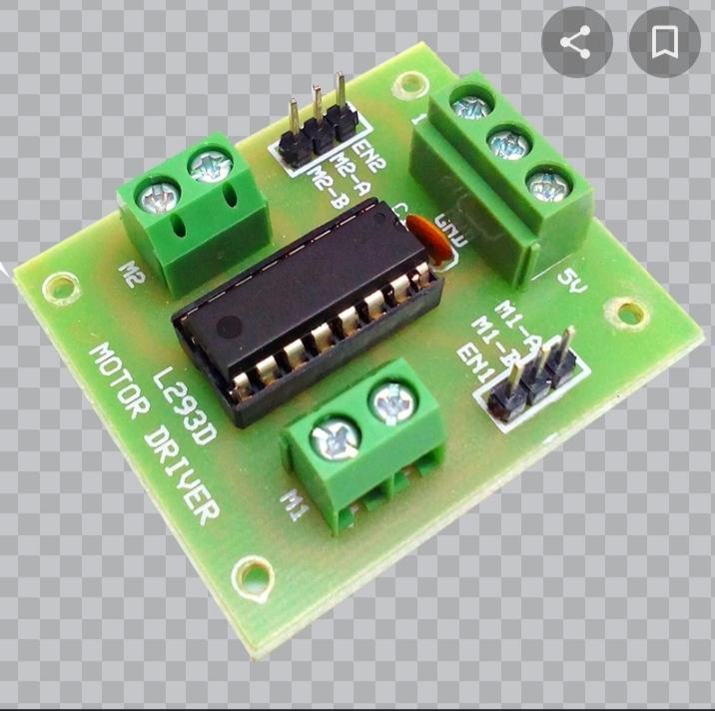

Slide 21
3.motor functioning and motion
Input 1 =HIGH(5v) | Output 1 = HIGH | Motor 1 rotates in Clock wise Direction
Input 2 = LOW(0v) | Output 2 = LOW
Input 3 =HIGH(5V) | Output1=HIGH | Motor 2 rotates in Clock wise Direction
Input 4=LOW(0) | Output=LOW

Slide 22
Input 1 = LOW(0) | Output 1 = LOW | Motor 1 rotates in Anti-Clock wise Direction
Input 2 = HIGH(5v) | Output 2 = HIGH
Input 3 = LOW(0v) | Output 1 = LOW | Motor 2 rotates in Anti -Clock wise Direction
Input 4 = HIGH(5v) | Output 2 = HIGH

Slide 23
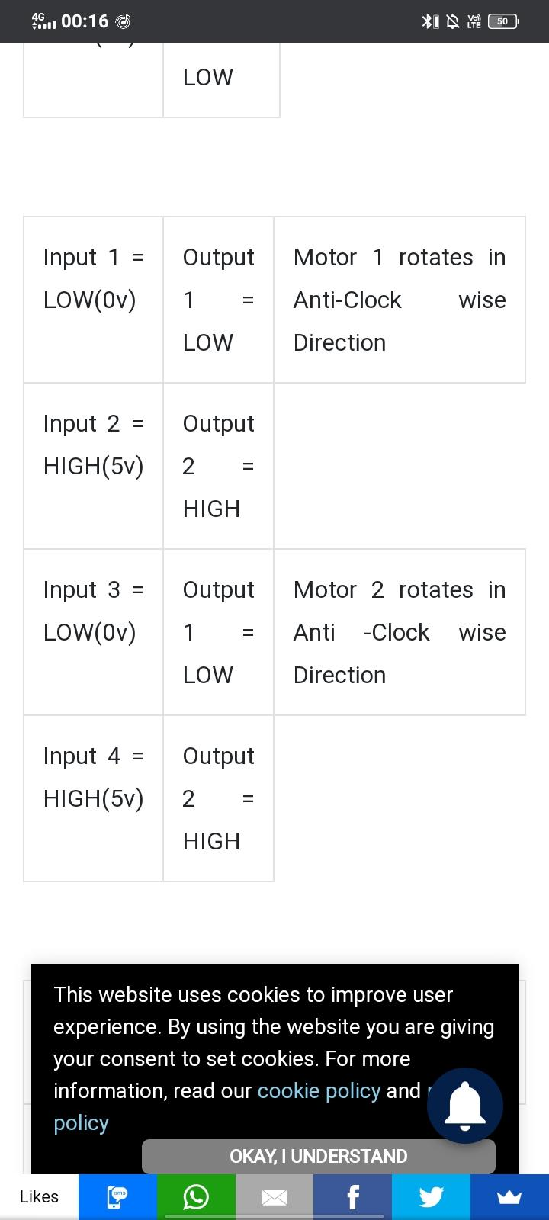

Slide 24
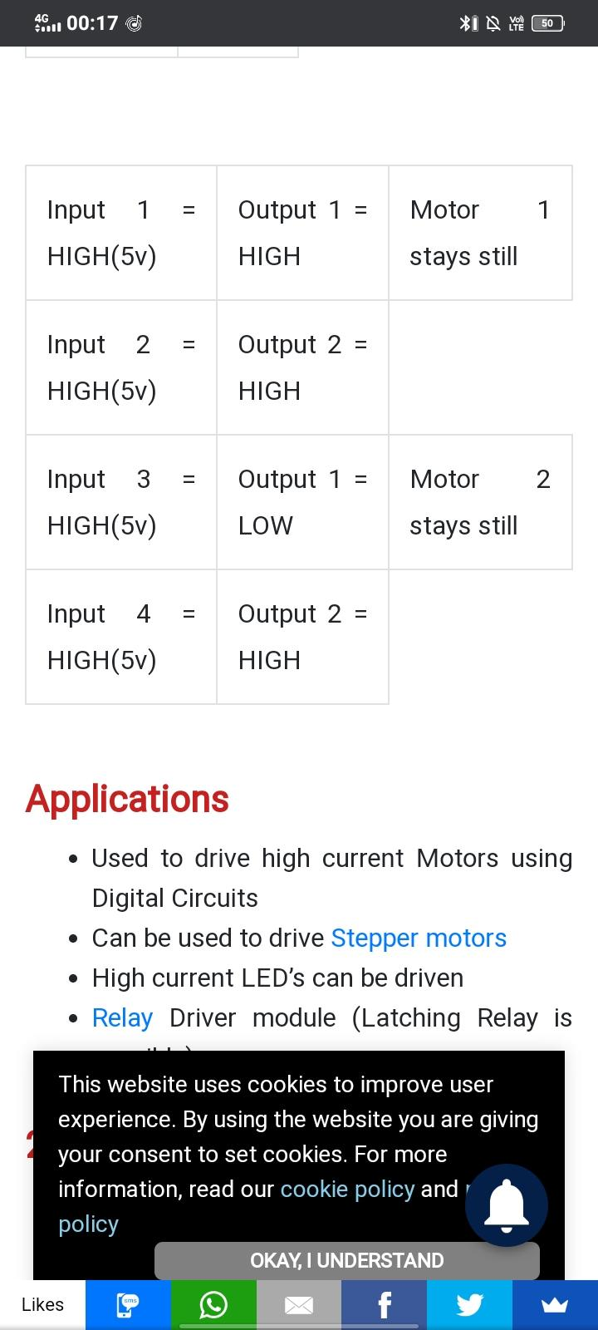

Slide 25
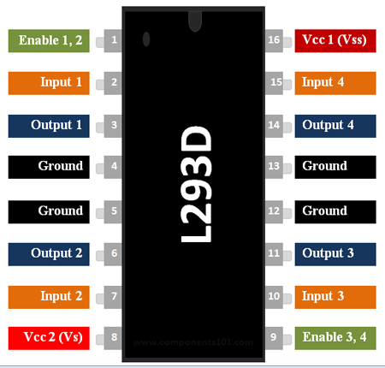

Slide 26
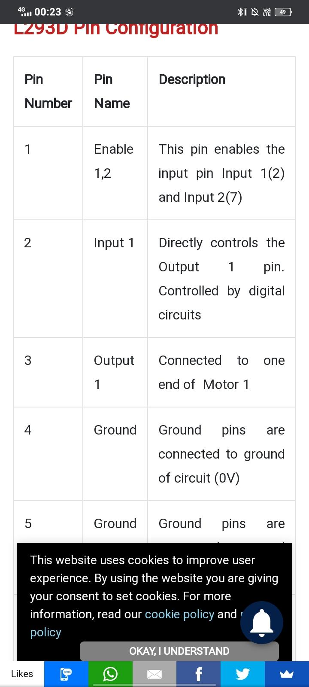
4.Pin configuration

Slide 27
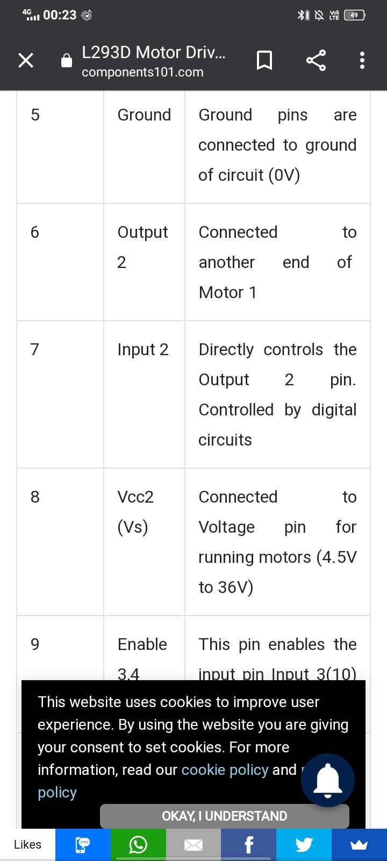

Slide 28
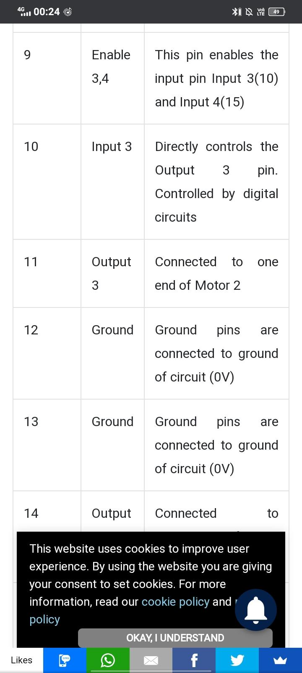

Slide 29
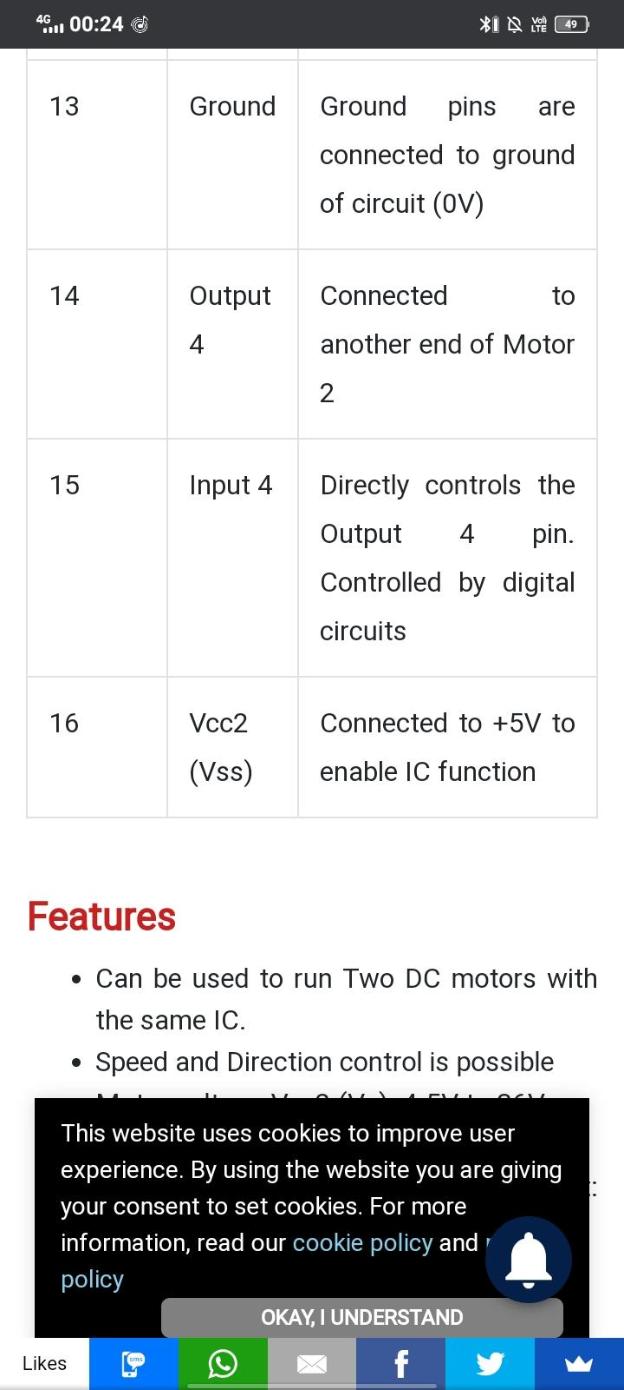

Slide 30
(D).ESP8266 Wifi module
Introduction
Pin configuration

Slide 31
1.Introduction
The Wifi module generally contains two main parts:
1. A wifi chip
2. An application host processor
ESP8266 is a low cost wifi module
With full TCP\IP stack and microcontroller capacity.

Slide 32
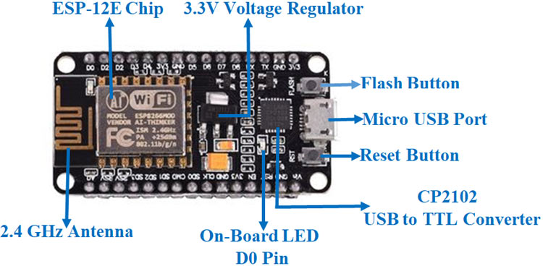

Slide 33
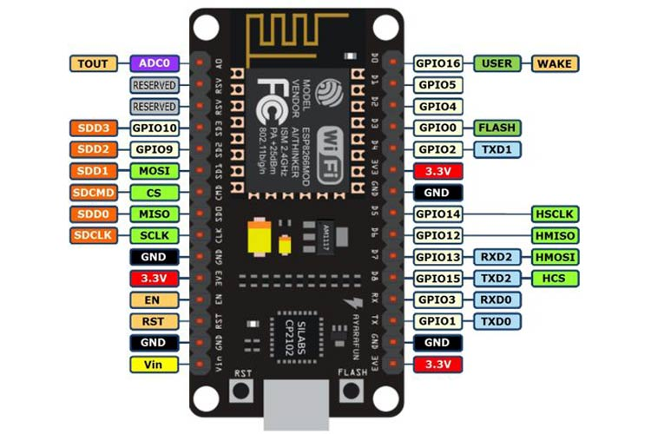
2.Pin configuration

Slide 34
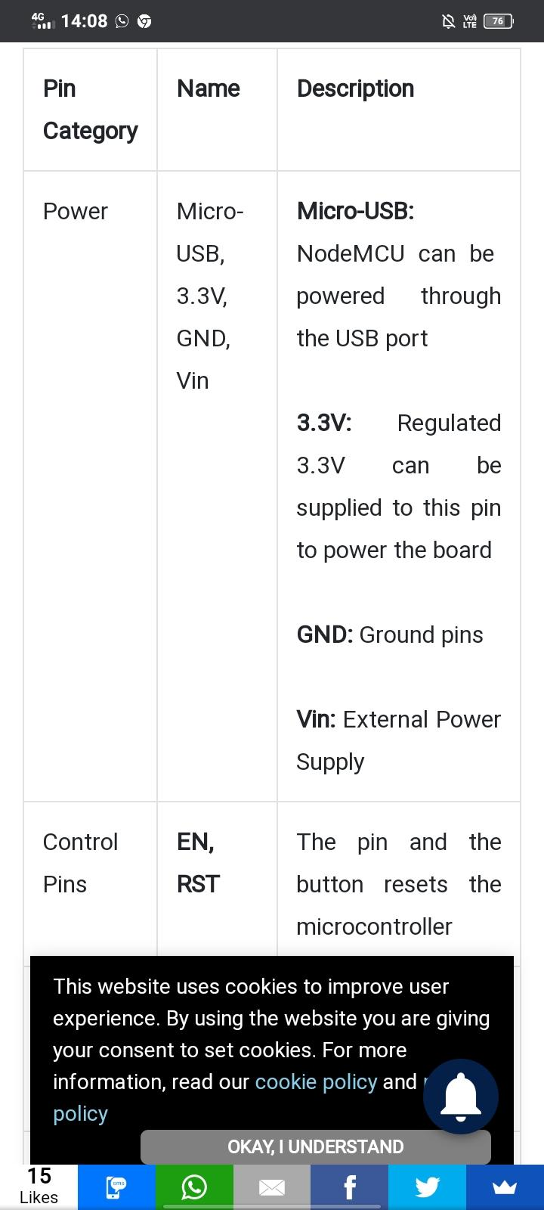

Slide 35
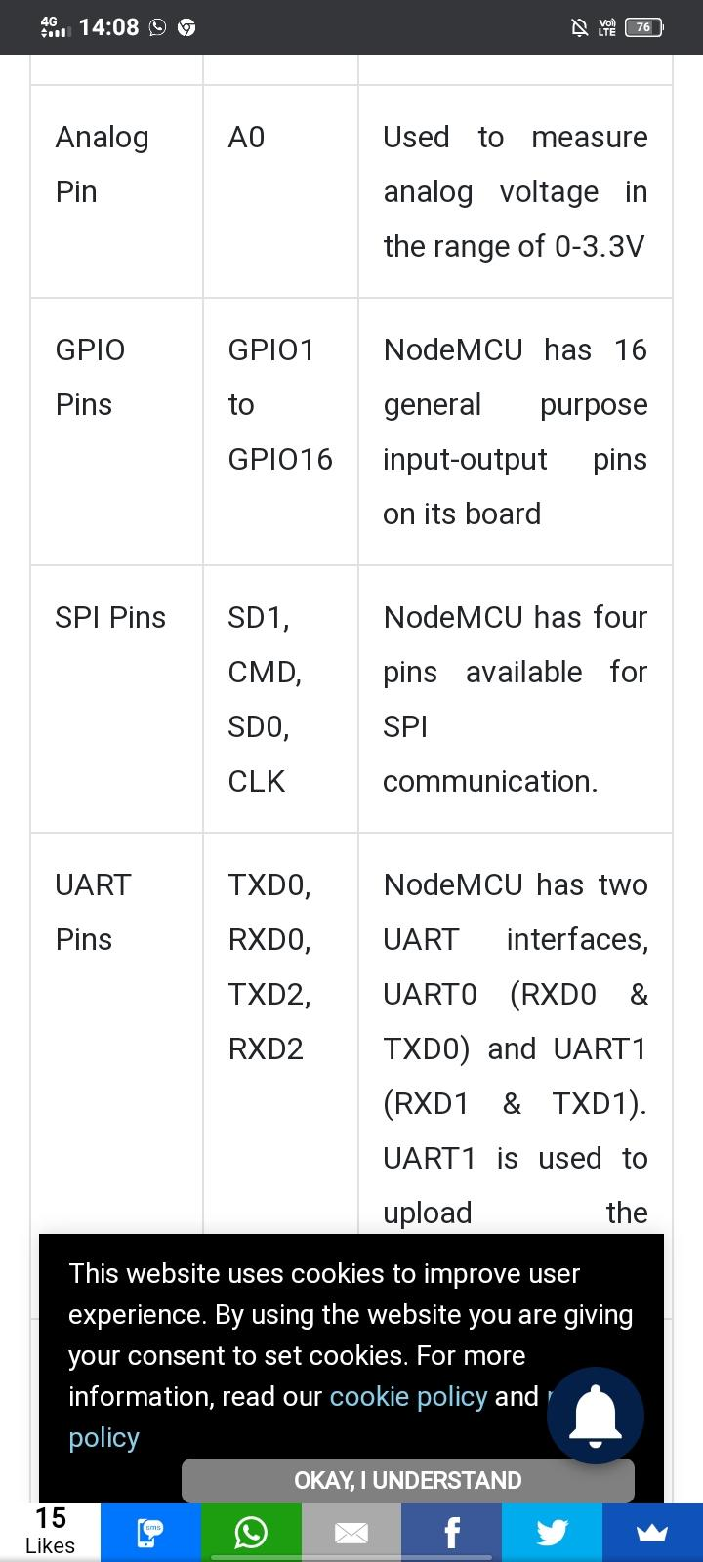

Slide 36
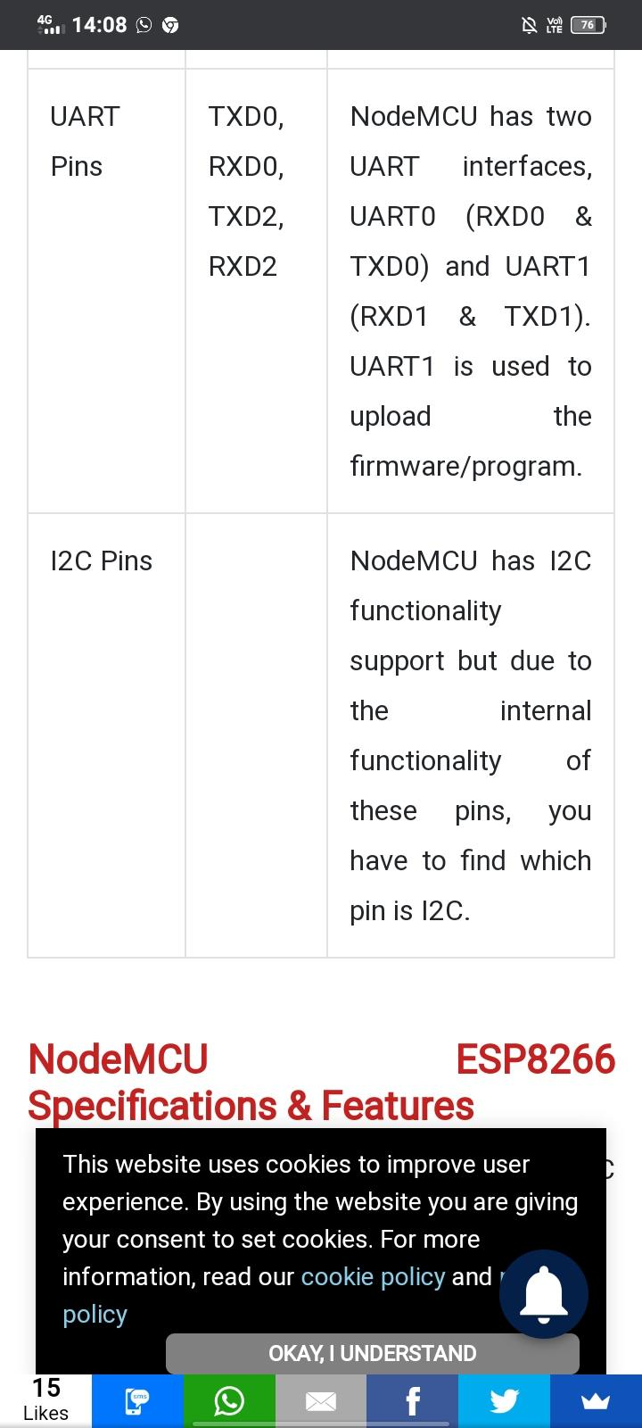

Slide 37
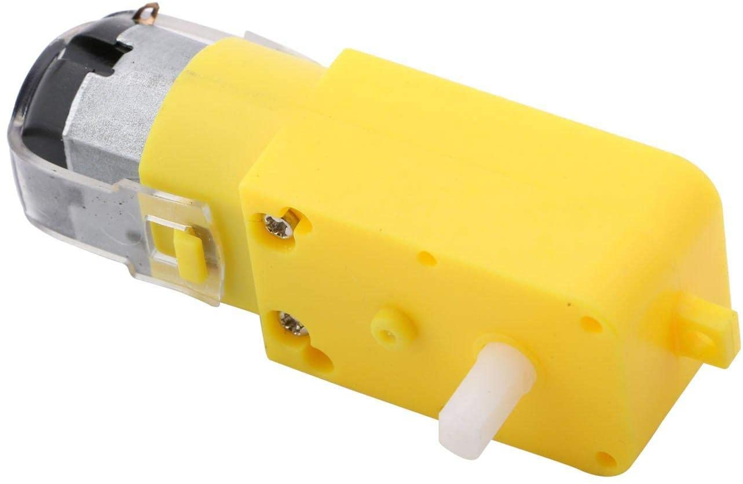
(E).Gear motors
A geared motor is a component whose mechanism adjusts the speed of the motor, leading them to operate at a certain speed.

Slide 38
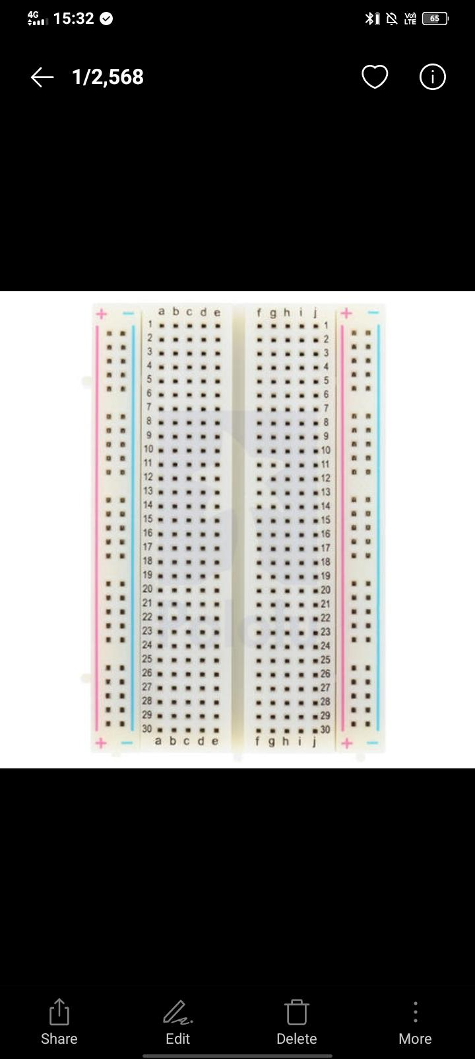
(F).Bread board
A breadboard, or protoboard, is a construction base for prototyping of electronics.

Slide 39
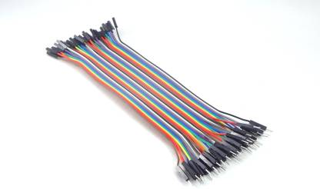
(G). Jumbled wires
A jump wire is an electrical wire, or group of them in a cable, with a connector or pin at each end, which is normally used to interconnect the components of a breadboard or other prototype or test circui

