Slide 1
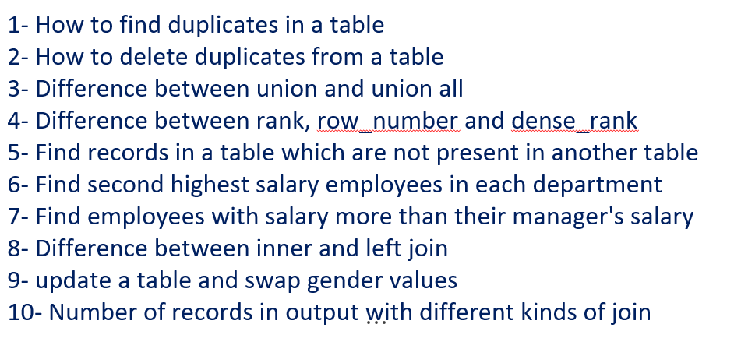
Do you know the importance of SQL as Data Analyst or Scientist - Interview Questions

Slide 2
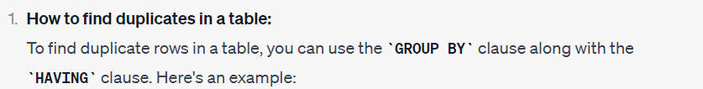

Do you know the importance of SQL as Data Analyst or Scientist - Interview Questions

Slide 3
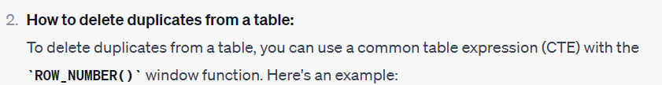
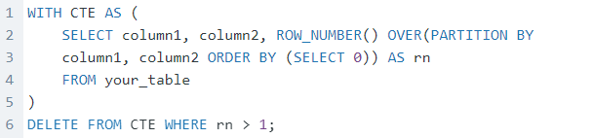
Do you know the importance of SQL as Data Analyst or Scientist - Interview Questions

Slide 4
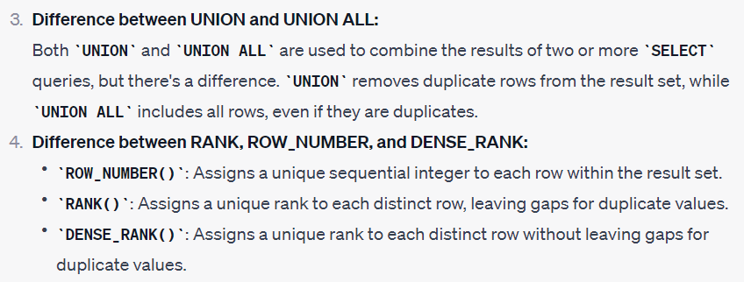
Do you know the importance of SQL as Data Analyst or Scientist - Interview Questions

Slide 5
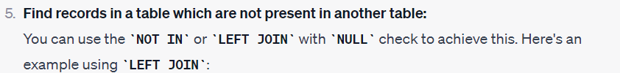
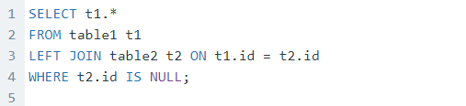
Do you know the importance of SQL as Data Analyst or Scientist - Interview Questions

Slide 6
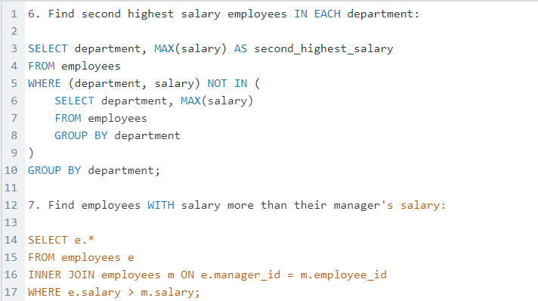
Do you know the importance of SQL as Data Analyst or Scientist - Interview Questions

Slide 7
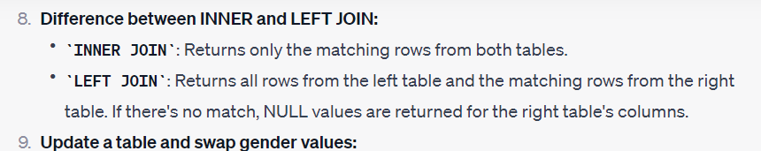
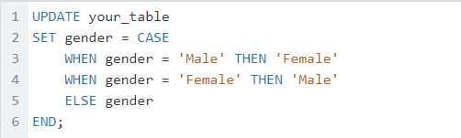
Do you know the importance of SQL as Data Analyst or Scientist - Interview Questions

Slide 8
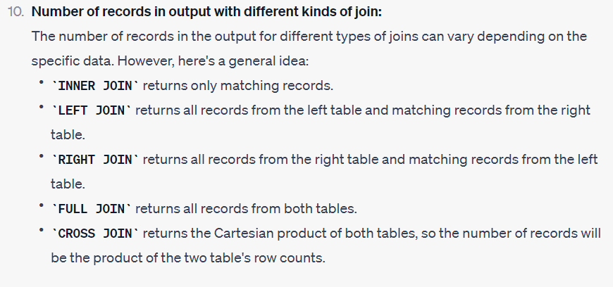
Do you know the importance of SQL as Data Analyst or Scientist - Interview Questions

