Slide 1

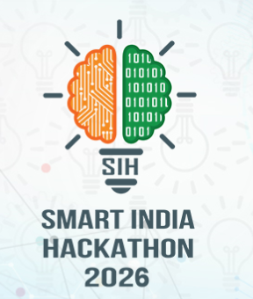
SMART INDIA HACKATHON 2026
• Problem Statement ID - SIH26133
• Problem Statement Title- Accessibility and quality of public healthcare services, particularly in rural and underserved areas
• Theme- Healthcare & Biomedical Technology / Rural Development
• PS Category- Software
• Team ID-
• Team Name:- Arogya
• Project Name:- Sanjeevani
@Sanjeevani-TeleHealth 1

Slide 2
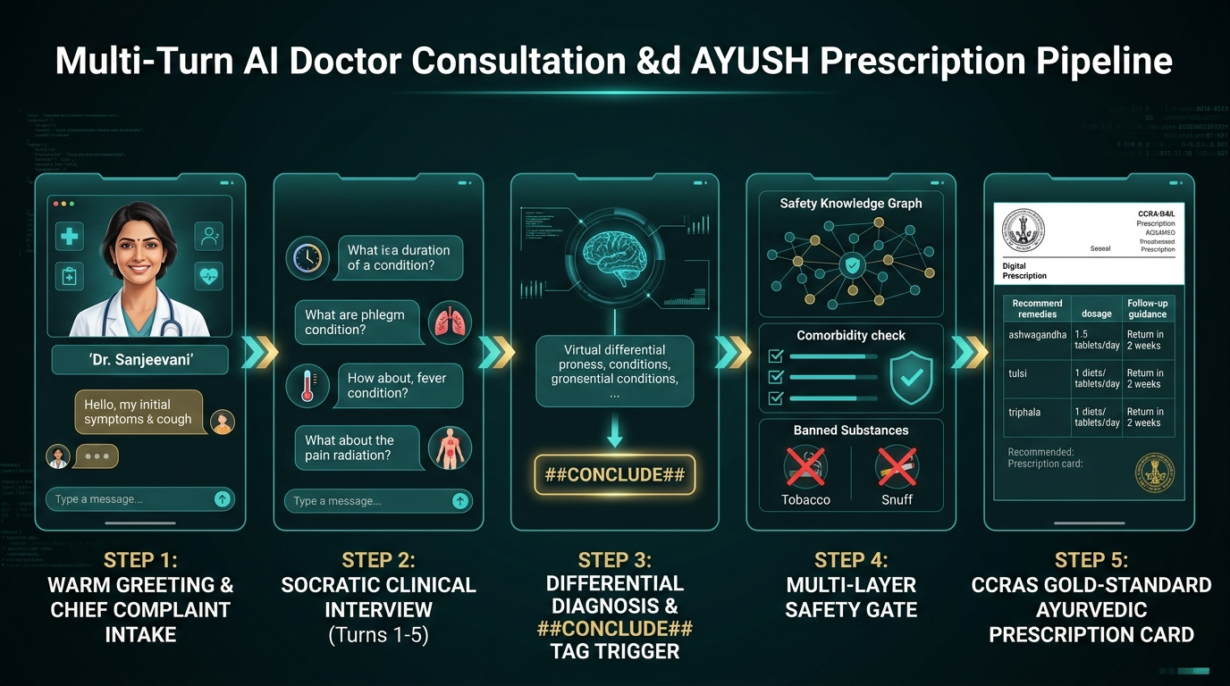
Team
Arogya
Sanjeevani: AI Platform for Verifiable Himalayan Health
Proposed Solution & Clinical Capabilities
Autonomous, dialect-aware clinical triage & decision platform digitizing primary healthcare across isolated mountain villages.
• Deterministic Manchester Triage: Rules engine evaluates complaints with bi-directional negation awareness, eliminating generative AI hallucinations.
• Socratic Clinical Interview: Conducts adaptive multi-turn differential history taking (turns 1-5) before finalizing assessments.
• AYUSH Hybrid Vector RAG: Indexes 100+ CCRAS formulations, 114 Vaidya Chikitsa chapters & 119 Dravyaguna herbs via FastEmbed & Qdrant.
• Five-Layer Clinical Safety Gate: Programmatically blocks contraindicated herbs (ulcers, hypertension) and toxic folk substances (tobacco/snuff).
• Multilingual Dialect Voice: Native Garhwali & Hindi speech recognition (Sarvam Saaras v3) + neural streaming voice (Bulbul v3) in <1.5s.
• Non-Invasive Optical Screening: Pure CPU OpenCV algorithms estimating Hemoglobin (Anemia) and Bilirubin (Jaundice) right at the doorstep.
Key Innovations & Problem Fit
• Eliminates Distance Barrier: Saves villagers hazardous 15-30 km mountain hikes; safely resolves ~45% routine symptoms at home.
• Instant Emergency Escalation: Classifies Red-tier life threats (cardiac, stroke, dyspnea) in <2s with 1-tap 108 SOS ambulance dispatch.
• ABDM & HL7 FHIR Interoperability: Generates standardized electronic referral records ready for direct Ayushman Bharat ingest.
@Sanjeevani-TeleHealth 2

Slide 3

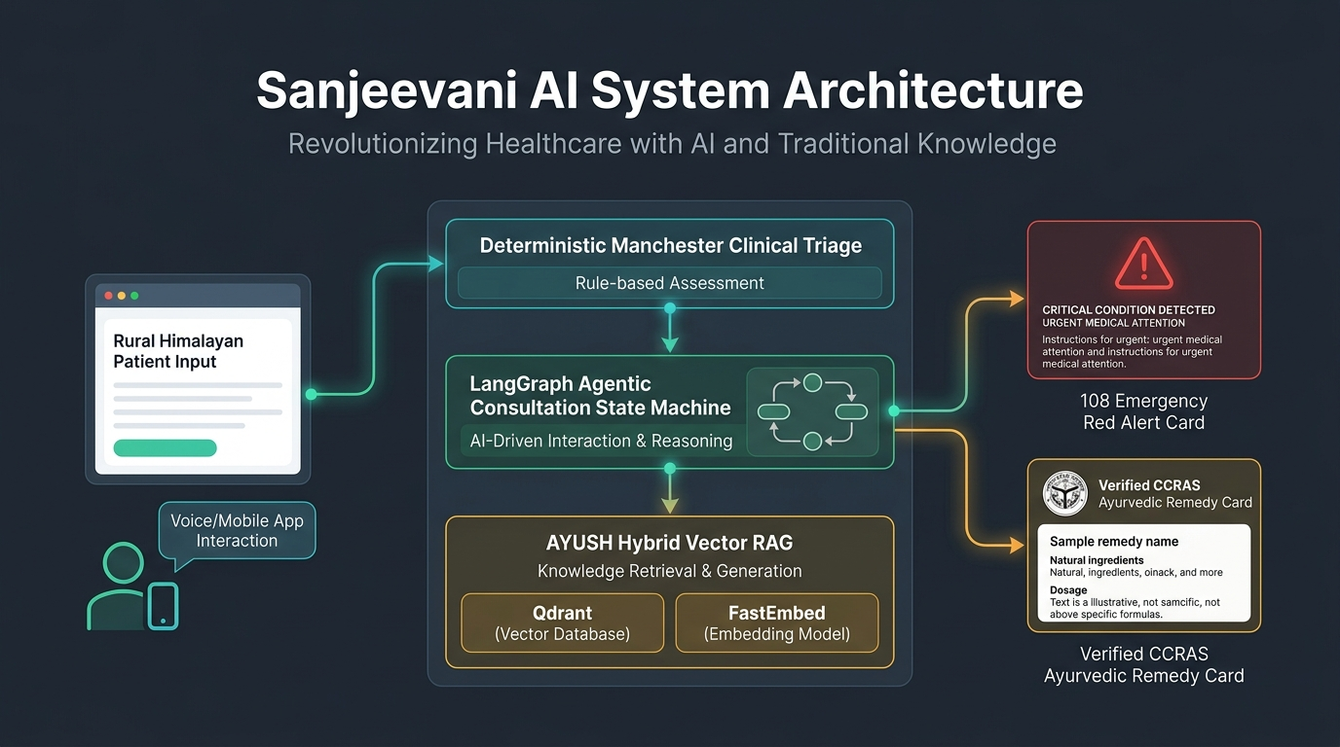
Team
Arogya
TECHNICAL APPROACH & SYSTEM ARCHITECTURE
Tech Stack for Mobile App and Web
Modular, High-Performance Production Stack
• Client Application:
PWA (React 19, Vite, Tailwind v4), Web Audio API, Web Workers, IndexedDB Offline Cache
• Backend API Core:
FastAPI (Async Python 3.13), LangGraph Cyclic Workflow, SQLAlchemy, Uvicorn Daemon
• AI & Speech Engine:
Sarvam AI (Saaras v3 STT & Bulbul v3 TTS), Groq Llama-3.1 70B, Gemini Flash fallback
• Vector Database & RAG:
Qdrant Vector DB (Cloud & Local Disk), FastEmbed dense 384-dim (all-MiniLM-L6-v2)
• Edge CV Pipeline:
OpenCV, NumPy, CIELAB Erythema Index, HSV Sclera masking, Bilateral specular filter
• Persistence & Sync:
SQLite in WAL mode (sessions.db), Dual Checkpointer, HL7 FHIR R4, Zero-PII Audit Log
End-to-End Clinical Dataflow Pipeline
1. Multimodal Input: Patient speaks in Garhwali/Hindi or ASHA uploads camera photo.
2. Deterministic Triage: Manchester Triage (MTS) rules engine parses urgency with negation checking.
3. LangGraph Reasoner: Multi-turn clinical interview executes Socratic intake, differential diagnosis & RAG.
4. Dual Clinical Action: Dispatches 108 Emergency Ambulance SOS OR delivers verified CCRAS prescription.
@Sanjeevani-TeleHealth 3

Slide 4
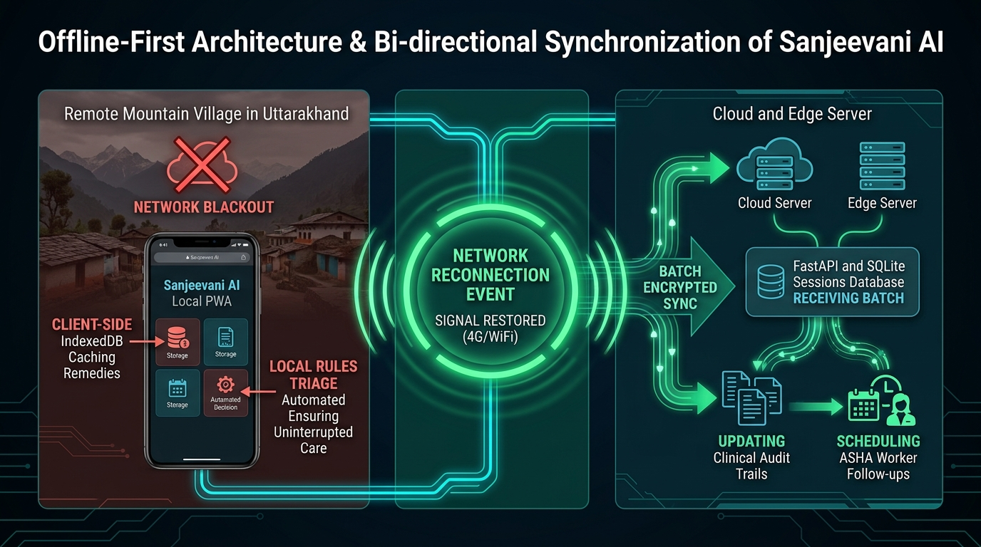
Team
Arogya
FEASIBILITY, VIABILITY & OFFLINE RESILIENCE
Feasibility Across Key Dimensions
• Technical: Lightweight PWA runs smoothly on low-cost 2GB RAM phones; <1.5s voice-to-voice response.
• Operational: Offline-first design, intuitive Devanagari UI & voice prompts require <15 mins ASHA training.
• Economic: Zero capital hardware expense; saves remote families ₹1,200 to ₹3,500 in mountain transit costs.
• Legal/Compliance: Patient consent architecture, Zero-PII analytics logging, and strict clinical disclaimers.
• Market/Value: Directly bridges critical gaps for Ayushman Bharat Digital Mission (ABDM) in mountain states.
Challenges / Risks | Root Cause & Description | Sanjeevani Architectural Mitigation
Network Outages & Landslides | Fiber breaks and zero cellular signal in mountain gorges block cloud LLMs. | Dual-layer offline architecture: Client-side rule MTS triage + IndexedDB sync queue to SQLite WAL.
Dialect & Acoustic Wind Noise | Alpine winds and colloquial Garhwali idioms cause speech transcription errors. | Acoustic noise cancellation filter + specialized Garhwali phonetic lexicon + confirmation chips.
AI Clinical Hallucination Risk | Generative LLMs prescribing unsafe herbs or missing acute cardiac signs. | Deterministic Safety Knowledge Graph blocks toxic herbs; Red flags bypass LLM to trigger 108 SOS.
Himalayan Lighting in CV | High-altitude UV glacier glare or dim stone huts distort camera colors. | Bilateral specular denoising + CLAHE contrast normalization in CIELAB/HSV color spaces.
Low Tech Adoption in Elders | Elderly villagers unable to read screens or navigate complex touch interfaces. | Hands-free conversational voice interface (Sarvam TTS) with respectful village tone ('Dada-ji').
@Sanjeevani-TeleHealth 4

Slide 5
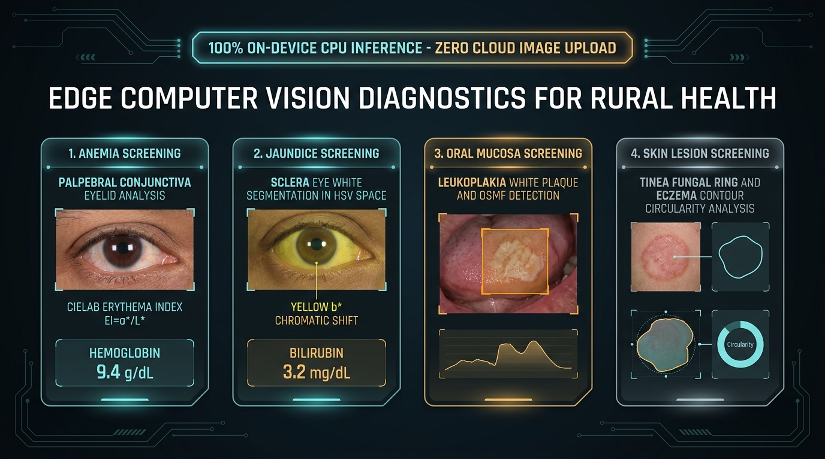
Team
Arogya
IMPACT, CLINICAL BENEFITS & OUTCOMES
Potential Impact on Target Audience
• Mountain Citizens & Remote Villagers:
– Eliminates arduous 15-30 km treks over mountain cliffs for routine minor ailments.
– Guarantees 24/7 clinical emergency assessment in their native mother tongue (Garhwali).
– Reduces average household healthcare travel expenditure by ₹1,200 to ₹3,500 per episode.
• ASHA Workers & Primary Health Centers:
– Equips 1,000+ frontline health workers with non-invasive optical screening for Anemia/Jaundice.
– Generates standardized HL7 FHIR referral cards, eliminating manual record-keeping errors.
– Safely resolves mild routine cases, saving ~35% of PHC medical officer bandwidth.
• District CMOs & State Health Authorities:
– Live geospatial outbreak heatmaps pinpoint waterborne or respiratory clusters before spread.
– Complete auditable chain of custody with Zero-PII compliance for state health monitoring.
Societal & Economic Value
🎯 TARGET OUTCOMES (12-MONTH UTTARAKHAND PILOT)
• 45%+ — Reduction in unnecessary travel for routine non-emergency visits
• < 2s — Emergency Red-tier detection and 108 SOS ambulance dispatch trigger
• 100% — Operational triage availability during monsoon network blackouts
• 50+ — CCRAS validated Ayurvedic remedies with comorbidity safety screening
• Social Equality: Democratizes specialist triage to remote border villages, replacing hazardous folk superstitions with CCRAS-verified AYUSH remedies.
• Healthcare Savings: Early detection of Yellow/Red tier symptoms saves district hospitals up to ₹45 Lakhs annually in preventable emergency room congestion.
@Sanjeevani-TeleHealth 5

Slide 6
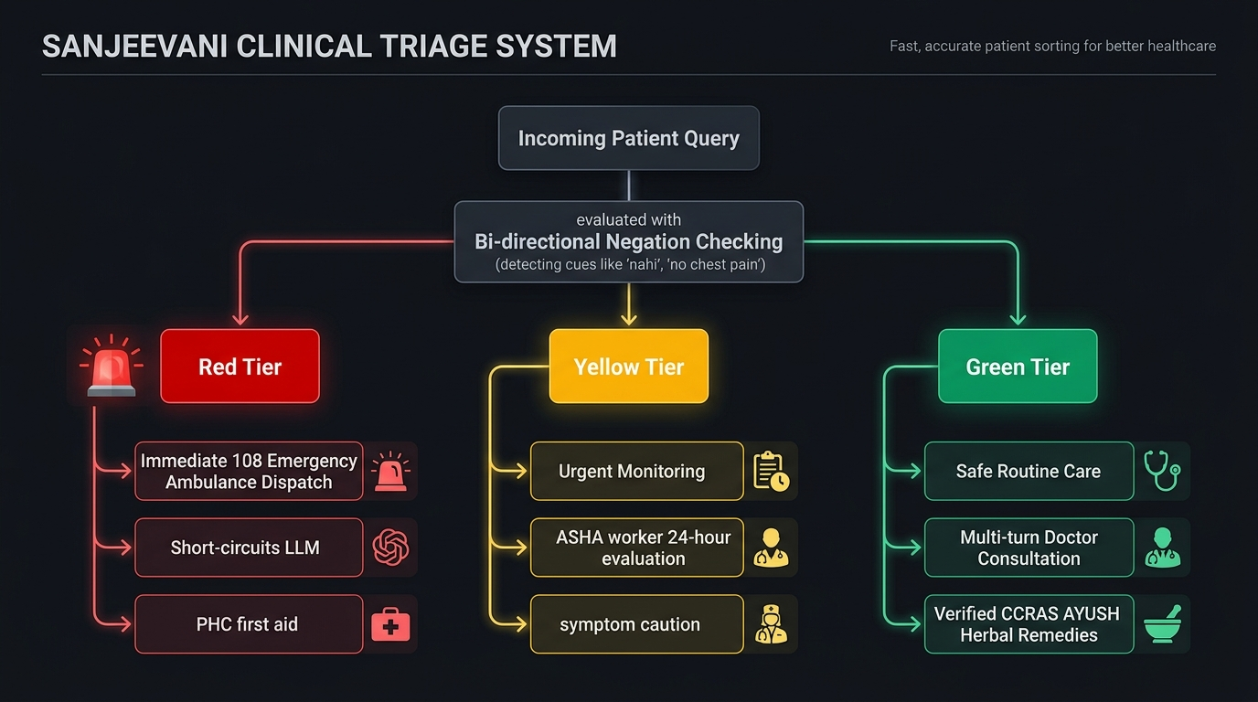
Team
Arogya
RESEARCH, CLINICAL REFERENCES & GOVERNANCE
Peer-Reviewed Biomedical & Algorithmic Foundations
❑ Manchester Triage Group (BMJ Books / Wiley, 2014):
↳ Mackway-Jones et al. Foundational clinical protocol for Sanjeevani's 3-tier deterministic severity scoring (Red / Yellow / Green mapping).
❑ Ministry of Ayush, Govt of India (CCRAS & Pharmacopoeia):
↳ The Ayurvedic Pharmacopoeia of India (API). Clinical dosage, contraindications, and preparation standards for all 50+ classical remedies in Qdrant.
❑ Nature Communications (Mannino et al., 2018):
↳ Smartphone app for non-invasive detection of anemia using optical imaging of palpebral conjunctiva. Underlying biomedical CV basis for Erythema Index (EI = a*/L*).
❑ World Health Organization (WHO Digital Health, 2021):
↳ Recommendations on Digital Interventions for Health System Strengthening. Validates frontline ASHA decision-support and offline-first mobile sync.
❑ National Health Authority (ABDM FHIR Release 4, 2023):
↳ Ayushman Bharat Digital Mission specifications for electronic referral payloads, role-based patient consent, and hospital EHR interoperability.
❑ Sarvam AI & Bhashini Project (MeitY, 2024):
↳ Indic Speech & NLP Technologies for low-resource regional dialects. Benchmarks for Garhwali speech transcription and low-latency Indic acoustic voice synthesis.
Clinical Governance & Ethical Guardrails
• Clinical Decision Support (Not Independent Diagnosis): Sanjeevani is engineered as clinical decision support for ASHAs and citizens, explicitly watermarked with PHC referral instructions.
• Deterministic Pre-LLM Safety Net: Urgency is classified by deterministic rules before any generative model is called, eliminating risk of LLM hallucinatory reassurance in acute crises.
• Data Privacy & Consent: Full compliance with DISHA & Digital Personal Data Protection (DPDP) Act with zero cloud upload of biometric images.
@Sanjeevani-TeleHealth 6

