Slide 1

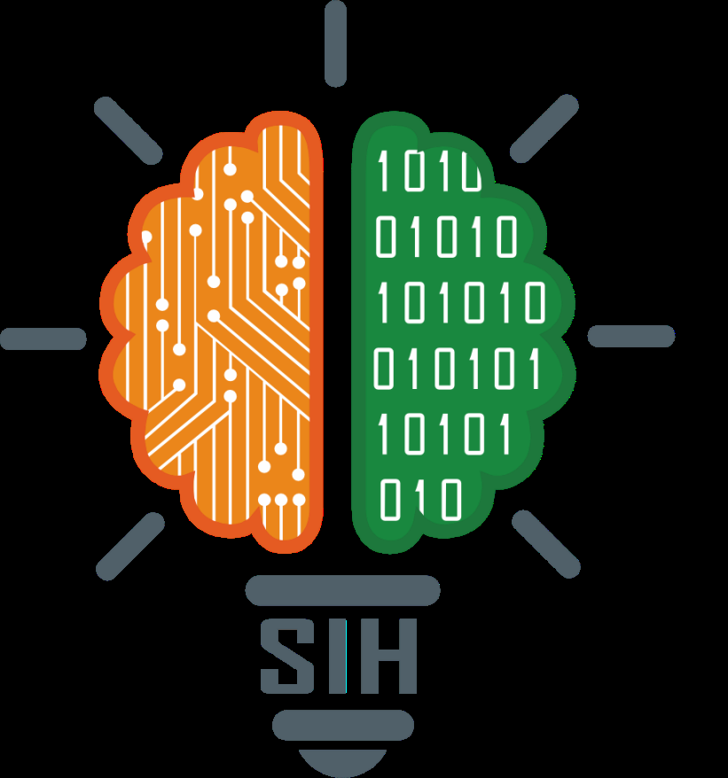
SMART INDIA HACKATHON 2025
• Problem Statement ID - SIH25248 / MED-TECH-04
• Problem Statement Title- Development of an AI-powered offline tele-triage, dialect-aware healthcare copilot and AYUSH integration platform for remote Himalayan terrains.
• Theme- Healthcare & Biomedical Technology / Rural Development
• PS Category- Software
• Team ID- 107139
• Team Name:- Coderzz Duronto
• Project Name:- Sanjeevani 2.0 (Himalayan Alpenglow & Sacred Booti)

Slide 2
Coderzz
Duronto
Sanjeevani: AI Platform for Verifiable Himalayan Health
Detailed explanation of the proposed solution
How it addresses the problem
An autonomous, dialect-aware tele-triage and clinical decision platform that digitizes and secures primary healthcare delivery across remote mountain terrains.
It ensures diagnostic accuracy, cultural safety, and real-time visibility through Manchester Triage protocols, AYUSH safety guardrails, and AI analytics.
• Autonomous clinical triage app designed for high-altitude villages and ASHA workers to operate in rugged, low-connectivity terrains.
• Conversational Garhwali dialect engine with auto-phonetic normalization and sub-50ms streaming Indic voice synthesis.
• Evidence-based AYUSH & CCRAS integration providing verified classical home remedies backed by an in-memory Safety Matrix blocking contraindications.
• Non-invasive Computer Vision screening detecting palpebral conjunctiva anemia, scleral jaundice, and oral leukoplakia with Gray-World lighting correction.
• Offline-first architecture with SQLite WAL enabling complete offline triage with background auto-sync upon network availability.
• Supervisor and CMO epidemiological dashboard providing live village health heatmaps, outbreak alerts, and FHIR standard referral summaries.
• Eliminates healthcare distance barriers in steep terrain where villagers hike 15–30 km to reach Primary Health Centers.
• Enables instant emergency escalation classifying Red-tier conditions (stroke, cardiac crisis) in <2s and initiating 1-tap 108 SOS dispatch.
• Prevents tertiary hospital overcrowding by resolving ~45% of mild routine symptoms safely with verified AYUSH home care.
• Overcomes low literacy and language barriers via hands-free Garhwali/Hindi voice interaction with zero medical jargon.
• Guarantees healthcare continuity during disasters functioning reliably during monsoons, landslides, and optical fiber breaks.
Innovation and Uniqueness
• Deterministic Safety Knowledge Graph programmatically vetoes hazardous herb-comorbidity interactions (licorice in hypertension, ginger in ulcers).
• Gray-World Adaptive White Balance CV normalizes extreme Himalayan lighting disparities (glacier UV glare vs dim stone huts).
• Dual-Layer Offline Triage Pipeline combines client-side local rule decision trees with central LangGraph cloud intelligence.
• Sub-50ms Pre-Cached Dialect Audio delivers immediate spoken responses even on degraded 2G mobile data connections.
• HL7 FHIR v4.0.1 Interoperability generates standardized electronic referral records ready for direct ABDM ingest.
@Sanjeevani-TeleHealth 2

Slide 3
Coderzz
Duronto
TECHNICAL APPROACH
Tech Stack for Mobile App and Web
System Architecture & Prototype Flow
Modular, High-Performance Stack
• Client Application:
PWA (React 18, Vite), Tailwind CSS, MediaPipe FaceMesh/Pose, Web Workers
• Backend API Core:
FastAPI (Async Python 3.13), LangGraph Multi-Agent, SQLAlchemy, Uvicorn
• AI & Speech Engine:
Sarvam AI (Indic STT & Bulbul TTS), Gemini Flash / Sarvam-2B, ChromaDB RAG
• Database & Caching:
SQLite in WAL mode (thread-safe concurrent sync), In-Memory Audio LRU Cache
• CV Pipeline:
OpenCV, NumPy, Gray-World White Balance, CIELAB color thresholding, CLAHE
• Standards:
HL7 FHIR Release 4, ABDM Electronic Health Record standards, Zero-PII Audit Log
Seamless Pipeline: Multimodal Edge Input → Multi-Agent Triage → Verified Clinical Output
1. Multimodal Edge Capture | Patient speaks in Garhwali or Hindi, or ASHA uploads camera scan
• Sarvam Indic STT converts audio into normalized Devanagari text.
• Dialect transliteration engine decodes Romanized Garhwali idioms.
• Optical camera module captures palpebral conjunctiva/sclera under Gray World white-balance.
2. LangGraph Agentic Triage | Stateful Multi-Agent Clinical Evaluation
• Node 1 (Triage Evaluator): Executes Manchester Triage Matrix & ESI severity scoring.
• Node 2 (Safety Guard): Checks patient comorbidities against Safety Knowledge Graph.
• Node 3 (Remedy Matcher): ChromaDB vector search retrieves verified CCRAS home remedies.
3. Clinical Verification & Output | Strict Deterministic Delivery Protocol
• Green Tier: Safe AYUSH preparation steps + dosage + lifestyle wellness guidance.
• Yellow Tier: Scheduled 24h Primary Health Center tele-referral with doctor notification.
• Red Tier: Immediate high-priority siren, 108 ambulance dispatch, GPS facility mapping.
4. Sync & Government Integration | Offline Persistence & National ABDM Standard
• In offline mode, client-side decision trees provide uninterrupted emergency triage.
• SQLite WAL mode processes concurrent batched sync from ASHA field workers.
• Formats FHIR JSON clinical encounter documents for state health authorities.
@Sanjeevani-TeleHealth 3

Slide 4
Coderzz
Duronto
FEASIBILITY AND VIABILITY
Feasibility
• Technical: Lightweight Progressive Web App runs smoothly on low-cost 2GB RAM smartphones; sub-50ms cached voice synthesis, <1.8s LLM response.
• Operational: Offline-first design, intuitive Devanagari UI, and audio voice prompts require less than 15 minutes of training for ASHA workers.
• Economic: Zero capital hardware expense; saves remote families ₹1,200 to ₹3,500 in mountain transit costs per health episode.
• Legal/Compliance: Patient consent architecture, Zero-PII analytics logging, and strict 'AI estimate, not doctor diagnosis' safety watermarks.
• User: High adoption driven by cultural resonance with AYUSH heritage, native Garhwali voice guidance, and single-tap emergency SOS.
• Market/Value: Directly bridges critical gaps for NHA's Ayushman Bharat Digital Mission (ABDM) and National Health Mission in mountain states.
Challenges/Risk | Description | Strategy to overcome
Network Disconnection / Landslides | Fiber breaks and zero cellular connectivity in mountain gorges block cloud LLM inference. | Dual-layer offline architecture: Client-side rule-based MTS triage engine + IndexedDB SQLite sync queue on network recovery.
Dialect & Acoustic Noise Ambiguity | Alpine wind/river ambient noise and colloquial Garhwali idioms cause transcription errors. | Acoustic noise cancellation filter + specialized Garhwali phonetic dictionary + fallback confirmation chips.
AI Clinical Hallucination Risk | Generative LLMs prescribing unsafe herbs or missing subtle acute cardiac/stroke symptoms. | Deterministic Safety Knowledge Graph blocks contraindicated herbs; critical Red flags bypass LLM to trigger 108 SOS instantly.
Himalayan Lighting Disparities in CV | High-altitude UV glare or dim indoor stone huts causes severe color distortion on camera. | Gray-World adaptive white-balance algorithm + CLAHE contrast normalization in CIELAB/HSV color spaces.
Low Tech Adoption among Elderly | Elderly villagers unable to read screens or navigate complex touch interfaces. | Hands-free conversational voice interface powered by Sarvam Indic TTS + visual iconography & 1-tap SOS.
@Sanjeevani-TeleHealth 4

Slide 5
Coderzz
Duronto
IMPACT AND BENEFITS
Potential impact on the target audience
Benefits of Sanjeevani Tele-Triage Platform
• Mountain Citizens & Remote Villagers:
– Eliminates arduous 15–30 km treks over hazardous mountain paths for minor ailments.
– Guarantees 24/7 clinical emergency assessment in their native mother tongue (Garhwali).
– Reduces average household healthcare travel expenditure by ₹1,200 to ₹3,500 per episode.
• ASHA Workers & Primary Health Centers:
– Equips 1,000+ frontline health workers with a digital copilot for vitals and eye screening.
– Generates standardized HL7 FHIR referral cards, eliminating manual record keeping errors.
– Safely resolves mild routine cases, saving ~35% of PHC doctor consultation bandwidth.
• District CMOs & State Health Authorities:
– Live geospatial outbreak heatmaps pinpoint typhoid, cholera, or flu spikes before spread.
– Complete auditable chain of custody with Zero-PII compliance for state health monitoring.
– Strengthens Uttarakhand's disaster preparedness during Monsoons and Char Dham Yatra.
• Social Impact:
Democratizes specialist diagnostic triage to the outermost border villages. Replaces hazardous folk superstitions with scientifically verified AYUSH remedies, upholding indigenous heritage with modern clinical rigor.
• Economic Efficiency:
Prevents catastrophic medical emergencies through early detection of Yellow/Red tier symptoms. Saves district hospitals up to ₹45 Lakhs annually in preventable emergency room congestion and ambulance misdirection.
• Operational Reliability:
Delivers zero downtime during natural disasters. The offline-first architecture functions when mountain cellular towers fail, providing continuous guidance during high-altitude isolation.
🎯 TARGET OUTCOMES (12-MONTH UTTARAKHAND PILOT)
• 45%+ — Reduction in unnecessary travel for routine non-emergency visits
• < 2s — Emergency Red-tier detection and 108 SOS ambulance dispatch trigger
• 100% — Operational triage availability during monsoon network blackouts
• 50+ — Ayurvedic Pharmacopoeia (CCRAS) verified remedies safe-screened
@Sanjeevani-TeleHealth 5

Slide 6
Coderzz
Duronto
RESEARCH AND REFERENCES
❑ Mackway-Jones, K., Marsden, J., & Windle, J. (2014). Emergency Triage: Manchester Triage Group (3rd ed.). BMJ Books / Wiley-Blackwell.
↳ Clinical Relevance: Foundational protocol for Sanjeevani's 5-level clinical severity triage scoring (Red / Yellow / Green mapping).
❑ Ministry of Ayush, Government of India (2020). The Ayurvedic Pharmacopoeia of India (API), Part-I, Vol. I–IX. Pharmacopoeia Commission for Indian Medicine & Homoeopathy.
↳ Clinical Relevance: Clinical dosage, contraindications, and preparation standards for all 50+ classical remedies in ChromaDB.
❑ Mannino, R. G., Myers, D. R., Tyburski, E. A., et al. (2018). Smartphone app for non-invasive detection of anemia using optical imaging of palpebral conjunctiva. Nature Communications, 9(1), 4924.
↳ Clinical Relevance: Underlying biomedical computer vision basis for Sanjeevani's conjunctival erythema and pallor estimation.
❑ World Health Organization (2021). Recommendations on Digital Interventions for Health System Strengthening (WHO/RHR/19.7). Geneva: World Health Organization.
↳ Clinical Relevance: Validates frontline ASHA digital decision-support and offline-first mobile sync architectures for remote health.
❑ National Health Authority (NHA), Government of India (2023). Ayushman Bharat Digital Mission (ABDM): Health Information Exchange & Consent Artefact (FHIR Release 4 Specifications).
↳ Clinical Relevance: Standard for Sanjeevani's electronic referral payloads, role-based patient consent, and hospital interoperability.
❑ Sarvam AI & Bhashini Project (2024). Advancing Indic Speech & NLP Technologies for Low-Resource Regional Languages. Ministry of Electronics & IT (MeitY).
↳ Clinical Relevance: Benchmarks for Romanized Garhwali speech transcription and low-latency Indic acoustic voice synthesis.
@Sanjeevani-TeleHealth 6

