Slide 1
Job Market Analysis Project
Project ID :- PTID-CDA-APR-25-418
📘 Report:
This Job Market Analysis report is designed to provide a comprehensive overview of the current employment landscape, using real-time data visualized through Power BI. The objective is to uncover meaningful insights into the demand for job roles, industry-wise opportunities, salary trends, educational preferences, and regional job distribution.
Your aim of this project is to analyze the job market trends for positionsby analyzing job data which includes 742 rows and 42 features like Jobtitle, Salary Estimate, Job Description, Rating, Company, Location,Company, Headquarters and many more acquired from various sources.Your goal is to identify the most in-demand skills, qualifications, jobresponsibilities and provide insights that can inform job seekers andemployers.

Slide 2
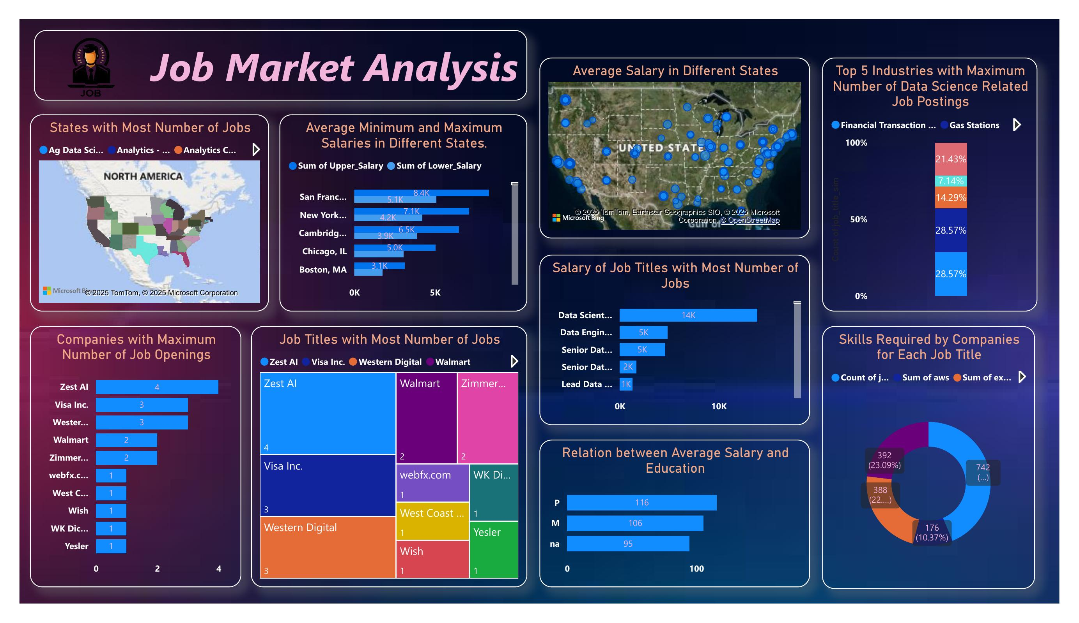
:DashBoard:

Slide 3
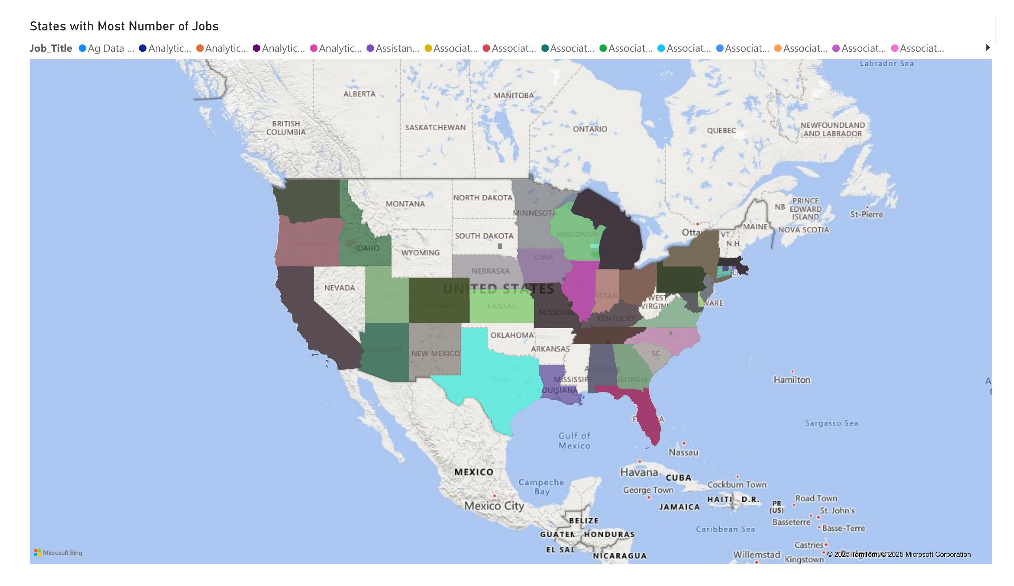
States with Most Number of Jobs :
Description:
A bar chart showing the number of job openings in different states or cities in the U.S.
Top Locations:
San Francisco, CA – 8.4K jobs
New York, NY – 7.1K jobs
Cambridge, MA – 6.5K jobs
Chicago, IL – 5.0K jobs
Boston, MA – 3.1K jobs
Insight: California, especially San Francisco, is the top location for data-related jobs, followed by New York and Massachusetts.

Slide 4
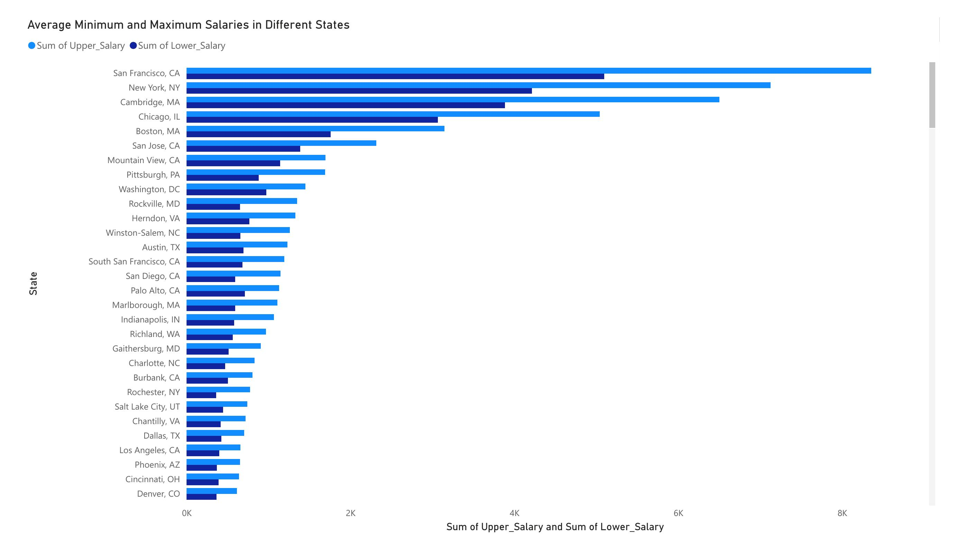
Average Minimum and Maximum Salaries by State :
Description:
A bar chart comparing lower and upper salary ranges for jobs across various states.
Example Data:
San Francisco, CA: High upper and lower salary values
New York, NY: Slightly lower than SF
San Jose, CA, Boston, MA: Close third and fourth
Insight: California cities offer the highest salary ranges, making them attractive for high-skilled professionals.

Slide 5
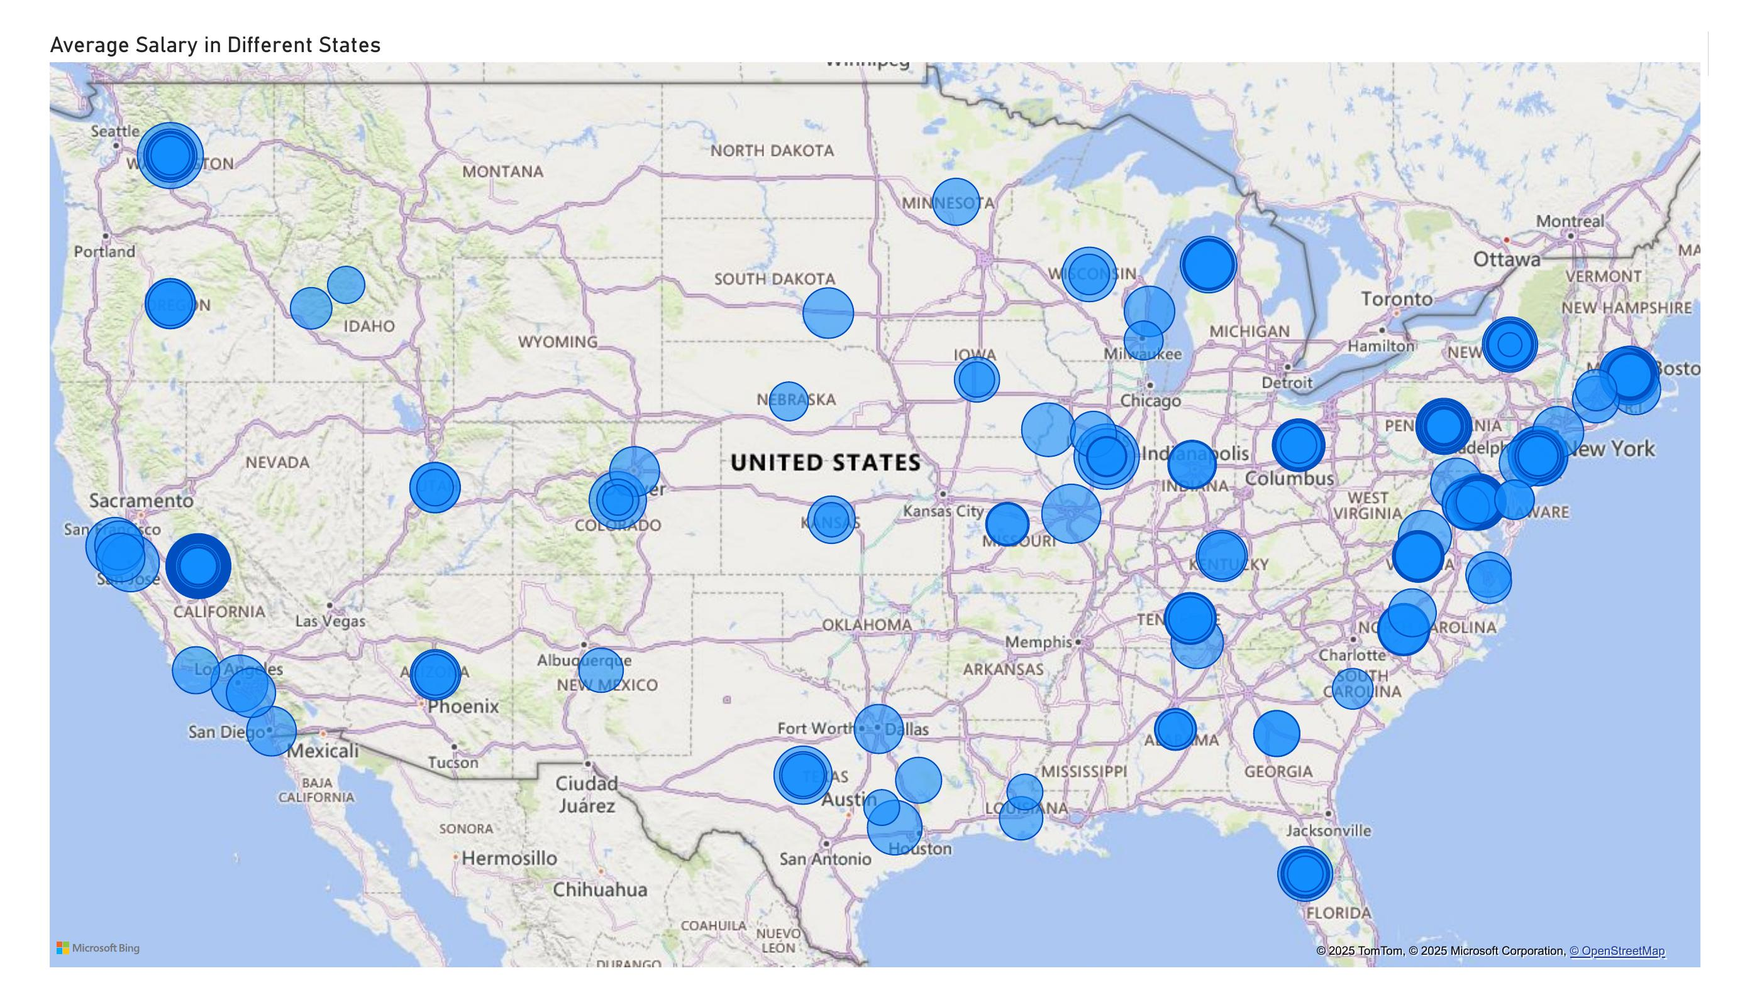
Average Salary in Different States :
Description:
Map visualization showing salary averages across states.
Insight:
Western and Northeastern U.S. states show higher average salaries, while interior and southern regions show relatively moderate pay.

Slide 6
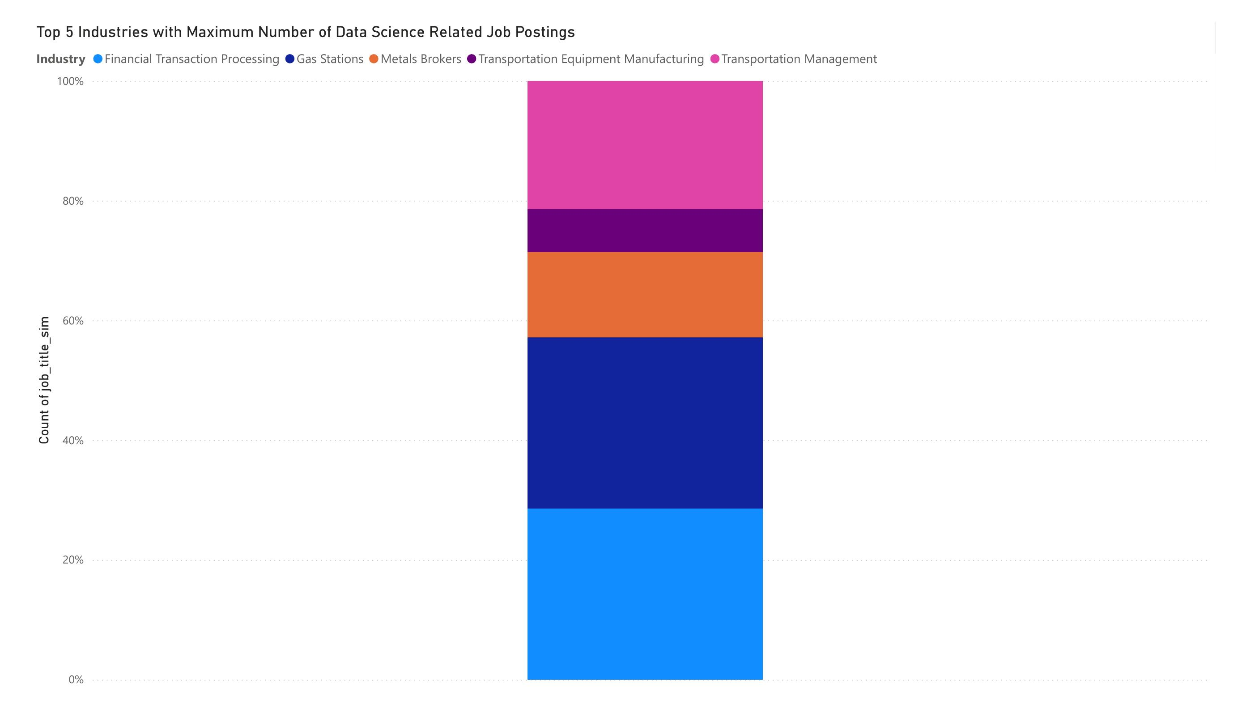
Top 5 Industries with Most Job Postings :
Description:
Horizontal bar chart showing industry-wise job count.
Top 5 Industries:
1. Financial Transaction Processing 2. Gas Stations 3. Metals Brokers 4. Transportation Equipment Manufacturing 5. Transportation Management
Insight:
There’s a surprising presence of data jobs even in non-traditional tech sectors like gas stations and metal brokerage.
21.43%
7.14%
14.29%
28.57%
28.57%

Slide 7
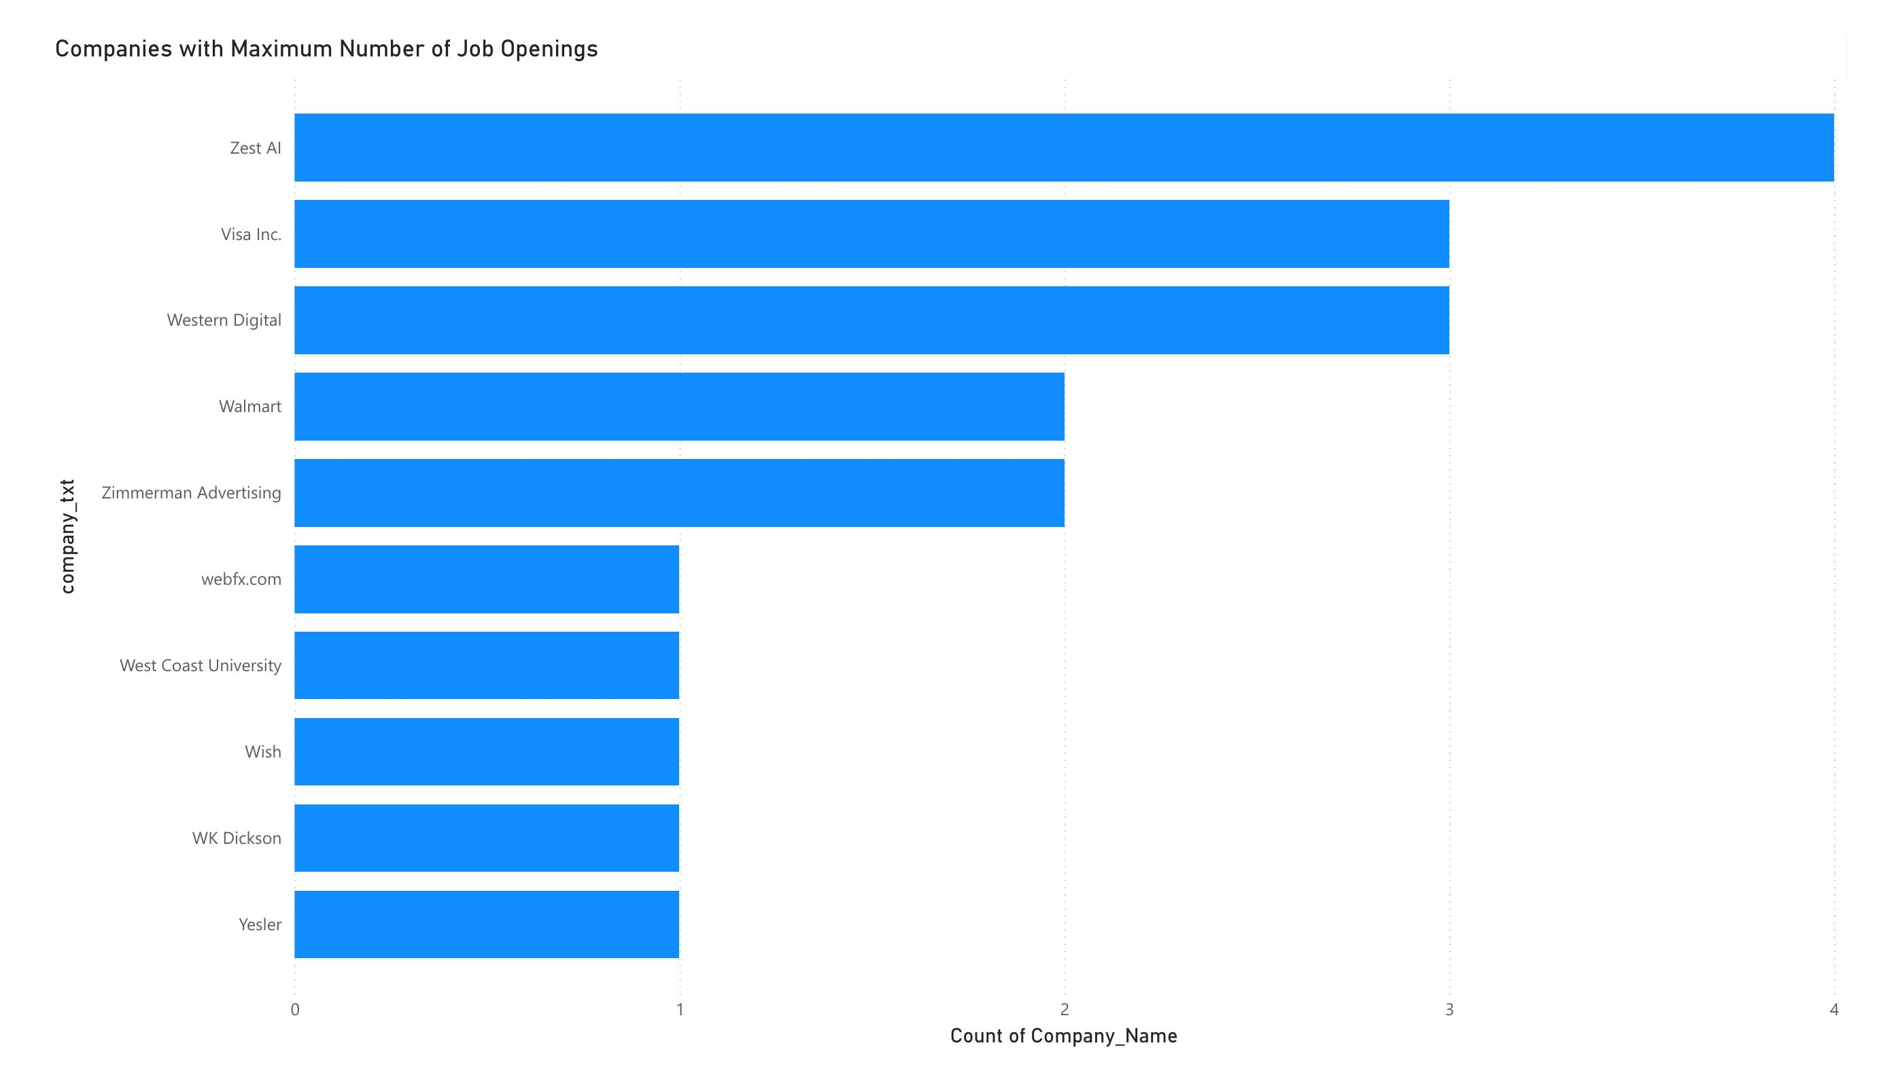
Companies with Most Job Openings :
Description:
Bar chart listing top companies hiring.
Top Companies:
Zest AI- Visa Inc
- Western Digital
- Walmart
Zimmerman Advertising
Insight:
Tech and financial companies dominate hiring, but there are also opportunities in retail and media.
4
3
3
2
2
1
1
1
1
1

Slide 8
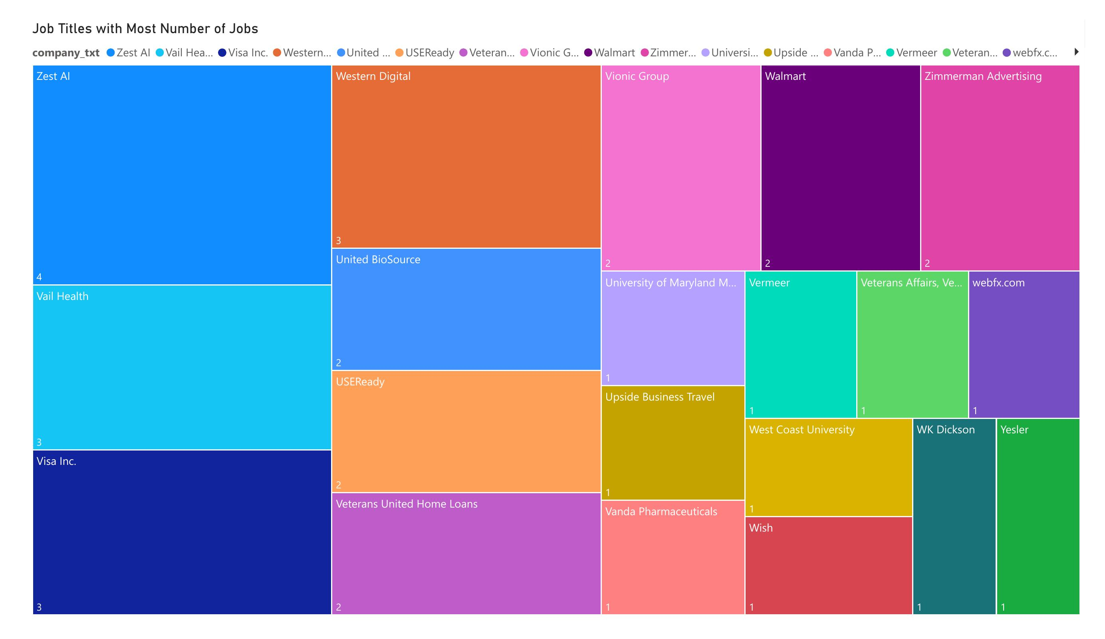
Job Titles with Most Job Postings :
Description:
Bar chart showing the most common job titles in the data field.
Top Roles:
Data Scientist
Data Engineer
Senior Data Scientist
- Senior Data Engineer
Lead Data Scientist
Insight:
Data Scientist and related roles are in high demand across different experience levels.

Slide 9
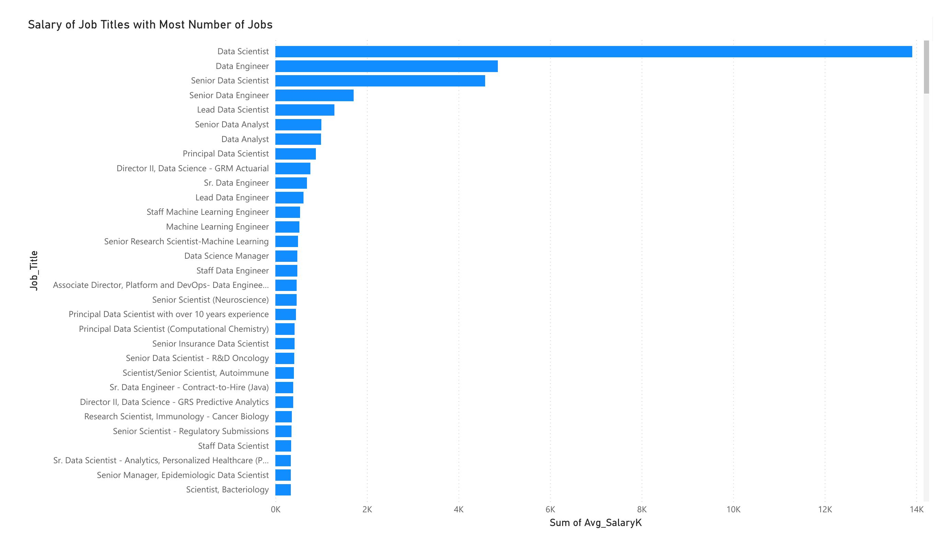
Salary of Job Titles with Most Jobs :
Description:
Bar chart showing salary averages for various job titles.
Top-Paying Roles:
Lead Data Scientist
Principal Data Scientist
Director
level roles
Staff Machine Learning Engineer
Insight:
Leadership and specialized roles like Machine Learning Engineers command the highest salaries.

Slide 10
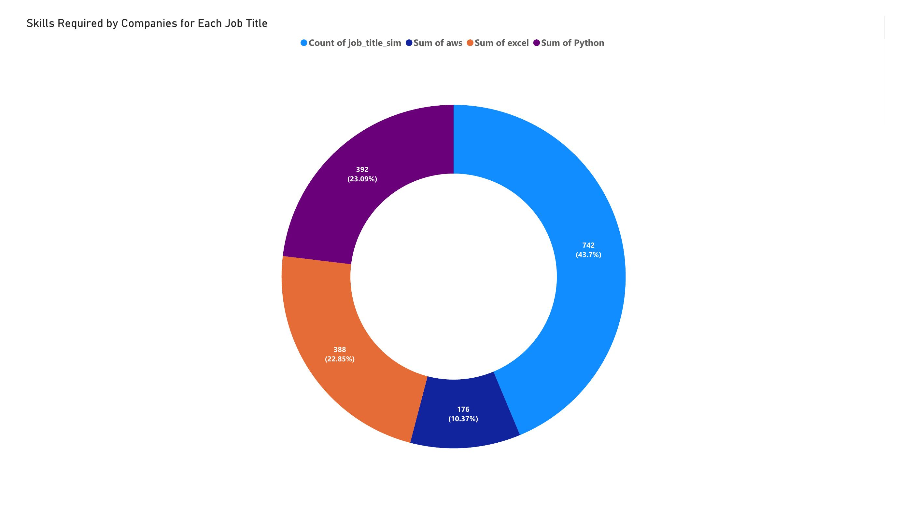
Skills Required by Companies :
Description:
Bar chart of job postings vs specific skills.
Top Skills: 1. Python (23.09%) 2. Excel (22.85%) 3. AWS (10.37%) 4. General data tools
Insight:
Python and Excel remain essential. AWS knowledge boosts employability in data roles.

Slide 11
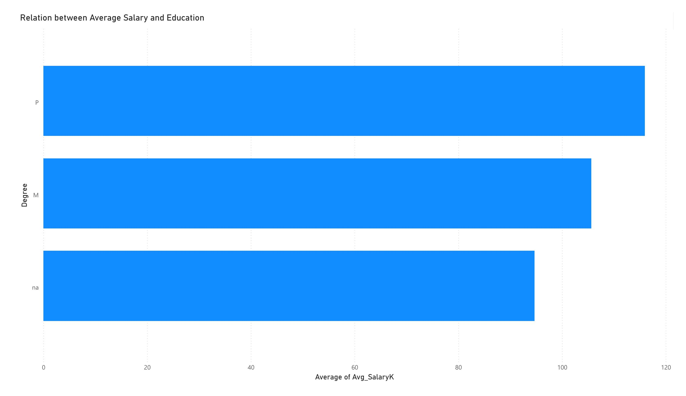
Average Salary by Education Level :
Description:
Bar chart comparing education level (PhD, Master's, etc.) with average salary.Insight:
PhDs earn the highest average salaries.
Master’s degree holders also earn well.
There’s a clear salary progression with higher education.
116
106
95

Slide 12
Conclusion :
This Job Market Analysis provides a comprehensive view of the evolving employment landscape, with a focus on data-related roles across industries and regions. The insights gathered from the Power BI dashboard highlight key trends in job availability, salary ranges, in-demand skills, and educational expectations.
The data clearly shows that:
- Data science and analytics roles are at the forefront of job market demand.
- Geographic regions like San Francisco, New York, and Cambridge lead in job opportunities and salary offerings.
- Technical skills such as Python, Excel, and cloud platforms are crucial for employability.
- Higher educational qualifications correlate with higher average salaries.
By aligning hiring strategies, skills training, and compensation structures with these insights, organizations and individuals can make informed decisions that support growth, efficiency, and long-term success.

