Slide 1
Medical Data SQL Queries
A compilation of SQL commands for patient data analysis
Presented By :- Nakul Saxena

Slide 2
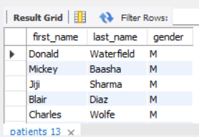
Query 1
SELECT first_name, last_name, gender FROM patients WHERE gender = 'M';

Slide 3
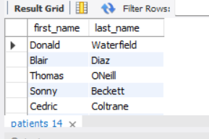
Query 2
SELECT first_name, last_name FROM patients WHERE allergies IS NULL;

Slide 4
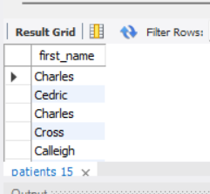
Query 3
SELECT first_name FROM patients WHERE first_name LIKE 'C%';

Slide 5
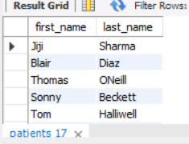
Query 4
SELECT first_name, last_name FROM patients WHERE weight BETWEEN 100 AND 120;

Slide 6
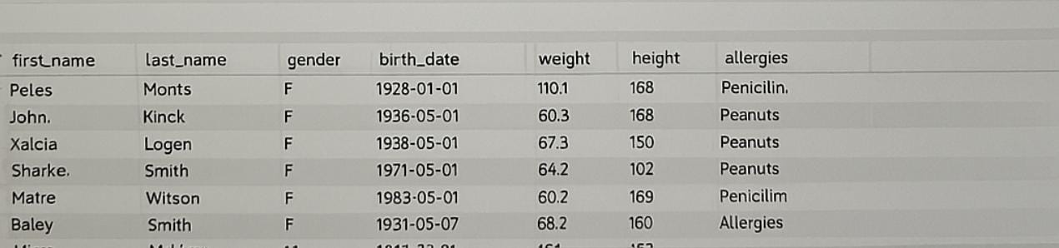
Query 5
UPDATE patients SET allergies = 'NKA' WHERE allergies IS NULL;

Slide 7
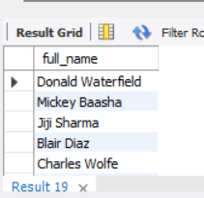
Query 6
SELECT CONCAT(first_name, ' ', last_name) AS full_name FROM patients;

Slide 8
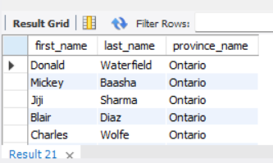
Query 7
SELECT p.first_name, p.last_name, prov.province_name FROM patients p JOIN province prov ON p.province_id = prov.province_id;

Slide 9
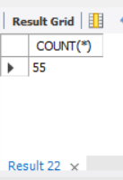
Query 8
SELECT COUNT(*) FROM patients WHERE YEAR(birth_date) = 2010;

Slide 10
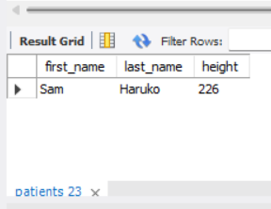
Query 9
SELECT first_name, last_name, height FROM patients ORDER BY height DESC LIMIT 1;

Slide 11
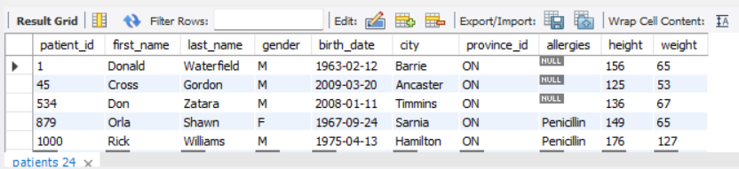
Query 10
SELECT * FROM patients WHERE patient_id IN (1, 45, 534, 879, 1000);

Slide 12
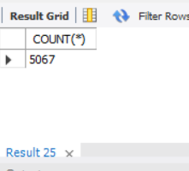
Query 11
SELECT COUNT(*) FROM admissions;

Slide 13
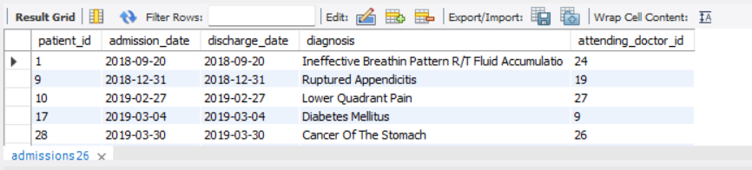
Query 12
SELECT * FROM admissions WHERE admission_date = discharge_date;

Slide 14
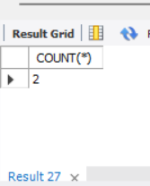
Query 13
SELECT COUNT(*) FROM admissions WHERE patient_id = 579;

Slide 15
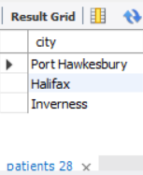
Query 14
SELECT DISTINCT city FROM patients WHERE province_id = 'NS';

Slide 16
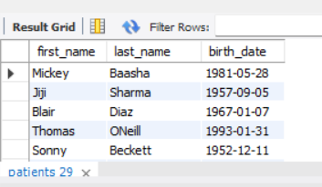
Query 15
SELECT first_name, last_name, birth_date FROM patients WHERE height > 160 AND weight > 70;

Slide 17
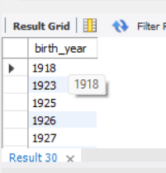
Query 16
SELECT DISTINCT YEAR(birth_date) AS birth_year FROM patients ORDER BY birth_year ASC;

Slide 18
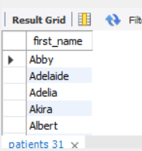
Query 17
SELECT first_name FROM patients GROUP BY first_name HAVING COUNT(*) = 1;

Slide 19
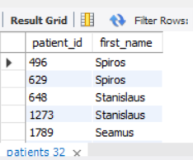
Query 18
SELECT patient_id, first_name FROM patients WHERE first_name LIKE 's%s' AND LENGTH(first_name) >= 6;

Slide 20
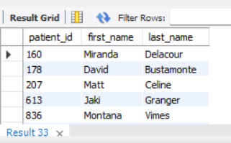
Query 19
SELECT p.patient_id, p.first_name, p.last_name FROM patients p JOIN admissions a ON p.patient_id = a.patient_id WHERE a.diagnosis = 'Dementia';

Slide 21
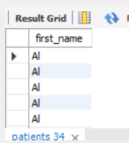
Query 20
SELECT first_name FROM patients ORDER BY LENGTH(first_name), first_name;

Slide 22
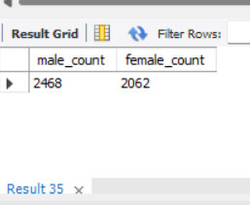
Query 21
SELECT COUNT(CASE WHEN gender = 'M' THEN 1 END) AS male_count, COUNT(CASE WHEN gender = 'F' THEN 1 END) AS female_count FROM patients;

Slide 23
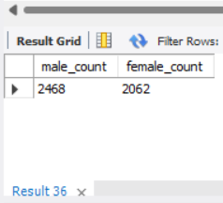
Query 22
SELECT COUNT(CASE WHEN gender = 'M' THEN 1 END) AS male_count, COUNT(CASE WHEN gender = 'F' THEN 1 END) AS female_count FROM patients;

Slide 24
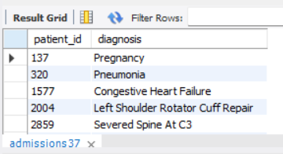
Query 23
SELECT patient_id, diagnosis FROM admissions GROUP BY patient_id, diagnosis HAVING COUNT(*) > 1;

Slide 25
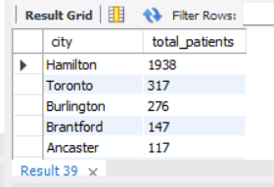
Query 24
SELECT city, COUNT(*) AS total_patients FROM patients GROUP BY city ORDER BY total_patients DESC, city ASC;

Slide 26
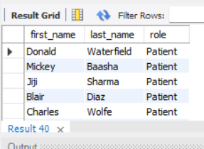
Query 25
SELECT first_name, last_name, 'Patient' AS role FROM patients UNION SELECT first_name, last_name, 'Doctor' AS role FROM doctors;

Slide 27
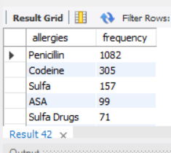
Query 26
SELECT allergies, COUNT(*) AS frequency FROM patients WHERE allergies IS NOT NULL GROUP BY allergies ORDER BY frequency DESC;

Slide 28
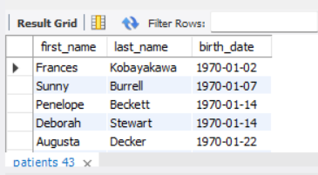
Query 27
SELECT first_name, last_name, birth_date FROM patients WHERE YEAR(birth_date) BETWEEN 1970 AND 1979 ORDER BY birth_date ASC;

Slide 29
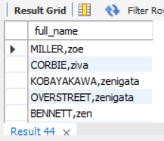
Query 28
SELECT CONCAT(UPPER(last_name), ',', LOWER(first_name)) AS full_name FROM patients ORDER BY LOWER(first_name) DESC;

Slide 30
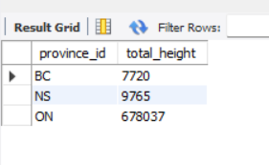
Query 29
SELECT province_id, SUM(height) AS total_height FROM patients GROUP BY province_id HAVING SUM(height) >= 7000;

Slide 31
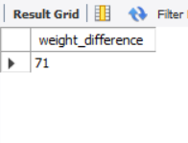
Query 30
SELECT MAX(weight) - MIN(weight) AS weight_difference FROM patients WHERE last_name = 'Maroni';

Slide 32
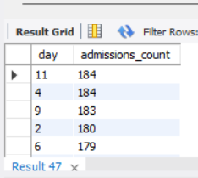
Query 31
SELECT DAY(admission_date) AS day, COUNT(*) AS admissions_count FROM admissions GROUP BY DAY(admission_date) ORDER BY admissions_count DESC;

Slide 33
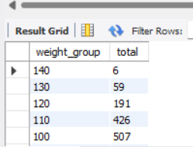
Query 32
SELECT FLOOR(weight / 10) * 10 AS weight_group, COUNT(*) AS total FROM patients GROUP BY weight_group ORDER BY weight_group DESC;

Slide 34
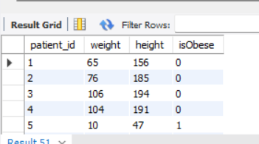
Query 33
SELECT patient_id, weight, height, CASE WHEN (weight / POWER(height / 100.0, 2)) >= 30 THEN 1 ELSE 0 END AS isObese FROM patients;

Slide 35
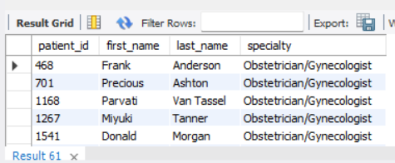
Query 34
SELECT p.patient_id, p.first_name, p.last_name, d.specialty FROM patients p JOIN admissions a ON p.patient_id = a.patient_id JOIN doctors d ON a.doctor_id = d.doctor_id WHERE a.diagnosis = 'Epilepsy' AND d.first_name = 'Lisa';

Slide 36
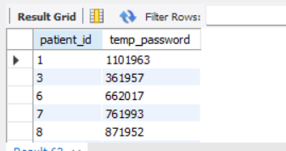
Query 35
SELECT p.patient_id, CONCAT(p.patient_id, LENGTH(p.last_name), YEAR(p.birth_date)) AS temp_password FROM patients p JOIN admissions a ON p.patient_id = a.patient_id GROUP BY p.patient_id, p.last_name, p.birth_date;

