Slide 1

Data Glacier Healthcare Project
Nayanika
Sachin Subramanian
Nishi

Slide 2

OBjective
One of the challenge for all Pharmaceutical companies is to understand the persistency of drug as per the physician prescription. To solve this problem ABC pharma company approached an analytics company to automate this process of identification.

Slide 3

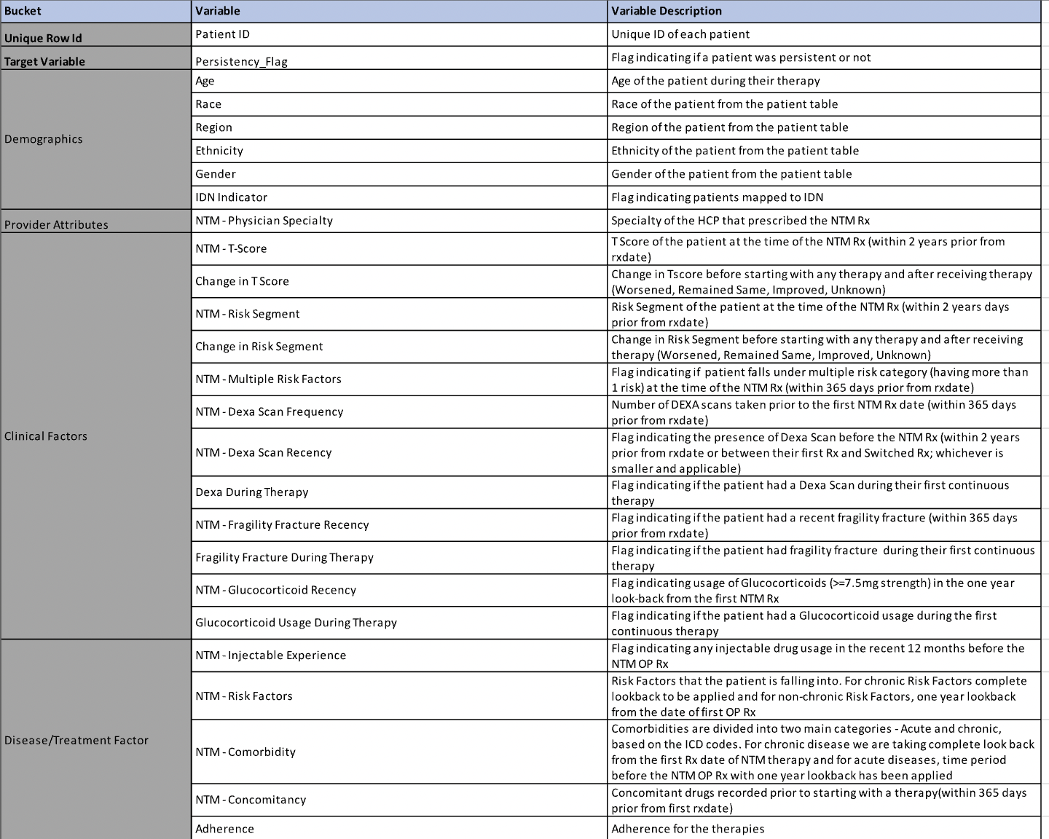
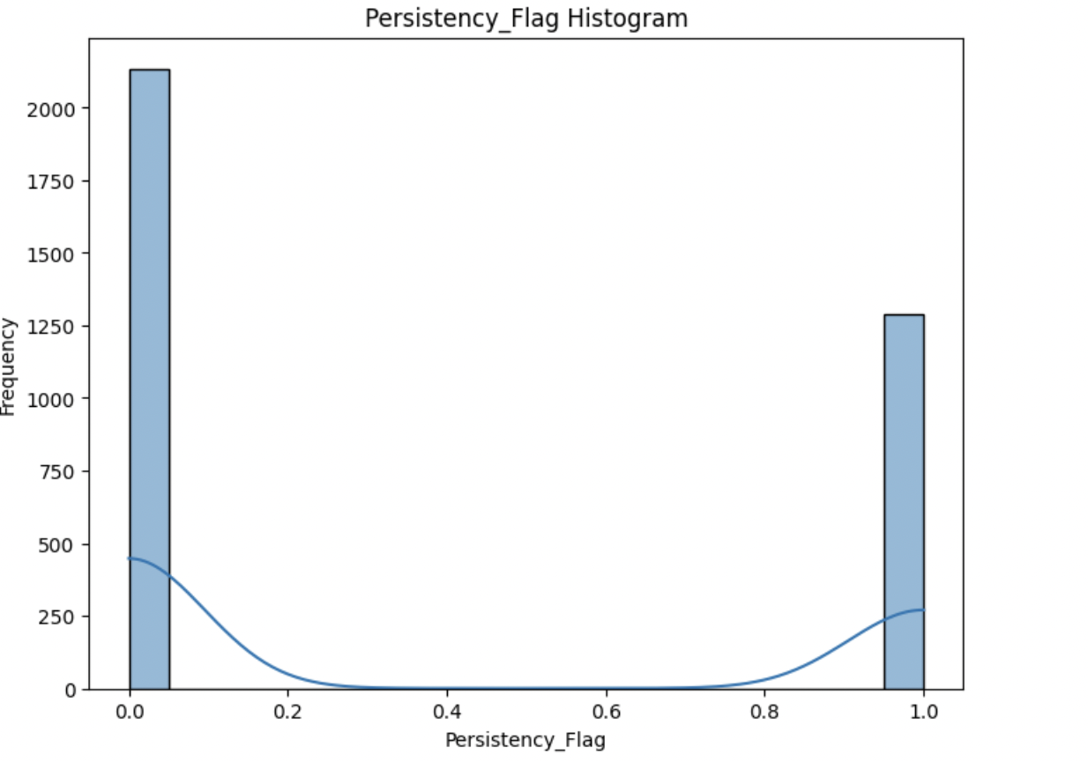
Dataset + EDA
Variables located on right
Target variable: persistency_flag
With EDA: Dexa_Freq_During_Rx Count_Of_Risks included for analysis

Slide 4
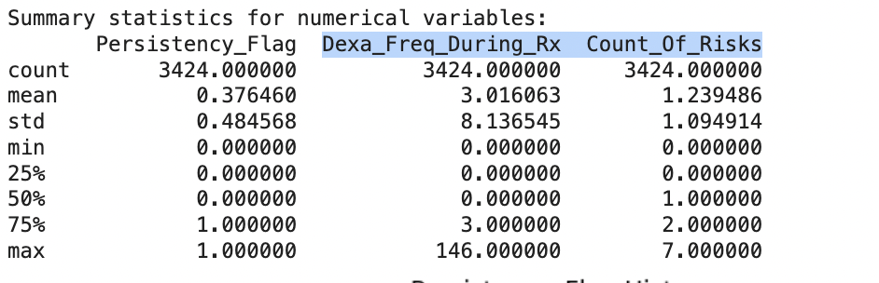
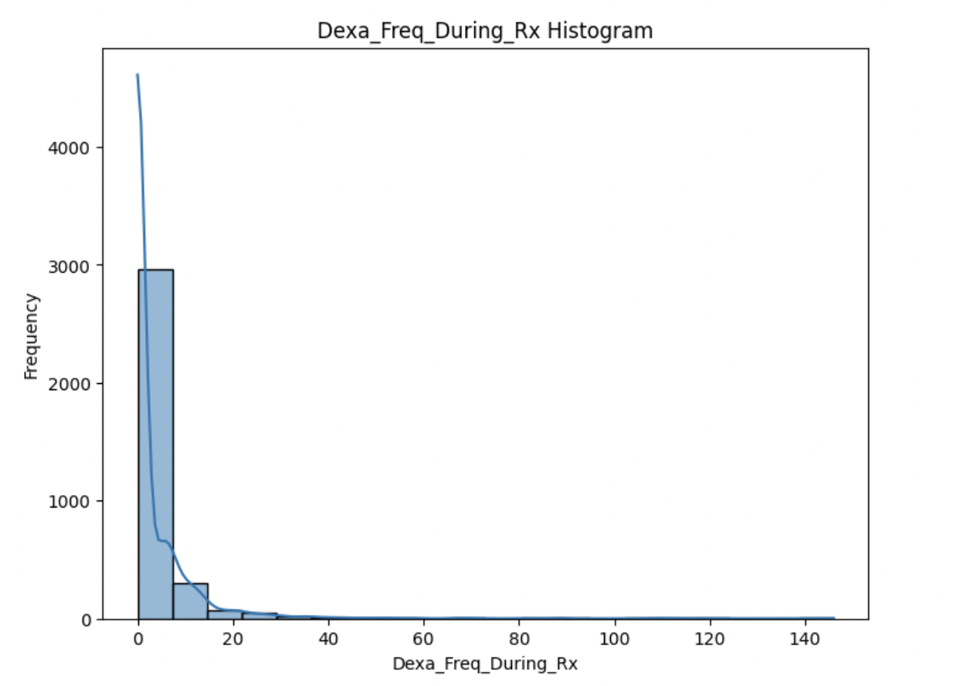
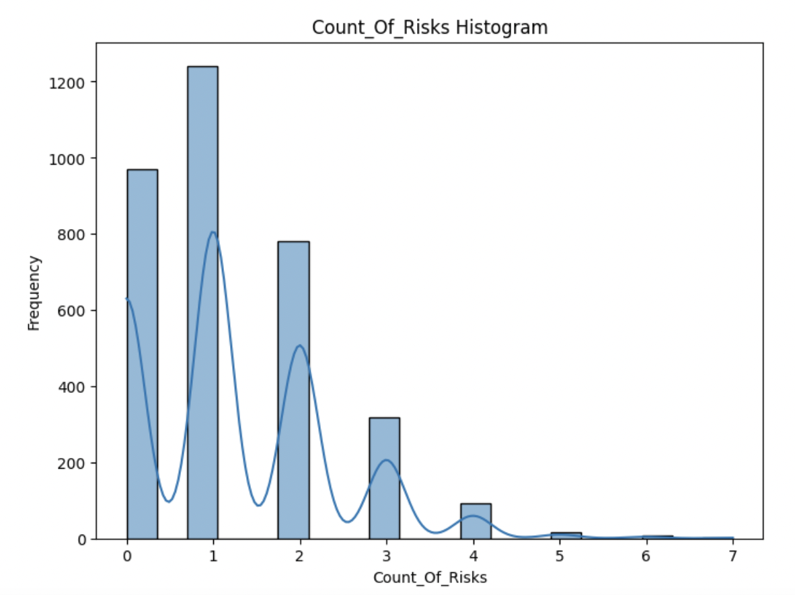
Continuation
Variables located on right
Target variable: persistency_flag
With EDA: Dexa_Freq_During_Rx Count_Of_Risks included for analysis

Slide 5
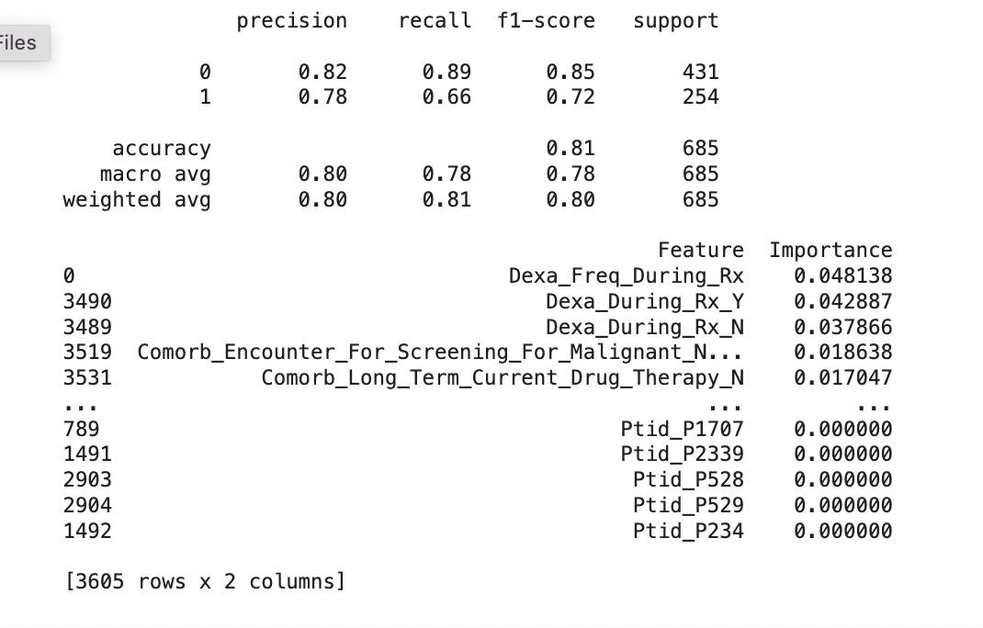
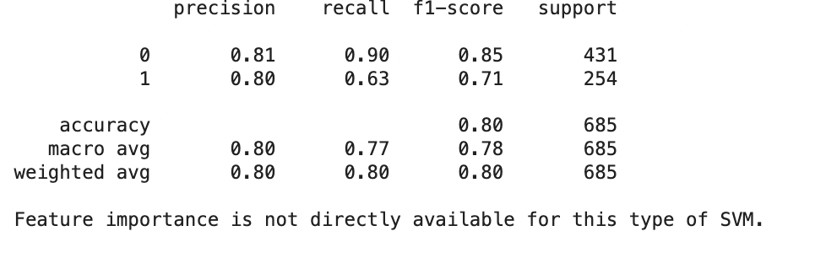
ClassificAtion Model
CUSTOMER SEGMENTATION
Random Forest vs SVM

Slide 6

Conclusions
Random Forest has higher precision and recall for Class 1, indicating it performs better at identifying instances of Class 1.
SVM has slightly higher precision for Class 0, but Random Forest has higher recall for Class 0
Both models perform quite similarly in terms of overall accuracy, with Random Forest slightly edging out SVM (81% vs. 80%)

Slide 7

Thank you

