Slide 1
GUIDED BY- PROF. Dharmadhikari sir
ALL TERRAIN VEHICLE WITH INDEPENDENT SUSPENSION SYSTEM

Slide 2
Group Members:
SR NO. | STUDENT NAME | ROLL NO.
1 | Sachin Tandale | ME3439
2 | Chaitanya kale | ME3440
3 | Shaunak Samudra | ME3441

Slide 3
INTRODUCTION:
The independent Suspension System Combines a differential mechanism and an oscillating system to provide more stability.
Suspension systems must support both road holding/handling and ride quality, which are at odds with each other.

Slide 4
OBJECTIVES:
OBJECTIVES
To design obstacles crossing vehicle using minimum linkages
To design vehicle's suspension without using any spring.
To design vehicle which is well suited for multi purpose applications.
To design vehicle with high rolling & pitching stability.

Slide 5
Problem statement
To identify engineering problems in industry.
Solutions
To find out the solution for problem we found
To generate 3D cad modelwith appropriate dimensions.
DESIGN

Slide 6
Problems:
The vehicle with only ternary link is insufficient of overcoming an obstacle having height more than its wheel.
So to overcome this problem if the ternary link is broken down into a binary link, it will reduce the strength of the vehicle.
In some conditions this mechanism may also lead in breakdown of the vehicle.
Thus a mechanism which will overcome this problem is to be designed

Slide 7
Solution:
The ternary link on each side is now provided with the a additional support link.
The support link is used to overcome larger obstacles with a small radius wheel.
The additional link also useful in providing extra traction/grip against the surface while climbing.

Slide 8
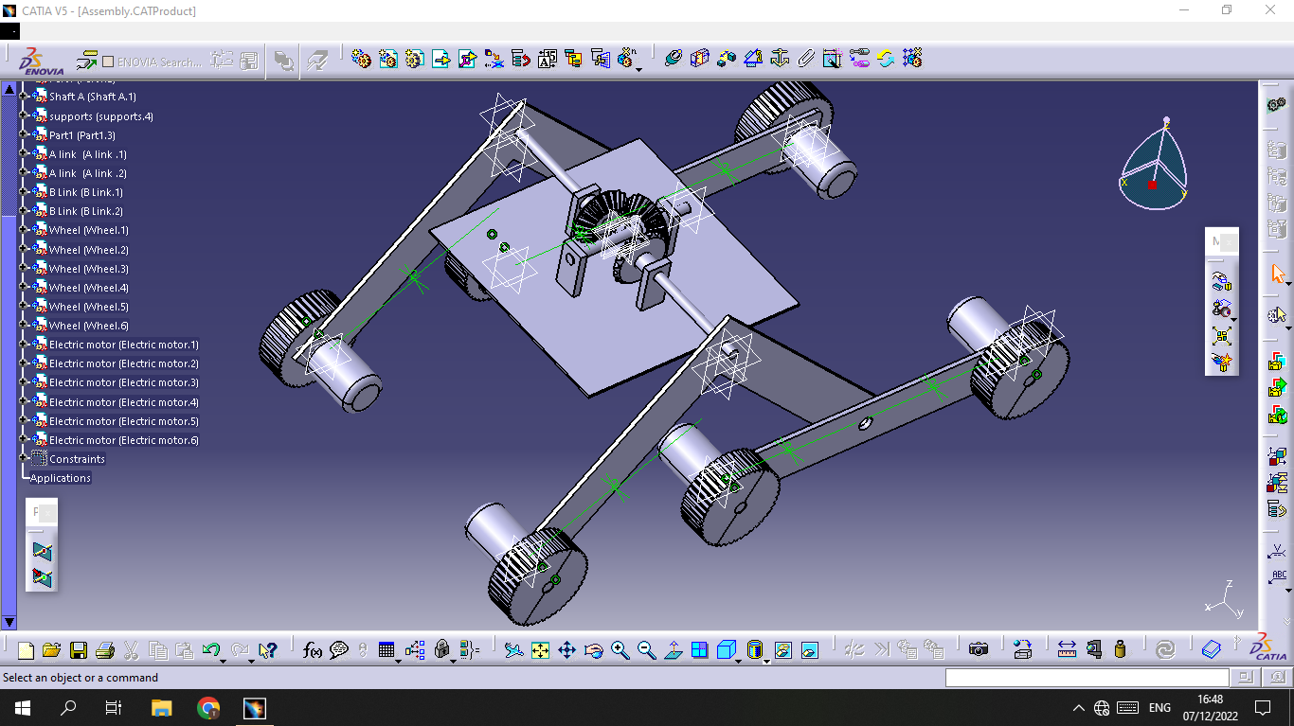
CAD MODEL

Slide 9
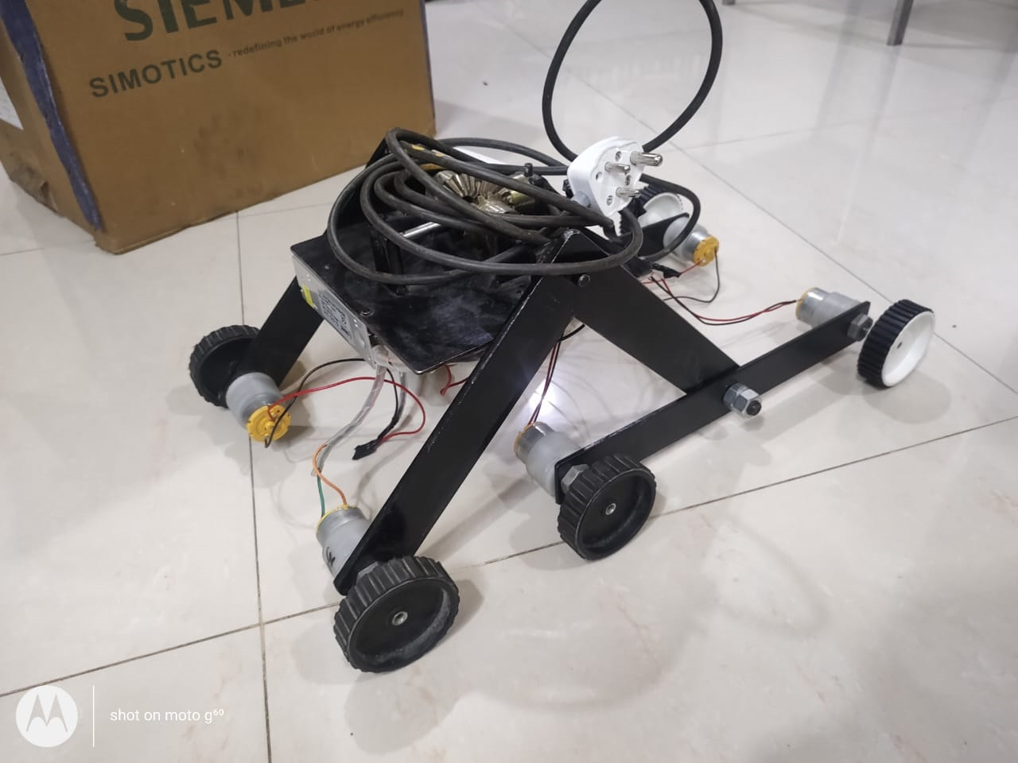
Actual Model

Slide 10
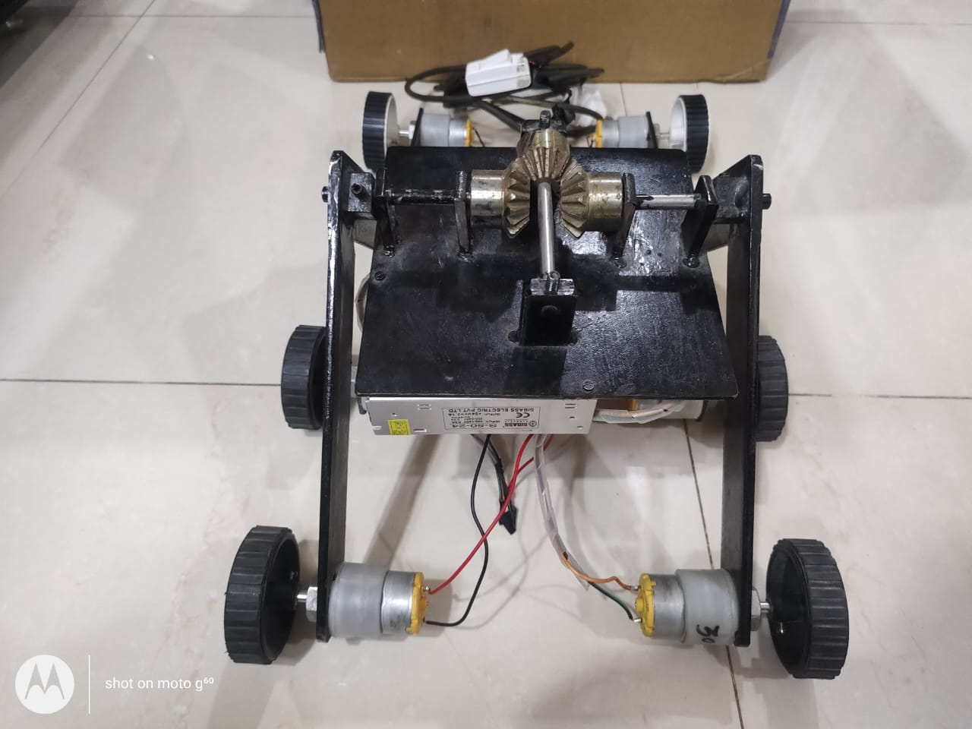

Slide 11

Working

Slide 12
Advantages
This robust system is cheaper than other suspension systems.
Due to less moving parts the losses are less and hence the efficiency is more

Slide 13
Disadvantages.
The link design may fail sometimes if the additional link entangles with some external body.
The system is applicable only for remotely operated vehicles.

Slide 14
Applications:
Remotely operated military vehicles for special operations
Remotely operated vehicle for mine detection
Space rovers

Slide 15
Future Scope
If the design of the link is changer from triangular to some other geometry it can help in crossing bigger obstacles.
If the shapes of the link and the additional link is changed from a rectangular section to a C section it can result in better statistics.
Moreover a Adriano and a Bluetooth module can help in making it a wireless vehicle.
A freely moving link mechanism can help in giving a gyroscopic action the vehicle which can reduce its deflections.

Slide 16
Conclusion
The model that was developed was capable of passing over all sorts of obstacles. The vehicle can successfully transmit the up thrust from one side to another side and can also apply the resultant force. The result so produced was that the vehicle would experience a deflection of a few degrees which can be minimized by employing better machining techniques. If the wheel diameter is increased the vehicle can cross larger obstacles

Slide 17
THANK YOU

