Slide 1



A Project Stage-I
Project Title: IoT based Wobbling Motion Detector for Motor cycles, Light and Heavy Vehicles.
Presented By
1. Tejas J. Nale (ME4234) 2. Nishant M. Ghode (ME4240)
3. Sachin P. Tandale (ME4246) 4. Virendra S. Abitkar (ME4351)
Under the Guidance of
Dr. P. D. Patil
Assistant Professor
Department of Mechanical Engineering
A.Y - [2023-24]

Slide 2
Contents
Introduction
Problem statement
Objectives
Scope
Methodology
Literature Review
Proposed experimental setup & work.
Concluding Remarks
Scope for the Future Work.
References …..(Include more point as per requirement)
1

Slide 3
1. Introduction
Purpose: The project focuses on monitoring wheel motion in motorcycles, light and heavy vehicles to prevent accidents and enhance safety.
Technology Solution: An IoT-based wobbling motion detector system utilizes ultrasonic sensors attached to the vehicle's swingarm/frame. These sensors continuously measure the perpendicular distance between the frame and the wheel rim.
Detection and Alert: If wobbling is detected, a microcontroller is triggered to provide a visual alert to the driver.
Safety Enhancement: The system's goal is to significantly reduce the safety risks associated with wheel wobbling in motorcycles and light vehicles, making road travel safer for all.
2

Slide 4
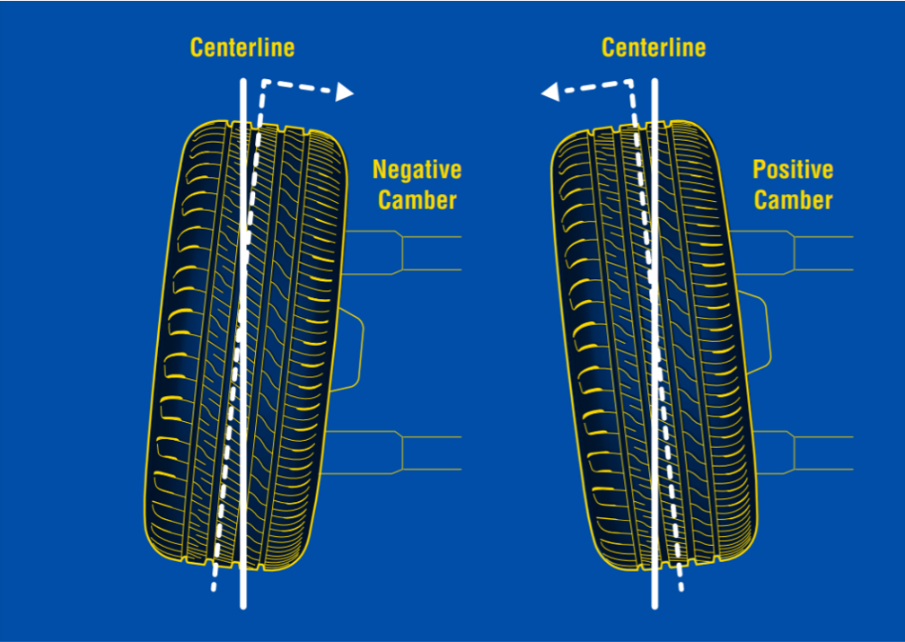
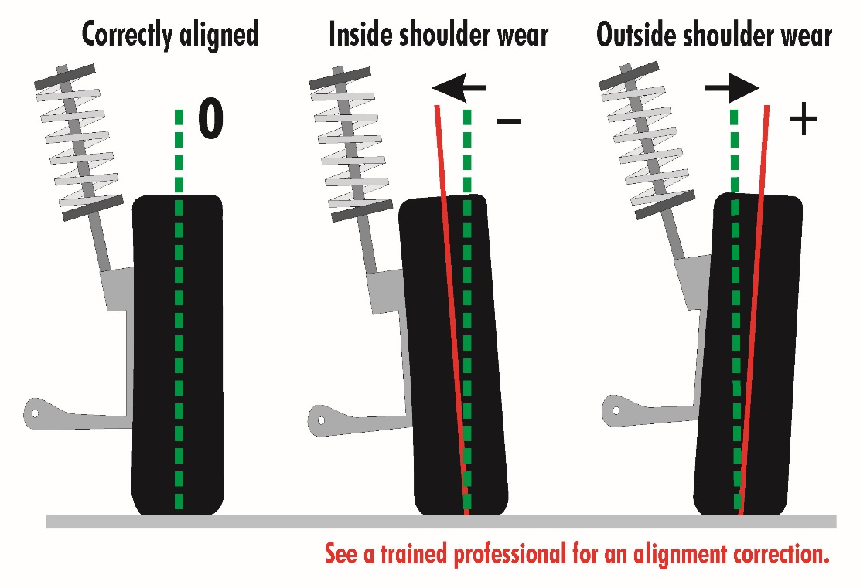
2. Problem Statement
In an ever-evolving world of transportation, road safety remains a paramount concern. The "IoT Based Wobbling Motion Detector for Vehicle Safety" project addresses this concern by introducing an innovative system designed to enhance safety for both light and heavy-weight vehicles.
3

Slide 5
3. Objective
Detect Wheel Wobbling: Develop a reliable system capable of detecting wheel wobbling in vehicles to prevent potential safety hazards.
Mitigate Risks: Implement measures to mitigate the risks associated with wheel wobbling, such as reducing inefficiency and enhancing vehicle occupant safety.
Utilize Technology: : Utilize cutting-edge technology, including an ultrasonic sensor and Arduino, for accurate and real-time detection of wheel wobbling
Real-time Analysis: Employ Python for real-time data analysis to provide immediate feedback and enable timely corrective actions.
Improve Vehicle Efficiency: Maintain proper wheel motion to enhance overall vehicle efficiency, reducing fuel consumption and environmental impact.
4

Slide 6
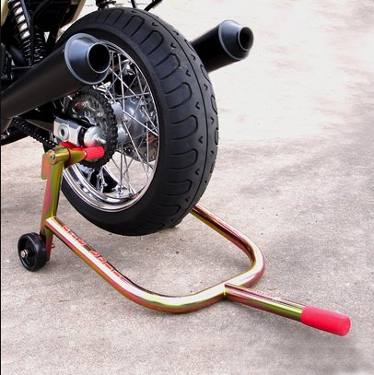
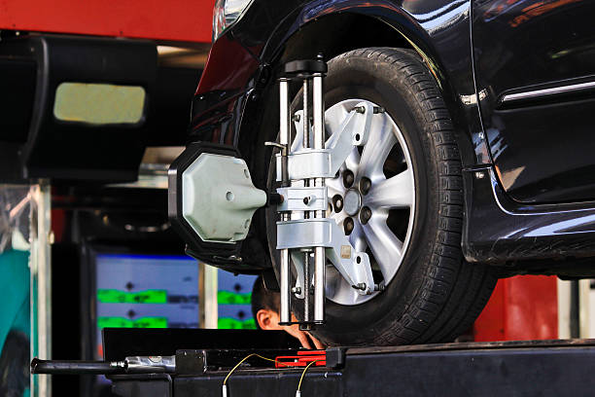
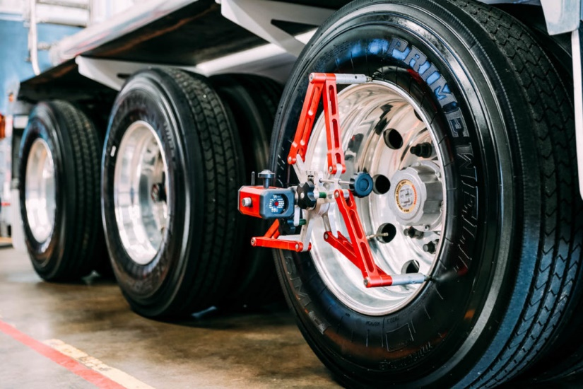
4. Scope
IoT-Based Wobbling Motion Detector for Vehicle Safety will be in the various Application such as-
Motor Cycle
Light Vehicles
Heavy Vehicles
5

Slide 7
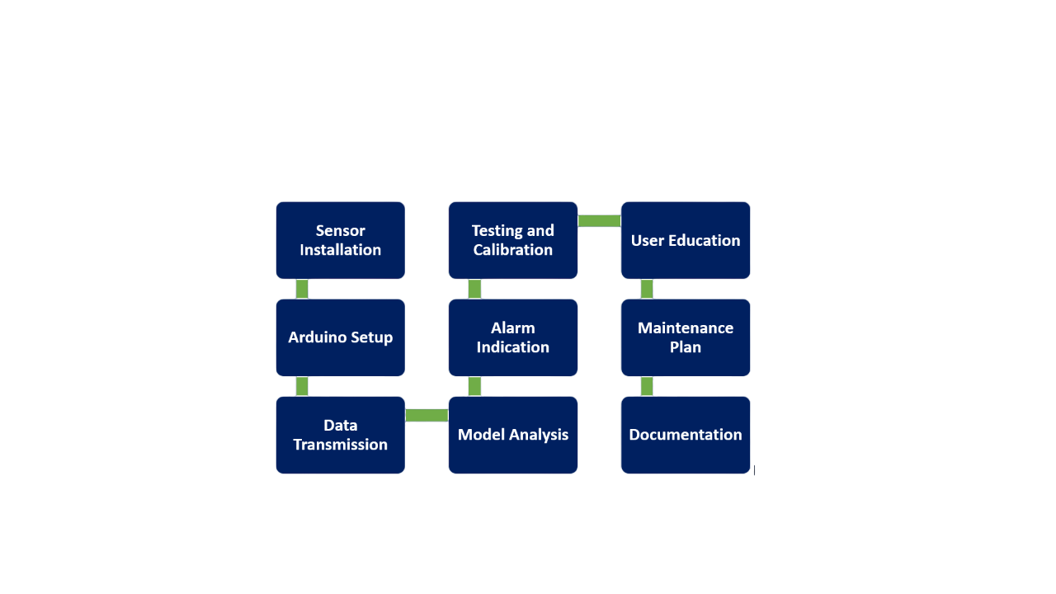
5. Methodology
Our work methodology encompasses sensor installation, Arduino programming, real-time data transmission, Python-based data analysis, and alarm indication. Rigorous testing, calibration, and a maintenance plan ensure system reliability.
6

Slide 8
6. Literature Review
Author/Year | Contribution | Remarks
Grynal D'Mell o et al (Dec 2021) | The author presents a novel approach to wheel alignment monitoring systems that typically rely on complex computer vision technologies, expensive high-end cameras, precise objects, and significant computational resources, often requiring experienced operators. In an effort to improve accessibility, the study introduces an easy-to-use, cost-effective solution using an MPU6050 sensor and an ESP32 microcontroller, complemented by a customized graphical user interface (GUI). Testing this IoT-based wheel alignment system on a vehicle yielded results comparable to traditional methods, indicating its practicality and potential as a viable alternative in the field of wheel alignment inspection. | The author introduces a simplified, cost-effective alternative to conventional wheel alignment systems, which usually rely on complex computer vision tech and expensive equipment. This solution employs an MPU6050 sensor and an ESP32 microcontroller, along with a user-friendly graphical interface. Testing showed comparable results to traditional methods, showcasing its practicality and potential as a viable wheel alignment inspection alternative.
7

Slide 9
6. Literature Review
Author/Year | Contribution | Remarks
Riton Kumer Das (Dec 2018) | This study focuses on the experimental investigation of wheel alignment systems for light vehicles. Various wheel alignment adjustment techniques are applied in real-time to enhance vehicle performance. The paper introduces a computerized and computer vision-based system for measuring automobile wheel alignment. The experimental analysis indicates that vehicle wheel alignment tends to become misaligned in the range of 4000 km to 5000 km of running. The findings underscore the importance of regular wheel alignment checks using advanced technologies, which substantially extend tire life, enhance tire safety, and improve vehicle handling satisfaction | This study introduces a computerized, computer vision-based system for real-time measurement of wheel alignment in light vehicles. Findings indicate that wheel alignment tends to drift after 4000-5000 km of use, underscoring the importance of regular checks using advanced technology. This practice greatly extends tire life, improves safety, and enhances overall vehicle handling satisfaction.
Brian David Hayes et al (March 2006) | The author introduces a loose wheel detection assembly featuring a sensor securely mounted to the hub, which identifies movement between the wheel and hub. A controller processes the data and triggers an in-cabin warning system, bolstering vehicle safety by promptly alerting the operator to potential loose wheel issues. | This innovation significantly enhances vehicle safety by promptly notifying the operator of potential loose wheel concerns.
8

Slide 10
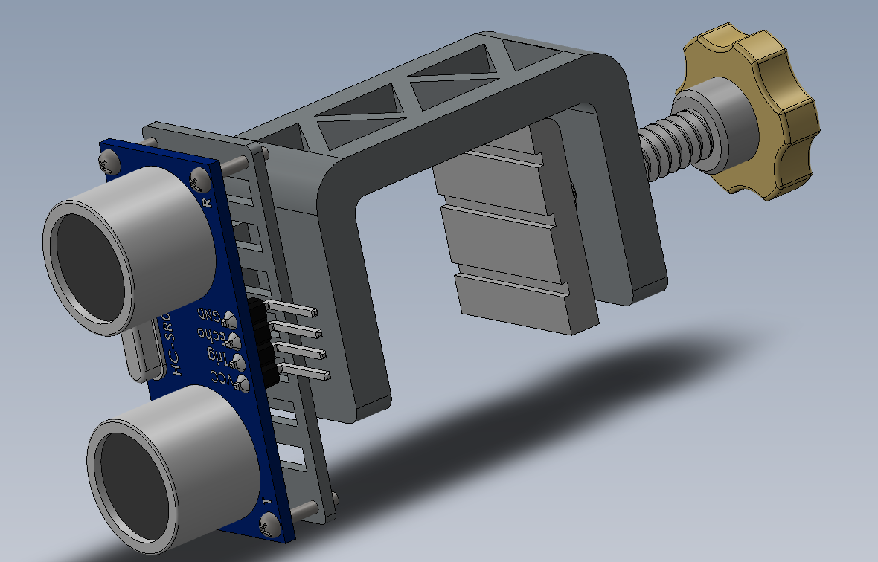
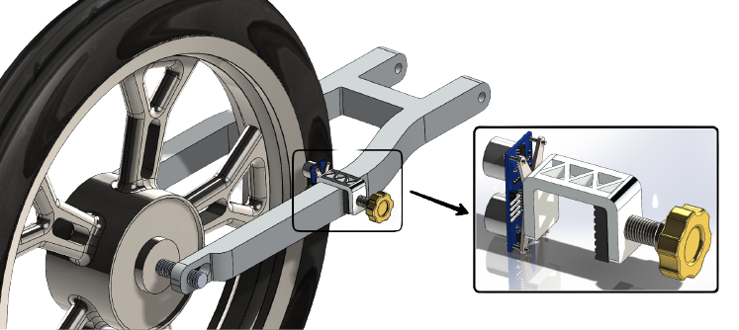
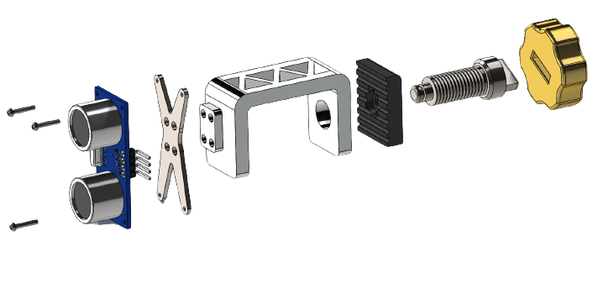
7. Proposed Experimental Setup & Work
For Motorcycle
9

Slide 11
8. Concluding Remarks
In today's dynamic transportation landscape, road safety remains a top priority, and our project contributes to this by introducing an innovative solution tailored for all vehicle types.
We have developed a resilient system incorporating an ultrasonic sensor and Arduino, coupled with real-time Python data analysis, to achieve this goal.
By implementing the "IoT-Based Wobbling Motion Detector for Vehicle Safety," we aim to make road travel safer and more secure for everyone, fostering a future where accidents are minimized, lives are saved, and transportation is made more reliable
10

Slide 12

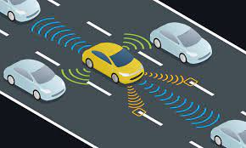
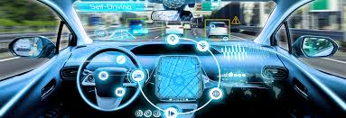
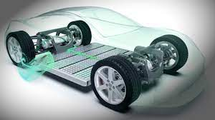
9. Future Scope
Mobile Application Integration
Integration with Autonomous Vehicles
Vehicle-to-Vehicle Communication (V2V)
Powertrain Accessibility
Government Regulations
11

Slide 13
10. References
[1] Ifor C. Davies, “ Wheel Lug nut locking device” US 8,708,627 B2 Apr. 29, 2014.
[2] N. Salave and P. L. Sarode, Experimental Study on Wheel Alignment of TATA Motors Heavy Commercial Vehicle, International Journal of Latest Engineering Research and applications, Vol. 2 , pp 64-70 (2017).
[3] Riton Kumer Das, “Experimental Study on Wheel Alignment System of Light Vehicles” International Conference on Mechanical, Industrial and Energy Engineering 2018, December 2018
[4] Huibo Wu, “Development of an early warning system for loose automobile tires” Volume 103, Issue 3, July-September 2020
[5] Grynal D'Mello, “Wheel alignment detection with IoT embedded system” volume 52, Part 3, 2022, Pages 1924-1929
[6] Riton Kumer Das, “Detecting Loose Wheel Bolts of a Vehicle Using Accelerometers in the Chassis” Pattern Recognition and Image Analysis (pp.665-679) June 2023
12

Slide 14

Thank You….

