Slide 1

DSC 323 Final Project: Seoul Bike Sharing
Sachit Patel

Slide 2
Dataset Overview
This dataset is about the amount of bikes rented out from a bike rental system in Seoul, South Korea.
Data entry is sorted in chronological order, using dates and hour. The data set records the amount of bikes rented out by hour.
There are a total of 8760 observations within the dataset.
The dependent variable (DV) is Rental Bike Count.

Slide 3
Different Variables/Predictors
Predictors Involved Include (units in parentheses):
Rental Bike Count (numerical count, dependent variable)
Hour of day (from 0 to 24)
Temperature (Celsius)
Humidity (%)
Windspeed (m/s)
Visibility (based on 10 meters)
Dew Point Temperature (Celsius)
Solar Radiation (MJ/M2)
Rainfall (mm)
Snowfall (cm)
Seasons (Winter/Spring/Summer/Autumn)
Holiday/No Holiday
Functioning Day (Business hour/Not Business Hour)
Dummy Variables are necessary for some predictors!

Slide 4
Research Focus and Questions
Goal: Help provide the city with a stable supply of bikes at all times bikes are available.
Why?: We want to assure that there is constant access to rental bikes.
How? We should be able to reliably predict the number of rental bikes that will be rented based on our predictors.
Areas that could be contextualized based on given predictors: Weather & Seasonality influence, Holidays, Business Hours.

Slide 5
Exploratory Analysis
Various methods were used in the exploratory analysis to help understand the data. Some tools used were the means procedure, histograms of predictors and rental bike counts, and correlation tables.
The exploratory analysis thrives off of answering questions that are created about the data. The power of applications like SAS in terms of descriptives is that you can answer those questions proficiently. Some that came to mind during this were:
What is the distribution of rental bike count like?
How do conditions (such as weather) affect rental bike counts?

Slide 6
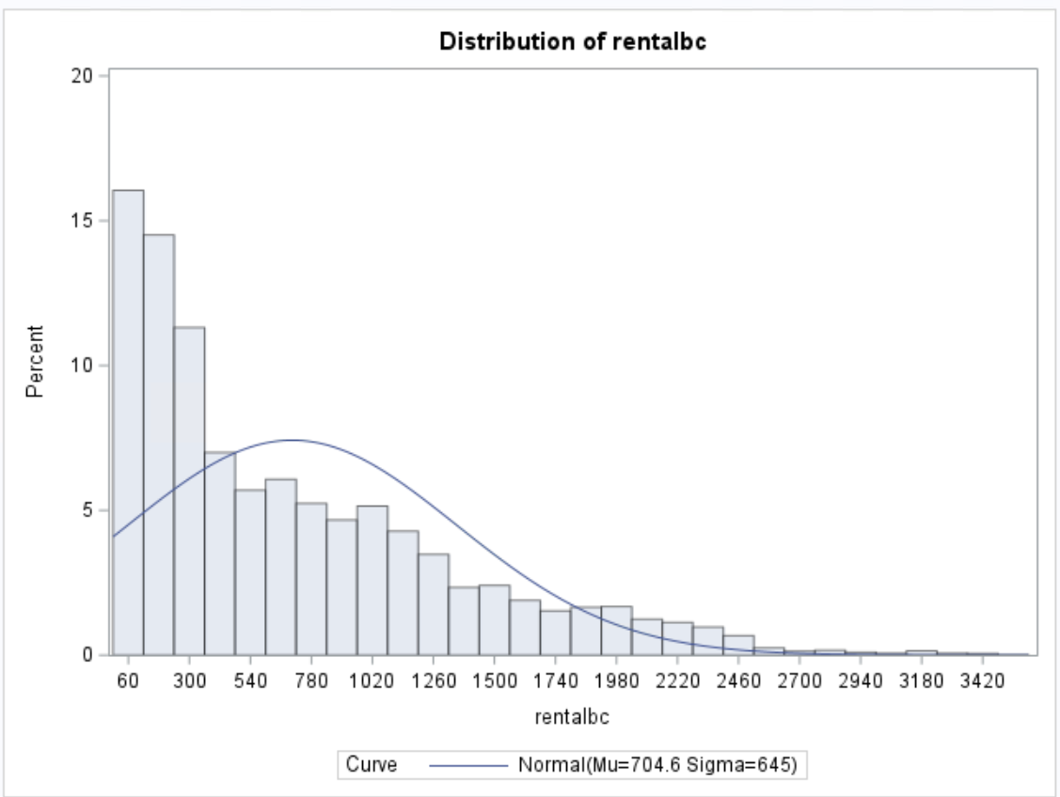
Rental Bike Count Histogram
High skew to the left, negative skew.
What should we consider based on the results of this histogram?
The distribution of rental bike count is NOT normal.
Transformations may help in making the distribution of rental bike count more normal.
How do we wish to handle the case of 0 bikes being rented out?

Slide 7
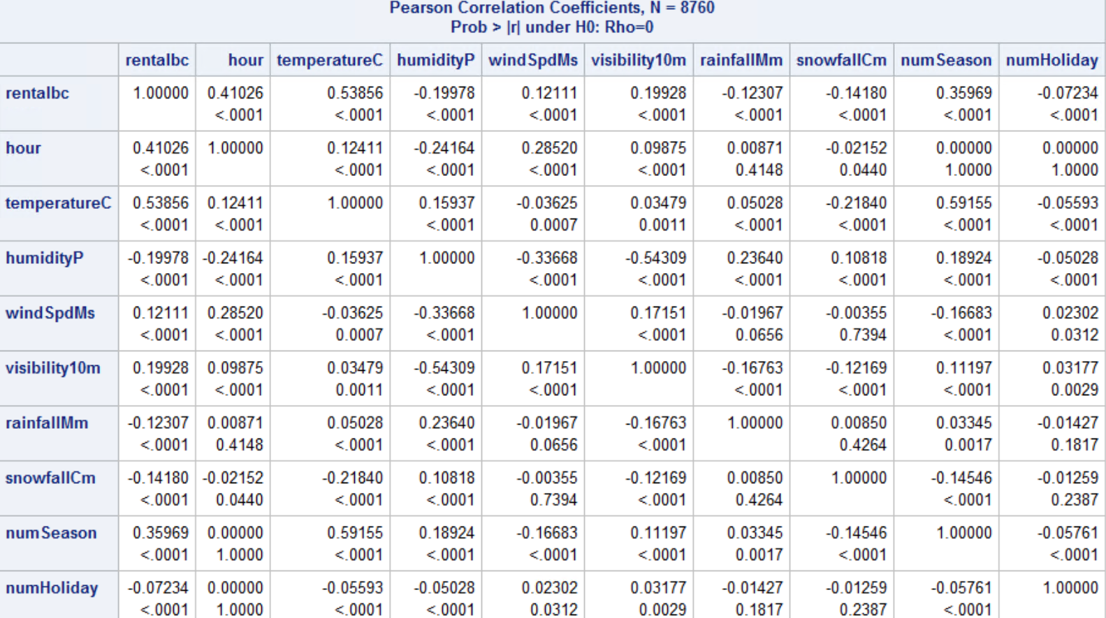
Correlation Values
Not all predictors are shown in this correlation table.
Low correlation with rental bike count in general.
What does this say about the relationship between dependent variable and predictors?

Slide 8
Interaction Variables
Two interaction variables were tried in this model:
Hour of day was crossed between Holiday. An interaction term was created between these two to help predict rental bike counts around holidays. A common occurrence in this dataset was groups of high rental bike counts in consecutive hours due to holiday seasons.
Hour of day was also crossed between functioning day. Functioning day just covers the days where the rental bike system is working or not. After realizing that “no” for functioning day was synonymous with 0 entries, this variable was removed.

Slide 9
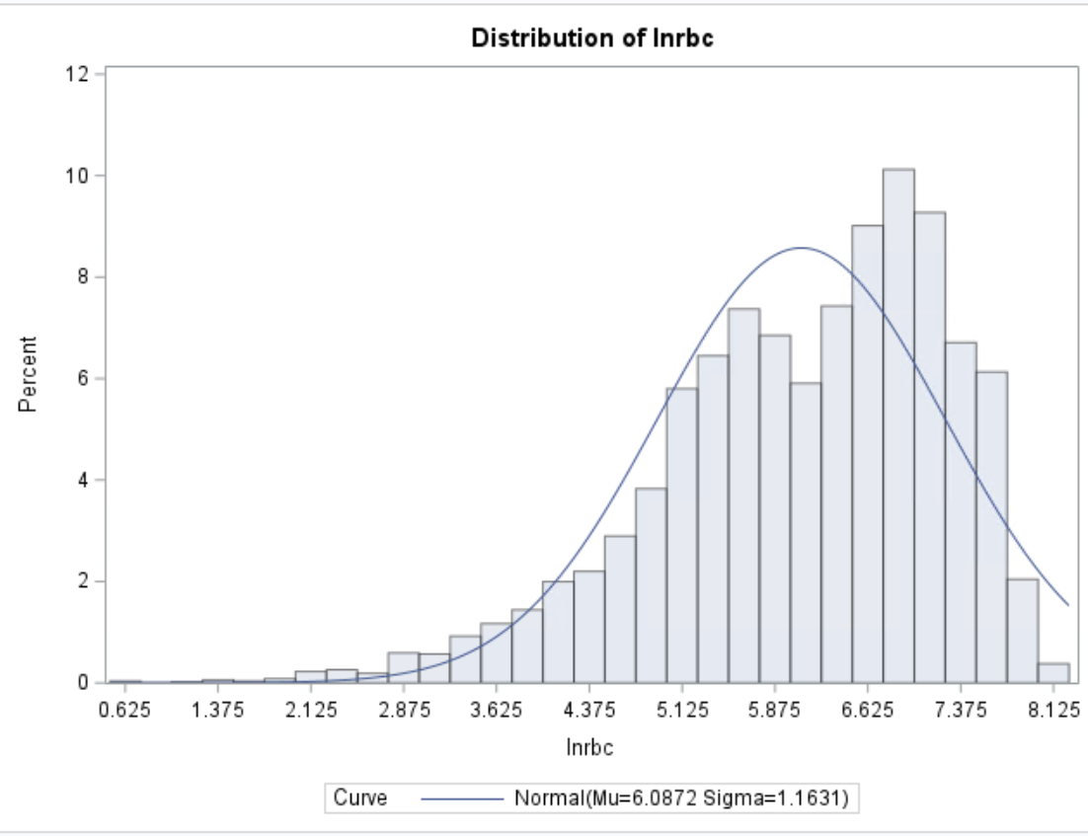
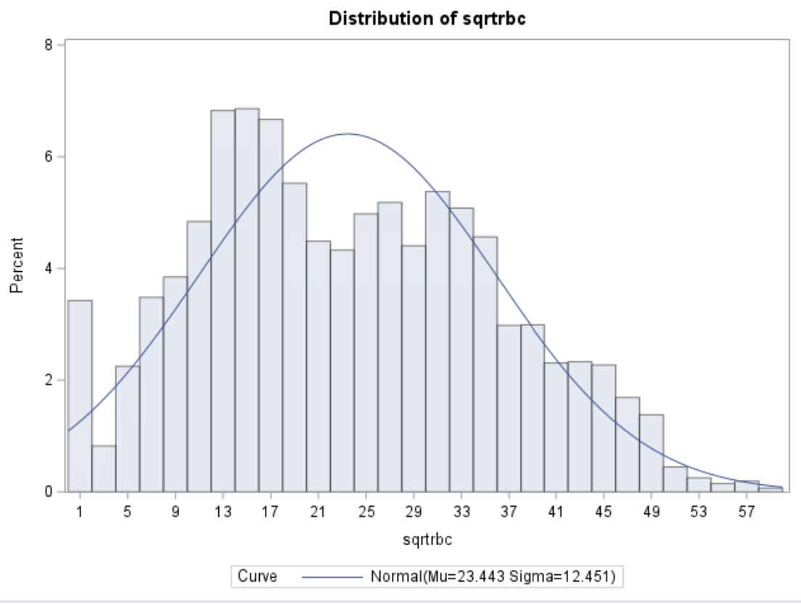
Transformations
Square Root Transformation
Log Transformation
Much less skewed distribution then rental bike count.
Much higher variance and std. deviation than log transformation.
Closer to normal distribution than sqrt transformation
Issue regarding log transformation and value of 0 (295 observations of 0 for rental bike count).

Slide 10
Model Choices
The main choice was between which transformation to use. This did affect the significance of some predictors as well.
Predictors could be transformed to make them more significant.
Choice between square root and log transformation.
Log transformation chosen despite 0 observations.

Slide 11
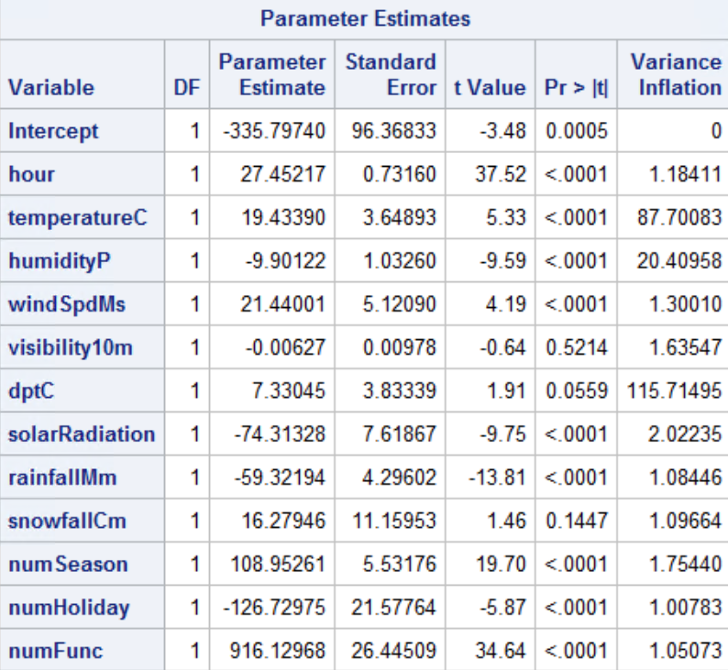
Multicollinearity
Multicollinearity is present within the full model. Between temperature, humidity, and dew point temperature.
Removing Dew Point Temperature from the Model entirely fixed these issues.

Slide 12
Outliers and Influential Points
Outliers
Influential Points
295 Observations of Rental Bike Count = 0 removed
Dataset afterwards was refit and examined for outliers (studentized residuals > 3 or < --3).
110 observations met these qualifications were removed (alongside two influential points) for a total of 8353 observations.
Influential Points were examined after outliers were removed. Most influential points were left within the model.
Further work could be done to remove more influential points based on Cook D’s Distance.
DFFits cutoff: > .7257 or < -.7257.

Slide 13
Variable Selection
Some predictors were not found to be significant (p > 0.05) and thus were removed. Do note that the significance of predictors were altered as a result of removing outliers and influential points. These include:
Wind speed (windSpdMs)
Solar radiation (solarradiation)
Interaction term between hour and functioning day (hour_numFunc)

Slide 14
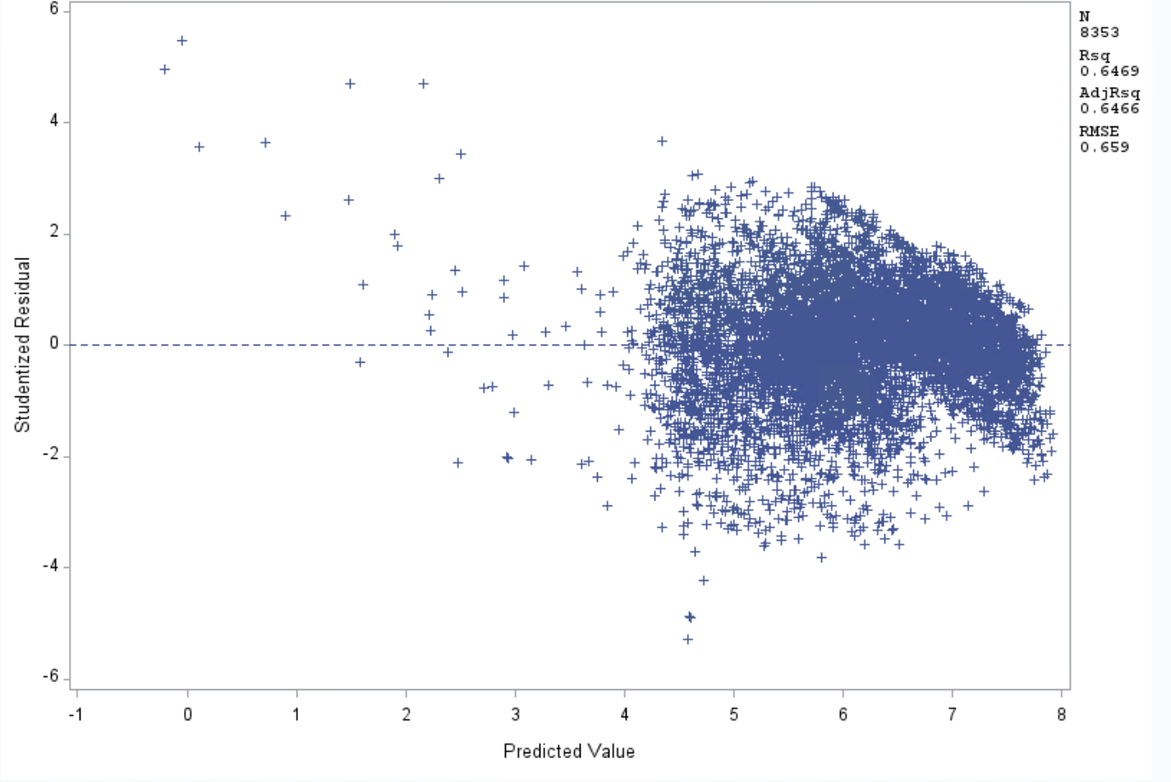
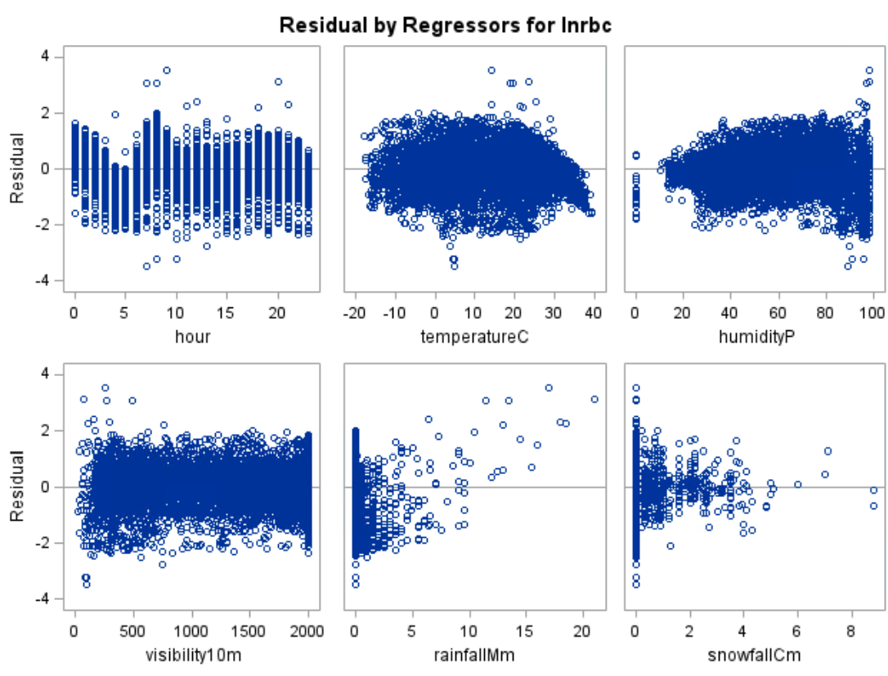
Model Assumptions
Residual Plot, fails constant variance.
Normality Assumption (is the QQ plot a straight line?) Passes
Constant Variance Assumption (is there a constant spread within the residual plots?) Fails.
Independence Assumption (are the model error terms independent of each other?) Fails.
Linearity Assumption (are predictors linear with response variable?) Fails.

Slide 15
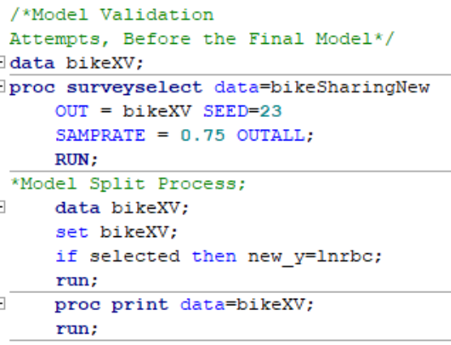
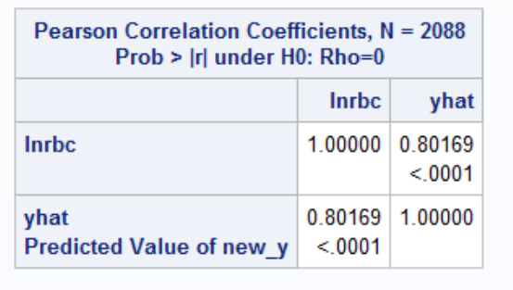
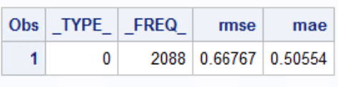
Model Validation
75-25 split used for Model Validation -> 6265 entries in training set -> 2088 in testing set.

Slide 16
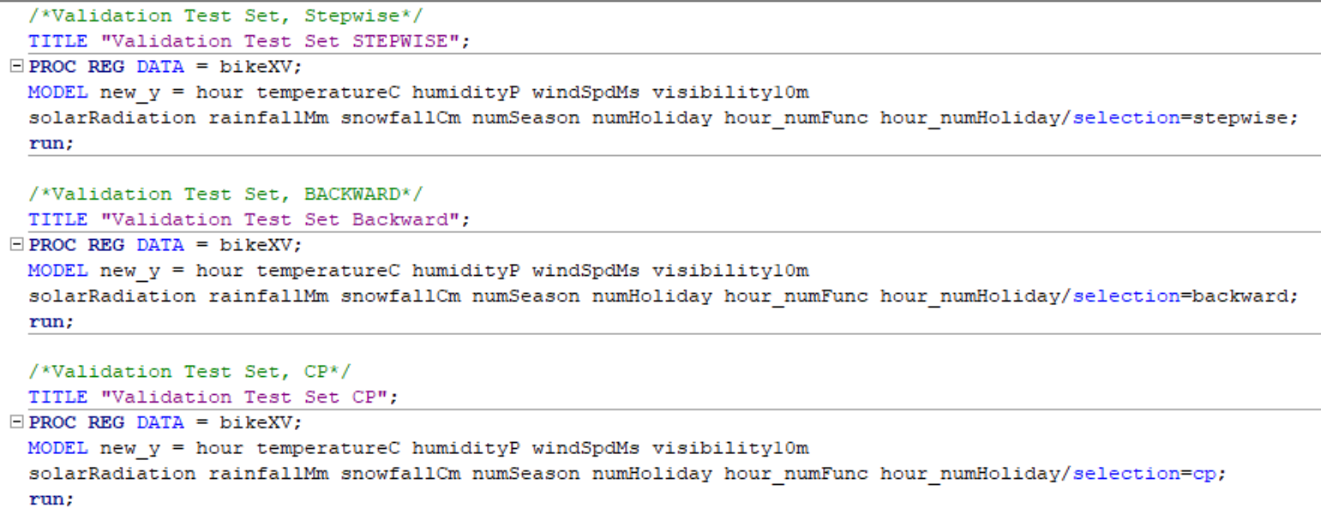
Model Selection
Model selection was done with the training set against the new_y created through model validation. (Roughly 75% of the total data set)
CP and Backward returned the same predictors, that selection was used for the final model instead of stepwise.

Slide 17
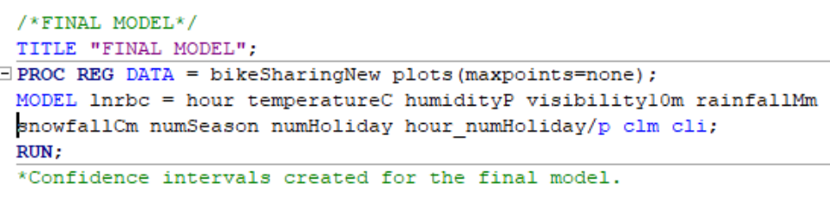
Final Model, Model Equation
- Final Model Equation: lnrbc = 5.6161 + 0.047(hour) + 0.041(temperatureC) – 0.0135(humidity) -557E-7(visibility10m) – 0.3288(rainfallMm) -0.0867(snowfallCm) + 0.2551(numSeason) -0.2945(numHoliday)-0.0084(hour_numHoliday) + 3623.23549 [this is the error sum of squares]

Slide 18
Can this model be improved?
Absolutely. Here are a couple key issues with this model:
Adjusted R^2 is not as high as it could be. It ends at around 0.646, which is non-negligible, but not necessarily high.
Multiple assumptions of the model are violated. These have to be addressed for the model to fit well.
Predictions are off as a result of the model assumptions being violated. The confidence interval range is extremely wide.
RMSE, MAE, etc. are close to a value of 0, but aren’t quite there.

