Slide 1

RAMAIAH INSTITUTE OF TECHNOLOGY
Department of Information Science & Engineering
Department of Information Science and Engg
(An Autonomous Institution, Affiliated to VTU)
Hearty Welcome to Panel Members
Internship Evaluation Capstone Life Villa Customisation Portal
Sachit Reddy H (1MS22IS113)
Under the Guidance of
Industry Guide
Rohit Rao
Business Technology Manager
Capstone Life, Bengaluru
Internal Guide
JR Shruthi
Assistant Professor
Dept of ISE, RIT

Slide 2
Agenda
Introduction
Problem Statement
Scope and Objectives
Methodology
Implementation
Results and Discussion
Conclusion

Slide 3



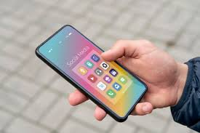
Introduction
Villa customisation at Capstone Life was entirely manual — catalogues, spreadsheets, and in-person meetings.
MSR Phase 3 features luxury three-floor villas (East & West Facing) needing a digital upgrade selection platform.
A full-stack web portal was built to digitise the end-to-end customisation journey for villa buyers.
The portal serves four user roles: Customer, Admin, CRM Admin, and Design Admin.
Internship conducted on-site at Capstone Life, Bengaluru with weekly mentor review sessions.

Slide 4


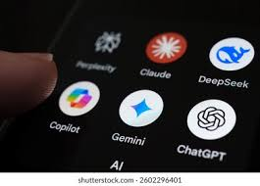
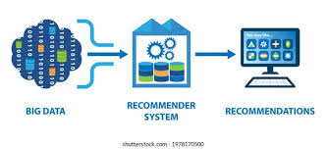
Problem Statement
No digital platform existed for villa buyers to browse and select upgrade options independently.
Manual, catalogue-based process caused frequent miscommunication and selection errors.
Admin teams had no centralised system to track customer selections or generate itemised quotes.
The solution needed to support:
Multi-role access (Customer, Admin, CRM, Design)
Room-level customisation navigation
End-to-end quote lifecycle management
Architectural drawing distribution

Slide 5

Scope and Objectives
Build a production-ready full-stack portal for villa upgrade customisation.
Develop a customer hub covering 8 upgrade categories (Flooring, Bathroom, Smart Home, etc.).
Implement room-based navigation for:
Flooring Upgrades (individual & packages)
Bathroom Upgrades (Sanitaryware & CP Fittings)
Design a complete quote workflow from selection to acceptance.
Build role-specific admin panels for:
Admin (full access)
CRM Admin (customer & quote management)
Design Admin (drawing register)
Deploy on Render with MongoDB Atlas as cloud database.
Support live use by Capstone Life customers and internal teams.

Slide 6
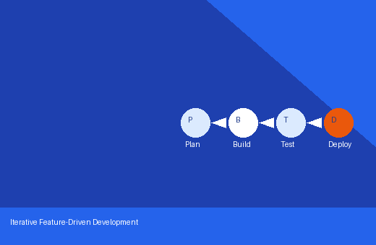




Methodology
Adopted an iterative, feature-driven development approach with weekly mentor reviews.
Selected React 19 + TypeScript (frontend) and Python FastAPI (backend) for the tech stack.
Used MongoDB Atlas as the cloud-hosted NoSQL database with async Motor driver.
Implemented JWT-based authentication (access + refresh tokens) with role-based access control.
Developed and tested API endpoints incrementally using FastAPI’s Swagger UI (/docs).
Seeded and patched the database using dedicated Python scripts for each category.
Deployed progressively to Render (backend) and Render Static (frontend) with MongoDB Atlas.

Slide 7
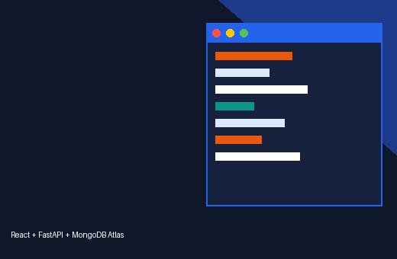
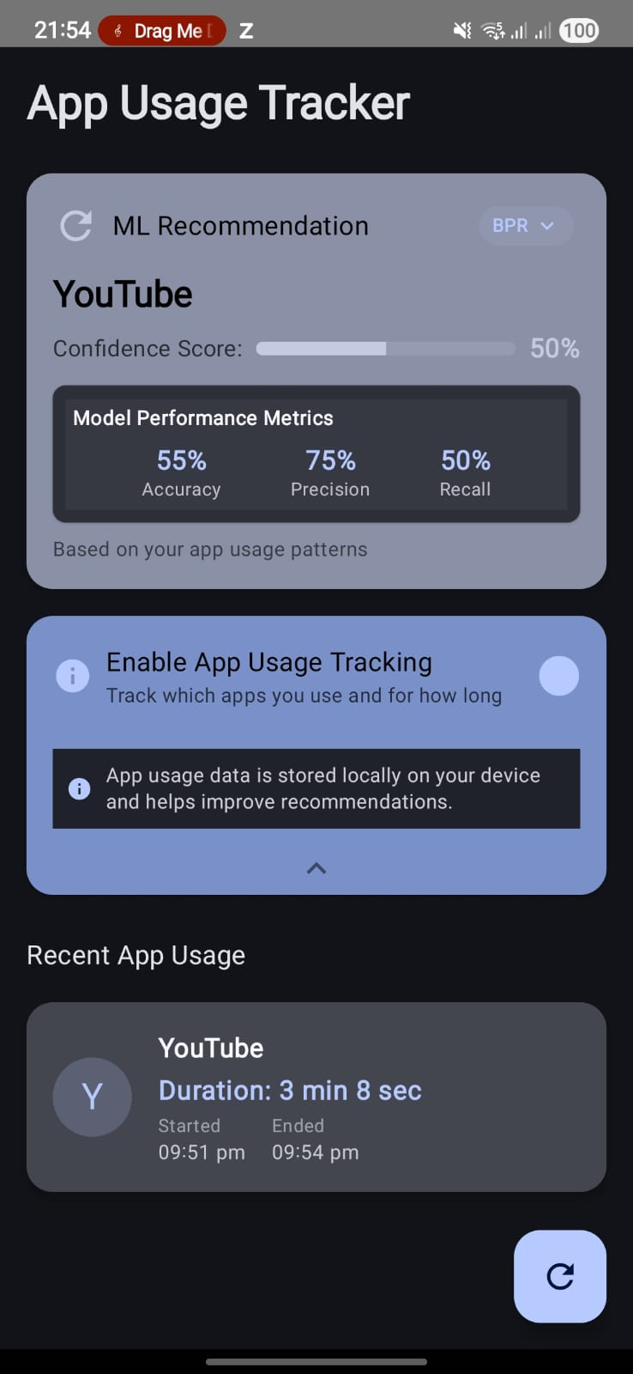
Implementation
Built React SPA with TypeScript, Vite, React Router v7, Axios, and Lucide React icons.
Implemented:
JWT auth with 4 user roles and sessionStorage/localStorage token management
8-category Customisation Hub with room-based navigation for Flooring & Bathroom
Selection persistence (upsert/remove/submit) via FastAPI REST API
Quote lifecycle: submission → admin pricing → customer acceptance/revision
Built admin panels: Dashboard, Customers, Quotes, Options & Drawing Register.
Python seeding & patching scripts for the product catalogue.
Deployed on Render: FastAPI backend + React frontend with MongoDB Atlas.

Slide 8
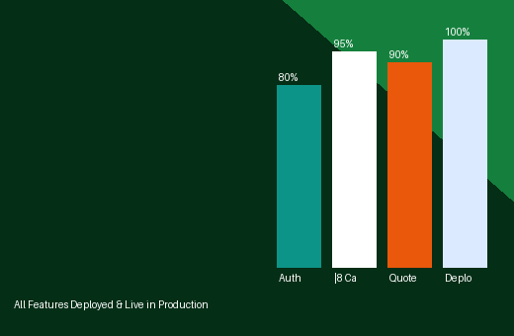
Results and Discussion
All 8 customisation categories implemented and deployed to live production on Render.
Room-based navigation dynamically derived from live MongoDB data — no hardcoding.
Quote workflow enabled seamless customer-admin interaction with dual notification flags.
Drawing Register replaced email-based plan distribution for all MSR Phase 3 villas.
Client-side Excel quotation generator (xlsx-js-style) delivered to customers on demand.
Portal is live and actively used by Capstone Life customers and internal team.

Slide 9

Conclusion
Successfully designed, developed and deployed the Capstone Life Villa Customisation Portal.
Delivered a production-ready full-stack system serving real customers and the internal team.
Demonstrated complete software lifecycle from requirements to cloud deployment.
Gained practical experience in:
Full-stack development (React 19 + TypeScript + FastAPI)
Cloud deployment (Render + MongoDB Atlas)
JWT authentication & role-based access control
Iterative, feature-driven software delivery
Future enhancements: email notifications, automated testing, and mobile-responsive redesign.

Slide 10
Thank you

