Slide 1
Research Progress Report
Hydraulic Multistability and Transient Carbon Storage Dynamics: A Coupled Carbon–Water Matrix Approach
10/16 Takuma Sakauchi

Slide 2
Table of contents
Previous research
Research gaps
Research question
Methods
Results
Discussions
Future plans

Slide 3
Previous research
Understanding the land carbon cycle
Carbon equilibrium
Matrix approach
Carbon storage capacity

Slide 4
Understanding the land carbon cycle
Land ecosystem play a important role in Earth system in this situation of climate change.
The dynamics of carbon storage can be regarded as the change of equilibrium of photosynthesis and respiration.
(Olson, J.S. (1963), Energy Storage and the Balance of Producers and Decomposers in Ecological Systems. Ecology, 44: 322-331. https://doi.org/10.2307/1932179 )

Slide 5

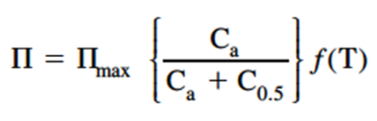
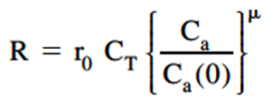
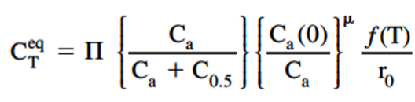
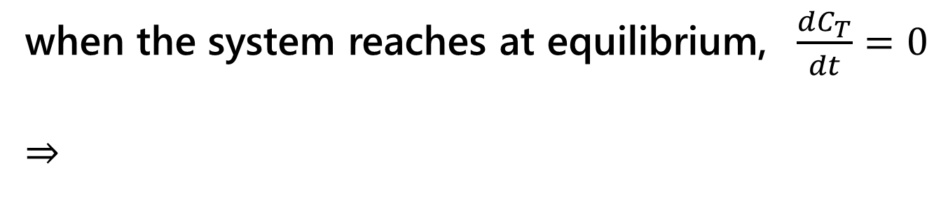
Carbon equilibrium
Cox, P. et al showed analytical examples on differential equation of carbon mass balance. They regarded the earth system as a closed system. (Cox, Peter M.; Huntingford, Chris; Jones, Chris D. (2006). Conditions for sink-to-source transitions and runaway feedbacks from the land carbon cycle. University of Exeter. Chapter. https://hdl.handle.net/10036/48545 )
Photosynthesis - Respiration
when the system reaches at equilibrium, $\frac{dC_{T}}{dt}=0$
⇒
max

Slide 6
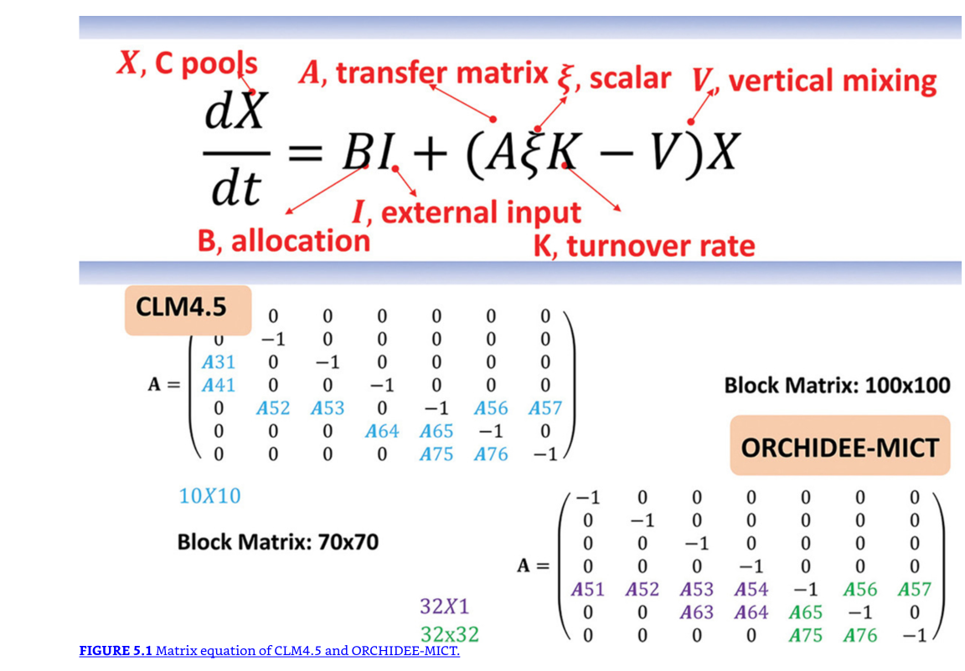
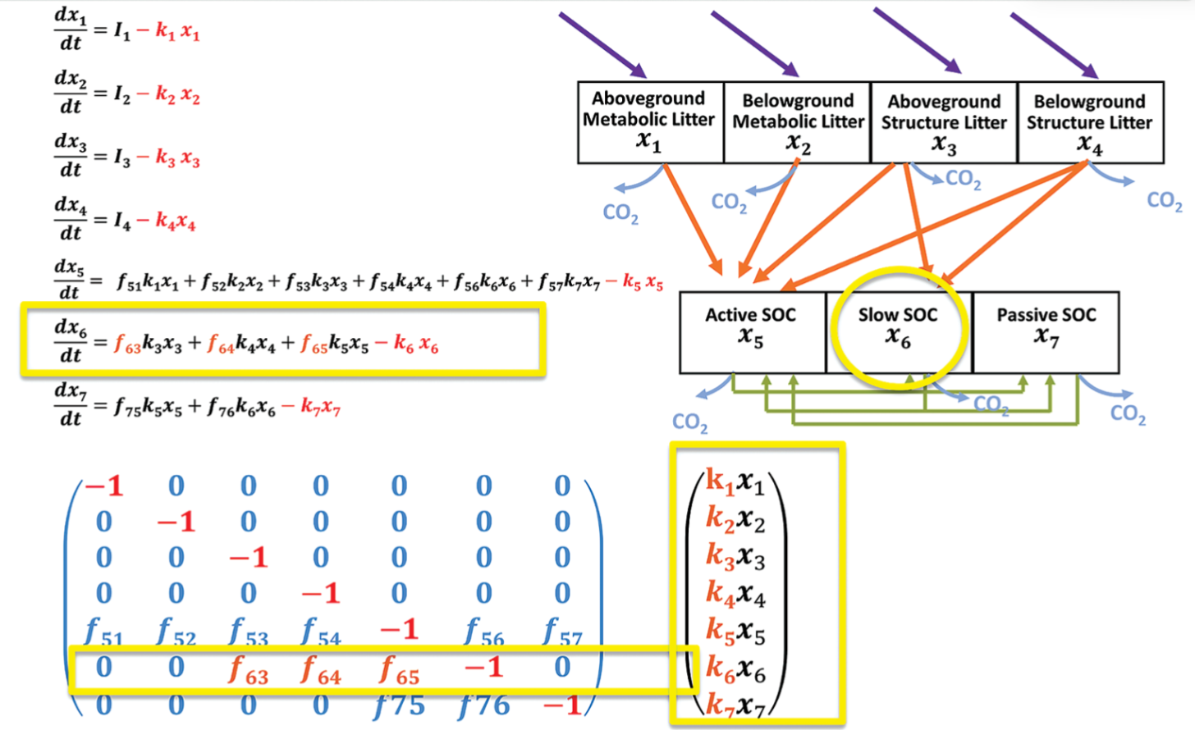
Matrix approach
Luo et al (2022) gave a perspective on representation of land ecosystem model as a differential equation by utilizing matrices. (Luo, Y., Huang, Y., Sierra, C. A., Xia, J., Ahlström, A., Chen, Y., et al. (2022). Matrix approach to land carbon cycle modeling. Journal of Advances in Modeling Earth Systems, 14, e2022MS003008. https://doi.org/10.1029/2022MS003008 )
Notes:
Luo, Y., & Smith, B. (Eds.). (2024). Land Carbon Cycle Modeling: Matrix Approach, Data Assimilation, Ecological Forecasting, and Machine Learning (2nd ed.). CRC Press. https://doi.org/10.1201/9781032711126

Slide 7
Carbon storage capacity
Luo and Weng precisely defined equilibrium point and called it carbon storage capacity. (Yiqi Luo, Ensheng Weng, Dynamic disequilibrium of the terrestrial carbon cycle under global change, Trends in Ecology & Evolution, Volume 26, Issue 2, 2011, Pages 96-104, ISSN 0169-5347, https://doi.org/10.1016/j.tree.2010.11.003. )

Slide 8
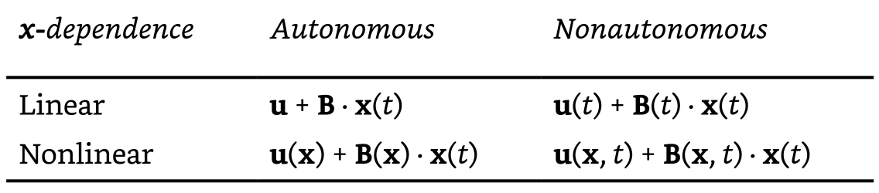
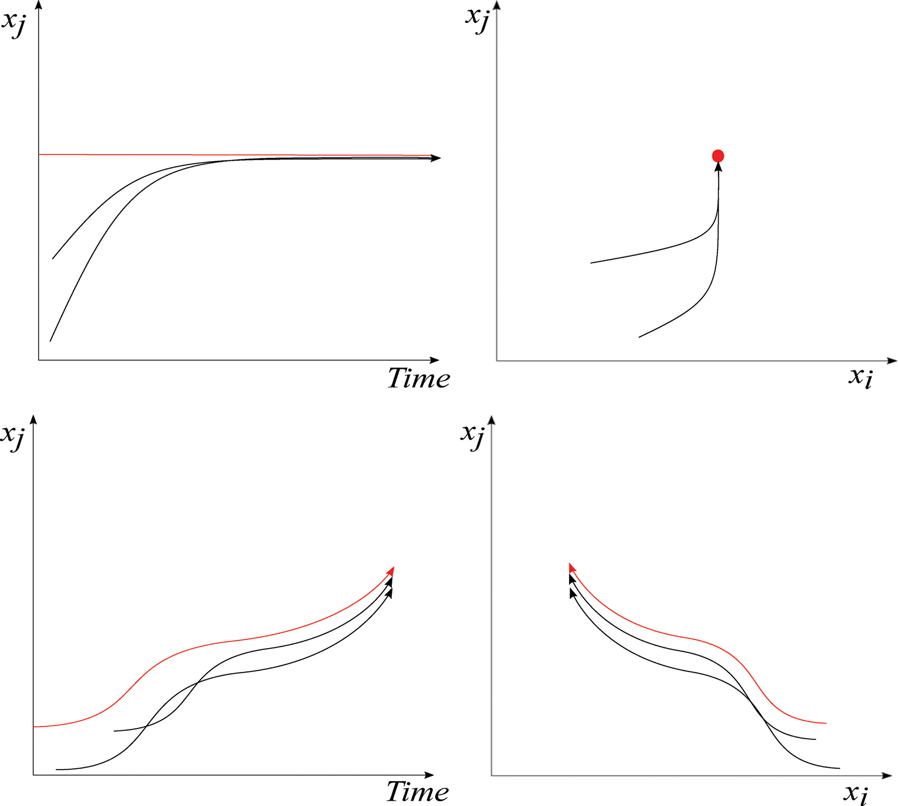
Research gaps
Nonlinearity
Notes:
Luo2022

Slide 9
Research gaps
Nonlinear conditions are the frontier
Notes:
Luo2022

Slide 10
Research gaps

Slide 11
Research question

Slide 12
Methods
Add water cycle into carbon cycle
  Soil-Plant-Atmosphere Continuum (SPAC) into differential equation
  Assume only VPD is forcing
  Add feedbacks stepwise
Analysis based on catastrophe theory
  Solve fixed points then check Jacobian matrices

Slide 13
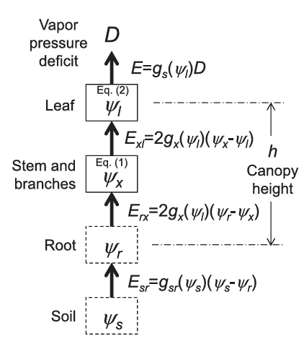
Soil-Plant-Atmosphere Continuum (SPAC)
Manzoni (2014)

Slide 14
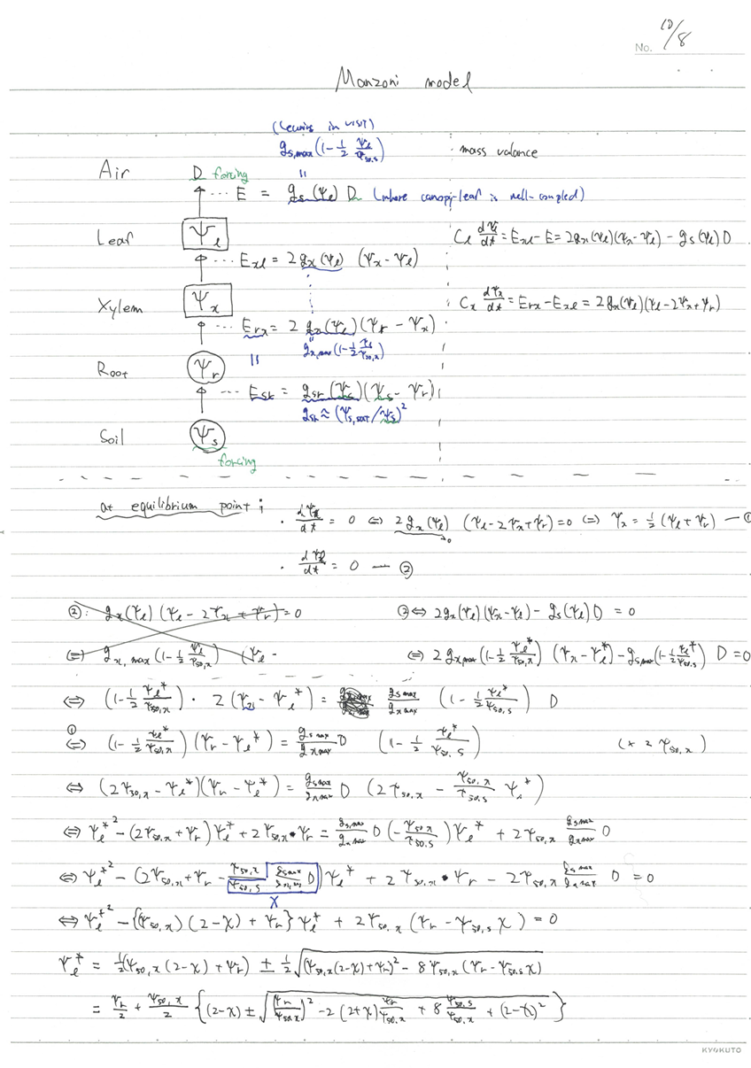
Soil-Plant-Atmosphere Continuum (SPAC)
Manzoni (2014)

Slide 15
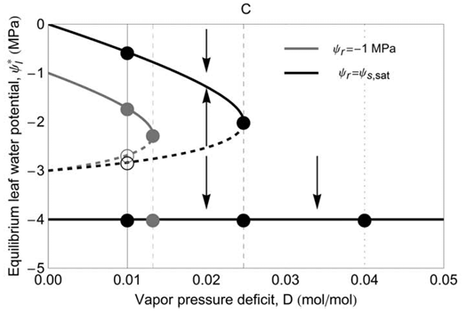
Soil-Plant-Atmosphere Continuum (SPAC)
Manzoni (2014)

Slide 16
Catastrophe theory

Slide 17
Results
Model equations

Slide 18
Results
Equilibria

Slide 19
Results
Conditions

Slide 20
Discussions
Contribution

Slide 21
Future plans

