Slide 1
Research Progress Report
Hydraulic multistability and nonlinear carbon storage capacity
16 October 2026 | Takuma Sakauchi

Slide 2
Presentation roadmap
01
Why carbon storage capacity?
02
What changes in nonlinear models?
03
Coupling Manzoni hydraulics and carbon pools
04
Equilibrium classification and hydraulic failure
05
What has been established, and what comes next?
OVERVIEW
2

Slide 3
Previous research
1963 | Olson
Carbon input–loss balance
2006 | Cox et al.
Analytical carbon equilibrium and feedback
2011 | Luo & Weng
Dynamic disequilibrium and storage capacity
2022 | Luo et al.
Matrix approach to multi-pool carbon models
BACKGROUND
3
Notes:
[Sources]
Olson 1963 DOI 10.2307/1932179; Cox et al. 2006 as cited in original deck; Luo & Weng 2011 DOI 10.1016/j.tree.2010.11.003; Luo et al. 2022 DOI 10.1029/2022MS003008.

Slide 4
Carbon stocks follow a mass balance
dC/dt = carbon input − carbon loss
A carbon equilibrium occurs when inputs and outputs balance.
Equilibrium is a statement about the equations—not yet a guarantee of global convergence.
Historical starting point: Olson (1963)
BACKGROUND
4
Notes:
[Sources]
Olson 1963; original deck slide 4.

Slide 5

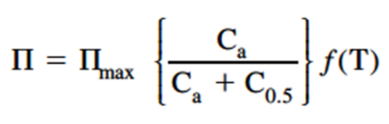
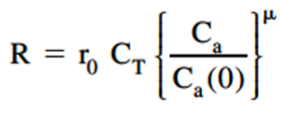
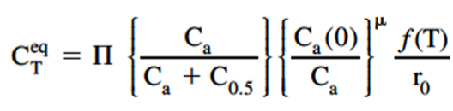
Analytical carbon equilibrium
Cox et al. (2006): feedbacks can be analysed from carbon mass balance.
Key idea: solve dC/dt = 0
BACKGROUND
5
Notes:
[Sources]
Cox et al. 2006, as cited in original deck. Equation images retained from the user-provided deck.

Slide 6
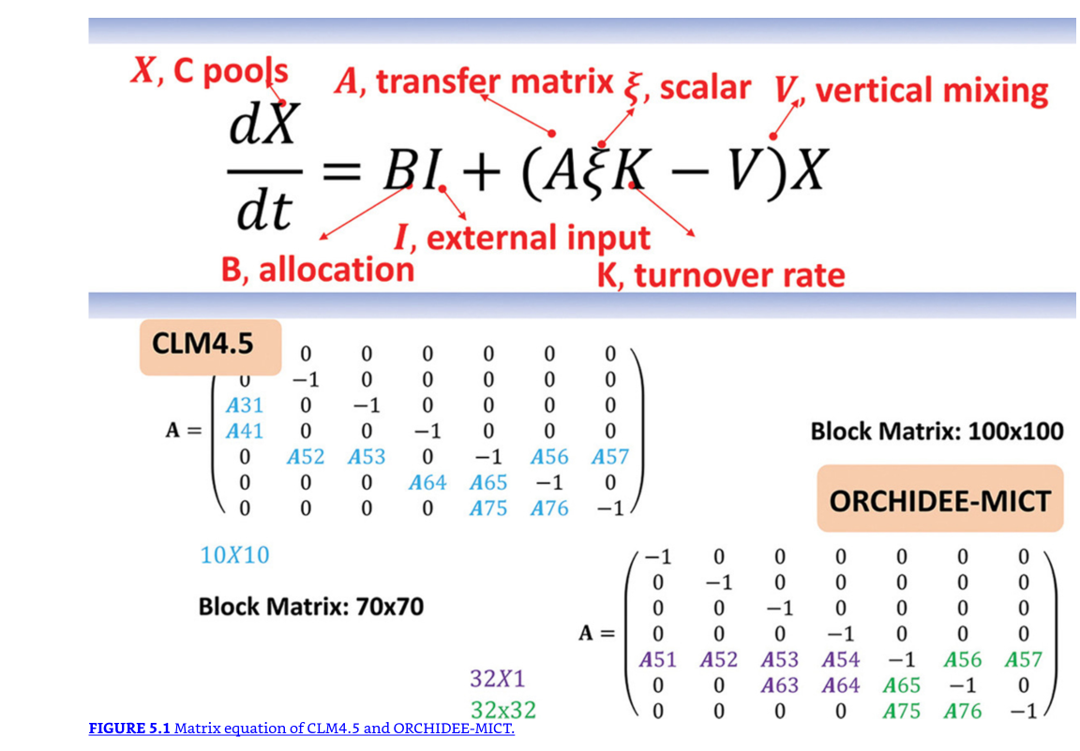
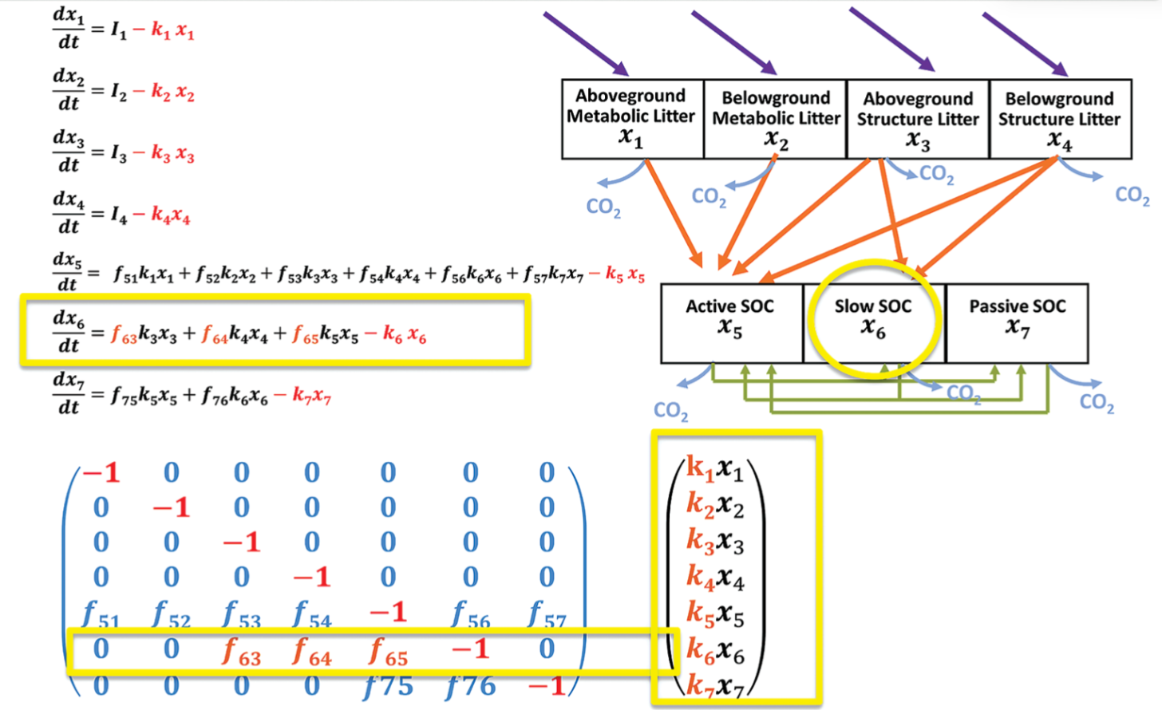
Matrix approach to land carbon
Multi-pool carbon dynamics can be represented compactly as a matrix system.
Luo et al. (2022)
BACKGROUND
6
Notes:
[Sources]
Luo et al. (2022) DOI 10.1029/2022MS003008. Equation/figure images from original user deck.

Slide 7
Carbon storage capacity
dC/dt = u + MC
Capacity K = −M⁻¹u | Potential P = K − C
For a stable linear system with fixed coefficients, K is the attracting equilibrium.
Question: What does K mean when input and hydraulics depend on the current state?
BACKGROUND
7
Notes:
[Sources]
Luo & Weng (2011); Luo et al. (2022). Fixed matrix conventions and user project Stage C definition ledger.

Slide 8
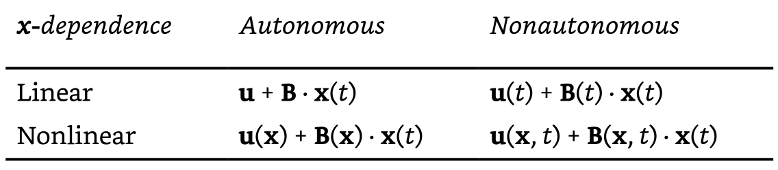
Research gap: nonlinear state dependence
In a coupled plant system, photosynthesis and conductance depend on state.
Therefore capacity becomes a map K(y, v)—not automatically a unique target.
MOTIVATION
8
Notes:
[Sources]
Matrix form based on image retained from original deck; project Stage C. Do not claim nonlinear land carbon modelling is absent.

Slide 9
The gap is interpretation, not lack of nonlinear models
Calculation
Can K(y,v) be computed?
Equilibrium
Does C = K also satisfy water balance?
Stability
Is that coupled equilibrium attracting?
Initial conditions
Will a particular plant state reach it?
MOTIVATION
9
Notes:
[Sources]
Interpretation motivated by project Stage C definitions, latest scalar equilibrium report.

Slide 10
Research question
When does nonlinear carbon storage capacity correspond to an equilibrium that actually attracts carbon stocks?
Case study: a six-state carbon–water system driven by VPD.
OBJECTIVE
10

Slide 11
Method: progressively coupled models
Manzoni hydraulics
Two water potentials
Carbon pools
Leaf · wood · root · soil
Coupling
Water stress → GPP
Feedback E0 → E1 → E4
Leaf / wood stocks → water flows
VPD is the controlled external forcing; root water potential is fixed.
METHODS
11

Slide 12
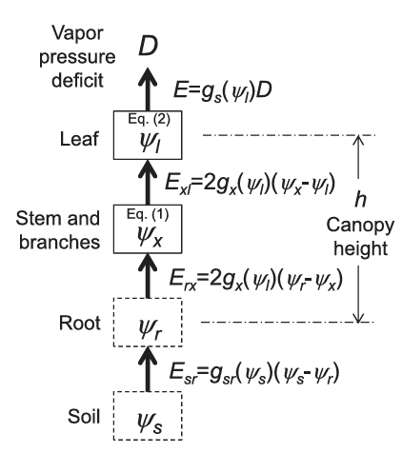
Manzoni: soil–plant–atmosphere continuum
Water supply = transpiration demand
Leaf and xylem water potentials respond dynamically to VPD.
Conductance decreases as leaf water potential becomes more negative.
METHODS
12
Notes:
[Sources]
Manzoni, Katul & Porporato (2014), Water Resources Research, DOI 10.1002/2013WR015236. Diagram retained from user-provided deck.

Slide 13
Manzoni: equilibrium reduced to a quadratic
Set dψx/dt = dψleaf/dt = 0
Eliminate ψx → one equation in ψleaf
Quadratic roots + physical-domain checks → hydraulic equilibria
Multiple roots can coexist; the Jacobian distinguishes stable and saddle branches.
Same elimination strategy for the coupled system
METHODS
13
Notes:
[Sources]
Manzoni et al. (2014); user hand derivation in original slides 14 and uploaded HSindex.pdf; hydraulic reproduction report.

Slide 14
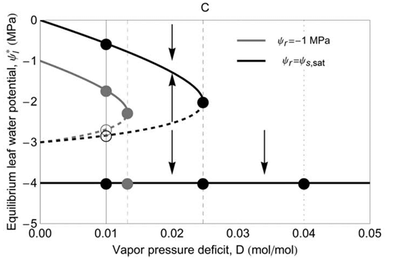
Hydraulic multistability in the reference model
A wet, conducting equilibrium can coexist with a dry-state branch.
METHODS
14
Notes:
[Sources]
Manzoni et al. (2014), Fig. 2 style image retained from original presentation; reproduce with permissions/attribution before public distribution.

Slide 15
A coupled six-state carbon–water model
y = (ψx, ψleaf, L, W, R, S)
GPP = p · h(ψleaf) · (1 − exp(−qL))
Carbon inflow depends on stomatal opening and leaf biomass.
E0: water → carbon
E4: carbon ↔ water
METHODS
15
Notes:
[Sources]
Source implementation: src/control_carbon/spac_carbon.py and spac_carbon_two_way.py, 2026-10-14 commit b827521. Synthetic coefficients, not calibrated plant physiology.

Slide 16
Main analytical result: reduce 6 equations to 1
At equilibrium: W = 21.33L, R = 4L, S = 54L
h(L) = rL / (1 − exp(−qL))
D = Dcurve(L)
Every positive conducting equilibrium is recovered from a root of this scalar equation.
The reduction concerns equilibria only—not the time-dependent six-state ODE.
RESULTS
16
Notes:
[Sources]
docs/spac_carbon_scalar_equilibrium_results.md sections 3–4, commit b827521. Algebraic reduction, not dynamic dimension reduction.

Slide 17

Root counts: two candidates versus one
The number of positive self-consistent capacity candidates follows from the equilibrium curve.
RESULTS
17
Notes:
[Sources]
Schematic (not quantitatively plotted) based on analytic shape results in docs/spac_carbon_scalar_equilibrium_results.md §4.

Slide 18
Quantified equilibrium classification
Model
Positive roots
Key VPD threshold
Stability message
E0
Up to 2
Fold 2.472 kPa
High-L stable; low-L saddle
E1
Up to 2
Fold 1.547 kPa
High-L stable; low-L unstable
E4
Exactly 1 or 0
Positive root for VPD < 4.807 kPa
Can lose stability at Hopf
The E4 root-existence limit is mathematical; >3.17 kPa exceeds saturation VPD at 25°C.
RESULTS
18
Notes:
[Sources]
Analytic fold and root counts: docs/spac_carbon_scalar_equilibrium_results.md. E4 Hopf and synthetic coefficients: stage_b3_e4_results.md. Thresholds are model values, not observed drought thresholds.

Slide 19
A capacity candidate need not be an attractor
At every full equilibrium: K(y*,v) = C*
E0 / E1
E4
Two candidate capacities can coexist—only the high-L branch is stable.
A unique candidate can become unstable at a Hopf bifurcation.
Main implication: existence, uniqueness, and attraction are distinct mathematical properties.
RESULTS
19
Notes:
[Sources]
Scalar equilibrium report §6; E4 subcritical Hopf VPD 2.664752905 kPa, based on numerical local bifurcation diagnostics, not interval certified.

Slide 20
Hydraulic closure: capacity and stocks separate
Instantaneous closure
Persistent non-assimilation
gs = 0 → GPP = 0 → K = 0
dC/dt = MC
Stocks C can still be positive.
C(t) → 0 only over time.
Additional result: with xylem closure, even gs > 0 can coexist with K(t) → 0.
RESULTS
20
Notes:
[Sources]
Analytical propositions A–D in docs/spac_carbon_scalar_equilibrium_results.md §7. All long-run extrapolation is formal past the positive-leaf simulation domain; no physiological death model.

Slide 21
Same VPD, different initial states
Fixed VPD = 2.44 kPa. Initial leaf water potential is varied.
Initial ψleaf
E0 outcome
E4 outcome
−1.5 MPa
Near healthy equilibrium after 100 y
Near healthy equilibrium after 100 y
−2.5 MPa
Leaf-domain exit ~14.15 y
Leaf-domain exit ~14.49 y
−4.2 MPa
Leaf-domain exit ~14.15 y
Leaf-domain exit ~14.49 y
−3.5 MPa, very low L
Exit ~0.87 y
Exit ~1.20 y
“Leaf-domain exit” means reaching the numerical Lmin cutoff—not observed mortality.
RESULTS
21
Notes:
[Sources]
Initial-condition cases from docs/spac_carbon_scalar_equilibrium_results.md §9. Actual full six-component initial states stored in gitignored local results JSON, not available in public repository.

Slide 22
Stage B / C: bifurcation meets tracking
Frozen-environment view
Time-dependent view
How many equilibrium capacities exist?
Can the plant track a moving equilibrium?
Are equilibria stable or unstable?
How fast do responses decay or amplify?
Where do fold and Hopf occur?
Do initial states remain in the attracting region?
E4: a unique equilibrium loses stability near VPD 2.665 kPa; rapid changes can trigger leaf-domain exit.
DISCUSSION
22
Notes:
[Sources]
Stage B3 and C2/C3 reports: subcritical Hopf is numerical, unstable cycles not attractors; ramp 2.66 kPa endpoint and 10-day domain exit are separate tests; no proven basin boundary or true R-tipping.

Slide 23
Discussion: what is actually established?
Proved
Positive conducting equilibria reduce to one scalar equation. E0/E1 have one fold; baseline E4 is monotone.
Proved
Stomatal closure implies K = 0. Sustained closure drives carbon stocks toward zero in the formal equations.
Numerically checked
E4 has a local subcritical Hopf; fixed-VPD initial conditions can give very different outcomes.
Not yet established
Real-tree mortality, global basin boundaries, or a general physiological VPD tipping threshold.
DISCUSSION
23
Notes:
[Sources]
docs/spac_carbon_scalar_equilibrium_results.md and stage_c23_results.md; evidence categories deliberately distinguished.

Slide 24
Main conclusion
Carbon storage capacity remains mathematically definable—but in a nonlinear coupled system it is not automatically a unique, stable, or reachable storage target.
The next step is to identify which initial conditions lead to the positive capacity branch versus persistent low-assimilation dynamics.
DISCUSSION
24
Notes:
[Sources]
Synthesis of Luo-style capacity definitions and repository analytical/numerical results; interpretation is model-specific.

Slide 25
Next steps
01
Classify the basin boundary for fixed VPD
Start with one-way E0; compare with E4 feedback.
02
Connect local bifurcation results to long-run outcomes
Keep unstable periodic orbits separate from true attractors.
03
Test robustness to uncertain physiological assumptions
Prioritize qualitative capacity conclusions over new detailed wood anatomy.
04
Clarify when capacity can be interpreted as a prediction
State assumptions on equilibria, stability, and initial states.
FUTURE
25
Notes:
[Sources]
Priorities from latest scalar equilibrium report and user research objective.

Slide 26
Selected references & research sources
• Olson (1963), Ecology 44, 322–331. doi:10.2307/1932179
• Luo & Weng (2011), Trends Ecol. Evol. 26, 96–104. doi:10.1016/j.tree.2010.11.003
• Luo et al. (2022), JAMES 14, e2022MS003008. doi:10.1029/2022MS003008
• Manzoni et al. (2014), Water Resour. Res. 50, 5170–5183. doi:10.1002/2013WR015236
• Control_carbon_model, commit b827521 (2026-10-14): scalar equilibrium and capacity analysis.
Synthetic model calculations are not empirical calibration results.
REFERENCES
26
Notes:
[Sources]
Bibliographic sources as specified on earlier slides; GitHub repo https://github.com/Sachitama2001/Control_carbon_model .

