Slide 1
VISIT: structure and usage
2020/08/12
Akihiko Ito (National Institute for Environmental Studies)

Slide 2


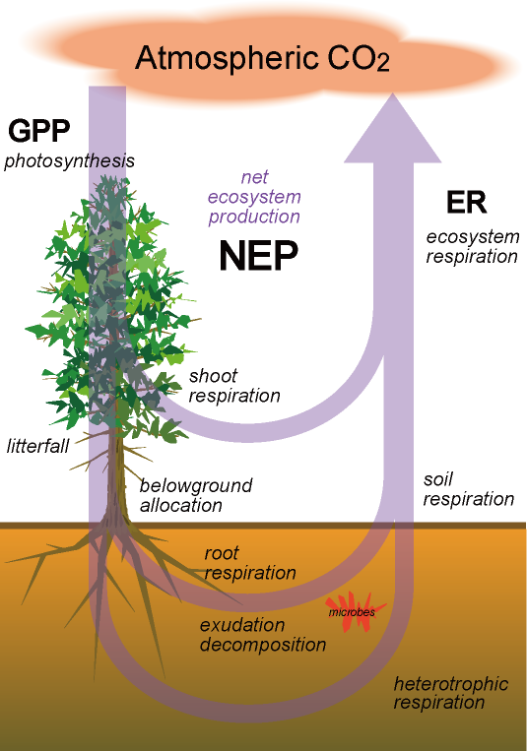
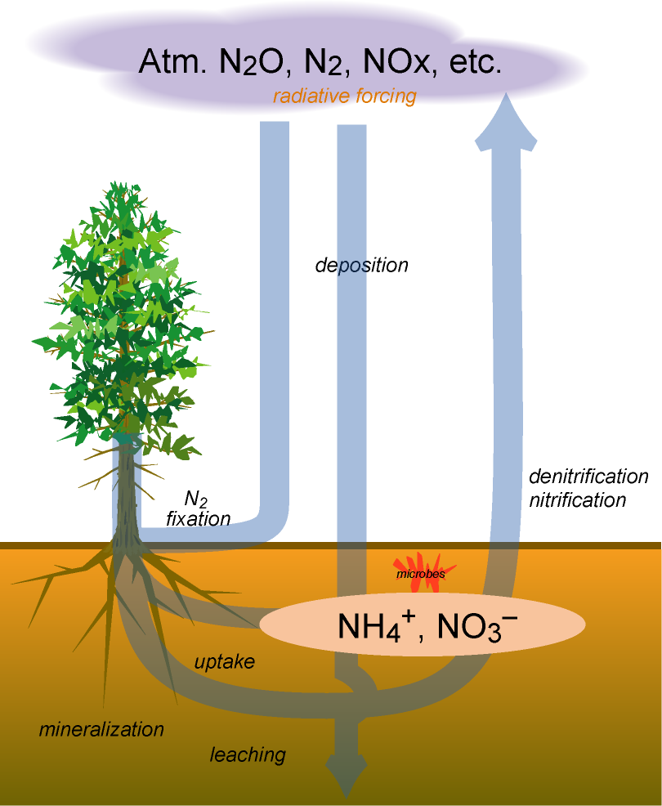
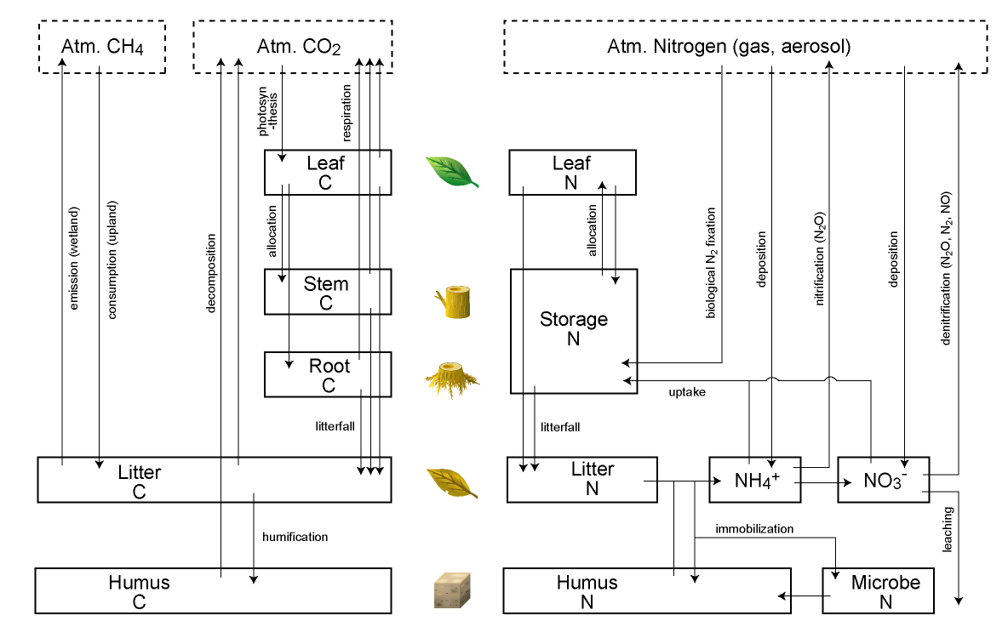
“Ordinary” explanation
Vegetation Integrated SImulator for Trace gases
(Developed in NIES & FRCGC-JAMSTEC)
Objectives
• Atmosphere-ecosystem biogeochemical interactions
• Especially, major greenhouse gases (CO₂, CH₄, and N₂O) budget
• Assessment of climatic impacts and biotic feedbacks
Point-global, daily-monthly
- CO₂: photosynthesis & respiration
- CH₄: production & oxidation
- N₂O: nitrification & denitrification
- LUC emission: cropland conversion
- Fire emission: CO₂, CO, BC, etc.
- BVOC emission: isoprene etc.
- Others: N₂, NO, NH₃, erosion
Carbon-cycle
(Sim-CYCLE-based)
Nitrogen-cycle

Slide 3
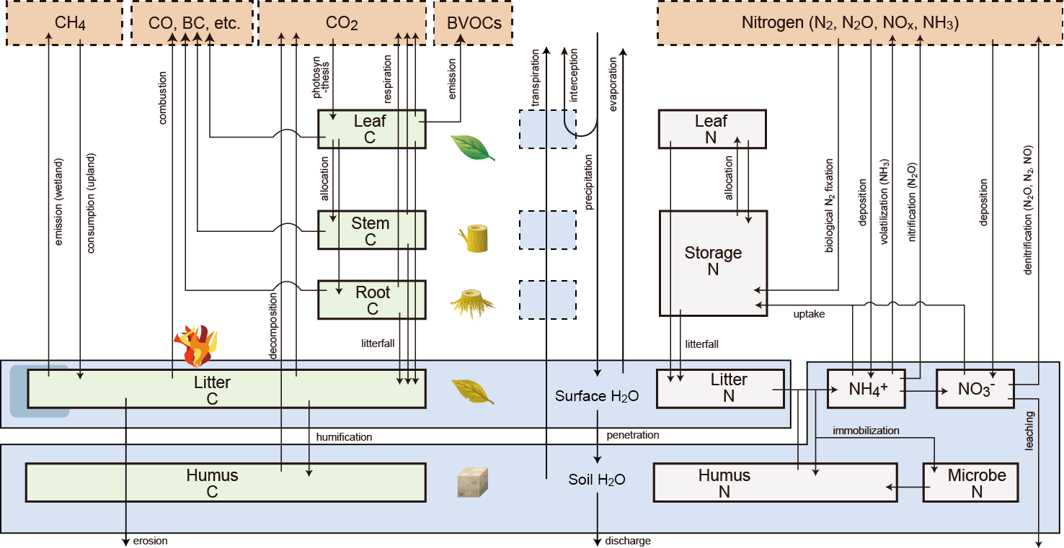
Model
Vegetation Integrated SImulator for Trace gases
(Developed by NIES & JAMSTEC)
Objectives
• Atmosphere-ecosystem biogeochemical interactions
• Assessment of climatic impacts and biotic feedbacks
• Ecosystem functions related to ecosystem services
Carbon-cycle
Water-cycle
Nitrogen-cycle

Slide 4
Concepts
What are characteristics of VISIT?
• Origin in ecophysiology, especially the dry-matter production theory
• Generality in simulating atmosphere-biosphere trace gas exchange
• Intermediate complexity
• Broad scalability: from point to the globe

Slide 5
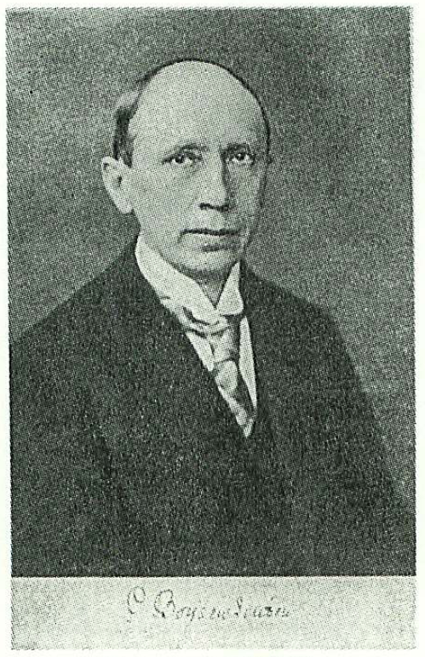
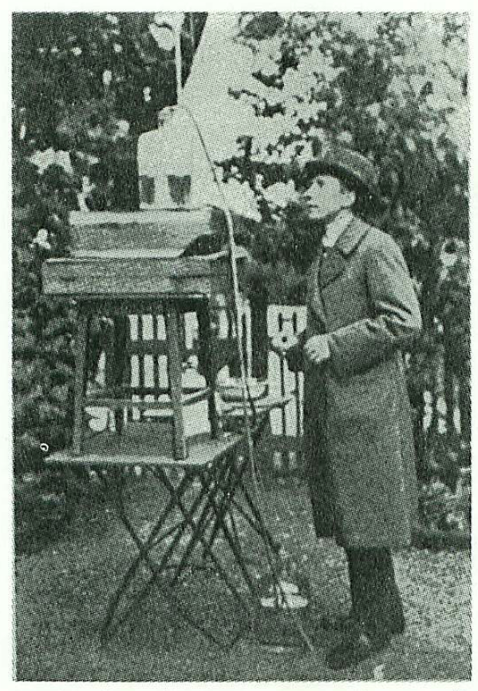
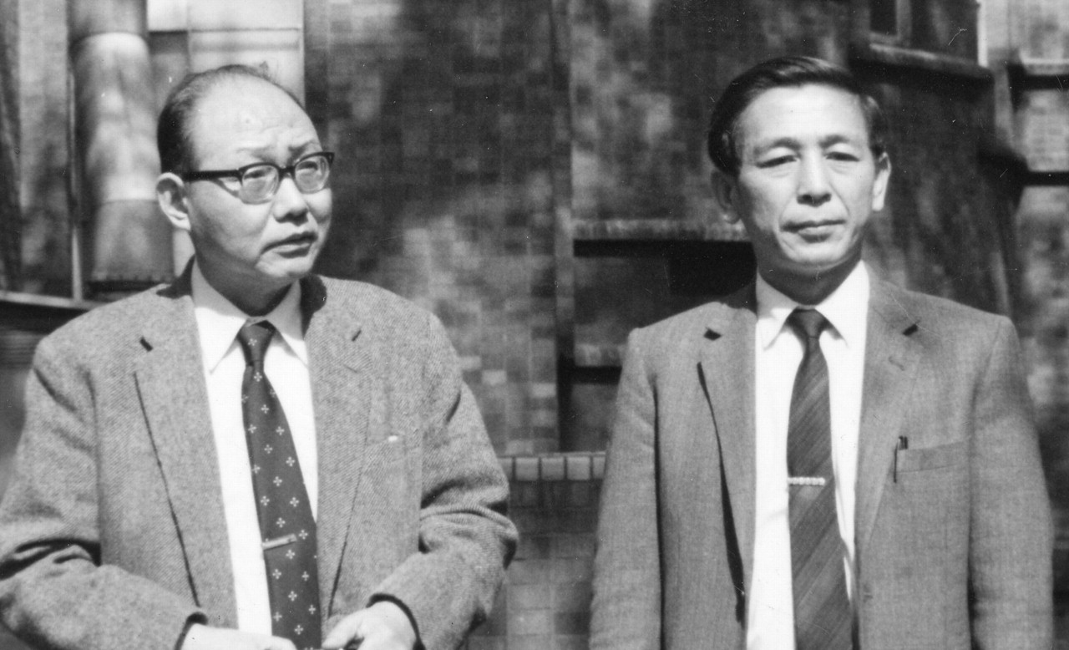
Pioneers of plant ecophysiology
Peter Boysen-Jensen (1883-1959)
- first measurement of canopy photosynthesis
Masami Monsi (門司正三: 1914-1997: left)
Toshio Saeki (佐伯敏郎: 1927-2004: right)
- first model of canopy photosynthesis
- dry-matter production theory (物質生産理論)
Annals of Botany 95/3 © Annals of Botany Company 2004; all rights reserved

Slide 6
Short history of modeling
1953 Mathematical model of canopy photosynthesis (Monsi & Saeki)
1985 Box-flow model of carbon cycle (T. Oikawa)
1997 Global terrestrial carbon cycle model, Sim-CYCLE (A.Ito)
2000 Interannual variability (e.g., ENSO: Ito & Oikawa 2000a, b)
2002 Description paper (Ito & Oikawa 2002)
2003 Carbon isotope (Ito 2003a), East Asian simulation (Ito 2003b)
2004 Global radiation use efficiency (Ito & Oikawa 2004)
2005 Global warming impacts (Ito 2005a, b), Siberian fire (Ito 2005c)
Simulation at Takayama site (Ito et al. 2005)
2006 Model intercomparison (Ito & Sasai 2006)
2007 Erosion (Ito 2007)
2008 East Asian carbon budget (Ito 2008), ecosystem resp. (Ito et al. 2008)
2009 Climate-carbon coupling (Kato, Ito, Kawamiya 2009)
2010 Typhoon impact (Ito 2010), East Asian MIP (Ito et al. 2010)
GHG evaluation (Inatomi, Ito, et al. 2010)
2011 ?

Slide 7
3 lines of VISIT
VISITa
- applicable mainly at global scale
- monthly time-step
- includes major trace gas exchange schemes
- simple: 1-layer vegetation + 2-component soil carbon
- fast (<2days for the globe at 0.5°x0.5° resolution)
VISITb
- applicable at point, region, and global scales
- daily (and 30-min) time-step
- includes major trace gas exchange schemes and biochemical photosynthesis scheme
- fine: 2-layer vegetation + 9-component soil carbon
- not so fast?
used by ongoing projects
VISITc
- hourly

Slide 8
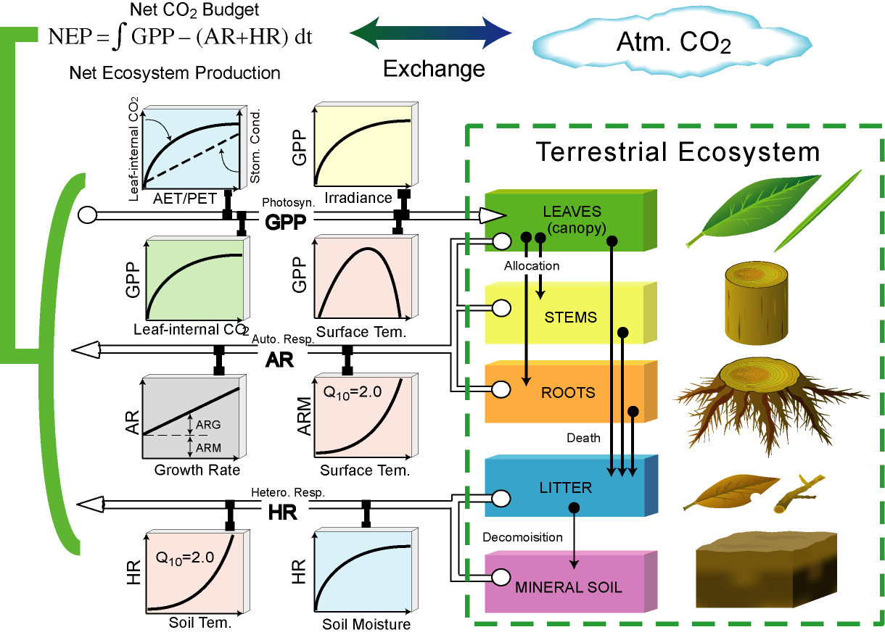
Explanation of Sim-CYCLE (-2007)
Ito and Oikawa (2000)

Slide 9
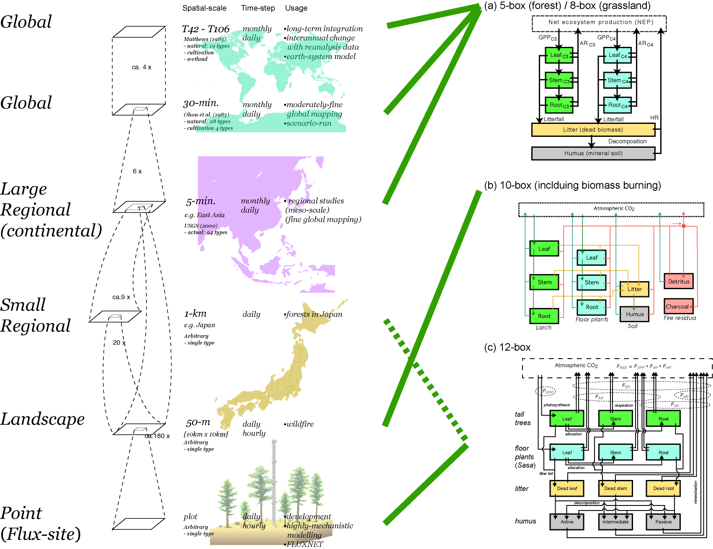
Model scaling
VISITa
VISITb
VISITc

Slide 10
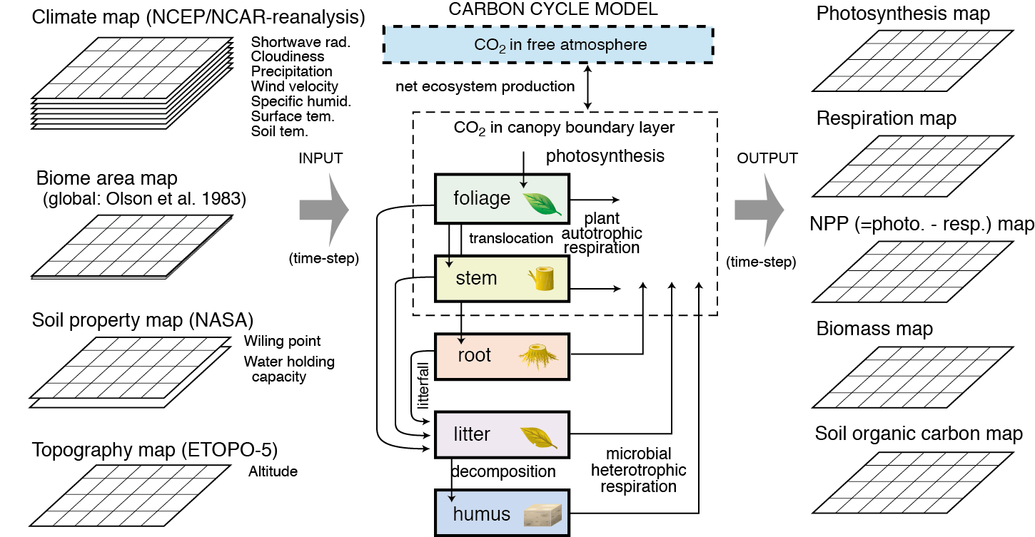
Overview

Slide 11
Data
temporal loop
spatial loop
Input
Input
Input
Input
Input
Input
[space x time]
Characteristics
MODEL
(e.g. VSIT)
Parameter
Input
Output
Input
Input
Input
Output
[space x time]

Slide 12


Data: inputs
Definition：data that drive model simulation (i.e., required at every time-step)
=> gaps should be filled by interpolation, look-up table, etc.
Radiation
Temperature
Atm. CO₂ conc.
Humidity
Wind
Others（veg. prop.）
（land-use change）

Slide 13
Data: characteristics
Definition：data that characterize simulation point （i.e., fixed throughout time-steps）
=> hopefully, they should be obtained by observation; otherwise, from datasets
Latitude
Longitude
Altitude
Vegetation data
・biome
・plant functional type (composition)
・species composition
・disturbance history（logging, fire, etc.）
Soil type
（e.g., spodosol, andisol, etc.）
Soil properties
・sand/clay fractions
・bulk density, albedo
・pH
・soil depth etc.

Slide 14
Data: parameters
Definition：data that characterize model behavior (medium variables)
→e.g.,：light-photosynthesis parameters: A_{max}, Φ
→observation of representative parameter values is difficult
→limited observation and biome-specific values are used
Stomatal conductance：mon., max., VPD-dependence
Parameters are required for each biome, plant functional type, and soil type
（e.g.,：C₃/C₄、tree/grass）
Leaf N（profile）
Max. rates（Vcmax、Jmax）
Quantum yield
Dark respiration
Arrhenius-eq. parameters
Leaf thickness（SLA）
Reflectance
Attenulation（K）
Mortality
Stem resp.：sap-wood, heart-wood
（maintenance, construction）
（temperature dependence, Q₁₀）
Mortality
Decomposition for each component
（mean residence time）
・temperature dependence
・water dependence
Mineralization （CO₂） coefficient
Allocation, allometry
Root resp.：fine/coarse roots
（maintenance, construction）
（temperature dependence, Q₁₀）
Mortality

Slide 15
Data: outputs
Definition：data that are obtained from model simulation at every time step
=> these data are compared with observation for validation
Net CO₂ budget（NEP）
Water-use efficiency
Light-use efficiency
decomposition
photosynthesis
（GPP）
respiration
Canopy conductance
Light absorption
Growth rate
（RGR etc.）
Biomass
（for each organ）
GHG budget
（CH₄、N₂O）
Other gases
（BVOC etc.）
Water budget
（evapotranspiration,
runoff）
Soil carbon
（for each component）

Slide 16
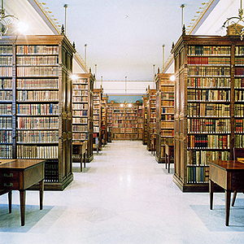


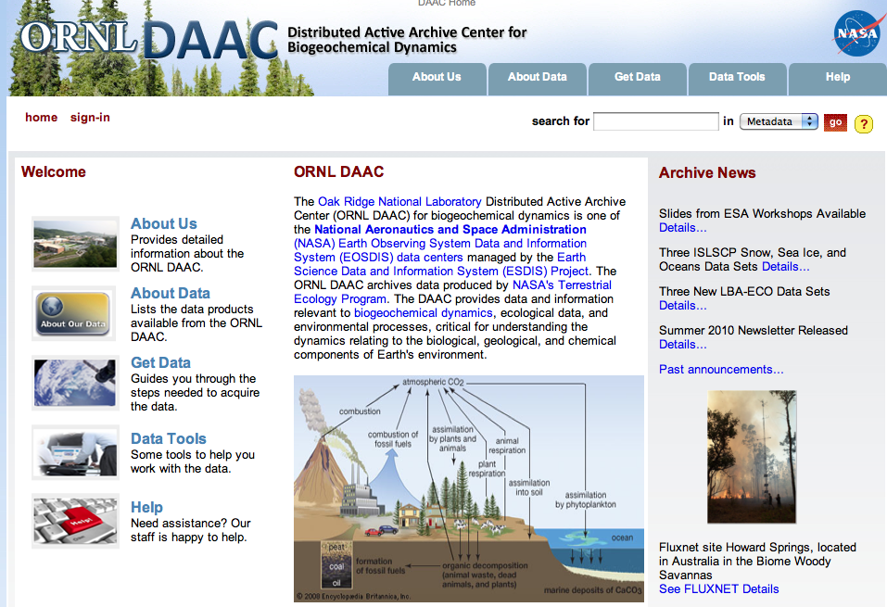
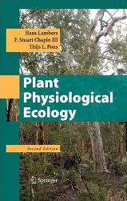
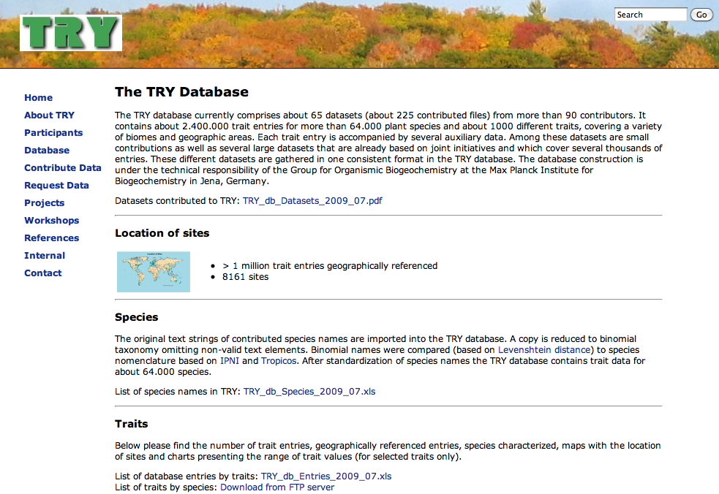
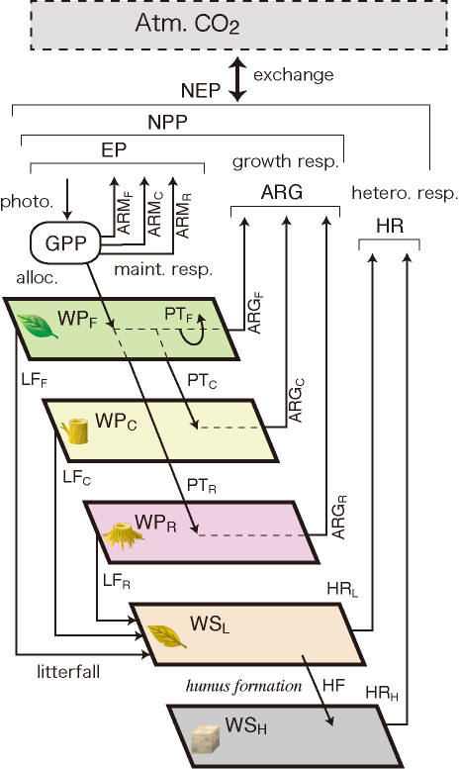
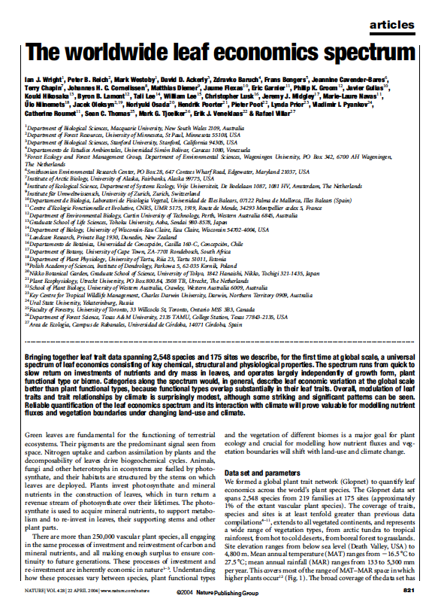
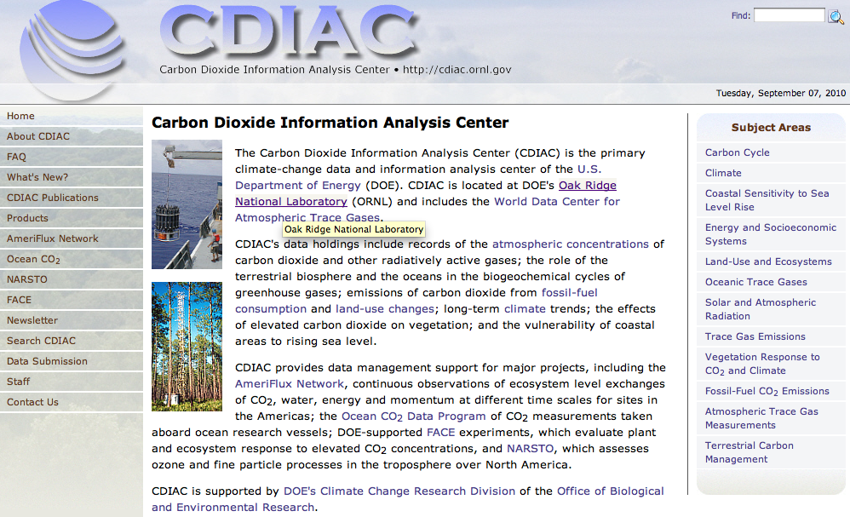
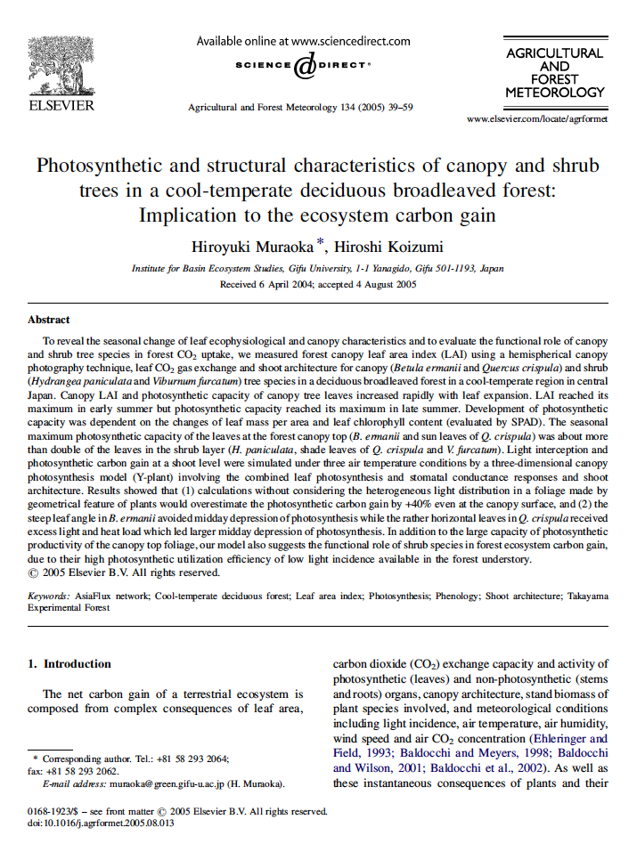
Data sources
Past data （problems：bias, time-lag）
On-line dataset
（problems: credibility）
Text（equation, representative parameters）
Literature（reviews, meta-analyses）
Other models
（papers, codes, pers.comm.）

Slide 17
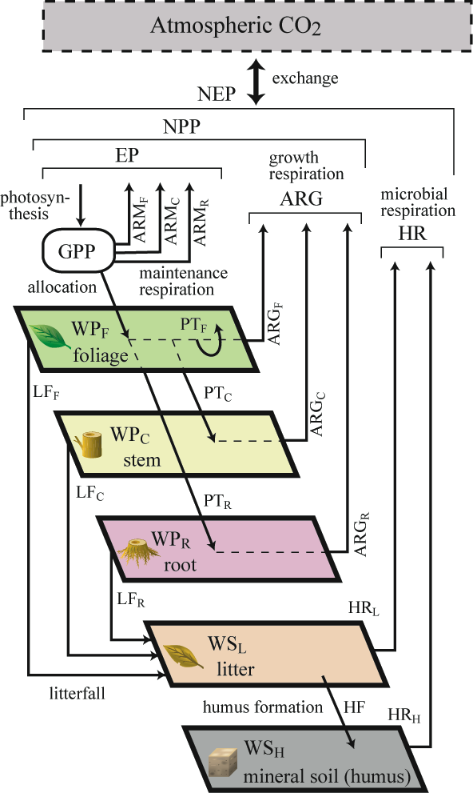
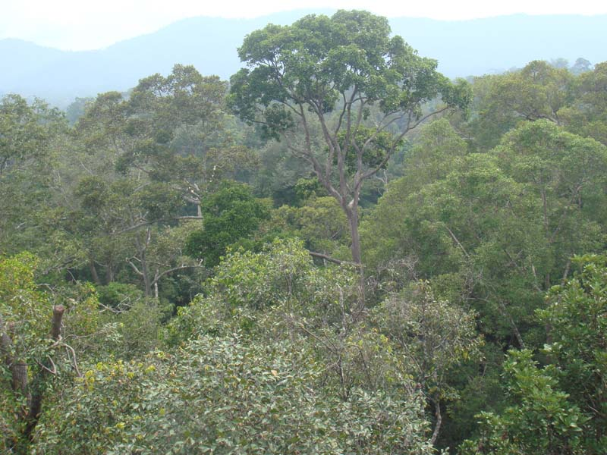
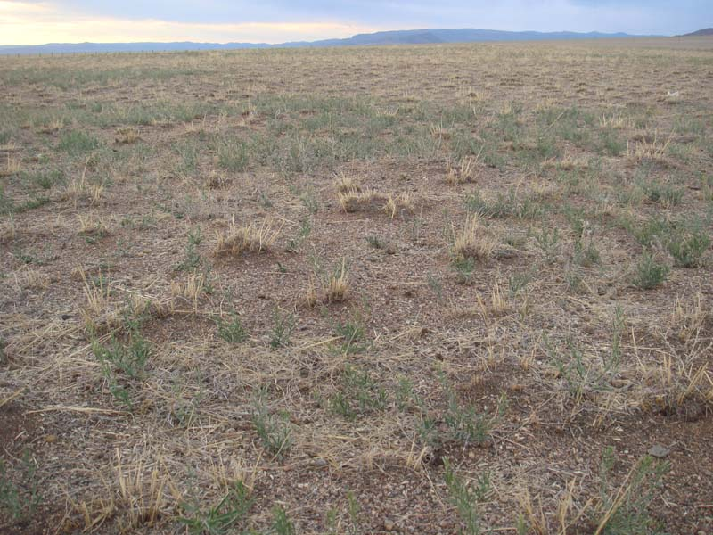
Box-flow approximation
• simplification (low computational cost)
• generalization (global applicability)
Sim-CYCLE (VISITa )
complexity
non-linearity
diversity
uncertainty

Slide 18
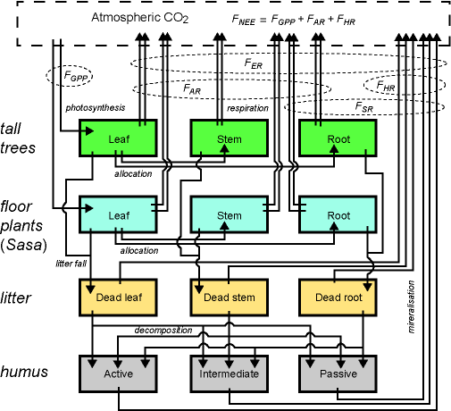
Box-flow system of VISITb
Full carbon cycling expression
(nitrogen cycle ignored)
C-N cycling expression
(carbon cycle simplified)

Slide 19
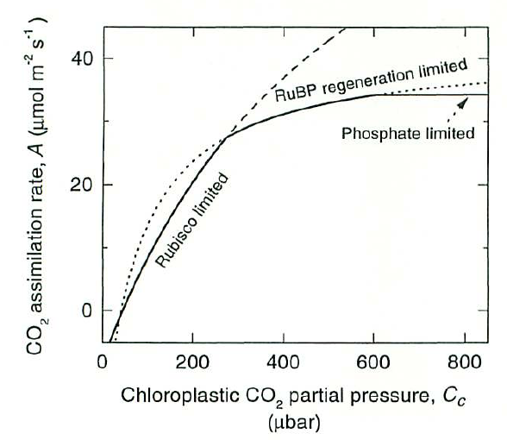
GPP: biochemistry
Leaf biochemical photosynthesis scheme（C₃）
Effective Michaelis-Menten constant
Light-electron transport
PAR absorbed by PSII
respiration/maximum photosynthetic rate
Net photosynthesis
Arrhenius equations：K_{c}, K_{o}, V_{l}, J_{m}, R_{l}, Γ*
Rubisco-limitated rate
Temperature dependence：Γ*
RUBP-regeneration-limited rate
Temperature dependence：J_{m}
Farquhar, von Caemmerer, Berry (1980)

Slide 20
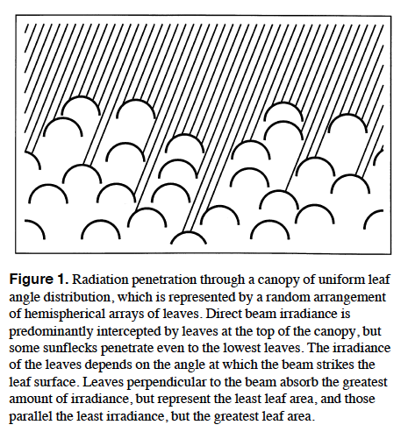
GPP: 1-layer canopy
1-layer（big-leaf）
Leaf area index: Lc
diffuse
beam
Absorption of solar radiation
beam
Total N
beam
diffuse
diffuse
Max. carboxylation rate (V_{c} or V_{cmax})
Dark respiration
Max. electron transport rate (J_{m})
De Pury & Farquhar (1997)

Slide 21

GPP: 2-layer canopy
Canopy photosynthesis
sun
sun
sun
Rubisco-limited
sun
shade
shade
shade
Electron transport-limited
Stomatal conductance
I_{cSun}
A_{Sun}
Sunny canopy
pi_{Sun}
L_{Sun}
V_{cSun}
gs_{Sun}
Intercellular CO₂ concentration
I_{cSh}
A_{Sh}
Shade canopy
Solution of simultaneous equations
pi_{Sh}
- numerical: Newton-Raphson method
- analytical: Baldocchi (1994)
L_{Sh}
V_{cSh}
gs_{Sh}

Slide 22
GPP: 2-layer canopy
Leaf area index
sun
sun
sun
sun
Absorbed solar radiation
sun
shade
shade
sun
Sun leaves
sun
shade
shade
shade
beam
diffuse
scattered
Carboxylation capacity: sun leaves
Electron transport capacity (J_{m})

Slide 23
GPP: 2-layer canopy
Absorbed solar radiation (continued)
Shade leaves
sun
sun
sun
sun
sun
shade
diffuse
scattered
shade
sun
sun
shade
shade
shade
Carboxylation capacity: sun leaves
Electron transport capacity (J_{m})

Slide 24
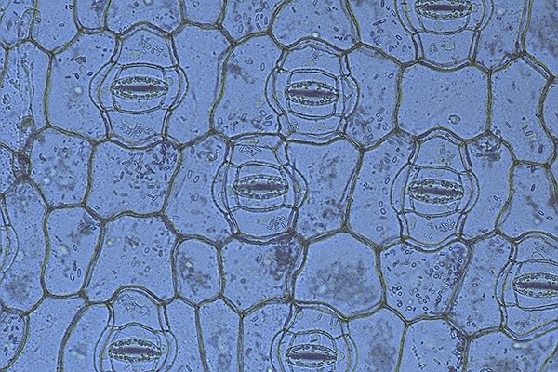
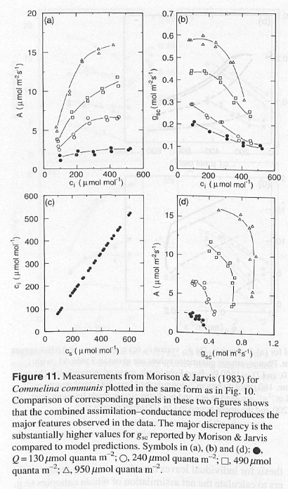
Stomatal conductance
Intercellular CO₂ pressure
Stomatal conductance
Jarvis (1976)
Ball et al. (1986)
Leuning (1995)
Canopy conductance（scaling）
（Leuning 1995: PCE）

Slide 25
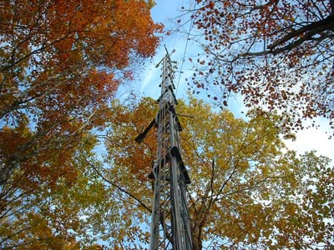
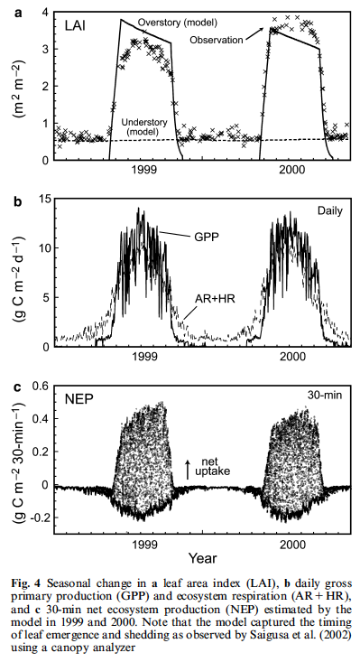
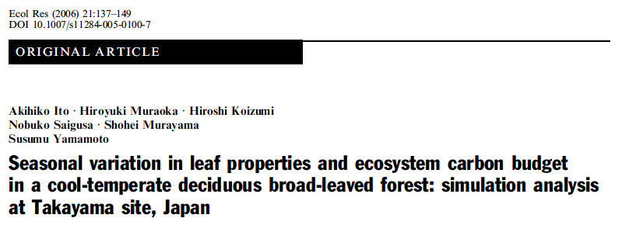
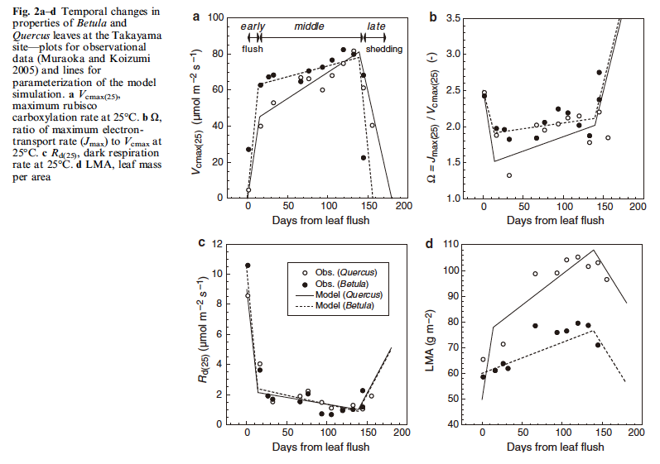
Simulation at Takayama site

Slide 26
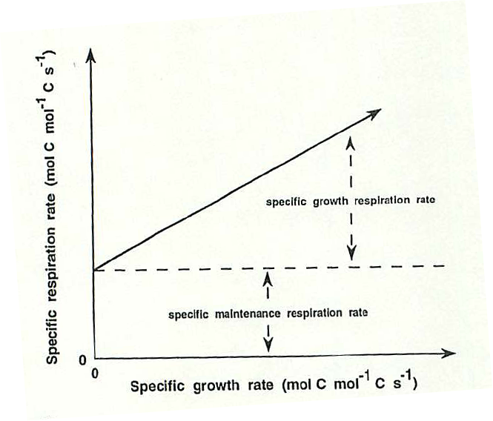
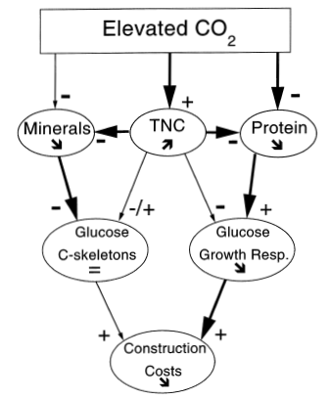
Respiration
Whole-plant respiration
2-component scheme
maintenance
construction (growth)
Maintenance
biomass
Construction
growth
m: maintenance cost
g: construction cost
（Poorter et al. 1997: PCE）

Slide 27
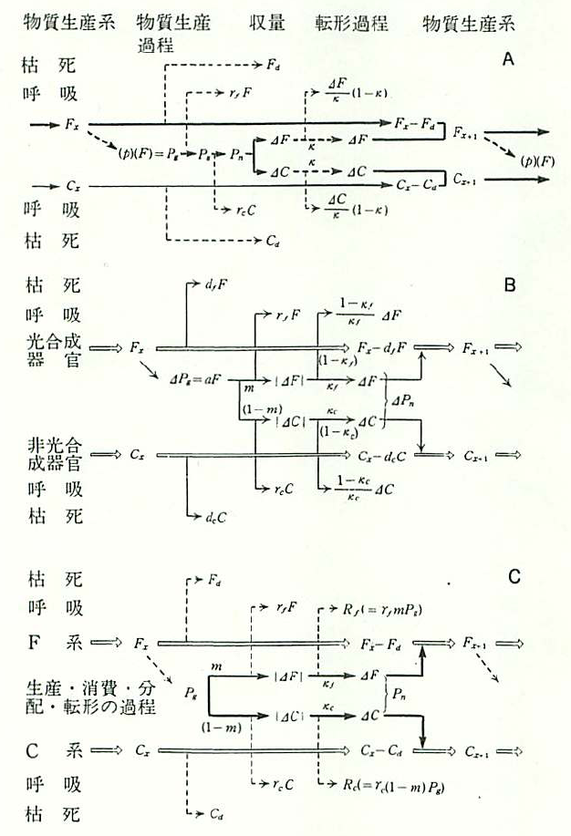
Partitioning / Allocation
Temporal change in leaf biomass （VISIT）
photosynthesis
maintenance resp.
If LAI < LAI_{opt}
allocation
construction resp.
leaf litter
If LAI >= LAI_{opt}
Change in leaf nitrogen
allocation
re-allocation
litter
absorption
biological fixation
Kuroiwa (1990)

Slide 28
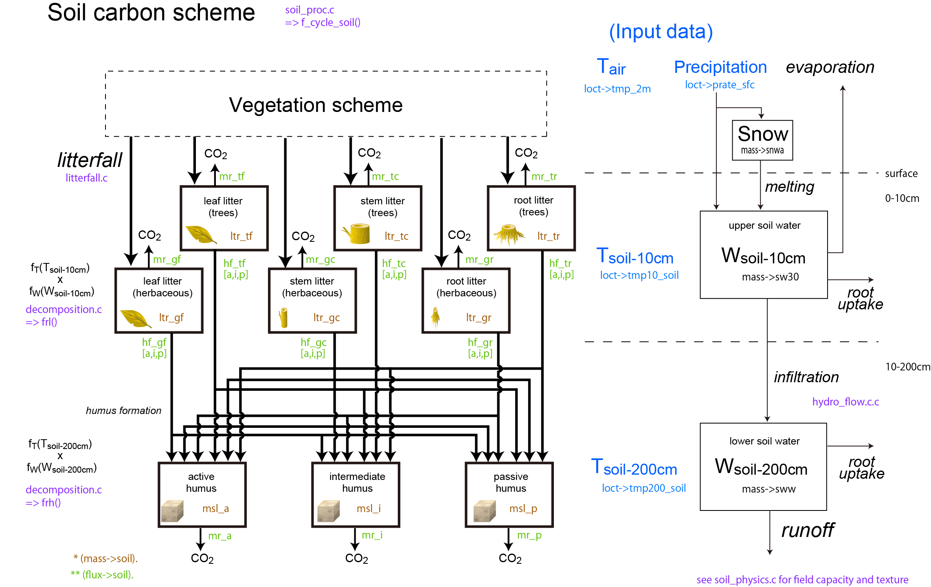
Underground processes

Slide 29
Not yet described…
• Phenology
• Nitrogen flows
• Net radiation
• Evapotranspiration
• Runoff
• Disturbance: logging, wildfire, etc.
• BVOC emission
• Erosion
• DOC discharge
• CH4 exchange
• Ecophysiology: leaf aging etc.

Slide 30
Usage: overview
Data preparation: input, characteristics, parameters
Editing set-up files and parameters
Compilation [gcc, icc, Xcode[gcc], Visual Studio, etc.]
Debugging, if required
Performing simulations
Analysis of simulation output

Slide 31
Code and header files
Headers
definition.h
structure.h
prototype.h
global_variables.h
Codes
agriculture.c
allocation.c
ansis.c
atm_co2.c
canopy.c
ch4_emit.c
ch4_oxy.c
clear.c
daily_scheme.c
decomposition.c
disturbance.c
doc.c
ecophysiology.c
erosion.c
experiment.c
flux_site.c
hydro_balance.c
hydro_flows.c
init_region.c
init_site.c
initi_mass.c
initialize.c
isotope.c
leaf_aging.c
litterfall.c
location_init.c
location_proc.c
main.c
miscellaneous.c
n2o_emit.c
n_budget.c
n_flux.c
parameter.c
parameter_var.c
phenology.c
photosynthesis.c
plant_proc.c
radiation.c
respiration.c
setting.c
soil_physics.c
soil_proc.c
spinup.c
two_canopy.c
vocemit.c

Slide 32
Structure
Q. What is ‘structure’ in C-language?
A. Structure is a group of variables.
gloval_variables.h
/* structures */
struct Grid grid[DROW][DCOL]; /* grid condition*/
struct Mass mass[DROW][DCOL]; /* carbon and nitrogen mass */
struct Loct loct; /* local conditions*/
struct Echar echar; /* ecosystem characteristics */
struct Flux flux; /* flux variables */
struct Echar echar_type[NFILE]; /* default parameters */
Definition of Grid, Mass, Loct, Echar, Flux => structure.h
Ex (main.c) f_initialize(grid, &loct, &echar, echar_type, mass, &flux, fp_r);

Slide 33
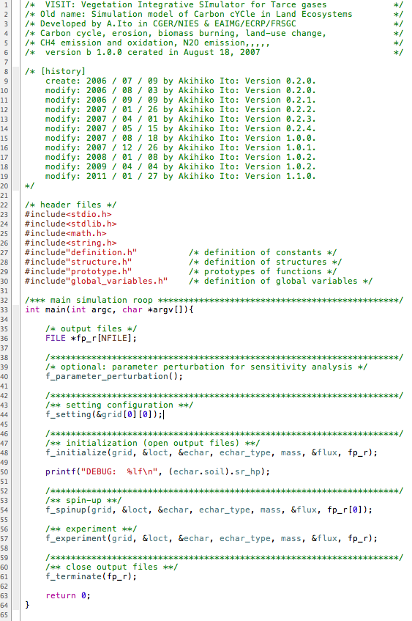
main.c
comments
including header files
(parameter perturbation)
simulation setting
initialization
spin-up
experiment
termination

Slide 34
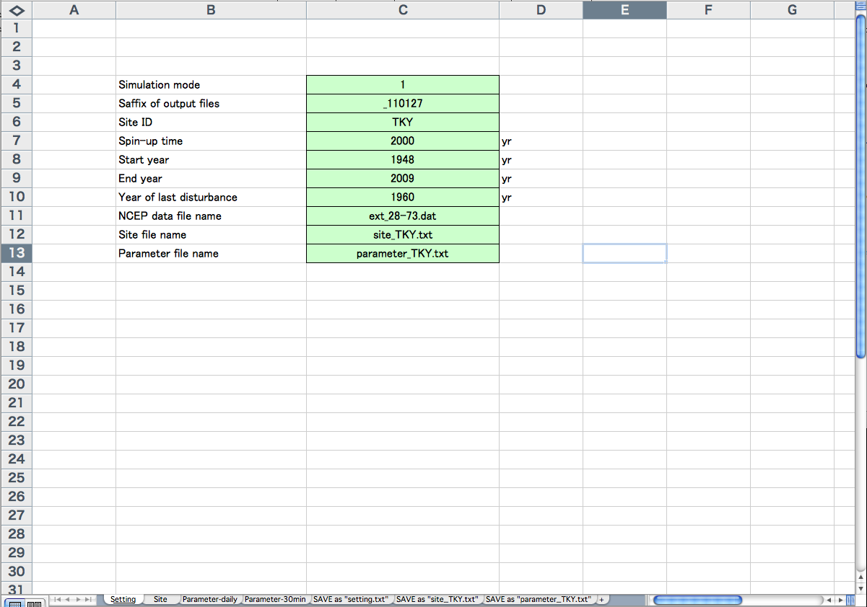

2. Editing set-up files and parameters [1]
Setting files are in MS-EXCEL sheets.
Edit ‘setting’
Save as ‘setting.txt’
(text format)

Slide 35
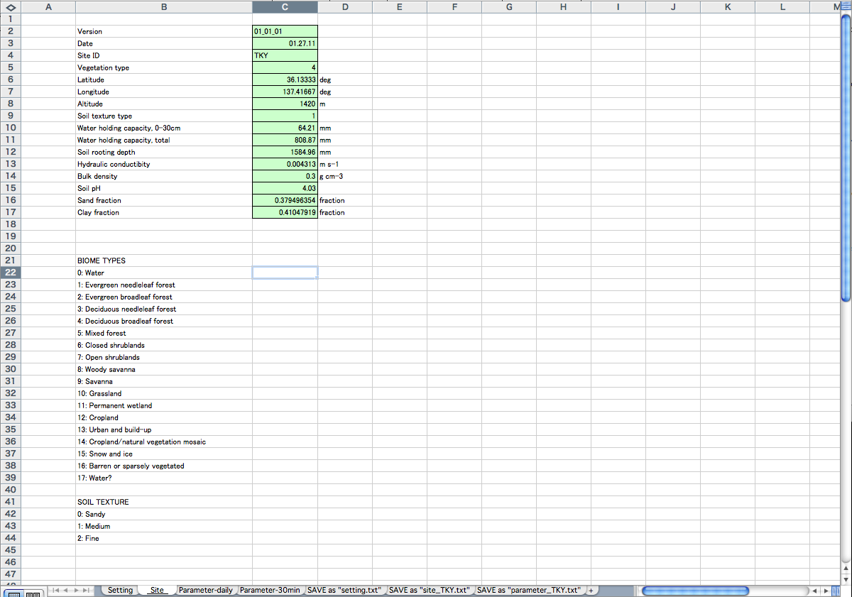

2. Editing set-up files and parameters [2]
Setting files are in MS-EXCEL sheets.
Edit ‘Site’
vegetation type
location
Save as ‘site_XXX.txt’
(text format)
XXX = ID
soil properties

Slide 36
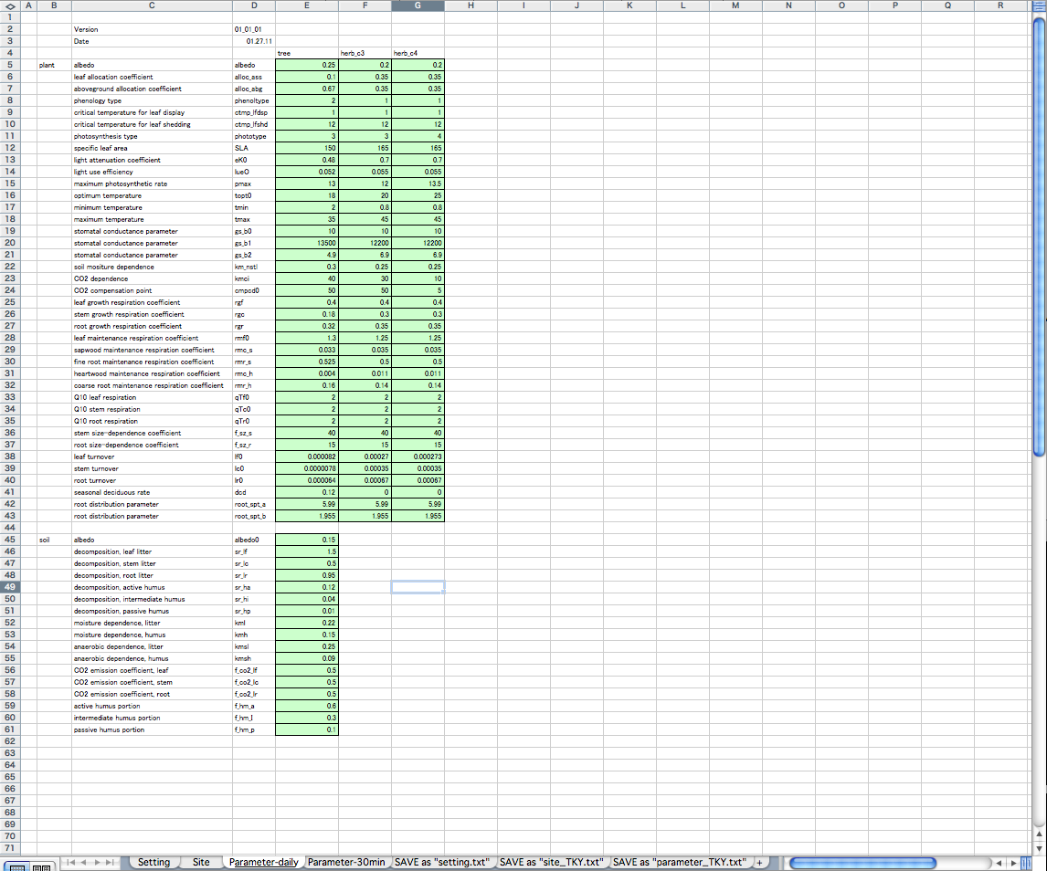

2. Editing set-up files and parameters [3]
Setting files are in MS-EXCEL sheets.
Edit ‘Parameter-daily’
Save as ‘parameter_XXX.txt’
(text format)
XXX = ID

Slide 37
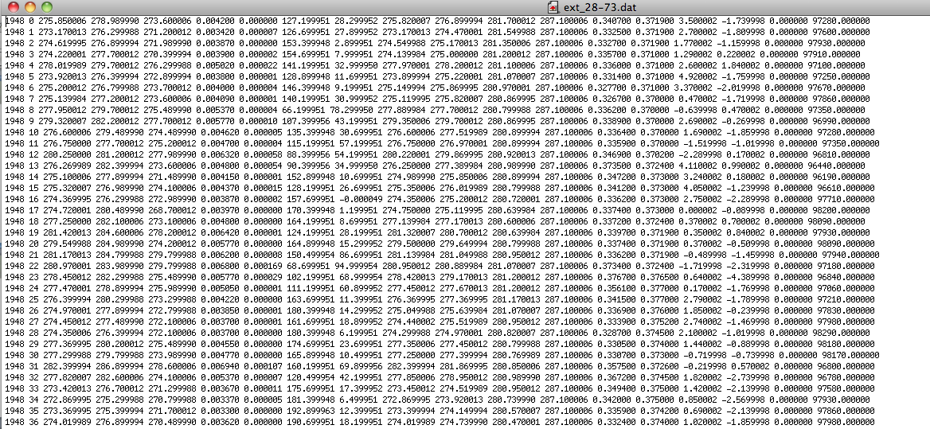
Climate [NCEP] data
Column
year
day of year
mean 2m air temp. [K]
max 2m air temp. [K]
min 2m air temp. [K]
specific humidity at 2m [kg/kg]
daily precipitation [kg/m2/s]
daily mean down SW [W/m2]
cloud cover [fract.]
surface temp. [K]
soil 0-10cm temp. [K]
soil 10-200cm temp. [K]
soil 300cm temp. [K]
soil 0-10cm water content [frac.]
soil 10-200cm water content [frac.]
east-west wind [m/s]
north-south wind [m/s]
snow accumulation [kg/ms]
surface air pressure [Pa]
[text format, blank/tab-spaced]
IMPORTANT!
In some case, climate data should be corrected on the basis of field observation data.

Slide 38
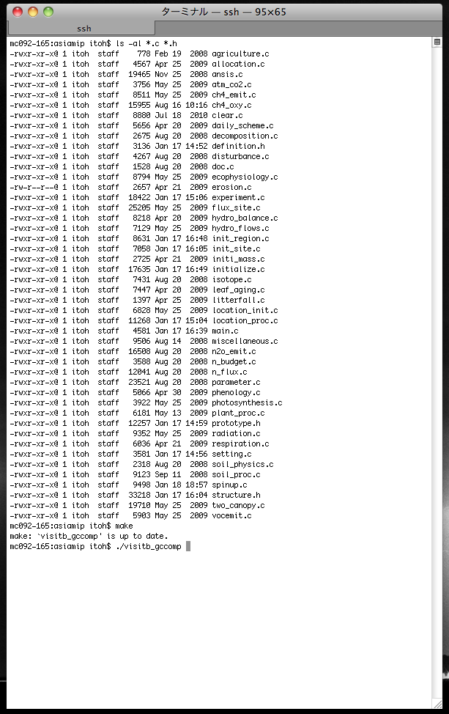
Usage: command-based
Compiling and debugging tool: gcc/icc, gdb
Editor: vi, emacs, etc.
Usage: compilation and simulation run
1. > make
2. > ./visitb
See README

Slide 39
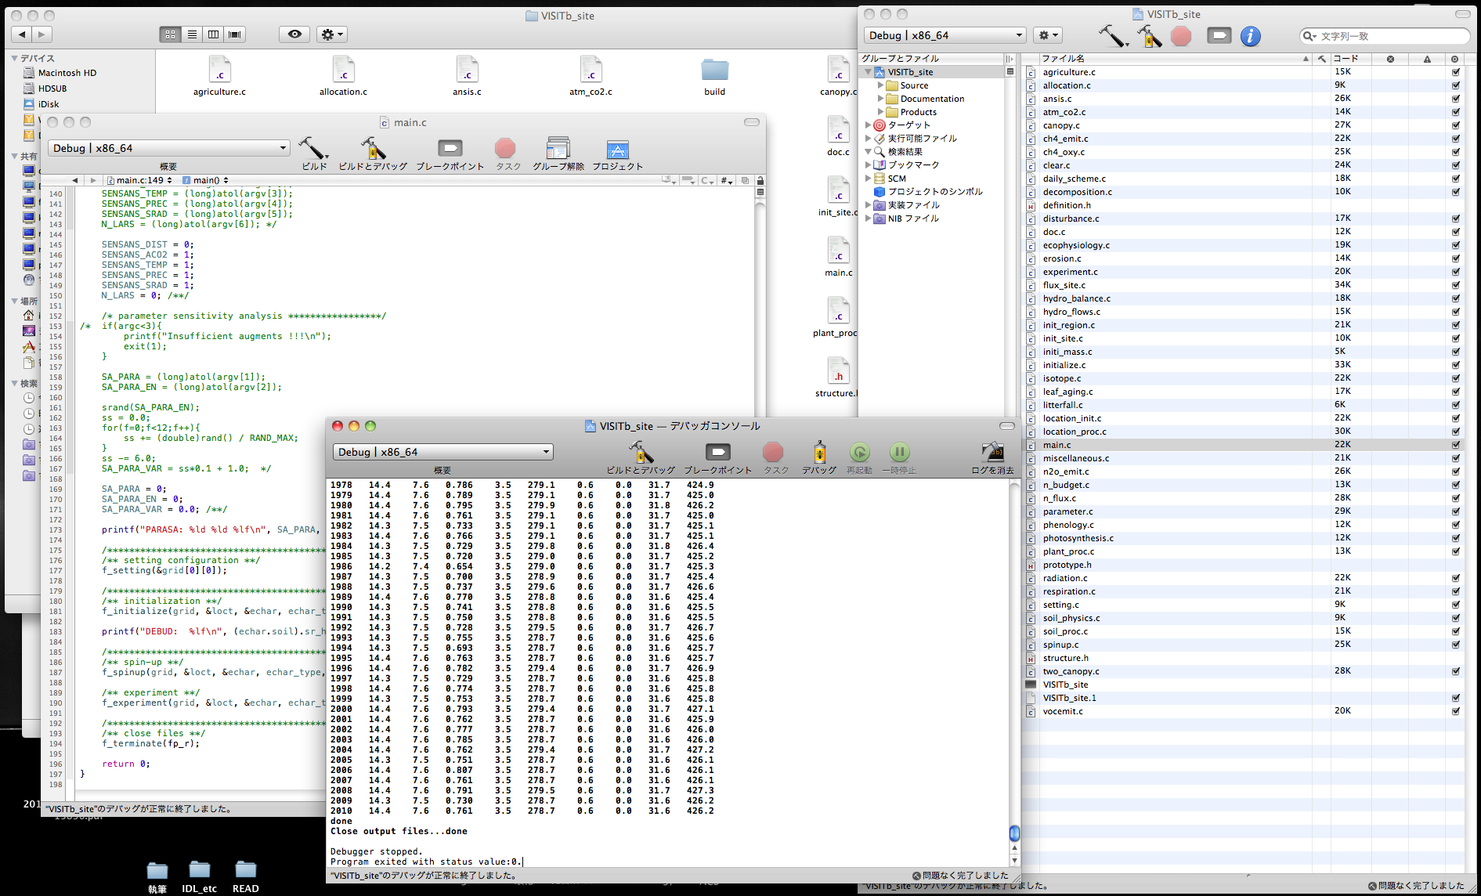
Usage: GUI-based
Coding and debugging tool: Xcode [compiler: gcc]
Coding and debugging tool: Visual C++, Visual Studio

Slide 40
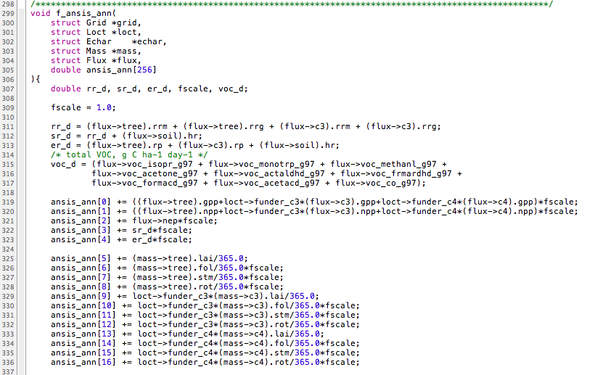
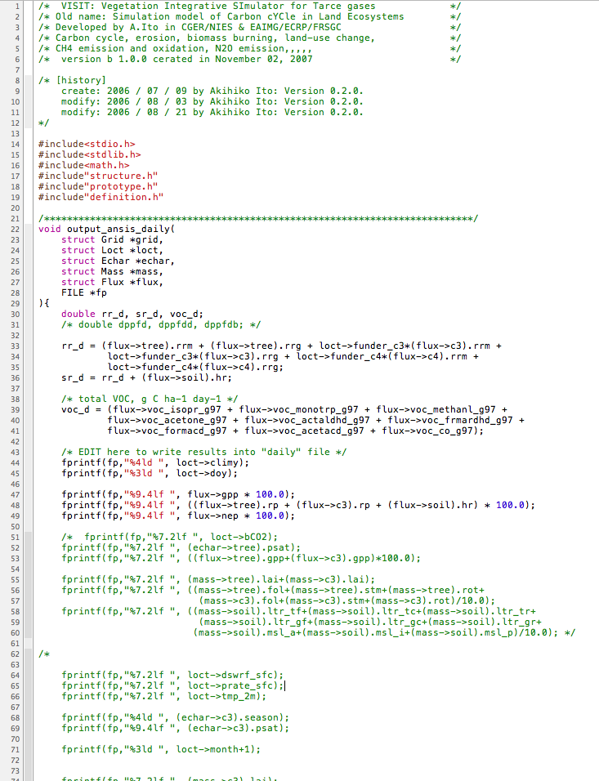
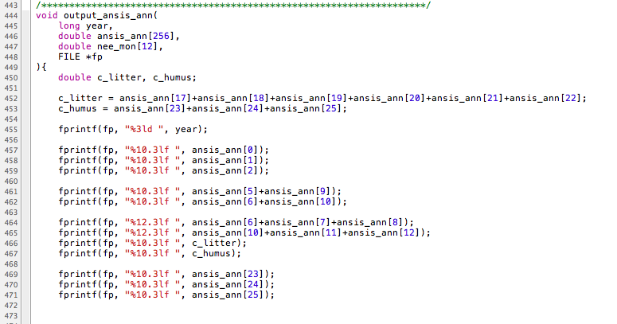
Management of output files
Edit: ansis.c
Annual mean/summary variables
=> annual.txt file
Daily variables => daily.txt file
prepare annual summation (mean)
ansis_ann[XX]
describe variables you want to output
output the variables

Slide 42
References [2006-2010]
Ito A. (2010) Evaluation of defoliation impacts of tropical cyclones on the forest carbon budget using flux data and a process-based model. Journal of Geophysical Research 115: doi:10.1029/2010JG001314.
Ito A. (2010) Changing ecophysiological processes and carbon budget in East Asian ecosystems under near-future changes in climate: Implications for long-term monitoring from a process-based model. Journal of Plant Research 123: 577-588.
Ito A., Ichii K. & Kato T. (2010) Spatial and temporal patterns of soil respiration over the Japanese Archipelago: A model intercomparison study. Ecological Research 25: 1033-1044.
Ichii K., Suzuki T., Kato T., Ito A., Hajima T., Ueyama M., Sasai T., Hirata R., Saigusa N., Ohtani Y. & Takagi K. (2010) Multi-model analysis of terrestrial carbon cycles in Japan: Reducing uncertainties in model outputs among different terrestrial biosphere models using flux observations. Biogeosciences 7: 2061-2080.
Inatomi M., Ito A., Ishijima K. & Murayama S. (2010) Greenhouse gas budget of a cool temperate deciduous broadleaved forest in Japan estimated with a process-based model. Ecosystems 13: 472-483.
Ise T., Litton C., Giardina C. P. & Ito A. (2010) Comparison of modeling approaches for carbon partitioning: Impact on estimates of global net primary production and equilibrium biomass of woody vegetation from MODIS GPP. Journal of Geophysical Research 115: doi:10.1029/2010JG001326.
Kato T., Ito A. & Kawamiya M. (2009) Multiple temporal scale variability during the twentieth century in global carbon dynamics simulated by a coupled climate-terrestrial carbon cycle model. Climate Dynamics 32: 901-923.
Ito A. (2008) The regional carbon budget of East Asia simulated with a terrestrial ecosystem model and validated using AsiaFlux data. Agricultural and Forest Meteorology 148: 738-747.
Ito A. (2007) Simulated impacts of climate and land-cover change on soil erosion and implication for the carbon cycle, 1901 to 2100. Geophysical Research Letters 34: 10.1029/2007GL029342.
Ito A., Inatomi M., Mo W., Lee M., Koizumi H., Saigusa N., Murayama S. & Yamamoto S. (2007) Examination of model-estimated ecosystem respiration by use of flux measurement data from a cool-temperate deciduous broad-leaved forest in central Japan. Tellus 59B: 616-624.
Ito A. (2006) Simulation of global terrestrial carbon cycle using the JRA-25 reanalysis as forcing data. SOLA 2: 148-151.
Ito A. & Sasai T. (2006) A comparison of simulation results from two terrestrial carbon cycle models using three climate datasets. Tellus 58B: 513-522.

Slide 43
References [2000-2005]
Ito A. (2005) Climate-related uncertainties in projections of the 21st century terrestrial carbon budget: off-line model experiments using IPCC greenhouse gas scenarios and AOGCM climate projections. Climate Dynamics 24: 435-448.
Ito A. (2005) Modelling of carbon cycle and fire regime in an east Siberian larch forest. Ecological Modelling 187: 121-139.
Ito A. (2005) Regional variability in the terrestrial carbon-cycle response to global warming in the 21st century: simulation analysis with AOGCM-based climate projections. Journal of the Meteorological Society of Japan 83: 251-259.
Ito A. (2005) Developing a new model to simulate net CO2 exchange at AsiaFlux sites. Phyton 45: 55-59.
Ito A. (2005) A reinterpretation of the earliest quantification of global plant productivity by von Liebig (1862). New Phytologist 167: 641-643.
Ito A., Saigusa N., Murayama S. & Yamamoto S. (2005) Modeling of gross and net carbon dioxide exchange over a cool-temperate deciduous broad-leaved forest in Japan: Analysis of seasonal and interannual change. Agricultural and Forest Meteorology 134: 122-134.
Ito A. & Oikawa T. (2004) Global mapping of terrestrial primary productivity and light-use efficiency with a process-based model. In: Global Environmental Change in the Ocean and on Land (ed. M. Shiyomi) pp. 343-358. TERRAPUB, Tokyo.
Ito A. (2003) High-resolution mapping of the net primary productivity of terrestrial ecosystems in East Asia using a process-based model. Journal of Agricultural Meteorology 59: 23-34.
Ito A. (2003) A global-scale simulation of the CO2 exchange between the atmosphere and the terrestrial biosphere with a mechanistic model including stable carbon isotopes, 1953-1999. Tellus 55B: 596-612.
Ito A. & Oikawa T. (2002) A simulation model of the carbon cycle in land ecosystems (Sim-CYCLE): A description based on dry-matter production theory and plot-scale validation. Ecological Modelling 151: 147-179.
Ito A. & Oikawa T. (2000) A model analysis of the relationship between climate perturbations and carbon budget anomalies in global terrestrial ecosystems: 1970-1997. Climate Research 15: 161-183.
Ito A. & Oikawa T. (2000) The large carbon emission from terrestrial ecosystems in 1998: a model simulation. Journal of the Meteorological Society of Japan 78: 103-110.

Slide 44
Other references
Tachiiri K., Hargreaves J. C., Annan J. D., Oka A., Abe-Ouchi A. & Kawamiya M. (2010) Development of a system emulating the global carbon cycle in Earth system models. Geoscientific Model Development 3: 365-376.
Yoshikawa C., Kawamiya M., Kato T., Yamanaka Y. & Matsuno T. (2008) Geographical distribution of the feedback between future climate change and the carbon cycle. Journal of Geophysical Research 113: 10.1029/2007JG000570.
Kawamiya M., Yoshikawa C., Kato T., Sato H., Sudo K., Watanabe S. & Matsuno T. (2005) Development of an integrated earth system model on the Earth Simulator. Journal of the Earth Simulator 4: 18-30.

Slide 45
Projects
JAMSTEC（Patra）
大気輸送拡散モデル
CO₂＆CH₄出力提供
文科省革新（立入）
気候-炭素フィードバック
VISITaコード
推進費S5-4
NIES（山形＆木下）
JAMSTEC（加藤）
土地利用モデル
NPPデータ
VISITaコード
NIES（Maksyutov&齊藤）
GOSAT地表CO₂収支
VISITbコード
JAMSTEC（八代）
大気化学モデル
BVOC出力提供
推進費A0801
NIES（山形＆安立）
熱帯林減少
REDD
陸域生態系モデル
PJ3 ・科研基盤Ｂ
・推進費S5-1-1
・推進費A801
・科研費新学術
日中韓（A3）
AsiaFluxサイト
（高山、苫小牧、天塩、富士吉田）
CO₂フラックス
モデル相互比較
科研費
新学術領域（高CO2）
NIES（飯尾）、東北大など
筑波大学（廣田）
菅平センター
植生遷移＆土壌
乾燥地モデル相互比較
APN & 科研費基盤B
岐阜大学（村岡）
高山サイト
科研費基盤B（分担）
生物領域（唐）
JST日中共同研究
チベット青海サイト
CO₂フラックス
NIAES（宮田）
真瀬水田サイト
CH₄フラックス
北大（GCOE）
フィールドサイト
（シベリア、モンゴル、北海道、インドネシア）
IARC（Kim）
アラスカサイト
CO₂、積雪＆凍土
地球一括
NIES（梁）
日本 土壌呼吸
HydroEastAsia
JST申請中
（市井、金ら）

