Slide 1
Modelling the Popularity of a Song
Internship Project
Sachithra Mapatunage

Slide 2
Content
1. Introduction
Background
Motivation
2. Data Preparation
3. Data Analysis
4. Conclusion

Slide 3
Introduction
Music is one of the universal languages that offer inner peace to a person.
In current busy context the recognition for music and songs and have gone up.
Music industry have now become more competitive and become a stabilize profession in world.
Furthermore, in present context artists are investing huge sum of money for their songs.
For an instance, the famous singer Rihanna have spent about $53,000.00 on a song before Rihanna even steps into the studio with her vocal producer and the final basic cost for the song is $78,000 (Money, 2011).

Slide 4
Introduction (Cont..)
Do artist have measurement or pre generated criteria to looked at whether their song is going to be a popular or not by investing this much of money.
Therefore, the intension of this project is to generate a model to identify the popularity of a song by analysing the factors effecting to it.

Slide 5
Motivation of Project
The motivation of this project is to build up a model to predict the popularity of a song before undertaking an investing over it.
Singers, music directing companies, music artists and sponsors are the identified main stakeholders who will be benefited via the model.
To build up a model to predict about popularity of a song we have selected data set from “tidytuesday”.
The data set that we have selected called as “Song Genres” and the source is “spotifyr”.
19,000 total number observation included in the data set.

Slide 6
Main project Question
Analyse the factors affecting for the popularity of a song and predicting a model with corresponding variables
predictive model gives an ides to singers, artists and song directing companies about the popularity of a particular song prior investing and what parameters to be tuned in order to make a song popular.

Slide 7
Sub Questions
Does duration of a song can impact for the popularity of a song?
Do positive vibes in a song affect to its popularity?
How strongly metallic and acoustic nature affect for a song popularity?

Slide 8
Data preparation
Selecting a random sample of 17,000 observations : Eliminate overfitting and generalize the model on population.
Select() to extract relevant variables
Why artist name is not included for the analysis?
Outliers : data scale for the “loudness” is -60db to 0. Observations which exceeded the scale was removed.
Variable | Variable type | Description
track_id | character | Song ID
track_name | character | Name of the song
track_artist | character | Name of the Artist
track_album_id | character | Album ID
track_album_name | character | Name of Song album
track_album_release_date | character | Released Date of the album
playlist_name | character | Playlist Name
playlist_id | character | Playlist ID
playlist_genre | character | Playlist genre
playlist_subgenre | character | Playlist subgenre

Slide 9
Data preparation ctd.
Lm() function is applied to each parameter against “track_popularity” to investigate the significance. (p-value)
7 significant variables
danceability
energy
loudness
accousticness
instrumentalness
liveness
duration_ms
Observations under track popularity were categorized into 2 categories as “popular” and “not popular” using case when() command. Benchmark was 50.

Slide 10
Data Analysis
Analysis was done upon the defined main and sub-questions.
Main question: Parameters affecting the popularity of a song and developing a corresponding model to predict the popularity.
Random Forest was used as the model : predictor is a character
Parameters were tuned and best was chosen upon the accuracy for workflow
Sub-Question 1: Does the duration of a track impact the popularity of a song
Corresponding variable : “duration_ms”
Lm() command was used to identify the linkage with “track popularity”

Slide 11
Data Analysis ctd.
Sub-Question 2: Does the emotions embedded in a track affect the popularity
Corresponding variable : valence where values closer to 1 denotes songs with positive emotions and values close to 0 denotes negative emotions.
Lm() command was used to identify the linkage with “track popularity”
Sub-Question 3: Which songs are more popular between metal and acoustic
Corresponding variable : high “energy” represent metal songs and high “accousticness” represent acoustic songs
Lm() command was used for each variable to identify the linkage with “track popularity”
Later, lrtest() command in “lmtest” package is used to compare the 2 linear models.

Slide 12
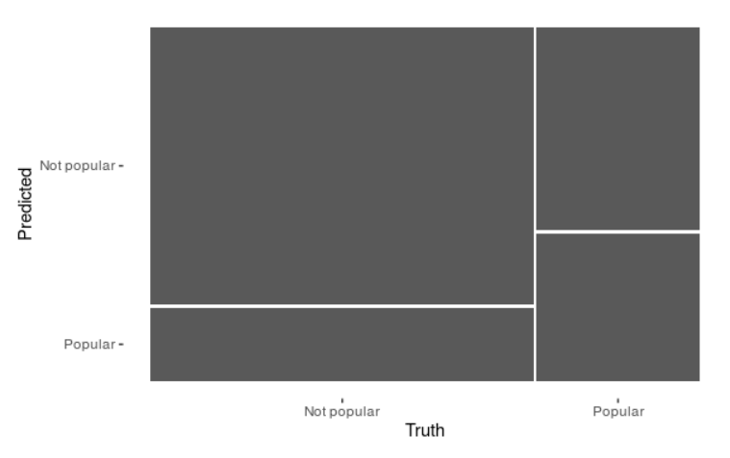
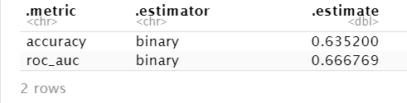
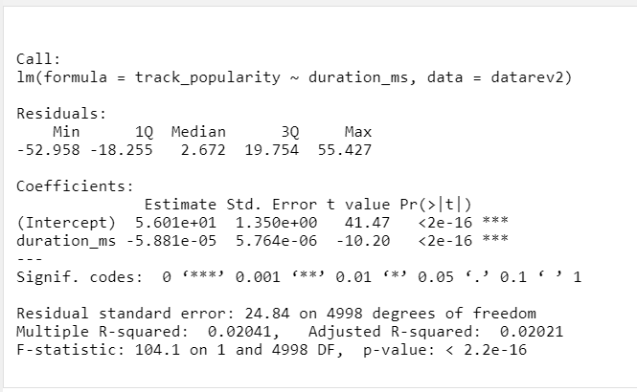
Conclusion
The fitted model is capable of achieving an accuracy over 63%.
Sub-Question 1: Does the duration of a track impact the popularity of a song
Strong relationship : negative gradient
Songs with shorter durations are more popular

Slide 13
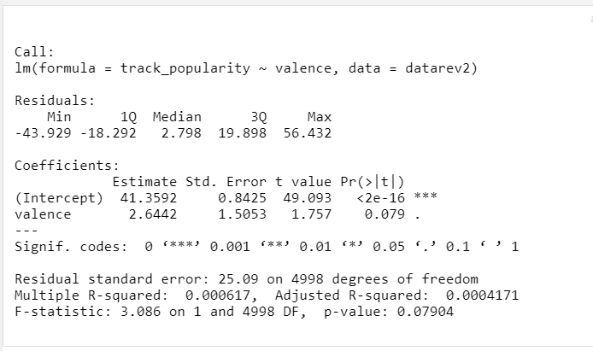
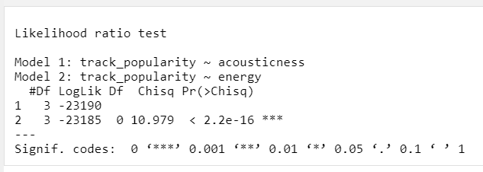
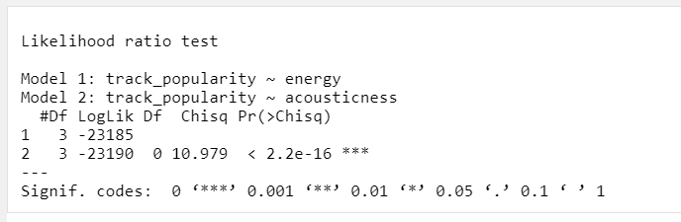
Conclusion ctd.
Sub-Question 2: Does the emotions embedded in a track affect the popularity
Relationship isn’t significant as p-value is more than 0.05
Decision may be subjective, and it doesn’t matter the song carries
positive vibes or not
Sub-Question 3: Which songs are more popular between metal and acoustic
lrtest() didn’t generate a significant output as the 2 variables are strongly correlated to song popularity.

Slide 14
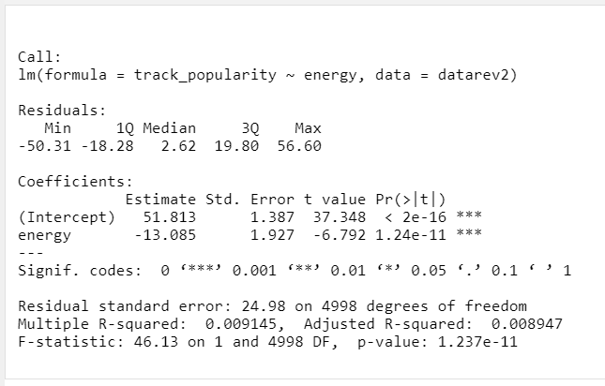
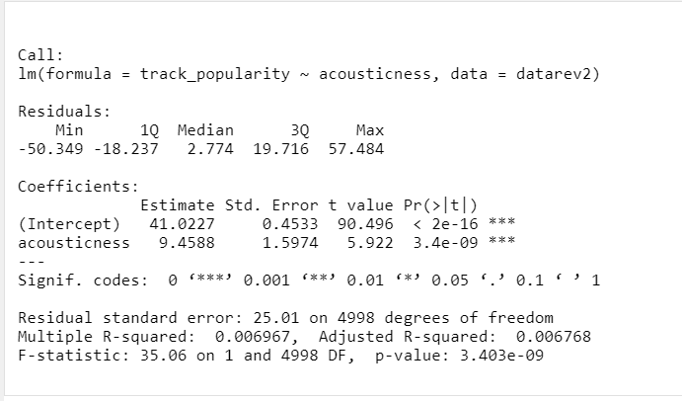
Conclusion ctd.
Acoustic songs are directly proportional a song’s popularity whereas metal songs are opposite of it, as the gradient of the model is negative for the linear model of energy.

Slide 15
References
Depersio, G., 2018. Investopedia. [Online] Available at: https://www.investopedia.com/ask/answers/042915/what-are-advantages-using-simple-random-sample-study-larger-population.asp#:~:text=Simple%20random%20sampling%20is%20a,generalizations%20about%20the%20larger%20group.&text=The%20advantages%20of%20a%20simple, [Accessed 06 06 2020].
Frontiers, 2017. A song's structure can be linked to its popularity. [Online] Available at: https://phys.org/news/2017-08-song-linked-popularity.html [Accessed 06 06 2020].
Money, T. P., 2011. How Much Does It Cost To Make A Hit Song. [Online] Available at: https://www.npr.org/sections/money/2011/07/05/137530847/how-much-does-it-cost-to-make-a-hit-song [Accessed 06 06 2020].

Slide 16


