Slide 1


01
type it. edit it. undo it.
CLARO
an on-device, reversible AI workbench for building screens
hacking the horizon 3.0 · edge AI · everything runs on this laptop
~4ms
0 3B
100%
GATE DECIDES A SIMPLE ASK
WAKES ON EASY REQUESTS
ON-DEVICE, OFFLINE-FIRST
small local model + a smart gate = AI edits you can undo, privately, offline.
CLARO · Hack the Horizon 3.0 · team training deck
Notes:
Why we exist: most AI app builders are chat boxes that produce text. CLARO is a real IDE where AI edits are structured, reversible, and fully offline.

Slide 2


WHY EDGE AI
02
02
the trap we are avoiding
THE TRAP
OUR ANSWER
CLOUD
ON-DEVICE
your code leaves the laptop; latency, cost, privacy, and a demo that dies without Wi-Fi
Ollama qwen2.5:3b + nomic-embed-text. offline first.
70B-CLASS
SMALL + GATED
impressive until you can't run it on the judges' table, offline
an embedding gate means the 3B model sleeps on easy asks
CHAT, NOT EDITOR
REVERSIBLE
text suggestions you can't undo are not a product — they're a demo of a demo
every AI edit is a PatchOp; undo is structurally free
judges care less about model size and more about: does it run here, offline, and can a person drive it?
2 · problem & answer
Notes:
Lead the demo from this framing: 'the demo runs entirely on this laptop. There is no network hop.'

Slide 3



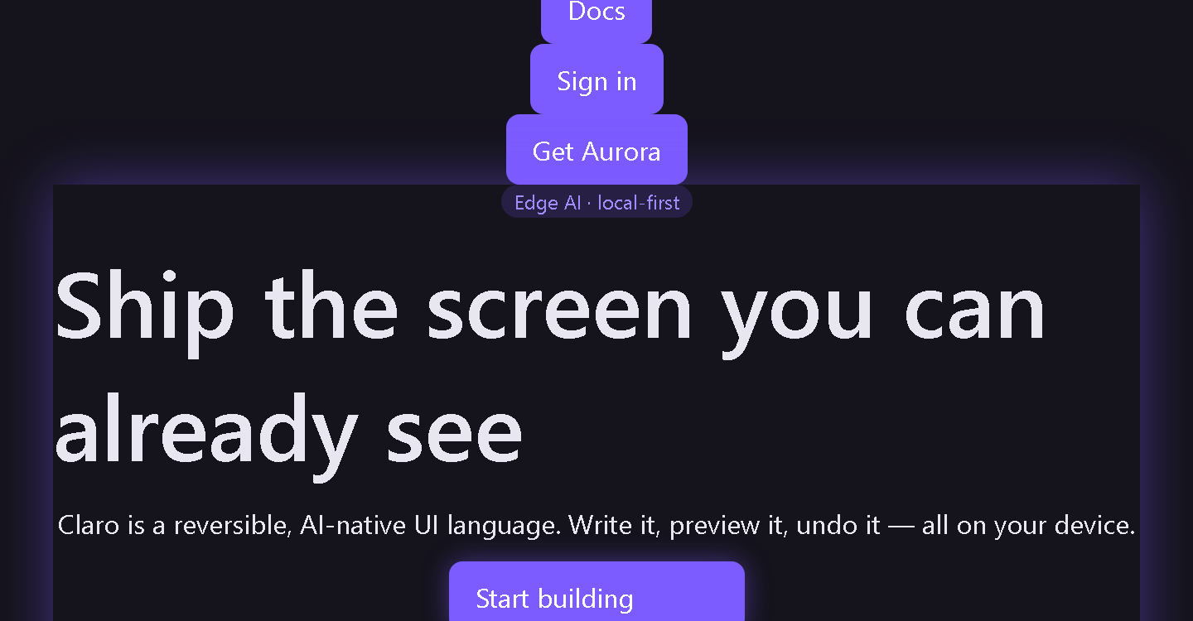
ONE PICTURE
03
03
a whole app, from 150 lines of text
WRITE
PREVIEW
ASK
UNDO
a .cl file: pages, sections, elements in plain words
renders instantly and deterministically — no build step
plain English in; structured edit ops out
every edit lands in Stitch, reversible one step
demo source
the real preview — no mockup
page Aurora {
navbar {
button "Get Aurora" { variant: primary }
}
section hero {
heading "Ship the screen you can already see"
button "Start building" { variant: primary }
}
}
3 · one picture of the product
Notes:
Right panel is a real screenshot of the app rendering the exact source on the left. Point at each pipeline card as you explain the flow. 21 block elements in the DSL.

Slide 4
THE 60-SECOND LANGUAGE
04
04
the parser never cries
Aa
ø
?
case-insensitive
ignores filler
did-you-mean
"HELLO" and "hello" are the same thing. indentation is never meaning.
a / an / the / then / extra spaces and semicolons are silently skipped.
unknown words degrade to suggestions, never a crash. a judge can mash keys.
why this wins: a stranger with zero training can type a screen in ~60 seconds — and mistakes become helpful diagnostics instead of dead ends. try: "ree upd tne speling". still works.
4 · forgiveness as a feature
Notes:
'ree upd tne speling' is not a typo in the deck — it's the demo. Typos survive.
Show the 60-second cheat-sheet challenge to a judge.

Slide 5
REVERSIBLE EDITS
05
05
undo is structural, not cosmetic
every AI change is a typed, reversible operation — a PatchOp with an inverse:
set_property
set_text
add_element
remove_element
change a prop (color, size, gap)
change element text
insert a node
delete a node
move_element
set_layout
set_effects
clear_property
reorder in a layout
switch row→stack→grid
aurora, glow, particles
reset to default
because edits are ops with inverses, "undo" is a real rewind of exactly what AI did — not an LLM re-parsing from memory.
5 · the reason undo works
Notes:
No code regeneration on every change. Ops validate against the live project model. That is what makes 'step back' instant.

Slide 6



THE AI INSIDE
06
06
BHASM: one panel, four intents
ASK
CODE
REVIEW
CHAT
explain what this is
make a concrete change
find problems
plain conversation
explain / inspect / answer
propose + apply patch ops
rule checks + LLM feedback
what can you do / casual
the guardrail: before AI ops apply, a decision layer approves or rejects them. confident reject → blocked. unsure → allowed through — a wrong apply must never be worse than no apply.
6 · BHASM panel + guardrail
Notes:
Four-mode classification is the visible AI; the guardrail is the invisible safety.
Demo: '# make the hero pop' enters the right mode automatically.

Slide 7
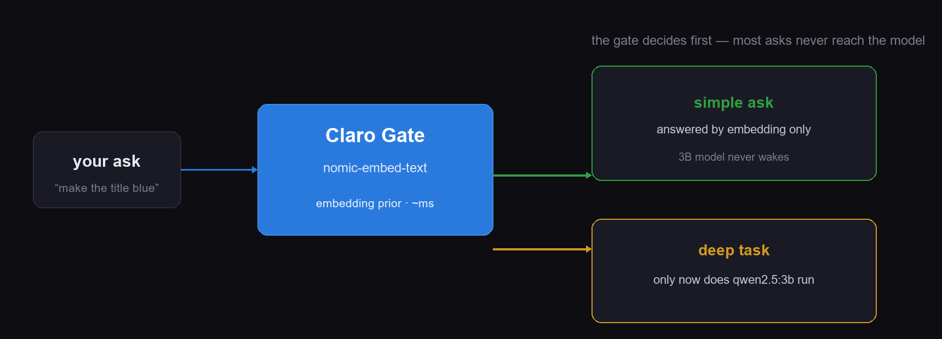
THE EDGE-AI STORY
07
07
the gate makes the 3B model lazy
most requests are simple. a tiny local embedding model decides first — the big model only wakes for the hard 10%.
the honest framing: we did not try to run a big model on-device — we made the small one earn its keep.
7 · the gate = the edge-AI story
Notes:
Carries the whole theme. Say: simple asks never wake the 3B model — the metric strip counts them live.
Fallback: cold start loads the embedder; verbalize it and keep moving.

Slide 8
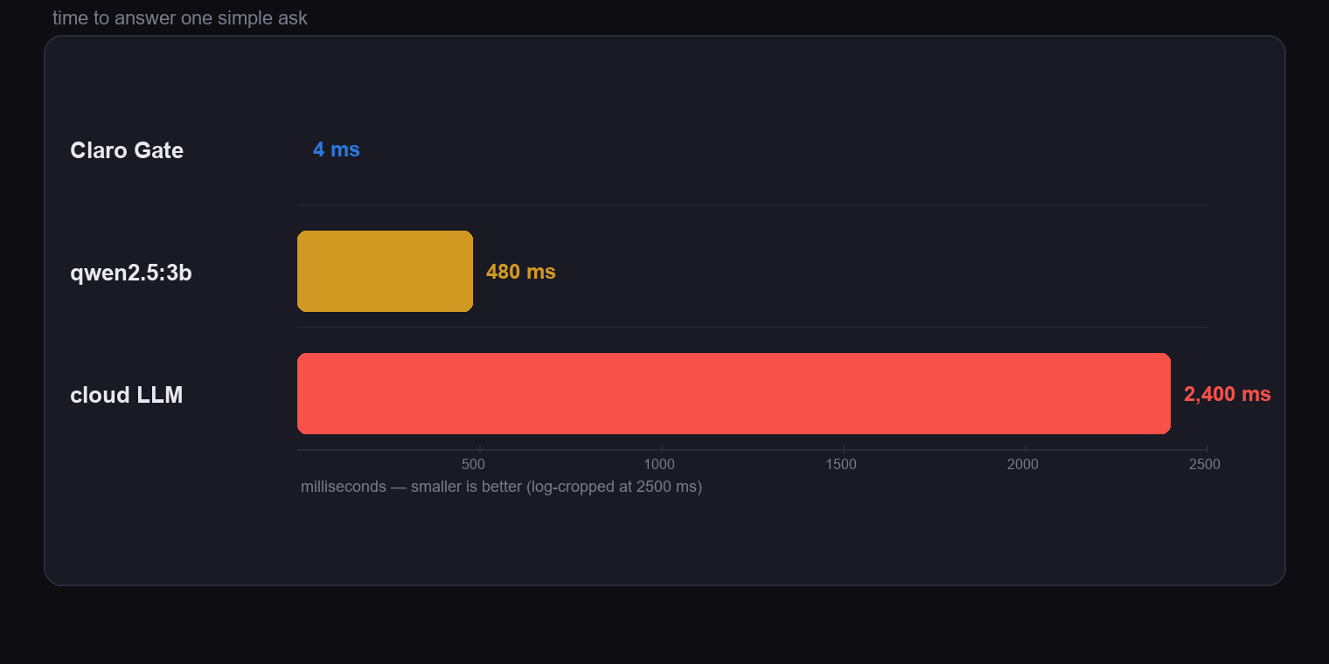
MEASURED LIVE
08
08
~4ms vs seconds
~4ms
embedding-only answer on a simple ask
0
3B model wakes for greetings / small talk
12,000×
less work than asking the 3B for "thanks!"
8 · measured on the demo rig, not a slide promise
Notes:
These are the real numbers from the metric strip during rehearsal. If embeddings are slow on first call, say so and keep moving.

Slide 9


NO CLOUD, NO TELEMETRY
09
09
private by design, offline by default
no cloud dependency
runtime
Ollama serves both models from localhost; the app talks to it over a loopback IPC bridge
qwen2.5:3b
decisions · ~3B params
no telemetry
source, edits, and decisions never leave the machine — nothing is phoned home
nomic-embed-text
the gate · embeddings
Ollama
small runtime
local model server
slim installer + two local models; runs on a demo laptop with no server in sight
installed & verified on demo rig
9 · the privacy headline
Notes:
If a judge asks 'where does this run' — this laptop, Ollama on localhost, no Wi-Fi needed. Privacy is judge bait at edge-AI hackathons; make it a headline.

Slide 10


THE DEMO'S PIVOTAL MOVE
10
10
fix any screen, in one ask
“make the hero title bigger and accent-colored, then add a badge under it” — the exact pre-filled prompt.
1 · type the ask
2 · the gate roams
3 · propose ops
4 · keep or undo
plain English. no structured commands.
embedding says: build-y intent → 3B wakes with a typed contract
PatchOps validated and applied to the live model
preview updates live; Stitch unwinds with one key
this exact prompt is pre-filled in the tour (step 2) — you never have to improvise live.
10 · the demo's pivotal moment
Notes:
This is what happens in the tour. Deliver: 'I said it in English; it edited the file; I can undo it.'

Slide 11
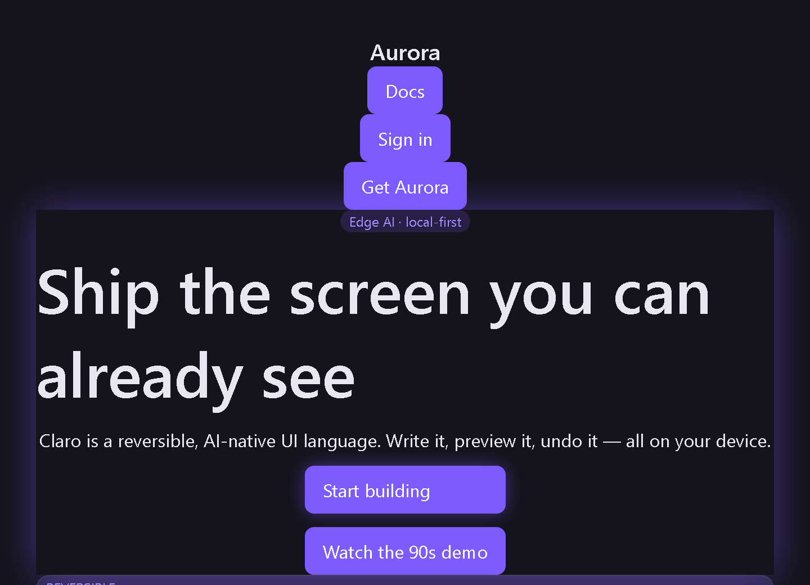
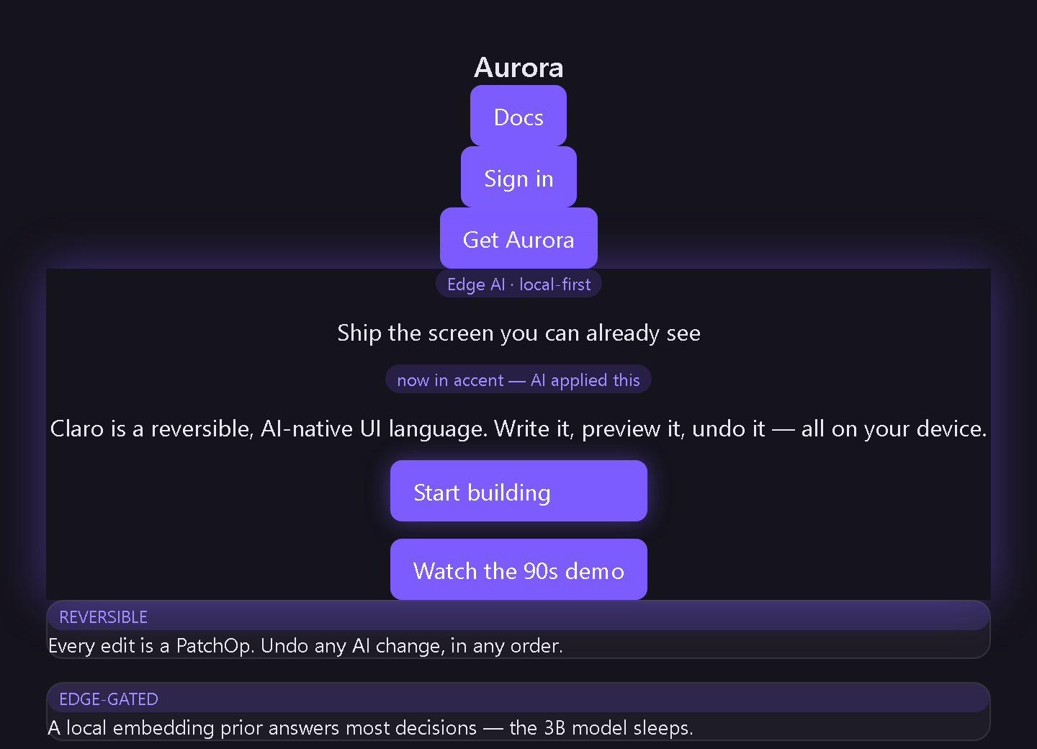
90-SECOND JUDGING SCRIPT
11
11
watch it happen: see → edit → undo
step 1 · see it
step 2 · edit it
the app renders from source, live
one English ask → the screen changes
step 3 · undo it — one key sends every op back. no memory re-parse. history is real.
11 · every teammate's rehearsal card
Notes:
Run this three times before the venue. The whole demo is one keyboard shortcut + three clicks.
The 'after' screenshot is the same source, rendered after the exact pre-filled prompt was applied.

Slide 12
REHEARSED FAILURE
12
12
if something hiccups
!
Ollama not running
keep going
tours 1 & 3 still work (load + undo); skip the gate beat; say edits are shown as DSL
!
embed model slow
rehearse
first call loads it into RAM — verbalize it, keep moving
!
no Wi-Fi / no adapter
advantage
everything is local by design — this is our advantage, say it with a smile
!
AI gives a useless patch
recovery
don't apply it; say 'see, it proposed; I choose not to take it' — that's the point
!
sound is off
visual
the tour is visual; the one-pager carries the verbal beats
11b · failure is rehearsed, not surprising
Notes:
Every row maps to a real failure mode we hit. The consistent theme: the product degrades gracefully on purpose — say that instead of apologising.

Slide 13
THE SIX QUESTIONS
13
13
answers they'll fish for
“What model is under it?”
“Why not a bigger model?”
Ollama qwen2.5:3b for decisions, nomic-embed-text for the gate. Both local.
It couldn't run offline on the judges' laptop — and most asks are simple, so a gate + 3B is the honest weight class.
“Is undo really undoing AI?”
“Where's the cloud?”
Yes — every edit is a PatchOp with an inverse; Stitch rewinds the exact ops.
There is none. Loopback IPC to localhost Ollama. The demo survives airplane mode.
“Can it generate real code?”
“What was the hardest bug?”
Yes — single-file web app export and Kotlin templates already exist.
Making a parser that never throws: unknown words become 'did you mean', never a crash.
13 · prep the whole team on all six
Notes:
Everyone on the team can answer all six cold. Insurance line: 'we never claim unlimited scale — we claim it runs here, and you can undo it.'

Slide 14
FOR TEAMMATES
14
14
the 60-second language, compressed
ELEMENTS
page Home {
stack hero {
heading "Any screen you can imagine"
button "Try Claro" { variant: primary }
badge "edge AI" { variant: accent }
}
}
# make the hero pop
component Hero(title: string) { }
21 blocks: page, section, container, layouts, heading, text, button, badge, card, navbar, input, textarea, form, modal, image, spacer, divider
PROPS
size gap padding margin color background align justify weight width height radius border shadow opacity effect animation
SYNONYMS
column=stack · flex=row · line/para=text · separator=divider
REUSE
component Hero(title: string) { … }; then Hero "Hi" anywhere
IDEAS
# make the hero pop → double-click → BHASM classifies the intent
14 · full copy: docs/claro-cheatsheet.md
Notes:
Give each teammate this slide memorized — they should able to hand-type a screen in front of a judge.

Slide 15
ARCHITECTURE
15
15
four layers, one monorepo
renderer
CL { DSL } engine
BHASM (AI)
edge stack
Electron + React: editor, preview, inspector, command palette
forgiving parser · project model with stable IDs · PatchOp apply/undo · codegen
intent layer (ask/code/review/chat) · guardrail · Claro Gate · metrics
Ollama localhost → qwen2.5:3b + nomic-embed-text · optional graphify sidecar
apps/ide (Electron) · packages/dsl (parser+engine) · packages/ai (decisions) · packages/android (codegen)
15 · point at this when they ask 'how is it structured?'
Notes:
Demo features → layers: preview→1, typo tolerance→2, undo→2, AI ops→3, gate→3+4.

Slide 16

THE RECEIPTS
16
16
hashes we can prove
tests
gate verified
126 passing across DSL, AI, and IDE — the parser and patch engine are regression-guarded
live on this rig: greetings never wake the 3B model, deep asks do
metric strip
installers
real-time counts: X/Y decisions skipped 3B, avg latency, epoch reset per run
real Win64 EXEs via electron-builder — not a dev-mode screenshot demo
run the numbers yourself — every claim has a command behind it.
16 · the receipts
Notes:
Filling the metric-strip numbers is part of rehearsal: run the tour once, read the real counts, then re-record. Live beats slides every time.

Slide 17
17
type it. edit it. undo it. all offline.
a small model, a smart gate, and real undo for AI edits.
open the tour with Ctrl+Shift+J · hand judges the one-pager · let the laptop carry the demo
17 · go tell the story
Notes:
Rehearse the tour twice, read the fallback card once, let the metric strip speak. Good luck, team.

