Slide 1
Ingredients
Software Infrastructure
IDE : Visual Studio 2013/ 2015 /2017
OS : Windows 7 or 10 - 32 bit or 64 bit.
OpenGL version : Higher than 4.0
Language : C++
Libraries
GLFW(OpenGL FrameWork )
GLM (OpenGL Mathematics http://glm.g-truc.net/0.9.8/index.html)
GLEW (The OpenGL Extension Wrangler Library http://glew.sourceforge.net/)
SOIL (Simple OpenGL Image Library http://www.lonesock.net/soil.html)

Slide 2
Important points
We are going to use win32 project, not win64 project
All required libraries are pre-compiled for win32.
All your assignments/programs must be compiled on win32(not win64)
Every students must installed all required libraries on a specific directory
C:\Graphics\Tools
If you don’t follow my instruction, I will take points off.

Slide 3
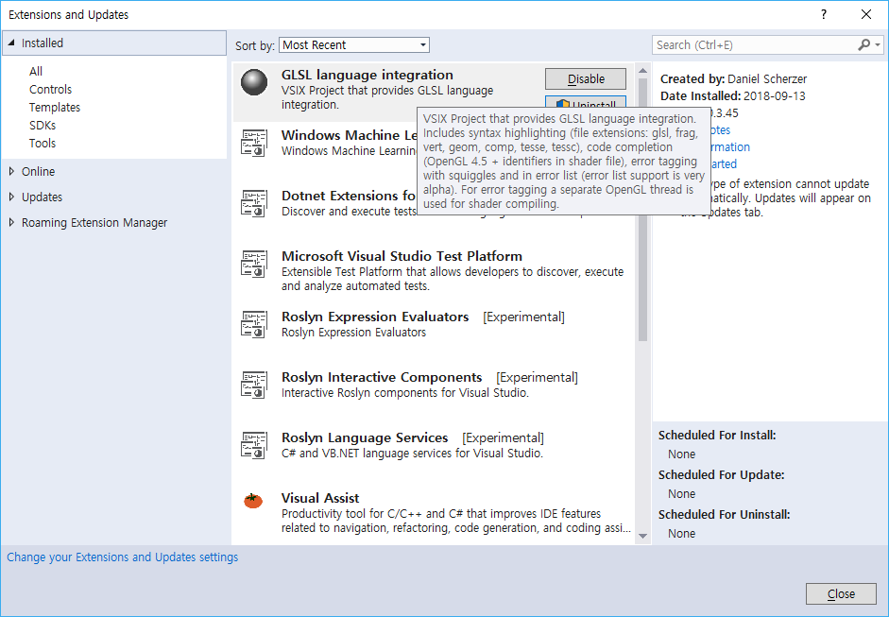
Installation of GLSL Extension on Visual Studio
Go to Tools-> Extensions and Update
Go to On-line and search with “GLSL” to find the GLSL Language Integration

Slide 4
glfw setup

Slide 5
glfw
http://www.glfw.org/
OpenGL is just a rendering API, they don’t have functions for creating windows and event handling.
We are going to use GLFW for that
The most current version: 3.2.1 (Aug/2016)

Slide 6
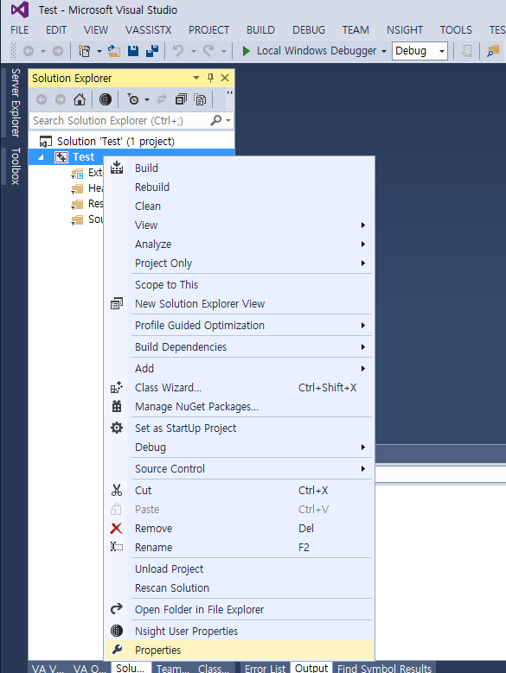
Project Name
Properties

Slide 7
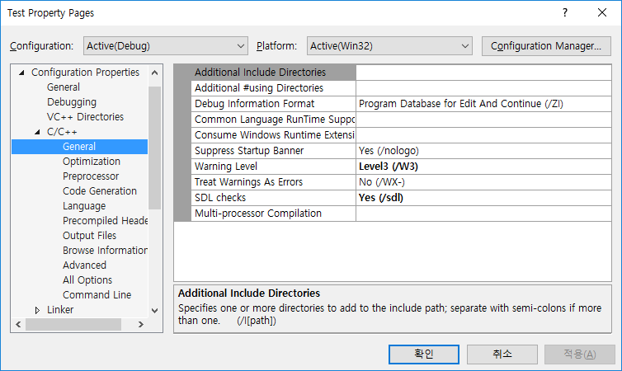
c:\Graphics\Tools\glfw\include
c:\Graphics\Tools\glm
c:\Graphics\Tools\glew\include
c:\Graphics\Tools\Assimp\include

Slide 8
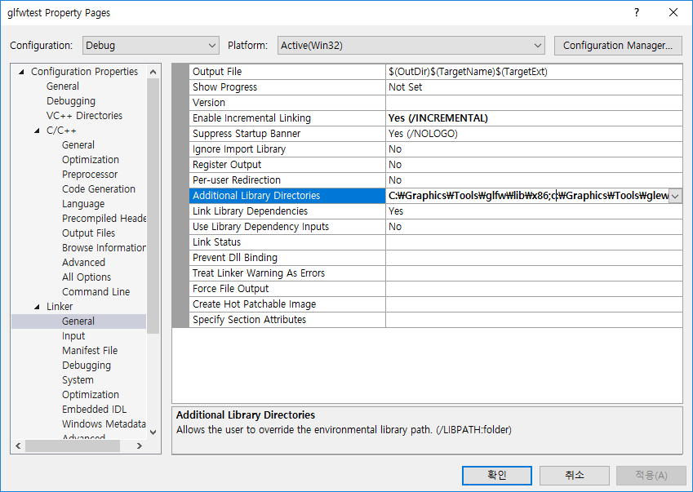
c:\Graphics\Tools\glfw\lib\x86
c:\Graphics\Tools\glew\lib
c:\Graphics\Tools\Assimp\lib\x86

Slide 9
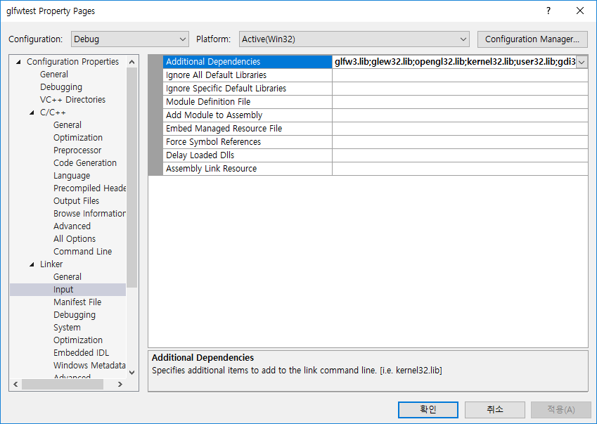
glfw3.lib;
glew32.lib;
opengl32.lib;
assimp.lib;
assimp-vc140-mt.lib;

Slide 10
Go to c:\Graphics\Tools\Assimp\bin\x86
Copy the .dll and paste it into the Debug folder of the project

Slide 11
YOUR PROJECT MUST COMPILED IN x86

