Slide 1
DIPLOMA PROJECT
CBR-GRABBER (VARIANT 5)
Student: Voloshin Nikolai
Stream 24
2022

Slide 2
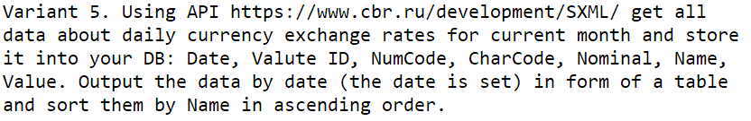
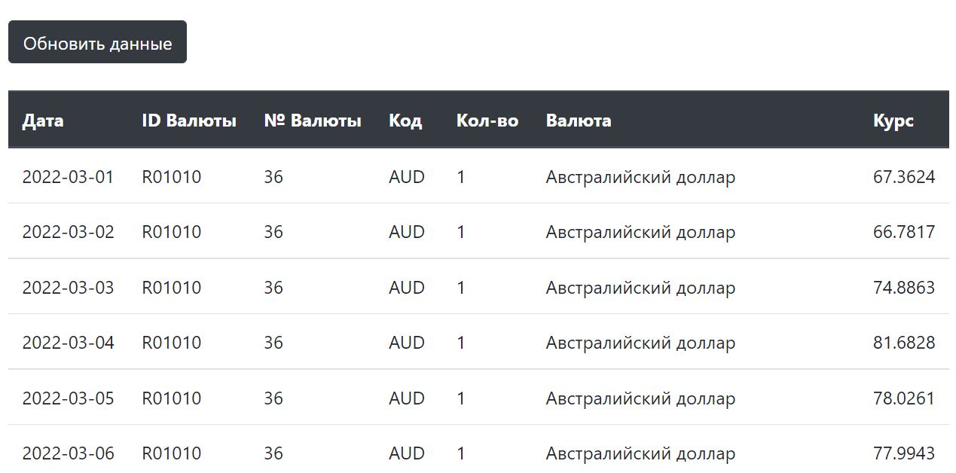
Application
https://grabber.homeline.kg/
https://github.com/Sacrament84/cbr-grabber

Slide 3












Technology stack

Slide 4



3-tire architecture
Backend
REST API
Frontend
REST API
HTTPS
REST API
DATA
WEB Browser
cbr.ru REST API
MYSQL RDS

Slide 5
Branching strategy:
Main branch
Deploy
Production environment
Dev branch
Deploy
Development environment
V0.1
V0.2
V0.3
V0.1
V0.11
V0.21
V0.3

Slide 6
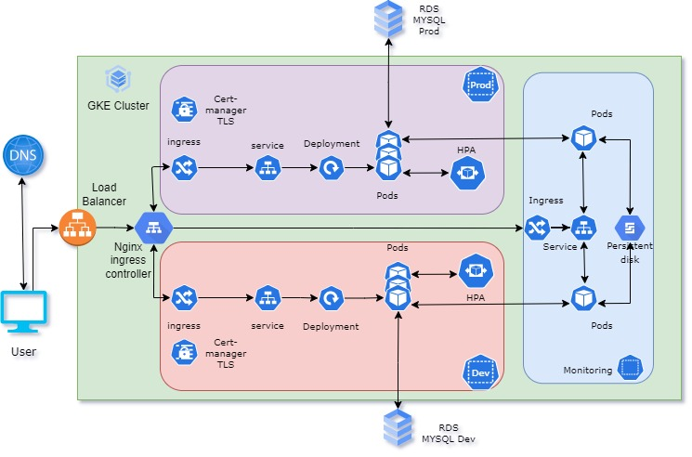
Infrastructure diagram

Slide 7




CI/CD Diagram
GKE Cluster
Dev
Prod
Container Registry
Dev environment
Pull
Push
Monitoring
1
webhook
2
3
Push
5
7
Pull
Logging
Deploy
6
4
Prod environment
Quality gate
Build
9
Review
Monitoring
8

Slide 8
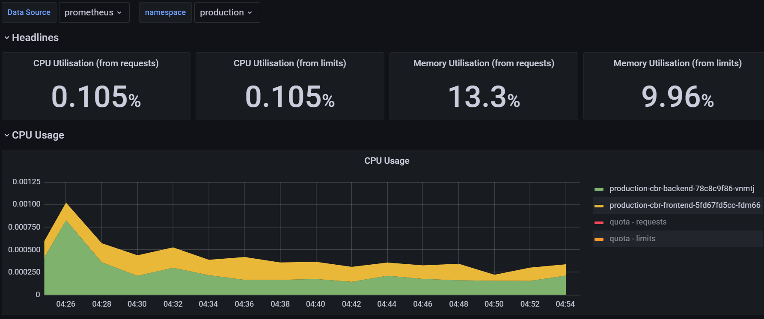
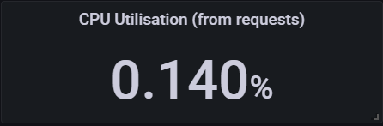
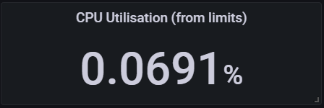
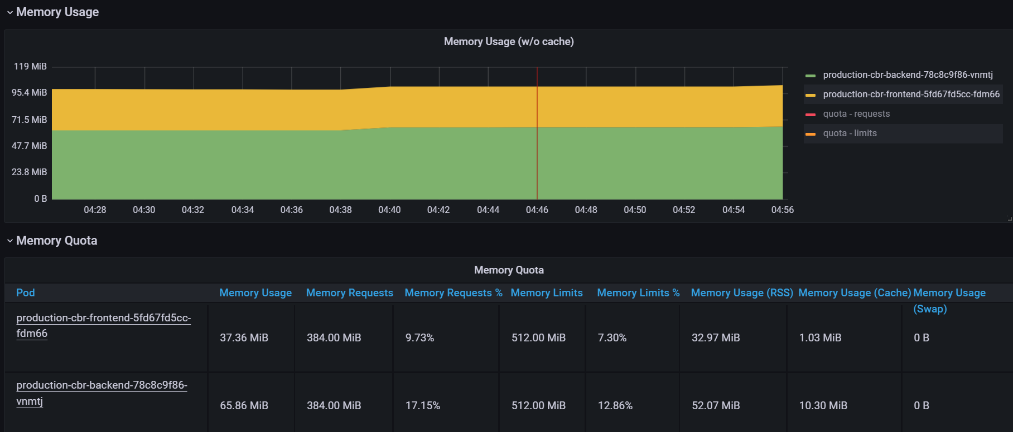
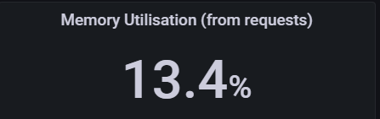
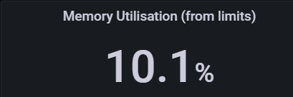
Monitoring

Slide 9
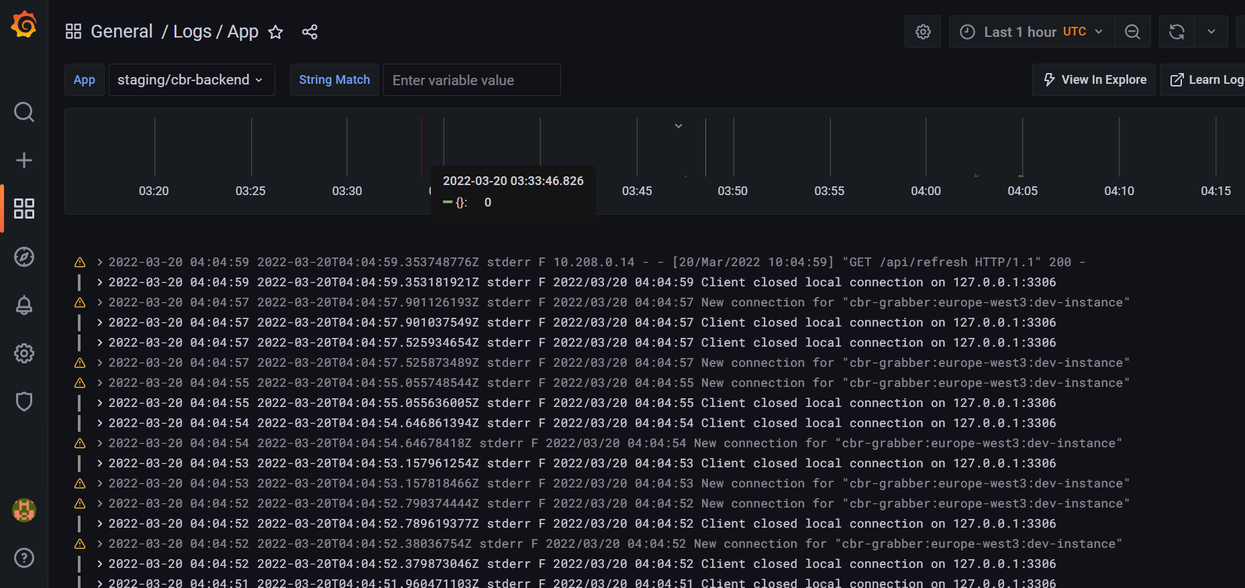
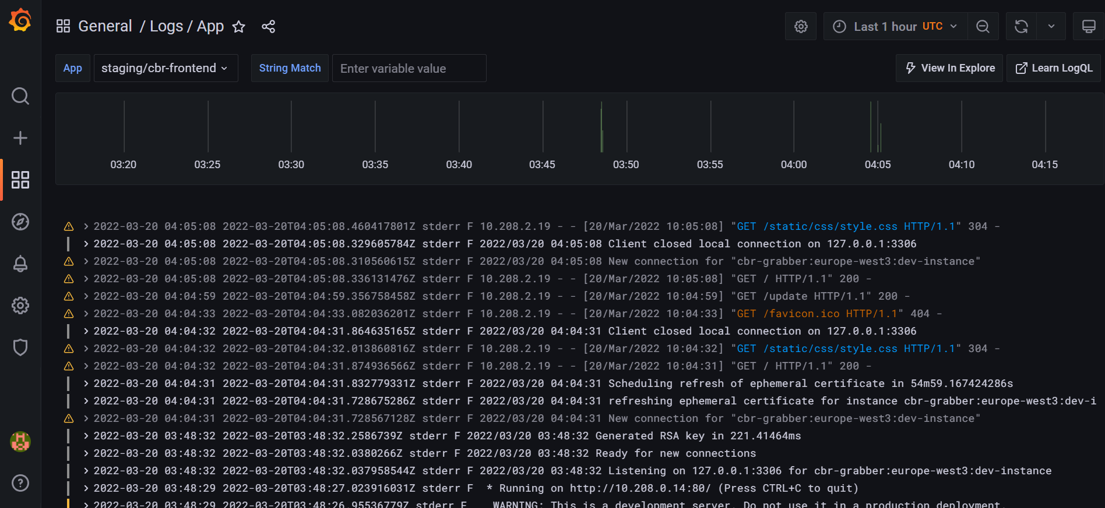
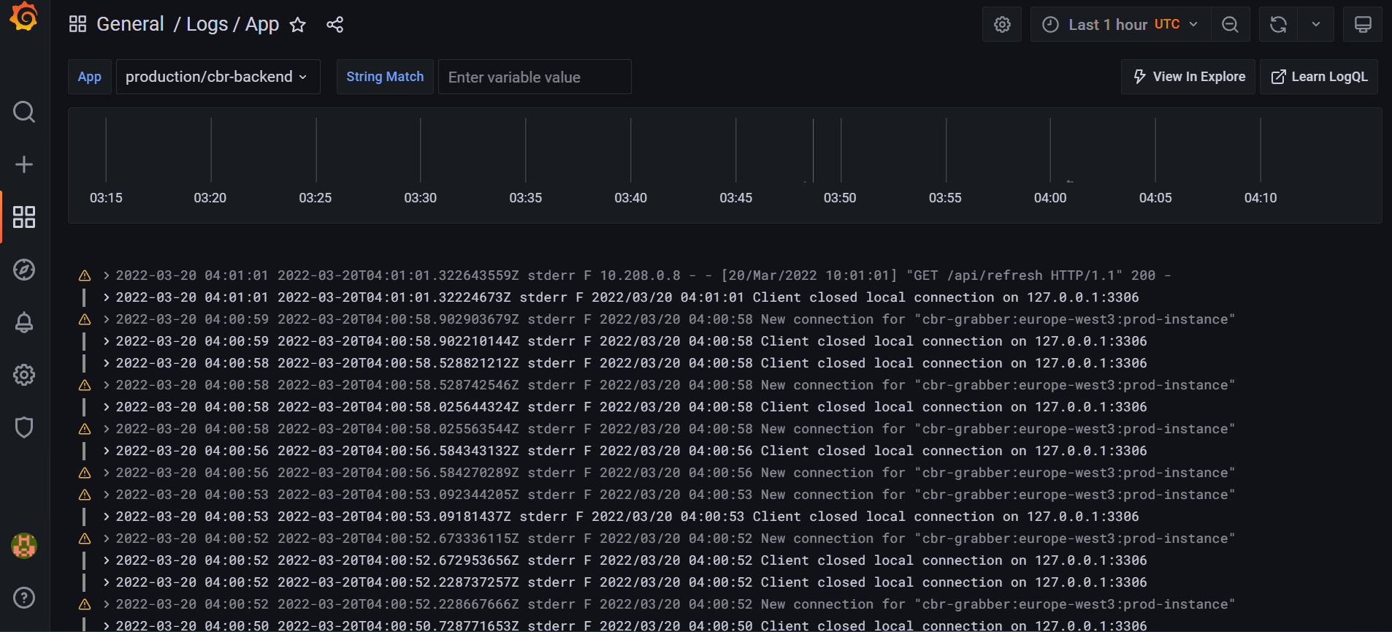
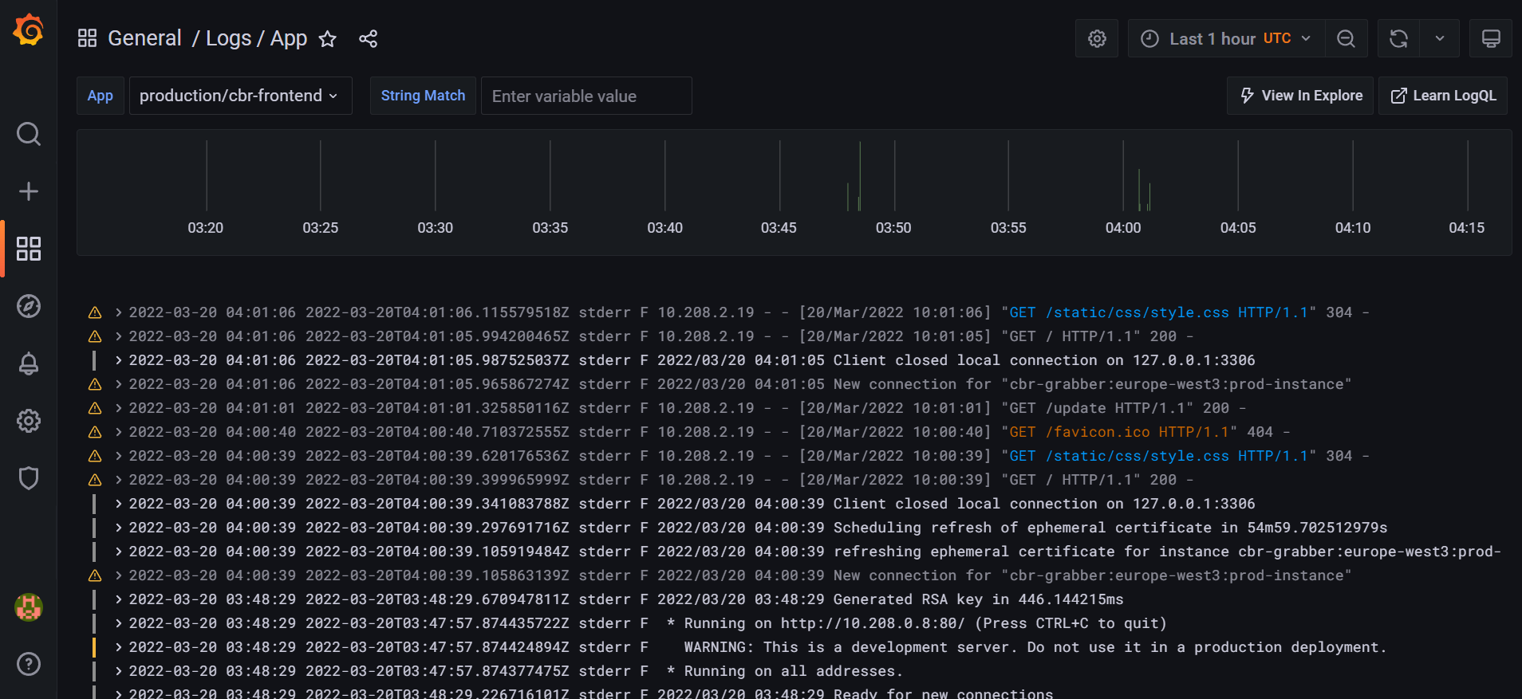
Logging

Slide 10
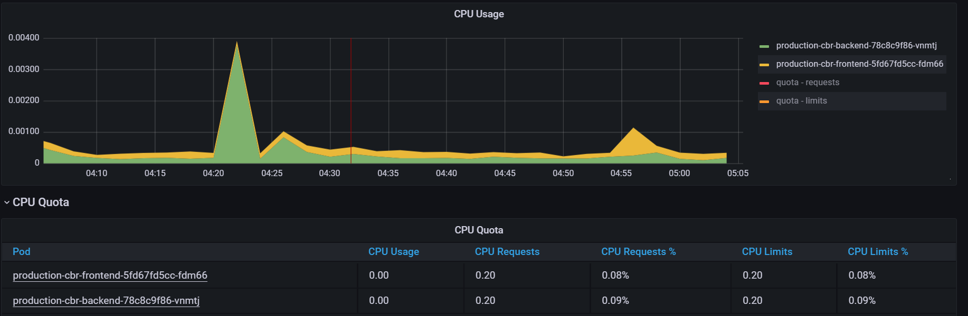
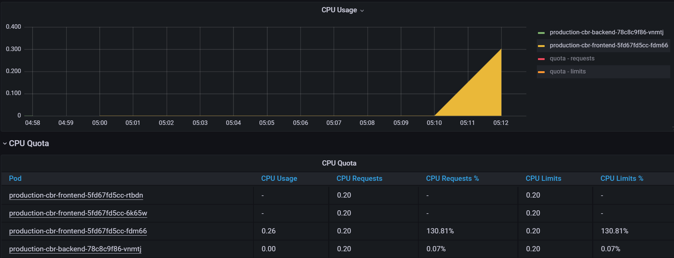
Scalability
based on K8S Horizontal pod autoscaler
LOAD
OFF
LOAD
ON

Slide 11
Cloud and Cost efficiency
Service | Count | 1 Month price | 1 year price | Currency
Google GKE | 1 | 64.24 | 770.88 | USD
Network Load Balancer | 1 | 17.90 | 214.80 | USD
VM Instances | 3 | 39.26 | 471.12 | USD
Persistent Disk | 1 | 5.60 | 67.2 | USD
Cloud SQL (MySQL 5.7) | 2 | 19.66 | 235.92 | USD
Total |  | 146.66 | 1759.92 | USD

Slide 12
Q&A
Student:
Nikolai Voloshin
2022

