Slide 1
Tropes in Oscar-Winning Films
A data driven approach to quantify successful plots

Slide 2

Outline
1. Introduction
1.1 What Are Tropes?
1.2 Premise
1.3 Execution
2. Yearwise Analysis
2.1 Oscar Best Picture 2008-2017
2.2 Highest Grossing 2008-2017
3. Genrewise Analysis
3.1 Oscar Winning Action Movies
3.2 Highest Grossing Crime Movies
4. Next Steps

Slide 3

1.1 Introduction: What Are Tropes?
Dictionary Defintion of a trope is a figure of speech
In colloquial, or literary terms a trope is a storytelling “figure of speech” or shorthand.
Tropes can be diverse: “Hero”, “Big Bad”, “Love Triangle”, “Disapproving Parental Figure”

Slide 4
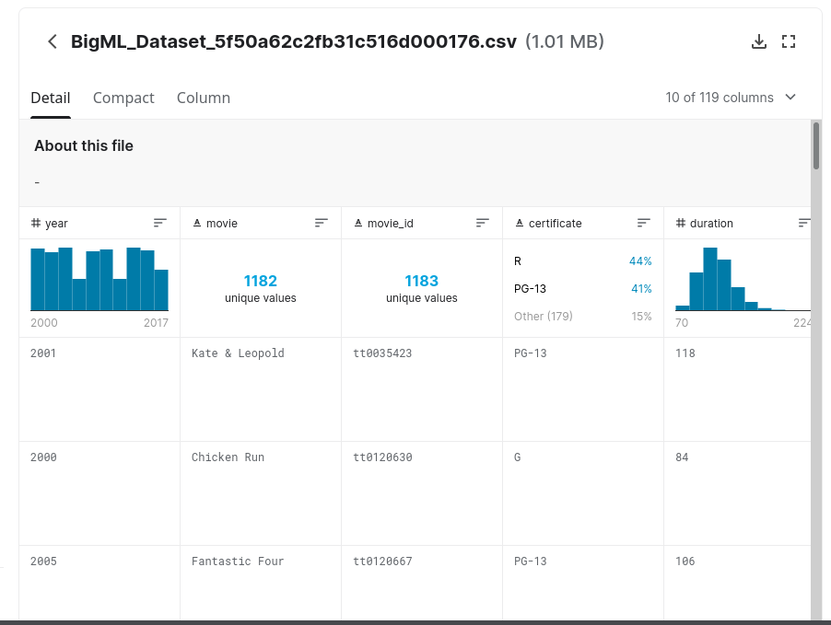
1.2 Introduction: Premise
Tropes are fundemental to stories, so which ones are the most popular or profitable over the years?
Which Tropes are regularly Oscar-Winning for Best Picture?
Which Tropes have been highest grossing within certain genres?
Is there a discernable relationship at all?

Slide 5
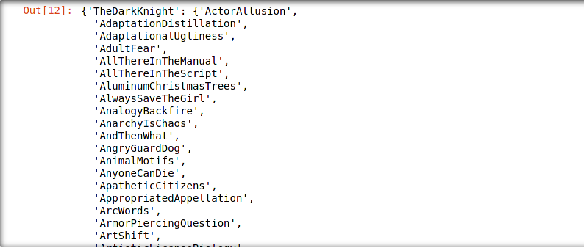
1.3 Introduction: Execution
Version control with git&hub, Numpy for Arrays, Pandas for Databases, Counter for Dictionaries
Matplotlib to plot
Inflect, re used for text processing and filtering. Title must be converted to web query
BeautifulSoup4, and Requests lib for scraping TvTropes

Slide 6
2. Yearwise Analysis
Best Picture and Highest Grossing Films from 2008 to 2017

Slide 7
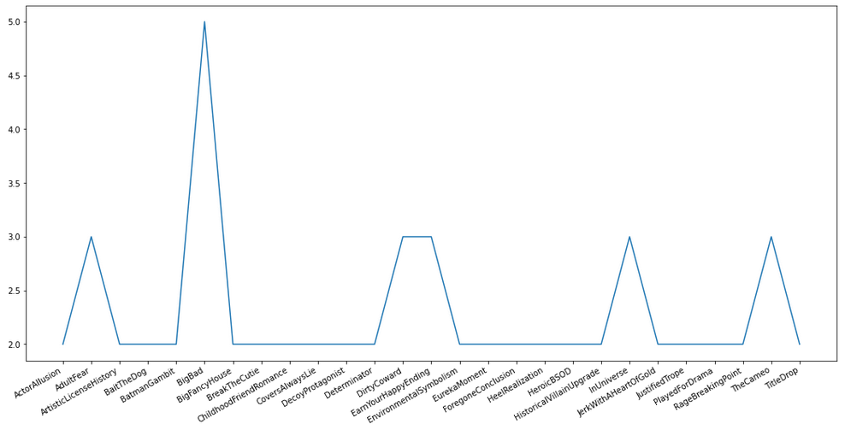
2.1 (2008-2017): Oscar Best Picture Winners
Over the Past 9 Winners:
5(56%):
Big Bad
3 (33%):
Adult Fear
Dirty Coward
Earn Your Happy Ending
In Universe
The Cameo

Slide 8
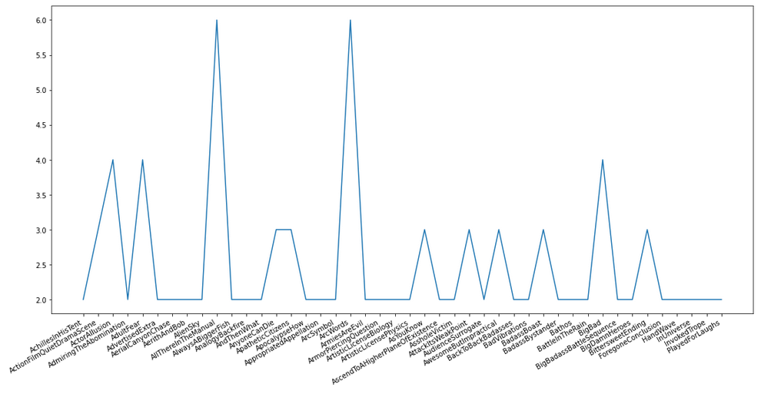
2.2 (2008-2017): Highest Grossing (Over $.5B)
Of the 7 Highest Grossing:
6 (86%):
Arc Words
All There In The Manual
4 (57%):
Big Bad
Action Film Quiet Drama Scene
Adult Fear

Slide 9
3. Genrewise Analysis
Oscar Winning Action Movies and Highest Grossing Crime Movies

Slide 10
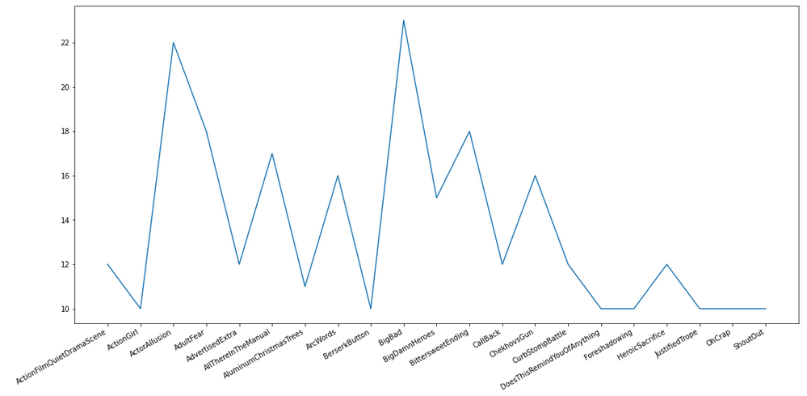
3.1 Action: Oscar-Nominated Movies
Of 54 total:
24 (44%):
Big Bad
22 (41%):
Actor Allusion
18 (33%):
Bittersweet Ending

Slide 11
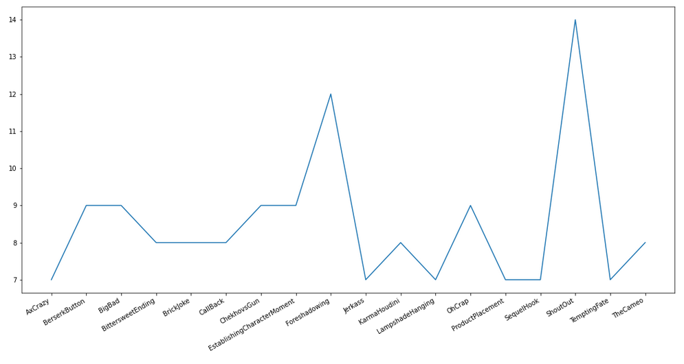
3.2 Crime: Highest-Grossing Movies (>$100M)
Of 22 Movies:
14 (64%):
Shout Out
12 (55%):
Foreshadowing
9 (41%):
Berserk Button,
Checkovs Gun,
“Oh Crap”

Slide 12

4. Next Steps
Quantification of each tropes occurance. Compare Winners to Nominated.
Adaptation for TV shows: ‘/Series/’ in Tvtropes
Inverse problem 1: Given a set of tropes, find movies with them.
Inverse problem 2: Given history of tropes (say Oscar winners), predict next movie’s tropes.

Slide 13
Bibliography
Vipul, (U. (2020, September 8). Oscars nominated movies 2000-2017. Kaggle. Retrieved January 31, 2022, from https://www.kaggle.com/vipulgote4/oscars-nominated-movies-from-2000-to-2017
email, S. G. S. an, Ghazanchyan, S., &amp; email, S. an. (2021, December 7). Armenia Movie Wins Gold at tokyo film awards. Public Radio of Armenia. Retrieved January 31, 2022, from https://en.armradio.am/2021/12/07/armenia-movie-wins-golden-winner-prize-at-tokyo-film-awards/

