Slide 1
Tropes in Oscar-Winning Films
A data driven approach to quantify successful plots

Slide 2

Outline
Introduction
What Are Tropes?
Premise
Execution
Yearwise Analysis
Oscar Best Picture 2008-2017
Highest Grossing 2008-2017
Genrewise Analysis
Oscar Winning Action Movies
Highest Grossing Crime Movies
Next Steps

Slide 3

Introduction: What Are Tropes?
Dictionary Defintion of a trope is a figure of speech
In colloquial, or literary terms a trope is a storytelling “figure of speech” or shorthand.
Tropes can be diverse: “Hero”, “Big Bad”, “Love Triangle”, “Disapproving Parental Figure”

Slide 4
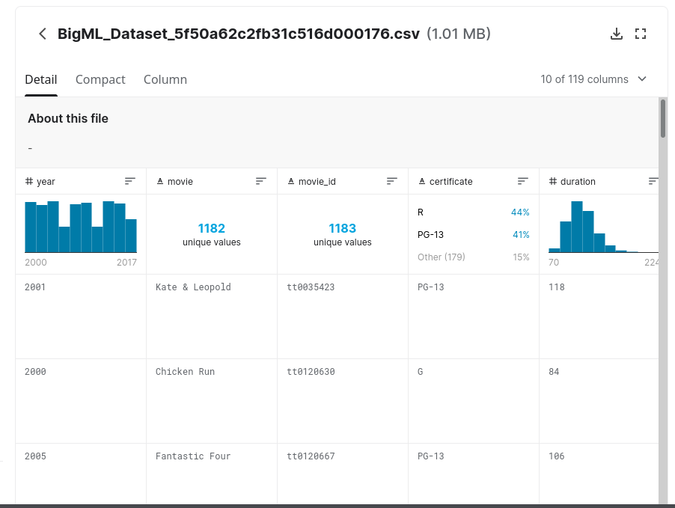
Introduction: Premise
Tropes are fundemental to stories, so which ones are the most popular over the years?
Which Tropes are regularly Oscar-Winning for Best Picture?
Which Tropes have been highest grossing, or within certain genres?
Is there a discernable relationship at all?

Slide 5
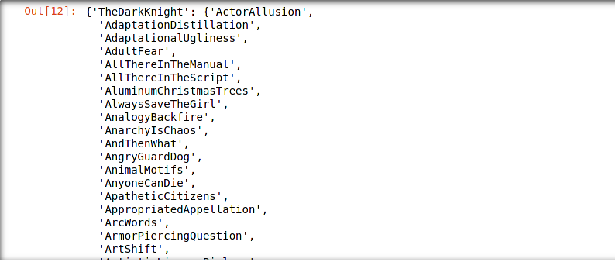
Introduction: Execution
Used Jupyter notebook, Version control with git, Numpy for Array features, Pandas for Databases
Inflect, re used for text processing and filtering. Title must be converted to web query
BeautifulSoup4, and Requests for scraping TvTropes

Slide 6
Yearwise Analysis
Best Picture and Highest Grossing Films from 2008 to 2017

Slide 7
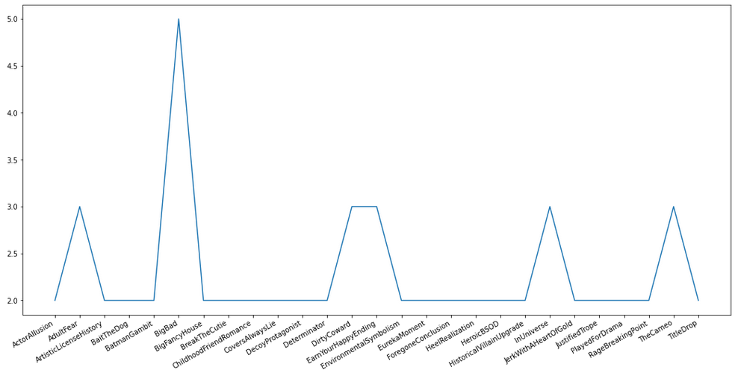
2008-2017: Oscar Best Picture Winners
Over the Past 9 Winners:
5: “Big Bad”
3: “Adult Fear”
3: “Dirty Coward”
3: “Earn Your Happy Ending”
3: “In Universe”
3” “The Cameo”

Slide 8
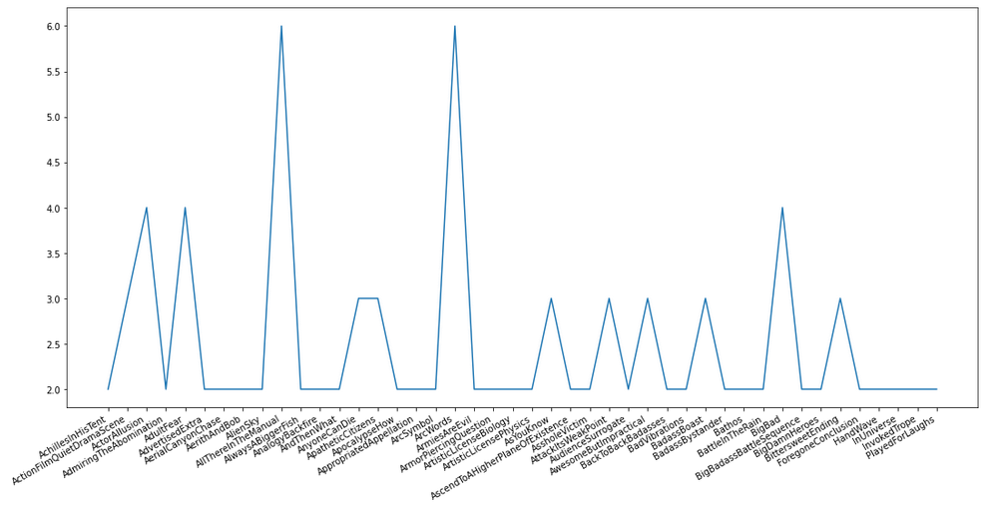
2008-2017: Highest Grossing (Over $.5B)
Of the 7 Highest Grossing:
6: Arc Words
6: All There In The Manual
4: Big Bad
4: Action Film Quiet Drama Scene
4: Adult Fear

Slide 9
Genrewise Analysis
Oscar Winning Action Movies and Highest Grossing Crime Movies

Slide 10
Action: Oscar-Winning Movies

Slide 11
Crime: Highest-Grossing Movies

Slide 12
Next Steps
Quantification of each tropes occurance
Adaptation for TV shows: ‘/Series/’ in Tvtropes
Inverse problem 1: Given a set of tropes, find movies with them.
Inverse problem 2: Given history of tropes (say Oscar winners), predict next movie’s tropes.

Slide 13
Bibliography

