Slide 1
CRYPTOGRAPHY
Classical Cryptography

Slide 2
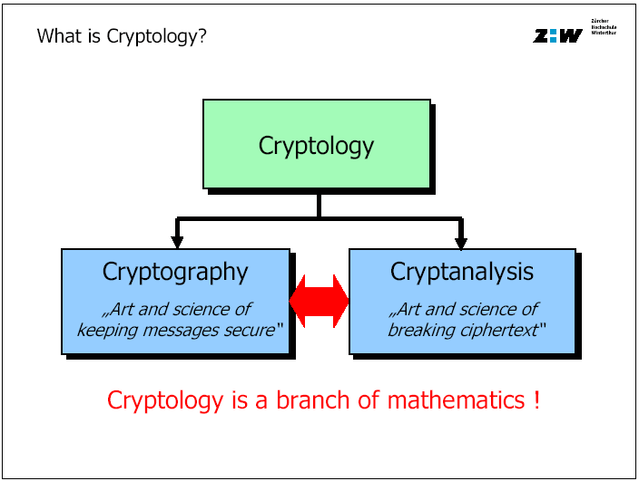
Cryptology

Slide 3
Cryptology
Cryptography
  The art and science of keeping message secure, is called cryptography
  Cryptography comes from Greek and it means hidden/secret (crypto) and writing (graphy)
Cryptanalysis
  The art and science of breaking ciphertext: that is seeing through disguise (without the knowledge of key)
Cryptology
  The branch of mathematics encompassing both cryptography and cryptanalysis is Cryptology. Its practitioners are Cryptologists

Slide 4
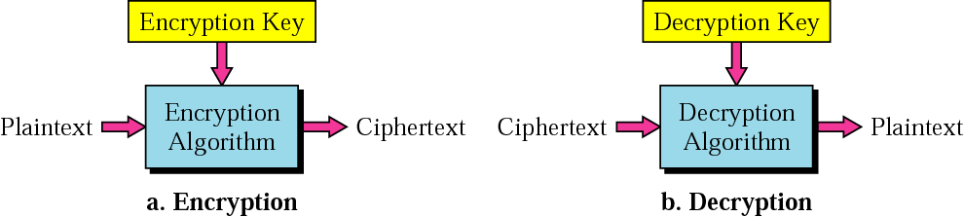
Messages and Encryption
Encryption
  The original message is called Plaintext
  The process of disguising a message in such a way to hide its substance, is called Encryption
  The Encryption is done using the specified key: C = E_{K}(P) or E(K, P)
  The encrypted message is called Ciphertext
Decryption
  The mathematical function mapping ciphertext to plaintext using the specified key: P = D_{K}(C) or D(K, Y) = E_{K}⁻¹(C)
C = E_{K}(P)
P = D_{K}(C)
P
C
C
P

Slide 5
Algorithms and Keys
Cipher
  A cryptographic algorithm is called a cipher. It is a mathematical function used for both encryption and decryption
Key & Key Space
  The security of modern cryptosystem is based on a Key: which could a be one of any large values.
  The range of possible key values is called the Key Space
  Both encryption and decryption depends upon the Key
  Given a key, every possible plaintext must result in a unique ciphertext—if not – decryption would not be unambiguously possible

Slide 6
Cryptosystem
A cryptosystem is a five-tuple (P, C, K, E, D), where following
conditions are satisfied :
  P is a finite set of possible plaintexts
  C is a finite set of possible ciphertexts
  K, the keyspace, is a finite set of possible keys
  For each K ∈ K, there is an encryption algorithm E_{K} ∈ E and a corresponding decryption algorithm D_{K} ∈ D. Each E_{K} : P → C and D_{K} : C → P are functions such that D_{K}(E_{K}(X)) = X for every plaintext X ∈ P.

Slide 7
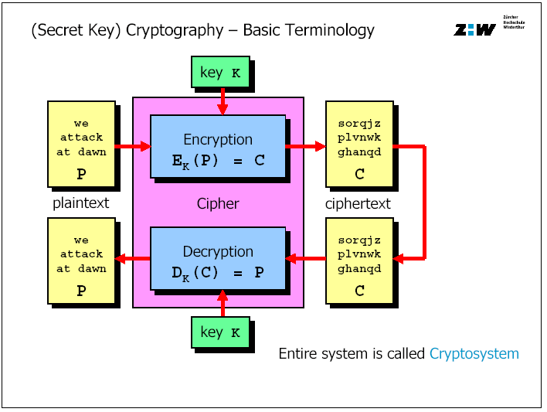
Cryptosystem

Slide 8
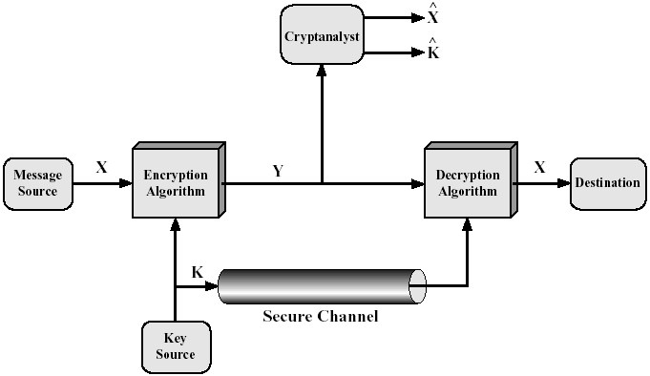
Conventional Cryptosystem Model
Requirements
  Strong encryption algorithm
  Share of the secret key in a
  secure fashion
Conventional
  Secret-Key (⇔ Public-Key)
  Single-Key (⇔ Two-Key)
  Symmetric (⇔ Asymmetric)

Slide 9
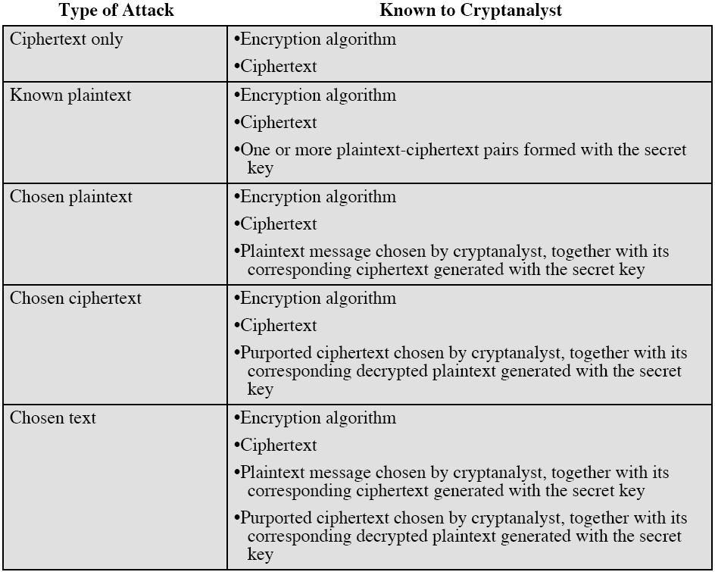
Cryptanalysis
Process of attempting to discover Plaintext (P) or Key (K) or both.
Various types of cryptanalytic attacks

Slide 10
Classification of Attacks
  Ciphertext only
The attacker has access only to the ciphertext of several messages encrypted through same encryption scheme. The knowledge of the plaintext is minimal.
His job is to find plaintext, or key or the algorithm.
Known
C₁=E_{k}(P₁), C₂=E_{k}(P₂),……, C_{J}=E_{k}(P_{J})
To be Known
P₁, P₂, P₃,……., P_{j} OR An algorithm OR Key (K)

Slide 11
Classification of Attacks
  Known Plaintext
The attacker has access to the plaintext as well as to their corresponding ciphertext. He intends to find plaintext, or key or the algorithm.
Known
P1,C₁=E_{k}(P₁), P₂,C₂=E_{k}(P₂),……, P_{J}, C_{J}=E_{k}(P_{J})
To be Known
An algorithm OR Key (K) to get P1, P2, P3,……., P_{j}

Slide 12
Classification of Attacks
  Chosen-Plaintext
The attacker has access to the plaintext as well as to their corresponding ciphertext and also he has ability to encrypt texts of his own choice. That is possible when an encryption box embedded with a secure key comes in the hands of attacker or the attacker can send his own plaintexts to the owner of the secret key to decrypt. His job is to deduce either algorithm or key to get plaintexts.
Known
P₁,C₁=E_{k}(P₁), P₂,C₂=E_{k}(P₂),……, P_{J}, C_{J}=E_{k}(P_{J})
(attacker can choose P₁, P₂, ….,P_{j,})
To be Known
An algorithm OR Key (K) to get P1, P2, P3,……., P_{j}

Slide 13
Classification of Attacks
  Adaptive Chosen-Plaintext attack
This is a special case of chosen plaintext attack which makes the attacker to have even more active actions because he can modify his choices of encrypted texts based on the previous results. He can choose a smaller block of plaintext, then another based on the results of previous one and so forth.
Known
P₁,C₁=E_{k}(P₁), P₂,C₂=E_{k}(P₂),……, P_{J}, C_{J}=E_{k}(P_{J})
(attacker can choose P₁, P₂, ….,P_{j,} & Length of P_{j} is not fixed)
To be Known
An algorithm OR Key (K) to get P1, P2, P3,……., P_{j}

Slide 14
Classification of Attacks
  Chosen-Ciphertext attack
In contrast to chosen plaintext attack, here an attacker can choose different ciphertexts to be decrypted and he has access to the decrypted plaintexts. The attacker has access to a decryption box or can send to the owner his ciphertexts to decrypt. His job is to deduce the key.
Known
C₁,P₁=D_{k}(C₁), C₂,P₂=D_{k}(C₂),……, C_{J}, P_{J}=D_{k}(C_{J})
(attacker can choose C₁, C₂, ….,C_{j})
To be Known
Key (K)

Slide 15
Cryptography
Goals/Services
Confidentiality - protect info value
Authentication - protect info origin (sender)
Integrity - protect info accuracy
Non-repudiation - protect from deniability
Access control - access to info/resources

Slide 16
Cryptography
Goals/Services
Data Confidentiality- protect info value
The protection of data from unauthorized disclosure
  The protection of all user data during transmission
  The protection of all user data in a single data block
  The confidentiality of single field
  The protection of information due to traffic flow
Data Integrity- protect info accuracy
The assurance that data received are exactly as sent be by
authorized entity-contains no modification, insertion deletion,
or replay

Slide 17
Cryptography
Goals/Services
Data Authentication- protect info origin (sender)
The assurance that the communicating party is the one that it claims to be.
  Peer entity authentication
  Data origin authentication
Non-repudiation- protect from deniability
Provides protection against denial by one of the entities involved
in a communication of having participated in all or part of the
communication
When a message is sent:
  the receiver can prove that the alleged sender in fact send the message
  The sender can prove that the alleged receiver in fact received the message

Slide 18
Cryptography
Goals/Services
Access Control - access to info/resources
Access control is the ability to limit and control the access to the resources/information. Each entity trying to gain access must first be identified or authenticated, so that access rights can be tailored to the individual

Slide 19
Some Practical Applications
secure mail
secure communications
network authentication
electronic voting
electronic notary
digital money (digital wallet)
data distribution

Slide 20
Kerchhoff’s Principle
“Encryption algorithms being used should be assumed to be publicly known and the security of the algorithm should reside only in the key chosen”

Slide 21
Steganography
The art of covered writing
“Security by obscurity”
Hide messages in other messages
Conceal the existence of message
Conceal what you are communicating (Sending encrypted messages would make you a spy)
Character marking. Overwrite with a pencil
  Invisible ink, - First letter of each word
  Letter position on page, - Drawings, - Codes
  Typewriter correction ribbon

Slide 22
Steganography - Example
News Eight Weather: Tonight increasing snow. Unexpected precipitation
Smothers Eastern towns. Be extremely cautious and use snowtires especially
heading east. The highways are knowingly slippery. Highway evacuation is
suspected. Police report emergency situations in downtown ending near
Tuesday
First letter of each word yields: Newt is upset because he thinks he is President
This example was created by Neil F. Johnson, and was published in
Steganography,Technical Report TR_95_11_nfj, 1995. URL: http://www.jjtc.com/pub/tr_95_11_nfj/
From WWII German spy (Kahn):
Apparently neutral’s protest is thoroughly discounted and ignored. Isman
hard hit. Blockade issue affects pretext for embargo on by products, ejecting
suets and vegetable Oils.
Second letter of each word yields: Pershing sails from NY June 1.

