Slide 1
William Stallings
Computer Organization and Architecture
10th Edition
Chapter 13
Reduced Instruction
Set Computers (RISC)

Slide 2
Major Advances in Computers(1)
The family concept
  IBM System/360 in 1964
  DEC PDP-8
  A set of computers is offered, with different price/performance characteristics, that presents the same architecture to the user
  The differences in price and performance are due to different implementations of the same architecture
Micro-porgrammed control unit
  Idea by Wilkes 1951
  Produced by IBM S/360 in 1964
  It eases the task of designing and implementing control unit and provides support for family concept
Cache memory
  First introduced commercially on IBM S/360 model 85 in 1968, it dramatically improves performance

Slide 3
Major Advances in Computers(2)
Solid State RAM
  (See memory notes)
Pipelining
  Introduces parallelism into the essentially sequential nature of a machine-instruction program (fetch execute cycle or inst pipelining)
Multiple processors
  This category covers a number of different organizations and objectives

Slide 4
The Next Step - RISC
RISC architecture is a dramatic departure from the historical trend in processor architecture. It brings into focus many of the important issues in computer org & arch
RISC systems have been defined & designed in a variety of ways by different groups, but the key elements shared by most designs are these:
Key features
  A large number of general-purpose registers, and/or the use of compiler technology to optimize register usage
  A limited and simple instruction set
  An emphasis on optimising the instruction pipeline

Slide 5
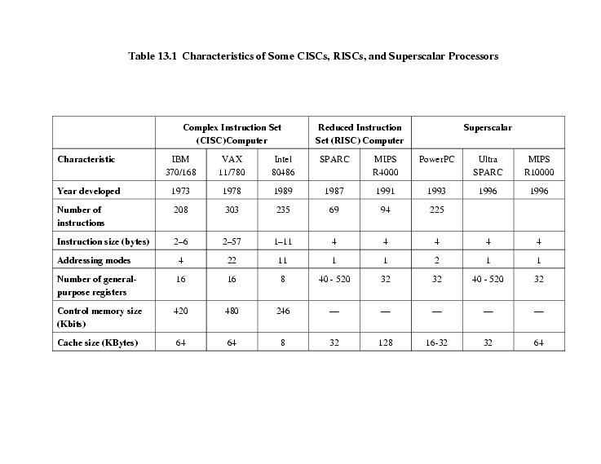
Comparison of some RISC and non-RISC systems
Figure shows the characteristics of some CISCs, RISCs, and Superscalar Processors

Slide 6
Driving force for CISC
Software costs far exceed hardware costs
Response from researchers and industry has been to develop ever more powerful and complex high level programming languages (HLLs), that allow programmer to express algorithm more concisely
Another problem is Semantic gap: difference b/w operations provided in HLLs & those provided in computer architecture
Such complex instruction sets leads to:
  Large instruction sets
  More addressing modes
  Hardware implementations of HLL statements
    e.g. CASE (switch) on VAX

Slide 7
Instruction Execution Characteristics
To understand the line of reasoning of RISC advocates, some points are as follows:
Operations performed- these determine functions to be performed by processor and its interaction with memory
Operands used- types of operands and frequency of their use determine memory organization for storing and addressing modes for accessing them
Execution sequencing- this determines control and pipeline organization
-Studies have been done based on programs written in HLLs
-Dynamic studies are measured during the execution of the program

Slide 8
Operations
Assignment statements
  Suggesting that simple Movement of data is of high importance
Conditional statements (IF, LOOP)
  This suggests that Sequence control mechanism of the instruction set is important
Procedure call-return is very time consuming
Some HLL instruction lead to many machine code operations
The table (next slide) results indicates relative significance of various statement types in an HLL, when that HLL is compiled for a typical instruction set architecture.

Slide 9
Relative Dynamic Frequency of HLL Operations
Dynamic Machine Instruction Memory Reference
Occurrence (Weighted) (Weighted)
Pascal C Pascal C Pascal C
Assign 45% 38% 13% 13% 14% 15%
Loop 5% 3% 42% 32% 33% 26%
Call 15% 12% 31% 33% 44% 45%
If 29% 43% 11% 21% 7% 13%
GoTo - 3% - - - -
Other 6% 1% 3% 1% 2% 1%
To determine average number of machine instruction and memory reference per statement type. 2nd & 3rd column show relative frequency of occurrence of various HLL instructions in a variety of programs.
Results suggest that procedure call/return is the most time-consuming operation in typical HLL programs.

Slide 10
Operands
Results show that majority of references are to simple scalar variables (more than 80% of scalars were local variables to the procedure)
This study suggest that a prime candidate for Optimisation is the mechanism for storing and accessing local scalar variables
Pascal C Average
Integer constant 16% 23% 20%
Scalar variable 58% 53% 55%
Array/structure 26% 24% 25%

Slide 11
Procedure Calls
Procedure calls and returns are the most time consuming operations in compiled HLL programs. Thus it will be profitable to consider ways of implementing these operations efficiently
Depends on number of parameters passed & variables
Depends on level of nesting
Study found that 98% of dynamically called proc were passed fewer than 6-arguments, and that 92% of them used fewer than 6-local scalar variables
Conclude that operand references are highly localized

Slide 12
Implications (Suggestions)
Conclude that HLLs can be best supported by optimizing performance of the most time consuming features of typical HLL programs. So three elements emerge that (i.e. RISC characterize)
First, use a large number of registers or use a compiler to optimize register usage. This is intended to optimize operand referencing (i.e. performance can be improved by reducing memory references at the expense of more register references)
Careful attention needs to be paid to design of instruction pipelines. Because of high proportion of conditional branch & procedure call instructions, a straightforward instruction pipeline will be inefficient.
Finally, a simplified (reduced) instruction set is indicated

Slide 13
The Use of a Large Register File
Two basic approaches are possible:
Software solution
  Require compiler to allocate registers to those variables that will be used the most in a given time period
  A strategy is needed that will allow the most frequently accessed operands to be kept in registers and to minimize register-memory operations
  This approach requires sophisticated program analysis
Hardware solution
  Have more registers (due to fastest available storage device than both main & cache memory), Register file is physically small, on same chip as ALU/CU, employs much shorter addresses than both.
  Thus more variables will be in registers for longer periods

Slide 14
Register Windows (Hardware Approach)
Only few parameters (As previous results shown)
Limited range of depth of call, i.e. register windows can be used to hold few most recent proc activation
Older activation must be saved in memory and later restored when nesting depth decreases (showing a circular buffer of overlapping windows)
Multiple small sets of registers are used, each assigned to a different procedure
A procedure call switches processor to use a different fixed-size window of registers, rather than saving registers in memory
Returns switch back to a previously used set of registers

Slide 15
Register Windows cont.
Window is divided into three fixed-size areas within a register set
  Parameter registers
  Local registers
  Temporary registers
  Temporary registers are used to exchange parameters and results with next lower level proc
  Temporary registers from one set overlap parameter registers from the next
  This allows parameter passing without actual movement of data

Slide 16
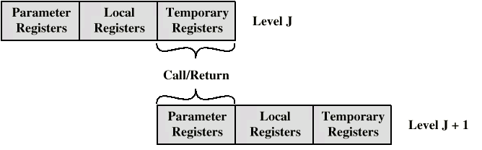
Overlapping Register Windows

Slide 17
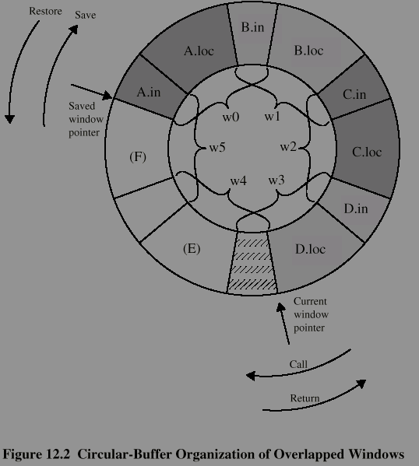
Circular Buffer diagram
Figure shows a circular buffer of six windows. Buffer is filled to a depth of 4 (A called B; B called C; C called D) with procedure D active.
Current window pointer (CWP) points to window of currently active proc.
Saved window pointer identifies window most recently saved in memory. If proc D now called proc E, arguments for E are placed in D’s temporary registers (overlap b/w W3 & W4) and CWP is advanced by one window.
If proc E then makes a call to proc F, CALL cannot be made with current status of buffer. Because F’s window overlaps A’s window. If F begins to load its temporary registers on call, it will overwrite parameter registers of A (A.in). i.e. CWP = SWP.

Slide 18
Operation of Circular Buffer
When a call is made, a current window pointer (CWP) is moved to show the currently active register window
If all windows are in use, an interrupt is generated and the oldest window (the one furthest back in the call nesting, i.e A) is saved to memory, only first two portions (A.in & A.loc)
SWP is incremented & call to F proceeds. A similar interrupt can occur on returns. SWP indicates where the next saved windows should restore to
An N-window register file can hold only N-1 proc activations. N need not be large. With 8 windows, a save/restore is needed on only 1% of calls/returns. Berkeley RISC computers use 8-windows of 16 registers each. Pyramid computers employs 16-windows of 32 registers each.

Slide 19
Global Variables
Registers window technique provides an efficient organization for storing local scalar variables, however, does not address the need to store global variables, those accessed by more than one procedure. 2 points suggested:
First, variables declared as global in an HLL can be assigned memory locations by compiler, and all machine inst that reference these variables will use memory-reference operands, but
  Inefficient for frequently accessed global variables
An alternate is to Have a set of registers for global variables. These registers would be fixed in number and available to all procedures

Slide 20
Registers v Cache
Large Register File Cache
All local scalars Recently used local scalars
Individual variables Blocks of memory
Compiler assigned global variables Recently used global variables
Save/restore based on procedure Save/restore based on nesting caching algorithm
Register addressing Memory addressing

Slide 21
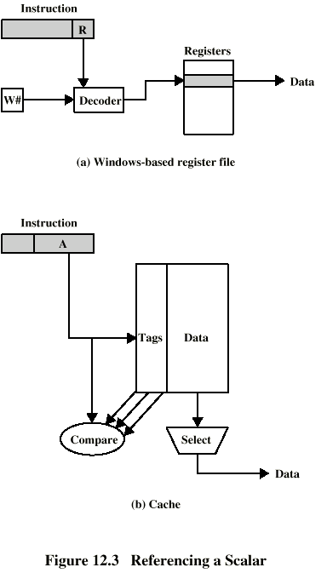
Referencing a Scalar -
Window Based Register File

Slide 22
Referencing a Scalar - Cache

Slide 23
Compiler Based Register Optimization
Assume small number of registers (16-32)
Optimizing use is up to compiler
HLL programs have no explicit references to registers
  usually - think about C - register int
Assign symbolic or virtual register to each candidate variable
Map (unlimited) symbolic registers to real registers
Symbolic registers that do not overlap can share real registers
If you run out of real registers some variables use memory

Slide 24
Graph Coloring
Given a graph of nodes and edges
Assign a color to each node
Adjacent nodes have different colors
Use minimum number of colors
Nodes are symbolic registers
Two registers that are live in the same program fragment are joined by an edge
Try to color the graph with n colors, where n is the number of real registers
Nodes that can not be colored are placed in memory

Slide 25
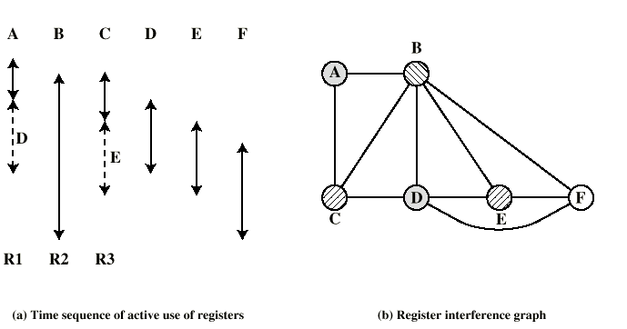
Graph Coloring Approach

Slide 26
Why CISC (1)?
Compiler simplification?
  Disputed…
  Complex machine instructions harder to exploit
  Optimization more difficult
Smaller programs?
  Program takes up less memory but…
  Memory is now cheap
  May not occupy less bits, just look shorter in symbolic form
    More instructions require longer op-codes
    Register references require fewer bits

Slide 27
Why CISC (2)?
Faster programs?
  Bias towards use of simpler instructions
  More complex control unit
  Microprogram control store larger
  thus simple instructions take longer to execute
It is far from clear that CISC is the appropriate solution

Slide 28
RISC Characteristics
One instruction per cycle
Register to register operations
Few, simple addressing modes
Few, simple instruction formats
Hardwired design (no microcode)
Fixed instruction format
More compile time/effort

Slide 29
RISC v CISC
Not clear cut
Many designs borrow from both philosophies
e.g. PowerPC and Pentium II

Slide 30
RISC Pipelining
Most instructions are register to register
Two phases of execution
  I: Instruction fetch
  E: Execute
    ALU operation with register input and output
For load and store
  I: Instruction fetch
  E: Execute
    Calculate memory address
  D: Memory
    Register to memory or memory to register operation

Slide 31
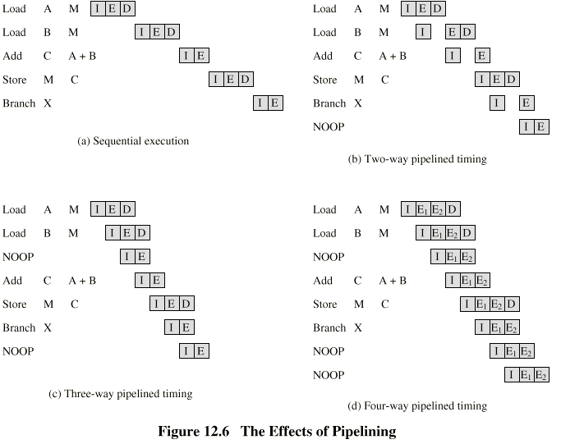
Effects of Pipelining

Slide 32
Optimization of Pipelining
Delayed branch
  Does not take effect until after execution of following instruction
  This following instruction is the delay slot

Slide 33
Normal and Delayed Branch
Address Normal Delayed Optimized
100 LOAD X,A LOAD X,A LOAD X,A
101 ADD 1,A ADD 1,A JUMP 105
102 JUMP 105 JUMP 105 ADD 1,A
103 ADD A,B NOOP ADD A,B
104 SUB C,B ADD A,B SUB C,B
105 STORE A,Z SUB C,B STORE A,Z
106 STORE A,Z

Slide 34
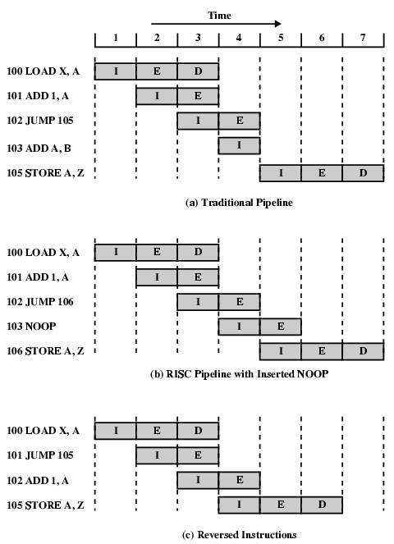
Use of Delayed
Branch

Slide 35
Controversy
Quantitative
  compare program sizes and execution speeds
Qualitative
  examine issues of high level language support and use of VLSI real estate
Problems
  No pair of RISC and CISC that are directly comparable
  No definitive set of test programs
  Difficult to separate hardware effects from complier effects
  Most comparisons done on “toy” rather than production machines
  Most commercial devices are a mixture

Slide 36
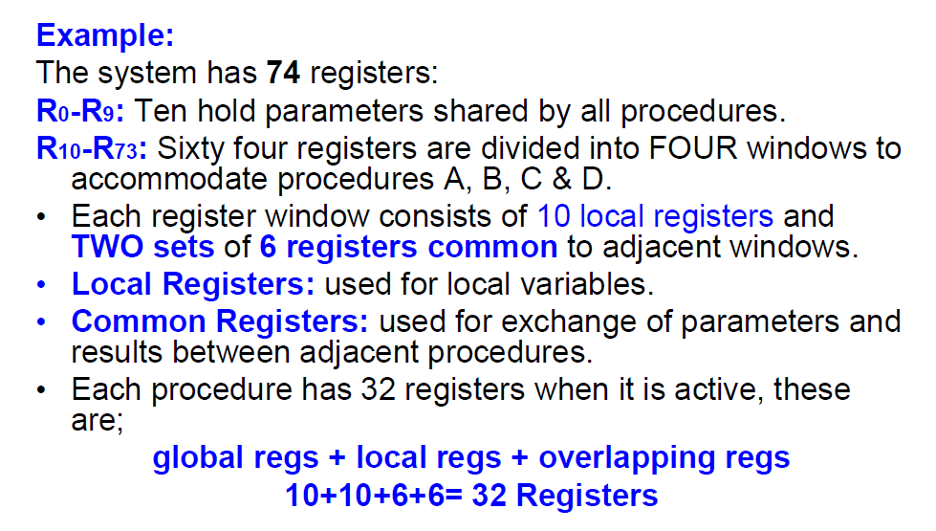
Required Reading

Slide 37
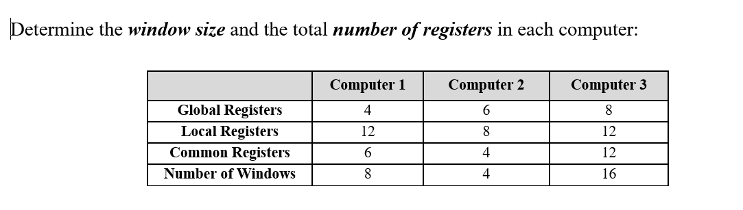
Required Reading

Slide 38
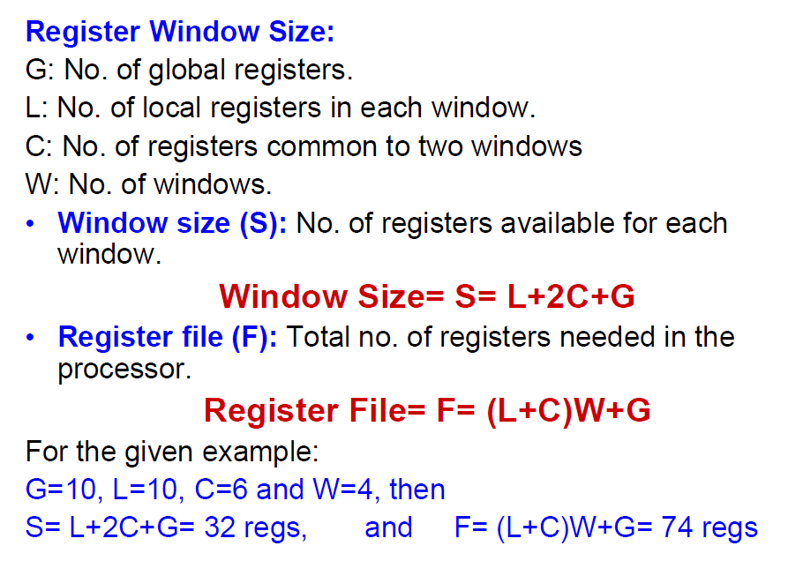
Required Reading

Slide 39
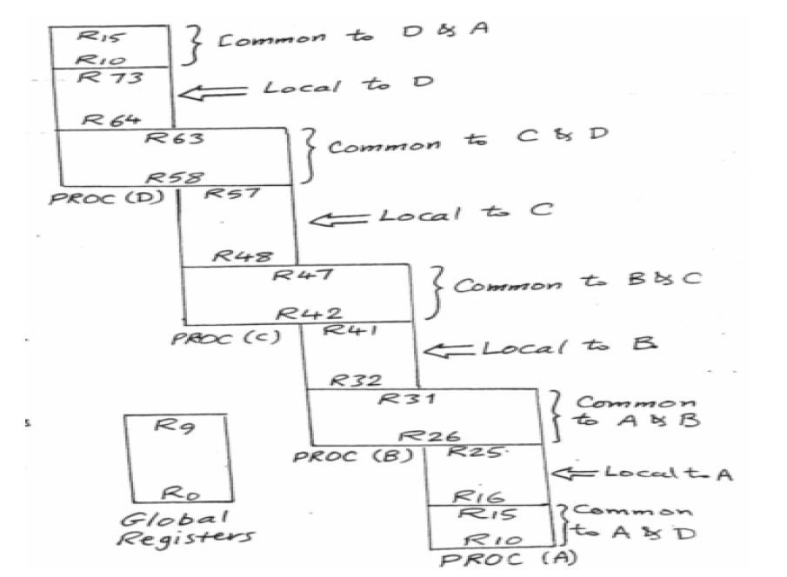
Required Reading

