Slide 1
CUSTOMER SEGMENTATION
Business Intelligence Analysis & Machine Learning
Submitted By:- Mir Sadab Ali
Project Code: CDACL-002

Slide 2
Project Objective
• Power BI is used for exploratory data analysis (EDA) to understand customer purchasing patterns Analysis.
• Machine Learning is used to identify customer groups through clustering.
• Random Forest learns to predict the cluster labels generated by K-Prototypes.
• The web application presents the predicted cluster and can provide an AI-generated explanation.

Slide 3
Workflow: BI vs Machine Learning
POWER BI
MACHINE LEARNING
Exploratory Data Analysis (EDA) And KPI
Customer Segmentation
• Purchase value by category
• K-Prototypes finds groups of similar customers
• Average purchase amount
• Profile the three generated clusters
• Discount comparisons
• Random Forest predicts cluster labels
• Season labels, subscriptions and locations
• FastAPI displays prediction; Gemini explains

Slide 4
Project Architecture
Power BI EDA
Data exploration
KPIs · category · season
location · discount patterns
Customer Dataset
CSV · 3,900 records
18 columns
Preprocessing
Select mixed features
Scale numeric features
K-Prototypes
Unsupervised clustering
K = 3
Creates cluster labels
Random Forest
Supervised classifier
Learns generated labels
Predicts cluster group
User Interface
Customer feature form
Shows predicted segment
FastAPI Backend
Receives customer inputs
Runs model prediction
Saved Model
Preprocessing + RF model
Used for inference
Gemini Explanation
Plain-language explanation

Slide 5
Dataset Overview
3,900 customer records • 18 columns
3,900
18
$996.38K
$255.48
customer records
columns
total purchase value
average purchase amount
• Fields include demographics, product/category, purchase amount, location, season, subscription, discounts and purchase frequency.
• Initial checks reported no missing values or duplicate rows, CustomerID was unique.
• No company identifier, transaction dates, costs or future outcome labels are available.

Slide 6
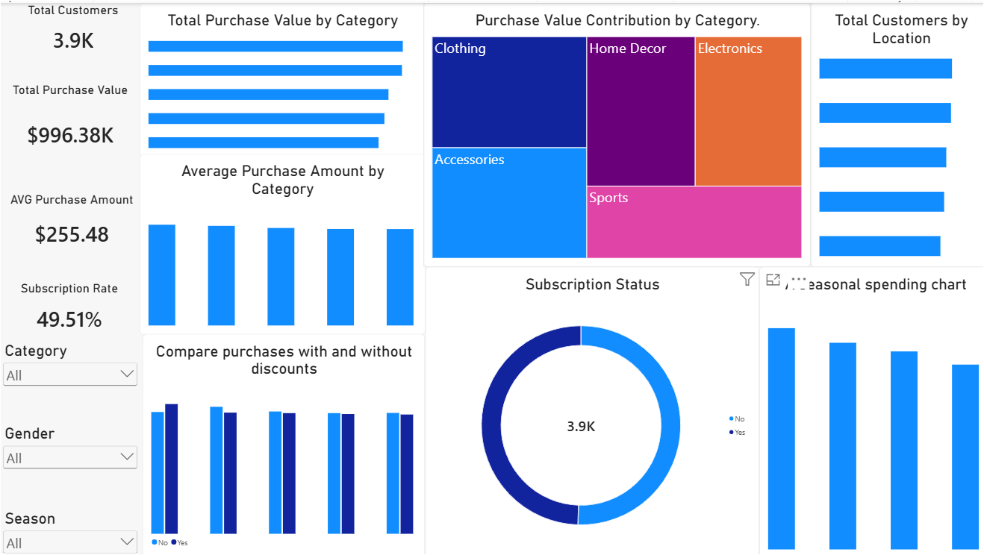
Power BI Dashboard Overview

Slide 7
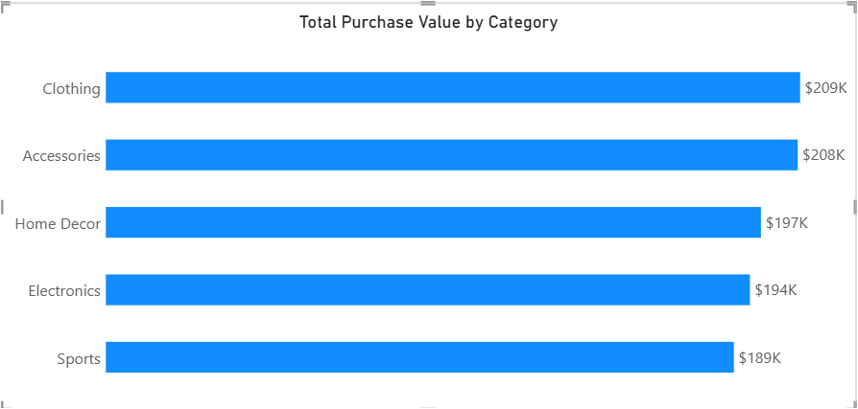
Power BI Finding: Purchase Value
Descriptive analysis by category
• Clothing: approximately $209K total purchase value.
• Accessories: approximately $208K; Home Decor: approximately $197K.
• Electronics: approximately $194K; Sports: approximately $189K.
• Total purchase value displayed: approximately $996.38K.

Slide 8
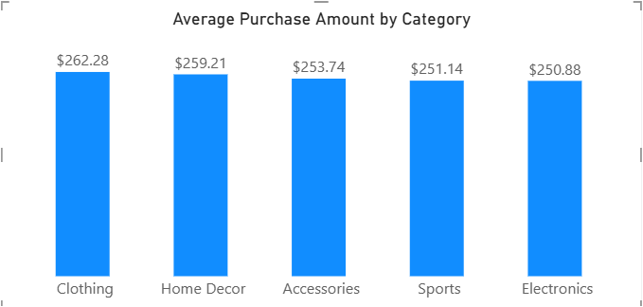
Power BI Finding: Average Purchase
Average values are relatively close
• Clothing: $262.28 (highest displayed average).
• Home Decor: $259.21; Accessories: $253.74.
• Sports: $251.14; Electronics: $250.88.
• Difference between highest and lowest averages: approximately $11.40.

Slide 9
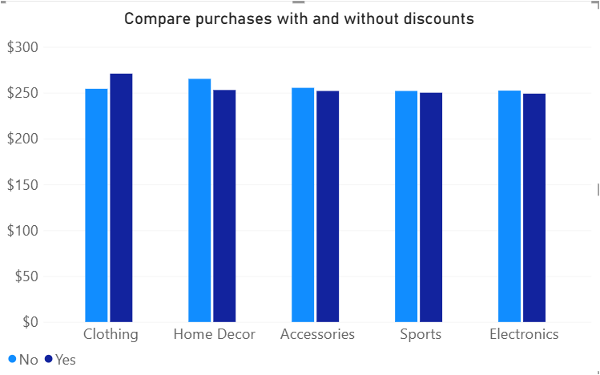
Power BI Finding: Discounts
Descriptive comparison; not causal evidence
• Discount patterns differ across categories.
• The chart does not establish that discounts cause spending changes.

Slide 10
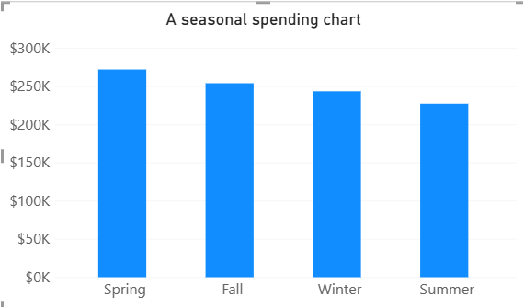
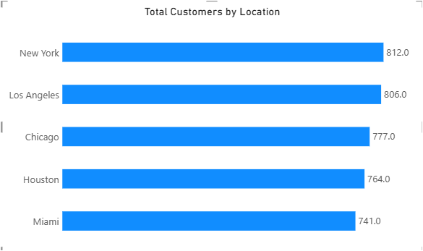
Power BI Finding: Season & Location
• Spring has the highest displayed seasonal total; Summer the lowest.
• Location counts range from 741 (Miami) to 812 (New York).
• No transaction dates are available to claim year-over-year trends.

Slide 11
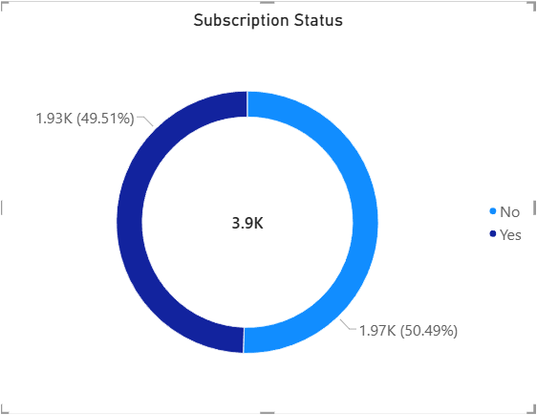
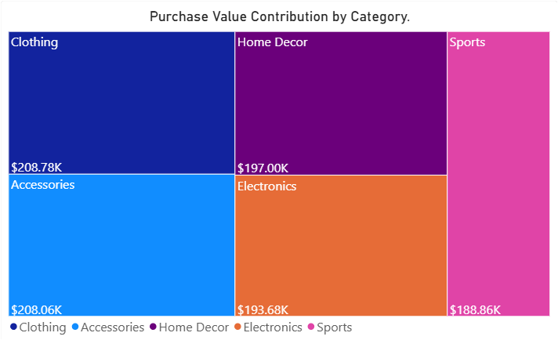
Power BI Finding: Subscription & Category
• Subscription status is almost balanced: 49.51% Yes and 50.49% No.
• All five categories contribute meaningful purchase value.

Slide 12
Machine Learning: K-Prototypes
Unsupervised learning finding groups
• Selected because customer data contains both numeric and categorical features.
• Numeric: Age, PurchaseAmountUSD, PreviousPurchases.
• Categorical: Category, SubscriptionStatus, DiscountApplied, PromoCodeUsed, FrequencyOfPurchases.
• CustomerID excluded as an identifier.
• Three clusters were generated for customer profiling.

Slide 13
Three Customer Groups
Cluster profiles from the K-Prototypes solution
CLUSTER 0
CLUSTER 1
CLUSTER 2
1,488 customers
1,220 customers
1,192 customers
$111.27 average purchase
$337.86 average purchase
$351.20 average purchase
Lower-spend group
Higher spend; highest reported previous-purchase average
Highest average purchase in this solution
• Cluster sizes total 3,900 records. Cluster labels are identifiers, not rankings.

Slide 14
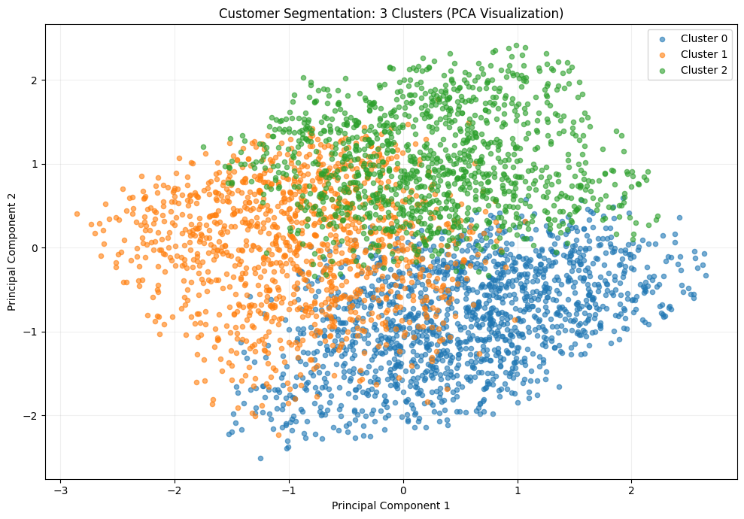
Cluster Quality
Reported Gower silhouette score: 0.0676
• Calculated on a sample of 600 records.
• The score indicates weak separation between clusters in the sampled mixed-type feature space.
• Use these segments as exploratory profiles, not definitive customer types.

Slide 15
Why Are the Customer Clusters Weak?
0.0676
Gower silhouette
(sample of 600)
1. Limited feature information
The dataset has a single snapshot per customer and no dates, profit/margin, or customer-lifetime-value measures.
2. Similar category patterns
The clusters share similar dominant categories and subscription/discount patterns, so many features do not strongly distinguish them.
3. Overlapping customers
A low silhouette score suggests customers are not clearly separated; some may fit more than one group.
4. Spending drives much of the difference
Average purchase amount differs across groups, but that alone may not create well-separated customer profiles.

Slide 16
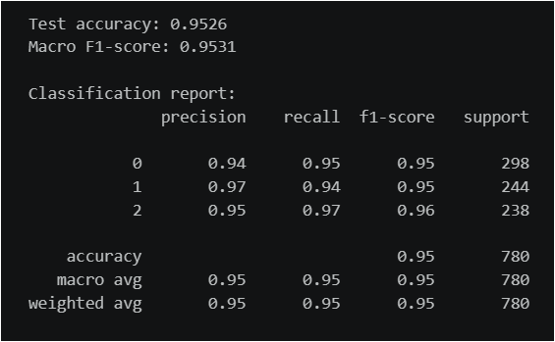
Machine Learning: Random Forest
Supervised prediction of generated cluster labels
• Target variable (y): Cluster_Scaled, generated by K-Prototypes.
• Input features (X): the eight customer attributes used in the segmentation workflow.
• Pipeline: StandardScaler + OneHotEncoder + Random Forest classifier.
• Reported test accuracy: 95.26%; macro F1: 0.9531.

Slide 17
Application Flow
How a customer input becomes a segment prediction and a plain-language explanation
1. User Interface
User enters customer features
2. FastAPI Backend
Receives request and validates input
3. Random Forest
Predicts the assigned cluster label
4. Prediction Result
Returns the predicted customer group
6. UI Displays Output
Shows segment and explanation to user
5. Gemini Explanation
Turns prediction context into simple language

Slide 18
Conclusion
• Power BI was used for exploratory analysis of purchasing patterns.
• K-Prototypes was used to find three customer groups.
• Random Forest predicts the cluster labels generated by K-Prototypes.
Github Link

Slide 19
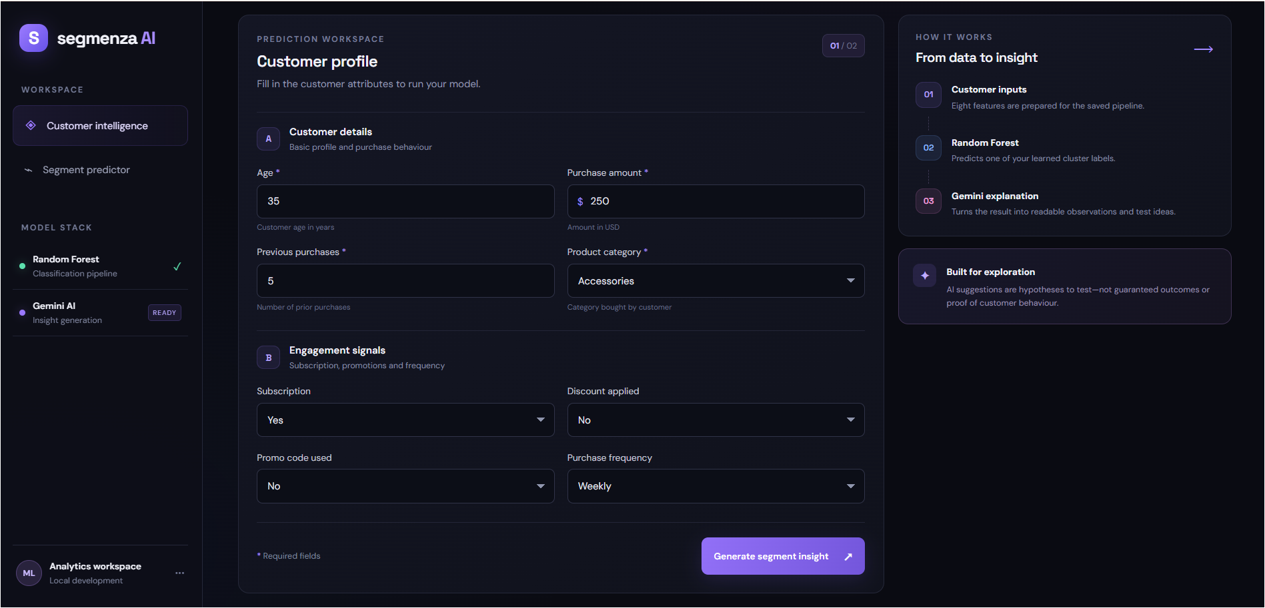
Application UI — Customer Input

Slide 20
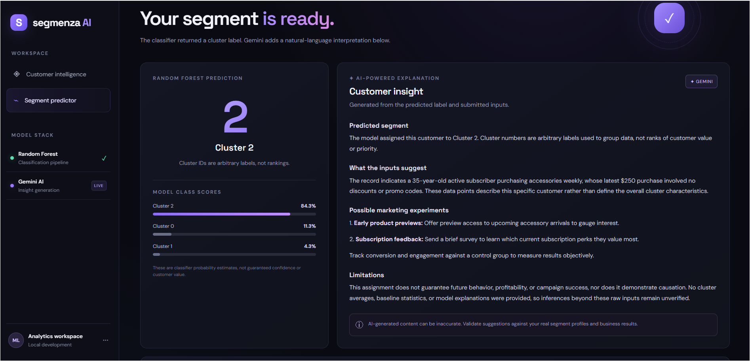
Application UI Prediction & Explanation

Slide 21
Thank You

