Slide 1
PRDA – 03
HR ANALYTICS
Power BI Project Presentation
Submitted to: DataMites
Centre: Bengaluru – Marathahalli
Submitted by: Mir Sadab Ali
Tool: Microsoft Power BI
1

Slide 2
Content
Project Objective
Dataset & Data Preparation
Key Performance Indicators
Workforce Distribution
Workforce Demographics
Hiring & Termination Trends
Employee Status & Job Titles
Power BI Dashboard Overall View
Key Insights
Business Suggestions
Conclusion

Slide 3
1. Project Objective
• Analyze employee workforce data using Power BI.
• Create HR KPIs for workforce size, age and work location.
• Understand hiring, termination and workforce distribution patterns.
• Analyze demographic and organizational features.
• Provide data-driven HR insights and practical suggestions.
2

Slide 4
2. Dataset & Data Preparation
Employee Records
22,214
Main Tool
Power BI
Preparation
Power Query
Calculation
DAX
• HR data contains demographic, employment, location, hiring and termination information.
• termdate was cleaned by removing the time portion using Text Before Delimiter.
• termdate was converted to Date; missing values remained blank/null.
• Close & Apply loaded the prepared data into the Power BI model.
3

Slide 5
3. Key Performance Indicators
Total Employees
22,214
Average Age
38.43
Remote Employees
24.75%
HQ Employees
75.25%
• The average employee age is 38.43 years.
• Remote employees represent roughly one-quarter of the workforce.
• The majority of employees are classified as Headquarters-based.
4

Slide 6
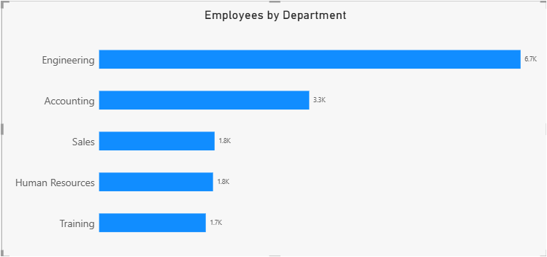
4. Workforce Distribution
• Engineering is the largest department at approximately 6.7K employees.
• Accounting is the second-largest displayed department at approximately 3.3K.
• The remaining displayed departments have smaller workforce sizes.
5

Slide 7
5. Workforce Demographics
Largest Age Groups
25–34
Gender Distribution
50.81% / 46.46% 2.72%
Largest State
Ohio
Race
White
• The 25–54 age groups are the largest workforce segments.
• The two largest gender categories are relatively close in size.
• Ohio has the largest employee concentration, approximately 18.0K.
• White is the largest displayed race category.
6

Slide 8
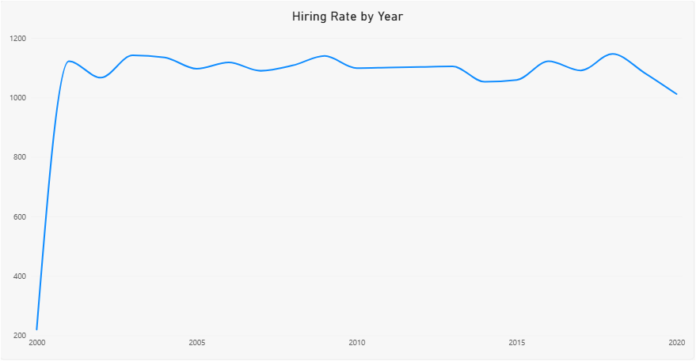
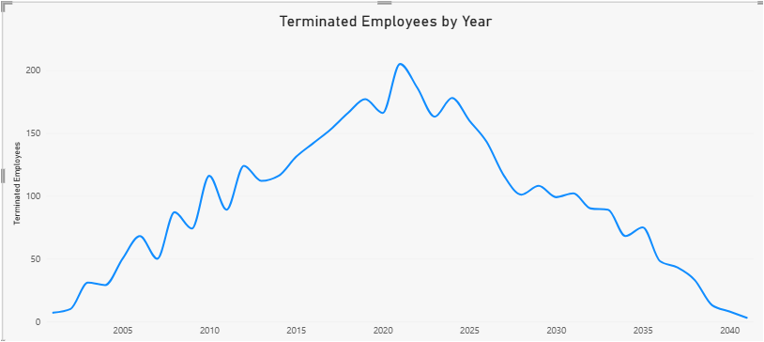
6. Hiring & Termination Trends
• Hiring counts rise sharply at the beginning and then remain comparatively stable with fluctuations.
• Termination counts rise to a visible peak and decline toward the later period.
• Further analysis by department, job title and location can explain these patterns.
7

Slide 9
7. Employee Status & Job Titles
Active Employees
18.29K (82.31%)
Terminated
3.93K (17.69%)
Top Job Title
Research Assistant II
Second
Business Analyst
• Active employees make up the large majority of the workforce.
• Research Assistant II is the largest displayed job-title category.
• Business Analyst follows among the displayed job titles.
8

Slide 10
8. Power BI Dashboard Overall View
Employees
22,214
Average Age
38.43
Remote
24.75%
HQ
75.25%
State
Ohio ≈ 18.0K
Department
Engineering ≈ 6.7K
Location
HQ 75.25%
Status
Active 82.31%
Age
25–54 largest
Job Title
Research Assistant II – 754
9

Slide 11
9. Key Insights
• 22,214 employee records are included, with an average age of 38.43 years.
• 75.25% are classified as Headquarters-based and 24.75% as Remote.
• Engineering has the largest department workforce.
• Ohio has a much larger employee concentration than the other displayed states.
• Employees aged 25–54 form the largest age segments.
• 82.31% of records are Active and 17.69% are Terminated.
• Hiring is comparatively stable after the initial rise, while termination counts show a distinct peak and later decline.
10

Slide 12
10. Business Suggestions
• Review Engineering staffing, workload and future skill requirements.
• Evaluate roles suitable for remote or hybrid work given the current 75.25% HQ share.
• Investigate termination patterns by department, job title, age group and location.
• Align training and career-development programs with the large 25–54 workforce segments.
• Monitor geographic workforce concentration, particularly Ohio, for future hiring and capacity planning.
• Continue using Power BI for regular HR monitoring and management reporting.
11

Slide 13
11. Conclusion
• The project demonstrates an end-to-end HR analytics workflow using Power Query, DAX and Power BI.
• The dashboard converts employee data into clear workforce KPIs and visual insights.
• The analysis covers workforce size, demographics, location, departments, hiring, termination and employee status.
• The findings provide a foundation for deeper HR investigation and workforce planning.
Thank You
12

