Slide 1
PRDA – 04
JOB MARKET ANALYSIS
Project Presentation
Submitted by: Mir Sadab Ali
Tool: Microsoft Power BI
Year: 2026
PRDA-04 | Job Market Analysis

Slide 2
Index
Project Objectives
Dataset Overview
Data Preparation in Power Query
Executive KPIs
Power BI Dashboard
Job-Market Distribution
Salary Analysis
Company Characteristics
Key Findings
Business Suggestions
Conclusion

Slide 3
Project Objectives
Analyze job distribution across states, industries, companies, and job titles.
Compare salary levels using minimum, average, and maximum salary measures.
Examine education requirements and company characteristics.
Prepare the data in Power Query and build analytical measures in DAX.
Present findings through a Power BI dashboard and derive business suggestions.
PRDA-04 | Job Market Analysis

Slide 4
Dataset Overview
742 job-market records with 42 features.
Major fields: Job Title, Company Name, Location, Founded, Industry, Sector, Revenue, Rating, Salary fields, skills, seniority, and Degree.
Avg Salary(K), Lower Salary, and Upper Salary are represented in USD thousands (K).
Skill indicators use 1 = required and 0 = not required.
-1 represents unavailable information in the source dataset.
PRDA-04 | Job Market Analysis

Slide 5
Data Preparation in Power Query
Removed FIELD4 because it contained no useful information.
Cleaned Company_Name by removing the trailing rating text.
Converted skill indicators to numeric whole-number 0/1 fields.
Converted numeric -1 values to null and categorical -1 values to NA/Not Available.
Split Location and Headquarters into city and state fields.
Kept Revenue as categorical ranges rather than creating artificial numeric midpoints.
PRDA-04 | Job Market Analysis

Slide 6
Executive KPIs
Summary of the analyzed job-market dataset
742
Total Job Postings
343
Companies Hiring
74.75K
Avg. Minimum Salary
101.48K
Average Salary
128.21K
Avg. Maximum Salary
Salary values are shown in USD thousands (K). For example, 101.48K represents approximately $101,480.
PRDA-04 | Job Market Analysis

Slide 7
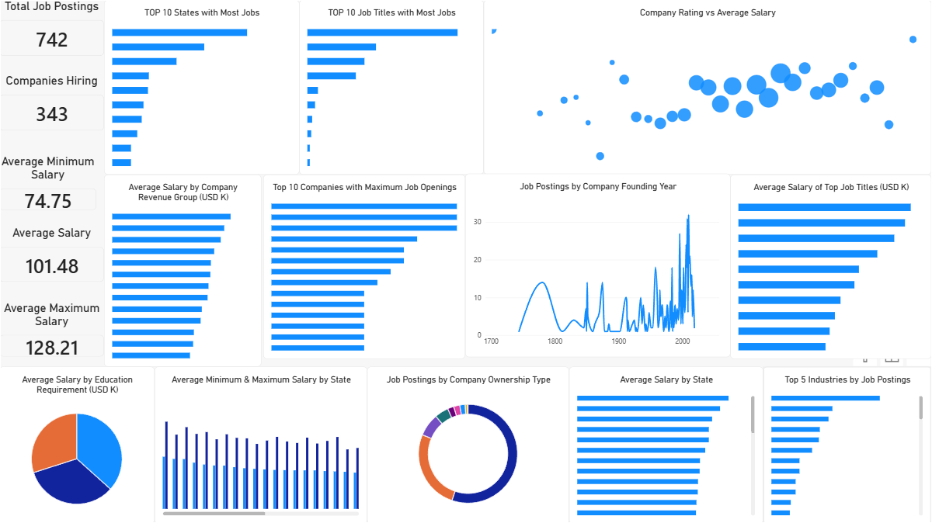
Power BI Dashboard
PRDA-04 | Job Market Analysis

Slide 8
Job-Market Distribution
California has the largest job-record count among the displayed top states, followed by Massachusetts and New York.
Biotech & Pharmaceuticals is the largest displayed industry by job postings.
Data Scientist is the largest displayed job-title category.
MassMutual, Reynolds American, and Takeda Pharmaceuticals appear among the highest-opening companies in the displayed ranking.
PRDA-04 | Job Market Analysis

Slide 9
Salary Analysis
Overall average salary is 101.48K USD.
Average minimum salary is 74.75K USD and average maximum salary is 128.21K USD.
Average salary differs across states, job-title categories, education groups, and revenue groups.
Salary comparisons are descriptive and should be interpreted within the scope of the 742-row dataset.
PRDA-04 | Job Market Analysis

Slide 10
Company Characteristics
The scatter chart compares company Rating with Average Salary.
The visual shows salary variation across different rating values.
Revenue is stored as categorical ranges, so salary-by-revenue is interpreted as a group comparison rather than a continuous correlation.
Company ownership is shown as a part-to-whole distribution using a donut chart.
PRDA-04 | Job Market Analysis

Slide 11
Key Findings
742 job records are represented across 343 distinct companies.
The dashboard reveals clear geographic, industry, company, and job-title concentration.
Salary levels vary across states and role categories, with an overall average of 101.48K USD.
Education and revenue groups show different average salary patterns.
Company rating and salary show variation, but the dashboard does not establish causation.
Later founding-year ranges contain more of the displayed job records, reflecting dataset composition.
PRDA-04 | Job Market Analysis

Slide 12
Business Suggestions
Use state and industry concentration to support recruitment and market-planning decisions.
Use common job titles to guide workforce planning and role-specific skill development.
Use salary measures as broad benchmarks while considering state and title differences.
Use revenue and ownership groups for company segmentation.
Use the available binary skill fields for a deeper skill-demand analysis by job title.
Refresh the Power BI model when new job-market data becomes available.
PRDA-04 | Job Market Analysis

Slide 13
Conclusion
The project converts a 742-row job-market dataset into an interactive Power BI analytical dashboard.
Power Query handled data cleaning and transformation, while DAX provided the core KPI measures.
The dashboard combines rankings, salary comparisons, composition, distribution, and relationship analysis.
The results can support job-market exploration, compensation benchmarking, workforce planning, and further skill-demand analysis.
PRDA-04 | Job Market Analysis

Slide 14
Thank You
PRDA-04 | Job Market Analysis

