Slide 1
Final Project
Next-Gen NLP:
March 12, 2026
Sadaf Khan

Slide 2
Overview
I. Introductions
II. Data
III. Methodology
IV. Results
V. Insights
VI. Conclusion & Q&A

Slide 3
Introduction
Artificial Intelligence and Industry Transformation
Artificial Intelligence and Industry Transformation
Artificial Intelligence is transforming industries by enabling automation, improved decision-making, and new technologies.
Companies across sectors are investing in AI to increase productivity, reduce costs, and gain competitive advantages.
However, the impact of AI varies across industries and companies.
News media provides insights into how AI developments are discussed, adopted, and perceived.
Project Context
Analysis of ~200,000 news articles related to AI, machine learning, and data science.

Slide 4
Research Questions
Which industries and companies are most likely to be impacted by AI over the next several years?
How are these industries and companies impacted by AI?
(positive, negative, or uncertain impact)
What factors appear to influence successful or unsuccessful AI adoption?

Slide 5
Data
Dataset Overview
Source: AI related news content
Dataset size:
• ~200,000 news articles
Key columns used in analysis:
Why this dataset?
• Large corpus of real-world news coverage
• Captures how AI developments are discussed across industries and companies
Column | Description
Text | Full article content
Date | Publication date
Language | Article Language

Slide 6
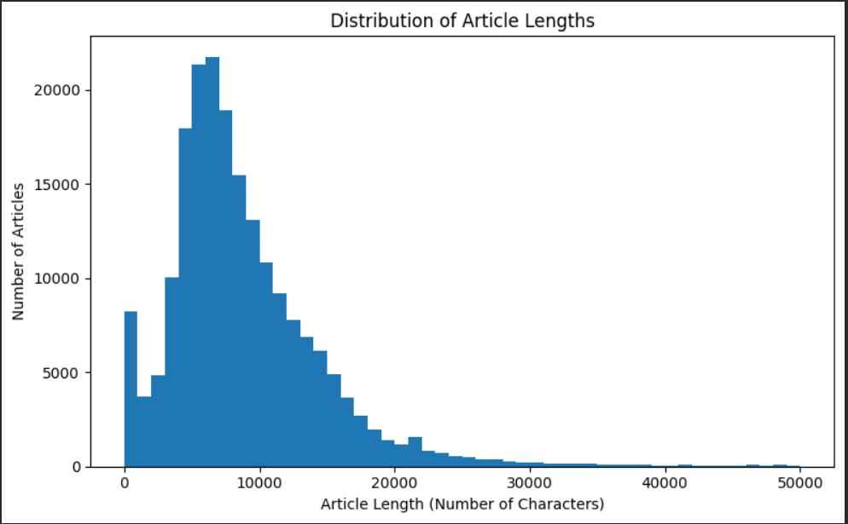
Article Cleaning & Filtering
1. Duplicate Removal
Removed duplicate articles based on the
text column. Prevents repeated articles from biasing the analysis
2. Article Length Filtering
Created column:
text_length = length of article text
Filtered articles to remove:
• very short articles (low information)
• extremely long articles (possible noise)
3. Relevance Filtering
Created a relevance score:
rel_score
Based on presence of:
• AI-related keywords
• impact-related keywords
Filtering rule :rel_score ≥ 3. This keeps articles discussing AI impact on industries and companies.

Slide 7

Text Preprocessing
Before applying NLP models, the article text was standardized. Create column: clean_text
Processing steps:
Convert text to lowercase
Remove punctuation and numbers
Remove extra whitespace
Purpose:
Standardize text across articles
Reduces noise in the text data.
Prepare text for feature extraction and topic modeling.

Slide 8
Feature Engineering (TF-IDF)
To represent text numerically, I applied TF-IDF vectorization to the cleaned articles.
Input:
clean_text
Output:
TF-IDF document-term matrix
What TF-IDF measures
Term Frequency (TF)
• How often a word appears in a document
Inverse Document Frequency (IDF)
• Reduces weight of words that appear in many documents
Why TF-IDF?
• Highlights informative words in articles
• Reduces influence of very common words
• Creates numerical features for topic modeling

Slide 9
Topic Detection (NMF)
Applied Non-negative Matrix Factorization (NMF) to TF-IDF features to identify major themes in the articles.
TF-IDF Vectorizer
Extracts words
Computes weights
NMF Model
Identifies topic patterns
Discovered Topics
• Enterprise AI
• AI Regulation
• Healthcare AI
Article Text
"AI transforms industries..."
Model Input
TF-IDF document-term matrix.
Model Output
topic_id — dominant topic assigned to each article
topic_weight — strength of that topic in the article.
Each topic represents a cluster of articles discussing similar themes related to AI.
Why NMF ?
Works well with TF-IDF features
Produces interpretable topics
Groups articles based on similar word patterns
?

Slide 10
Topic Interpretation
Top words from each NMF topic were examined to assign interpretable topic labels.
Topic | Label
Topic 0 | AI Policy, Regulation & Public Opinion
Topic 1 | AI in Healthcare & Compliance
Topic 2 | Enterprise AI Platforms
Topic 3 | AI Stocks & Market Investing
Topic 4 | AI Startups & Product Launches (Press Releases)
Topic 5 | Global AI Business & Impact Narratives ( Asia/India, Bubble Fears, Risk)
Topic 6 | Big Tech GenAI Products (Apple/Google/Gemini/ChatGPT)
Topic 7 | Enterprise Adoption & Digital Transformation (Deployments/Innovation)
Topic 8 | Noise (Currency Conversion / Spam) - DROP
Topic 9 | OpenAI/ Microsoft Leadership & Company News
Topic labels were assigned by examining the top weighted keywords from each NMF topic.

Slide 11
Entity Extraction
To identify companies and technologies mentioned in the articles, I applied Named Entity Recognition (NER) using the spaCy NLP library.
Entities extracted:
• org_entities — organizations and companies
• product_entities — technologies and AI products
Purpose
Entity extraction allows us to:
• Identify which companies are most frequently associated with AI developments
• Link companies to specific AI topics and sentiment patterns
Example Entities Detected
Examples of organizations frequently mentioned:
• Microsoft
• Google
• Nvidia
• Amazon
• OpenAI
These companies appear frequently in discussions of AI development and adoption.

Slide 12
Most Mentioned Companies
Org_entities | Count | Org_entities | Count
Microsoft | 10172 | npr | 2065
Google | 8507 | the u s | 2011
IBM | 4734 | fcc | 1934
gray television inc | 3326 | un | 1823
gpt | 3318 | gray media group inc | 1797
fda | 3017 | microsoft s | 1713
intel | 2745 | pbs | 1623
congress | 2705 | cnn | 1539
sec | 2475 | android | 1476
samsung | 2360 | cbs | 1458

Slide 13
Supervised Sentiment Model
Training Data
• A labeled sentiment dataset was used to train the Logistic Regression classifier. (positive / negative text examples)
• Dataset used to train a sentiment classifier
Model
• Logistic Regression classifier trained on TF-IDF features
Pipeline
Clean text
TF-IDF vectorization
Logistic Regression sentiment classifier
Predict sentiment for AI news articles
Output
• Predicted sentiment label
• Positive / Neutral / Negative
Model evaluation on validation set:
Accuracy: 0.87
F1-score: 0.85
Model Performance
Logistic Regression classifier achieved ~87% accuracy on labeled sentiment data, indicating reliable sentiment classification performance.

Slide 14
Sentiment Analysis Method
Method: Sentiment classification was performed using a trained Logistic Regression classifier on TF-IDF features.
Output: Two variables were created:
sentiment_score
Predicted sentiment score produced by classifier
sentiment_label
Final sentiment category assigned to each article
(Positive, Neutral, Negative)
Purpose
Sentiment analysis helps evaluate:
• whether AI developments are portrayed positively or negatively in the media
• how sentiment varies across industries, companies, and topics
Example:
"AI technology is transforming healthcare"
→ predicted sentiment = Positive
Predicted Sentiment | Description
Positive | Article Expresses Optimistic or favourable view of AI
Neutral | Article presents balanced or factual discussion
Negative | Article highlights risks, regulation, or concerns

Slide 15
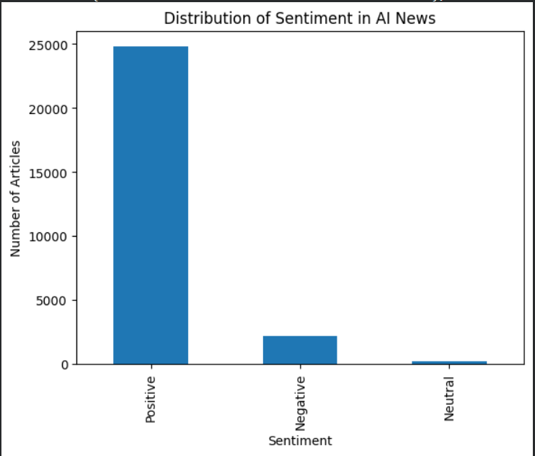
Overall Sentiment Distribution
Method: Sentiment labels were predicted using the trained Logistic Regression classifier applied to the TF-IDF text features.
Articles were classified as:
Positive
Neutral
Negative
This allows us to measure how AI developments are portrayed in news coverage.
Key Findings:
Most AI-related news articles are neutral or positive.
Positive sentiment often appears in discussions about:
  AI innovation
  technological advancements
  business adoption

Slide 16
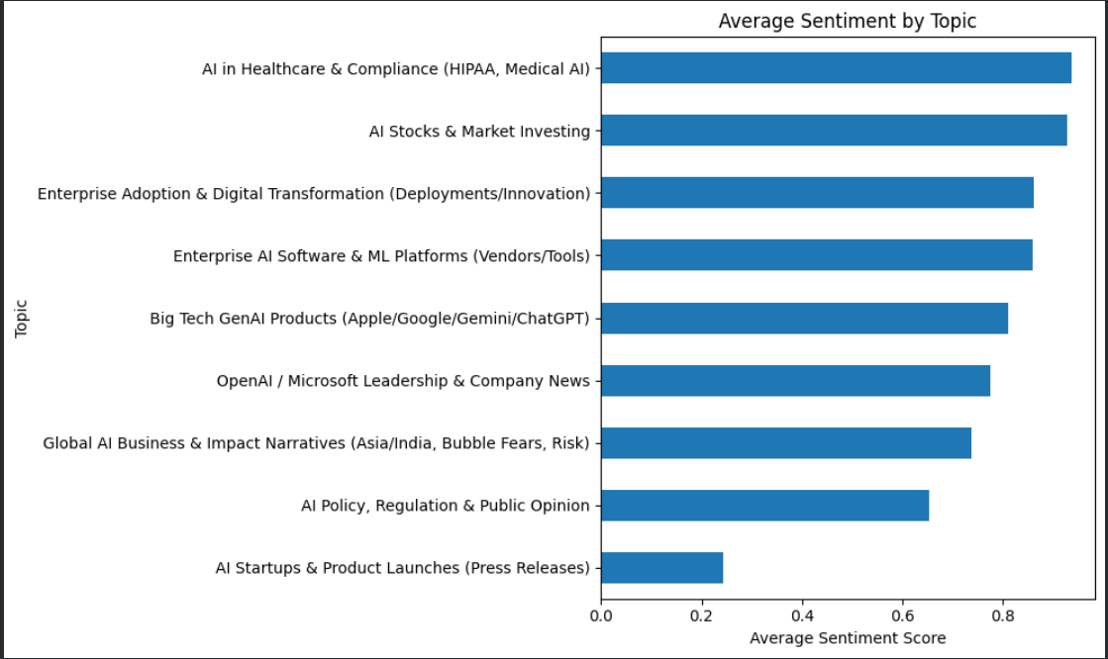
Topic-Level Sentiment
Method
To understand how AI is discussed across different themes,
sentiment scores were aggregated by topic.
Metrics analyzed:
Average sentiment score
Percentage of positive articles
Percentage of negative articles
Key Observations
Topics related to AI innovation and product development show more positive sentiment.
Topics related to regulation, risks, and workforce impact tend to show more negative sentiment.
Many topics remain neutral, reflecting balanced news coverage of AI.

Slide 17
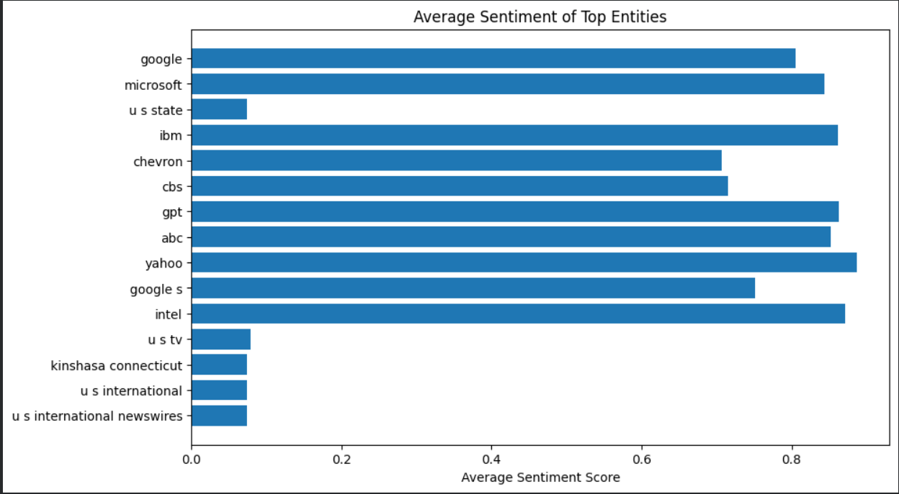
Entity-Level Sentiment
Method
Sentiment scores were linked with organizations extracted using Named Entity Recognition (NER).
This allows us to evaluate how companies involved in AI development are portrayed in news coverage
Key Findings
• Major technology companies such as Microsoft, Google, and IBM tend to appear in articles with more positive sentiment.
• Discussions involving government institutions or regulatory bodies show more neutral sentiment.
• AI innovation and product development are generally portrayed positively in news coverage.
Interpretation
Companies leading AI innovation tend to receive more positive media coverage, while discussions involving regulation, competition, or ethical risks produce more neutral or negative sentiment.

Slide 18
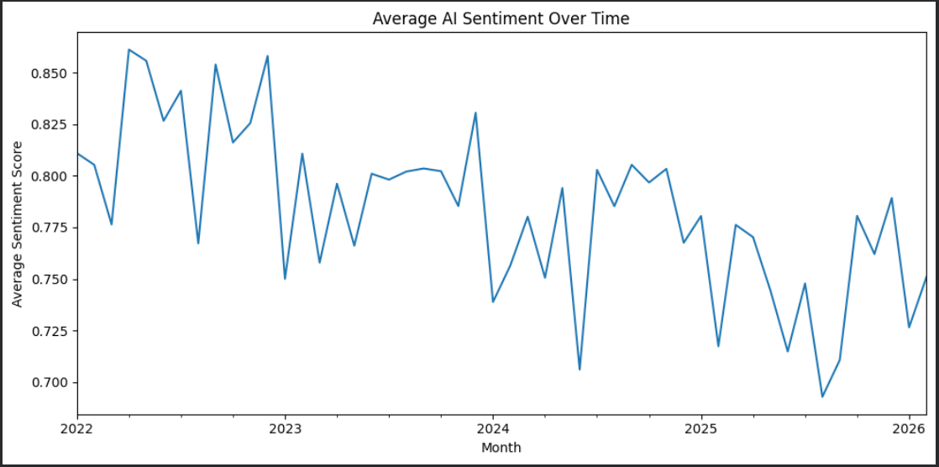
Sentiment Over Time
o
Method
Sentiment scores were aggregated by month using the article publication date to track how AI sentiment changes over time.
Key Findings
Overall sentiment toward AI remains mostly neutral to positive.
Negative sentiment spikes often correspond to discussions about:
  regulation
  ethical concerns
  workforce disruption
Positive sentiment increases during periods of:
  AI innovation
  major product announcements

Slide 19
Key Findings
1. AI discussions are dominated by large technology companies
• Companies such as Microsoft, Google, Nvidia, and Amazon appear most frequently in AI-related news articles.
2. AI innovation topics tend to have more positive sentiment
• Articles discussing AI development, products, and innovation often show positive sentiment.
3. Regulation and workforce concerns show more negative sentiment
• Topics involving policy, ethics, and job displacement tend to have more negative or cautious sentiment.
4. AI adoption varies across industries
• Some industries focus on product innovation, while others emphasize regulation and societal impact.

Slide 20
AI Adoption Insights
The analysis of topics, entities, and sentiment suggests several factors that influence AI adoption across industries.
Drivers of Successful AI Adoption
• Clear business use cases for AI technologies
• Strong data infrastructure and technical capabilities
• Integration of AI into existing workflows and decision-making
Challenges to AI Adoption
• Regulatory and policy uncertainty
• Concerns about ethical implications and job displacement
• High implementation complexity and cost
Interpretation
News coverage suggests that organizations with strong technological capabilities and clear AI strategies are more likely to successfully adopt AI technologies.

Slide 21
Conclusion & Q&A
This project analyzed ~200,000 news articles to understand how AI is discussed across industries.
Key takeaways:
• AI discussions are dominated by major technology companies
• Innovation-focused topics show more positive sentiment
• Regulatory and societal concerns introduce more cautious or negative sentiment
Overall, AI is transforming industries, but its impact varies depending on context and industry.
This analysis shows that AI discussions are dominated by major technology firms, innovation topics tend to receive positive sentiment, and adoption success appears linked to strong infrastructure, clear use cases, and regulatory context.

