Slide 1

D.Y PATIL PRATISHTHAN’S D.Y PATIL COLLEGE OF ENGINEERING, AKURDI, PUNE
Subject: BE Project Stage I
GROUP MEMBERS:
Aditya Sadakal : BECO2223A001
Saaniya Syed : BECO2223A009
Shrishti Sethi : BECO2223A013
Gauri Waikar : BECO2223A043
Tanisha Sahu : BECO2223A054
GUIDE: Dr. Mrs. M.A. Potey.
CO-GUIDE: Ms. Anuradha Lamgunde.

Slide 2
PROBLEM STATEMENT
The YouTube comment section serves as a space for viewers to express their opinions, share feedback, and engage with content creators. Nevertheless, it can also become a breeding ground for spam, hate speech, or irrelevant comments. The core problem we aim to address is as follows:
"How can we effectively classify comments on YouTube videos into positive, negative, and neutral categories to help users assess the relevance and quality of a video's content?"

Slide 3
PROPOSED WORK
1. Data Collection and Preprocessing:
• Use YouTube Data API to retrieve the comments for the selected videos or channels.
• Clean the comments by removing any special characters, URLs, and irrelevant information.
• Tokenize the comments into individual words or subwords.
• Perform text normalization (lowercasing, stemming, lemmatisation) to reduce word variations.
2. Sentiment Labeling:
• Label the comments with sentiment scores, such as positive, negative, or neutral. You might use a pre-existing sentiment lexicon or consider manual labelling or third-party sentiment analysis tools for a small subset of data.
3. Building a Baseline Model with NLTK:
• Use NLTK's built-in sentiment analysis tools, such as the VADER (Valence Aware Dictionary and sentiment Reasoner), designed for social media text.
• Preprocess the data and train the VADER model on labelled data and evaluate its performance using appropriate metrics like accuracy, precision, recall, and F1-score.

Slide 4
4. Building an Advanced Model with Transformers:
• Choose a pre-trained transformer-based sentiment analysis model from the Hugging Face Transformers library (e.g., BERT, RoBERTa).
• Preprocess the data and fine-tune the transformer model on the split dataset.
5. Model Evaluation and Interpretation:
• Evaluate the advanced transformer model on the test set to assess its generalization performance.
• Compare the performance of the NLTK-based baseline model and the transformer-based model.
6. Deployment and Application:
• Once satisfied with the model's performance, deploy it to perform sentiment analysis on new YouTube comments.

Slide 5
PROJECT’S END USER
YouTube Viewers
Content Creators
YouTube Moderators
YouTube Analytics Teams
Advertisers and Marketers
Researchers and Data Analysts

Slide 6
Literature Review
Sr. No | Title and Authors | Conference/Journal Name and Publication in Year | Topic Reviewed/ Algorithms or Methodology Used | Advantages and disadvantages
1. | “Sentiment Analysis Meets Explainable Artificial Intelligence: A Survey on Explainable Sentiment Analysis”, A.Diwali,K. Saeedi, K. Dashtipour, M. Gogate, E. Cambria and A. Hussain. | IEEE Transactions on Affective Computing- 2023. IEEE Xplore Digital Library: Particularly for engineering and technology-related projects. | The paper discusses the latest advancements in the field, focusing on methods such as the Lexicon-Based approach, Machine-Learning approach and explainable AI models that enhance the interpretability of sentiment analysis models. | Advantages: 1. Increased Interpretability 2. Customizable and easy to adapt. Disadvantages: 1. Explainable sentiment analysis methods are complex. 2. Language keeps evolving and Context keeps changing.
2. | “Sentiment Analysis of Imbalanced Comment Texts Under the Framework of BiLSTM”, H. Wen and J. Zhao. | IEEE 6th International Conference on Artificial Intelligence and Big Data (ICAIBD)- IEEE Xplore Digital Library: Particularly for engineering and technology-related projects. 2023 | The paper investigates how to effectively analyze sentiments in text data that is imbalanced using the BiLSTM framework that can capture contextual information from both directions in a sequence, making it suitable for text analysis tasks. | Advantages: 1.BiLSTM is capable of capturing contextual information from both past and future words. 2.BiLSTM automatically extracts features from text data. Disadvantages: 1. Complexity of BiLSTM models can lead to larger model sizes. 2. Depends on the Quality of data.

Slide 7
3. | “Retrieving YouTube video by sentiment analysis on user comment”, H. Bhuiyan, J. Ara, R. Bardhan and M. R. Islam, | IEEE International Conference on Signal and Image Processing Applications (ICSIPA)- 2017 IEEE Xplore Digital Library: Particularly for engineering and technology-related projects. | The paper proposes a sentiment analysis approach to enhance youtube video retrieval by analyzing user comments.The method preprocesses comments, generates datasets with adjectives and applies sentiment analysis using SentiStrength. | Advantages: 1. Improved Relevance. 2. Helps in filtering out low-quality videos. Disadvantages: 1. Ambiguous comments make it hard to determine user sentiment accurately. 2. Analyzing user comments raises privacy concerns.
4. | “Sentiment Polarity Classification at EVALITA: Lessons Learned and Open Challenges”, Valerio Basile, Nicole Novielli, Danilo Croce, Francesco Barbieri, Malvina Nissim, and Viviana Patti. | IEEE Transactions on Affective Computing -2021 IEEE Xplore Digital Library: Particularly for engineering and technology-related projects. | The paper discusses the importance of sentiment analysis in social media research, particularly in the context of Italian tweets. It mentions the organization of the SENTIPOLC sentiment classification task, dataset details, evaluation methods, and insights from participating systems. | Advantage: The organization of tasks like SENTIPOLC leads to the creation of valuable datasets for sentiment analysis, particularly for languages like Italian, which might have limited resources available. Disadvantage: Sentiment analysis tasks like SENTIPOLC may be language-specific, limiting their generalizability to other languages and regions.

Slide 8
5 | “COVID-19 Sentiment Analysis Based on Tweets.” ValerioLa Gatta, Vincenzo Moscato, Marco Postiglione, and Giancarlo Sperlí. | IEEE Intelligent Systems- 2023 IEEE Xplore Digital Library: Particularly for engineering and technology-related projects. | The paper discusses about how to analyze Twitter data to understand how individuals in Italy perceive the COVID-19 outbreak and its various implications. The investigation reveals the dominant narratives, evolving sentiments, and shifting emotions surrounding the pandemic. | Advantage: Tweet-based sentiment analysis allows for the real-time tracking of public sentiment and opinions Disadvantage: Twitter users may not be representative of the entire population, potentially leading to biased or skewed sentiment analysis results that do not reflect broader public sentiment accurately.
6. | “Movie Recommendation System Using Sentiment Analysis From Microblogging Data” , Sudhanshu Kumar , Kanjar De, and Partha Pratim Roy. | IEEE Transactions on Computational Social Systems- 2020 IEEE Xplore Digital Library: Particularly for engineering and technology-related projects. | This article introduces a hybrid movie recommendation system that harnesses collaborative filtering, content-based filtering, and sentiment analysis of movie tweets, aiming to enhance recommendations by considering current trends and public sentiment, with promising outcomes in experimental trials. | Advantages: 1.Enhanced Personalization capture and recommend movies based on current trends and public sentiment Real-time Trends Disadvantages: 1. CF algorithms can become slow and resource-intensive as user and item databases grow. 2. Bias Amplification

Slide 9
7. | "Improving Sentiment Polarity Detection Through Target Identification", Mohammad Ehsan Basiri , Member, IEEE, Moloud Abdar , Arman Kabiri, Shahla Nemati, Member, IEEE, Xujuan Zhou, Forough Allahbakhshi, and Neil Y. Yen, Member, IEEE. | IEEE Transactions on Computational Social Systems-2019 IEEE Xplore Digital Library: Particularly for engineering and technology-related projects. | This article presents a novel method for Persian sentiment analysis in long reviews. It breaks reviews into sentences, identifies main targets, and improves system accuracy by approximately 17%. The "most general first" policy works best for target identification, while "most occurring first" is optimal for determining review polarity. | Advantages: 1. MGF is best for main target identification, while MOF is optimal for overall review sentiment analysis. 2. Five policies (MOF, MGF, MSF, FOF, LOF) offer flexible target detection for diverse review styles. Disadvantages: 1. Complexity of Target Identification 2. Dependency on Sentiment Lexicon
8. | “Adversarial Learning-Based Sentiment Analysis for Socially Implemented IoMT Systems”, Yueshen Xu, Rui Li, and Shahid Mumtaz | IEEE Transactions on Computational Social Systems- 2023 IEEE Xplore Digital Library: Particularly for engineering and technology-related projects. | This article proposes a novel solution, which is composed of adversarial learning and a hierarchical attention mechanism. We propose to apply the attention mechanism both at the word level and sentence level, enabling us to learn the knowledge from each word and each sentence. | Advantages: 1. Research and Development Insights 2. Ethical and Legal Compliance 4. Early Detection of Issues Disadvantages: 1. Security Risks 2. User Perception and Trust 3. Limited Context

Slide 10
9. | “Aspect-Based Sentiment Analysis: A Survey of Deep Learning Methods”, Haoyue Liu; Ishani Chatterjee; MengChu Zhou; Xiaoyu Sean Lu; Abdullah Abusorrah. | IEEE Transactions on Computational Social Systems- 2020 IEEE Xplore Digital Library: Particularly for engineering and technology-related projects. | This article summarizes the recently proposed methods to solve an aspect-based sentiment analysis problem. At present, there are three mainstream methods: lexicon-based, traditional machine learning, and deep learning methods | Advantages: 1. Contextual Understanding 2. Reduced Feature Engineering 3. Automated Aspect Identification Disadvantages: 1. Data Dependency 2. Domain Adaptation Challenges 3. Noisy Handling
10. | “A Survey on Aspect-Based Sentiment Analysis: Tasks, Methods, and Challenges”, Wenxuan Zhang, Xin Li, Yang Deng, Lidong Bing, and Wai Lam. | IEEE Transactions on Knowledge and Data Engineering-2022 IEEE Xplore Digital Library: Particularly for engineering and technology-related projects. | A comprehensive review of the aspect-based sentiment analysis problem, including its various tasks, methods, current challenges, and potential | Advantage: (ABSA) is the problem to identify sentiment elements of interest For a concerned text item,either a single sentiment element, or multiple elements with the dependency relation between them. Disadvantage: The relatively small size of data (e.g., hundreds of sentences) makes it difficult to clearly compare different models.

Slide 11
MATHEMATICAL MODEL
1. Text Preprocessing:
•Tokenization: Divide text into individual tokens (words or sub words). NLTK and Transformers libraries handle tokenization, which involves breaking text into meaningful units.
•Text Normalization: Techniques like lowercasing, stemming, and lemmatization help reduce word variations and bring words to their base forms.
2. Feature Extraction:
• Bag-of-Words (BoW): Represent text as a vector of word frequencies. This approach ignores word order and syntax but considers word occurrence.
• TF-IDF (Term Frequency-Inverse Document Frequency): Measures the importance of words in a document relative to a corpus. It balances frequent and rare words.
• Word Embeddings: Represent words in a continuous vector space. Word2Vec and GloVe are common algorithms used for generating word embeddings.

Slide 12
3. Sentiment Analysis Models:
• Logistic Regression: A basic classification algorithm that models the relationship between features and sentiment labels using a logistic function.
• Neural Networks: Deep learning models, including recurrent neural networks (RNNs) and convolutional neural networks (CNNs), can be used for sentiment analysis. Transformers, such as BERT and GPT, are highly effective for capturing contextual information.
• Support Vector Machines (SVM): A machine learning algorithm that finds a hyperplane to separate data points of different sentiments.
4. Model Evaluation Metrics:
• Accuracy: The ratio of correctly predicted instances to the total instances in the dataset
• Precision: The ratio of true positive predictions to the total positive predictions (indicative of how many predicted positive instances are actually positive).
• Recall (Sensitivity): The ratio of true positive predictions to the total actual positive instances (indicative of how well the model detects positive instances).
• F1-Score: The harmonic mean of precision and recall, providing a balance between the two metrics.
• Confusion Matrix: A table used to describe the performance of a classification model, displaying true positives, true negatives, false positives, and false negatives.

Slide 13
SYSTEM ARCHITECTURE
The architectural design for sentiment analysis of YouTube comments using BERT and BiLSTM in python includes components such as data collection, data storage, data preprocessing, training the model using BERT and BiLSTM, evaluating the two models to analyze them further and see for which trained model provides the best results with the highest efficiency and accuracy by analyzing the comments and segregating them into the three categories that are: Positive, Neutral and Negative.
Continuous improvement and user feedback will be crucial for the long-term success of the application. To enhance the user experience and to increase the ease of use for the user a user-friendly interface can be built for sentiment analysis and then the model can be deployed as a web application or could be integrated with other platforms.
The diagram below represents the flow of data and processes in the architecture. Each block represents a component or step in the system. Arrows indicate the flow of data and control. This system architecture provides an overview of the steps involved in building a sentiment analysis model for YouTube comments using BERT and BiLSTM.

Slide 14
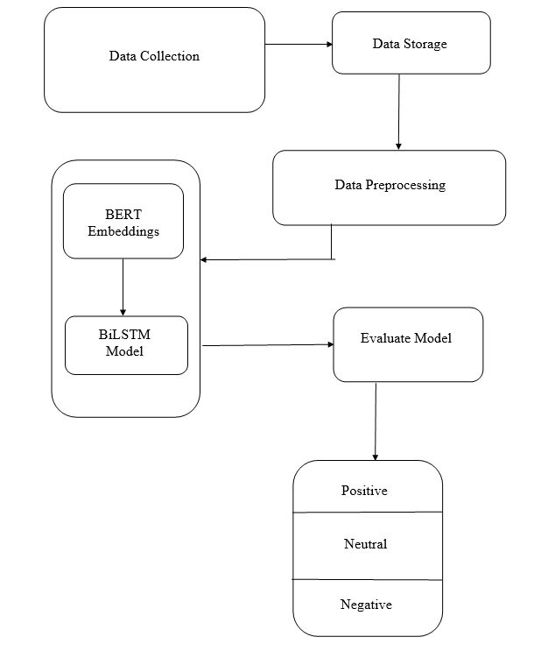

Slide 15
ALGORITHMS
BERT Algorithm
Implementing the BERT (Bidirectional Encoder Representations from Transformers) model in a sentiment analysis project for YouTube comments involves several steps:
• Load Pretrained BERT Model: Load a pretrained BERT model using a deep learning framework like PyTorch or TensorFlow.
• Data Preprocessing: Tokenize the YouTube comments: Break down the comments into subword tokens using BERT's tokenizer. Handle any text cleaning as required. Convert tokenized comments into numerical input that BERT can understand.
• Padding and Attention Masks: Pad the tokenized sequences to a fixed length if needed. BERT requires input sequences of equal length
• BERT Embeddings: Pass the tokenized and preprocessed comments through the BERT model to obtain contextual word embeddings. BERT's embeddings capture the meaning of each word in the context of the entire sentence.
• Classification Head: Add a classification head on top of BERT for sentiment classification. This is typically a neural network layer that takes BERT's embeddings as input.
• Training: Train the BERT-based sentiment classification model using labeled data. Utilize a loss function such as cross-entropy and an optimizer (e.g., Adam) for training. Fine-tune BERT layers if necessary. Fine-tuning can be done on the classification head or lower layers of the BERT model.
• Evaluation: Assess the model's performance on a validation set using metrics like accuracy, precision, recall, F1-score, and a confusion matrix.
• Deployment: Serialize and save the trained BERT-based model for deployment. You may also serialize the BERT tokenizer for use in the deployment environment.

Slide 16
BiLSTM Algorithm
• Algorithm for BiLSTM Model in Sentiment Analysis is as follows:
• Data Preprocessing: Tokenize the YouTube comments, Apply text cleaning to remove special characters, URLs, and emojis. Encode the sentiment labels (positive, negative, neutral) into numerical values (e.g., 0, 1, 2). Split the dataset into training, validation, and testing sets.
• Word Embeddings: Convert tokenized comments into word embeddings. You can use pre-trained word embeddings or train embeddings from scratch on your comment dataset.
• BiLSTM Model Architecture: Build the BiLSTM model:
• Define the architecture with LSTM layers.
• Specify the number of LSTM units, dropout rates, and activation functions.
• Use a Bidirectional layer to capture both forward and backward contextual information.
• Training: Train the BiLSTM model on the training dataset using suitable optimizers and loss functions. Implement early stopping and model checkpointing to prevent overfitting and save the best model.
• Evaluation: Evaluate the model's performance on the test dataset using metrics such as accuracy, precision, recall, F1-score, and confusion matrix.
• Deployment: Serialize and save the trained BiLSTM model for deployment. Create a user-friendly interface, such as a web application or REST API, for users to input comments for sentiment analysis.

Slide 17
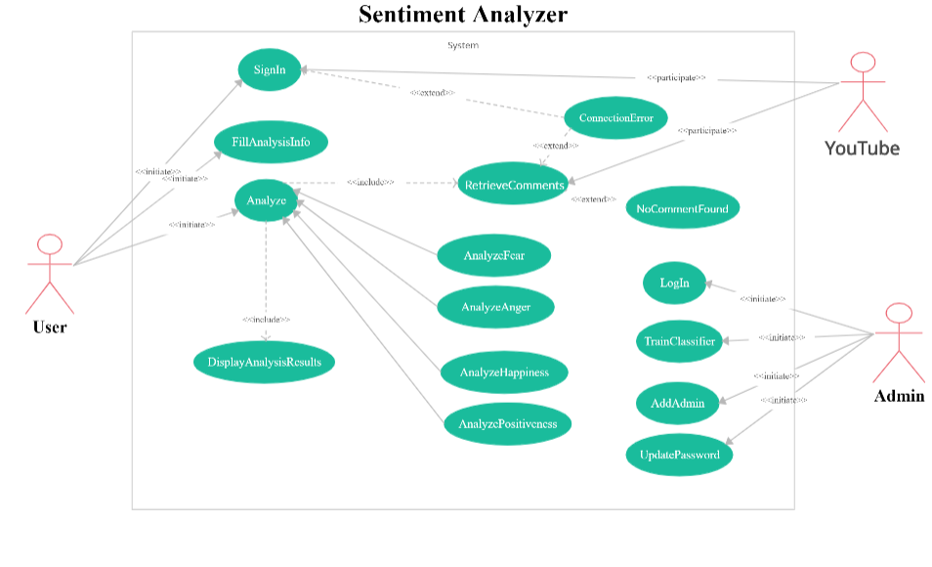
UML DIAGRAMS
USE CASE DIAGRAM

Slide 18
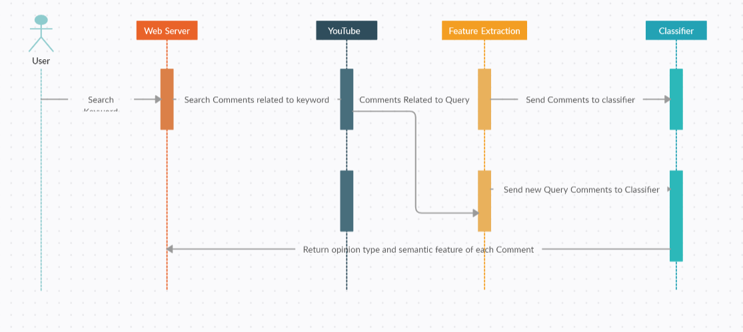
SEQUENCE DIAGRAM

Slide 19
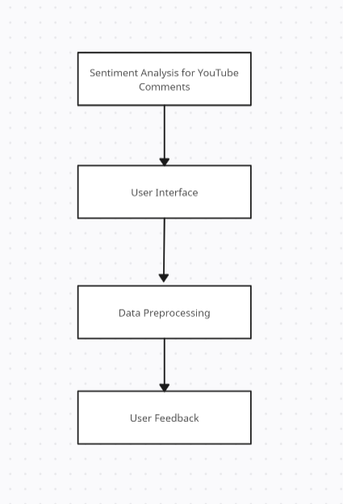
Data Flow Diagram Level 0

Slide 20
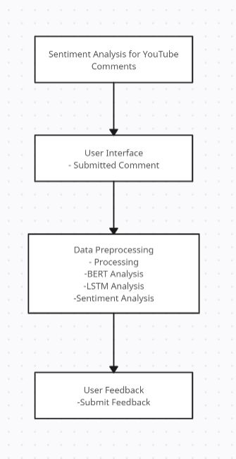
Data Flow Diagram Level 1

Slide 21
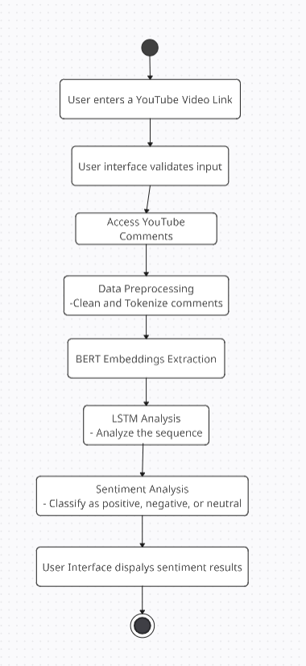
Activity Diagram

Slide 22
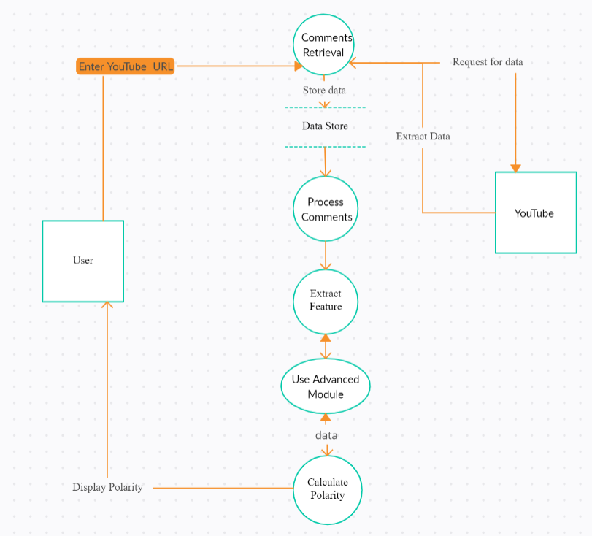
System Design

Slide 23
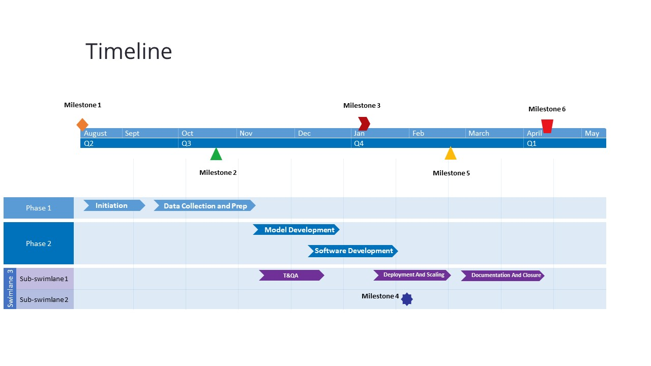
Timeline Chart

Slide 24
RISK ANALYSIS
Technical Risks:
Data Quality and Quantity
Computational Resources
Model Complexity
Model Interpretability
Overfitting
API Access and Legal Issues
Schedule Risks:
Data Collection Delays
Model Training Time
Data Preprocessing Complexity
Model Testing and Validation
Integration and Deployment
Parallel Tasks and Dependencies

Slide 25
RISK PRIORTIZATION
High Priority Risks:
User Privacy and Data Security.
Ethical Concerns.
Relevance to Users.
Moderate Priority Risks:
Negative Impact on User Engagement.
Platform Reputation.
Legal Compliance.
Lower Priority Risks:
Resource Allocation.
Competitive Landscape.
Monetization and Business Model.
Operational and Schedule Risks:
Operational and schedule risks are crucial but are in a separate category from business and technical risks. They can be addressed with sound project management practices and proactive risk management throughout the project.

Slide 26
PROJECTED COST
Most of the work is decided to be done on the available hardware if necessary Azure cloud services will be used.
Virtual Machines (VMs): Storage: For 10GB of data storage, Azure Blob Storage costs can range from INR 10k to 15k.
Data Transfer: Data transfer costs can vary. If your data transfer is relatively low, the cost may be as minimal as 80 Rupees, but it could range from a few hundred to a few thousand INR.
Database Services: If we use Azure database services, such as Azure SQL Database, costs can vary based on the service tier, performance level, and storage, which may range from INR 10K to 15K.
The mentioned services will be used when the available resources are insufficient.

Slide 27
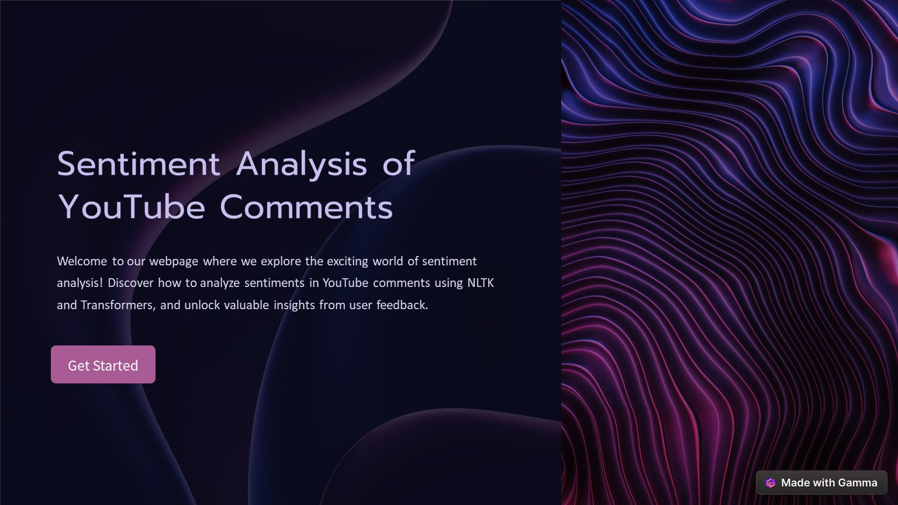
SCREEN DESIGNS
Fig. Home Page

Slide 28
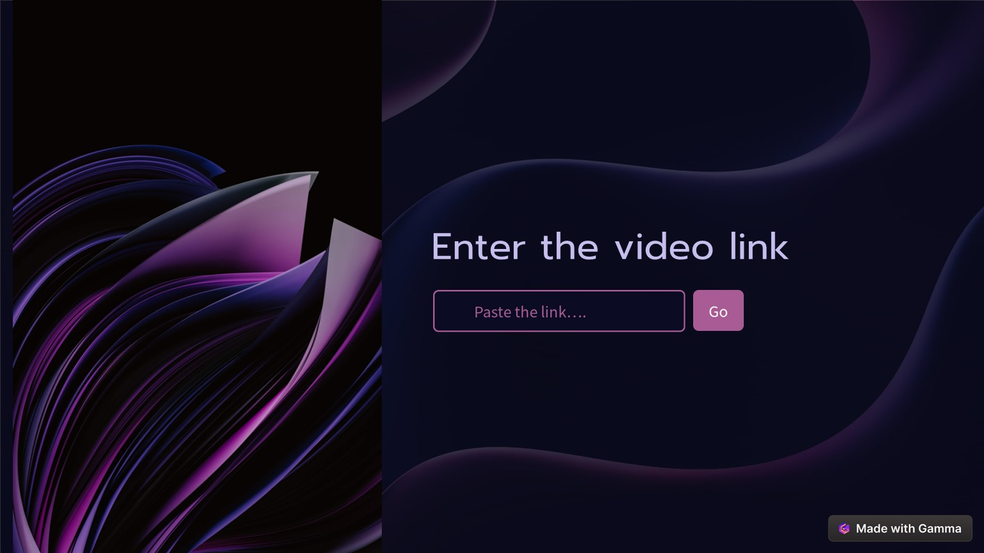
Fig. Input Page

Slide 29
TEST CASES
Sr. No | Test case | Test Data | Expected Outcome
1. | To verify that loss function calculates the loss correctly. | Choose a loss function respectively. | The model updates its weight to minimize the loss.
2. | To ensure meaningful sentiment classification scores are produced. | Softmax activation function used for the sentiment text. | Softmax assigns probabilities to each class accordingly.
3. | To test the API with invalid or missing parameters. | Invalid or missing parameters text. | API should return a response with the appropriate error code.
4. | To test if the sentiments are correctly categorized. | Sentiment text as input. | The respective sentiment is categorized in one of the three( positive, neutral, negative) categories.
5. | To test that data is correctly preprocessed. | Input the sentiment text for tokenization. | The text is correctly Tokenized by removing the non-meangingful words.
6. | To evaluate the performace of the BERT model with respect to the the evaluation metrics. | Train the BERT model on the dataset. | The BERT model should be trained well and the evaluation metrics should generate the correct scores.
7. | To evaluate the performance of the BiLSTM model with respect to the evaluation metrics. | Train the BiLSTM model on the dataset. | The BiLSTM model should be trained well and the evaluation metrics should generate the correct scores.

Slide 30
CONCLUSION
In conclusion, the sentiment analysis project for YouTube comments using BERT and BiLSTM offers a powerful solution for understanding and categorizing the sentiments expressed by users in the vast world of online comments. Through a combination of state of-the-art natural language processing techniques, machine learning, and careful system design, the project empowers content creators and platform administrators with insights into the sentiment of YouTube commenters, facilitating informed decision-making and improved user engagement. With a commitment to continuous improvement and a focus on user needs, this project stands as a valuable asset in the landscape of online content analysis.

Slide 31
PAPER PUBLICATION DETAILS
IEEE Xplore Digital Library
ACM Digital Library
ScienceDirect
JSTOR
ResearchGate

Slide 32
Thank You

