Slide 1

Analysis of Diabetes data
CS 555 Project

Slide 2
Dataset Overview
Several constraints were placed on the selection of these instances from a larger database. In particular, all patients here are females at least 21 years old of Pima Indian heritage.
Glucose: Plasma glucose concentration a 2 hours in an oral glucose tolerance test
BloodPressure: Diastolic blood pressure (mm Hg)
SkinThickness: Triceps skin fold thickness (mm)
Insulin: 2-Hour serum insulin (mu U/ml)
BMI: Body mass index (weight in kg/(height in m)^2)
Age: Age (years)
Outcome: Class variable (0 or 1), 1 is positive, 0 is negative diabetes
392 rows - 7 columns

Slide 3
Research questions
We are interested to know if there is difference between 2 groups (positive and negative diabetes) across different features?
What are factors which will influence most on Glucose level?
What factors that are statistically significant in predicting diabetes for women above 35?

Slide 4
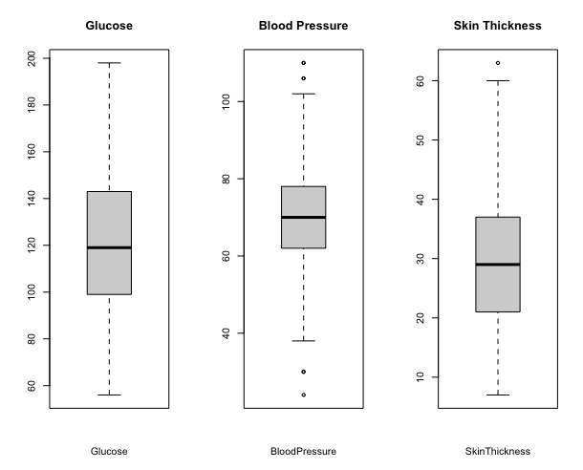
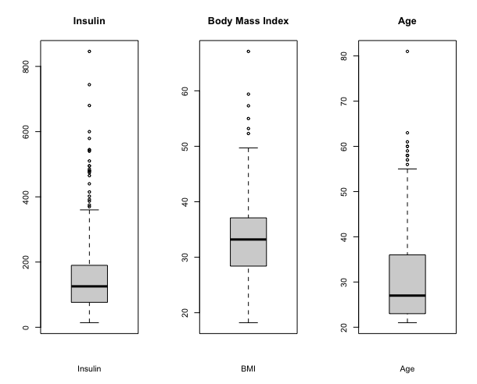
Box plots

Slide 5
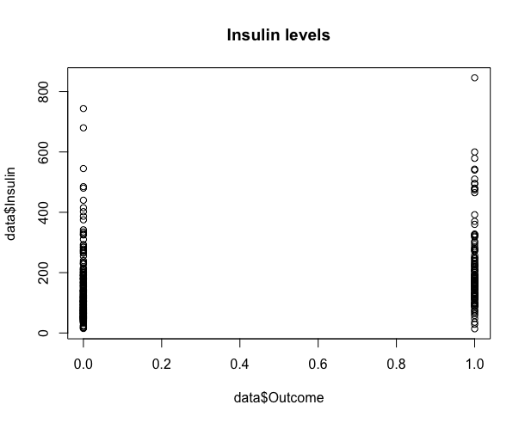
Insulin levels

Slide 6
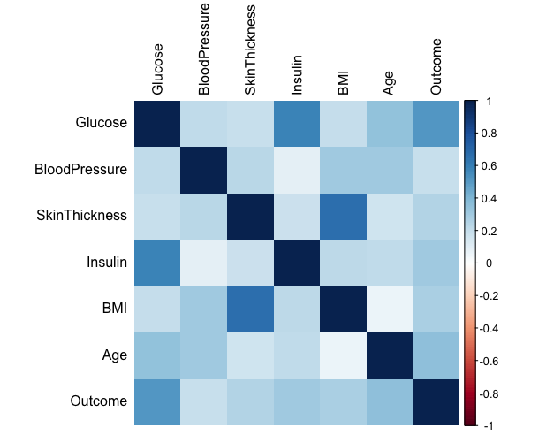
Correlation plot

Slide 7
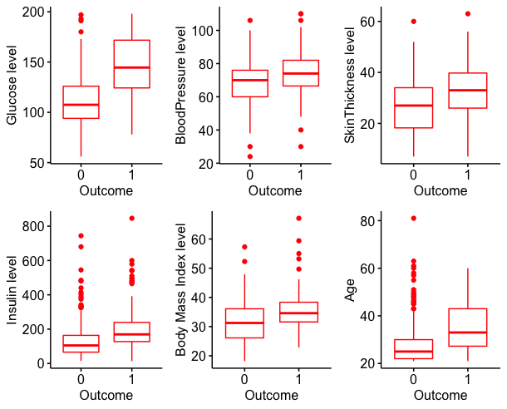
Boxplots of different features between negative and positive diabetes.

Slide 8
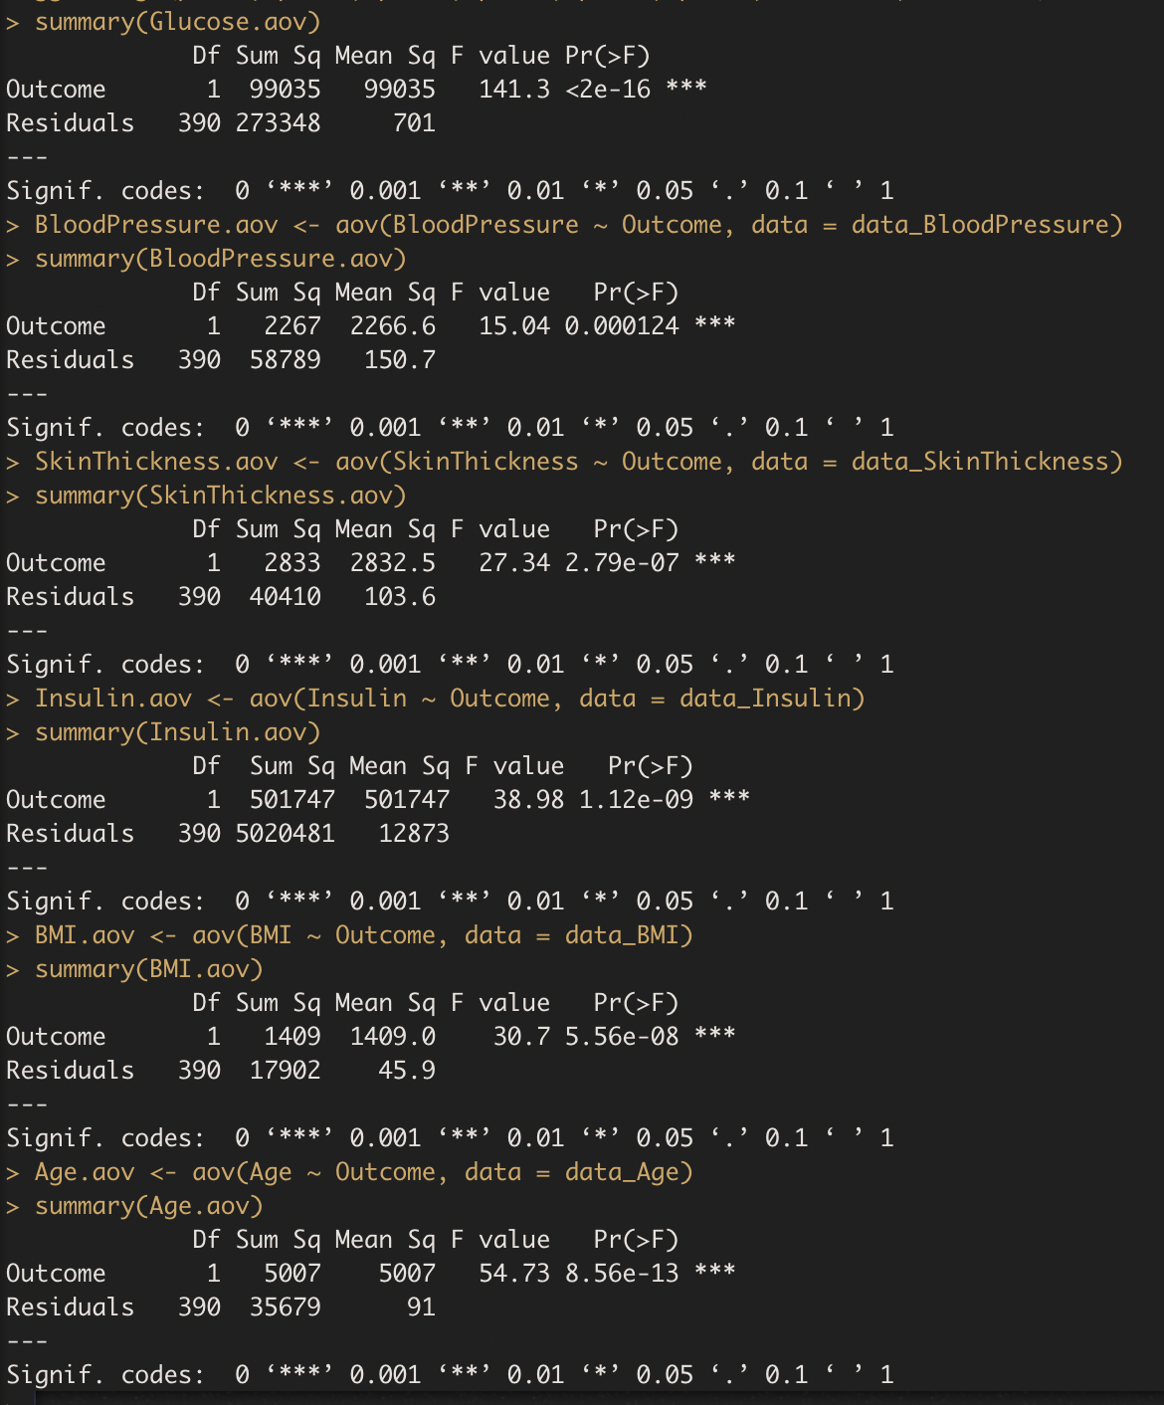
ANOVA
There are significant difference between 2 groups across all features

Slide 9
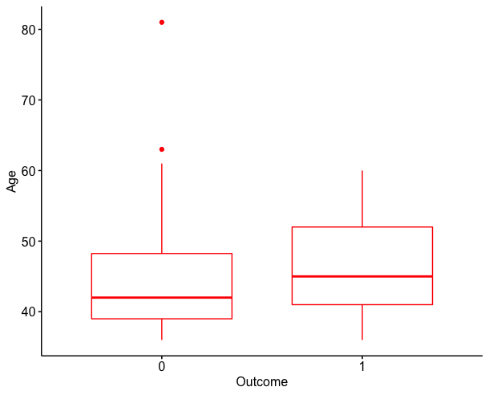
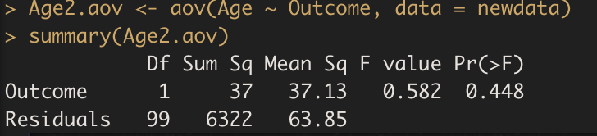
Checking 2 groups above 35 for significant difference between them in age

Slide 10
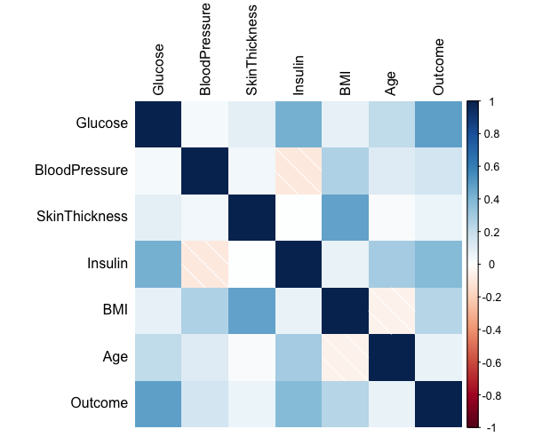
Correlation plot for women above 35 years old

Slide 11
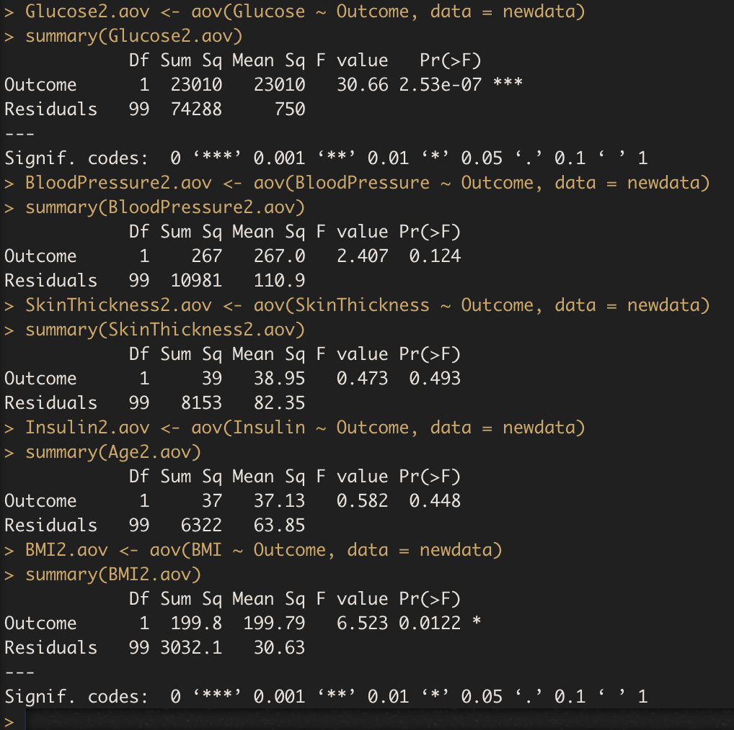

Only glucose levels have significant difference between negative and positive diabetes groups above 35 years old

Slide 12
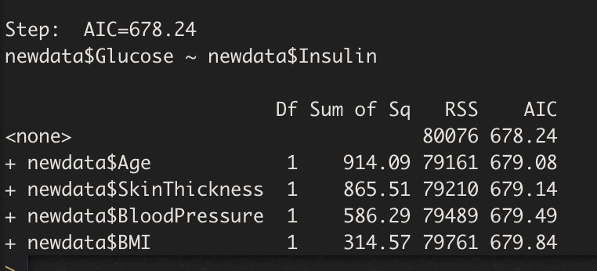
What factors influence glucose level?
According to stepwise regression Insulin levels is the only independent variable that significantly influence the dependent variable

Slide 13
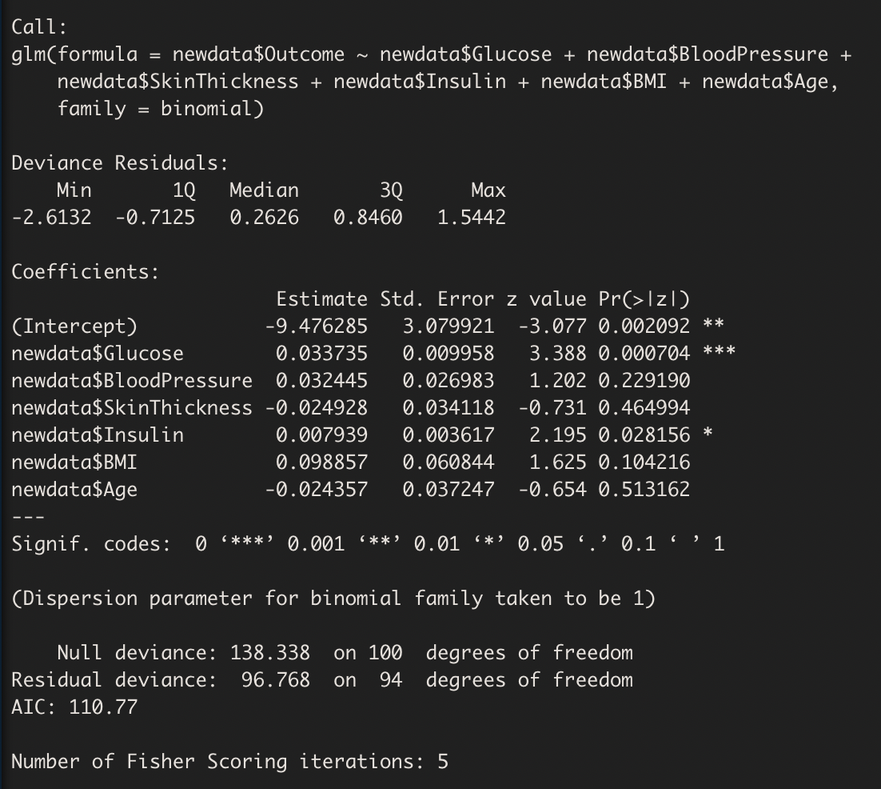
Logistic Regression

Slide 14
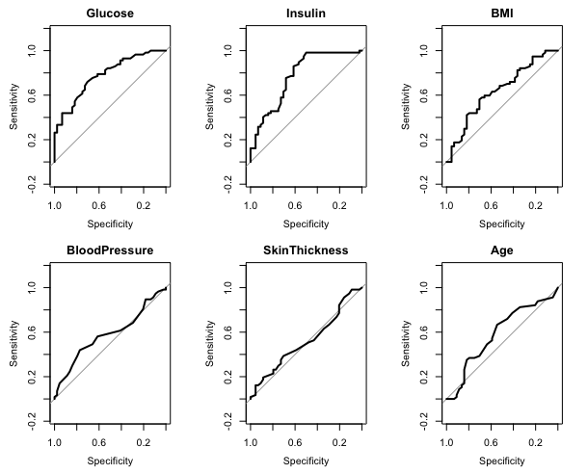
ROC and AUC
Glucose: 0.7775
Insulin: 0.7719
Body Mass Index: 0.6396
Blood Pressure: 0.5797
SkinThickness: 0.5223
Age: 0.5863

Slide 15
Conclusion
Only glucose levels have significant difference between negative and positive diabetes groups above 35 years old significance level of 0.05
According to stepwise regression Insulin levels is the only independent variable that significantly influence the Glucose levels
Glucose and Insulin levels are statistically significant predictor variables in the model at significance level of 0.05

