Slide 1
Methodology
Start from the economic mechanism, not from the indicator list — then try hard to disprove it
1 Audit
2 Hypotheses
3 Nested tests
4 Out of sample
5 Luck floor
Verify every field before modelling. Two defects found, one suspicion tested and rejected
5 economic hypotheses → 16 features; mechanism and direction fixed before any test
Does each extra variable ADD? Paired ΔIC + Fama-MacBeth after controlling for the incumbent
Discovery 2007-16 · 6M embargo · validation 2017-26 frozen
25,301-candidate sweep answers: how good does the best PURE NOISE result look?
Stage 1 — data audit findings
Finding | Evidence | Action
The supplied "price" file is not prices | Values reproduce each market's Forward P/E (corr 0.999987–1.000000); range 8–39 = multiples, not index levels | Implied price = P/E × EPS; price-return only
US EPS field differs in kind | US supplies Monthly_EPS, others BEst EPS; US declines in 20% of months vs 31–42% | Flagged — the US Overweight depends on it
Does the proxy contaminate the signals? | P/E and EPS sit inside the return denominator. Tested by lagging 1M and 3M — ICs do not collapse | Suspicion REJECTED; valuation's sign flip is real
Which columns can rank markets at all? | VIX takes 3 distinct values across 5 markets, Brent 2, DXY 1 | Global factors enter only as betas / regimes
Target
Rank the five markets by RELATIVE return: Y(i,t,h) = R(i,t,h) − peer average. A variable is only useful if it distinguishes BETWEEN markets — which rules out VIX, oil and the dollar as raw signals.
Developed Markets Scorecard v4 · hypothesis-driven research with a 25,301-candidate luck calibration · data as of 2026-04 · gross of costs · price proxy = fwd P/E × fwd EPS
1

Slide 2
Signal selection & predictive power
Five hypotheses, tested by nested comparison — does each added variable actually add?
Hypothesis | Test result | Verdict
H1 Economic acceleration (PMI → +credit → +FCI) | PMI alone IC −0.045; adding credit makes it WORSE (ΔIC −0.029). Fama-MacBeth: PMI −0.91 (t −0.79), credit +0.44 (t 0.41), FCI +1.53 (t +1.77) | PMI REJECTED FCI is the macro signal
H2 Revisions beat realised growth | EPS revision 6M val IC +0.131 vs growth +0.046. After controlling for revisions, growth slope is NEGATIVE (−1.09, t −0.82) | CONFIRMED revisions only
H3 Cheap + improving earnings (GARP) | Additive +0.162 → −0.042 · conjunction min(z) +0.080 → −0.043 · cheap-half filter fails both windows | REJECTED in all three forms
H4 Global shocks hit markets differently | Oil betas 0.10–0.20 across all five — too similar to rank. Local-currency oil cost +0.048 → −0.121 | REJECTED no usable dispersion
H5 Relative momentum persists | Momentum 12-1M positive both windows (+0.055 → +0.103) but discovery p = 0.19 | WEAK real but unproven
The pattern behind every rejection
Valuation-type signals were the STRONGEST in 2007–16 (relative P/E +0.168, earnings-yield spread +0.078, P/E z +0.141) and turned negative in 2017–26 (−0.108, −0.093, −0.126). Anything built on them — including the GARP hypothesis — inherits that reversal. Only EPS revisions and financial conditions keep the same sign in both regimes.
Developed Markets Scorecard v4 · hypothesis-driven research with a 25,301-candidate luck calibration · data as of 2026-04 · gross of costs · price proxy = fwd P/E × fwd EPS
2

Slide 3
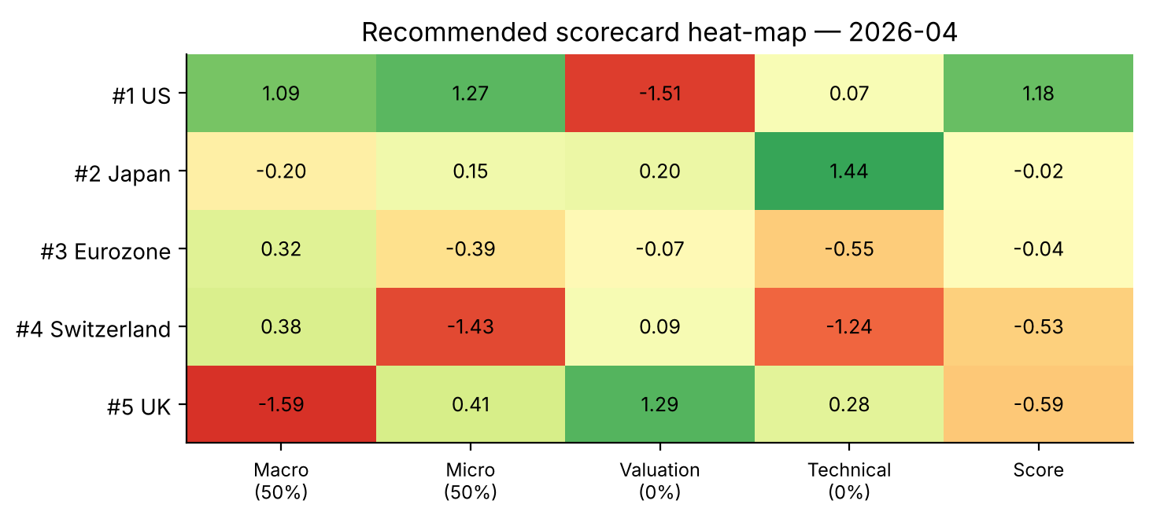
Scorecard construction
All four pillars are built and tested — then weighted by evidence, not by assumption
Pillar | Signal | Disc IC | Val IC | Weight
Macro | FCI 6M easing | +0.079 | +0.127 | 50%
Micro | EPS revision 6M | +0.117 | +0.131 | 50%
Valuation | Relative P/E vs peers | +0.168 | −0.108 | 0%
Technical | Momentum 12-1M | +0.055 | +0.103 | 0%
▪ Zero weight is a result, not an omission: the brief asks whether each signal has predictive power. For Valuation the answer is no — it reverses sign.
▪ Pillars are near-independent: Macro/Micro correlation 0.24, so the two that earn weight genuinely diversify.
The selection rule itself was tested — and it failed
Choosing each pillar by HIGHEST DISCOVERY IC picks relative P/E and EPS growth. That scorecard scores +0.165 in discovery and only +0.062 in validation (Sharpe 0.31). Picking by SIGN-STABILITY across both regimes scores +0.160 and +0.156 (Sharpe 0.51). Best-in-sample is the wrong rule.
Recommended model
Macro 50% (FCI 6M easing) + Micro 50% (EPS revision 6M). Cross-sectional z-scores, equal weight, rank 1–5.
Developed Markets Scorecard v4 · hypothesis-driven research with a 25,301-candidate luck calibration · data as of 2026-04 · gross of costs · price proxy = fwd P/E × fwd EPS
3

Slide 4
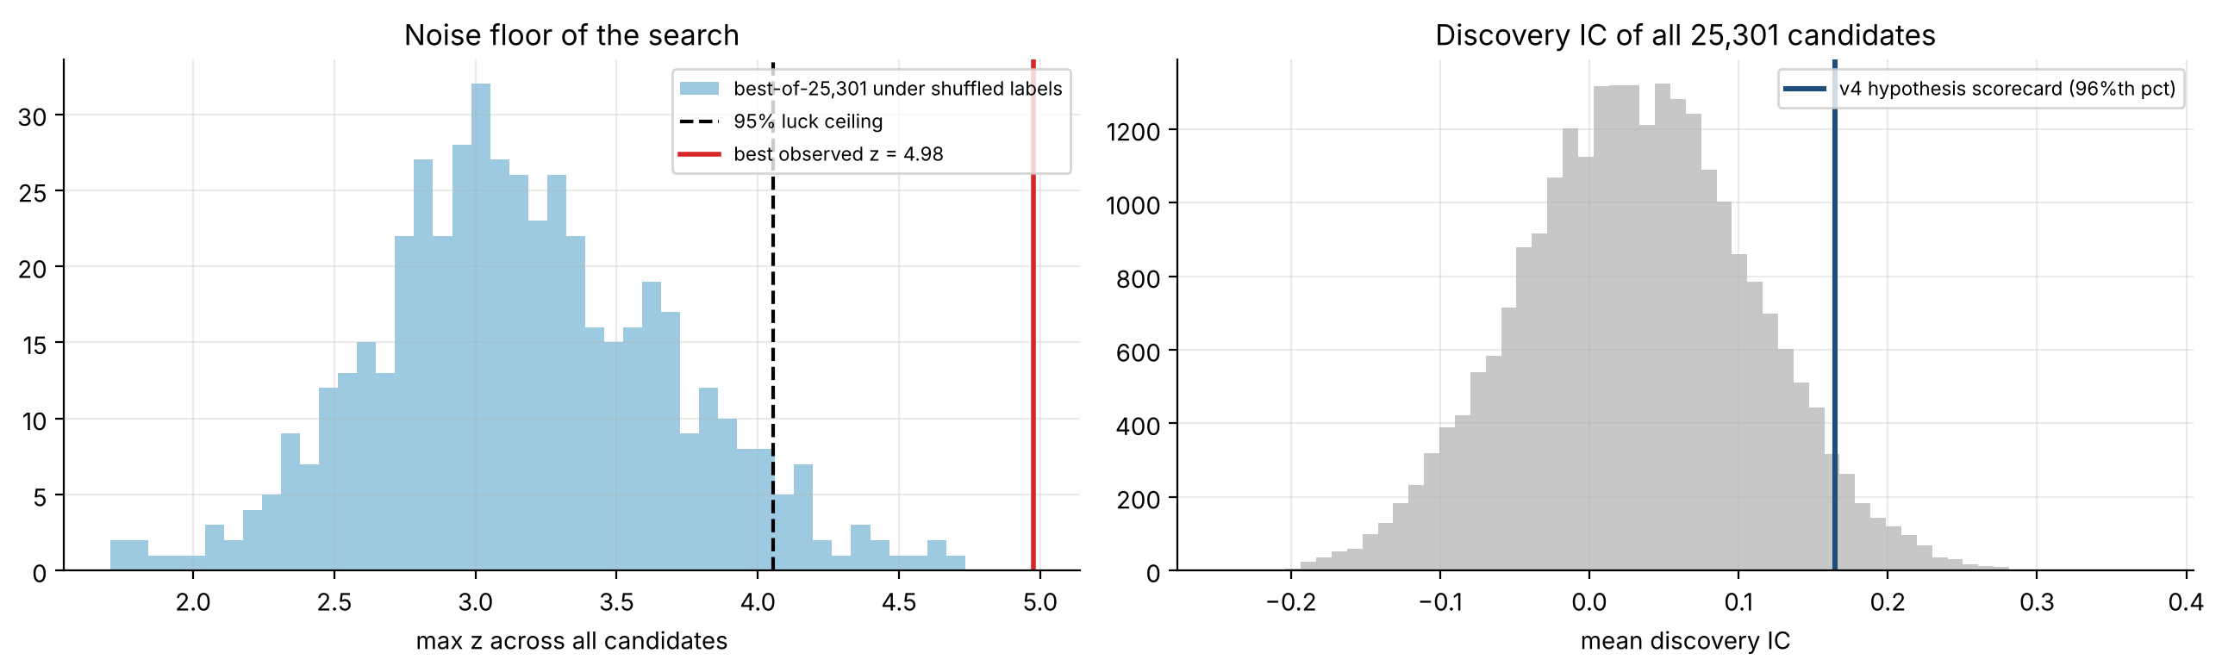
Backtest and the luck calibration
How good does the BEST of 25,301 candidates look when the signals carry no information?
 | Disc IC | Val IC | Val Sharpe | Perm p
Sweep winner (best of 25,301) | +0.374 | −0.091 | – | 0.91
Four-pillar (discovery rule) | +0.165 | +0.062 | 0.31 | 0.18
Recommended (sign-stable) | +0.160 | +0.156 | 0.51 | 0.064
▪ The sweep winner passed the strictest in-sample bar here — Westfall-Young adjusted p = 0.002 across 25,301 candidates.
▪ It still failed out of sample. Validation IC −0.091. All 10 discovery stars tested are negative (mean −0.060).
▪ Conclusion: surviving a multiple-testing correction on one sample is NOT evidence of an edge. Regime stability is the binding test.
▪ The reasoned model was never chosen by the search, yet sits at the 96th percentile of all 25,301 candidates.
Recommended model, USD, 3M tranches, gross: discovery Sharpe 0.60 / validation 0.51 · ann. 3.7% · max DD −11.9% · active IR vs equal-weight 0.47 · break-even cost 70 bps. Local-currency results are the same (0.51 / 0.53). Integrity checks passed: scipy re-computation, dollar-neutral manual check, look-ahead truncation test.
Developed Markets Scorecard v4 · hypothesis-driven research with a 25,301-candidate luck calibration · data as of 2026-04 · gross of costs · price proxy = fwd P/E × fwd EPS
4

Slide 5
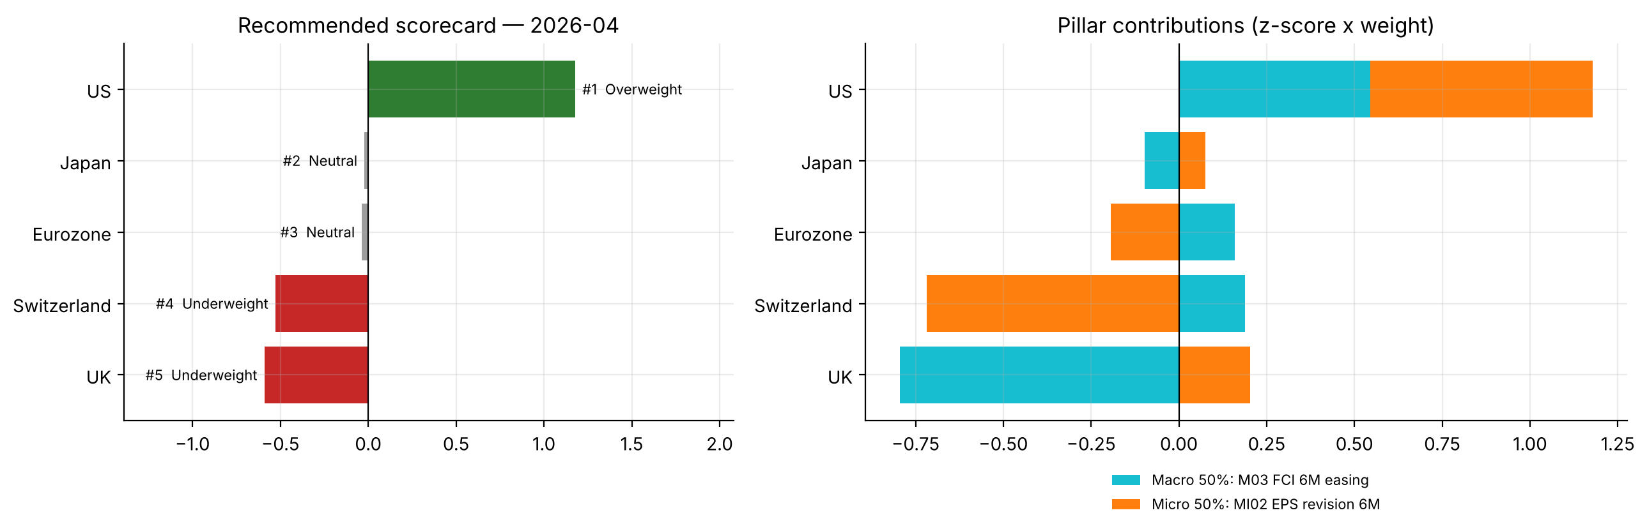
Current ranking & recommendation
Recommended scorecard as of 2026-04 (latest month available for all five markets)
# | Market | Score | Call | Macro | Micro
1 | US | +1.18 | Overweight | +1.09 | +1.27
2 | Japan | -0.02 | Neutral | -0.20 | +0.15
3 | Eurozone | -0.04 | Neutral | +0.32 | -0.39
4 | Switzerland | -0.53 | Underweight | +0.38 | -1.43
5 | UK | -0.59 | Underweight | -1.59 | +0.41
Call rule: |score| < 0.1 = Neutral (no real view).
Recommendation — one clear view, three honest neutrals
What would change this — and what we do NOT claim
OVERWEIGHT US (score +1.18): the only market strong on both scored pillars — best EPS revisions and easing financial conditions. UNDERWEIGHT UK (−0.59, sharply tightening conditions) and SWITZERLAND (−0.53, weakest EPS revisions). Japan and the Eurozone score near zero — no view, hold at benchmark. Japan looks better on momentum and valuation, but neither pillar earned weight.
Moderate evidence, not proof: permutation p = 0.064, five markets, ~20 years, validation window used twice. Next step is paper trading, not deployment. The US call rests on an EPS field that is not comparable with the other four (slide 1). If valuation re-establishes a stable sign it re-enters at 25%.
Developed Markets Scorecard v4 · hypothesis-driven research with a 25,301-candidate luck calibration · data as of 2026-04 · gross of costs · price proxy = fwd P/E × fwd EPS
5

