Slide 1
Methodology — v3: disciplined signal search
Widen the search to all supplied data, but control for luck and test on unseen months
1 Library
2 Discovery
3 Luck control
4 Validation
5 Scorecard
40 signals, 7 families (EPS, valuation, rates, credit, FX, technical, macro); direction fixed ex ante
2007-01 → 2016-12: rank signals by 3M USD rank-IC
Max-statistic permutation test: how good is the best of 40 pure-noise signals?
2017-07 → 2026-04 (6M embargo): top candidates frozen, then tested
Only evidence-backed signals get weight; backtest 3M tranches
Why a new approach | What v3 does about it
v1/v2 tested a handful of hand-picked signals; v2 was designed after seeing v1 | Pre-registered protocol: library, directions, split and selection rule fixed before any result
Best backtest of many tries is biased upward (selection noise) | Westfall-Young max-statistic test calibrates the noise floor for the best of 40 signals
In-sample IC says little about the future | Discovery / validation split with embargo; meta-check across all 40 signals
VIX and Brent are identical across most markets | Excluded: no cross-sectional information for a relative scorecard
Limits stated up front
Only 5 markets → low power. The v1/v2 signal families were already seen on the full history, so their validation is not clean. Stage 2 (pooled test) and the pillar scorecards v3b/v3c use all data to choose signals — multiplicity-controlled, but not out-of-sample evidence.
Developed Markets Scorecard v3 (disciplined search; v3b/v3c selection used pooled data, so validation window is not clean OOS) · data as of 2026-04 · gross of costs · price proxy = fwd P/E × fwd EPS
1

Slide 2
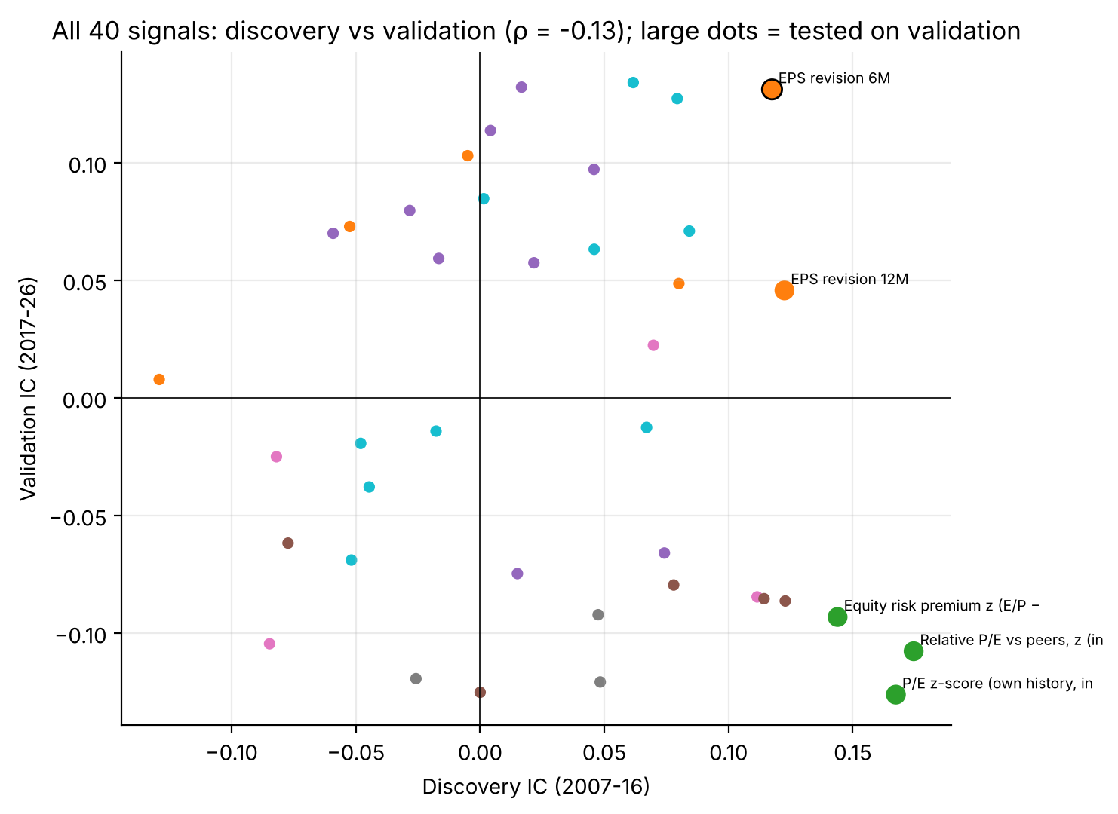
Signal selection & predictive power
What survives the search? Rank-IC vs 3M forward USD return across the five markets
Signal (pillar) | Discovery IC | Validation IC | Pooled IC | Adj. p (40 signals)
EPS revision 6M (Micro) | +0.117 | +0.131 | +0.122 | 0.09
FCI easing 6M (Macro) | +0.079 | +0.127 | +0.101 | 0.27
Momentum 12-1M (Technical) | +0.046 | +0.097 | +0.061 | 0.90
P/E z vs own history (Valuation) | +0.167 | -0.126 | +0.022 | 1.00
Relative P/E vs peers (Valuation) | +0.174 | -0.108 | +0.037 | 1.00
▪ Nothing passed discovery: best z = 2.64 vs 2.95 needed (95th pct of best-of-40 noise). 8 signals had p ≤ 0.05 vs ≈ 2 expected by chance.
▪ Valuation reversed: top discovery family (IC +0.14 to +0.17) turned negative in 2017-26 (−0.09 to −0.13).
▪ Whole library: discovery IC does not predict validation IC (ρ = −0.13) — discovery ranking alone is mostly noise.
▪ One signal held up: EPS revision 6M — positive in both windows, validation p = 0.02 (Bonferroni 0.11), pooled adj. p = 0.09. FCI easing is the runner-up (pooled adj. p = 0.27).
Developed Markets Scorecard v3 (disciplined search; v3b/v3c selection used pooled data, so validation window is not clean OOS) · data as of 2026-04 · gross of costs · price proxy = fwd P/E × fwd EPS
2

Slide 3
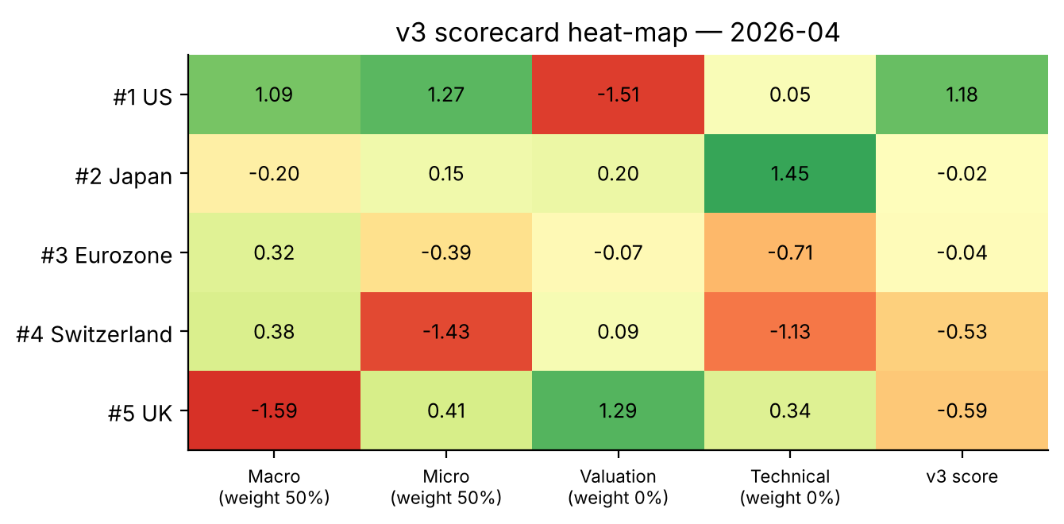
Scorecard construction
Evidence decides the weights: pillars without a sign-stable, significant signal get zero weight
Pillar | Signal chosen by rule | Pooled p (raw) | Weight
Micro | EPS revision 6M | 0.003 | 50%
Macro | FCI easing 6M | 0.011 | 50%
Technical | Momentum 12-1M | 0.081 | 0%
Valuation | Relative P/E vs peers | 0.215 | 0%
▪ Rule (fixed in advance): per pillar take the signal with the highest pooled z among those positive in both windows; keep the pillar only if its raw p ≤ 0.05.
▪ v3b (headline): EPS revision 6M + FCI easing 6M, equal weight. v3c: all four pillars equal-weight (assignment style).
▪ Scores: cross-sectional z-score per signal, averaged; rank 1–5.
Why Valuation and Technical get no weight
No valuation signal is sign-stable (all three reversed after 2016). Momentum is positive in both windows but weak (raw p = 0.08). They are still constructed, tested and shown in the heat-map — they just earn no vote until the data supports one.
Caveat
v3b/v3c pick signals using pooled data (incl. the validation window), so their validation-window results are not clean out-of-sample.
Developed Markets Scorecard v3 (disciplined search; v3b/v3c selection used pooled data, so validation window is not clean OOS) · data as of 2026-04 · gross of costs · price proxy = fwd P/E × fwd EPS
3

Slide 4
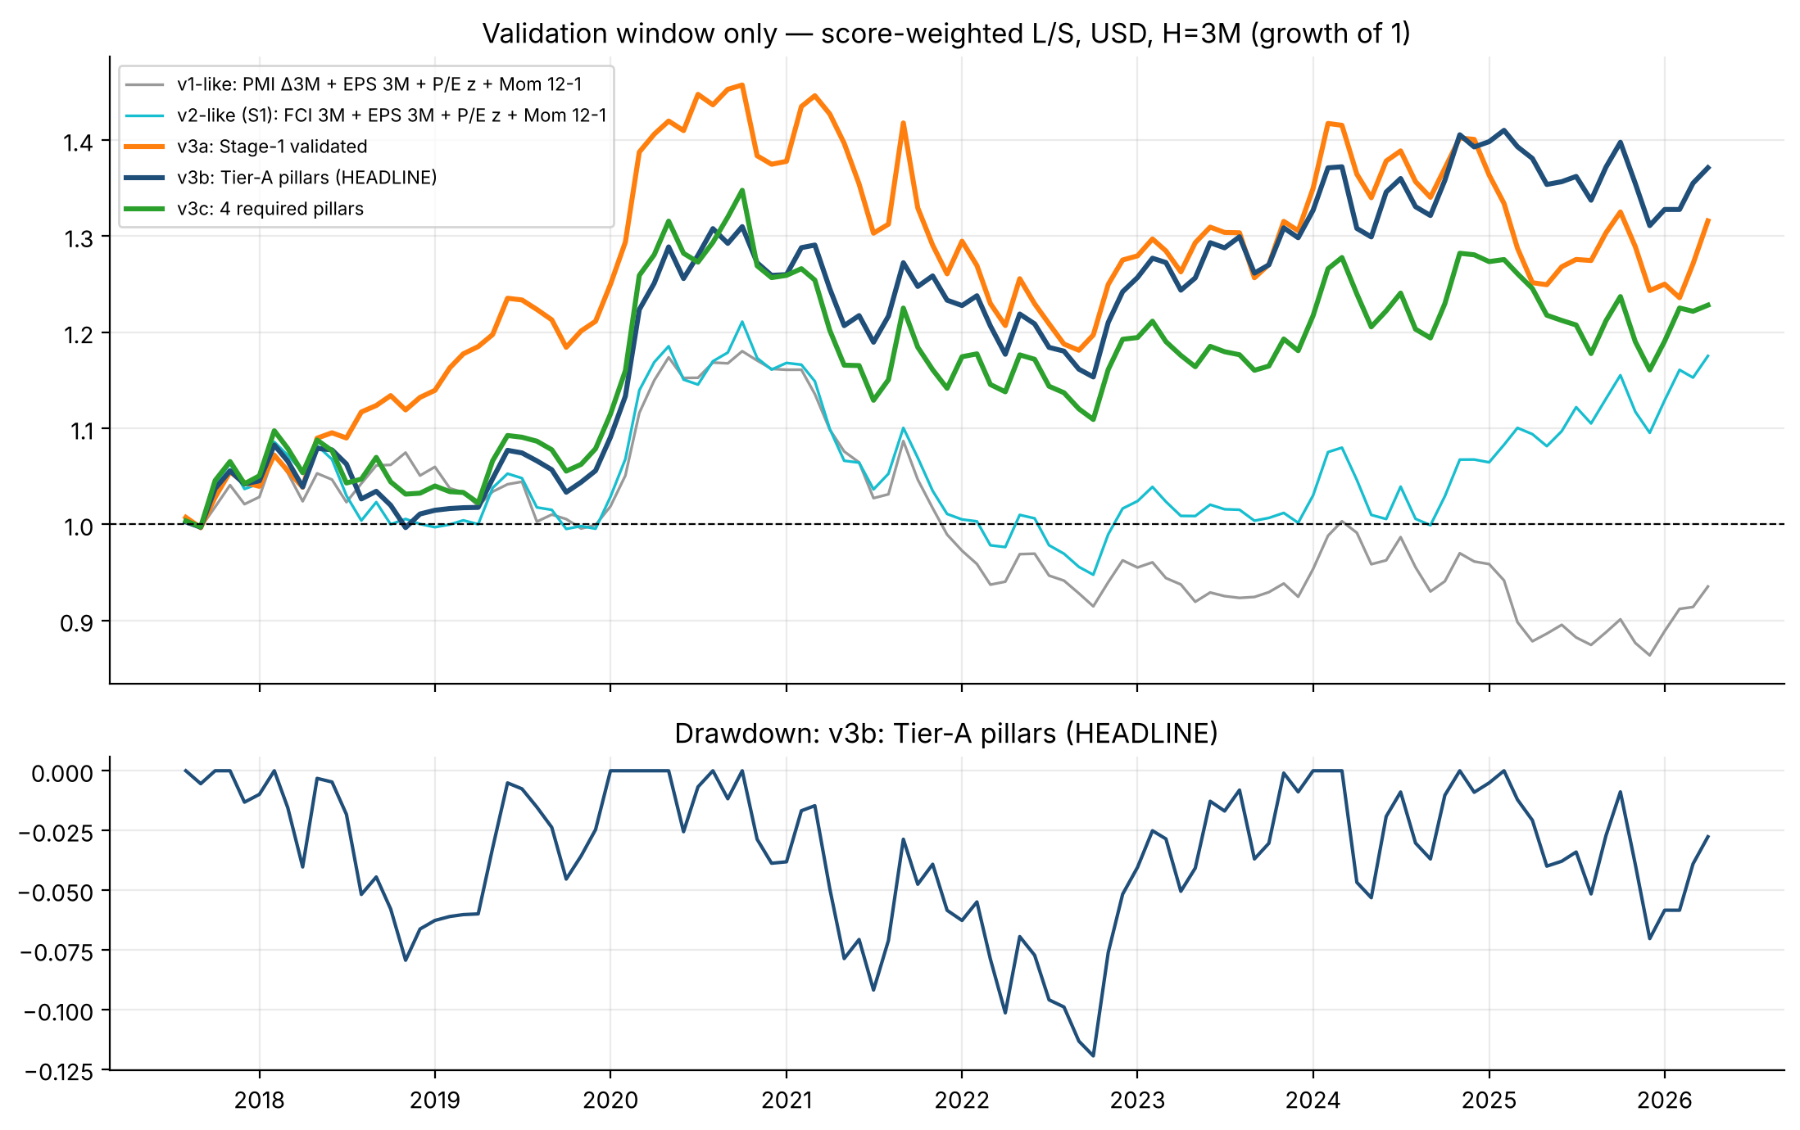
Backtest results
Score-weighted long/short, 3M tranches, gross of costs, USD · discovery 2007-16 vs validation 2017-26
Composite | IC disc. | IC valid. | Sharpe disc. | Sharpe valid. | Perm p (valid.)
v1-like (PMI, EPS 3M, P/E, Mom) | +0.057 | -0.006 | 0.22 | -0.07 | 0.57
v2-like (FCI 3M, EPS 3M, P/E, Mom) | +0.154 | +0.071 | 0.69 | 0.27 | 0.20
v3a: EPS revision 6M only | +0.117 | +0.131 | 0.18 | 0.41 | 0.11
v3b: EPS 6M + FCI 6M (HEADLINE) | +0.160 | +0.156 | 0.57 | 0.50 | 0.06
v3c: 4 required pillars | +0.195 | +0.063 | 0.65 | 0.32 | 0.16
▪ Headline v3b: IC ≈ +0.16 and Sharpe ≈ 0.5 in both windows (max DD −12% in validation) — the most consistent of all specs across the two windows.
▪ Old composites decay: v1-like ≈ 0 and v2-like falls from 0.69 to 0.27 out of sample.
▪ Robustness: dropping one market at a time keeps Sharpe positive (0.13 ex-US to 0.73 ex-Japan).
▪ Not proven: permutation p = 0.06, not adjusted for choosing among 40 signals; validation is not clean for v3b/v3c.
Dollar-neutral: longs +100% / shorts −100%, weight ∝ score. Costs not deducted. Integrity checks (scipy re-computation, look-ahead truncation test) passed.
Developed Markets Scorecard v3 (disciplined search; v3b/v3c selection used pooled data, so validation window is not clean OOS) · data as of 2026-04 · gross of costs · price proxy = fwd P/E × fwd EPS
4

Slide 5
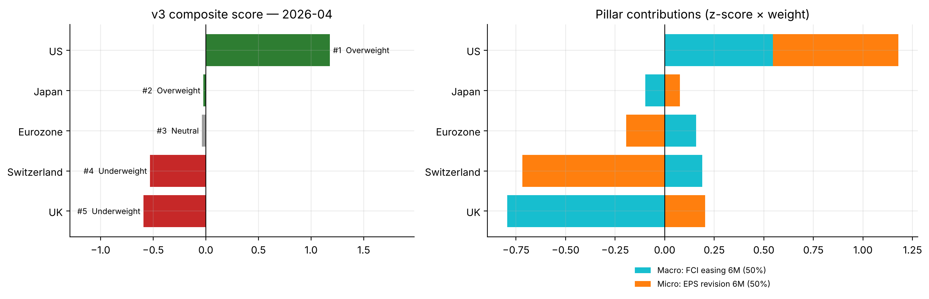
Current ranking & recommendation
v3b scorecard as of 2026-04 (latest month available for all five markets)
# | Market | Score | Call | Rank v1/v2/v3a/v3c
1 | US | +1.18 | Overweight | 3/3/1/2
2 | Japan | -0.02 | Neutral | 2/1/3/1
3 | Eurozone | -0.04 | Neutral | 5/5/4/4
4 | Switzerland | -0.53 | Underweight | 4/4/5/5
5 | UK | -0.59 | Underweight | 1/2/2/3
Call rule: |score| < 0.1 = Neutral (no real view).
Recommendation — moderate conviction on the US only
What would change the view / caveats
Overweight US: the one clear signal (score +1.18) — strongest EPS revisions and easing financial conditions; its rich P/E is not scored because valuation has no sign-stable edge. Japan and Eurozone score ≈ 0: stay neutral. Underweight Switzerland (weakest EPS revisions; bottom-two in every spec) and UK (tightening conditions; unstable across specs).
Evidence is moderate, not proven (p ≈ 0.06, 5 markets, ~20 years). UK ranks anywhere from #1 to #5 across specs — low conviction. Valuation is ignored by rule; if it re-establishes a sign-stable edge it re-enters. Price is a proxy (P/E × EPS); US data ends Apr-2026.
Developed Markets Scorecard v3 (disciplined search; v3b/v3c selection used pooled data, so validation window is not clean OOS) · data as of 2026-04 · gross of costs · price proxy = fwd P/E × fwd EPS
5

