Slide 1
1. Methodology
One indicator per pillar, z-scored across five markets, with predictive and diagnostic pillars kept separate
Objective
Rank the US, Eurozone, UK, Switzerland and Japan by expected relative USD performance over the next 3–6 months.
Data
Supplied Bloomberg workbooks only, monthly, Dec-2005 to Apr-2026. The dataset contains NO index price: the supplied "Price" file holds P/E ratios, so the index is reconstructed as forward P/E × forward EPS (an identity; the US matches published S&P 500 returns to 0.04 pp).
Process
① one indicator per pillar ② z-score across the 5 markets each month ③ equal-weight aggregate ④ rank 1–5 ⑤ test each pillar ⑥ backtest the ranking.
Testing
Rank IC against the next 3M/6M relative return. Discovery to Dec-2016, six-month embargo, examined window from Jul-2017. Bootstrap CIs, HAC t, block-permutation p, leave-one-country-out, walk-forward.
Two views, reported together
The four-pillar equal-weight scorecard is the primary deliverable. A predictive score containing only the pillars with out-of-sample evidence is shown alongside it. Failed pillars are kept and labelled, never given artificial weight.
Pillar | Indicator | Attractive when | Label
Macro | FCI 6M easing | conditions eased most over 6M | PREDICTIVE (provisional)
Micro | EPS revision 6M | forward EPS upgraded most over 6M | PREDICTIVE (provisional, 3M)
Valuation | Earnings-yield spread vs own history | earnings yield minus 2Y widest vs own history | DIAGNOSTIC
Technical | Signed trend quality 12M | smoothest rising 12M trend | DIAGNOSTIC
Key limitations
• Data end 30-Apr-2026, so the ranking is as of that date, not current. Only the supplied dataset may be used, so it cannot be extended.
• Price returns only — no dividend data is supplied.
• No index price exists, so the Technical pillar is a function of the same inputs as Micro and Valuation. It is not independent, and we do not claim it is.
• Switzerland uses the euro-area financial-conditions and credit series. The UK workbook's "VIX" column is not a volatility index and is excluded.
• The indicators were selected across sixteen research versions. No pillar is statistically significant after multiple testing.
Source: Markets_Scorecard_v16_FINAL.ipynb and output/v16; supplied Bloomberg workbooks only. USD price returns (no dividends). Latest common data date 30-Apr-2026.

Slide 2
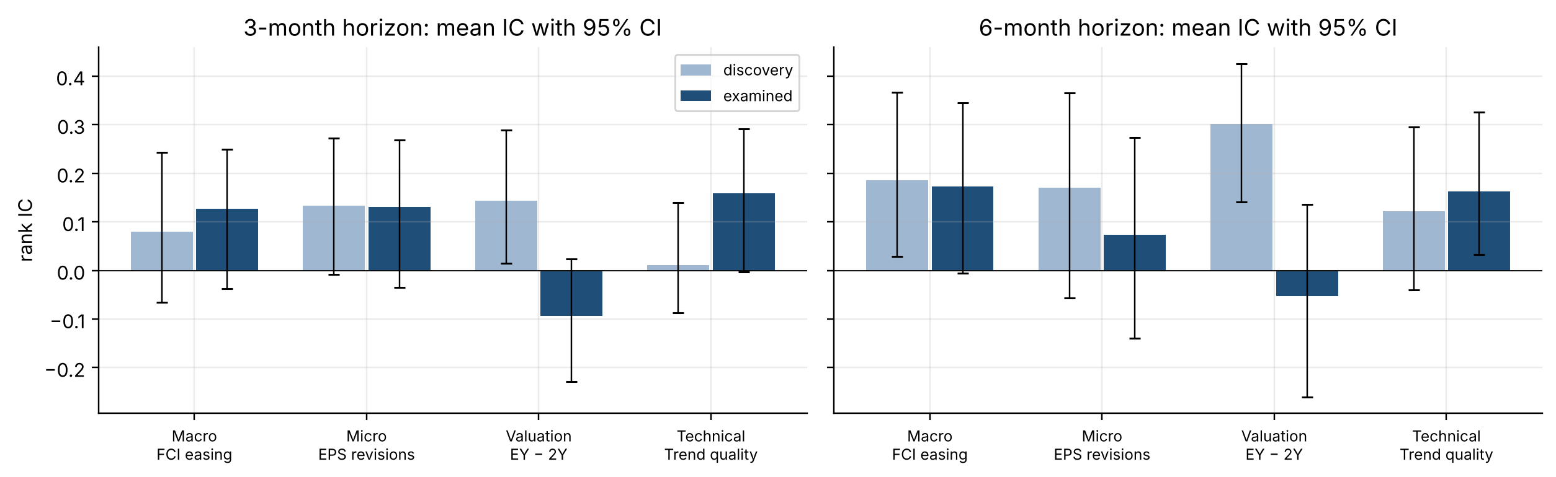
2. Signal selection and predictive power
Macro and Micro hold out of sample; Valuation and Technical do not survive their robustness tests
Pillar | IC 3M disc → exam | IC 6M disc → exam | ex-US 6M | Label
Macro | +0.079 → +0.127 | +0.186 → +0.173 | +0.151 | PREDICTIVE (provisional)
Micro | +0.134 → +0.131 | +0.171 → +0.074 | +0.105 | PREDICTIVE (provisional, 3M)
Valuation | +0.144 → -0.093 | +0.301 → -0.053 | +0.191 | DIAGNOSTIC
Technical | +0.011 → +0.158 | +0.121 → +0.163 | +0.007 | DIAGNOSTIC
What the tests show
• Macro: positive in both windows at both horizons; every leave-one-out IC positive (min +0.119). From 2014 its 6M IC is +0.162 (t 2.26); the yearly re-selection test in the investigation notebook picks this same construction every year.
• Micro: positive at 3M in both windows; weak at 6M out of sample. Revision acceleration and momentum were tested and refuted.
• Valuation: strong in discovery, negative out of sample (-0.053). Traced to the US — persistently the most expensive market, and it kept outperforming.
• Technical: raw IC looks good but falls to +0.007 without the US, and most of it is Micro and Valuation restated.
No pillar is statistically significant once the research history is accounted for. Error bars are 95% bootstrap intervals.
How to read
IC = monthly rank correlation between pillar scores and the next 3M/6M USD return relative to the five-market average (+1 = perfect ranking). Wide bars = discovery window, narrow bars = examined window.
The examined window (2017 onward) was inspected across sixteen research versions, so it is NOT untouched holdout data. That is why leave-one-country-out and walk-forward tests carry more weight here than the examined IC alone.
Source: Markets_Scorecard_v16_FINAL.ipynb and output/v16; supplied Bloomberg workbooks only. USD price returns (no dividends). Latest common data date 30-Apr-2026. Discovery: signal months to Dec-2016; examined: Jul-2017 onward.

Slide 3
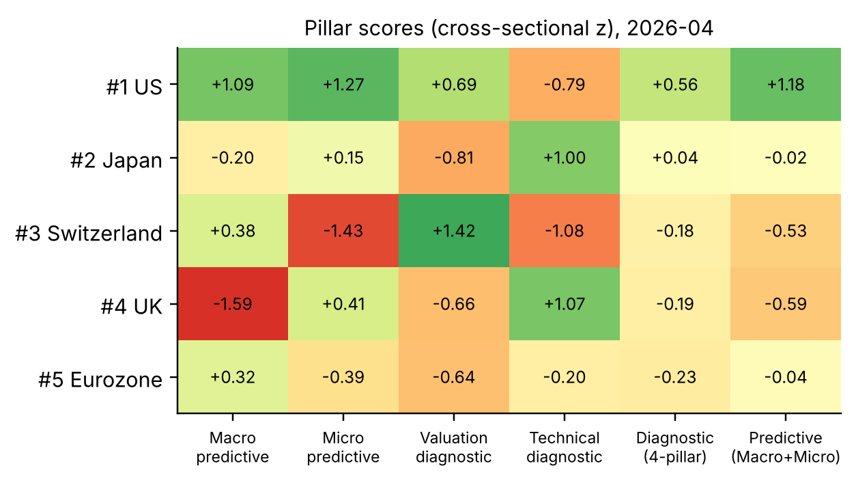
3. Scorecard construction
Equal-weight four-pillar scorecard, with a predictive score that excludes the two failed pillars
Pillar score
z = (indicator − five-market mean) ÷ five-market standard deviation, each month. Higher is always more attractive.
Diagnostic scorecard — the primary deliverable
Equal-weight average of the four pillar scores (25% each). A pillar's contribution is ¼ × its z. Equal weights because the brief requires four pillars and no pillar has validated evidence; weights fitted to past IC would be in-sample optimisation.
Predictive score — companion
Equal-weight average of Macro and Micro only. Valuation and Technical keep their scores and contributions on the scorecard but carry ZERO predictive weight. They are neither deleted nor given artificial importance.
Rankings
Rank 1–5. The 3M and 6M rankings are identical because the scores are horizon-independent; what differs is the evidence behind them — Macro is supported at both horizons, Micro mainly at 3M.
Predictive power of the two scores
Diagnostic 6M IC: +0.353 discovery → +0.073 examined. Predictive 6M IC: +0.259 → +0.123. Carrying the two failed pillars costs out-of-sample power — which is exactly why both views are shown.
Scores as of 30-Apr-2026. Columns labelled "diagnostic" are the pillars that failed their robustness tests (slide 2); they stay on the scorecard because the brief specifies four pillars.
Full monthly history — every pillar score, contribution, aggregate, rank, call and the realised next 3M/6M return — is in scorecard_history.csv.
Source: Markets_Scorecard_v16_FINAL.ipynb and output/v16; supplied Bloomberg workbooks only. USD price returns (no dividends). Latest common data date 30-Apr-2026.

Slide 4
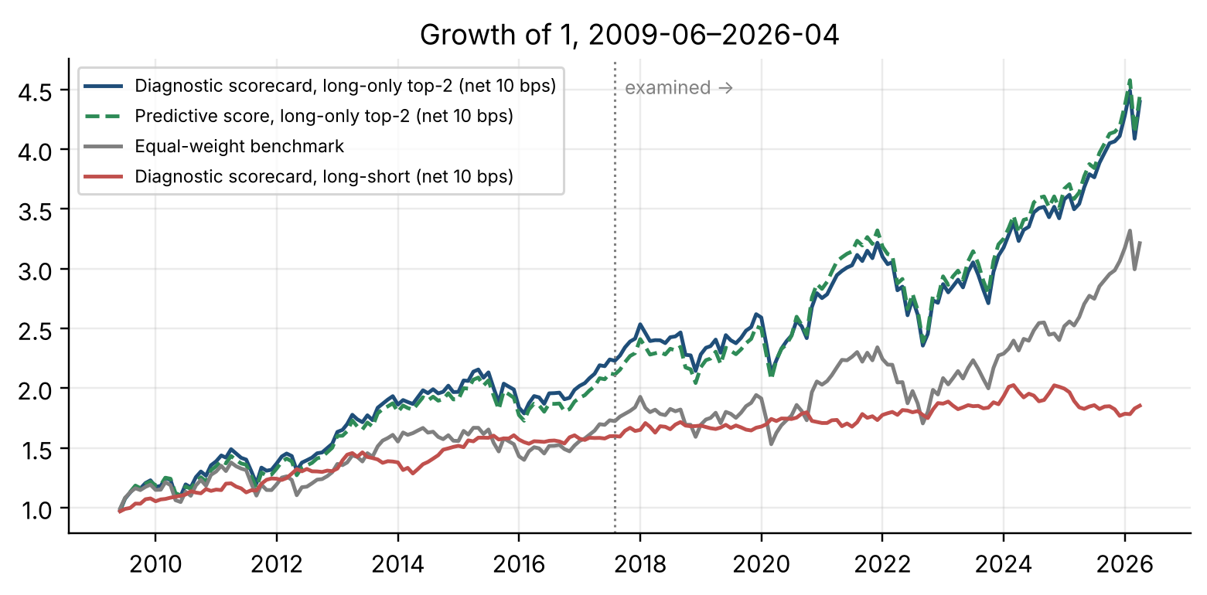
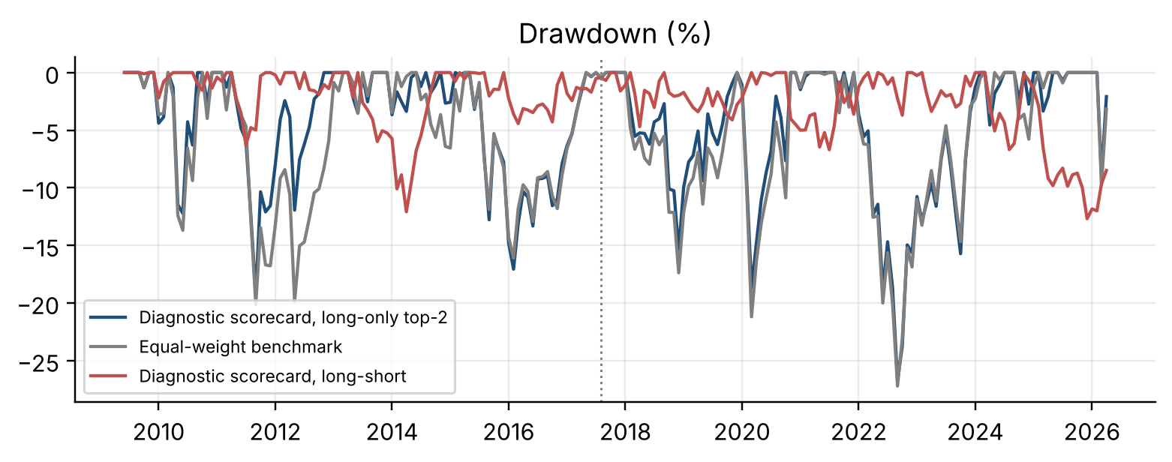
4. Backtest results
Both scorecards beat the benchmark long-only; the long-short edge is modest and comes from Macro
Full period, net 10 bps | Diagnostic long-only | Predictive long-only | EW benchmark | Diagnostic L/S top2
Return % p.a. | 9.1 | 9.2 | 7.1 | 3.7
Volatility % p.a. | 13.9 | 13.9 | 14.3 | 6.4
Sharpe | 0.70 | 0.71 | 0.56 | 0.60
Max drawdown % | -26.8 | -28.1 | -27.2 | -12.7
Turnover p.a. (x) | 1.8 | 2.1 | – | 3.8
Examined-window Sharpe | 0.61 | 0.65 | 0.55 | 0.30
Information ratio vs EW | 0.55 | 0.56 | – | –
Single-pillar attribution (long-short, examined window): Macro +0.68, Micro +0.35, Valuation -0.14, Technical +0.39. The edge is Macro; Valuation drags.
Costs are not the constraint: long-short Sharpe (full) 0.66 / 0.63 / 0.60 / 0.54 at 0/5/10/20 bps.
A concentrated top-1 / bottom-1 book is worse: Sharpe 0.59 full with a -23.1% drawdown. Rules were fixed in advance and not optimised.
Source: Markets_Scorecard_v16_FINAL.ipynb and output/v16; supplied Bloomberg workbooks only. USD price returns (no dividends). Latest common data date 30-Apr-2026. Backtest returns Jun-2009 to Apr-2026; examined window from Aug-2017. Benchmark carried cost-free; long-short Sharpe uses rf = 0.

Slide 5
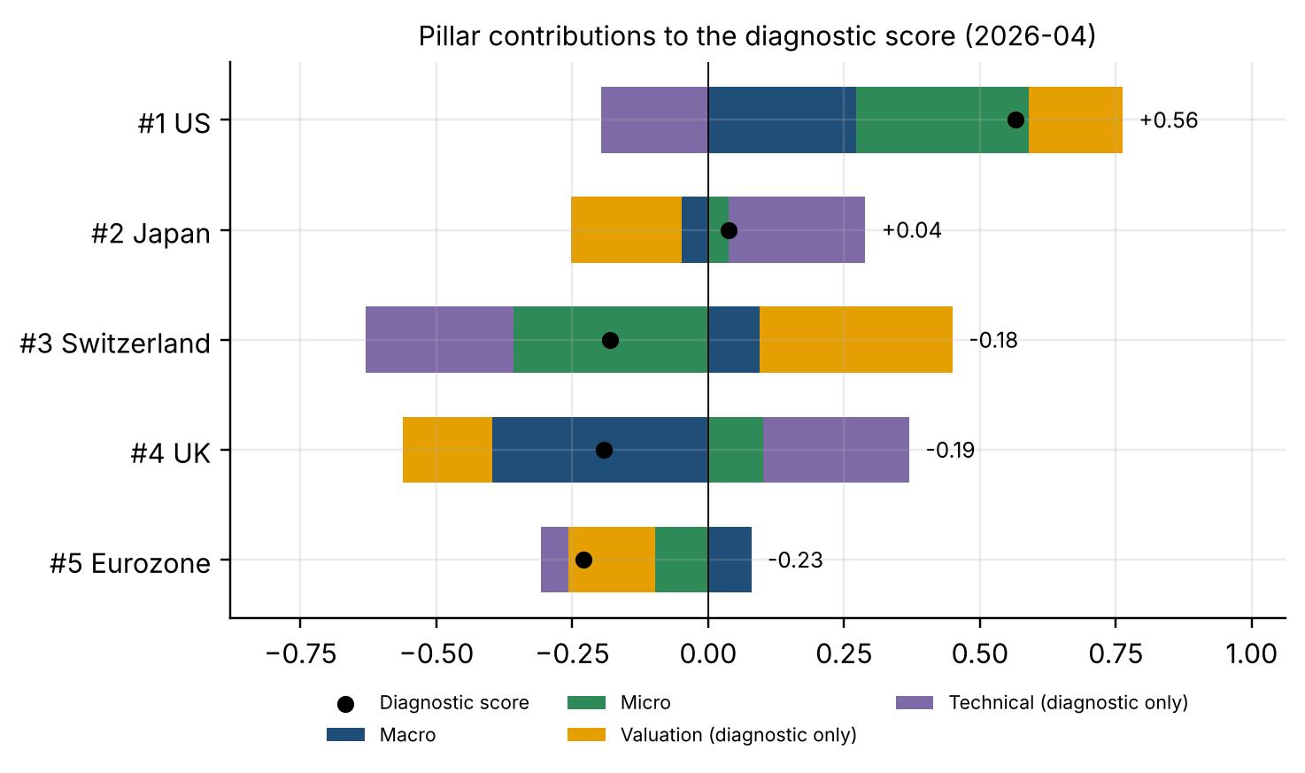
5. Current ranking and investment recommendation
As of 30-Apr-2026: both views overweight the US and Japan and underweight the UK; low conviction
Rank | Market | Score | 4-pillar call | Predictive call | Agree?
1 | US | +0.56 | OVERWEIGHT | OVERWEIGHT | yes
2 | Japan | +0.04 | OVERWEIGHT | OVERWEIGHT | yes
3 | Switzerland | -0.18 | NEUTRAL | UNDERWEIGHT | NO
4 | UK | -0.19 | UNDERWEIGHT | UNDERWEIGHT | yes
5 | Eurozone | -0.23 | UNDERWEIGHT | NEUTRAL | NO
Recommendation
• OVERWEIGHT US — the strongest case, and both views agree. Strongest financing-conditions easing (+1.1) and EPS upgrades (16.5% over six months), despite the richest multiple (20.7x).
• OVERWEIGHT Japan on both views, but on thinner evidence: its EPS revisions are mid-pack (+0.2) and its macro score is negative (-0.2).
• UNDERWEIGHT UK on both views — much the weakest financing conditions (-1.6).
• The views DISAGREE on the Eurozone and Switzerland, because the two failed pillars move them. Treat both as neutral.
Conviction: LOW
• The two views give the same call for only 3 of 5 markets, ranks 2 and 3 are separated by 0.22, and no pillar is statistically significant.
• Data are as of 30-Apr-2026 and cannot be extended with the supplied dataset. Refreshed exports of the same tickers regenerate every figure here.
Source: Markets_Scorecard_v16_FINAL.ipynb and output/v16; supplied Bloomberg workbooks only. USD price returns (no dividends). Latest common data date 30-Apr-2026.

