Slide 1
Methodology
Four-pillar relative-value scorecard for US, Eurozone, UK, Switzerland, Japan — 3–6 month horizon
1 Data
2 Price proxy
3 Signals
4 Scorecard
5 Test
Monthly P/E, EPS, PMI, FX per market; common window Dec-2005 → Apr-2026
Implied price = fwd P/E × fwd EPS; local and USD returns
One signal per pillar, direction fixed ex ante from economic logic
Cross-sectional z-scores → equal-weight composite → rank 1–5
IC, top-vs-bottom spread, permutation test, 3M / 6M backtest
Pillar | Signal (direction) | Economic rationale
Macro | 3M change in PMI, lagged 1M (↑ = better) | Improving activity momentum leads earnings and equity outperformance
Micro | 3M % change in forward EPS (↑ = better) | Analyst revisions drive absolute and relative returns
Valuation | Fwd P/E z-score vs own history, ≥60M (↓ P/E = better) | Cheap vs own history → higher subsequent returns
Technical | 12-1M price momentum (↑ = better) | Trend persistence; skip latest month to avoid reversal
▪ No look-ahead: signals use data ≤ month-end t; positions earn t → t+1. Verified by truncation test in the notebook.
▪ No fitting: equal pillar weights, one specification, no parameter search — so the backtest is not inflated by optimisation.
▪ Price data: the supplied "price" file actually holds P/E values, so returns use implied price (P/E × EPS), reported in local currency and USD.
Developed Markets Scorecard · data as of Apr 2026 · gross of costs · price proxy = fwd P/E × fwd EPS
1

Slide 2
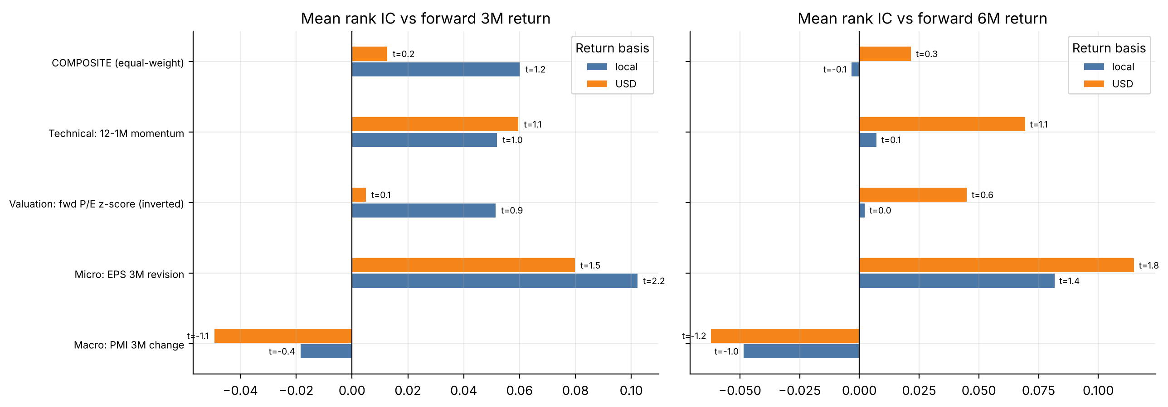
Signal selection & predictive power
Does each signal rank next-3M / 6M returns across the five markets? (mean rank IC, Newey-West t-stat)
Signal | 3M · Local | 3M · USD | 6M · Local | 6M · USD | Verdict
Macro | -0.018 (t -0.4) | -0.049 (t -1.1) | -0.049 (t -1.0) | -0.062 (t -1.2) | Wrong sign — not supported
Micro | +0.102 (t +2.2) | +0.080 (t +1.5) | +0.082 (t +1.4) | +0.115 (t +1.8) | Supported (perm p 0.02–0.09)
Valuation | +0.051 (t +0.9) | +0.005 (t +0.1) | +0.002 (t +0.0) | +0.045 (t +0.6) | Weak, unstable across halves
Technical | +0.052 (t +1.0) | +0.060 (t +1.1) | +0.007 (t +0.1) | +0.069 (t +1.1) | Weak
Composite | +0.060 (t +1.2) | +0.013 (t +0.2) | -0.003 (t -0.1) | +0.022 (t +0.3) | Not significant
▪ EPS revisions are the only pillar with consistent positive IC (6M USD: t = 1.8).
▪ PMI change has a negative IC. Sign was fixed ex ante, so it was not flipped.
▪ Equal-weight composite is diluted by the weak pillars: IC ≈ 0 (not significant).
▪ Power is low: 5 markets, ~185 months — treat t-stats as indicative.
Developed Markets Scorecard · data as of Apr 2026 · gross of costs · price proxy = fwd P/E × fwd EPS
2

Slide 3
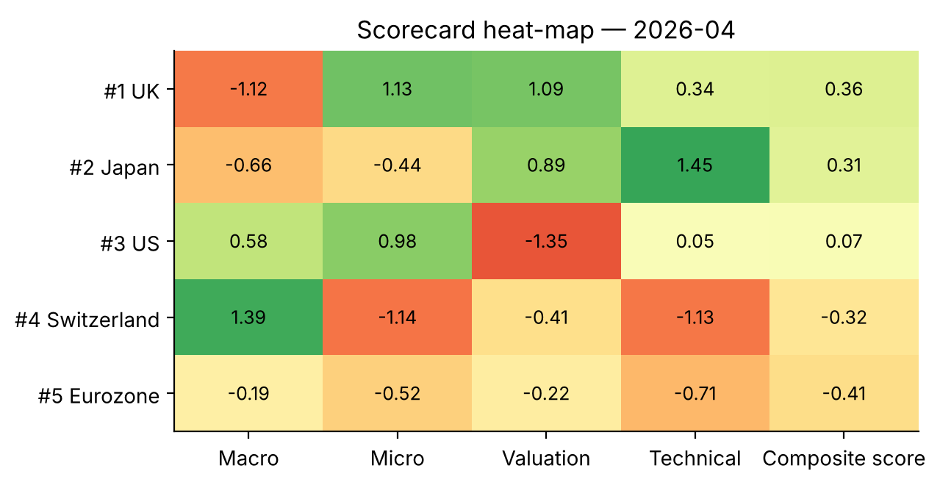
Scorecard construction
Pillar scores → aggregate country score → market ranking
▪ Pillar score: each raw signal is z-scored across the 5 markets every month (mean 0, SD 1).
▪ Country score: equal-weight average of the 4 pillar scores (25% each) — deliberately not optimised.
▪ Ranking & stance: rank 1–2 = Overweight · rank 3 = Neutral · rank 4–5 = Underweight.
▪ Diversification: pillars are largely uncorrelated (max pair: EPS vs momentum, 0.47).
Raw signal values behind the scores (Apr 2026)
Reading the heat-map
Market | PMI 3M chg | EPS 3M rev. | P/E (fwd) | Mom 12-1M
UK | +0.4 | +10.2% | 12.9x | +20.1%
Japan | +1.6 | +4.8% | 17.6x | +30.9%
US | +4.8 | +9.7% | 20.7x | +17.3%
Switzerland | +6.9 | +2.4% | 18.3x | +5.9%
Eurozone | +2.8 | +4.6% | 14.9x | +10.0%
Green = favourable. UK is the broadest-based Overweight (earnings revisions + cheap vs history). Japan ranks #2 mainly on momentum and valuation, while its EPS revisions rank below peers (+4.8% vs UK +10.2% over 3M). Switzerland and Eurozone rank lowest on relatively weak revisions and momentum.
Developed Markets Scorecard · data as of Apr 2026 · gross of costs · price proxy = fwd P/E × fwd EPS
3

Slide 4
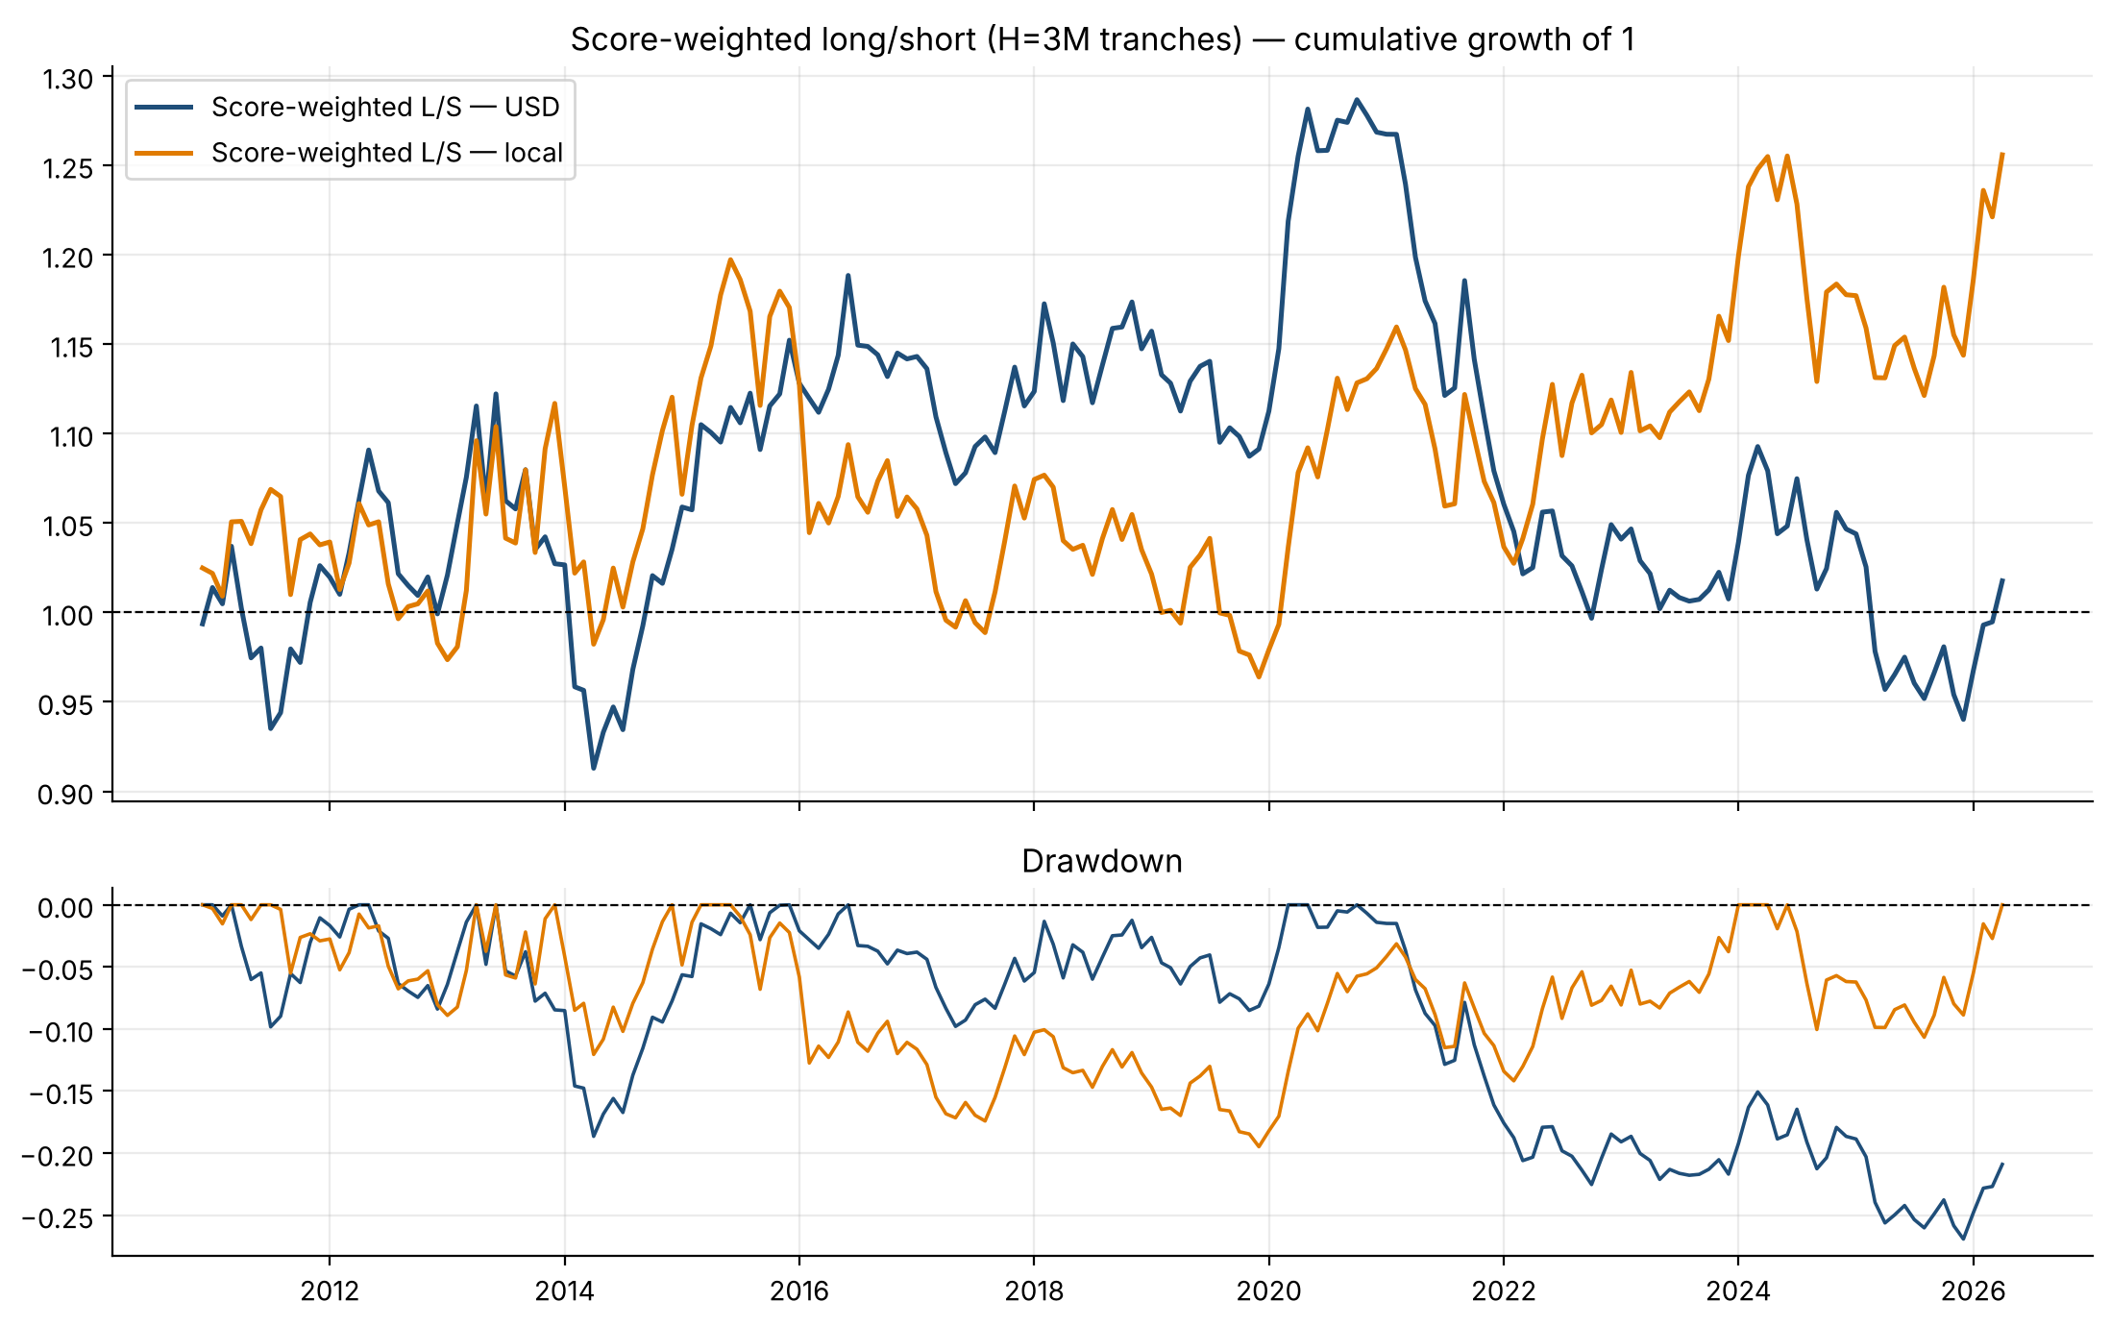
Backtest results
Monthly signals, positions held as 3M tranches · 2010-12 → 2026-04 · gross of costs · local and USD
Strategy (H = 3M) | Ann. ret | Sharpe / IR | Max DD
Score-weighted L/S · USD | +0.1% | 0.05 | -26.9%
Score-weighted L/S · Local | +1.5% | 0.21 | -19.5%
Top-2 long-only · USD | +6.0% | 0.50 | -28.4%
EW 5-market benchmark · USD | +6.7% | 0.53 | -27.2%
Active: top-2 − benchmark · USD (IR) | -0.8% | -0.19 | -15.3%
Score-weighted L/S · USD, H = 6M | +0.4% | 0.10 | -28.2%
▪ Result: the pre-specified equal-weight scorecard shows no reliable edge — L/S return ≈ 0 with a 27% USD drawdown; top-2 does not beat the equal-weight benchmark.
▪ Why: single-pillar L/S Sharpe — EPS 0.27, Valuation 0.09, Technical 0.18, Macro −0.37 (USD). The macro pillar subtracts value.
▪ Fragile: Sharpe +0.21 in 1st half vs −0.13 in 2nd half; dropping one market at a time moves Sharpe between −0.19 and +0.44.
Dollar-neutral: longs +100% / shorts −100%, weights ∝ composite score. Costs not deducted (break-even cost ≈ 1 bp in USD / 19 bps in local at H=3M — no cushion). Independent re-computation and a truncation (look-ahead) test passed.
Developed Markets Scorecard · data as of Apr 2026 · gross of costs · price proxy = fwd P/E × fwd EPS
4

Slide 5
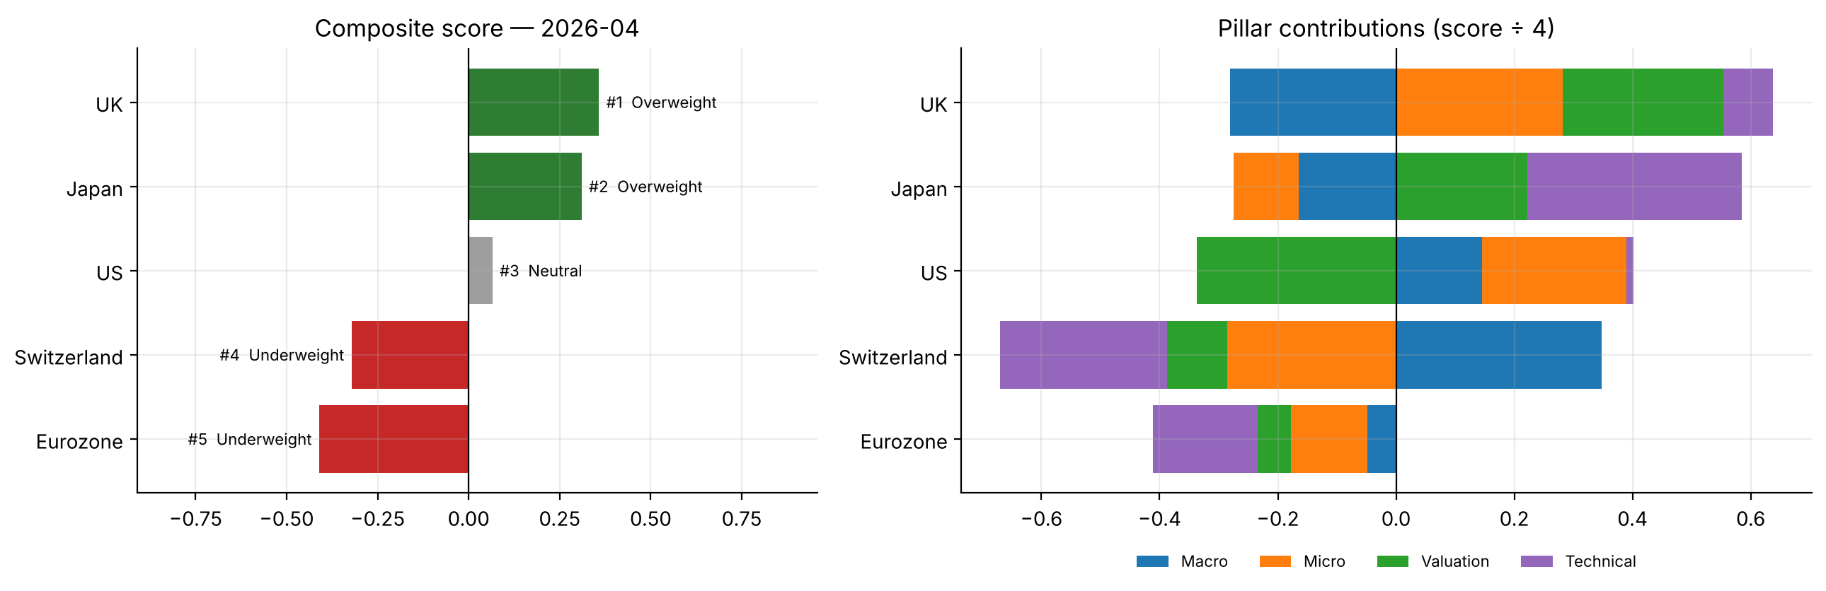
Current ranking & recommendation
Scorecard as of Apr 2026 (latest month available for all five markets)
# | Market | Score | Stance | EPS pillar
1 | UK | +0.36 | Overweight | +1.13
2 | Japan | +0.31 | Overweight | -0.44
3 | US | +0.07 | Neutral | +0.98
4 | Switzerland | -0.32 | Underweight | -1.14
5 | Eurozone | -0.41 | Underweight | -0.52
Recommendation — LOW conviction, modest tilt
Caveats the committee should know
Overweight UK (vs Eurozone and Switzerland): the only market with support from both EPS revisions and valuation. Hold US at Neutral — strong revisions offset by the richest valuation. Underweight Eurozone and Switzerland on relatively weak revisions and momentum. Japan is Overweight on momentum/valuation but its EPS revisions trail peers — size it smaller.
The equal-weight scorecard did not show a reliable historical edge (slide 4); only EPS revisions are statistically supported. Treat this ranking as a tilt, not a high-conviction call. Price is a proxy (P/E × EPS, no dividends); only 5 markets; US data ends Apr-2026 so all markets are as of Apr-2026.
Developed Markets Scorecard · data as of Apr 2026 · gross of costs · price proxy = fwd P/E × fwd EPS
5

