Slide 1
Methodology — v1 → v2
Same pipeline as v1; two pre-declared changes after v1 showed no reliable edge
1 Data
2 Price proxy
3 Signals
4 Scorecard
5 Test
Monthly P/E, EPS, PMI, FCI, FX; common window Dec-2005 → Apr-2026
Implied price = fwd P/E × fwd EPS; local and USD returns
One signal per pillar; direction fixed ex ante
Cross-sectional z-scores → weighted composite → rank 1–5
IC, spread, permutation tests, 3M / 6M backtest
Pillar | v2 signal (direction) | Rationale | vs v1
Macro | 3M easing of financial conditions index, scaled by own history (↑ = better) | Leading driver of risk assets; PMI is coincident and already public | CHANGED (was PMI)
Micro | 3M % change in forward EPS (↑ = better) | Analyst revisions drive returns | same
Valuation | Fwd P/E z-score vs own history, ≥60M (↓ P/E = better) | Cheap vs history → higher returns | same
Technical | 12-1M price momentum (↑ = better) | Trend persistence | same
C2 — Pillar weights
Integrity warning
Equal weights → walk-forward IC weights: weight ∝ max(trailing mean IC, 0), using only returns already realised at the time; equal weights until 36 IC observations exist.
v2 was designed after viewing v1 on the same history — there is no untouched out-of-sample data. All four combinations (v1, C1, C2, C1+C2) are run and reported; v2 headline = C1+C2, declared in advance.
Developed Markets Scorecard v2 (exploratory — designed after viewing v1; no untouched OOS) · data as of Apr 2026 · gross of costs · price proxy = fwd P/E × fwd EPS
1

Slide 2
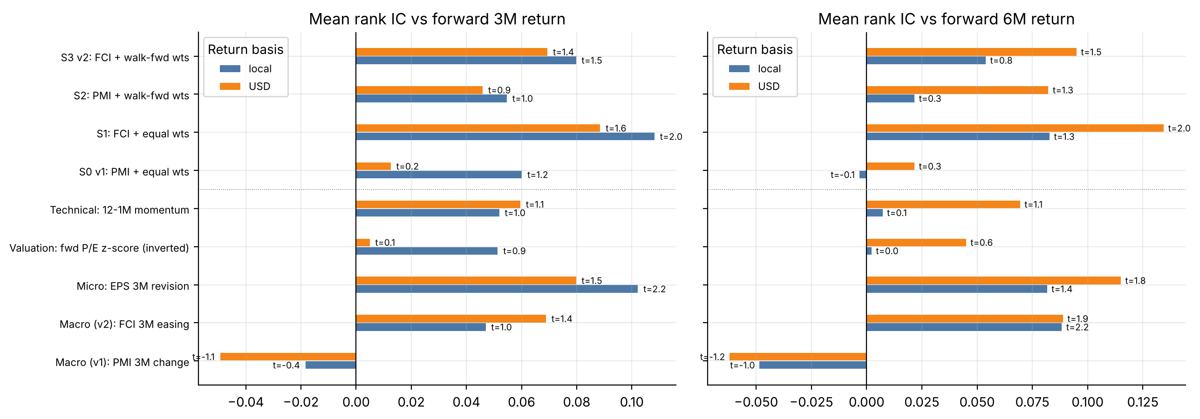
Signal selection & predictive power
Mean rank IC (Newey-West t-stat) vs forward 3M / 6M returns across the five markets
Signal | 3M · Local | 3M · USD | 6M · Local | 6M · USD | Verdict
Macro v1 — PMI | -0.018 (t -0.4) | -0.049 (t -1.1) | -0.049 (t -1.0) | -0.062 (t -1.2) | Wrong sign
Macro v2 — FCI | +0.047 (t +1.0) | +0.069 (t +1.4) | +0.088 (t +2.2) | +0.089 (t +1.9) | Positive, all 4 cases
Micro — EPS rev. | +0.102 (t +2.2) | +0.080 (t +1.5) | +0.082 (t +1.4) | +0.115 (t +1.8) | Supported
Valuation | +0.051 (t +0.9) | +0.005 (t +0.1) | +0.002 (t +0.0) | +0.045 (t +0.6) | Weak / unstable
Technical | +0.052 (t +1.0) | +0.060 (t +1.1) | +0.007 (t +0.1) | +0.069 (t +1.1) | Weak
Composite v1 (S0) | +0.060 (t +1.2) | +0.013 (t +0.2) | -0.003 (t -0.1) | +0.022 (t +0.3) | Not significant
Composite v2 (S3) | +0.080 (t +1.5) | +0.069 (t +1.4) | +0.054 (t +0.8) | +0.095 (t +1.5) | Improved; marginal
▪ FCI beats PMI: IC flips from negative to positive in all four cases (perm p 0.04–0.15).
▪ Composite IC rises from +0.013 to +0.069 (USD, 3M; perm p = 0.083) — better, still marginal.
▪ Chosen after v1 failed, so significance is exploratory. 4 specifications examined; p-values not adjusted.
Developed Markets Scorecard v2 (exploratory — designed after viewing v1; no untouched OOS) · data as of Apr 2026 · gross of costs · price proxy = fwd P/E × fwd EPS
2

Slide 3
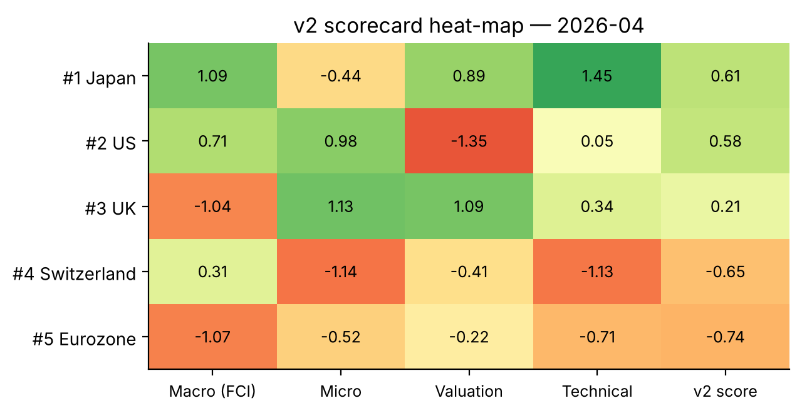
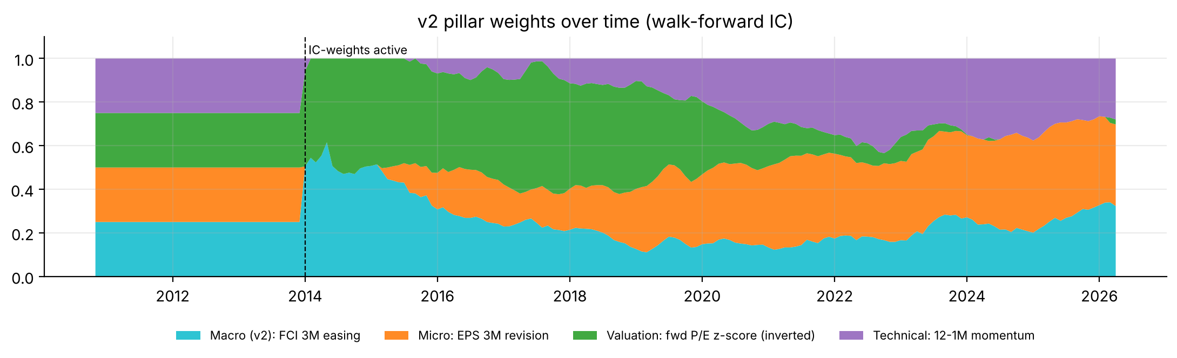
Scorecard construction
Pillar scores → walk-forward weighted country score → ranking
▪ Pillar score: each signal z-scored across the 5 markets every month.
▪ Weights: start equal; from Jan-2014 follow trailing IC (past data only). Today: FCI 32% · EPS 37% · Valuation 2% · Momentum 28%.
▪ Stance: rank 1–2 Overweight · 3 Neutral · 4–5 Underweight.
Reading the heat-map
Japan leads on easing financial conditions, momentum and valuation despite below-peer EPS revisions. US ranks #2 on EPS revisions and easing conditions; its rich P/E barely counts (valuation weight 2%). UK drops to Neutral: tightening financial conditions offset strong revisions. Switzerland and Eurozone lag on revisions and momentum.
Why walk-forward?
No hindsight in the weights: each month uses only ICs already realised (verified by a truncation test). It did not improve results — see next slide.
Developed Markets Scorecard v2 (exploratory — designed after viewing v1; no untouched OOS) · data as of Apr 2026 · gross of costs · price proxy = fwd P/E × fwd EPS
3

Slide 4
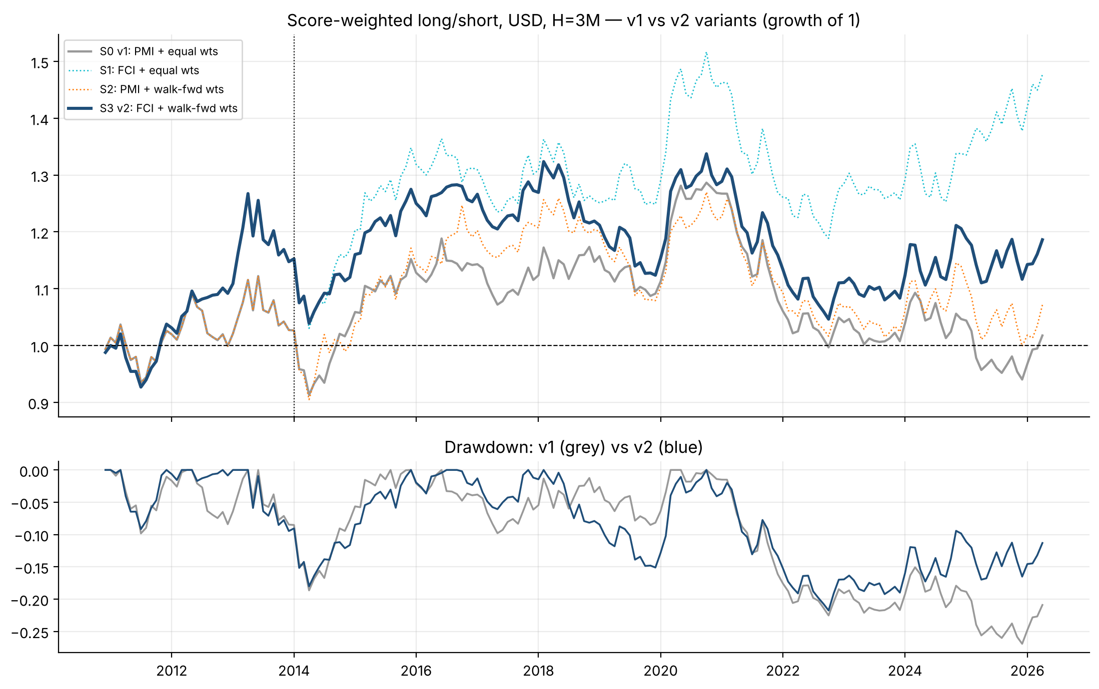
Backtest results — v1 vs v2
Score-weighted long/short, 3M tranches · 2010-12 → 2026-04 · gross of costs · USD unless stated
Specification | Sharpe | Ann. ret | Max DD | Perm p
S0 · v1 (PMI, equal) | 0.05 | +0.1% | -26.9% | 0.43
S1 · FCI, equal wts | 0.35 | +2.6% | -21.6% | 0.08
S2 · PMI, IC wts | 0.10 | +0.4% | -21.4% | 0.35
S3 · v2 HEADLINE | 0.18 | +1.1% | -21.8% | 0.24
Perm p = chance of a Sharpe this high under shuffled country labels (3M blocks, 3,000 draws)
▪ v2 beats v1 (Sharpe 0.05 → 0.18, max DD −27% → −22%, active IR −0.19 → +0.21) but p = 0.24: not distinguishable from luck.
▪ The macro swap did the work: S1 (FCI, equal weights) is best, Sharpe 0.35 (p = 0.08). IC weighting added noise. S1 was picked after the fact among 4 specs — shown, not promoted.
▪ Fragile: Sharpe +0.41 in 1st half, −0.05 in 2nd; ex-US −0.03, ex-Japan +0.63.
Dollar-neutral (longs +100% / shorts −100%, weight ∝ score). Dotted vertical line = IC weights switch on (Jan-2014). Costs not deducted (break-even ≈ 16 bps per unit of turnover, USD H=3M). Re-computation and look-ahead tests passed, including the walk-forward weights.
Developed Markets Scorecard v2 (exploratory — designed after viewing v1; no untouched OOS) · data as of Apr 2026 · gross of costs · price proxy = fwd P/E × fwd EPS
4

Slide 5
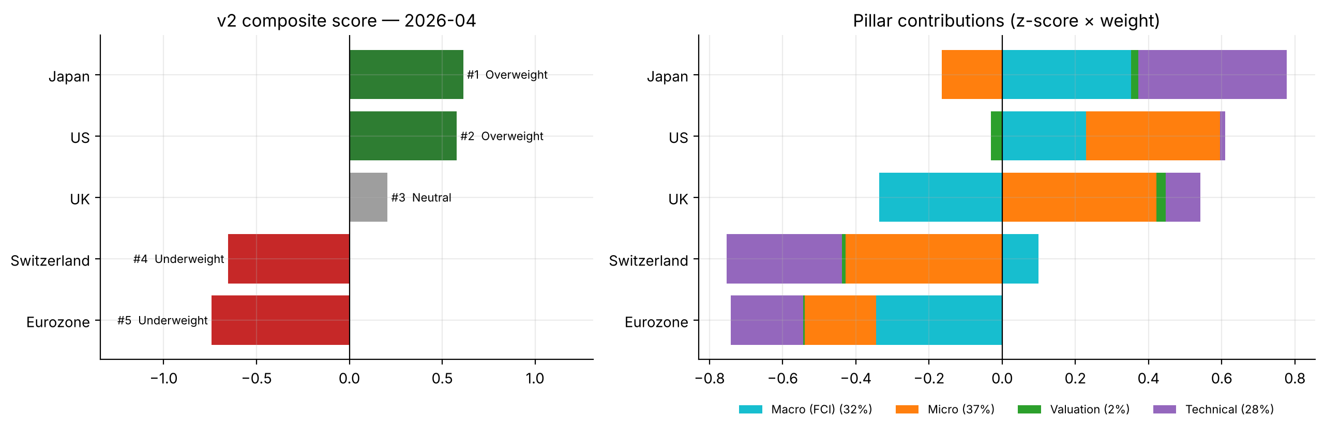
Current ranking & recommendation
v2 scorecard as of Apr 2026 (latest month available for all five markets)
# | Market | v2 score | v2 stance | v1 rank
1 | Japan | +0.61 | Overweight | 2
2 | US | +0.58 | Overweight | 3
3 | UK | +0.21 | Neutral | 1
4 | Switzerland | -0.65 | Underweight | 4
5 | Eurozone | -0.74 | Underweight | 5
Recommendation — direction robust, conviction low
Caveats the committee should know
Underweight Eurozone and Switzerland — bottom two in all four specifications (the most robust call). Overweight Japan (top two in 3 of 4 specs; driven by easing conditions and momentum, with EPS revisions below peers). US Overweight in v2, Neutral in v1; UK flips between #1 and #3 — keep both near benchmark.
v2 is exploratory: designed after seeing v1, no untouched out-of-sample data, 4 specifications examined. Headline Sharpe 0.18 (p = 0.24) is not statistically reliable; only the ranking direction is stable. Price is a proxy (P/E × EPS, no dividends); 5 markets; US data ends Apr-2026.
Developed Markets Scorecard v2 (exploratory — designed after viewing v1; no untouched OOS) · data as of Apr 2026 · gross of costs · price proxy = fwd P/E × fwd EPS
5

