Slide 1
1. Methodology
One signal per pillar, z-scored across five markets, combined with equal weights
Objective
Rank US, Eurozone, UK, Switzerland and Japan by expected relative USD equity performance over the next 3–6 months.
Data
Supplied Bloomberg workbooks, monthly, Dec-2005 to Apr-2026. Index level = forward P/E × forward EPS (an identity; US matches published S&P 500 returns).
Process
① Build one indicator per pillar ② z-score across the 5 markets each month ③ aggregate = equal-weight average (25% each) ④ rank 1–5 ⑤ test each pillar's predictive power ⑥ backtest the ranking.
Testing
Monthly rank IC vs next 3M and 6M relative USD returns. Discovery to Dec-2016; validation from Jul-2017 after a 6-month embargo. Bootstrap CIs, HAC t, block-permutation p.
Backtest
Long-only top-2 vs equal-weight benchmark; long-short top-2 / bottom-2. Monthly signal, 6-month overlapping tranches, costs 0–20 bps one-way.
Pillar | Indicator | Investment rationale | Attractive when
Macro | FCI 6M easing | Easier financing conditions support earnings and risk appetite with a lag | FCI eased most over 6M
Micro | EPS revisions 6M | Analyst revisions persist (anchoring); prices under-react to upgrades | Forward EPS upgraded most over 6M
Valuation | P/E relative to peers | Relative cheapness vs own history should mean-revert | P/E vs peers cheapest vs own history
Technical | Low realised volatility 12M | Low-volatility anomaly; calm markets carry lower risk-premium shocks | Lowest 12M realised vol
Key limitations
• Data end 30-Apr-2026: rankings are as of that date, not current. The proprietary inputs (BEst, GS/Bloomberg FCI) have no comparable free source to update them.
• Price return only (no dividends). Switzerland uses the euro-area FCI and credit series.
• The indicators were chosen during extensive research; no result survives a full multiple-testing adjustment.
Source: Markets_Scorecard_v14_FINAL.ipynb; supplied Bloomberg workbooks; latest common data date 30-Apr-2026. USD price returns (no dividends).

Slide 2
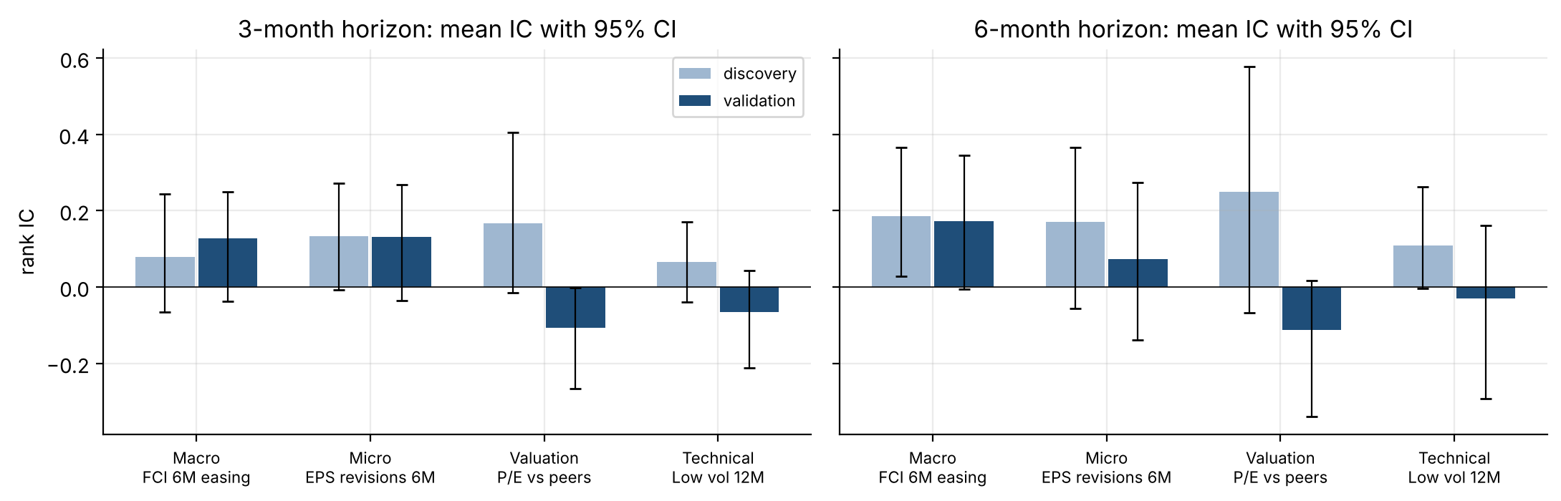
2. Signal selection and predictive power
Macro and Micro stay positive out of sample; Valuation and Technical reverse
Pillar | Val IC 3M [95% CI] | Val IC 6M [95% CI] | Perm p 3M / 6M | Status
Macro | +0.127 [-0.04, +0.25] | +0.173 [-0.01, +0.34] | 0.015 / 0.018 | PROVISIONAL
Micro | +0.131 [-0.03, +0.27] | +0.074 [-0.14, +0.27] | 0.019 / 0.195 | PROVISIONAL
Valuation | -0.108 [-0.27, -0.00] | -0.112 [-0.34, +0.02] | 0.951 / 0.878 | REJECTED
Technical | -0.066 [-0.21, +0.04] | -0.029 [-0.29, +0.16] | 0.850 / 0.626 | REJECTED
Reading the evidence
• Macro (FCI): positive in both windows (6M: +0.19 discovery, +0.17 validation). Strongest pillar.
• Micro (EPS): positive at 3M (+0.13), weak at 6M (+0.07). Partly a persistent US/Japan tilt.
• Valuation: +0.17 → -0.11 at 3M. Mostly the US: expensive throughout, yet the best performer.
• Technical: +0.07 → -0.07 at 3M. No stable mechanism at country level.
Caveat: no pillar has a validation CI entirely above zero (Valuation 3M lies almost entirely below it), and the signals were selected from many tested alternatives. No pillar is statistically significant after multiple testing.
How to read
IC = monthly Spearman correlation between pillar scores and the next 3M / 6M USD return relative to the 5-market average, averaged over months (+1 = perfect ranking). Error bars: 95% moving-block bootstrap. Perm p: one-sided, country labels shuffled in horizon-length blocks.
Classification rule (fixed in advance): PROVISIONAL = validation IC > 0 at both horizons and p < 0.05 at one or more; REJECTED = validation IC ≤ 0 at either horizon. RETAIN would also require CIs excluding zero — no pillar meets it.
Source: Markets_Scorecard_v14_FINAL.ipynb; supplied Bloomberg workbooks; latest common data date 30-Apr-2026. USD price returns (no dividends). Discovery: signal months to Dec-2016; validation: Jul-2017 onward.

Slide 3
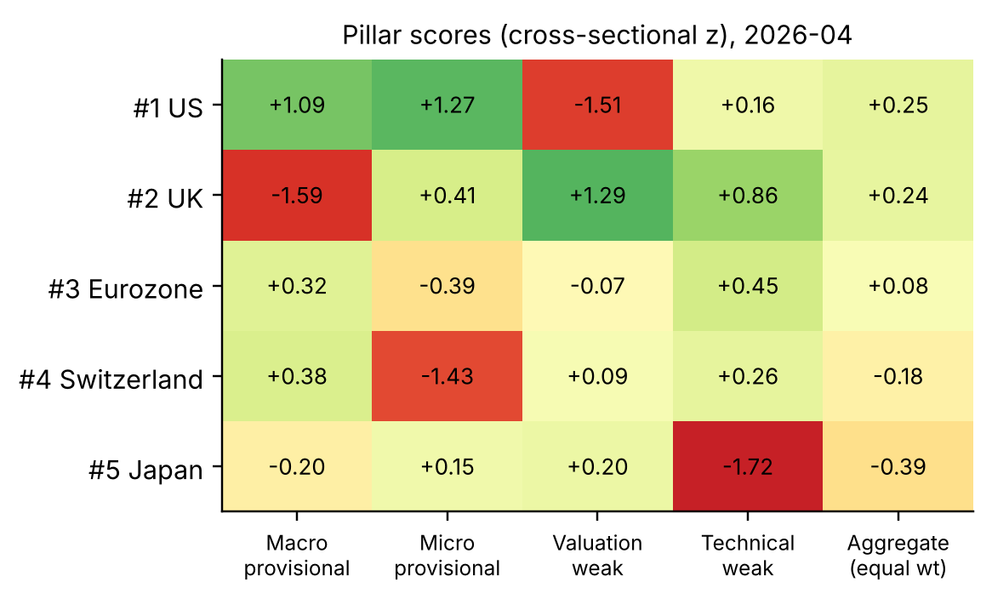
3. Scorecard construction
Equal-weight aggregate of four pillar z-scores; weak pillars are kept but flagged
Pillar score
z = (indicator − 5-market mean) ÷ 5-market sd, each month. Higher = more attractive for every pillar.
Aggregate country score
Aggregate = ¼ Macro + ¼ Micro + ¼ Valuation + ¼ Technical. Contribution of a pillar = ¼ × its z.
Equal weights because the brief requires four pillars and no pillar has validated evidence. Weights fitted to past ICs would be in-sample optimisation.
Ranking
Rank 1–5 by aggregate. Calls: ranks 1–2 overweight, 3 neutral, 4–5 underweight.
Companion model (shown separately)
FCI-only ranking (Macro z alone): the one pillar with consistent out-of-sample evidence. It does not replace the scorecard.
Predictive power of the aggregate
IC 3M: discovery +0.22, validation -0.04. IC 6M: discovery +0.31, validation -0.03. The two weak pillars that helped in discovery reversed after 2017 and dilute Macro and Micro.
Scores as of 30-Apr-2026. Columns flagged "weak" are rejected predictors (Slide 2). They are retained because the brief specifies a four-pillar scorecard.
Full monthly history (all pillar scores, aggregate, rank, call and the realised next 3M / 6M return) is in scorecard_history.csv.
Source: Markets_Scorecard_v14_FINAL.ipynb; supplied Bloomberg workbooks; latest common data date 30-Apr-2026. USD price returns (no dividends).

Slide 4
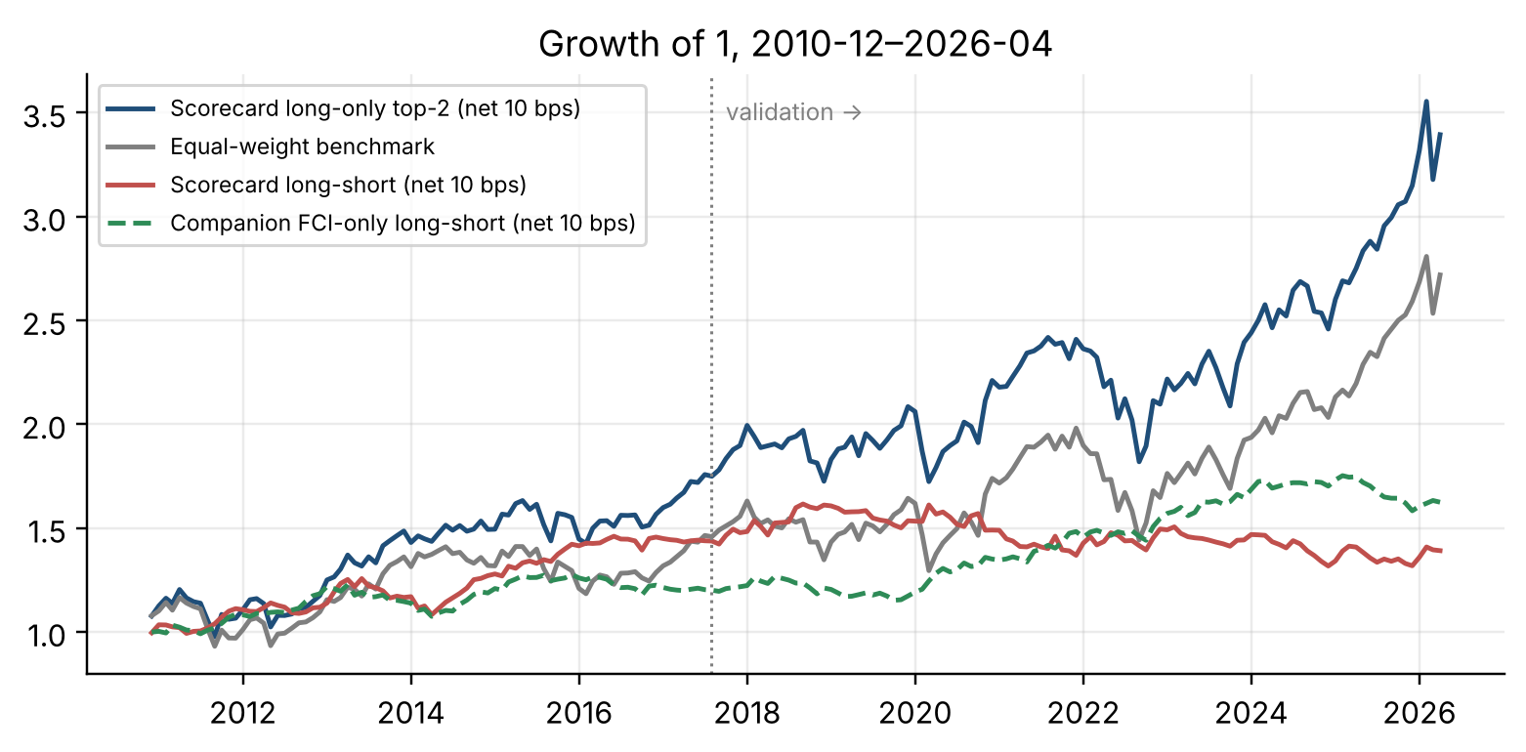
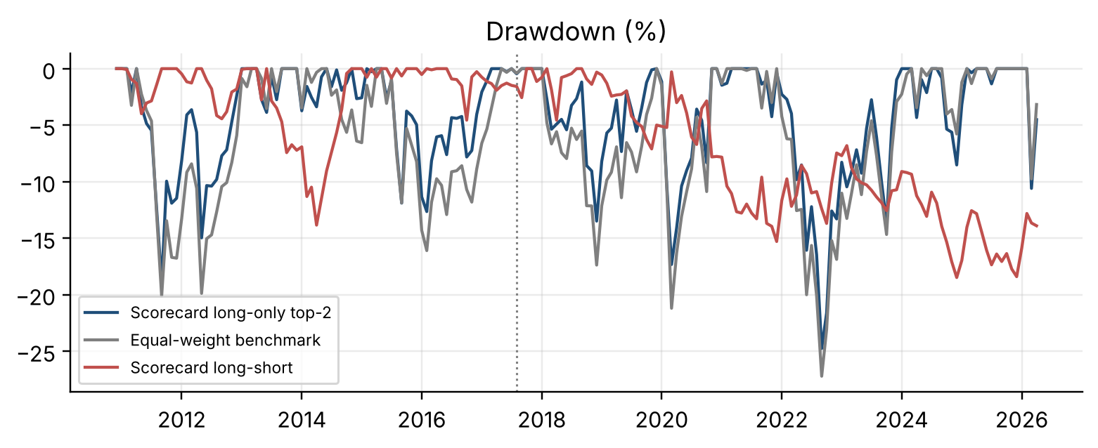
4. Backtest results
Long-only modestly beats the benchmark; the long-short edge disappears after 2017
Full period, net 10 bps | Scorecard long-only | EW benchmark | Scorecard long-short | FCI-only long-short
Return % p.a. | 8.2 | 6.7 | 2.2 | 3.2
Volatility % p.a. | 13.5 | 14.0 | 6.7 | 5.4
Sharpe ratio | 0.66 | 0.53 | 0.35 | 0.62
Max drawdown % | -24.8 | -27.2 | -18.5 | -12.4
Turnover p.a. (x) | 1.7 | – | 3.6 | 4.8
Validation Sharpe | 0.60 | 0.55 | -0.02 | 0.68
Info ratio vs EW (LO) | 0.37 | – | – | –
Costs: long-short Sharpe (full) 0.41 / 0.38 / 0.35 / 0.30 at 0 / 5 / 10 / 20 bps. Costs are not the problem.
Why the composite fails after 2017: run alone with the same rules, validation long-short Sharpe is Macro +0.68, Micro +0.35, Valuation -0.34, Technical -0.25. The two rejected pillars cancel the two that work.
Not optimised: rules were fixed in advance. Equal-weight benchmark carried cost-free. Long-short Sharpe uses rf = 0 (self-financing).
Source: Markets_Scorecard_v14_FINAL.ipynb; supplied Bloomberg workbooks; latest common data date 30-Apr-2026. USD price returns (no dividends). Backtest returns Dec-2010 to Apr-2026; validation Aug-2017 onward.

Slide 5
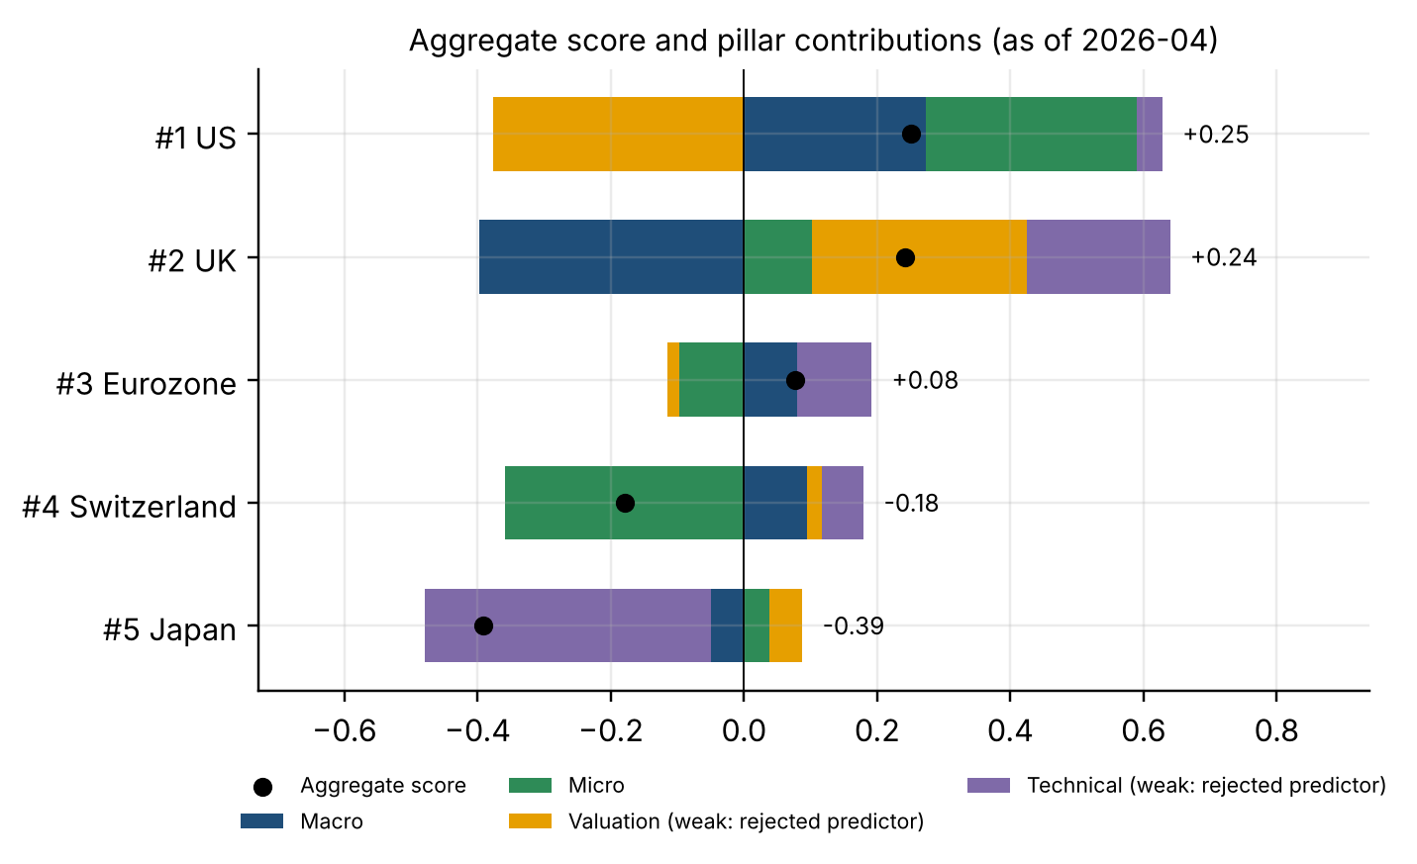
5. Current ranking and investment recommendation
As of 30-Apr-2026: overweight US and UK, underweight Switzerland and Japan — low conviction
Rank | Market | Aggregate | Call | FCI-only rank
1 | US | +0.25 | OVERWEIGHT | 1
2 | UK | +0.24 | OVERWEIGHT | 5
3 | Eurozone | +0.08 | NEUTRAL | 3
4 | Switzerland | -0.18 | UNDERWEIGHT | 2
5 | Japan | -0.39 | UNDERWEIGHT | 4
Recommendation (scorecard)
• OVERWEIGHT US: strongest FCI easing (+1.1) and EPS upgrades (16.5% over 6M), despite the richest P/E (20.7x).
• OVERWEIGHT UK: cheapest vs peers (+1.3) and low volatility (+0.9), but tightest FCI (-1.6). Its case rests on the two weak pillars.
• NEUTRAL Eurozone. UNDERWEIGHT Switzerland (weakest EPS revisions, +1.4%) and Japan (highest 12M volatility, 18.8%).
Conviction: LOW
• US and UK are near-tied (+0.25 vs +0.24), and the US rose from #4 in March. The companion FCI-only model, the only pillar that held up after 2017, ranks the UK last and Switzerland #2.
• Data are as of 30-Apr-2026. Refreshed Bloomberg exports (same tickers) regenerate this ranking automatically.
Source: Markets_Scorecard_v14_FINAL.ipynb; supplied Bloomberg workbooks; latest common data date 30-Apr-2026. USD price returns (no dividends).

