Slide 1
01 | METHODOLOGY
Four economic pillars, two of which carry predictive weight
Objective
Rank five developed equity markets by expected performance relative to one another over three to six months, and convert that ranking into an allocation view.
Markets
United States · Eurozone · United Kingdom · Switzerland · Japan
Data and period
Monthly panel, December 2005 to April 2026. Research window split into discovery to December 2016 and an examined window from July 2017, separated by a six-month embargo.
Measurement
Rank information coefficient against forward relative returns at three and six months, with HAC inference and block-bootstrap intervals to handle overlapping returns.
RESEARCH AND PORTFOLIO PROCESS
Signal
construction
Predictive
testing
Scorecard
Portfolio
One indicator per pillar,
standardised across markets
Discovery and examined
windows, leave-one-out
Equal-weight pillar scores,
ranked 1 to 5
Six-month tranches,
costs and turnover
Pillar | Indicator | Economic rationale | Status
Macro | Financial conditions impulse, 6 months | Easier financing lowers the discount rate and lifts risk appetite, with a lag | PREDICTIVE (provisional)
Micro | Earnings revision persistence, 12 months | Analysts revise gradually, so a sustained upgrade run tends to continue | PREDICTIVE (provisional)
Valuation | Earnings yield spread versus own history | Compensation for holding equities over the local risk-free rate | DIAGNOSTIC
Technical | Signed trend quality, 12 months | A smooth trend suggests information is being absorbed gradually | DIAGNOSTIC
Data constraints that shape the design
The dataset contains no index prices. The supplied price workbook holds valuation ratios, so the index is reconstructed as forward P/E multiplied by forward EPS. Returns are price returns, not total returns.
Because that reconstruction is an identity, any technical signal is a function of the valuation and earnings inputs. The Technical pillar is reported as a diagnostic and no claim of independence is made.
Monthly panel December 2005 to April 2026, five developed equity markets. Scores lagged one month before use. Returns are USD price returns relative to the five-market average; no dividend data available.

Slide 2
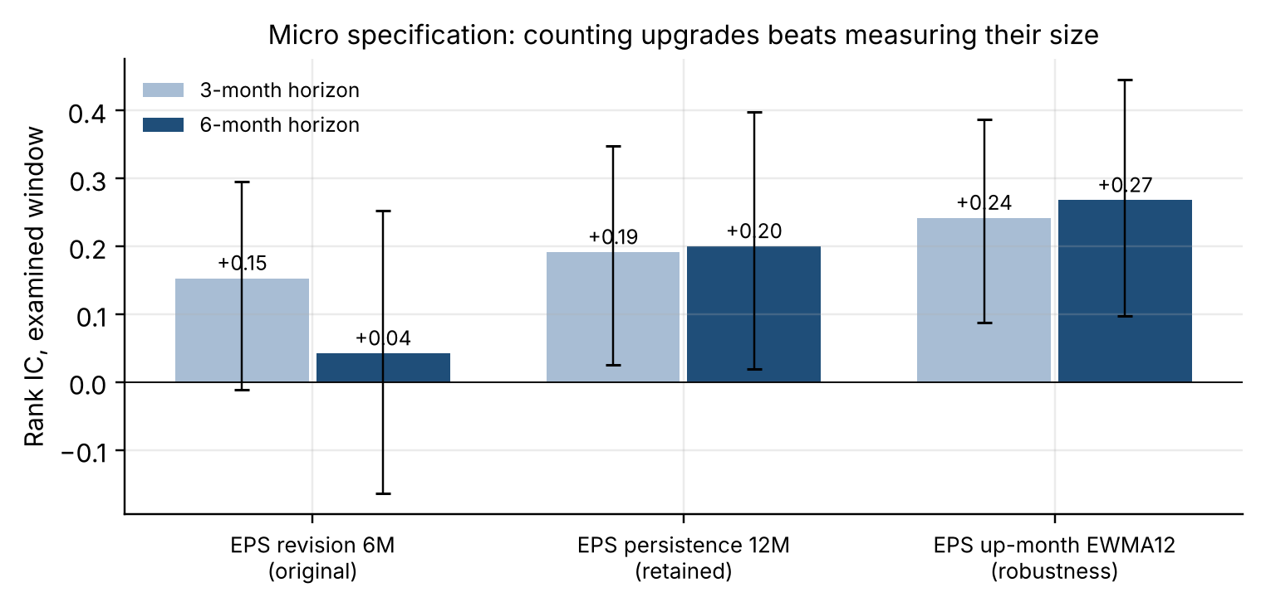
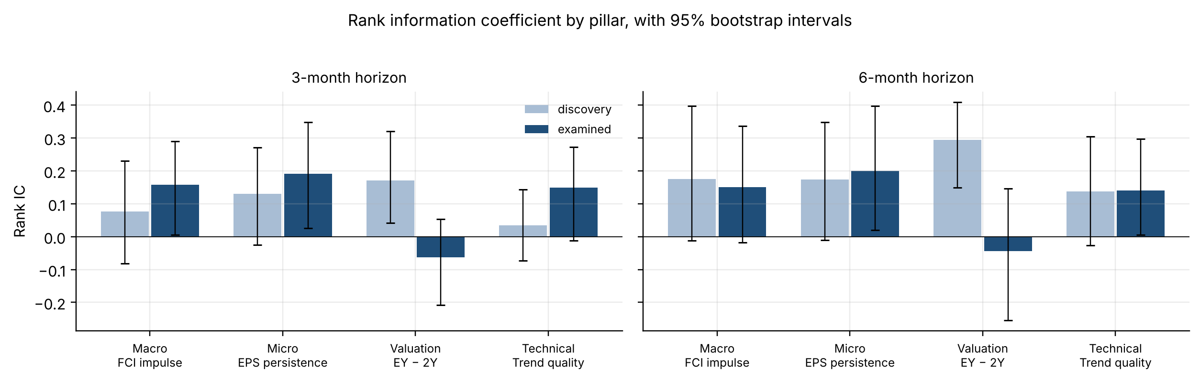
02 | SIGNAL SELECTION AND PREDICTIVE POWER
Counting earnings upgrades beats measuring their size
Pillar | Indicator | IC 3M disc → exam | IC 6M disc → exam | Status
Macro | Financial conditions impulse, 6 months | +0.076 → +0.158 | +0.175 → +0.150 | PREDICTIVE (provisional)
Micro | Earnings revision persistence, 12 months | +0.129 → +0.191 | +0.174 → +0.200 | PREDICTIVE (provisional)
Valuation | Earnings yield spread versus own history | +0.171 → -0.063 | +0.295 → -0.044 | DIAGNOSTIC
Technical | Signed trend quality, 12 months | +0.035 → +0.149 | +0.137 → +0.140 | DIAGNOSTIC
The change that mattered
My original Micro indicator was the six-month change in forward earnings. A single large revision can reflect a currency move or an index change rather than a genuine shift in expectations, so I replaced it with the share of the last twelve months in which earnings were revised up. On 97 matched months the six-month examined IC rises from +0.042 to +0.200.
An exponentially weighted version scores higher still at +0.268, but it adds a decay parameter the data cannot pin down. I kept the simpler measure and report the weighted one as a robustness check.
Why Valuation and Technical stay diagnostic
Valuation is strong in discovery and negative out of sample. The failure is concentrated in one market: excluding the US, the examined IC is +0.082. It still ranks future multiple expansion, but the earnings leg offsets it in total return.
Technical keeps 68% of its six-month IC once Micro and Valuation are removed, but excluding the US leaves -0.003. Built on reconstructed prices, it cannot be independent of Micro and Valuation.
No pillar is statistically significant once the length of the research process is taken into account, and the examined window is not untouched holdout data.
Monthly panel December 2005 to April 2026, five developed equity markets. Scores lagged one month before use. Returns are USD price returns relative to the five-market average; no dividend data available. Error bars are 95% moving-block bootstrap intervals.

Slide 3
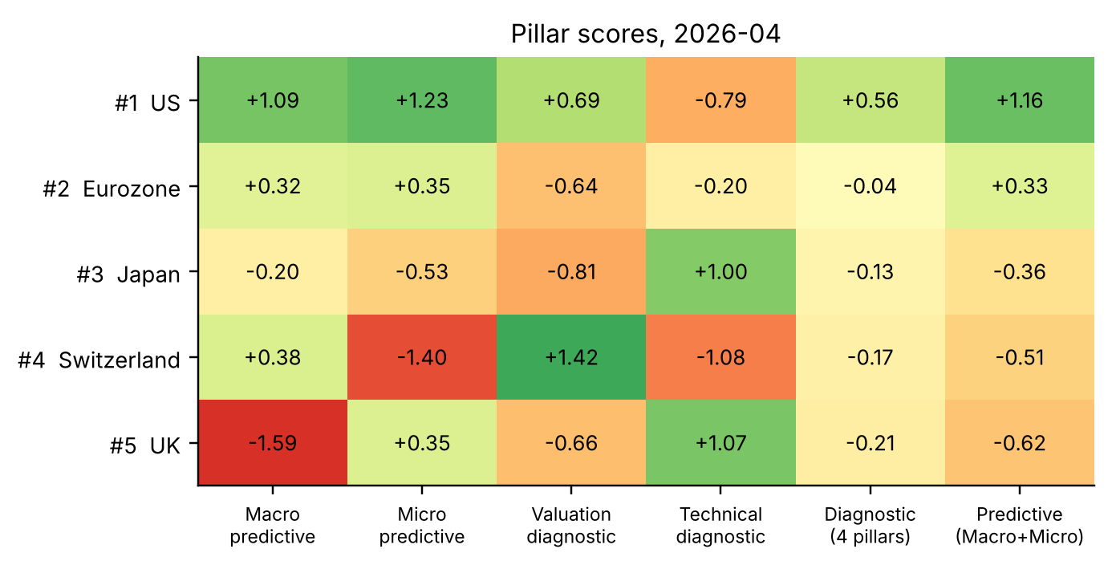
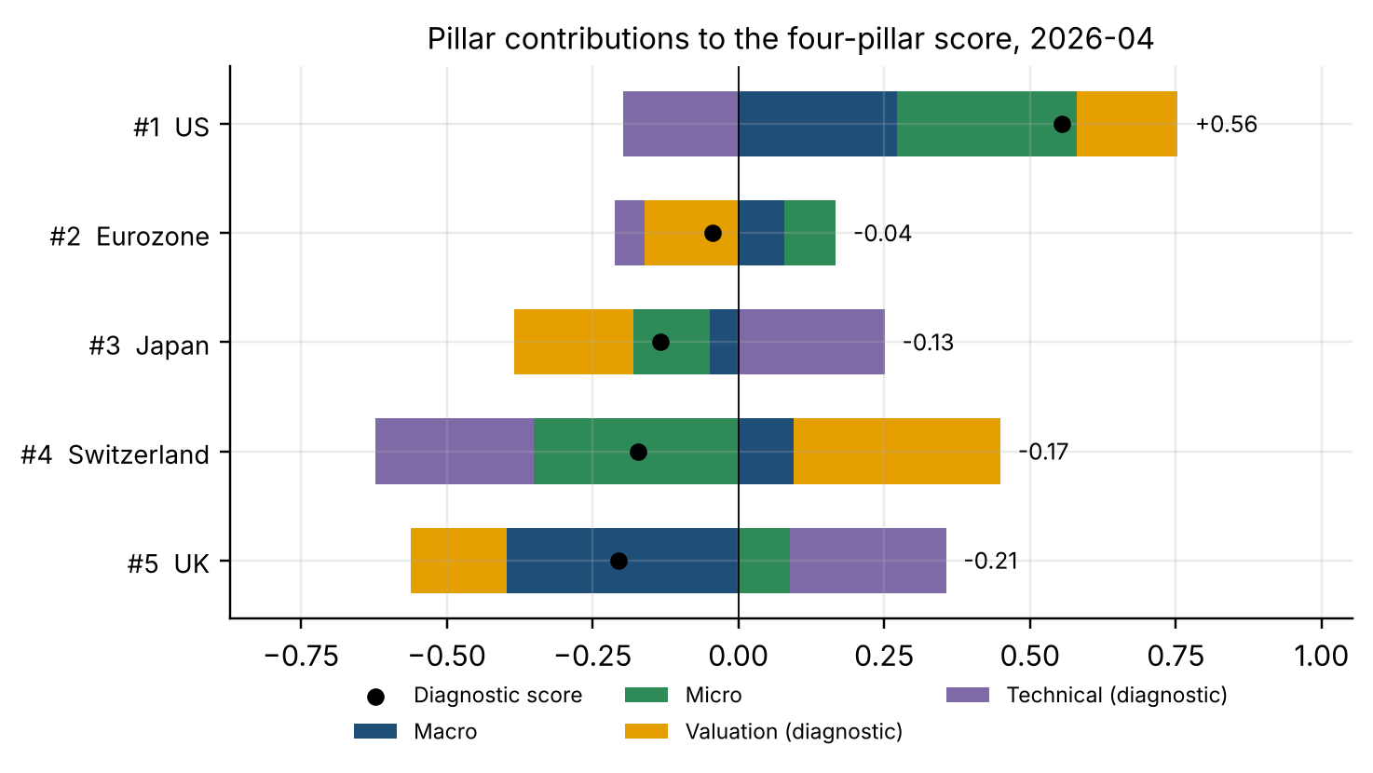
03 | SCORECARD CONSTRUCTION
Four pillars are reported; two carry weight in the allocation view
Construction
Each indicator is standardised across the five markets every month, so a score always states relative standing. The four-pillar score is the equal-weight average of all four; each pillar contributes one quarter of its z-score.
The predictive score averages only the two pillars that carry evidence. Valuation and Technical keep their scores and contributions on the scorecard but receive no predictive weight — they are neither removed nor given artificial importance.
Weights are equal and fixed. With four correlated pillars and roughly seventeen independent six-month periods out of sample, fitting weights would be optimisation on the data used to judge the result.
Score | IC 3M disc → exam | IC 6M disc → exam
Four-pillar diagnostic | +0.204 → +0.095 | +0.333 → +0.113
Predictive (Macro + Micro) | +0.163 → +0.195 | +0.278 → +0.219
Why the two views can differ
The four-pillar score is stronger in discovery and weaker out of sample. That is exactly what carrying two pillars that fail out of sample should do, and it is the reason both views are shown rather than one.
This month the two views agree on all five classifications. When they diverge, the predictive view carries the out-of-sample evidence and the four-pillar view is the complete framework.
Monthly panel December 2005 to April 2026, five developed equity markets. Scores lagged one month before use. Returns are USD price returns relative to the five-market average; no dividend data available.

Slide 4
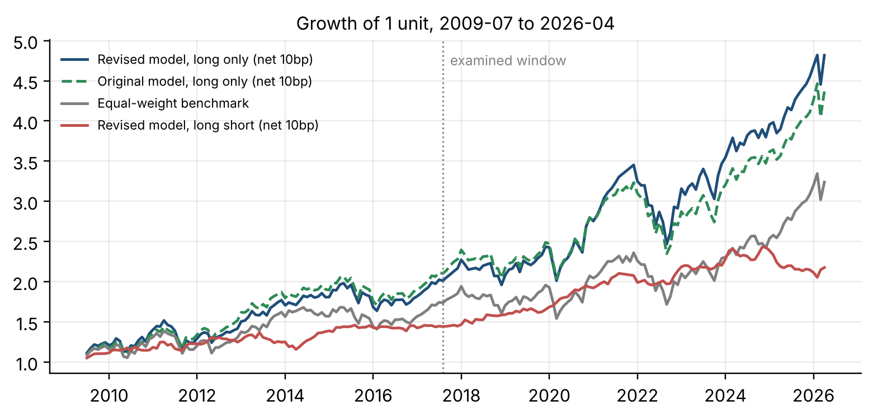
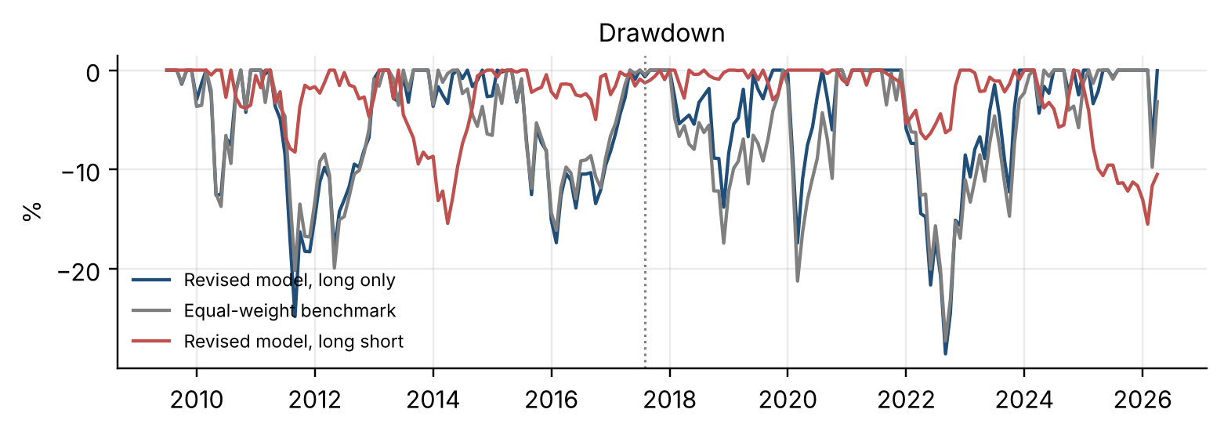
04 | BACKTEST RESULTS
The revised signal lifts Sharpe and information ratio, and trades less
Net of 10bp, full period | Revised long only | Original long only | Equal weight | Revised long short
Return % p.a. | 9.9 | 9.2 | 7.2 | 4.8
Volatility % p.a. | 14.4 | 13.9 | 14.3 | 7.0
Sharpe ratio | 0.73 | 0.70 | 0.56 | 0.71
Maximum drawdown % | -28.5 | -27.4 | -27.2 | -15.5
Turnover per year | 1.8x | 2.1x | — | 3.7x
Information ratio vs benchmark | 0.59 | 0.51 | — | —
Examined-window Sharpe | 0.76 | 0.65 | 0.55 | 0.79
Model | IC 6M examined | Long-short Sharpe, exam. | Turnover
Original: FCI + revision 6M | +0.079 | 0.46 | 4.3x
Macro only | +0.141 | 0.74 | 4.9x
Micro only | +0.200 | 0.69 | 2.7x
Revised: FCI + persistence | +0.219 | 0.79 | 3.7x
Ridge, four pillars | +0.097 | 0.26 | 3.0x
Transaction costs are not the constraint. In the long-only book the revised signal's volatility and drawdown are slightly higher than the original's. The revised long-short book returns a Sharpe ratio of 0.76 gross and 0.66 at 20 basis points. Rules were fixed before testing: six-month overlapping tranches, positions drifting with prices, turnover charged on both legs, benchmark carried cost-free.
Monthly panel December 2005 to April 2026, five developed equity markets. Scores lagged one month before use. Returns are USD price returns relative to the five-market average; no dividend data available. Backtest returns 2009-07 to 2026-04; examined window from August 2017.

Slide 5
05 | INVESTMENT VIEW
As of 30 April 2026
Overweight the US and Eurozone; underweight Switzerland and the UK
Rank | Market | Predictive score | Macro contrib. | Micro contrib. | Diagnostic contrib. | Classification | Principal reason
1 | US | +1.16 | +0.27 | +0.31 | -0.02 | OVERWEIGHT | Forward earnings marked up in all twelve months, the only market to do so
2 | Eurozone | +0.33 | +0.08 | +0.09 | -0.21 | OVERWEIGHT | Eleven upgrade months and a positive financing-conditions impulse
3 | Japan | -0.36 | -0.05 | -0.13 | +0.05 | NEUTRAL | Below average on both pillars, but not by enough to underweight
4 | Switzerland | -0.51 | +0.09 | -0.35 | +0.08 | UNDERWEIGHT | Weakest earnings persistence in the panel
5 | UK | -0.62 | -0.40 | +0.09 | +0.10 | UNDERWEIGHT | Much the weakest financing conditions, which dominate its score
Recommendation
Overweight the United States. It leads on both pillars that carry evidence, with the only perfect earnings-persistence reading in the panel and the strongest financing-conditions impulse. Its predictive score of +1.16 is well clear of the field.
Overweight the Eurozone, underweight Switzerland and the United Kingdom. The Eurozone ties for second on earnings persistence and has a positive financing-conditions impulse. Switzerland has the weakest earnings persistence in the panel and the United Kingdom much the weakest financing conditions. Japan is neutral.
Conviction and risk
Highest on the US, low on the ordering of the rest. The US has held first place in 6 of the last eight months. Japan, Switzerland and the UK are tightly bunched, so the order among them carries little information; the UK underweight is best supported, Switzerland's rests on a narrow margin over Japan. Rankings also move: in the final month the UK went from rank 1 to rank 5 and the Eurozone from rank 3 to rank 2.
The view rests on two pillars, neither statistically significant once the research process is accounted for, measured on a dataset ending 30 April 2026. The four-pillar and predictive views agree on all five classifications this month.
Monthly panel December 2005 to April 2026, five developed equity markets. Scores lagged one month before use. Returns are USD price returns relative to the five-market average; no dividend data available. This is the latest ranking the supplied dataset supports, not a reading of current market conditions.

