Slide 1
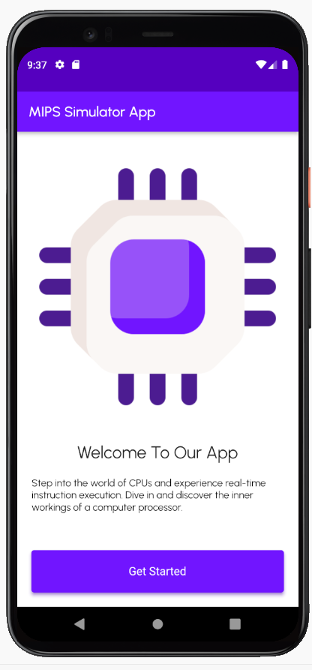
Mips simulator
Mobile application is done by : Sadan Nsour, Juman Hayajneh, and Roa’a Ziad

Slide 2
What we will discuss:
Why you need mips simulator .
Aim of our application.
Target group.
Advantages.
Features and functionality.
Development environment.
Future enhancements

Slide 3
Why you need mips simulator app ???
The project entails building a CPU simulator based on a small subset of the MIPS instruction set. instead of digital design.

Slide 4
Aim of our application
The Computer Architecture course is one of the most difficult courses in our department, this app can help students understand the five stages of a processor (fetch, decode, execute, memory, and writeback) easily by seeing what changes occur in registers in each stage.

Slide 5
Target group of our application
Both professors and students who studies computer architecture courses by providing a practical understanding of processor architecture and implementation.

Slide 6
Advantages:
Our application offers advanced features such as:
Educational advantages: help both professors and students by providing a practical understanding of processor architecture and implementation.
• Modularity: dividing the processor into separate modules for each stage, making it easier to understand and manage.

Slide 7
Advantages:
• Visualization: the graphical updates enhance comprehension by providing a visual representation of changes in registers and memory during code execution
• Step-by-step Execution: the option for step-by-step code execution facilitates a detailed examination of each stage, aiding in debugging and comprehension.

Slide 8
Feature and functionality
Our application provides a simple UI to deal easily with it.

Slide 9
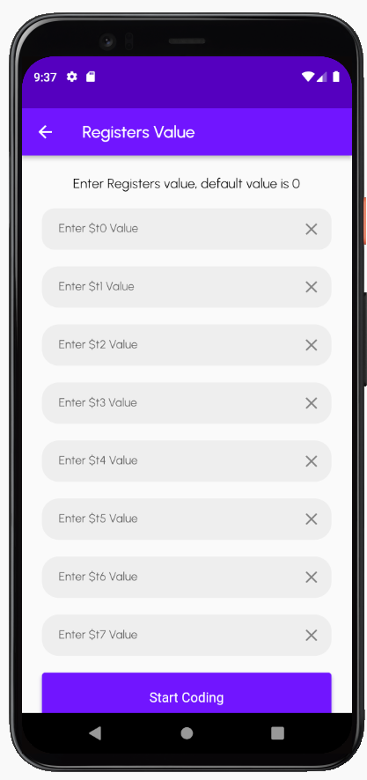
Feature and functionality
User’s Features:
Once you click on “get started “it immediately opens a screen where the user can enter the values of the registers. *it’s not necessary to fill all the registers.

Slide 10
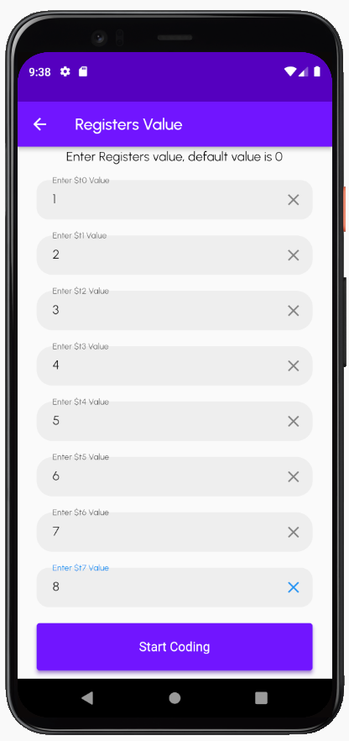
Feature and functionality
User’s Features:
The values should be entered as decimal values only .

Slide 11
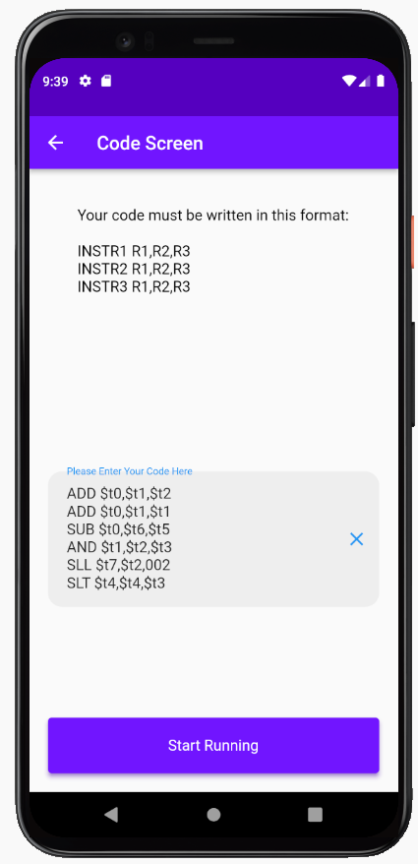
Feature and functionality
User’s Features:
Once the user entered the register values successfully the next screen will be entering the code.

Slide 12
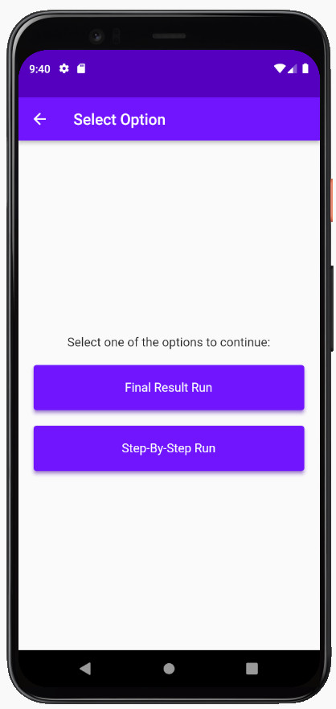
Feature and functionality
User Features:
The user has two options to run the code :
1- Final Result run
2- Step-By-Step run

Slide 13
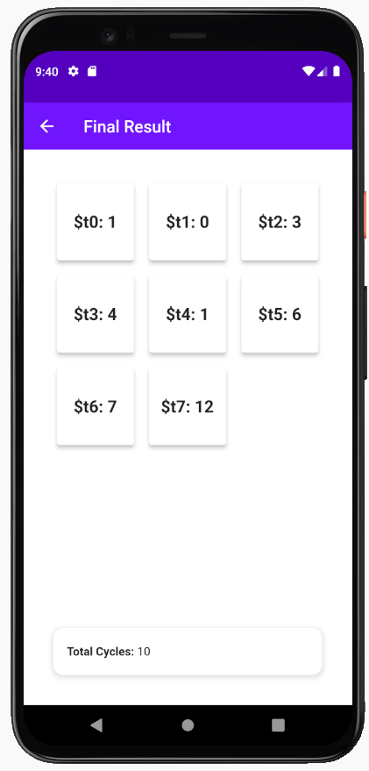
Feature and functionality
Final result run :
This feature shows the final values of registers after the 5 stages of processing , and the total number of cycles needed to run the code .

Slide 14
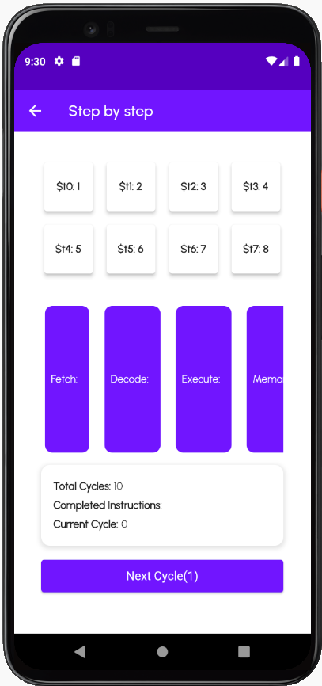
Feature and functionality
Step-by-step run :
This feature shows the changes in register values that occur in each stage.

Slide 15
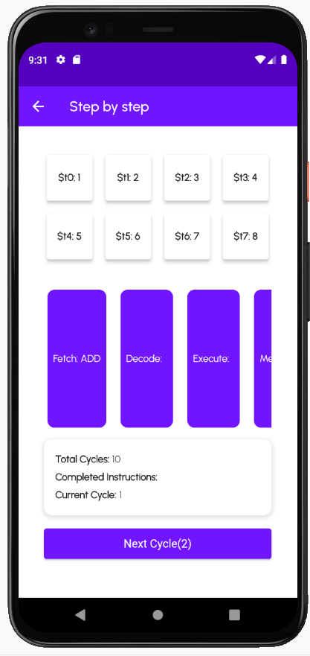
Feature and functionality
Step-by-step run :
you can see on the screen that we have 3 values :
Total cycles: represent the number of cycles needed to run all the code
Completed instructions: represent what instructions had done until the step user reached it.
Current cycle: counter count the number of cycles until this step.

Slide 16
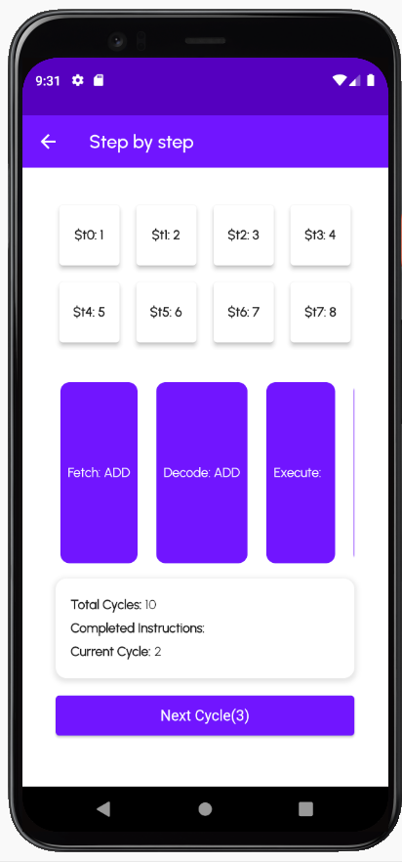
Feature and functionality
Step-by-step run :
you can see on the screen that we have 3 values :
Total cycles: represent the number of cycles needed to run all the code
Completed instructions: represent what instructions had done until the step user reached it.
Current cycle: counter count the number of cycles until this step.

Slide 17
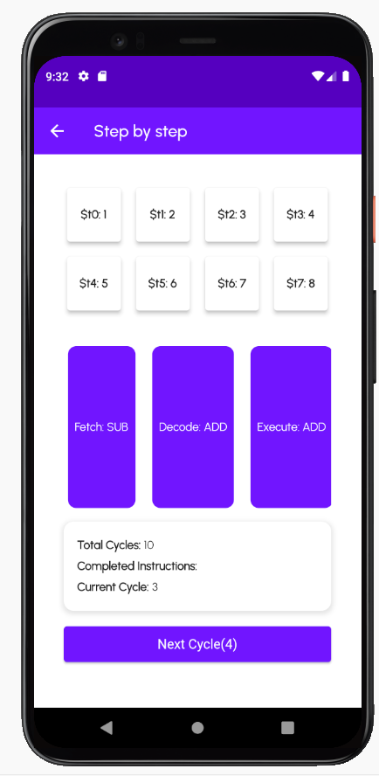
Feature and functionality
Step-by-step run :
you can see on the screen that we have 3 values :
Total cycles: represent the number of cycles needed to run all the code
Completed instructions: represent what instructions had done until the step user reached it.
Current cycle: counter count the number of cycles until this step.

Slide 18
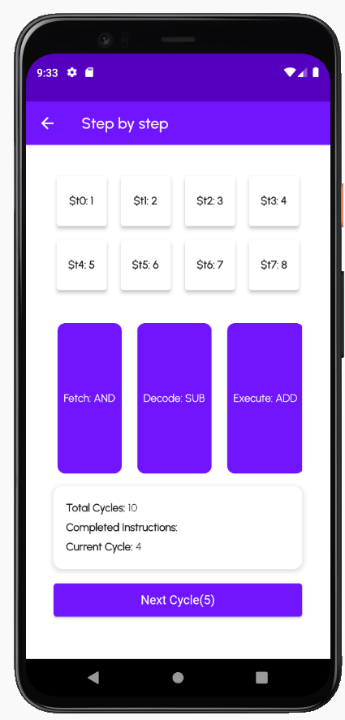
Feature and functionality
Step-by-step run :
you can see on the screen that we have 3 values :
Total cycles: represent the number of cycles needed to run all the code
Completed instructions: represent what instructions had done until the step user reached it.
Current cycle: counter count the number of cycles until this step.

Slide 19
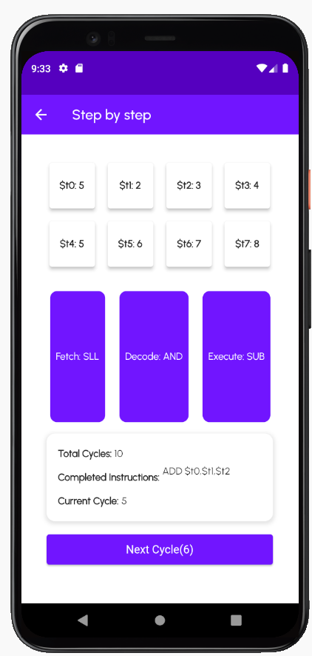
Feature and functionality
Step-by-step run :
you can see on the screen that we have 3 values :
Total cycles: represent the number of cycles needed to run all the code
Completed instructions: represent what instructions had done until the step user reached it.
Current cycle: counter count the number of cycles until this step.

Slide 20
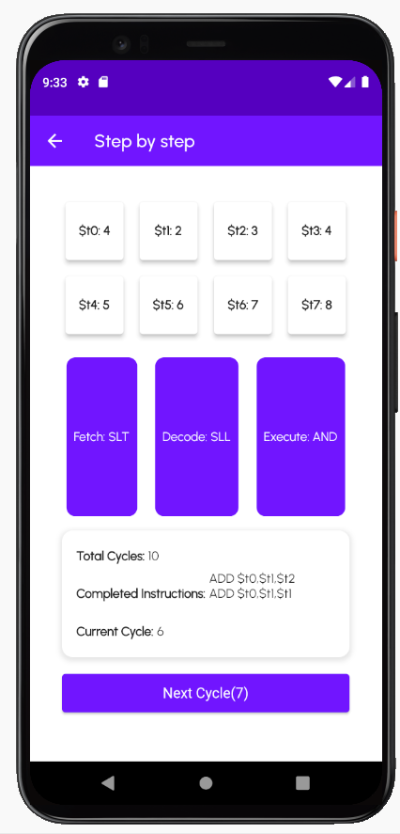
Feature and functionality
Step-by-step run : you can see on the screen that we have 3 values:
Total cycles: represent the number of cycles needed to run all the code
Completed instructions: represent what instructions had done until the step user reached it.
Current cycle: counter count the number of cycles until this step.

Slide 21
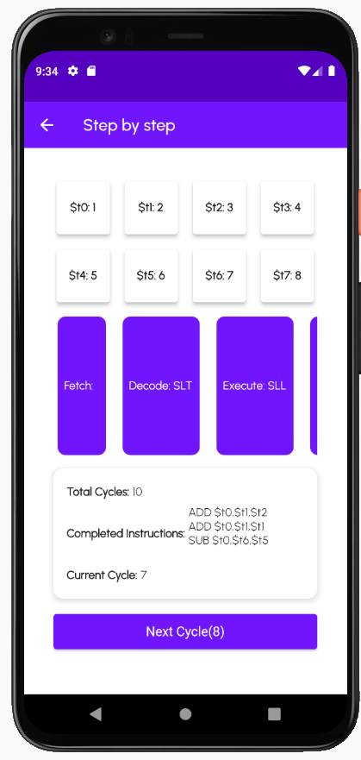
Feature and functionality
Step-by-step run :
you can see on the screen that we have 3 values :
Total cycles: represent the number of cycles needed to run all the code
Completed instructions: represent what instructions had done until the step user reached it.
Current cycle: counter count the number of cycles until this step.
.

Slide 22
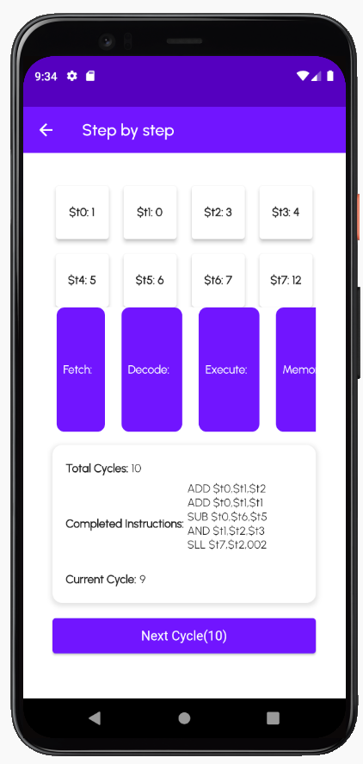
Feature and functionality
Step-by-step run :
you can see on the screen that we have 3 values :
Total cycles: represent the number of cycles needed to run all the code
Completed instructions: represent what instructions had done until the step user reached it.
Current cycle: counter count the number of cycles until this step.

Slide 23
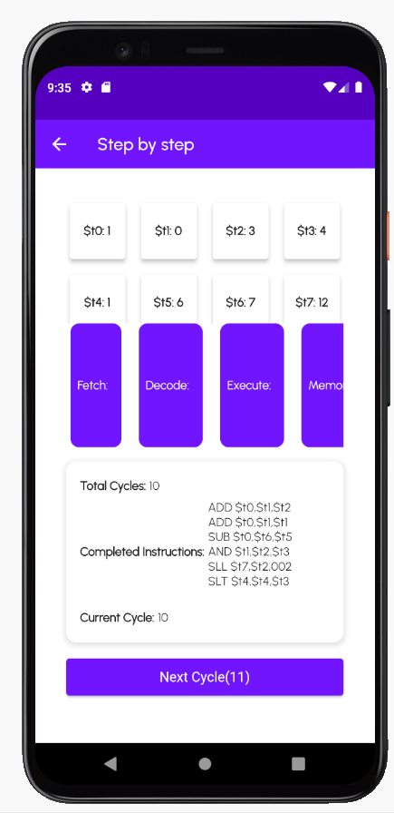
Feature and functionality
Step-by-step run :
you can see on the screen that we have 3 values :
Total cycles: represent the number of cycles needed to run all the code
Completed instructions: represent what instructions had done until the step user reached it.
Current cycle: counter count the number of cycles until this step.

Slide 24
Feature and functionality
Step-by-step run :
you can see on the screen that we have 3 values :
Total cycles: represent the number of cycles needed to run all the code
Completed instructions: represent what instructions had done until the step user reached it.
Current cycle: counter count the number of cycles until this step.

Slide 25
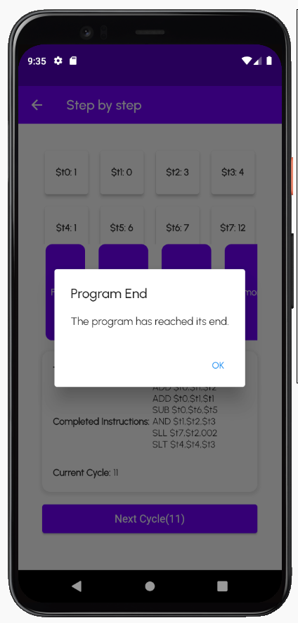
Feature and functionality
User’s Features:
The last screen shows the program ends message.

Slide 26

Development environment
Our application is implemented using Dart programming language, and flutter environment, because it provides a simple platform, FORMAL UI, quicker time to market, and faster code development.

Slide 27
Future enhancements: In the future we can offer more services to enhance our application, such as:
implement and install various types of instructions and not limit the application functionality on R-format instruction, such as I-format instructions and
J-format instructions .
Moreover, another approach to improving our application is by familiarizing the decoders with different numerical representation of an instruction such as octal representation or binary representation.
building an error correction and detection code (ECC) could be a huge modification to the application
Make the app usable offline

Slide 28
We hope that our application makes your EDUCATION PROCESS easier. Thank you!
We are happy to receive your feedback.
MIPSAPP2024@gmail.com
Cookie Bytes Team

