Slide 1
Generating Mechanized Proofs with LLM for Real-Time Systems

Slide 2
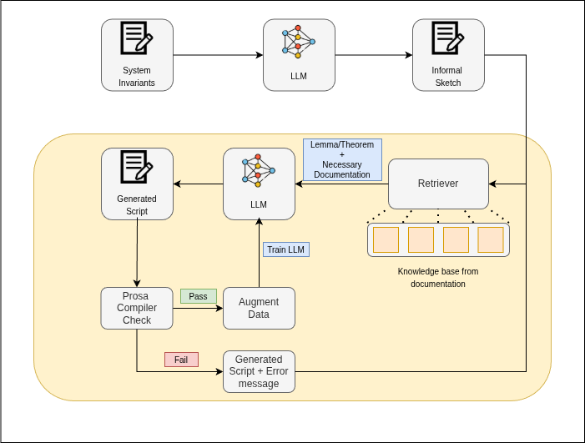
High Level Block Diagram

Slide 3
Prompt Used
I am willing to generate mechanized proof of some theorems and lemmas for real time system for schedulability analysis. This is the definitions in the real time system:
Workload model
Resource model
Scheduler
Analysis framework
Lemmas/Theorems

Slide 4
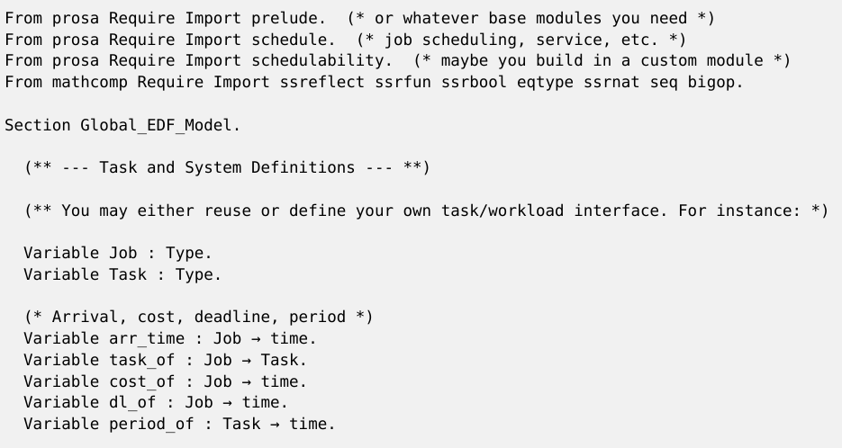
GPT Response
Wrong import statements
Doesn't seem to have knowledge of Prosa Library

Slide 5
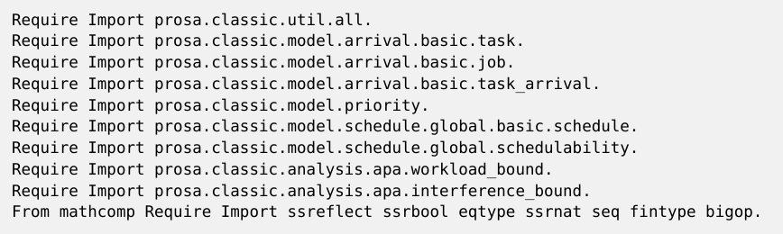
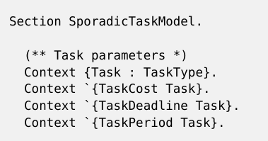
Claude Response
Correct import statements
Error: The reference TaskType was not found in the current environment.

Slide 6


Claude Response
Error: The type of the variable m should be Q
Syntax error: '.' expected after [gallina] (in [vernac_aux]).

Slide 7
Thank You

