Slide 1
Challenges
Scarcity of data
Poor performance of SOTA LLMs

Slide 2
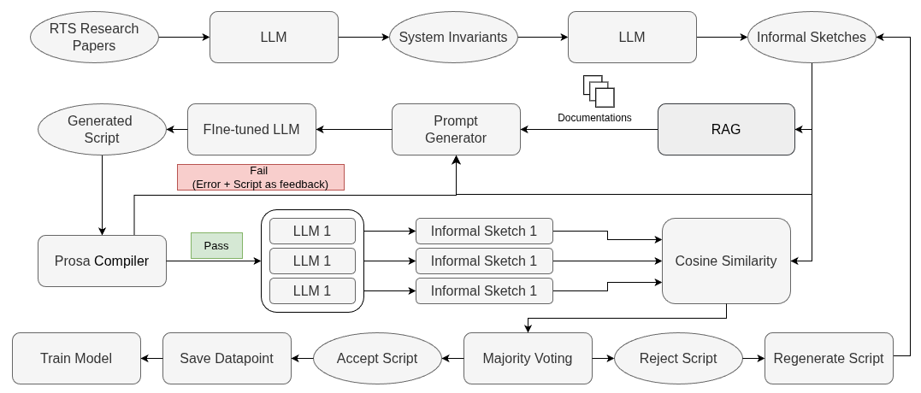
High Level System Diagram

Slide 3
High Level System Diagram

Slide 4
Data Collection
Arxiv papers with arxiv api
  Requirements:
    Query
  What we get?
    Paper metadata
    Papers in PDF format
    Collected 217 Papers
IEEE Papers with IEEE api
  Requirements
    IEEE Xplore Metadat API key
    Query
    Conference Names
  What we get?
    Paper metadata
    No Paper

Slide 5
Data Collection
IEEE Paper Download
  Launch chrome in debug mode
  Login to IEEE with FIU credentials
  Connect to debug session with Selenium
  Get paper link from paper metadata
  Open the paper in the chrome
  Perform element identification with Selenium and Mouse click operations with pyautongui to download the papers
  Collected 303 papers before session ending of IEEE. Will collect more.

Slide 6
High Level System Diagram

Slide 7
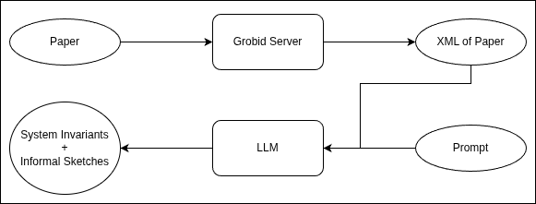
Paper to Informal Sketch

Slide 8
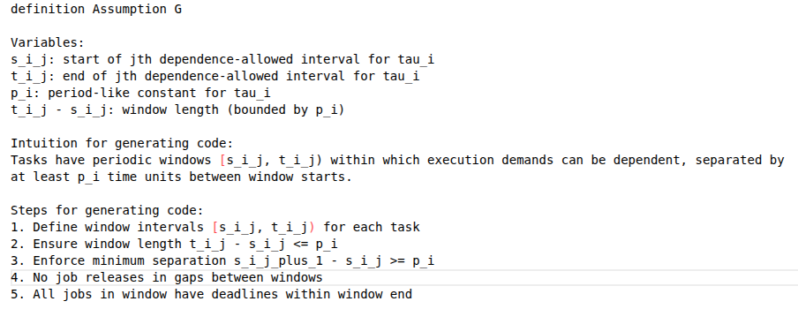
Example Informal Sketch

Slide 9
High Level System Diagram

Slide 10
RAG
Two methods
  Dense retrieval
  Sparse retrieval

Slide 11
Dense Retrieval
Embedding Model: Nomic-embedd-code
Vector Database: Faiss
Method:
  RAG Database
    Documentation RAG
    Knowledge RAG
  Retrieval
    Embed Informal Sketch with embedding model
    Perform top-k retrieval from both databases
Limitations:
  Context length becomes very large as the examples from Knowledge RAG is quite large

Slide 12
Sparse Retrieval
Retrieval Method: BM 25
Method
  For each lemma/theorem/definition/assumption in Prosa Documentation
    Collect the description from the documentaion
      Often Insufficient
    Generate a description with LLM (Few Shot examples provided)
  BM25 Query: Statement from Informal sketeches generated previously
  Fetch top-k lemma/theorems etc. From the prosa documentation
  Use these to guide the LLM to generate the Prosa script in the later stage
**Got the IDEA from the paper Rango**

Slide 13
Evaluate the Retrieval
Considering 4 options
  Option 1:
    Generate 5 Unique descriptions of Each Lemma in the Prosa documentation, Use them as query and See if the Retrieval system can fetch those lemma
      Generated the descriptions
  Option 2:
    Clustering between paper lemma statement and documentation lemma description and use that as ground truth
  Option 3:
    LLM as Judge: After the retrieval How well does the Code generation work
      Context Relevance
      Context Completeness
  Option 4:
    Check final theorem completion count with different RAG systems
      Collecting papers for theorems

Slide 14
High Level System Diagram

Slide 15
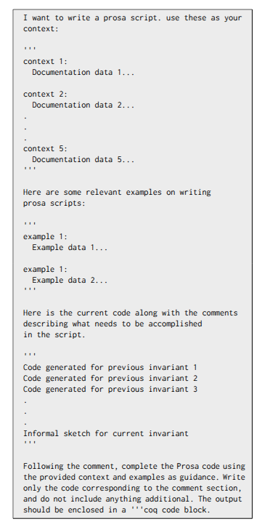
LLM Prompt
The LLM is instructed to generate the prosa script for the informal sketch of the current system invariant.
The documentation and the examples from the Prosa documentation are provided as context.
Also, the generated code for the previous system invariants are also being provided
Limitations:
  LLM Generates own assumptions of Admitted statement
  Thinking about implementing line by line generation
    Each line is a tactic
    Idea from Rango

Slide 16
High Level System Diagram

Slide 17
Compilation
The generated script is passed through the Prosa Compiler
If Error occurs, then the llm is prompted with the error message to fix the code
Issues:
  Whole code to solve the error message cannot be passed -> LLM summarizes the code and almost changes the whole structure
  Line by line prompting LLM to solve the error message
    Can't get the whole context of the code
    Sometimes duplicate variables or hypothesis are generated
  Need a method so that the LLM gets the whole code context + knows only which line to correct

Slide 18
Compilation
If the code passes without any error
  Then three LLMs are prompted to generate the description of the generated code
  Then this description is matched with the informal sketch from which the Script was generated
  Then a majority voting is performed to finally accept the code
This way the initial dataset for generating prosa script from informal sketch is generated
This dataset will be used to train the LLM

Slide 19
Fine-tune LLM
Iterative Fine-tuning of a code Model on the generated Scripts from the previous stage
Replace the Whole RAG system with fine-tuned LLM

